Slide 1
GDWG Report 2014 / 2015
Peter Miu / Masaya Takahashi
CMA, CNES, EUMETSAT, ISRO, IMD, JAXA, JMA, KMA, NASA, NIST, NOAA, ROSHYDROMET, USGS, WMO

Slide 2
Acknowledgement
The EP, new GDWG chairs and GDWG members thank Manik Bali of NOAA for his support in taking up the GDWG Acting Chair role at short notice in 2014.
The new GDWG chairs appreciate Manik’s passion, efforts and ideas, and will continue to lead the GDWG with these positive qualities.

Slide 3
Overview
GDWG Achievements
GSICS Collaboration Network Status
GDWG Work Plan 2015 / 2016

Slide 4
GDWG Achievements (1)
2014/2015 Action Plan was presented and approved by the GSICS Executive Panel.
Action Progress
8 actions proposed in 2014 joint meeting.
2 actions proposed in the lunar calibration workshop.
4 actions completed, 6 actions to be addressed in this in joint meeting.
Membership
New members added from IMD.
Changes in CMA, JAXA and KMA memberships.
Endorsement of new Chairs; Peter Miu EUMETSAT, Masaya Takahashi JMA, since Feb. 2015
Collaboration Servers Network Summary (more details in the next Slides)
CMA Server is now available; envisage collaboration network for Data Exchange is complete.
GSICS plotting tool has been updated to improve performance and to support pre-operational products on the NOAA GSICS server.
Proposals have been introduced to restructure the organisation of GSICS products. These proposals are discussed in a GDWG agenda items in the breakout session.
Developments for improving the services for the collaboration servers will be also discussed in the GDWG breakout sessions.
Notes:
Collaboration Server service improvements; GSICS product mirror and new product notification and distribution.

Slide 5
GDWG Achievements (2)
Calibration Event Logs
CGMS has tasked its participating agencies to provide working papers on current and future capabilities for calibration monitoring and event logs.
NOAA has taken a lead in providing a Data Model for the logging of the events, this is an agenda item to be discussed in the breakout session.
EUMETSAT has taken the lead in specifying a standard vocabulary for calibration events. There is also an agenda item to be discussed such that a paper can be presented to the CGMS calibration events team for further development (session at 17:00 tomorrow).
Support to the development of New GSICS Products
Input and output file format for Lunar calibration products
KMA GEOLEOIR products
CMA GEOLEOIR products
GSICS products generation framework; EUMETSAT leads an initiative to simplify and speed up the development of GSICS products by offering a SDE (prototype will be demonstrated in the breakout session).
Terms of Reference (ToR) Updates
Clarification of scope of responsibility for the roles; this is needed as GSICS is becoming bigger.
Clarification of the task responsibility for the roles in the working group.

Slide 6
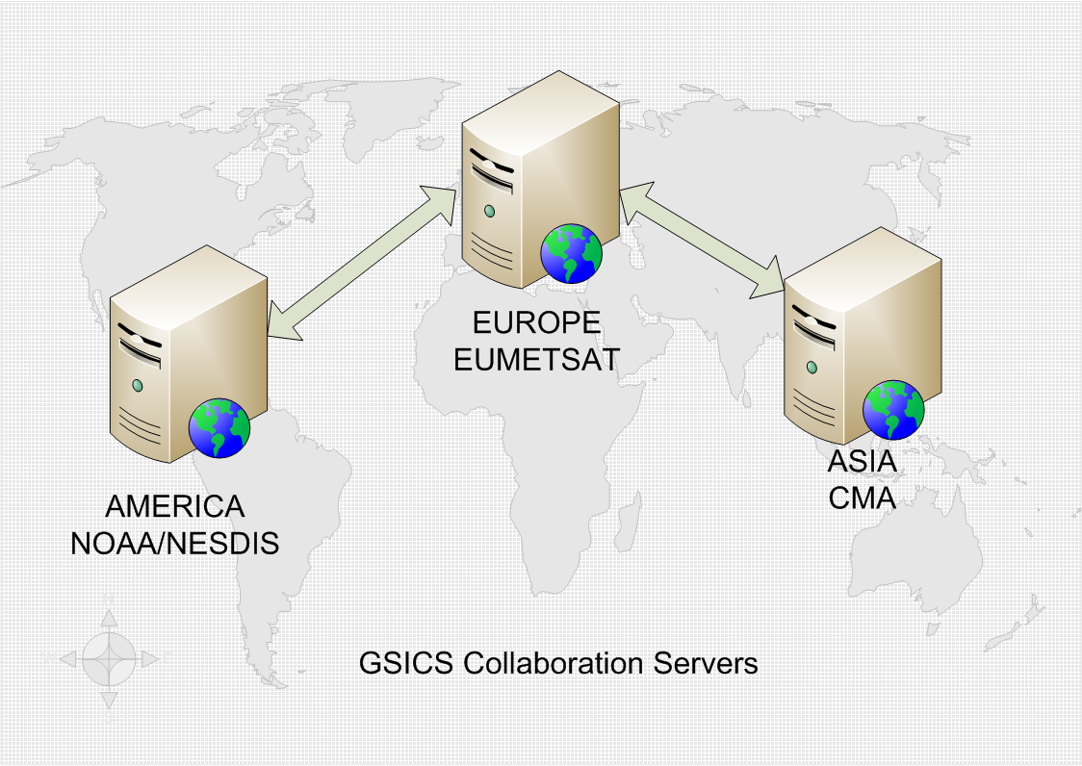
GSICS Collaboration Servers Network Status

Slide 7
What do these Servers do?
Provides the platforms offering a set of Data Management Services for the GSICS community to exchange data for the creation and then the access of GSICS products.
Existing source, intermediate and products are available from EUMETSAT, JMA and NOAA. CMA and KMA products are expected to be available in the near future for validation and operations.
Note: all data and products following agreed Data Management guidelines, conventions and standards.
The proposed GSICS Collaboration Servers are now in place. Each server should exchange on request satellite data most applicable for their region as well as provide redundancy for other servers in the network in terms of serving GSICS products to the user community.
The servers can also act as data sources for web tools that can work with the agreed GSICS formats. Also, dedicated GSICS tools such as the GSICS Product Plotting tools can exploit the data sets offered by these servers.

Slide 8
Planned Activities for the Collaboration Server Network: 2015
Revision of the directory structures to improve the usability of searching for data and products on these servers.
The automated transfer of GSICS products between servers requires implementation.
Enhancements to the GSICS Product Plotting Tools have been proposed and we need to define user requirements for these (to be discussed in the GDWG breakout session).
User service improvements; technical solutions for notification and distribution of operational products. This is to be coordinated with the GCC.

Slide 9
GDWG Proposed Work Plan 2015 / 2016 (1)
Specify an Archiving Strategy for operational products
Discuss the evolutions of product format, conventions, guideline, and standards.
Propose a technical solution for online collaboration access to source code and documents such as ATBDs.
Support developments in Events logging; events catalogue, landing pages, and brainstorm concepts for investigation by the CGMS calibration events team
Explore GSICS tools to support product developer and users.
Notes:
Product developers – framework, Users – notification and download tools.

Slide 10
GDWG Proposed Work Plan 2015 / 2016 (2)
Working with the GCC to further continue the collaboration branding of GSICS specific document templates, logos, etc.
Supporting the GCC in the optimisation of the GPPA.
Address the Resource Challenges to support GDWG activities.
Management of GDWG, GRWG, EP and Users expectations
Momentum / Motivation building through the investigation of initiatives such as short term expert visits to work on collaboration activities.
DOIs TBD (to be discussed in a later presentation later).

Slide 11
End of Presentation: Thank you for your attention
WMO GSICS Portal
http://gsics.wmo.int
GSICS Coordination Centre http://www.star.nesdis.noaa.gov/smcd/GCC/index.php
GSICS Product Catalog http://www.star.nesdis.noaa.gov/smcd/GCC/ProductCatalog.php
GSICS Collaboration Servers
http://gsics.nsmc.cma.gov.cn/thredds/catalog.html
http://gsics.eumetsat.int
http://gsics.nesdis.noaa.gov/thredds/catalog.html

