Slide 1
2014-2015 GSICS Coordination Centre (GCC) Report
Larry Flynn and Manik Bali
2015 GSICS Annual Meeting
New Delhi, India
March 16-20, 2015

Slide 2
Outline
Introduction
GCC Activities
Registrations in GUMS
GSICS Quarterly Newsletter
Meeting Support
GPPA and Product Acceptance.
Awards and Outreach
GSICS Product Status
Resource requirement
Data Use Policy
Near Term goals
Summary

Slide 3
Introduction-GCC
GCC has a New logo
GSICS Coordination Center (GCC) hosted by NOAA/STAR
GCC staff:
Lawrence E Flynn: Director
Manik Bali: Deputy Director, GSICS Newsletter Editor
Extensive help from Fred Wu and FangFang Yu, Cheng-Zhi Zou, Ralph Ferraro, Tim Hewison, Peng Zhang, Jerome Lafeuille and our friends across member agencies.
Some of the key GCC responsibilities
Support the establishment of GSICS product and services definitions and product evaluation processes, including product theoretical basis, quality assurance, data protocols, and associated documentation
Support Executive Panel in identifying GSICS data and information users, and recruiting new GSICS Members
Publish the GSICS Quarterly newsletter, and supports development of other GSICS documents and publications.

Slide 4
GCC Activities - Registrations in GUMS
15 New additions since last annual meeting

Slide 5
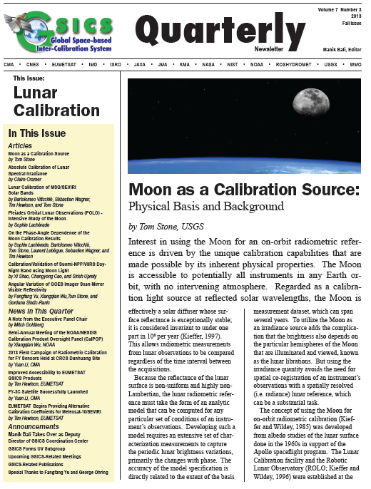
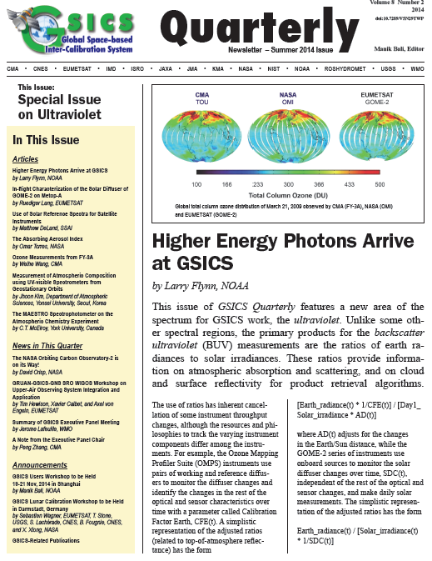
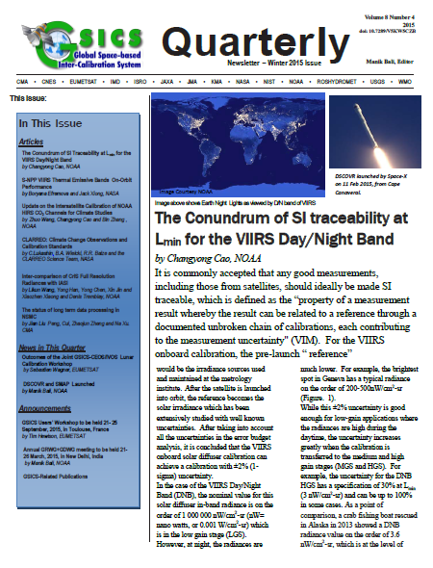
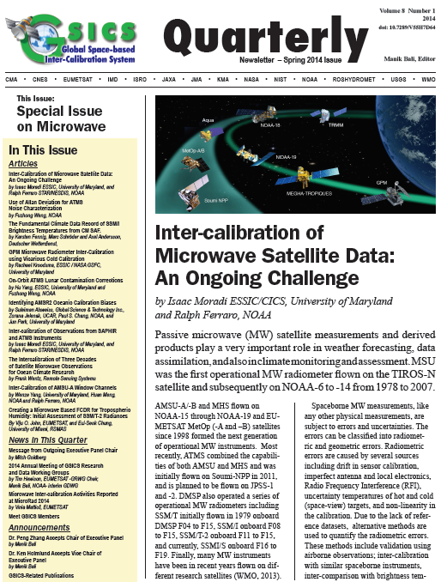
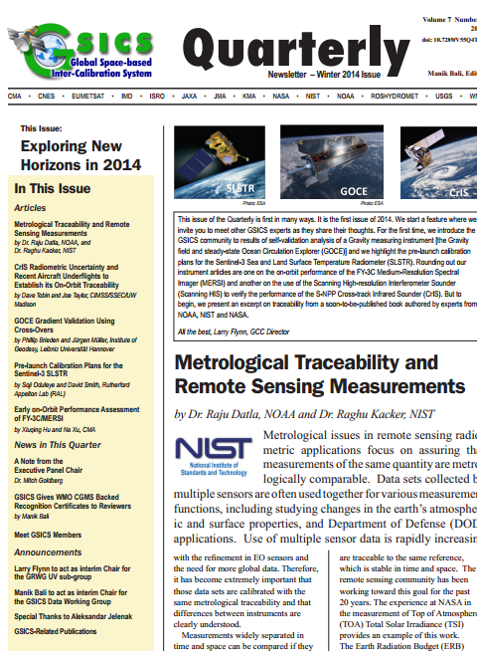
GCC Activities – GSICS Quarterly Newsletter
GSICS Quarterly Newsletter Features
Since Fall 2013, brand new format .
Since Winter 2014, the Newsletter has a doi.
Accepts articles on topics related to calibration (Pre and Post launch).
New Landing page on the GCC website.
Rate and Comment section: readers and authors can interact.
Articles are reviewed by subject experts
Help available to non native English speaking contributors.
Since Fall 2014, new navigation features added to the Cover Letter.
Journal of Physics and Chemistry of Earth invited Authors of GSICS Microwave issue to submit articles based on their submission to GSICS Newsletter .

Slide 6
GCC Activities – Meeting Support
EP Meeting at CGMS in Guangzhou, May 2014
CEOS WGCV-38 Meeting at NOAA in College Park, September 2014
GSICS Users’ Session in AOMSUC in Shanghai November 2014.
Distributed web meetings hosted by EUMETSAT
GRWG and subgroups and GDWG meeting
EP, UW and Annual meeting planning sessions

Slide 7
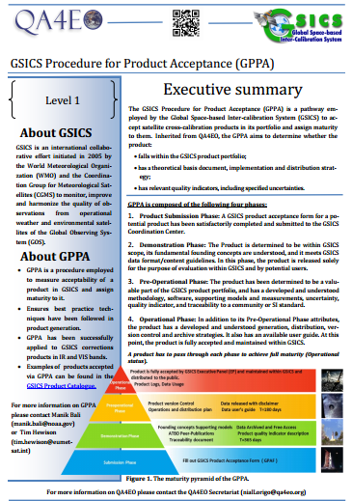
GCC Activities – Product Acceptance
GCC develops processes for accepting new products in a fast and efficient manner.
The GPERF was sent out to KMA and ISRO in anticipation of news submissions. We are maintaining close contacts.
Updates to the GPAT member list.
Modification of the GPPA is under discussion.
Worked with EUMETSAT to produce a GPPA
brochure for QA4EO.
Set up a robust review panel consisting of GPAT
and non-GPAT members to review current and
upcoming products.

Slide 8
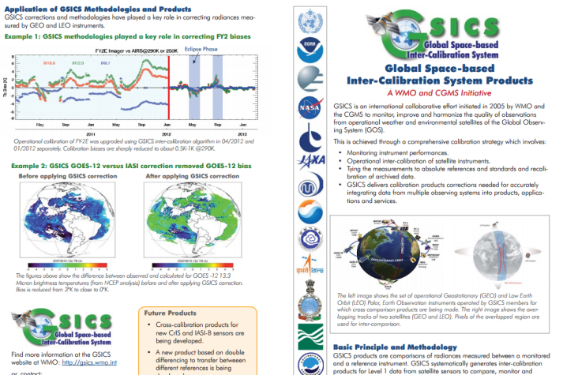
Outreach and Awards
Outreach
Encouraged members to contribute and take up responsibility
Designed a GSICS brochure that gives description of GSICS product and method used to create the product (downloadable here )
Work with CEOS QA4EO on GPPA.
Outreach with UMD and NIST (NIST Handbook on Traceability reviewed at GCC).
Reached out to scientists in India and US for GSICS product evaluation.
Awards
Forms for nominations for Appreciation Certificates
can be obtained from the GCC or EP members.

Slide 9
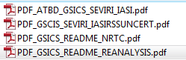
GSICS-Product status
Preoperational 8 products [4 EUMETSAT, 4 NOAA]
Demonstration 27 products [4 EUMETSAT, 13 NOAA, 6 JMA, 4 Ended]
Demo product example ^
Where are we in the process (EUMETSAT)?
What do we need to advance the product to PreOp
GRWG /GDWG assessment of the product quality/maturity.
User Feedback
Preoperational product example ^
Where are we in the process (NOAA)?
What do we need to advance the product to Op
Diurnal uncertainties *
^ Agencies need to commit resources to complete the transition
* Not requested by users.
Notes:
Four demonstration products (NOAA) have ended production.
There are two prototype products.

Slide 10
GSICS Data Use and Sharing Policy
Members have pointed out that their codes and algorithms have been used by others and full credit was not given.
What is our policy on aknowledgments?
We need a policy to have a healthy collaborative environment.

Slide 11
Near-term 2015-2016 Goals
GSICS Procedure for Product Acceptance
Support inclusion of New Products
Coordination
Continue to coordinate efforts to establish the GSICS baseline algorithms, especially those for the GEO solar reflective channels,
Continue to provide communication between the developing group and users
GSICS Quarterly
Continue to create and distribute this important link to the GSICS community.
Encourage Members to take up GSICS Challenges
Welcomes Pete and Masaya (GDWG), Strong Review team for articles and products.
Meeting Support
Joint Meeting, GSICS Web Meetings and QA4EO telcons.
Organization of GSICS 6rd Users Workshop.
Facilitate WMO Appreciation Certificate nomination.

Slide 12
Summary
GCC continues to provide coordination to GSICS activities
Product acceptance and promotion
Quarterly Newsletter
Meeting support
Awards and outreach
Thank you
Action Items follow

Slide 13
Action Items for GCC from 2014 Meeting (1)
GCC to coordinate with WMO to add GSICS products catalogue to WMO OSCAR Data base.
>>WMO is not in favor of this action because OSCAR is not a catalogue of products.
KMA to provide GCC with links to GEO-LEO-IR data and products for inclusion into the product catalogue.
>> Completed; KMA has provided links.
GCC to take a lead in discussing the GPPA with GSICS members to reduce the amount of time needed to move through the phases.
>> GCC led a discussion and organized a web meeting; additional discussion will take place at this meeting.

Slide 14
Action Items for GCC from 2014 Meeting (2)
GCC will discuss with GPRCs to prepare for the GSICS user conference 2014 to promote the GSICS
>> Completed
GCC shall take a look at WMO/CGMS documents to prepare templates for GSICS documents and provide these to the GDWG for discussion.
>> Work in progress.
GCC shall provide a Document Management Plan (DMP) (for example NOAAs) to the GDWG so that GSICS has a framework to publish documents.
>> DMS plans will be presented in this meeting.

Slide 15
Action Items for GCC from 2014 Meeting (3)
GCC to update Taxonomy information to the Wiki or GCC website. GPRCs are invited to clearly nominate their member for the GPAT.
>>Beta version of the website presented.
The GPAT member should promptly coordinate the review of the GSICS products before operations. This information will be presented into the GCC website
>> Now presented on the GCC website here .

Slide 16
Action Items for GCC from 2014 Meeting (4)
GCC and Tim Hewison to follow up on the support to CEOS WGCV regarding the GPPA as an example for best practises forQA4EO? -
>> Completed (See brochure)
GCC need to identify a user for advice on preferred format for delta correction.
>> This has been superseded by the new concept of generating Prime GSICS Corrections, in which the delta corrections are already applied. Masaya has proposed a format for these GSICS products, and is now finalizing the directory structure on the servers. Action is closed.
GCC to upload the netCDF checker to the GitHub? account.

Slide 17
THANK YOU

Slide 18
Backup Slide

Slide 19
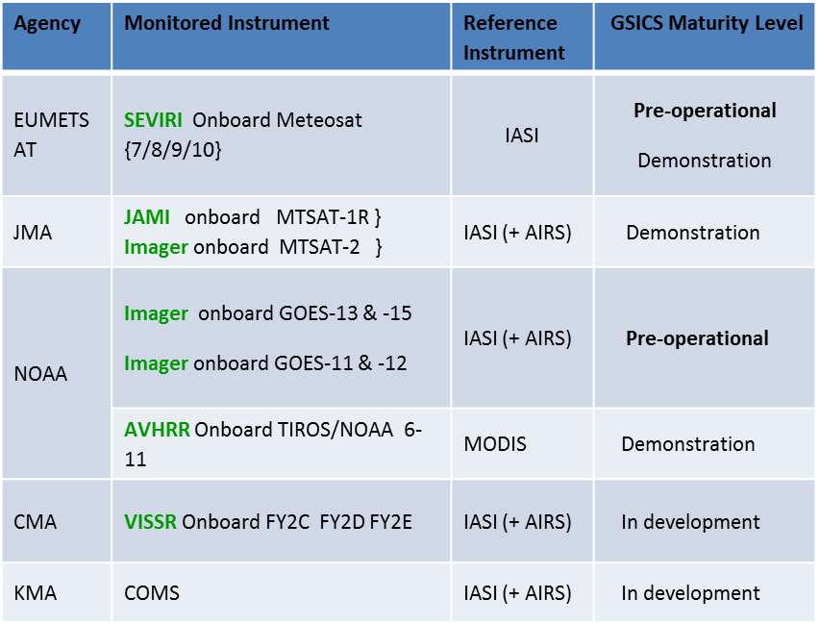
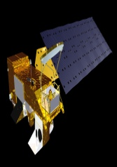
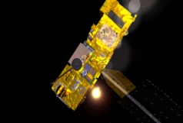
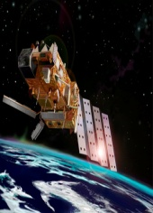
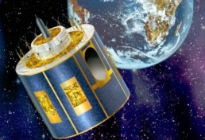
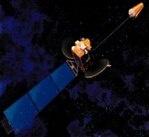
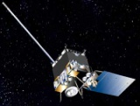
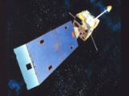
GSICS Products (1)
Near Real Time Correction Product
Re-Analysis Correction Product
GSICS Reference Instruments
AIRS MODIS IASI
GSICS Family of Monitored Instruments
GSICS Product application
Bias correction
SRF retrieval
Better SST Retrieval ,Cloud Height, Aerosol retrieval
SEVIRI MTSAT GOES AVHRR
GSICS also identifies best practices and principals
Critical need to evaluate and assign maturity to the product
Products span VIS and IR bands
Product Catalog

Slide 20
GSICS Products
Notes:
http://www.star.nesdis.noaa.gov/smcd/GCC/ProductCatalog.php

Slide 21
GSICS Products
Notes:
http://www.star.nesdis.noaa.gov/smcd/GCC/ProductCatalog.php

Slide 22
GSCIS Meetings
2015-03-16/20 GRWG/GDWG Annual GRWG+GDWG Meeting at IMD, New Delhi, India
2015-02-03 GRWG+GDWG Preparing for 2015 Meeting + DCC Seasonality
2015-01-20 GDWG Automation of GPPA & timeliness
2015-01-13 GRWG MWSubGroup Product Development Updates
2014-12-16 GRWG UVSubGroup Hyperspectral Vis inter-calibration
2014-12-01/04 GRWG/GDWG Lunar Calibration Workshop at EUMETSAT
2014-11-13 GRWG VIS/NIR Lunar Calibration Workshop last-minute Preparation
2014-11-21 Users Workshop Special GSICS Session at AOMSUC-5
2014-10-22 GRWG VIS/NIR Review VIS/NIR priorities & Combining Methods
2014-09-16 GRWG VIS/NIR Lunar Calibration Workshop Preparation
2014-08-26 GRWG MWSubGroup Inter-calibration of Microwave Imagers
2014-07-23 GRWG+GDWG Inter-Calibration Products to Primary GSICS References
2014-06-24 GRWG VIS/NIR Lunar Calibration Workshop Preparation
2014-06-05 GRWG VIS/NIR DCC: File formats + Plotting
2014-05-27 GRWG Delta Corrections
2014-03-24/28 GRWG/GDWG Annual GRWG+GDWG
2014-02-06 GRWG - UVSubGroup Four Initial Projects
2014-01-08 GRWG DCC Algorithm Application
https://gsics.nesdis.noaa.gov/wiki/Development/MeetingsAndConferences

Slide 23
GCC Roles http://www.star.nesdis.noaa.gov/smcd/GCC/index.php
Support the establishment of GSICS product and services definitions and product evaluation processes, including product theoretical basis, quality assurance, data protocols, and associated documentation;
Make recommendations to, and facilitate communication between, GRWG and GDWG during their efforts to develop, implement, organize, and direct GSICS research and data management projects;
Support GSICS end-to-end demonstration activities;
Track and make updates to GSICS Operations Plan;
Design and maintain GCC web sites;
Publish the GSICS Quarterly newsletter, and support development of other GSICS publications;
Support Executive Panel in finding GSICS data and information users and reviewers, and recruiting new GSICS Member.

