Slide 1
Intersatellite Calibration of infrared sensors onboard Indian Geostationary Satellites using LEO Hyperspectral Observations
ISRO GPRC Report
Pradeep Thapliyal, Munn Shukla, Ipshita Dey, C M Kishtawal
Space Applications Centre
Indian Space Research Organisation
Ahmedabad (INDIA)
pkthapliyal@sac.isro.gov.in

Slide 2
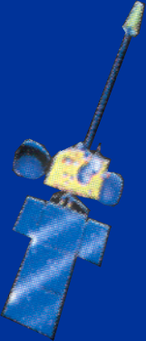
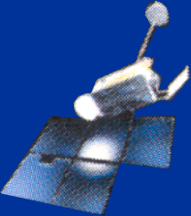
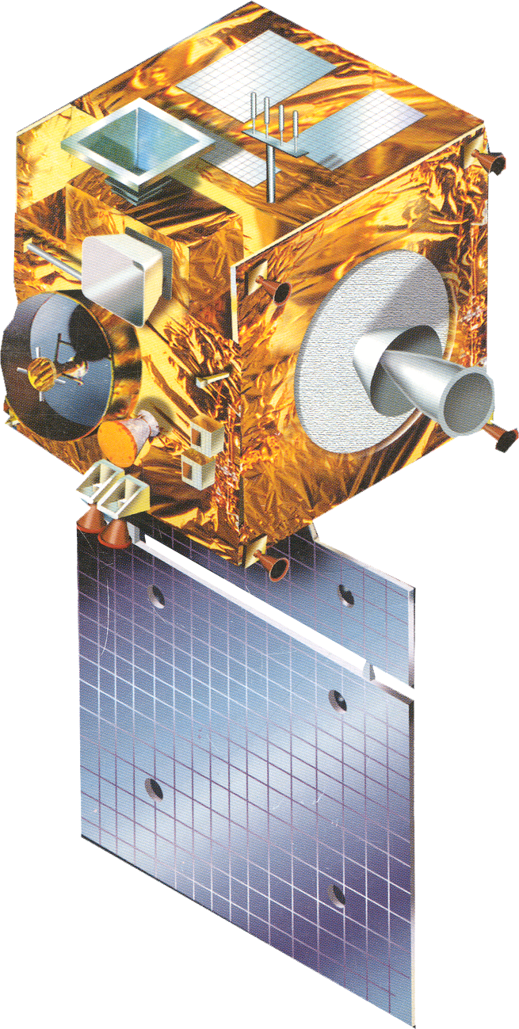

Indian Meteorological Geostationary Satellites
INSAT-1D
VHRR
1990
INSAT-2A/2B
VHRR
INSAT-2E
VHRR, CCD
1992/93
KALPANA-1
VHRR
1999
INSAT-3A
VHRR, CCD
2002
INSAT-3D
Imager/ Sounder
2003
2013
INSAT-3DR
Imager/ Sounder
GISAT
MX-LWIR/MX-VNIR/ Hys-VNIR/Hys-SWIR
2015
2016

Slide 3
INSAT-3A & Kalpana-1
Launch Date & Location : Kalpana-1 - 74.0ºE (Sep 2002)
INSAT 3A - 93.5ºE (Apr 2003)
Payload : (i) VHRR & CCD in INSAT 3A
(ii) VHRR in Kalpana-1
VHRR Bands (µm)
  Visible : 0.55 – 0.75
  Water vapour : 5.70 – 7.10
  Thermal Infra Red : 10.5 – 12.5
Resolution (km) : 2 X 2 for Visible
8 X 8 for TIR
CCD Bands (µm)
  Vis (0.62 – 0.68), NIR (0.77 – 0.86),
  SWIR (1.55 – 1.69)
  Resolution : 1 km

Slide 4
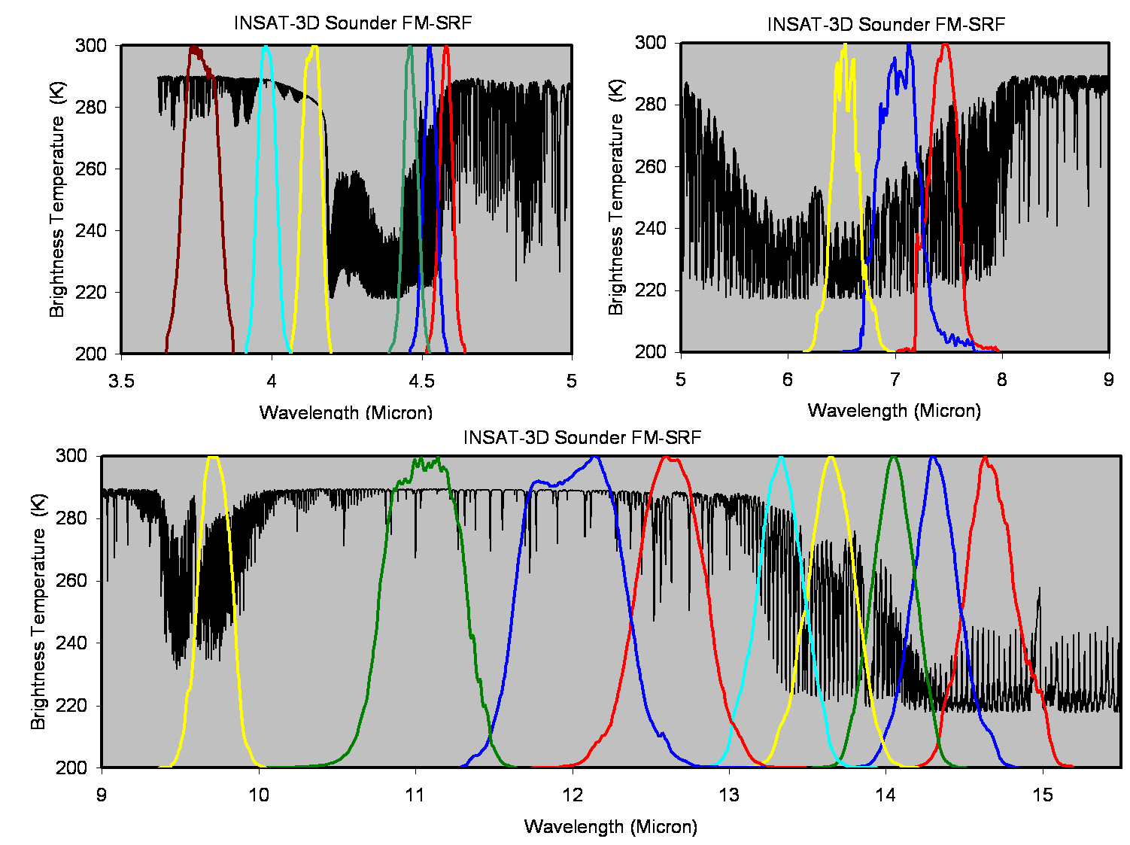
INSAT-3D
6 Channel IMAGER
19 Channel SOUNDER
Spectral Bands (µm) Resolution
Visible : 0.55 - 0.75 1 km
Short Wave Infra Red : 1.55 - 1.70 1 km
Mid Wave Infra Red : 3.70 - 3.95 4 km
Water Vapour : 6.50 - 7.10 8 km
Thermal Infra Red – 1 : 10.30 - 11.30 4 km
Thermal Infra Red – 2 : 11.30 - 12.50 4 km
Spectral Bands (µm)
Short Wave Infra Red : Six bands
Mid Wave Infra Red : Five Bands
Long Wave Infra Red : Seven Bands
Visible : One Band
Resolution : 10 km
Launch Date: 26 Aug 2013
Location: 83E

Slide 5
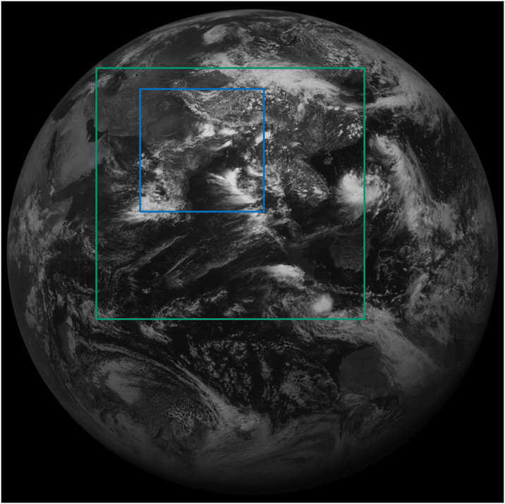
Future Indian GEO Satellite - GISAT
Launch Schedule: 2016, Geostationary orbit, 93E
MX-VNIR: Multispectral - Visible Near Infrared, HySI-VNIR: Hyperspectral Imager - Visible Near Infrared,
HySI-SWIR: Hyperspectral Imager - Short Wave Infrared, MX-LWIR: Multispectral - Long Wave Infrared.
GISAT Scan scenario
Scan area for two scan scenario (5° & 10 °)
Band | Ch | SNR/NEdT | IFOV (m) | Range (μm) | Channels (μm)
MX-VNIR | 4 | > 200 | 50 | 0.45 - 0.86 | B1: 0.45-0.52 B2: 0.52-0.59 B3: 0.62-0.68 B4: 0.77-0.86 B5N: 0.71-0.74 B6N: 0.845-0.875
HyS-VNIR | 60 | > 400 | 500 | 0.375 - 1.0 | Δλ < 10 nm
HyS-SWIR | 150 | > 400 | 500 | 0.9 - 2.5 | Δλ < 10 nm
MX-LWIR | 6 | NEdT < 0.15K | 1500 | 7.0 - 13.0 | CH1: 7.1-7.6 CH2: 8.3-8.7 CH3: 9.4-9.8 CH4: 10.3-11.3 CH5:11.5-12.5 CH6: 13.0-13.5
Every 10 minute interval
30-minutes triplet every 6 hour for winds

Slide 6
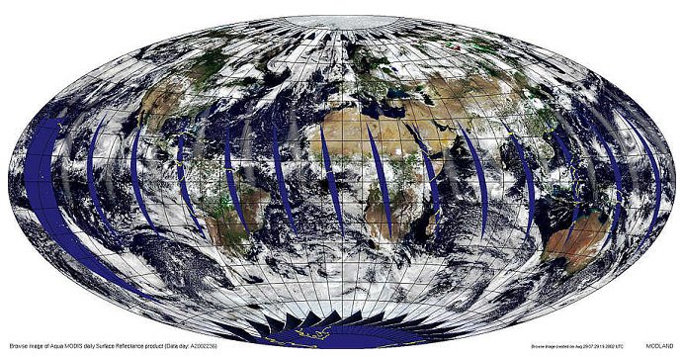
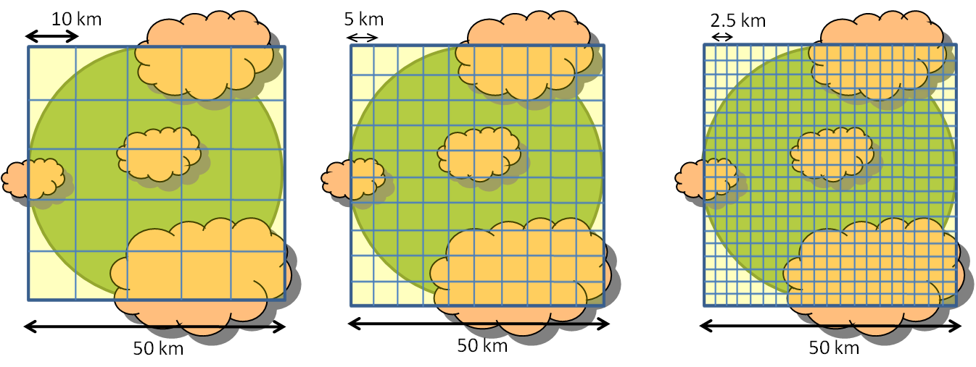
GISAT – Products
GISAT Strength
High spatial (1.5 km) and temporal resolution (10 minutes) from LWIR
High spatial and spectral resolution from VNIR and SWIR bands for cloud microphysics
GISAT Products
Cloud properties (type, amount, phase, height)
Atmospheric stability
Atmospheric motion vectors (AMV)
Mid-Tropospheric Humidity
Total Precipitable Water (TPW)
High spatio-temporal resolution Rainfall
Sea surface temperature (SST)
Outgoing longwave radiation (OLR)
Shortwave Radiation (SWR)
Total column ozone
Clear-sky Radiances
SO₂ estimates
FOV size (km)

Slide 7
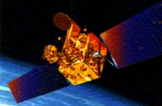
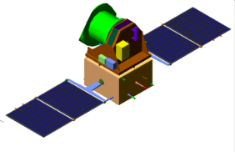
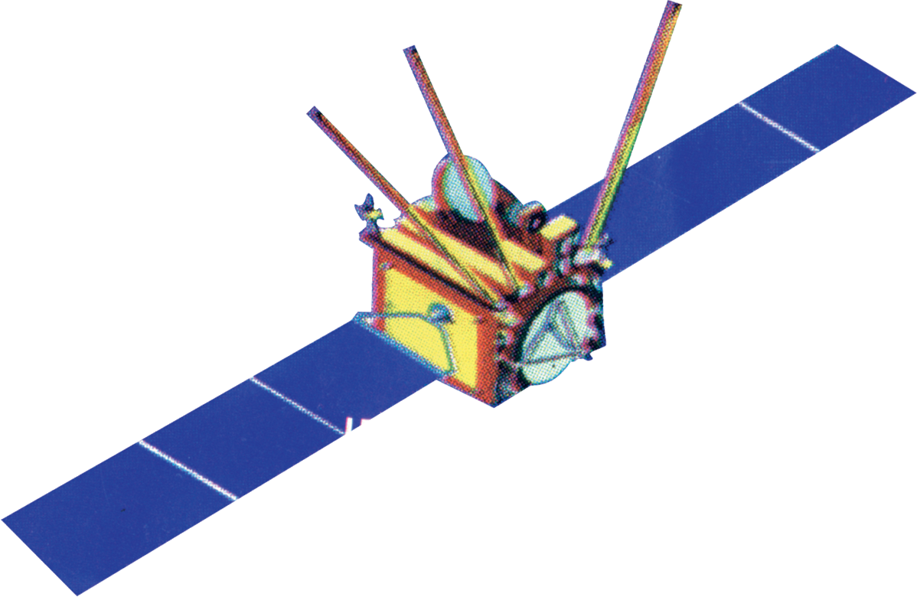
Indian LEO Weather Satellites
OCEANSAT–1 (1999)
OCEANSAT–2 (2009)
SARAL
(2011)
Megha-Tropiques
(2011)
Current
MSMR, OCM
OSCAT,
OCM, ROSA
Altimeter
MADRAS, SAPHIR,
ScaRaB, ROSA
OCEANSAT–3
(2017)
GCOM-W2
(2020)
Future
Scatterometer,
AMSR-2
OSCAT,
OCM, ROSA

Slide 8
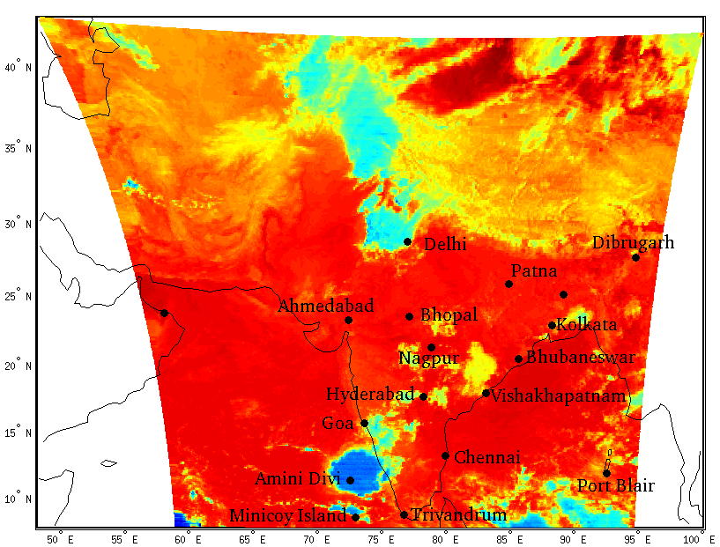
RT Model bias correction procedure for INSAT-3D Sounder
INSAT-3D Sounder Radiance (R_{obs})
RAOB/Analysis Atmospheric profiles
Forward RT model (PFAAST) Sounder Radiance (R_{RT})
Empirical relationship
R_{RT} = F(R_{SND}, β)
(Jan-Jun, 2014)

Slide 9
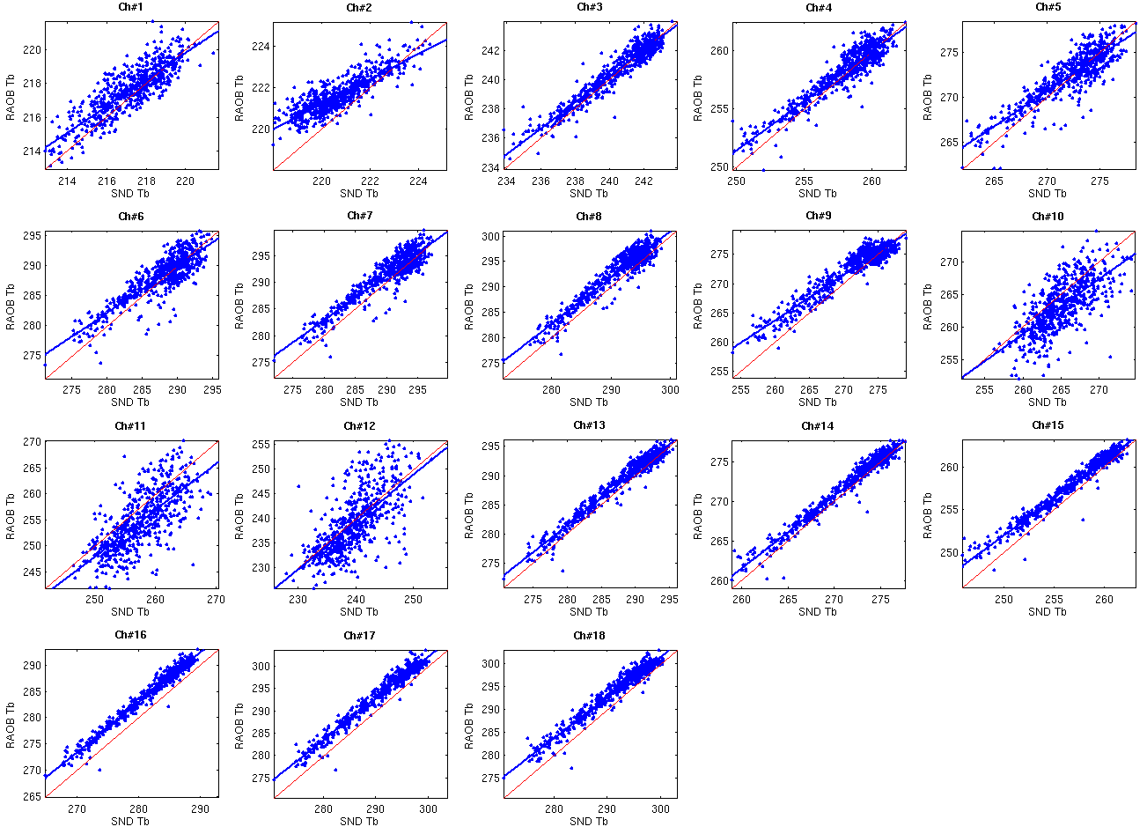
Before RT Model Bias Correction
INSAT-3D Sounder Tb vs RT model derived Tb
(Input profiles: RAOB)

Slide 10
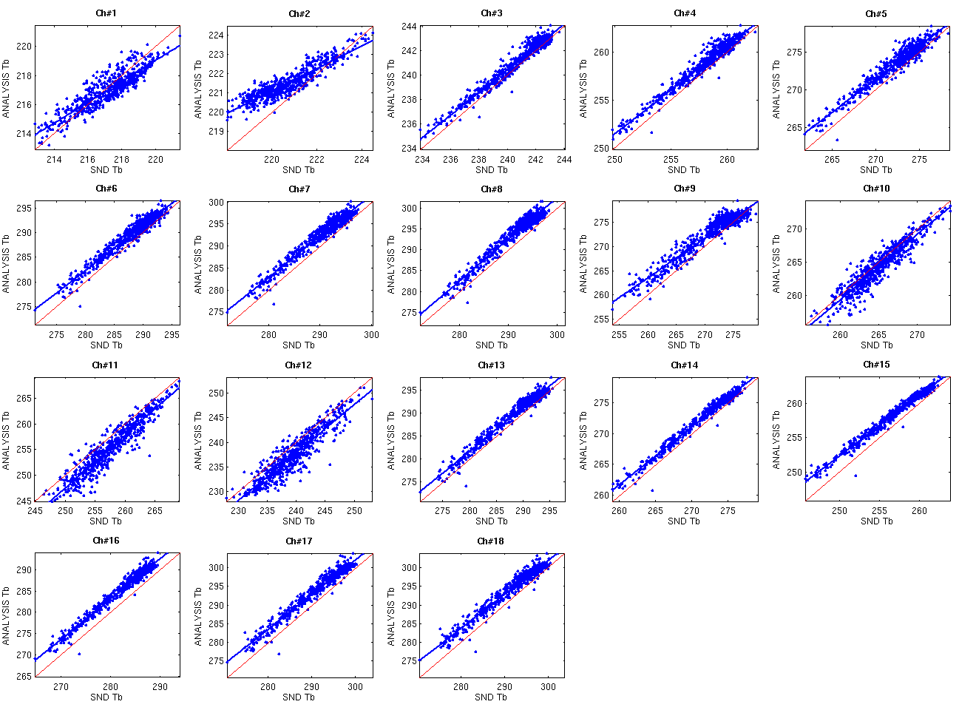
Before RT Model Bias Correction
INSAT-3D Sounder Tb vs RT model derived Tb
(Input profiles: Analysis)

Slide 11
GSICS Inter-calibration activities at
Space Applications Centre (SAC)
Indian Space Research Organisation (ISRO)

Slide 12
Satellite Sensors and Data Used
Indian Geostationary Satellites
www.mosdac.gov.in
Hyperspectral IR Sounders
IASI (Metop-A/B) 8461 IR-Channels (Morning/Evening Observations)
Data available through EUMETCAST
(data loss/reception problem???)
AIRS (Aqua) 2378 IR-Channel (Noon/mid-night Observations)
Data available through http://mirador.gsfc.nasa.gov/

Slide 13
Intercalibration reference instruments
AIRS: Atmospheric InfraRed Sounder
Polar Orbiting Aqua (2002)
Channels: 2378 (650 cm⁻¹ to 2675 cm⁻¹)
(3.74 μm - 15.4 μm)
Spectral resolution: ν/Δν≈1200
Spatial Resolution: 13.5 Km at Nadir
Brightness Temperature
AIRS
IASI: Infrared Atmospheric Sounding Interferometer
Polar Orbiting Metop (2007)
Channels: 8461 (645 cm⁻¹ to 2760 cm⁻¹)
(3.62 μm - 15.5 μm)
Spectral resolution: 0.35 cm⁻¹ at SWIR
0.50 cm⁻¹ at LWIR
(resampled at 0.25 cm⁻¹)
Spatial Resolution: ~12 km at Nadir
IASI

Slide 14
Past Work
Intercalibration of Kalpana and INSAT-3D for limited work (Presented at Working Group meeting in Darmstadt
Kalpana / AIRS Intercalibration
Kalpana TIR Channel intercalibrated with AIRS radiances for 2011 (clear sky conditions)
  Std. Dev. of differences very small 0.3-0.4K
  Bias smaller during daytime with seasonal variations
  Bias higher during nightime
Kalpana TIR and WV channel intercalibration with IASI radiances (all-sky conditions)
  Std. Dev. of differences high (1.3K TIR and 0.9K WV)
  TIR: bias smaller during daytime with seasonal variations during
  TIR: higher bias during nighttime
  WV: lower bias during daytime and higher bias during nighttime

Slide 15
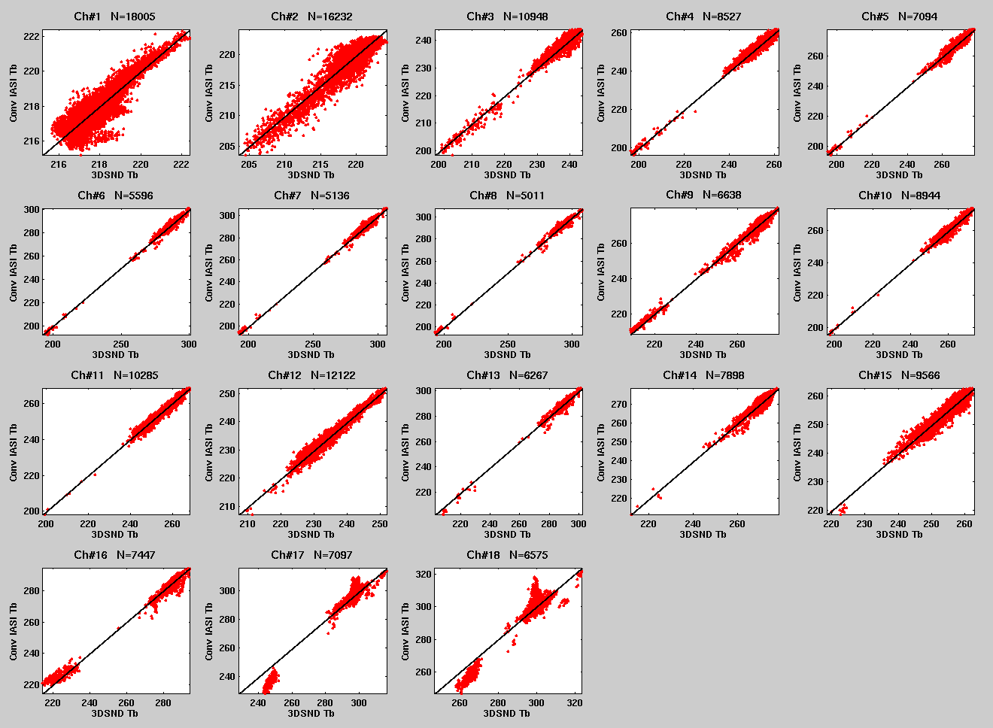
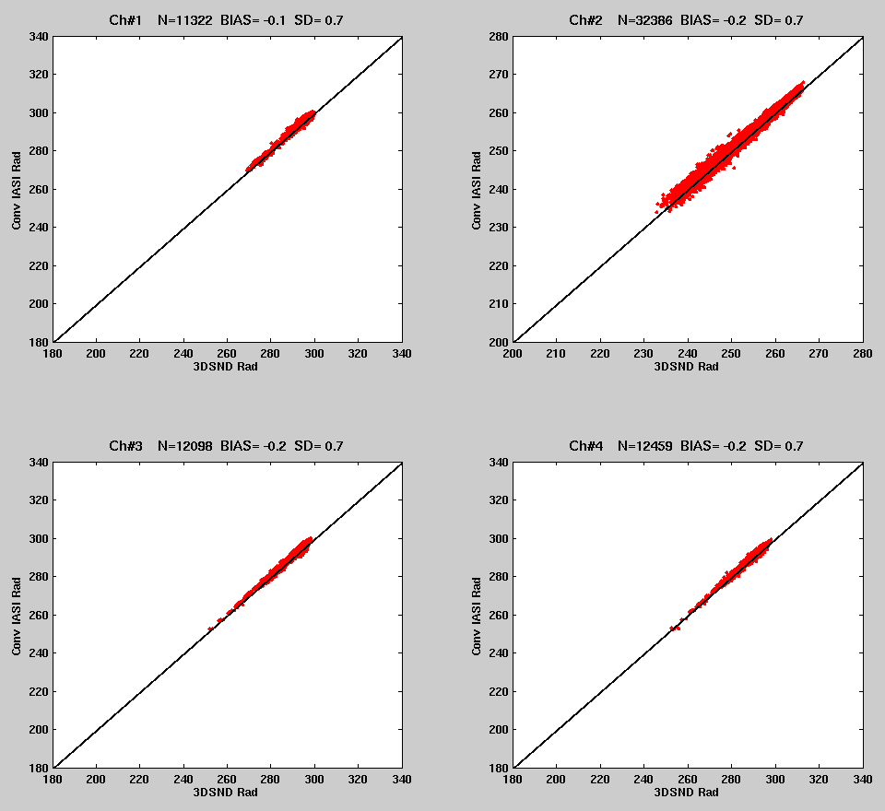
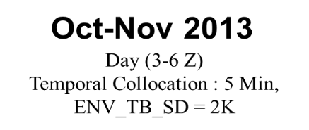
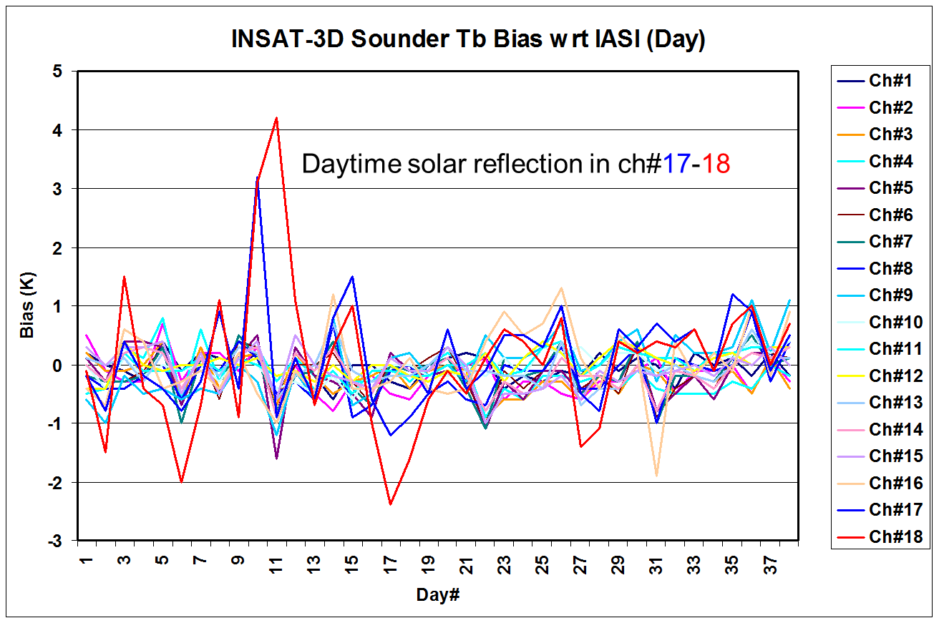
Past Work
INSAT-3D / IASI Intercalibration
Draft GSICS intercalibration ATBD is ready
A test run is being conducted offline for near real-time GSICS intercalibration of INSAT-3D Imager/Sounder since March 2014.
GSICS correction coefficients based on GSICS guidelines are being generated
Past data of Kalpana is being processed
Website for GSICS will be launched shortly
Intercalibration of solar channel to be taken in near future

Slide 16
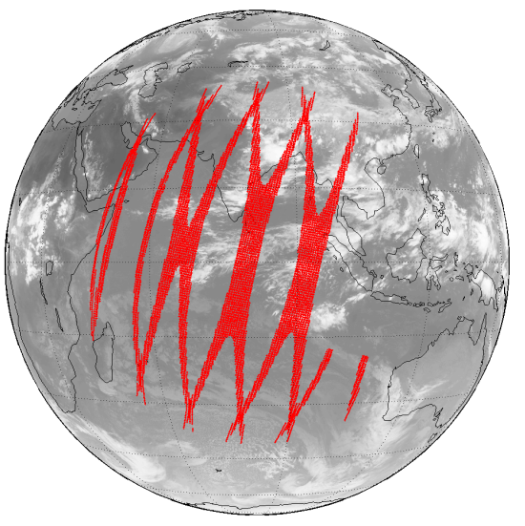
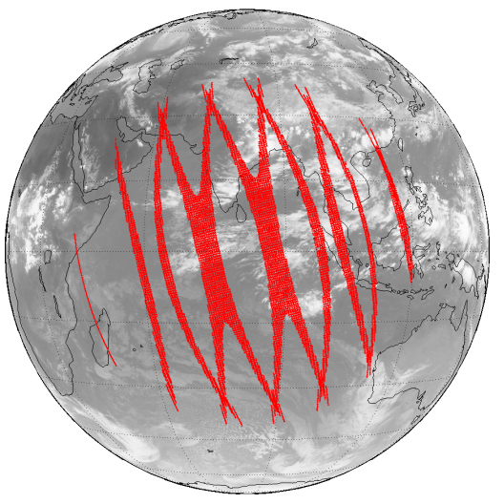
Global Space-based Inter-Calibration System (GSICS)
Monitored instrument: INSAT-3D Imager/Sounder, Ref. instrument: IASI
Modified ATBD (GSICS Guidelines)
Data Source: IASI L1C (Eumetcast)
Temporal Collocation: < 5 Minutes
Spatial Collocation: within IASI pixel (12 km)
Zenith angle collocation:
maxzen = 0.01
Spatial homogeneity test:
Variance of INSAT-3D (7x7 pixel) and IASI (5x5) radiances within environment surrounding the target pixel for weight in regression
Convolved radiance of broadband sensor using ‘n’ number of hyperspectral sounders channels may be computed using:
R_{conv} is convolved broadband radiance, R_{IASI} is radiance of hyper-spectral sounder, superscript ‘i’ is hyper-spectral channel index, S_{INSAT} is the sensor response function of INSAT-3D channels at the central wavenumber of hyper-spectral channel ‘i’, and ‘n’ is the total number of hyper-spectral channels in broadband sensor’s SRF range.

Slide 17
  Regression of Most Recent Results
  Weighted linear regression of collocated radiances is performed with the inverse of the sum of the spatial and temporal variance of the target radiance and the radiometric noise provide an estimated uncertainty on each dependent point as a weight.
  This method produces estimates of regression coefficients describing the slope and offset of the relationship between the two instruments’ radiances – together with their uncertainties, expressed as a covariance.
The observations of the reference instrument, x, and target instrument, y, are fitted to a straight line model of the form:
We assume an uncertainty σ_{i} associated with each measurement, y_{i}, is known and that the dependent variable, x_{i} is also known.

Slide 18
Intercept
Slope
Uncertainty in Intercept
Uncertainty in Slope
and their covariance

Slide 19
  Bias Calculation
  Inter-calibration biases should be directly comparable for representative scenes and conveniently expressed in units understandable by the users. Because biases can be scene-dependent, they are evaluated here at the standard radiances
The results may be expressed in absolute/ % bias in radiance, or Tb differences.
Currently, standard scene radiance are taken for Standard Tropical Atmosphere (Standard US atmosphere ????)

Slide 20
INSAT-3D Imager
Imager-MIR vs IASI-A (Night, Dec 2014)
Imager-WV vs IASI-A (Night, Dec 2014)
Imager-TIR1 vs IASI-A (Night, Dec 2014)
Imager-TIR2 vs IASI-A (Night, Dec 2014)

Slide 21
INSAT-3D Sounder
Ch#3
Ch#6
Ch#8
SND
SND
SND
Ch#10
Ch#13
Ch#6
SND
SND
SND

Slide 22
Bias Monitoring INSAT-3D Imager with IASI (MetOp-A)
2014 (Nighttime)
May
Jun

Slide 23
Aug
Oct
Dec

Slide 24
Bias Monitoring INSAT-3D Sounder with IASI (MetOp-A)
2014 (Nighttime)
MAY
JUN
JUL

Slide 25
SUMMARY
Updated the inter-calibration algorithm including GSICS guidelines and suggestions from last Working Group
Dedicated scientist assigned till GSICS product becomes operational
Generated initial GSICS products for INSAT-3D Imager and Sounder
Problem in IASI data continuity through Eumetcast, need to explore other means to get the near real-time/archive data (to be discussed with IMD, EUMETSAT)
Initiated web-site development, and product acceptance procedure for demonstration phase.
Sample products are available and will be submitted for demonstration product acceptance.

Slide 26
Thanks
Comments and suggestions!!!

