Slide 1
KMA Agency Report
Hyesook Lee
Dohyeong Kim, Tae-Hyeong Oh, Minju Gu
National Meteorological Satellite Center
Korea Meteorological Administration

Slide 2
CURRENT STATUS OF KMA
Visible channel
Operate vicarious calibration system using targets on the Earth
keep studying the moon targets for vicarious calibration
Infrared channel
Operate GSICS GEO-LEO Inter-calibration system
→ MI/COMS & IASI-A/-B and MI/COMS & AIRS/Aqua
Keep studying the cold bias correction in SW with SRF correction
Preparation for the Demonstration Phase
Preparing COMS IR to enter the Demonstration Phase of the GSICS Procedure for Product Acceptance

Slide 3
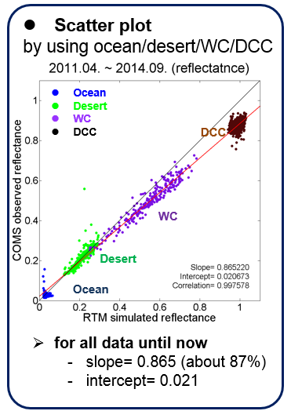
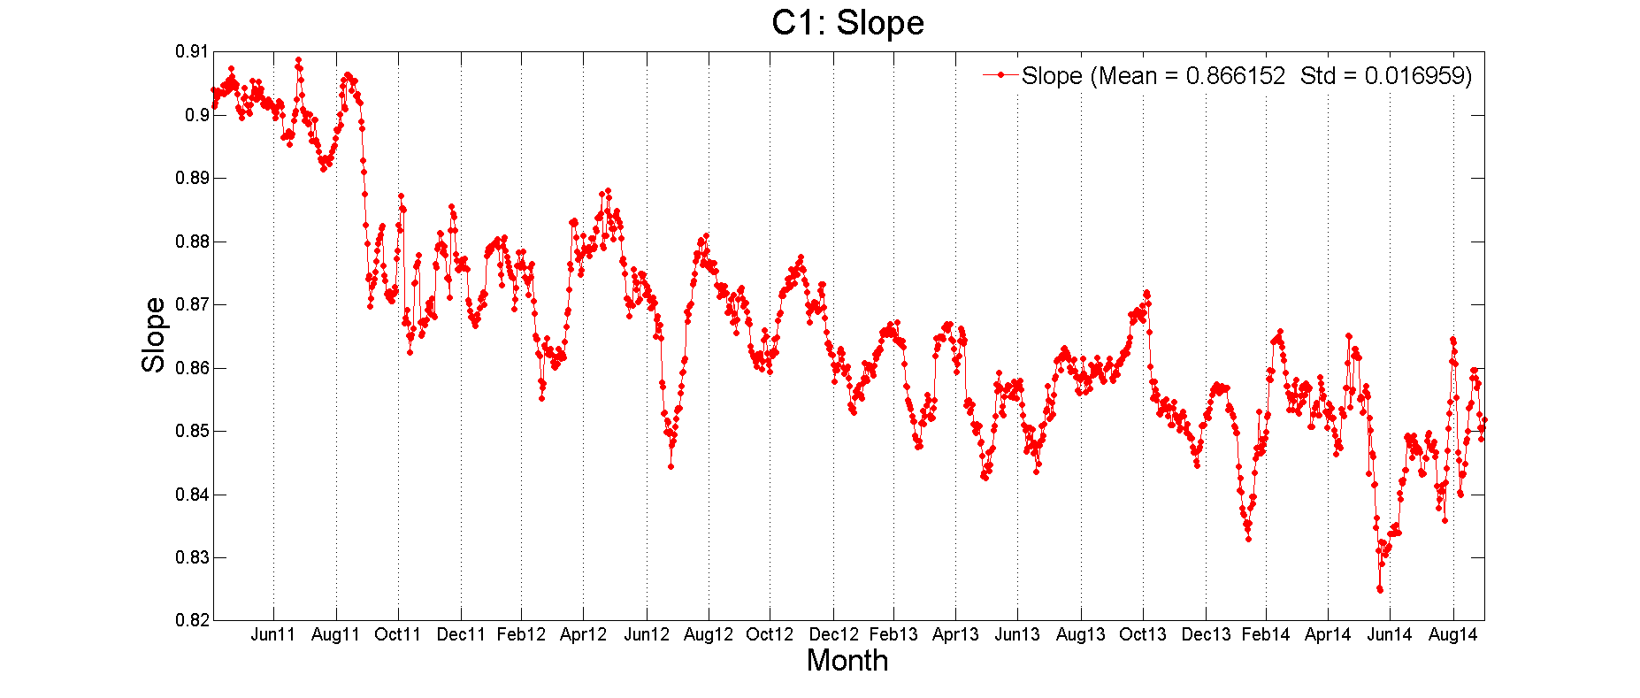
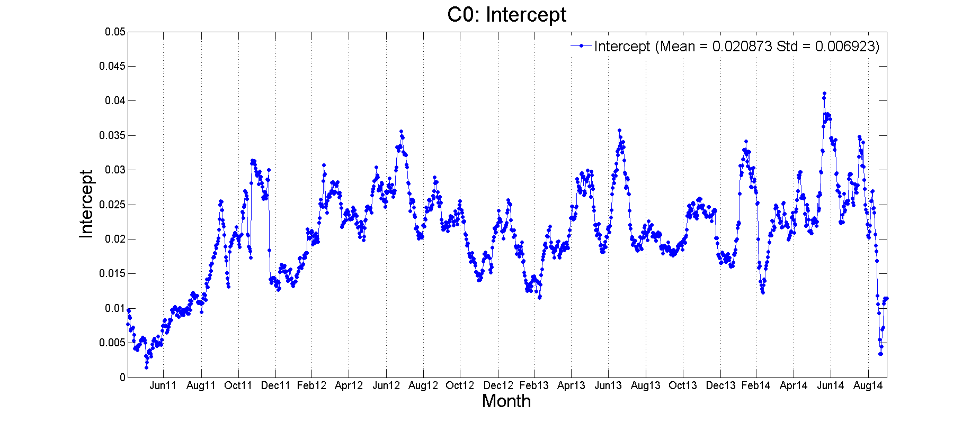
VISIBLE CHANNEL(1/2)
a scatter plot for 30 days data
get a slope/intercept
trend of slope for long period
Time series of slopes and intercepts
The degradation is about 5.67%(1.67%/year) from Apr.2011 to Sep. 2014.
3

Slide 4
VISIBLE CHANNEL(2/2)
Visible Calibration by Moon target
In 79 cases of COMS lunar observation
Compare the result of IMPS and GIRO_fourth realese
Degradation(IMPS) is about -5.97%(-1.41%/year)
Degradation(GIRO) is about -4.26%(-0.98%/year)
Issues
Vary the ratio of observed irradiance and ROLO irradiance through the threshold
And also change the ratio depend on the Moon area size
Need more test to define the Moon pixel and Moon area size

Slide 5
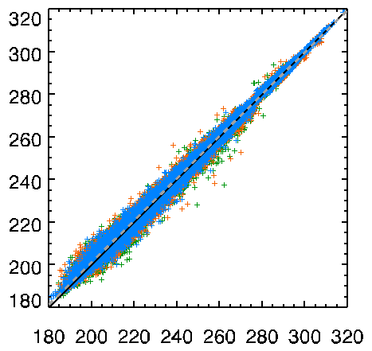
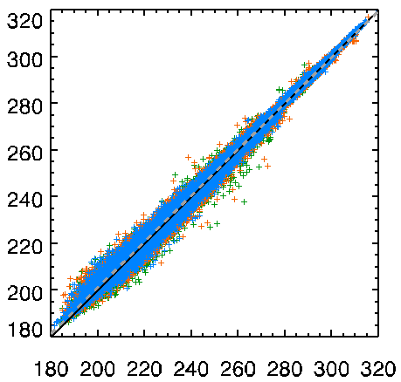
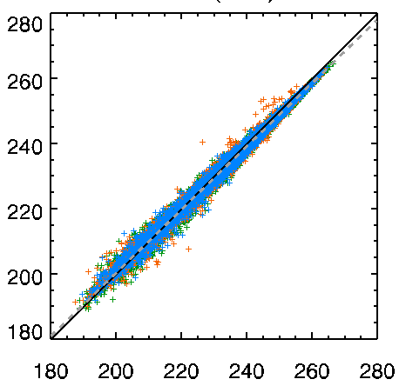
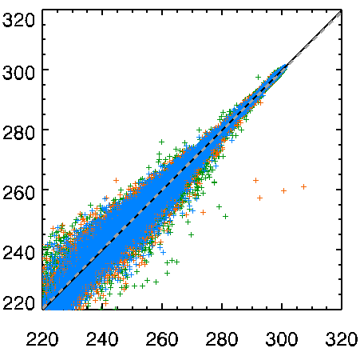
INFRARED CHANNEL(1/3)
check the TB bias for each IR channels using IASI_A, IASI_B and AIRS
period: 2011.04 – 2014.12(IASI_A, AIRS), 2013.08 – 2014.12(IASI_B)
AIRS IASI_A IASI_B
IR1 (10.8μm)
IR2 (12.0μm)
 |  | TOTAL | IASI_A | IASI_B | AIRS
IR1 | Number | 207072 | 71524 | 47349 | 88199
 | Bias | 0.2694 | 0.2859 | 0.3296 | 0.2237
 | RMSE | 1.5041 | 1.5024 | 1.4581 | 1.5295
IR2 | Number | 217960 | 75428 | 50108 | 92424
 | Bias | 0.2312 | 0.2186 | 0.2753 | 0.2175
 | RMSE | 1.3806 | 1.3781 | 1.3519 | 1.3979
IR3 (WV) | Number | 108183 | 36696 | 24648 | 46839
 | Bias | -0.8614 | -0.7485 | -0.7652 | -1.0005
 | RMSE | 1.1780 | 1.0805 | 1.0862 | 1.2920
IR4 (SWIR) | Number | 94528 | 37490 | 24304 | 32734
 | Bias | 0.0905 | 0.0374 | 0.0506 | 0.1811
 | RMSE | 2.6635 | 2.4108 | 2.4072 | 3.0869
COMS TB (K)
RMSE 1.3806
RMSE 1.5041
WV (6.75μm)
SWIR (3.75μm)
COMS TB (K)
RMSE 1.1780
RMSE 2.6635
LEO TB (K)
LEO TB (K)
5

Slide 6
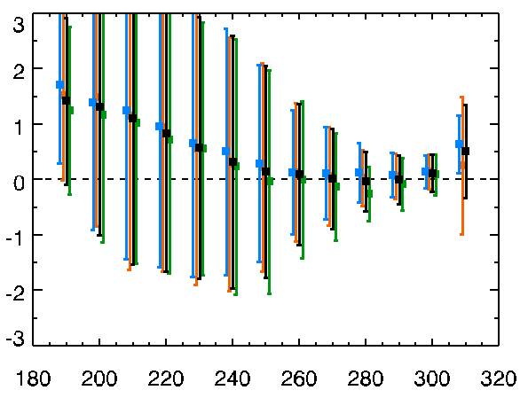
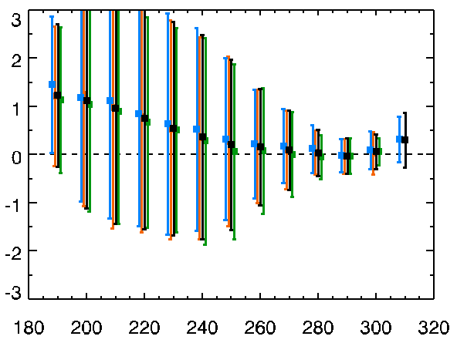
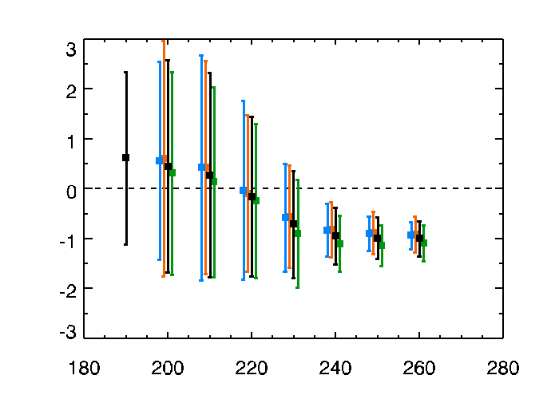
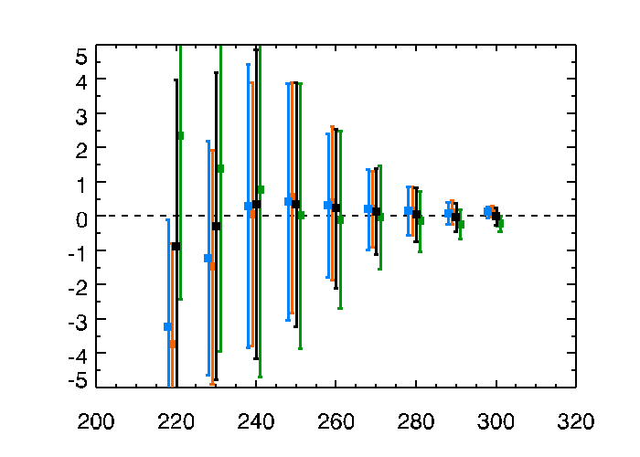
INFRARED CHANNEL(2/3)
AIRS IASI_A IASI_B TOTAL
trend of TB bias for COMS IR TBs
period: 2011.04 – 2014.12(IASI_A, AIRS), 2013.08 – 2014.12(IASI_B)
RMSE 1.3806
RMSE 1.5041
IR2
IR1
IR2
TB Bias (K)
Bias 0.2237 0.2859 0.3296 0.2694
Bias 0.2175 0.2186 0.2753 0.2312
RMSE 1.1780
RMSE 2.6635
WV
SWIR
TB Bias (K)
Bias -1.0005 -0.7485 -0.7652 -0.8614
Bias 0.1811 0.0374 0.0506 0.0905
COMS TB (K)
COMS TB (K)

Slide 7
INFRARED CHANNEL(3/3)
monthly variation of TB bias and RMSE
period: 2011.04 – 2014.12(IASI_A, AIRS), 2013.08 – 2014.12(IASI_B)
TB Bias (COMS-LEO)
AIRS IASI_A IASI_B TOTAL
TB RMSE
(K)
(K)
Bias 0.2237 0.2859 0.3296 0.2694
IR1
RMSE 1.5295 1.5024 1.4581 1.5041
RMSE 1.3979 1.3781 1.3519 1.3806
Bias 0.2175 0.2186 0.2753 0.2312
IR2
Bias -1.0005 -0.7485 -0.7652 -0.8614
WV
RMSE 1.2920 1.0805 1.0862 1.1780
SWIR
RMSE 3.0869 2.4108 2.4072 2.6635
Bias 0.1811 0.0374 0.0506 0.0905
7

Slide 8
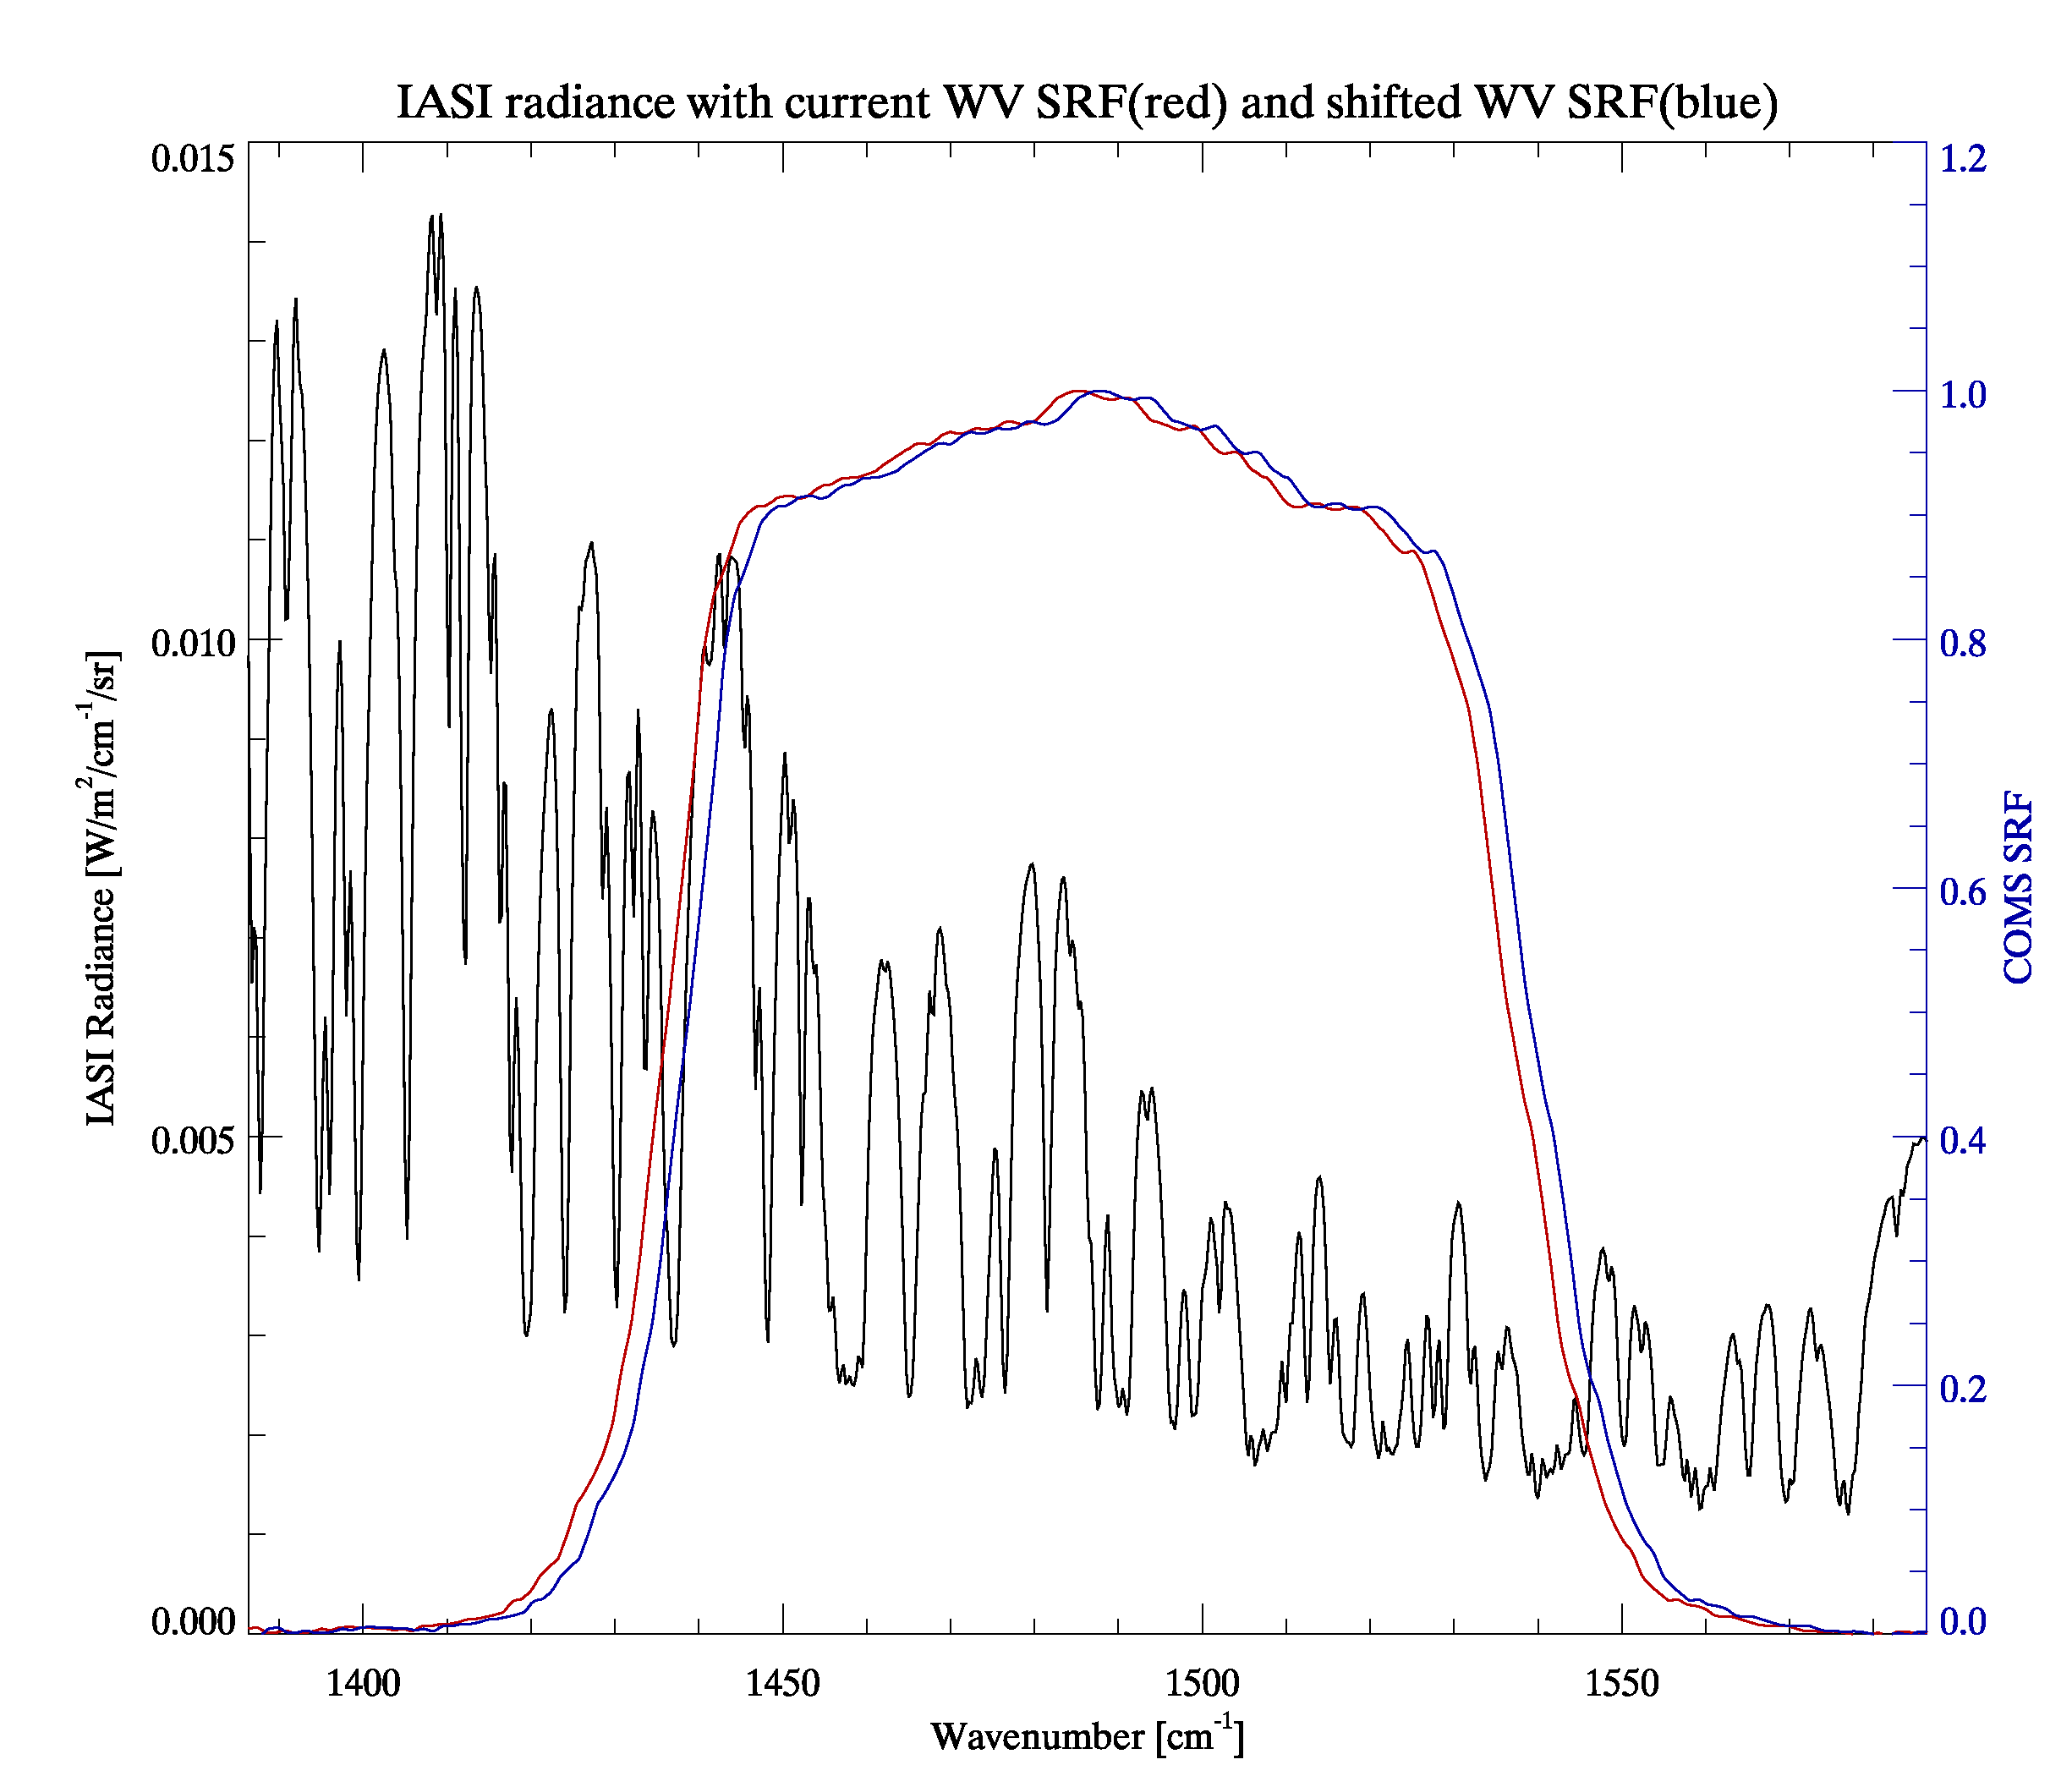
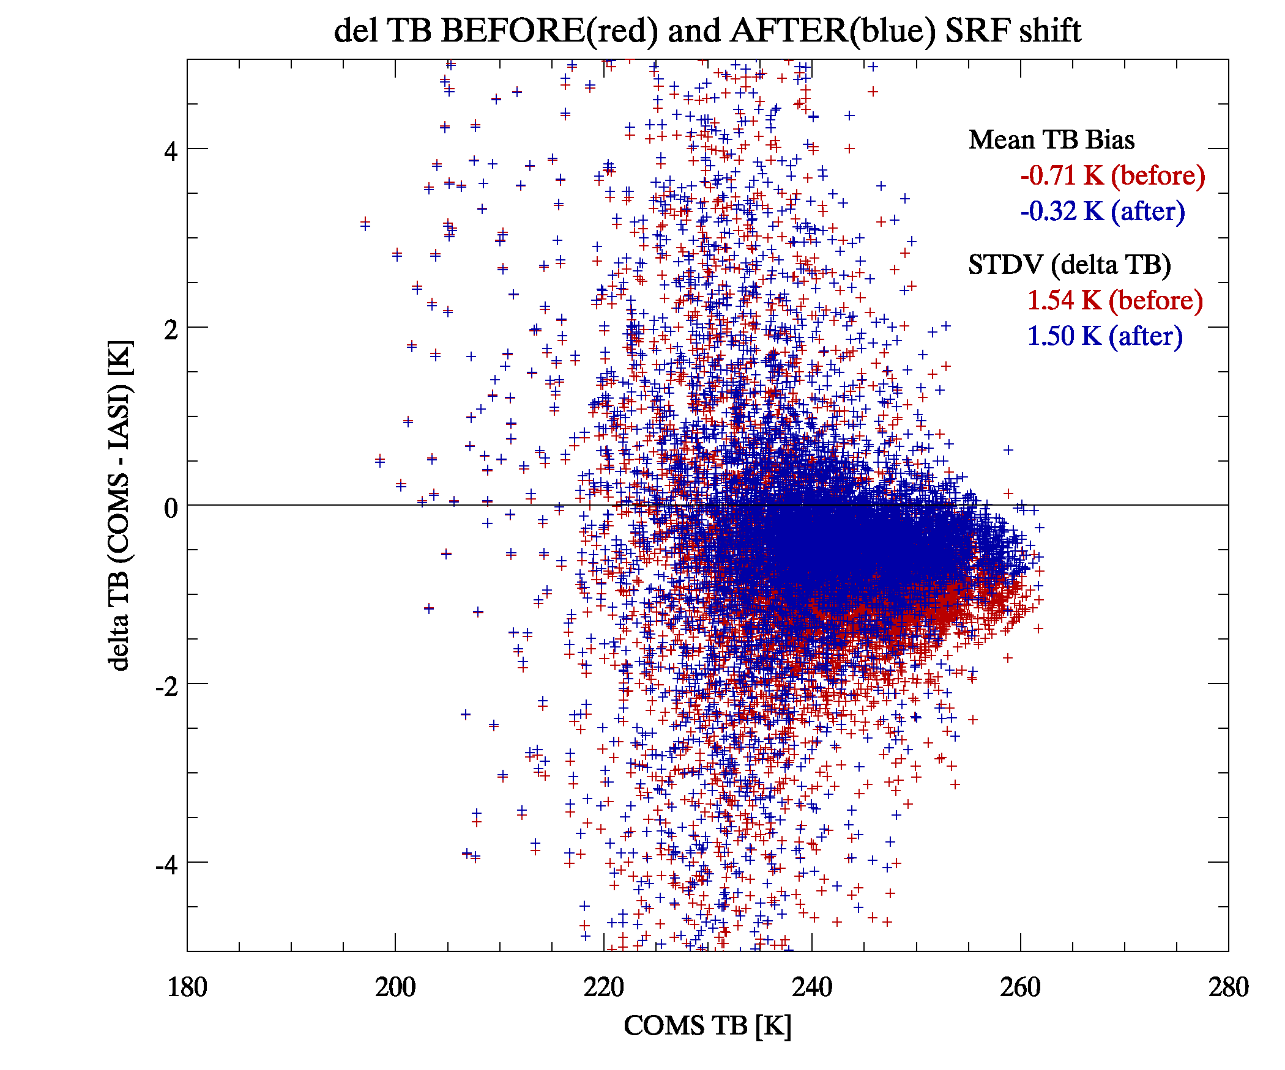
Cold Bias Correction in SW
TB bias btw. MI and IASI reduced by ~ 0.4K(-0.71K → -0.32K)

Slide 9
COMS IR for Demo Phase
Preparation for COMS IR to enter the Demonstration Phase of the GSICS Procedure for Product Acceptance(GPPA)
Preliminary version of ATBD and sample data (Nov. 2014)
Checking sample data format

Slide 10
Thank you

