Slide 1
Multi-Instrument Intercalibration (MIIC) Status
Chris Currey, Aron Bartle
2015 GSICS annual meeting, New Delhi, India
March 16, 2015

Slide 2
What is MIIC?
A ROSES ACCESS 2013 funded effort (2 years) to deploy web services at NOAA NCDC and NASA ASDC to improve access to select data products in support of coincident intercalibration and intercomparison level-2 studies
To demonstrate on the NOAA NCDC remote server
Expand beyond calibration to grab any parameter in a given HDF file
2nd MIIC proposal, First was a demonstration of the server side software needed to inter-calibrating GOES-13 and Aqua-MODIS
Demonstrated on local servers
Data products accessible by MIIC services
CERES and CALIPSO (L1 and L2) from LaRC ASDC
S-NPP instruments including VIIRS and CrIS (SDRs and EDRs) and GOES from CLASS

Slide 3
MIIC Objectives
Access matched observations from multiple instruments within large datasets distributed across multi-agency data centers
Demonstrate a successful deployment of a NOAA and NASA collaborative distributed data system
Reduce network data transfer by providing web services at host sites to match, subset, and filter data
Intercomparison data is less than 1% of the total volume of data
Transfer through the network only data (parameters, spatially) needed to dramatically reduce inter-comparison data size
Provide tool to support GSICS, Cal-Val and CLARREO teams
Demonstrate benefit of OPeNDAP server-side functions
Demonstrate feasibility of resampling large hyperspectral OSSE datasets for comparison with observations

Slide 4
MIIC Use Cases
Intercalibration (LEO-GEO and LEO-LEO)
Acquire and analyze matched data using the MIIC event predictor instrument models
Use MIIC OPeNDAP server-side functions to acquire, filter, and grid L1 or L2 data
Demonstrated capabilities with SCIAMACHY, MODIS, VIIRS, and CERES data
Intercomparison (support NPP CriMSS Validation study)
Acquire matched NPP and CALIPSO data
Data used for offline validation of CriMSS (profile T, H₂O) using RTM (X. Liu)
Acquire NPP CrIS SDR, ATMS SDR, VIIRS SDR, VIIRS EDR, CriMSS EDR, and CALIPSO L1 & L2 data for matched events
Surface Site Data Mining
Acquire data over geographic surface sites (eg., Libya-4, Dome C)
Use MIIC OPeNDAP server-side functions to acquire, filter, and grid L1 or L2 data
For ASDC products (CERES, CALIPSO) use PostGIS to speed up predictions
OSSE Data Access (support OSSE vs. SCIAMACHY analysis)
Demonstrate efficient access to large computed hyperspectral multi-year OSSE datasets
Develop spectral resample and spatial average server-side functions
OSSE vs. SCIAMACHY offline analysis (Y. Roberts)
Notes:
CrIS – NPP Cross track Infrared Sounder
ATMS – NPP Advanced Technology Microwave Sounder
CriMSS - Cross-track Infrared and Microwave Sounding Suite, to provide temperature and humidity profiles
CALIPSO on its own satellite, lidar in space
SDR sensor data record
EDR environmental data record
CDR climate data record

Slide 5
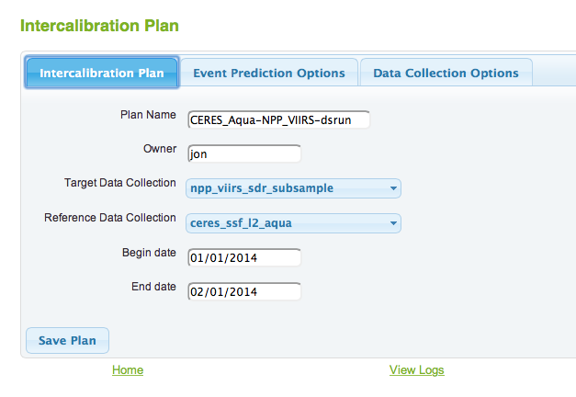
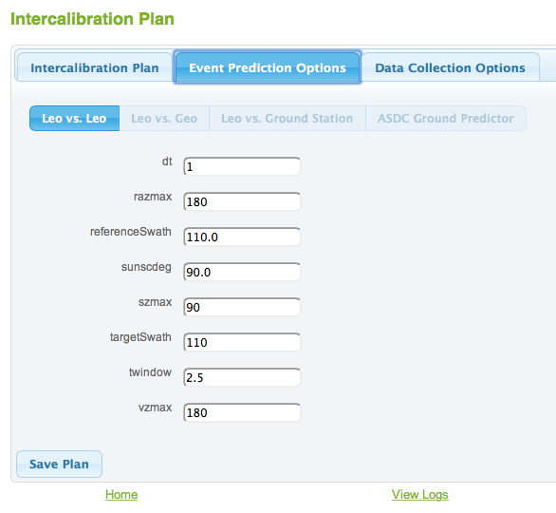
MIIC Selection Pages
Pick satellite and time frame
Pick SNO filters

Slide 6
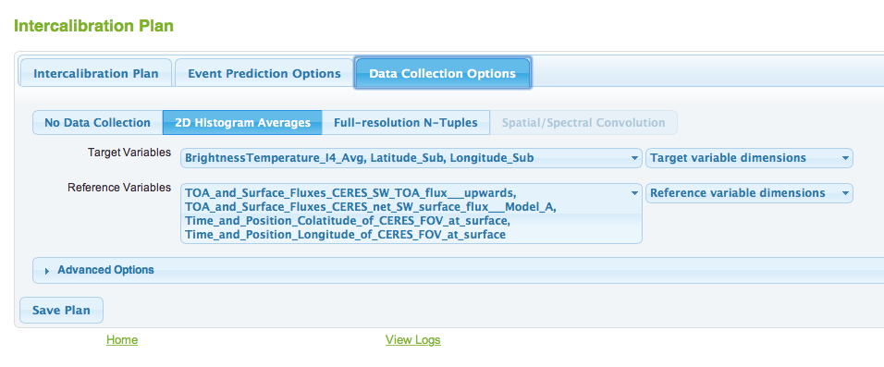
MIIC Selection Pages
Pick parameters, all parameters on HDF file are listed

Slide 7
User inter-comparison events are listed
User can submit ICPlans to through web page to predict, acquire, and analyze data,
Or REST API for program interface; need to insure fair resource utilization

Slide 8
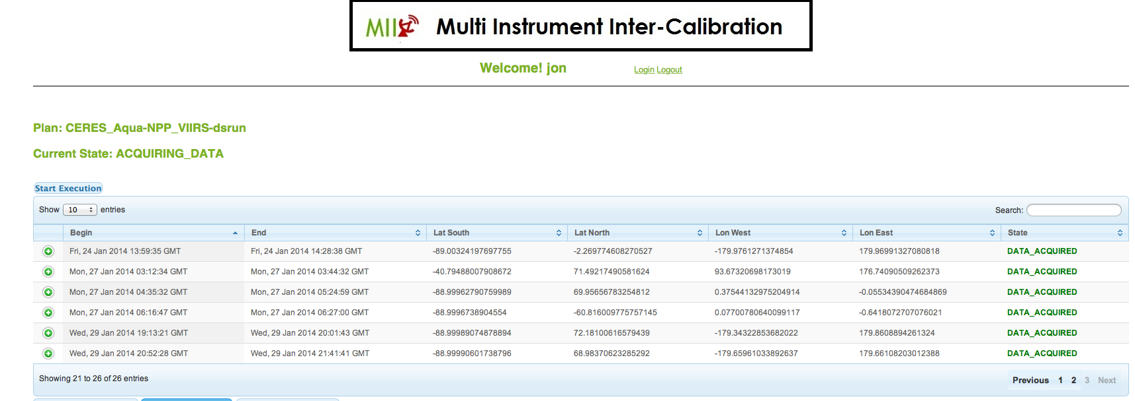
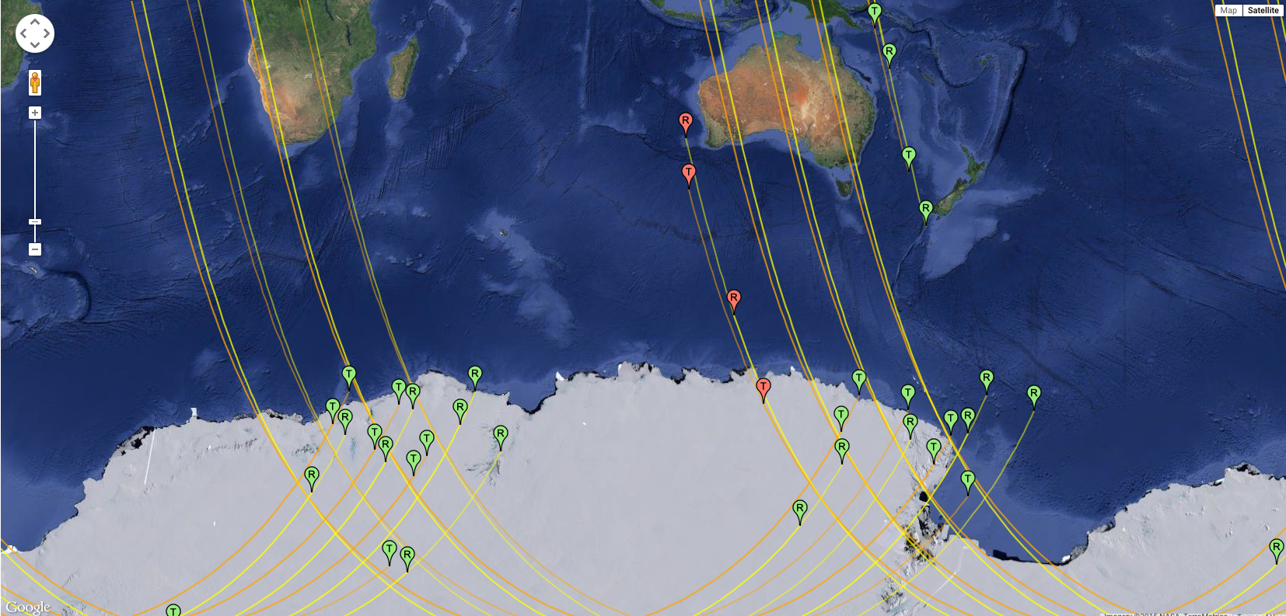
SNO event prediction
Event prediction based on TLEs, many satellite pairs to chose from
Google maps interface, to show even location and satellite orbits

Slide 9
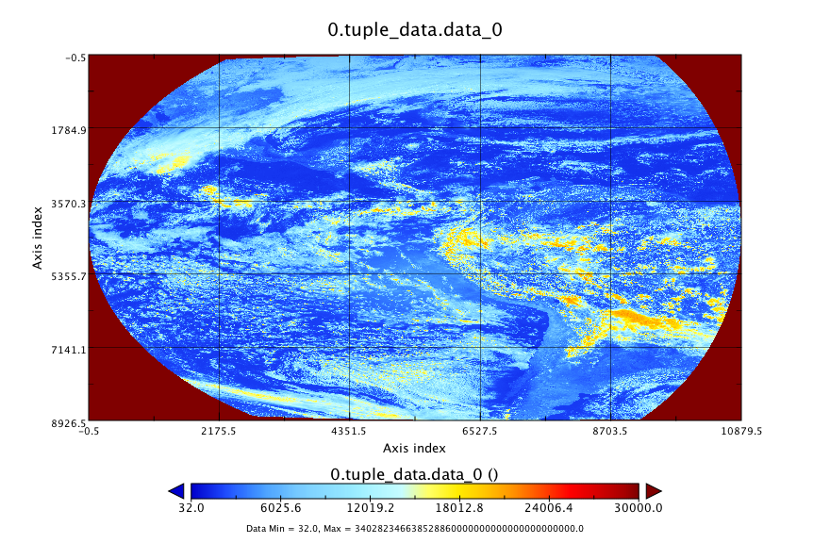
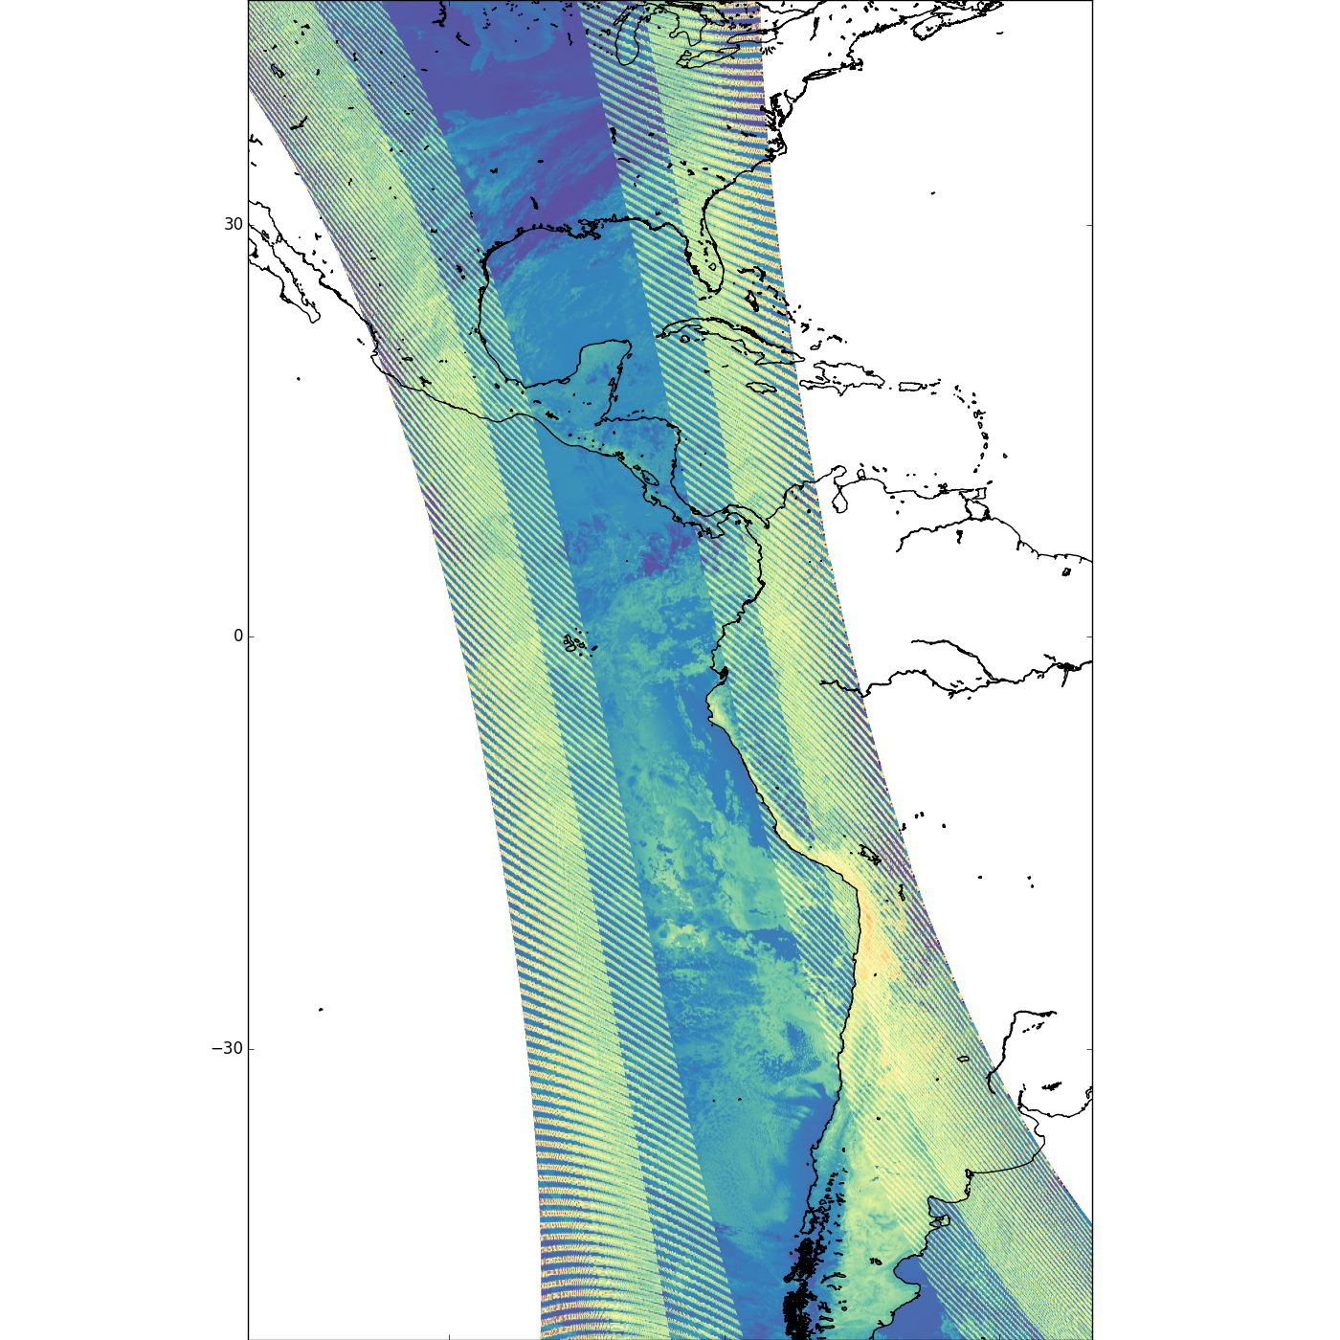
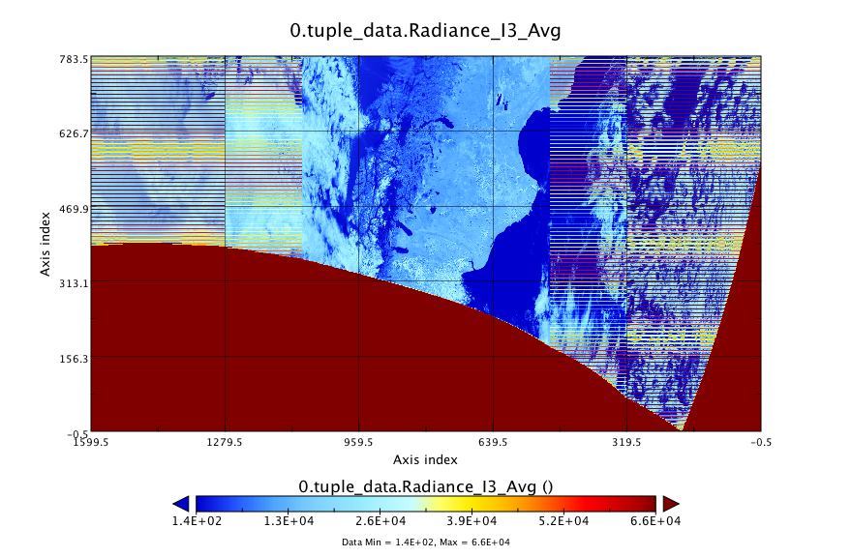
LEO-GEO Full Pixel Level Resolution Matched Event for VIIRS vs. GOES13 ; Jan. 1, 2013
a.
b.
c.
Jan. 1, 2013 NPP VIIRS-GOES13 MIIC IC Event,
46.4 N, -51.2 S, -114.7 W, -53.2 W, time 2013-01-01T18:49:40Z through 2013-01-01T19:17:00Z; a. 1 km GOES13 band 0 data from CLASS, b. Matched 2 km VIIRS SDR Radiance_I3_Avg data, c. one VIIRS granule (of 7) that make up matched LEO-GEO event scene, note artifact in data from “bow-tie” effect at scan angles greater than 31.7° and 56.3°; extremely large amount of data for 1 event!

Slide 10
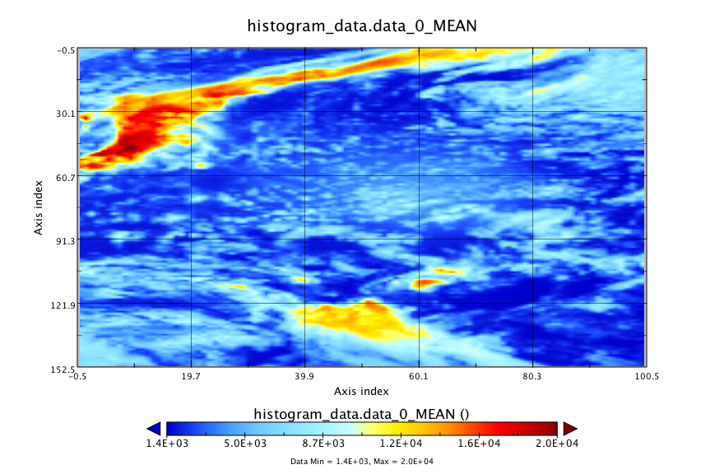
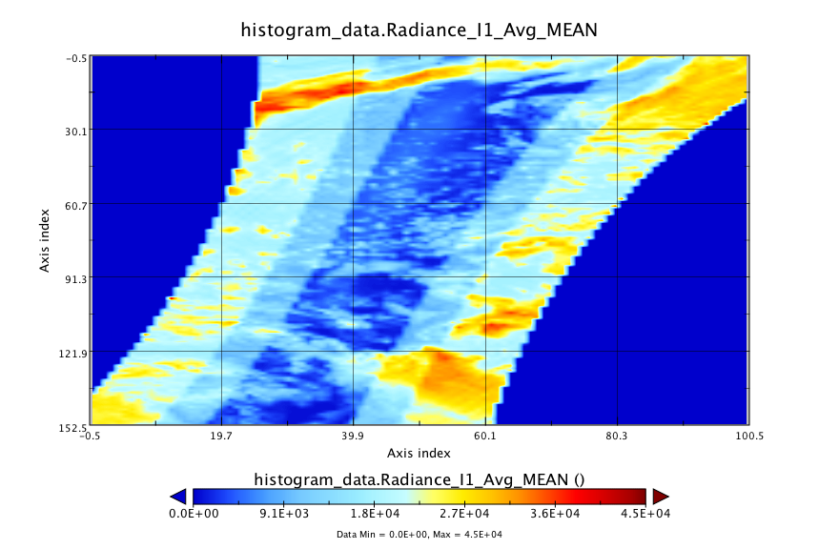
LEO-GEO Gridded Matched Event for VIIRS vs. GOES13 Jan. 1, 2013
GOES13 gridded
VIIRS gridded
Gridded data, 0.5 degree, returned from MIIC server-side 2DHistogram function for single LEO-GEO matched event, Jan. 1, 2013; factor of 3500 in data reduction

Slide 11
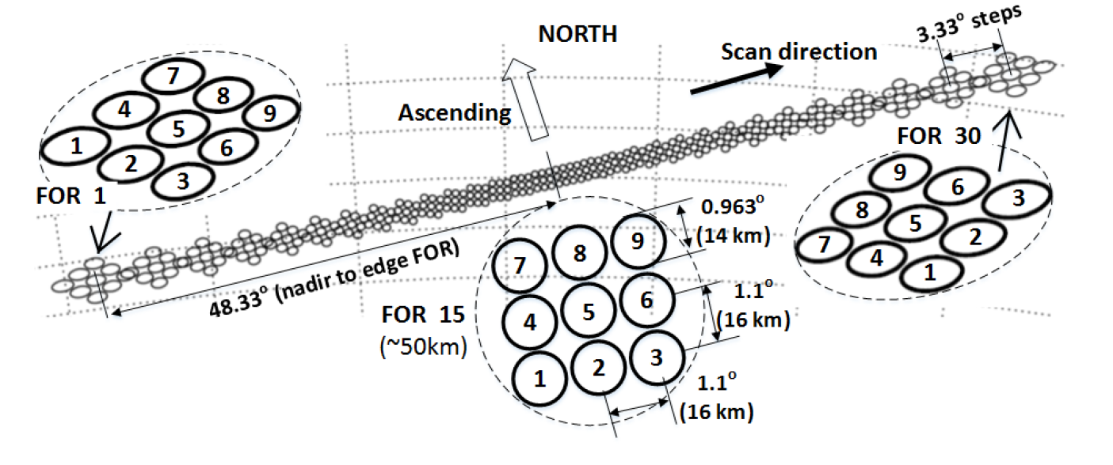
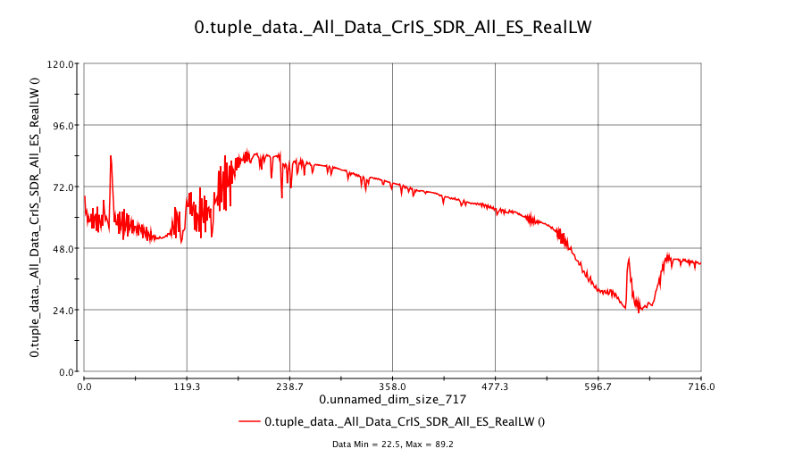
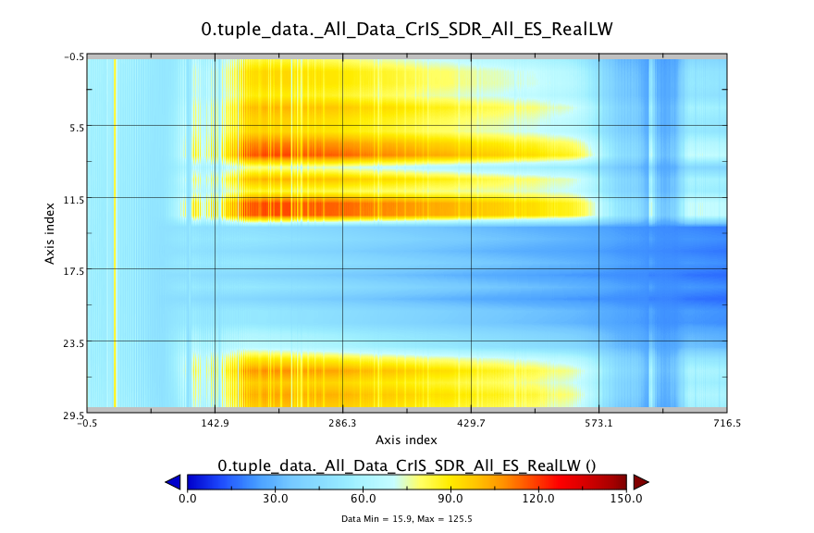
NPP/CALIPSO (LEO/LEO) Intercomparison for CrIMSS Validation Study (X. Liu) MIIC pixel-level function to acquire CALIPSO, CrIS, ATMS, VIIRS, and CriMSS Data IC Event Aug. 12, 2014
Tune MIIC event predictor to use CrIS scan width
CALIPSO groundtrack for matched event w/ NPP
Single CrIS SDR LW spectra for FOV1
Single scan of CrIS LW spectra for FOV1 (30 FORs per scan)

Slide 12
VIIRS and CALIPSO Data for MIIC IC Event August 12, 2014
Image shows full resolution VIIRS data returned from MIIC pixel-level server-side function and CALIPSO nadir view; for this scene MIIC processed 7 VIIRS SDRs, 2 L1 CALIPSO files, and 2 L2 5km Cloud Product files
MIIC additionally acquires full resolution NPP ATMS SDR and CrIS SDR data per event scene
Currently user will process these data offline; this is an example of a user using MIIC the predict, find, and acquire matched data
Data acquired on ASDC servers using test data; need to deploy MIIC OPeNDAP server at NOAA CLASS
szmax = 90, twindow = 2.5 min
start 2014-08-12T11:42:16Z, end 2014-08-12T12:16:26Z

Slide 13
Surface Site Filtering with MIIC FullRes Server-side Function CERES SSF, Jan. 2, 2011
This option lets users select parameter filters
a. No clear sky filter
b. 5 % clear sky filter
c. 95 % clear sky filter

Slide 14
Summary
MIIC software installed on new ASDC servers with connectivity to online storage
Working with NOAA NCDC to configure MIIC OPeNDAP server
with connectivity to S-NPP 90 day near real time cache
Data is compressed and tarred
VIIRS, CrIS, ATMS, OMPS datasets
After 90 days the data will reside in tape storage
Open up internet access to GSICS and NCDC for evaluation (TBC)
Conduct code review w/ ASDC to evaluate operations
Start visualization and analysis web services code development

Slide 15
Discussion
This allows GSICS members in near real time “automatically” download VIIRS data during VIIRS/GEO inter-calibration events
Other suggestions for Chris

Slide 16
BACK UP SLIDES

Slide 17
What can you do with MIIC?
Event Prediction
Acquisition of matched events
Analysis and visualization of events
Type | Target | Reference | Date range | Performance
Event prediction | GOES13 FD | NPP VIIRS | 2013 | 1492 events, 30 sec.
Event prediction | Aqua MODIS | NPP VIIRS | 2013 | 948 events, 1 min.
LEO-GEO 2DGridded | GOES13 FD | NPP VIIRS | Jan. 1, 2013 | 4 events, 5 min.
LEO-GEO FullRes | GOES13 FD | NPP VIIRS | Jan. 1, 2013 | 4 events, 7 min.
LEO-LEO 2DGridded | Aqua CERES | NPP VIIRS | Jan., 2013 | 27 events, 4 min.
LEO-LEO FullRes | NPP VIIRS | CALIPSO | Aug. 12, 2013 | 1 event, 2 min.
Surface Site FullRes | NPP VIIRS | N/A | 2014 | 274 events, 18 min.
Surface Site FullRes | CALIPSO | N/A | 2013 | 182 events, 4 min.
Surface Site 2DGridded | NPP VIIRS | N/A | 2014 | 274 events, 18 min.
All products staged on ASDC servers; surface site (5 degree box at 75 W); event prediction tests acquire no data

Slide 18
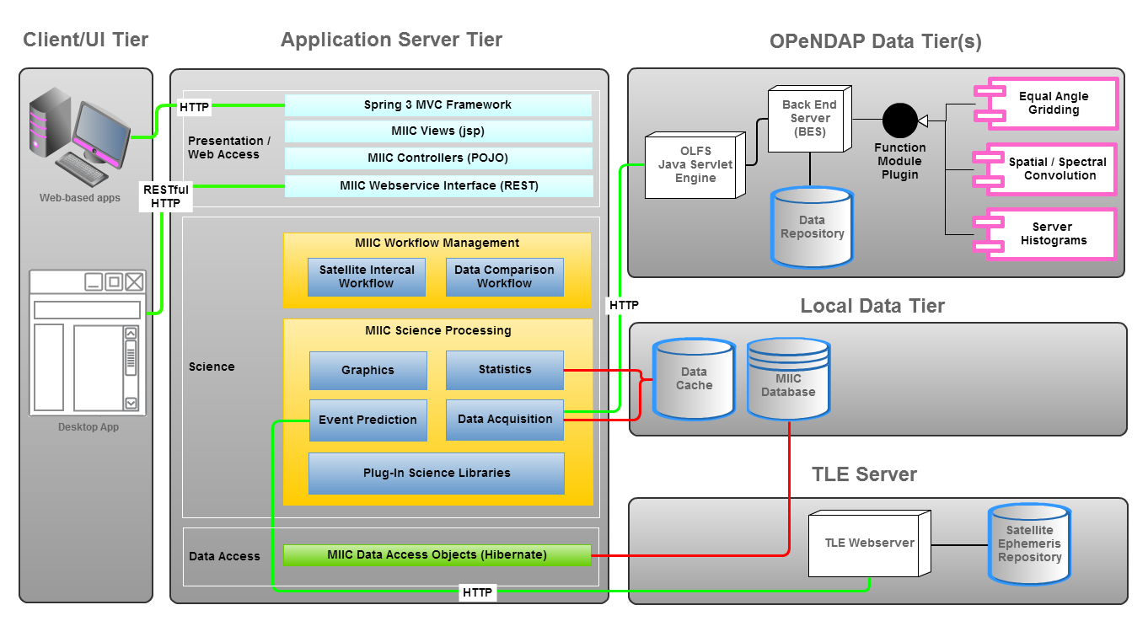
MIIC Architecture

Slide 19
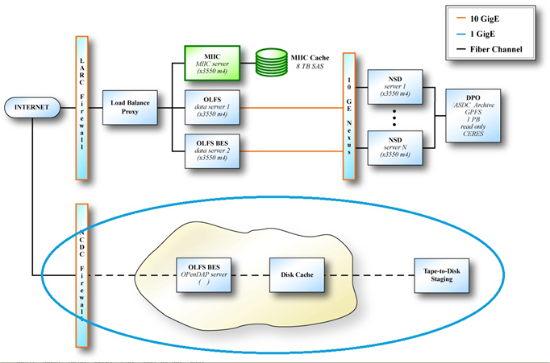
NOAA NASA Collaborative Deployment Progress
New servers installed at ASDC; 10 GE connectivity to online storage (7 PB)
Initial focus to provide MIIC OPeNDAP access to S-NPP 90 Day Cache

Slide 20
MIIC UI
User can submit ICPlans to through web page to predict, acquire, and analyze data,
Or REST API for program interface; need to insure fair resource utilization

Slide 21
S-NPP 90 Day Cache
Attempting to mount data available from ftp server (ftp://ftp-npp.class.ngdc.noaa.gov/ )
Include ATMS, VIIRS, and CRIS SDRs and EDRs
Need to solve tar + compression issue
MIIC software can be configured to access any of these data products for IC studies

Slide 22
TLEs Available for MIIC Event Prediction (red implemented)
http://www-angler.larc.nasa.gov/cgi-bin/site/showdoc?mnemonic=TLE&c=satellite-list
CAT# NAME TLE_LAST_UPDATED
13367 "Landsat 4" "2013-06-20 08:05:02"
14780 "Landsat 5" "2013-06-20 08:05:02"
15354 "ERBS" "2013-06-20 08:05:02"
15427 "NOAA-09" "2013-06-20 08:05:02"
16969 "NOAA-10" "2013-06-20 08:05:02"
19531 "NOAA-11" "2013-06-20 08:05:02"
21140 "Meteosat-5" "2013-06-20 08:05:02"
21263 "NOAA-12" "2013-06-20 08:05:02"
21574 "ERS-1" "2013-06-20 08:05:02"
23051 "GOES-8" "2013-06-20 08:05:02"
23455 "NOAA-14" "2013-06-20 08:05:02"
23522 "GMS-5" "2013-06-20 08:05:02"
23560 "ERS-2" "2013-06-20 08:05:02"
23581 "GOES-9" "2013-06-20 08:05:02"
23940 "TOMS-EP" "2013-06-20 08:05:02"
24786 "GOES-10" "2013-06-20 08:05:02"
24883 "OrbView-2" "2013-06-20 08:05:02"
24932 "Meteosat-7" "2013-06-20 08:05:02"
25063 "TRMM/VIRS" "2013-06-20 08:05:02"
25260 "SPOT-4" "2013-06-20 08:05:02"
25338 "NOAA-15" "2013-06-20 08:05:02"
25682 "Landsat 7" "2013-06-20 08:05:02"
25789 "QuikSCAT" "2013-06-20 08:05:02"
25991 "DMSP 5D-3 F15 (USA 147)" ""
25994 "Terra" "2013-06-20 08:05:02"
26352 "GOES-11" "2013-06-20 08:05:02"
26536 "NOAA-16" "2013-06-20 08:05:02"
26871 "GOES-12" "2013-06-20 08:05:02”
27386 "EnviSAT" "2013-06-20 08:05:02"
27421 "SPOT-5" "2013-06-20 08:05:02"
27424 "Aqua" "2013-06-20 08:05:02"
27453 "NOAA-17" "2013-06-20 08:05:02"
27509 "Meteosat-8 (MSG-1)" "2013-06-20 08:05:02"
27525 "Kalpana-1" "2013-06-20 08:05:02"
27642 "ICESat" "2013-06-20 08:05:02"
28054 "DMSP 5D-3 F16 (USA 172)" ""
28376 "Aura" "2013-06-20 08:05:02"
28451 "Feng Yun 2C" "2013-06-20 08:05:02"
28622 "MTSAT-1R" "2013-06-20 08:05:02"
28622 "MTSAT-1R/Aqua" "2013-06-20 08:05:02"
28654 "NOAA-18" "2013-06-20 08:05:02"
28912 "Meteosat-9 (MSG-2)" "2013-06-20 08:05:02"
28912 "Meteosat-9/Terra (MSG-2)" "2013-06-20 08:05:02"
28912 "Meteosat-9/Aqua (MSG-2)" "2013-06-20 08:05:02"
28937 "MTSAT-2" "2013-06-20 08:05:02"
29107 "CloudSAT" "2013-06-20 08:05:02"
29108 "Calipso" "2013-06-20 08:05:02"
29155 "GOES-13" "2013-06-20 08:05:02"
29499 "MetOp-A" "2013-06-20 08:05:02"
29522 "DMSP 5D-3 F17 (USA 173)" "2011-11-15 08:12:53"
29640 "Feng Yun 2D" "2013-06-20 08:05:02"
32382 "RadarSat-2" "2013-06-20 08:05:02"
33463 "FY2E" "2012-07-12 15:57:39"
33492 "GOSAT" "2013-06-20 08:05:02"
33591 "NOAA-19" "2013-06-20 08:05:02"
35951 "DMSP 5D-3 F18 (USA 210)" ""
36411 "GOES-15" "2013-06-20 08:05:02"
37838 "Megha-Tropiques" "2013-06-20 08:05:02"
37849 "Suomi National Polar Orbiting Partnership" "2013-06-20 08:05:02"
38552 "Meteosat-10 (MSG-3)" "2013-06-20 08:05:02"
38771 "MetOp-B" "2013-06-20 08:05:02"
Can run predictions for any spacecraft with TLEs from Space-Track.org
Current plans to access only instrument data hosted at ASDC or NCDC
User can run predictions to determine events w/o accessing data
Extended CLARREO algorithm (C. Roithmayr)

