Slide 1
What is a GSICS Product?
Larry Flynn and Manik Bali
2015 GSICS Annual Meeting
New Delhi, India
March 16-20, 2015

Slide 2
Outline: What is a GSICS Product?
Level 1 adjustments and corrections
Methods (e.g., SNO or double difference)
Transfer, stability,
Spectral region idiosyncrasies
Satellite and Instrument Data Bases
OSCAR (SRF -> product, etc.)
Geolocation and FOVs
Anomalies and period of coverage
FCDRs and ECVs
Users for reanalysis versus real time
Components, homogenization approach (algorithms?)
MW FCDR to GSICS Product example for discussion
References
Solar
Lunar (ROLO and GIRO)
DCC (radiance levels, frequencies?)
Targets (Surfaces emissions and relflectivities?)
Tools (SNO identifier, Display Graphics, Communication, Notification …)
Documents (Journal articles, ATBDs, Users’ manuals)
RTMs (Error analysis and comparisons studies)
Stability versus Traceability
Notes:
In looking over old presentations on GSICS products, Manik provided me with a couple on the GSICS Information Services and Products Roster (GISPR). I'm attaching one to show that we are just following a natural evolution. I do want to make it clear that I am not proposing that most of these all go through the GPPA or other reviews or become named, blessed, hosted GSICS products.
http://www.star.nesdis.noaa.gov/smcd/GCC/documents/GRWG/200901/DAY1_1445_Iacovazzi_GCC_GISPR.pdf

Slide 3
Level 1 Adjustments and Corrections
These are what we think of when we first think of GSICS products and users.
They are subject to the GSICS Procedure for Product Acceptance (GPPA) and to WMO naming conventions.
They are associated with well-defined, well-reviewed algorithms for their creation and evaluation of errors.
There are important considerations for designating reference instruments and transfer instruments.
The instruments and methods used for different spectral regions require flexibility in application of standards.
As the program progresses, we need to address how the reference instrument concept is expanded temporally.
Request guidance from GRWG subgroups on the following: reference instruments, prime corrections, metadata contents, new products, and adjustments used for long-term dataset creation.

Slide 4
Satellite and Instrument Data Bases
The goal is to have complete, accurate data bases for instruments used in GSICS products at WMO OSCAR.
We need accurate histories of instrument and satellite anomalies and performance issues.
We need accurate spectral response functions (SRFs) and wavelengths. These are derived directly from measurements for some wavelength regions.
We need to ensure that the data includes information to establish the Fields-of-View. Most Level 1 products contain geolocation data as part of the product.
Many UV/Vis products contain a measured solar irradiance spectrum to go with their Earth-view radiance spectrum. Their fundamental measurements are radiance/irradiance ratios.
Are we adequately storing detailed instrument histories? Are there other calibration datasets we should add?
Are corrections or adjustments to the SRFs, wavelength scales, and geolocation/pointing GSICS products?

Slide 5
Uniform Calibration to Create Long-term Records
Products are often generated from re-analysis of past records.
Long-term stability may be more important than traceability.
Level 2 ECVs may depend strongly upon the Level 1 consistency.
Should the inter-instrument adjustments for FCDRs become GSICS Products?
Should the algorithms to produce the inter-calibration adjustments be GSICS Products?
Should GSICS review the L1 adjustments used to create ECVs?
What benefits does putting their adjustments/algorithsm through the GSICS review process provide to FCDR developers and who are the users of the adjustments?
Notes:
Some ECVs are homogenized L1 products. For some L2 ECV creation efforts, e.g., ozone, ocean color, aerosols, MW precipitation, the approach to homogenization flows back to L1 adjustments. That said, I primarily view ECV creators as users of GSICS re-analysis correction products. One part of the MW discussion inverts this view, should GSICS review the L1 adjustments used to create ECVs and make the adjustments GSCICS products?

Slide 6
GSICS Reference Datasets
Reference datasets are used in comparisons to check on-orbit performance.
Models of Moon radiances have been developed to allow its use as a target.
Earth sites (deserts and ice) and Deep Convective Clouds have been identified as calibration targets.
Should GSICS create a high-resolution reference Solar spectrum? How should Solar activity be handled?
Should the GIRO model become a GSICS product? Or is it already one?
Should databases of target characteristics (BRDF, emissions, distributions) become GSICS products? How will their stability be independently modeled? Are the targets primarily transfer resources?

Slide 7
GSICS Tools
GSICS members have developed many useful tools including SNO prediction and interactive graphics capabilities.
The collaborative aspects of GSICS depend upon tools to provide good communication and notification of progress and processes.
Some of these tools are already components of the basic GSICS functionality.
Should GSICS create a library of tools to share? How are tools selected for this library?
Are there adequate tools for searching for documents, products and instruments?
Are meeting, action, and review notices being distributed as needed?

Slide 8
GSICS Documents
Documents are generated as part of the GSICS product review process.
GSICS has a set of documents defining its mission.
The GSICS Quarterly is used as a vehicle to publicize methods, results and meetings.
Records of GSICS meetings (presentations, minutes and actions) are collected.
Are the current document libraries and organization working well?
Are the ATBDs and Users’ Manuals fulfilling their roles?
Should we create better citation indices for product and method articles?

Slide 9
Radiative Transfer Models (RTMs)
RTMs are used with vicarious calibration applications.
RTMs are often used in weather applications and thus become part of the Observed-Forecast differences and in creating Jacobians for assimilation.
RTMs are used to compute measurement residuals with respect to climatology or other observations.
RTMs are used to transfer viewing conditions.
Should we identify standard RTMs for different spectral regions and provide error estimates for their use?
Should we support emission and absorption databases similarly? Should they be GSICS products?
Do we need to set up comparison and validation studies for candidate RTMs?

Slide 10
Background

Slide 11
What is a GSICS MW Product?
MW products differ from those from VIS or IR because there are not potential SI standards to consider
MW products can come in two classes:
Retrospective type products (FCDR “components” – geolocation, scan biases, intersatellite corrections, etc.)
Forward looking (quasi-real time)
A possible path forward:
Determine from users what specific MW products they would like to see from GSICS
Define a MW primary reference
WindSat or GMI for MW imagers?
ATMS for MW sounders?
A radiative transfer model like RTTOVS or CRTM?
Work with GDWG to define:
Data formats
Meta-data standards
Distribution mechanism
Work with the GCC to see how the products could be reviewed through the GPPA
Two potential products?
AMSU-MSU (C-Z. Zou)
SSM/I (K. Fennig)
Notes:
There are two classes of potential GSICS MW products - retrospective and forward looking/near-real time. The primary users are mostly those who develop them and their organizations, although other GSICS members might find the methods useful to extend to their own sensors. For the former, GSICS could consider simply developing tables of slopes/offsets for MW imagers and sounders. However, the group would have to agree on a common standard; since there is really no true SI traceable sensor we could use, we would have to determine for each time period, which sensor would be a reference. Plenty of work done in this regard by NOAA's CDR program and SCOPE-CM, so if we want, the MW sub group could come to some consensus on this, then we could develop these correction tables and call this a product (note, these would not qualify as a CDR because it might not directly include all of the adjustments needed). Now, for the current monitoring type of product, we could develop some sort of standard to then reference the operational sensors. For instance, NOAA is doing this for many sensors through comparisons with CRTM. So, an action for the MW sub group would be to determine what methods/references we should use and then we could move ahead with a proposed GSICS product. Manik has developed, based on both of these options, proposed Meta-data file structures. We thought that perhaps, with agreement from all on this email, that he could work those prototype formats (say using Cheng-Zhi's MSU and Karsten's SSMI) in parallel with the other activities just so we would have something defined in that regard. So if everyone agrees, we could then dive more into this at the next MW Sub-group meeting which I think I would like to have in April. Ralph

Slide 12
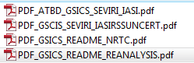
GSICS-Product status
Preoperational 8 products [4 EUMETSAT, 4 NOAA]
Demonstration 27 products [4 EUMETSAT, 13 NOAA, 6 JMA, 4 Ended]
Demo product example ^
Where are we in the process (EUMETSAT)?
What do we need to advance the product to PreOp
GRWG /GDWG assessment of the product quality/maturity.
User Feedback
Preoperational product example ^
Where are we in the process (NOAA)?
What do we need to advance the product to Op
Diurnal uncertainties *
^ Agencies need to commit resources to complete the transition
* Not requested by users.
Notes:
Four demonstration products (NOAA) have ended production.
There are two prototype products.

Slide 13
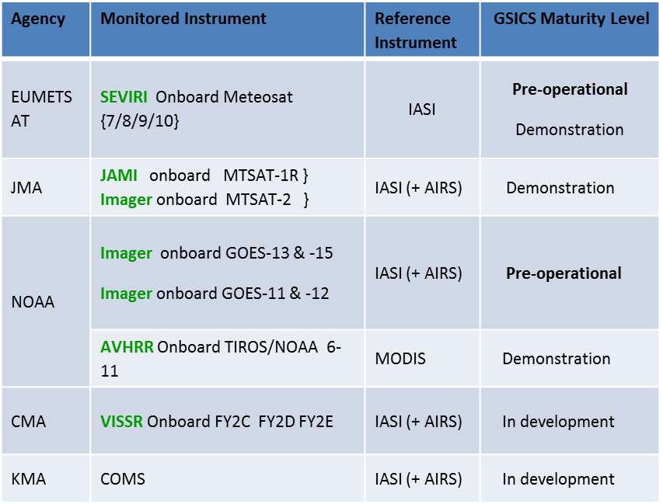
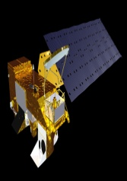
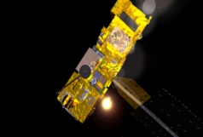
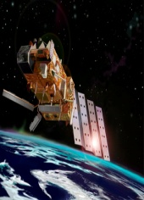
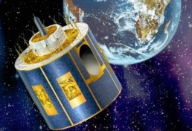
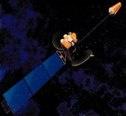
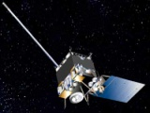
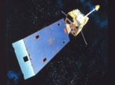
GSICS Products (1)
Near Real Time Correction Product
Re-Analysis Correction Product
GSICS Reference Instruments
AIRS MODIS IASI
GSICS Family of Monitored Instruments
GSICS Product application
Bias correction
SRF retrieval
Better SST Retrieval ,Cloud Height, Aerosol retrieval
SEVIRI MTSAT GOES AVHRR
GSICS also identifies best practices and principals
Critical need to evaluate and assign maturity to the product
Products span VIS and IR bands
Product Catalog

Slide 14
GSICS Products (2)
Notes:
http://www.star.nesdis.noaa.gov/smcd/GCC/ProductCatalog.php

Slide 15
GSICS Products (3)
Notes:
http://www.star.nesdis.noaa.gov/smcd/GCC/ProductCatalog.php

Slide 16
GCC Roles (1) http://www.star.nesdis.noaa.gov/smcd/GCC/index.php
Support the establishment of GSICS product and services definitions and product evaluation processes, including product theoretical basis, quality assurance, data protocols, and associated documentation;
Make recommendations to, and facilitate communication between, GRWG and GDWG during their efforts to develop, implement, organize, and direct GSICS research and data management projects;
Support GSICS end-to-end demonstration activities;
Track and make updates to GSICS Operations Plan;
Design and maintain GCC web sites;
Publish the GSICS Quarterly newsletter, and support development of other GSICS publications;
Support Executive Panel in finding GSICS data and information users and reviewers, and recruiting new GSICS Member.

Slide 17
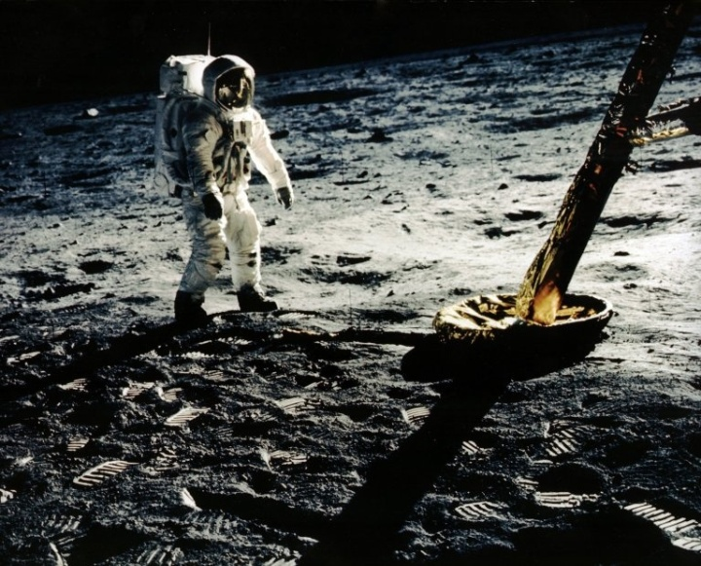
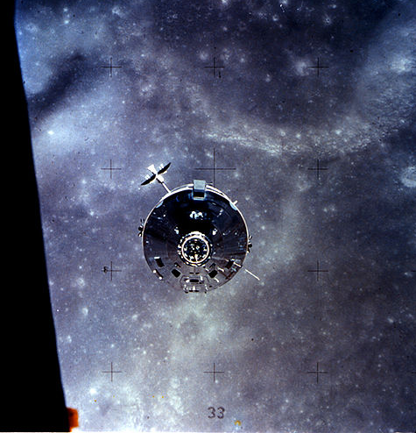
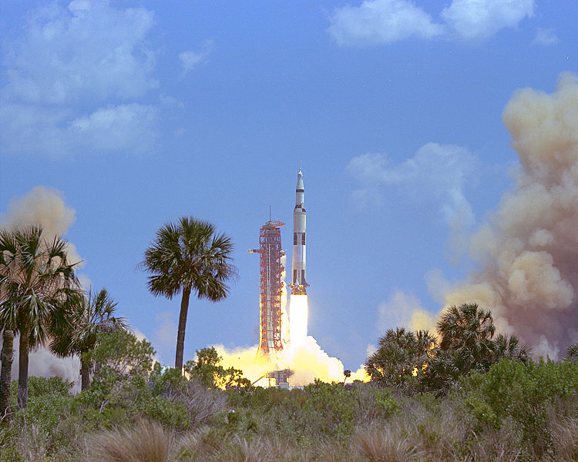
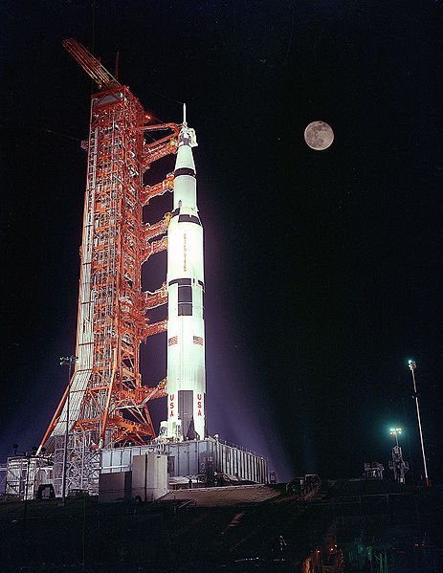
GSICS Coordination Center Roles (2)
GSICS Procedure for Product Acceptance
Operational
Phase
Product is fully accepted by GSICS Executive Panel (EP) and maintained within GSICS
and distributed to the public.
Product Logs, Data Usage
Preoperational
Phase
Product version Control Data released with disclaimer
C Operations and distribution plan Data user’s guide T=180 days
Demonstration Phase
Founding concepts Supporting models Data Archived and Free Access
ATBD Peer-Publications Product quality indicator description
Traceability document T=365 days
Submission Phase
Fill out GSICS Product Acceptance Form ( GPAF )
Introduction to GSICS/GCC
http://gsics.wmo.int
Introduction to GSICS/GCC
www.star.nesdis.noaa.gov/smcd/GCC/
gsics.nesdis.noaa.gov/wiki/GPRC/LeoLeo
gsics.nesdis.noaa.gov/wiki/Development/20140324

