Slide 1
Introduction to VIS/NIR, SBAF
Doelling and input from many others
March 18, 2015

Slide 2
Overview
VIS/NIR sub-group goals
DCC method
Referencing DCC and lunar to Aqua-MODIS
combining methods,
DCC demo products,
reference instrument and calibration tracing
SBAF
Solar irradiance
Detecting discontinuities

Slide 3
3 Levels of visible calibration
Characterized hyper-spectrally an invariant target traceable to an absolute calibration reference
Suggested by Nigel Fox at the 2014 GSICS annual meeting
The moon is best suited, since it has no reflectance natural variability
All visible invariant targets rely on the sun for stability, the 11-year sun-spot variability is 0.1%
Transfer the (on-orbit) traceable calibration of a hyper-spectral sensor using ray-matching
For example, the GSICS IASI based calibration
Future CLARREO mission visible sensor, SCIAMACHY
Transfer the traceable calibration of successive nearly identical temporal stable reference imagers
Aqua-MODIS, NPP-VIIRS, JPSS-1 VIIRS sequence
Relies on SBAF to account for the spectral differences between sensors
Use ray-matching or invariant targets characterized by the reference sensor

Slide 4
DCC calibration approach
DCC is a large ensemble statistical calibration technique requires sufficient sampling dependent on IR threshold
A simple IR threshold (<205K) still contains convective anvils – use spatial homogeneity test to remove
Since anvil conditions are not completely removed a statistical PDF mode, or median must be employed
DCC provide the most Lambertian earth views
Still requires a BRDF, Hu, CERES, POLDER, KMA models
BRDF deficiencies are removed by limiting the angle space, currently VZA<40° and SZA<40°
DCC monthly reflectances have a residual seasonal cycle
DCC migrate with the sun, land and ocean differences, and variations in the convective microphysics
However the seasonal cycle should be constant from year to year
Remove through deseasonalization or through fitting a trend

Slide 5
Referencing GEO sensor calibration
DCC absolute calibration is referenced to the Aqua-MODIS/VIIRS band 1 calibration
Assume that Aqua-MODIS and GEO observe the same DCC mode reflectance using the same methodology during MODIS overpass times and should be valid for historical GEO application
Validate by using GEO/MODIS ray-matching, preferably DCC raymatching to reduce SBAF uncertainty
Reference the ROLO model to the Aqua-MODIS band 1 calibration in order to combine methods
The GSICS lunar members have been extremely successful in implementing USGS ROLO lunar calibration under the leadership of Sebastien Wagner

Slide 6
Combining of methods
Consistent multi-calibration method gains then validate all methods
Methods are noted for stability or absolute calibration
If methods are referenced to the same reference then approaches can be evaluated for stability (target and method)
NOAA method
Radiometrically scale all method temporal gains by regressing individual methods to first day of satellite operation
Utilize recursive temporal filtering to remove measurement outliers
CNES method
Evaluate methods by uncertainty and application
Absolute calibration dependent on SBAF, solar spectra, on orbit and pre-launch calibration, and systematic biases dependent on methods

Slide 7
VIS/NIR calibration updates
Forward processing mode
Use last observation to update calibration, since degradation is unknown and on orbit calibration discontinuities are unpredictable but includes method noise
Use similar instruments to predict trend or deseasonalization, however each instrument is unique and may have contaminations
Use running mean to smooth noisy measurements rather than rely on trend
How often should calibration updates occur
For reanalysis mode
Entire record available to analyze and derive trend, is this the same thing as deseasonalization, given a long enough record
Assume variability about trend to method noise not instrument calibration noise

Slide 8
Reference Sensors
Successive well-calibrated (well documented and publicly available) nearly identical imagers are best suited as reference sensors
Similar orbits, spectral response, instrument design
Validate the reference sensor stability over time
Rely on invariant targets
A future absolute calibration reference (CLARREO) can be transferred back in time across successive sensors
Use invariant targets (moon, DCC) and SNO to transfer calibration
Investigate if double differencing can be used to transfer calibration
If the reference sensors include mirrors for scanning then the scan angle dependency must be validated over time
Can deserts and DCC calibration monitor the scan angle dependence

Slide 9
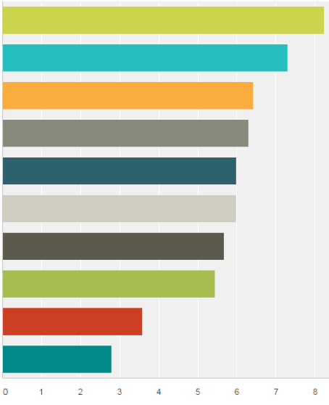
GSICS invariant target poll rankings
Agency Goals
Personal Goals
Lunar
Lunar
DCC
DCC
MODIS
GOME
GOME
RTM
Desert
Rayleigh
Rayleigh
MODIS
RTM
Desert
Snow
Glint
Glint
Snow
Star
Star
Poll ranking for sensor calibration
Prepare for future GEO sensors, Current GEO sensor, Historical GEO sensors, Apply to LEO

Slide 10
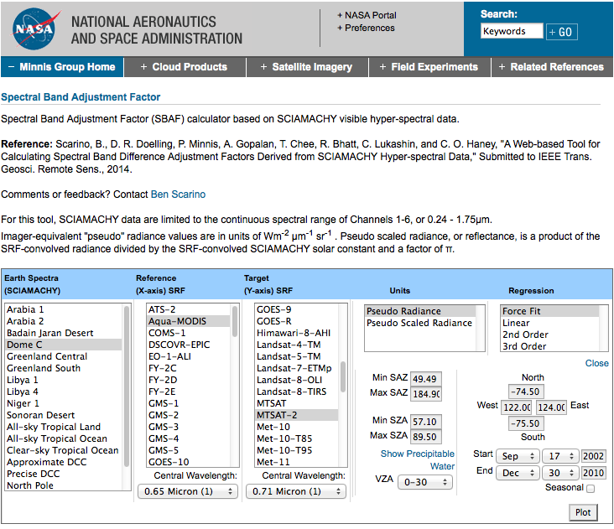
SCIAMACHY SBAF TOOL

Slide 11
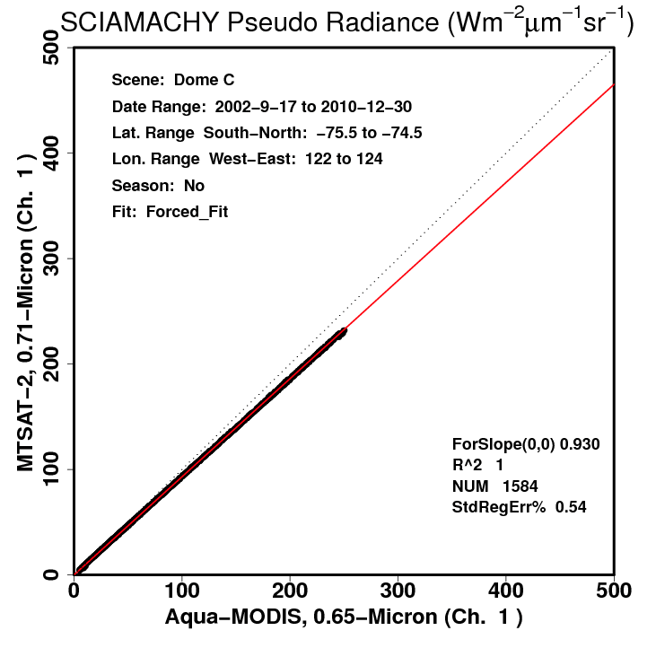

Slide 12
SBAF tool update
The SCIAMACHY provided by Costy does not contain the last two bands (1950-2380nm)
Too much effort to reprocess all 10 years again
The reflectances are very noisy in the last two bands
Outlier filter in place to remove noisy spectra
SBAF paper has been submitted
We are working with USGS to obtain the entire record of Hyperion data
19 TB, 10nm intervals, between 400 to 2500 nm
Dataset #1: Aggregate into 7.7x7.5 km spatial footprints
Dataset #2 Aggregate in steps of 10% reflectance bins
To isolate according to surface and cloud types
Perform hyper-spectral cloud mask
Also possible to rely on hourly GEO cloud retrievals and atmosphere, CERES is processing 15 year 5 GEO satellite record
Would also do the same for SCIAMACHY

Slide 13
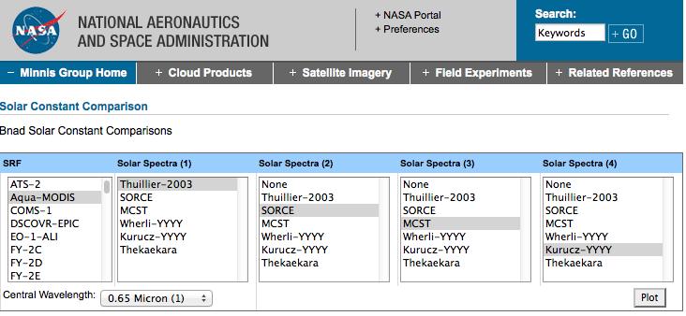
Solar Constant Comparison TOOL
Able to put in any solar spectra into web tool
CEOS WGCV recommends the standard spectrum at the highest resolution (Dec. 2006)

Slide 14
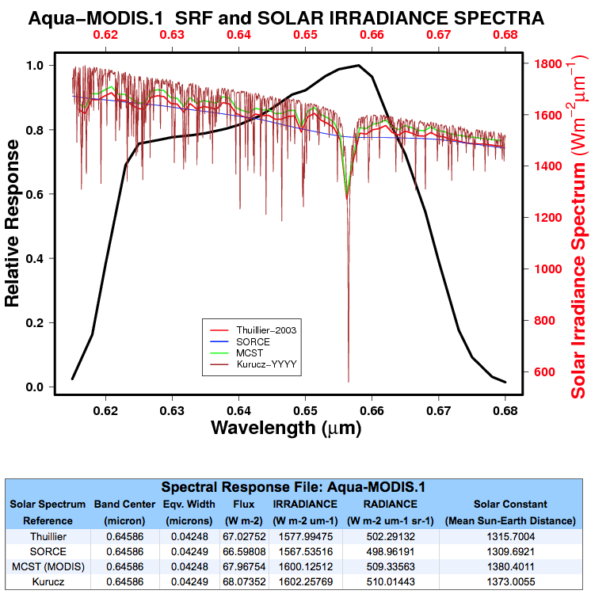
Thuillier and Kurucz difference is 1.6%

Slide 15
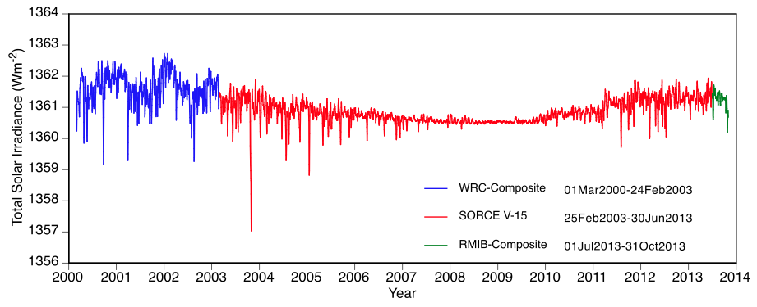
Daily SORCE Total Solar Irradiance (TSI)
11-year sunspot cycle is 0.1%, but daily events have exceeded 0.3%
This then indicates that the largest difference between TSI datasets is the absolute calibration

Slide 16
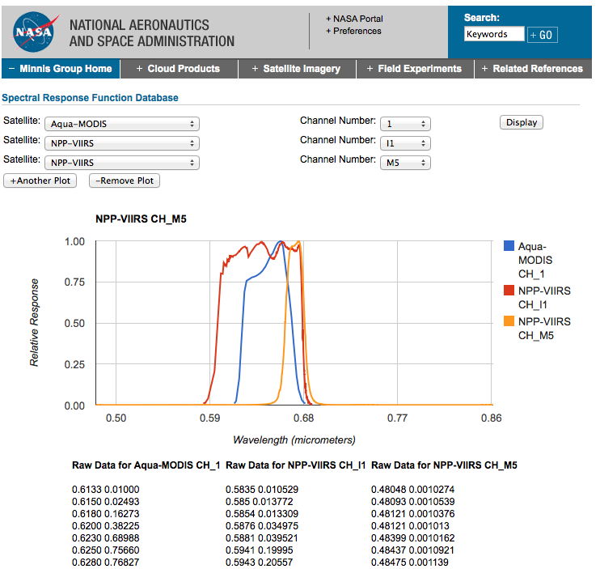
Spectral Response Comparison TOOL

Slide 17
Calibration discontinuity detection
Terra-MODIS Collection 5monthly global optical depth
Solar diffuser adjustment 1.5% drop in calibration
Solar diffuser door open, 1% drop in visible calibration
Aqua-MODIS Collection 5monthly global optical depth
No large known discontinuities

Slide 18
Terra and Aqua-MODIS C5 0.65µm
DCC calibration
Discontinuities can be discovered if they exceed the temporal noise of the measurements
Each data point that does not recover increases the confidence of the discontinuity
The detection of discontinuities is a function of standard deviation, auto-correlation, and number of measurements.

Slide 19
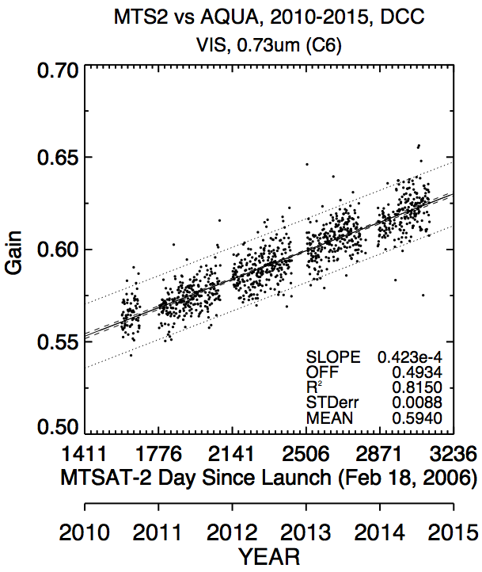
Visible discontinuity detection
To increase the detection of discontinuities, measurement time intervals need to be reduced.
Here is an example of daily DCC GEO/MODIS ray-matching.
If a daily point exceeds 2x standard deviation for several days a discontinuity is then realized

