Slide 1
Extending DCC to other bands and DCC ray-matching
Doelling and input from many others, March 18, 2015

Slide 2
Overview
DCC application to other visible bands
Applicability of DCC to derive scan angle dependency
DCC ray-matching to validate the DCC mode reflectance or absolute calibration

Slide 3
Extending DCC calibration to other bands
Apply the MODIS 0.65µm DCC calibration to other bands
  0.47µm, 0.55µm, 1.24µm, 1.37µm, 2.12µm bands
  Terra and Aqua MODIS Collection 6
  Plots in Terra to Aqua scaling paper (Doelling et al. 2015)
Apply the MODIS 0.65µm DCC calibration to VIIRS
  Mbands, 0.48µm, 0.55µm, 0.65µm, 0.86µm, 1.6µm, 2.25µm
  I bands, 0.65µm, 1.6µm
  VIIRS NASA LandPeate calibration applied
  Extend timeline to end of 2014 (Bhatt et al. 2014)
Apply to Met-9 0.86µm and 1.6µm bands

Slide 4
Terra and Aqua MODIS C6 DCC

Slide 5
Terra and Aqua MODIS C6 DCC

Slide 6
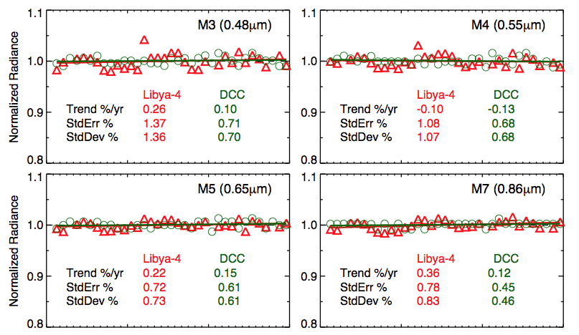
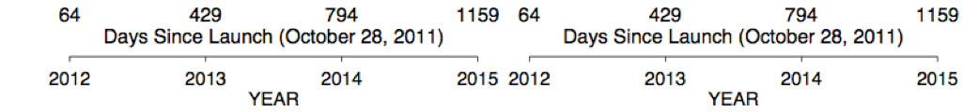
NPP-VIIRS DCC and Libya-4

Slide 7
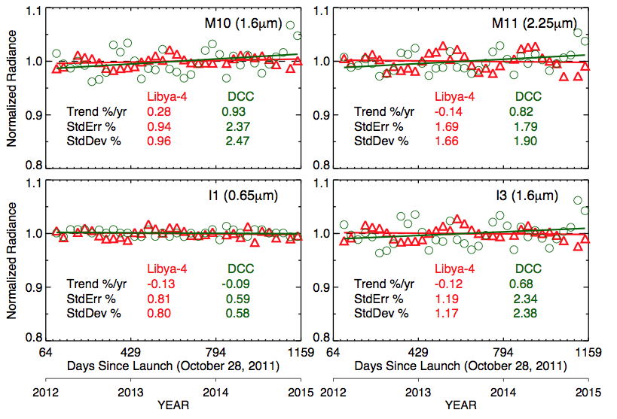
NPP-VIIRS DCC and Libya-4

Slide 8
DCC calibration standard errors
Band | Terra | Aqua | NPP-M | NPP-I
0.47 µm | 0.6 | 0.6 | 0.7
0.55 µm | 0.7 | 0.6 | 0.7
0.65 µm | 0.6 | 0.6 | 0.6 | 0.6
0.86µm |  |  | 0.45
1.24 µm | 0.6 | 0.9
1.37 µm | 1.0 | 1.3
1.6 µm |  |  | 2.4 | 2.3
2.2 µm | 1.8 | 3.4 | 1.9
• DCC has a standard error about the fit of < 0.7%, this includes instrument noise for wavelengths < 1.2 µm
• For wavelengths > 1.1 it is band specific
• Number of years needed to detect a trend the magnitude of 2σ at 95% confidence at 50% probability is ~10 years
• For DCC the number year to detect a trend > 2σ is ~5 years

Slide 9
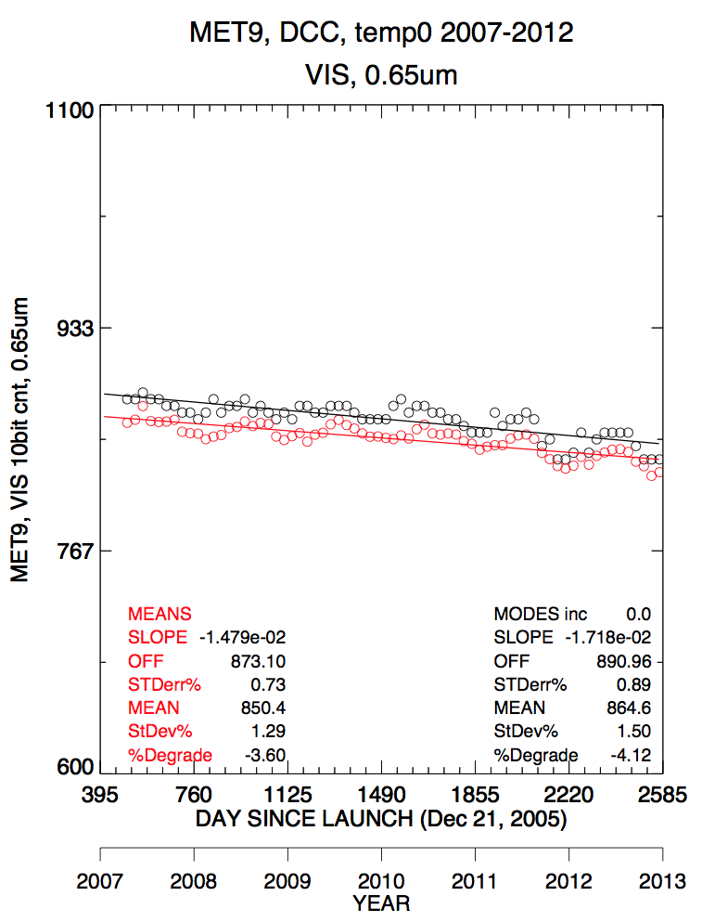
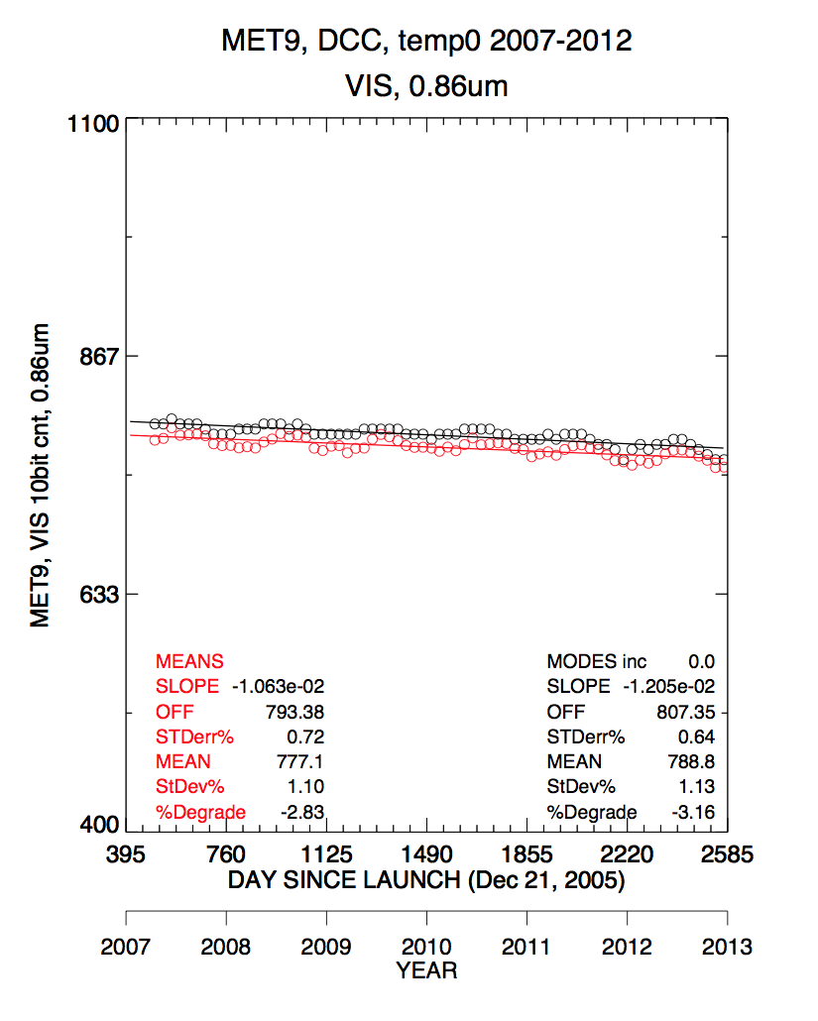
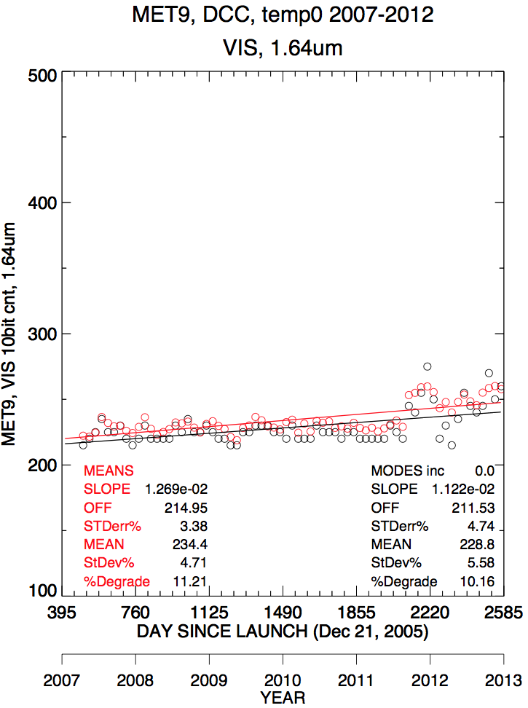
GEO examples
0.65µm
σ=0.9%
0.86µm
σ=0.6%
1.6µm
σ=4.7%
σ~2% 2007-2011
It seems that DCC works best for the 0.86µm band, verified by both Met-9 and VIIRS
Based on conversation with Sebastien, you can identify in the 0.65µm and 1.6µm the calibration discontinuity in late 2011.

Slide 10
MODIS RVS calibration using DCC
MODIS uses a mirror to scan the earth.
The mirror will have differences in reflectivity that change over time
The response versus scan angle (RVS) was characterized at prior to launch and changes over time on orbit
Currently the MODIS team uses deserts trends referenced at launch over time to detect trends in various RVS positions
Can DCC be used to track RVS dependencies?
Every band will have a different RVS correction

Slide 11
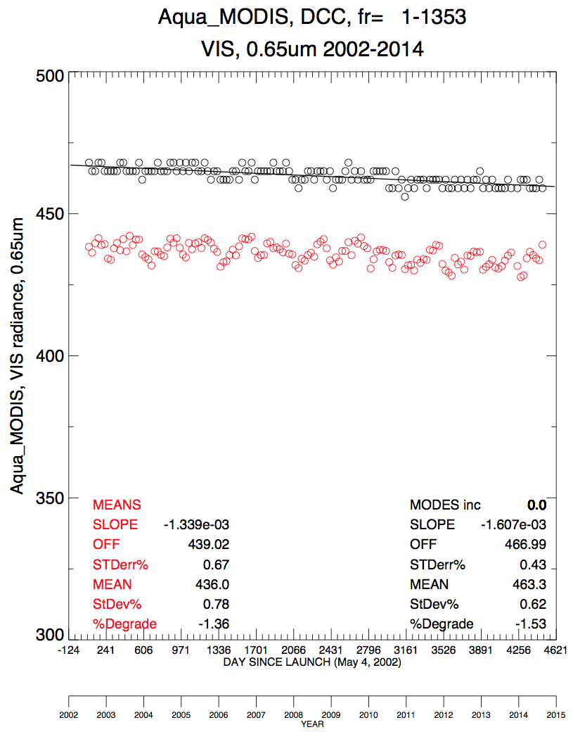
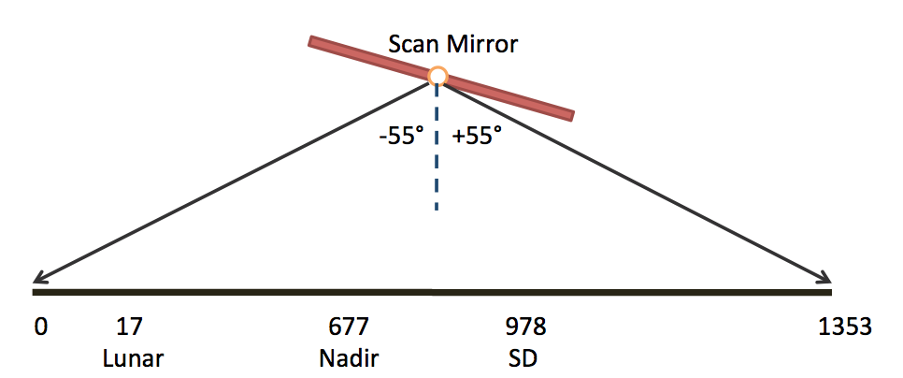
MODIS scan mirror schematic
The Solar Diffuser (SD) and Lunar scan angles can be perfectly calibrated, however, other scan angles may not be.
Apply DCC algorithm in segments of 100 frame numbers
Currently Aqua-MODIS Band 1 (0.65µm) shows a 1.53% degradation

Slide 12
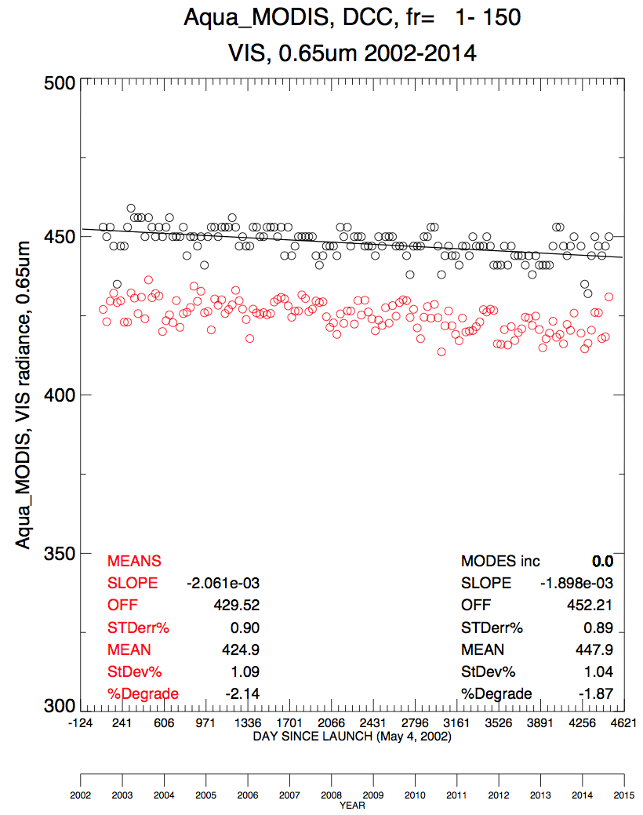
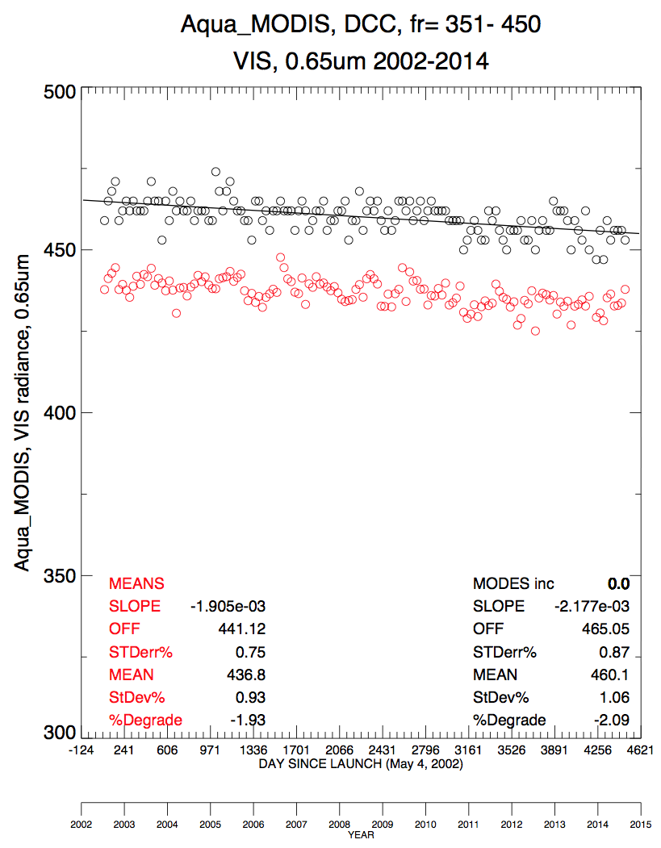
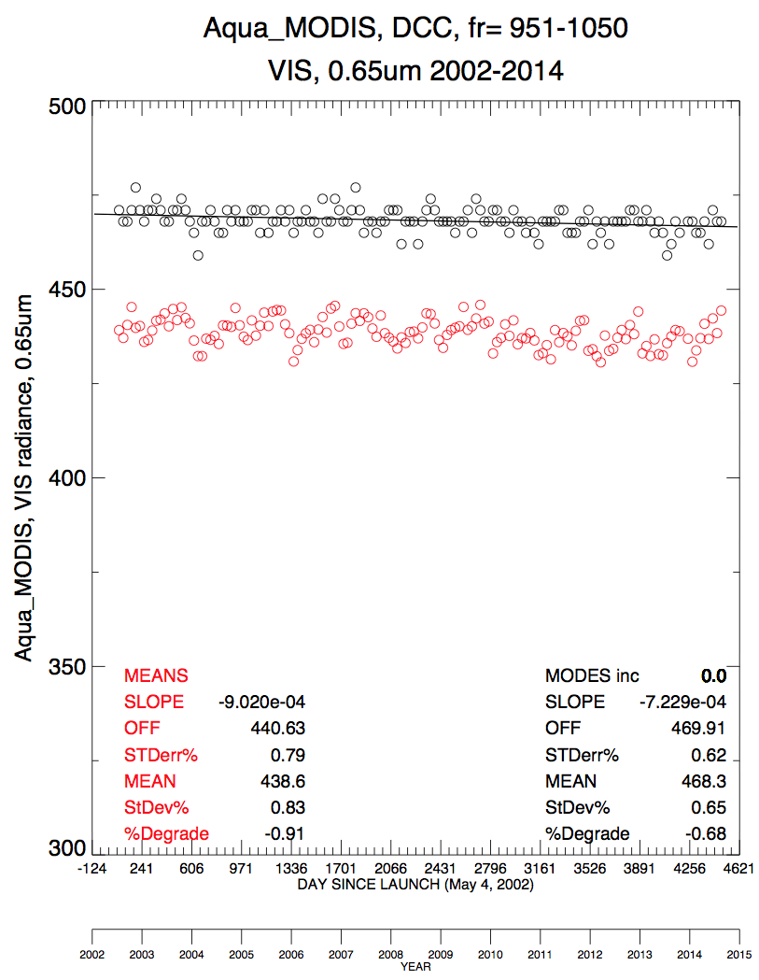
Aqua-MODIS C6 0.65µm DCC calibration by frame number
FRAMES 1-150
With lunar
FRAMES 1-150
With SD
RVS trends may not be linear

Slide 13
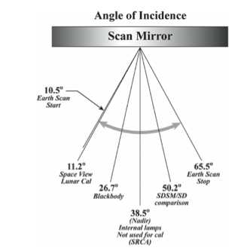
Aqua-MODIS 0.65µm frame number DCC trends
F# | 75 | 200 | 300 | 400 | 500 | 600 | 700 | 800 | 900 | 1000 | 1100 | 1200
trend | -1.9 | -2.2 | -2.1 | -2.1 | -1.6 | -1.2 | -1.4 | -1.4 | -0.9 | -0.7 | -0.8 | -0.9
σ | 1.0 | 1.0 | 1.0 | 1.1 | 0.9 | 0.9 | 0.8 | 0.8 | 0.8 | 0.7 | 0.7 | 0.7
• The SD frame numbers have the lowest trends
• Working with MODIS group to remove the scan angle dependencies
• DCC have the potential to derive scan mirror dependencies

Slide 14
DCC ray-matching
Verify the Aqua-MODIS BRDF corrected DCC multi-year mode radiance over the GEO domain
  Assume the same DCC are captured by both Aqua-MODIS during 1:30 PM overpass time and GEO, although not exactly coincident and by the same viewing conditions
  Rely on DCC BRDF model to remove sampling dependencies
DCC ray-matching vs gridded ray-matching
  DCC has lowest SBAF uncertainty, less stringent angle, temperature matching, but are DCC available over the matching domain
  Gridded has large SBAF uncertainty, stringent angle matching, and use all scenes
  Both should provide the consistent calibration
This calibration can then be used to validate the DCC mode reflectance

Slide 15
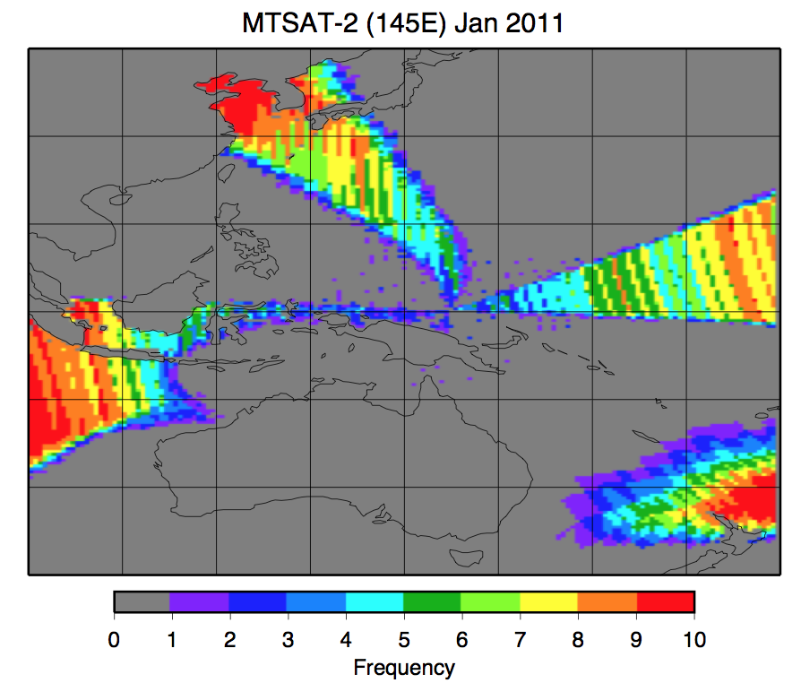
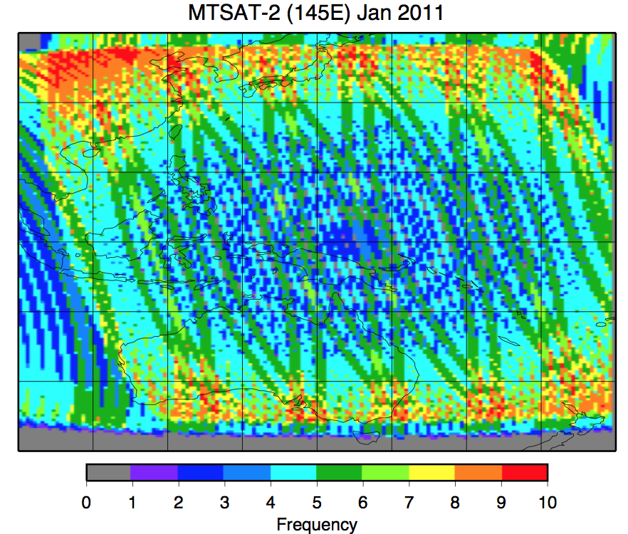
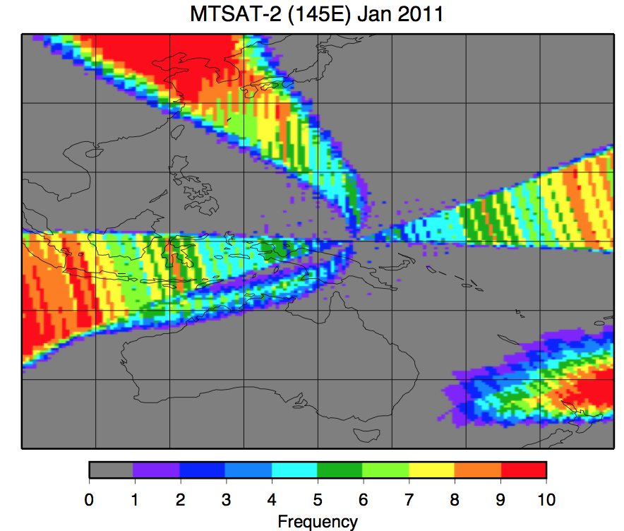
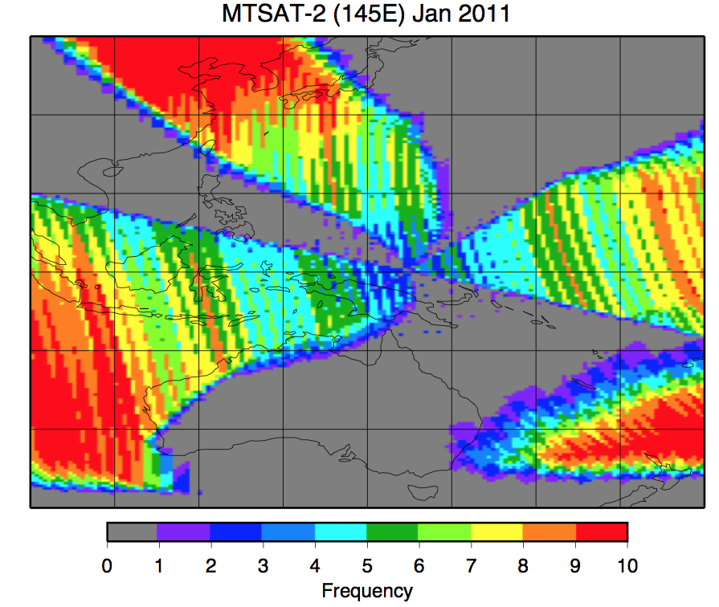
Jan 1, 2011, MTSAT2
Grid VS
Grid IR
DCC az<15
DCC az<30

Slide 16
MTSAT-2/Aqua-MODIS raymatching using all 0.5° lat/lon regions
SBAF based on radiance applied

Slide 17
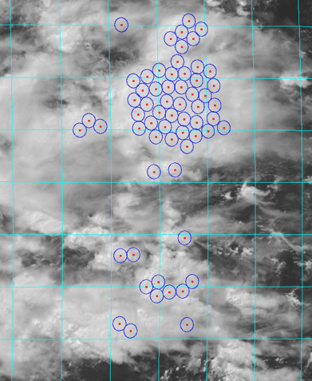
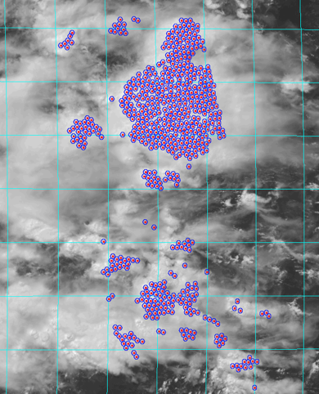
DCC Ray-matching
1° lat/lon grid, MTSAT-2, July 20, 2011 2:32 GMT
30²-km
9²-km

Slide 18
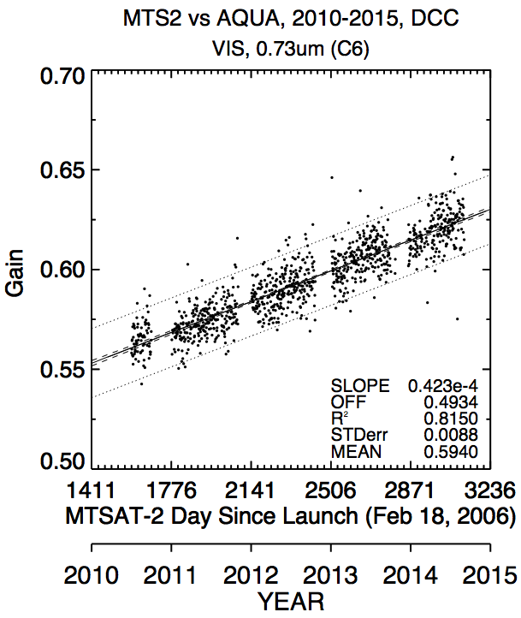
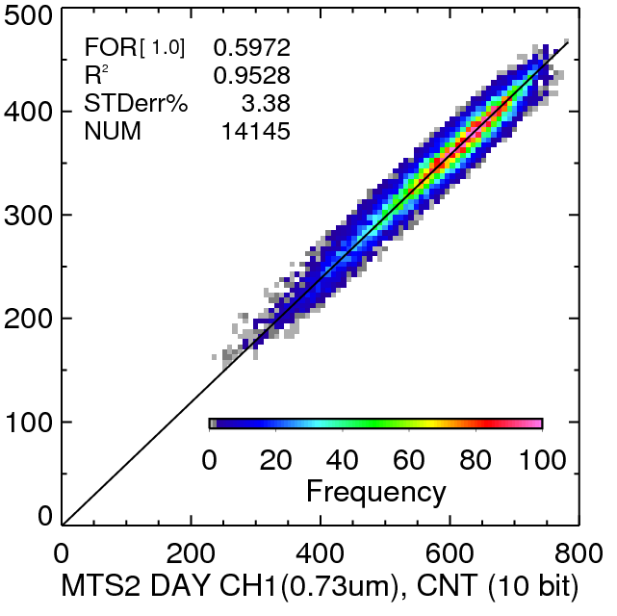
MTSAT-2 10-km DCC ray-matching
Monthly regression 10-km DCC ray matching
Daily gains 10-km DCC ray matching
Adding DCC BRDF to remove angular matching differences increased the noise

Slide 19
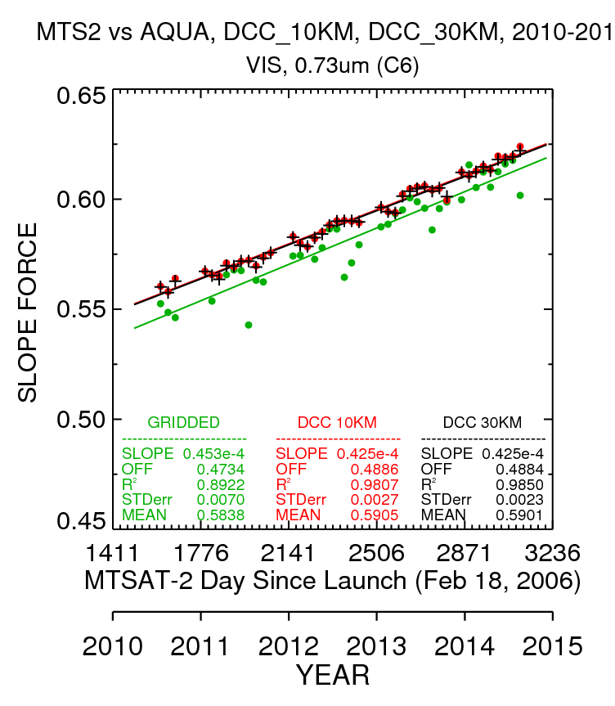
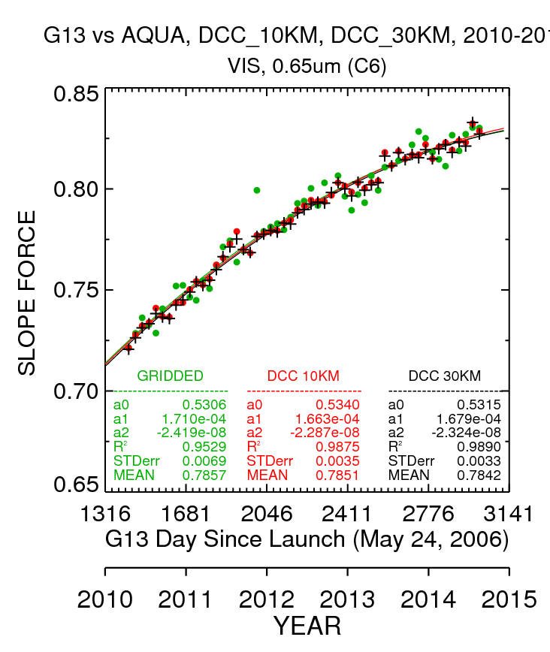
Gridded and DCC ray-matching
Investigating very carefully, SBAF, angular difference impact, sensor linearity, and Met-7 sub-satellite point. MODIS scan angle dependency unresolved

Slide 20
Gridded and DCC ray-matching
GEO σ(%) | Gridded | 10-km | 30-km
GOES-13 | 0.88 | 0.44 | 0.42
GOES-15 | 0.86 | 0.42 | 0.35
MET-9 (0.75 lunar) | 0.83 | 0.41 | 0.43
MET-7 | 0.85 | 0.55 | 0.60
MTSAT-2 | 1.12 | 0.45 | 0.39
GEO bias(%) | Gridded | 10-km | 30-km
GOES-13 | 0.19 | 0.11
GOES-15 | 0.27 | 0.10
MET-9 | -0.16 | 0.09
MET-7 | -0.31 | 0.00
MTSAT-2 | -1.07 | 0.07

Slide 21
Future DCC ray-matching and DCC absolute calibration
Determine issue with gridded and DCC ray-matching
Compare the DCC ray-matched calibration with the DCC mode reflectance

