Slide 1
Combining Vicarious Calibrations
F. Yu and X. Wu
NOAA GPRC

Slide 2
Outlines
Research of combined method at NOAA
Individual Vicarious Calibrations (GOES-12)
Desert
Ray-matching
DCC
Lunar
Combined Vicarious Calibration
Sensitivity analysis
Desert + ray-matching + DCC + lunar
DCC + lunar
Absolute calibration
Conclusions

Slide 3
background
Combined Vicarious Calibration

Slide 4
2010 Toulouse
Reviewed and compared several vicarious calibrations.
Combined all results by normalizing to a common Day 1.
Considered seasonal variations (even for DCC & star)
Shape, phase, amplitude
May penalize the good data

Slide 5
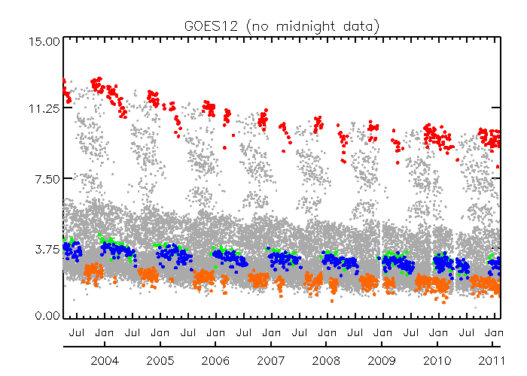
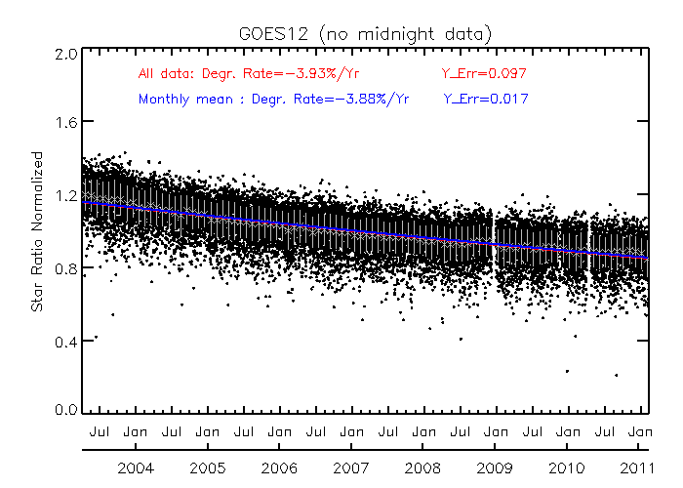
2011 Daejeon
Applied the recursive filter to GOES-12 star data
Normalized to a common intensity;
Applied the filter to daily data;
Computed the monthly value (comparable to DCC).

Slide 6
2014 Darmstadt
Removed target seasonal variation if can be characterized (e.g. desert).
Used monthly statistics for DCC, ray-matching, star, and desert data.
Normalized the monthly data to the estimated Day1 obs.
Applied the recursive filter.
Rename it as integrated method.

Slide 7
GOES-12 AS EXAMPLE
Combined Vicarious Calibration

Slide 8
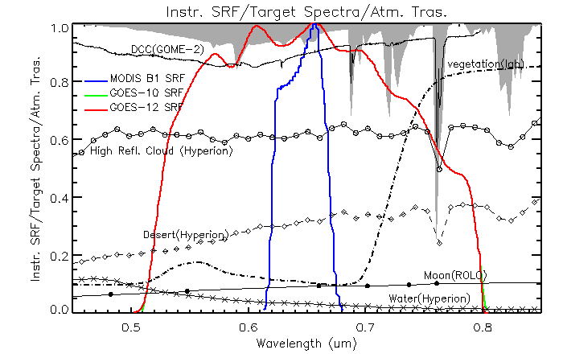
GOES Imager Visible Calibration Methods
Reference targets:
Sonoran desert
Deep Convective Cloud (DCC)
Ray-matching (e.g. over cloud)
Moon
Stars
Absolute calibration accuracy was achieved by calibrating the GOES Imager visible data traceable to Aqua MODIS Band 1 C6 standard
Absolute calibration
Absolute/relative calibration, depending on SBAF availability
Relative calibration

Slide 9
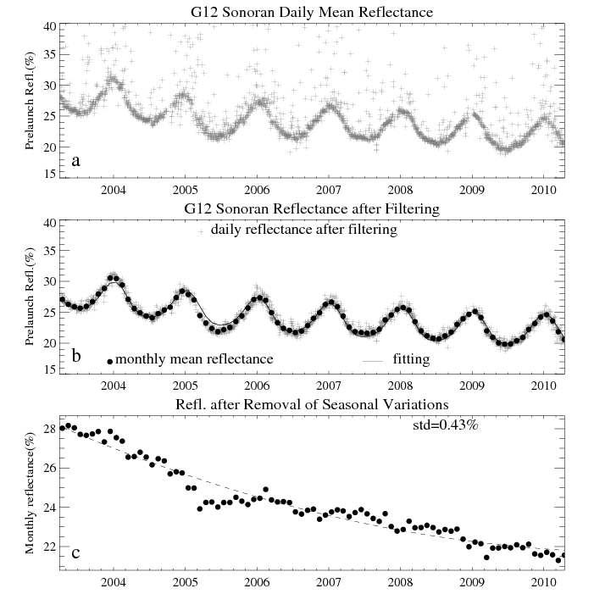
Sonoran Desert
Daily obs.
Remove the cloud contaminate daily obs. , then averaged the clear-sky data at monthly interval
Remove the seasonal variations caused by BRDF and atm. variations
Yu, F., Wu, X., Grotenhuis, M. & Qian, H. (2014). Inter-calibration of GOES Imager visible channels over the Sonoran desert, J. Geo. Res.-Atmosphere, 119, 8639-8659, doi:10.1002/2013JD020702.

Slide 10
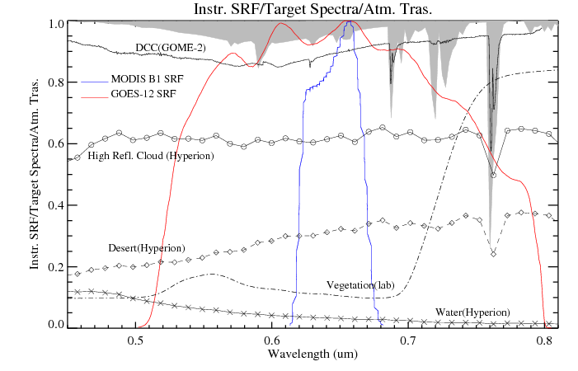
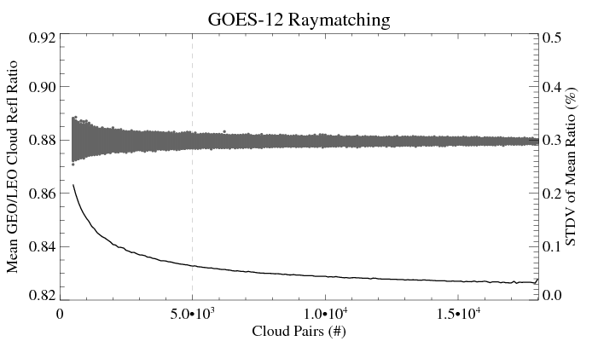
GOES/MODIS Ray-Matching
Ratio of ray-matched GOES and Aqua/MODIS reflectances
< 10 degree from GEO nadir
< 1% difference in viewing angles
< 10 minutes in viewing times
< 1km in central pixels
Select uniform cloudy scenes
MODIS reflectance > 50%
GOES reflectance > 25%
CoV < 3% within the 3x3 array
Monthly sample size > 5000 to ensure robust statistics.
Analyze the time-series of monthly mean reflectance ratios.

Slide 11
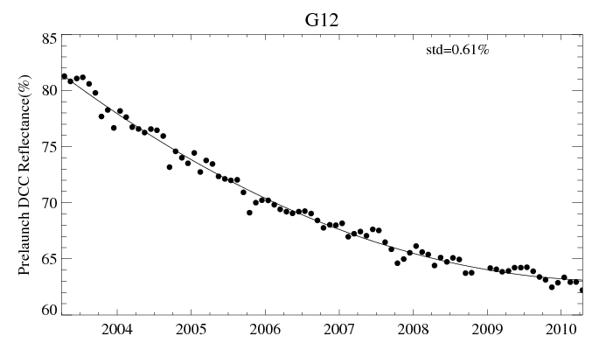
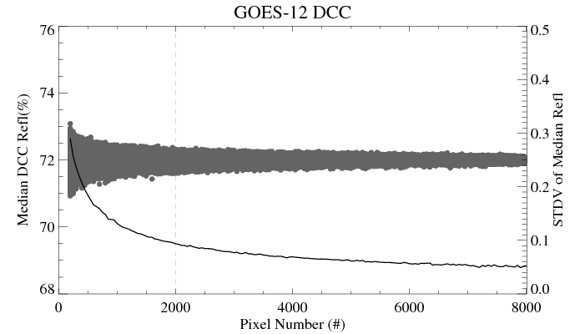
DCC Reflectance
Followed the GSICS DCC ATBD
Monthly sample size > 2000 to ensure robust statistics
Used the median value of monthly DCC reflectance. (Mode and mean were considered.)

Slide 12
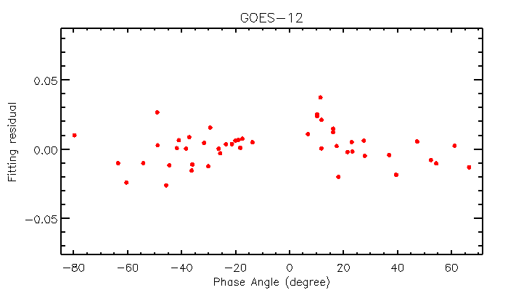
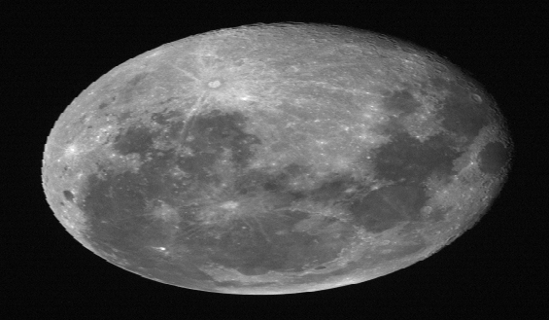
Lunar Irradiance Ratio
Time-series of GOES/ROLO lunar irradiance ratio.
Almost symmetric distribution of lunar phase angles during GOES-12 mission life
More observations since Nov 2005 when lunar obs. were scheduled.

Slide 13
COMBINED VICARIOUS CALIBRATION
Combined Vicarious Calibration

Slide 14
Theory
Why does target measurements vary in time?
Degradation/Anomaly of the instrument
Natural variability of the target
Inherent uncertainty of vicarious calibration
Combining multiple vicarious calibrations
Active: Experts assigns weight (can be binary) to each method / data based on a priori knowledge, e.g., B. Fougnie, GSICS web meeting, Oct. 22, 2014.
Passive: “1” is common to all methods. “2” & “3” vary among methods but tend to be mutually independent (this leads to iid).
Weighted by STDV.
Recursive filter
Use any / all where appropriate.

Slide 15
NOAA Implementation
Monthly Statistics
Removal of predictable oscillations
Trending fitting
Normalized to a common Day1 reflectance
Combining the Normalized Data

Slide 16
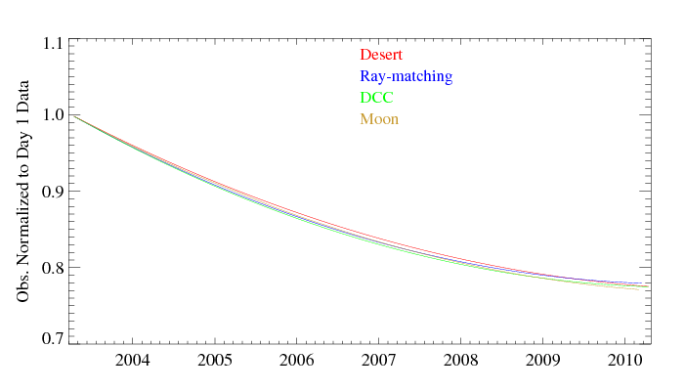
Multiple Vicarious Calibrations
Collection of Normalized Observations
Comparable relative calibration accuracy.
Similar degradation patterns over different reference targets indicate that the impact of spectral response function shift, if any, is very small and negligible on the reflectance.
Trending of the Normalized Results for Each Method

Slide 17
Recursive Filter Method
Adapted (with minor mod) from Wu et al. 2010.
Assumption: all and only outliers are not normally distributed.
Iteratively identify and remove outliers until the remaining data are normally distributed.
for iteration=1, max_iteration do begin ; max_iteration = 4
result = regress (x, y, yfit=yfit)
residual = y – yfit
threshold = sigma * stddev(residual) ; sigma = 2
outliers = where(abs(residual) > threshold)
If size(outliers)/size(x) < ratio then break ; ratio = 3%
; else prepare for the next iteraiton
valid = where(abs(residual) <= threshold)
x = x[valid]
y = y[valid]
endfor

Slide 18
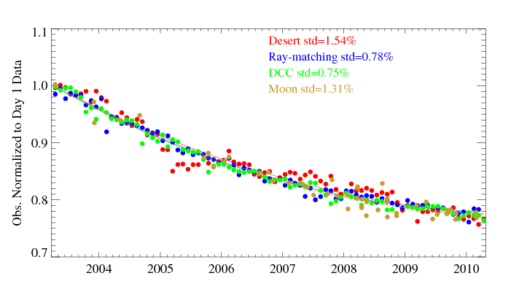
Recursive filtering result
Improved relative calibration accuracy
method with less variation contributes (weights) more in the RF results
 | #Obs. | #Outliers | %Selection
Desert | 85 | 37 | 56.5%
Ray-matching | 85 | 8 | 90.6%
DCC | 85 | 7 | 91.8%
Moon | 48 | 15 | 68.8%

Slide 19
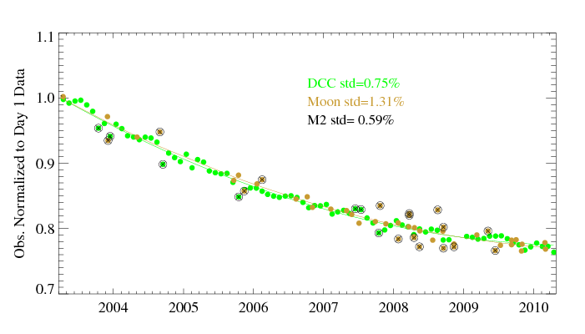
DCC + Lunar for GOES-12
 | # Obs. | # Outliers | % Selection
DCC | 85 | 7 | 91.8%
Moon | 48 | 15 | 68.8%
DCC
Monthly median
Lunar calibration with GIRO model
All the observations available

Slide 20
sensitivity
Combined Vicarious Calibration

Slide 21
Sensitivity Analysis (Desert + Ray-matching+ DCC + Moon)
Trending of the integrated method is generally the closest to that of DCC, followed by that of Ray-matching, moon and then desert method
Notes:
The iteration would break after 4th loop when the number of outliers is less than 3%. When the iteration is forced to continue in the sensitivity test, Fig a shows that the fitting residuals is nearly symmetrically distributed (skewness close to 0), the standard deviation of the fitting residual (STDV) becomes stable, and fewer outliers were found after the 4th iteration (none after the 10th).
Fig b shows that the fitting functions are very similar for all the 14 loops.
Figure c: M4 stands for the recursive filtering results from the four methods (Desert + Raymatching + DCC + Moon). The iteration breaks at 4th loop as shown in Figure a.
Figure d: solid lines are the trending of each individual method, referred to the primary y-axis. The dash lines are the trending difference between each individual method to the integrated method (M4), referred to the second y-axis. Trending of the integrated method is generally the closest to that of DCC, followed by that of Ray-matching, moon and then desert method

Slide 22
Sensitivity Analysis (DCC + Moon)
Same as previous slide. Only for DCC and Moon combined results
Sensitivity of threshold for the outlier selections in the recursive filtering was examined. The Sigma value is tested with 1.5, 2.0, 2.5, and 3. No difference in the outlier selections was found in this case.
DCC weights much more than lunar method in the integrated method result

Slide 23
Limited Data in Operation
Fitting function: y = a + b* t + c * t^2
Fitting parameters are noisy in the first year and become stable after about two years
Using the long-term trending as the reference, the fitting error of near real-time data is in general less than 2% after first year and reduced to about 1% after 2-3 years.
Notes:
Time-series of trending coefficients and the error budgets of integrated method for the ‘near real-time’ data. The coefficients are calculated with the fitting functions (Equation 2) in which the unit of time t is year after operation. The time on x-axis starts with the GOES-12 operational date on April 1, 2003. No integrated method results are available in the first three months.

Slide 24
Absolute calibration
Combined Vicarious Calibration

Slide 25
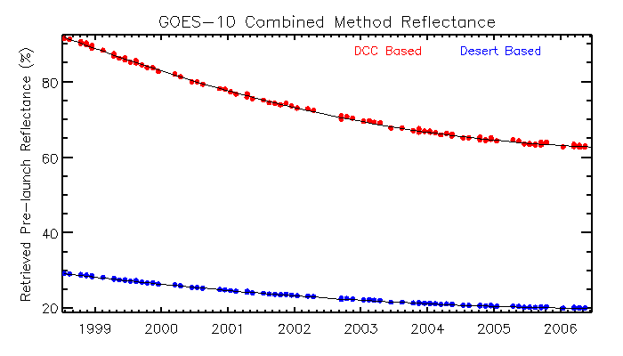
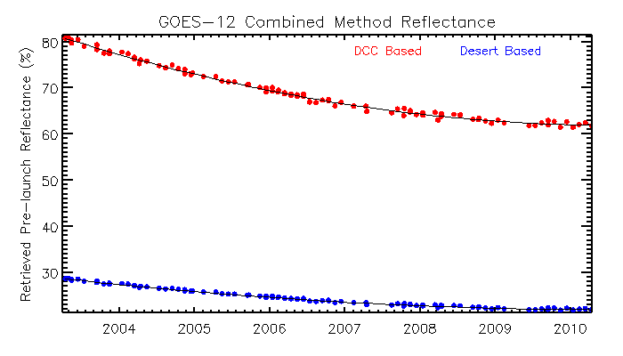
From Relative to Absolute Calibration
Use of desert and DCC methods as example to calculate the absolute calibration correction coefficients
Re-construct the pre-launch reflectance from the integrated calibration result.

Slide 26
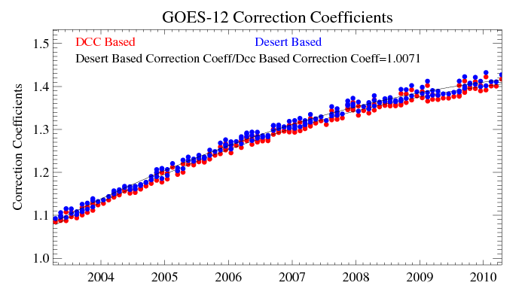
Absolute Calibration Correction
Sonoran Desert:
DCC :
The systematic difference between desert and DCC method is less than 1%

Slide 27
conclusions
Combined Vicarious Calibration

Slide 28
Discussions & Conclusions
Recursive filter can combine multiple calibration results
Normalize, then identify and remove outliers recursively
DCC / Lunar calibration contributes the most / least
As expected, considering their variations.
Had the similar effect as intended by weighted average.
A priori information is still useful, since recursive filter works better when population is nearly normal.
In operation, it take ~2 years for reliable results.
Relatively stable fitting parameters.
Uncertainty <1-2%
Recommend using DCC for the absolute calibration
1% absolute calibration difference between DCC and desert.
GOES views the Sonoran desert at a large angle – GOES scan mirror reflectivity may depend on incident angle.

