Slide 1
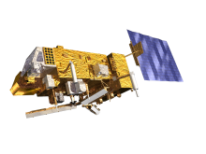
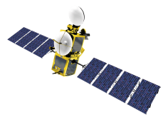
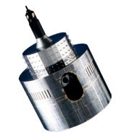
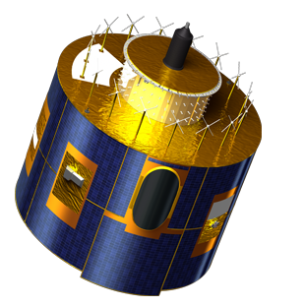
Outcome of the GSICS/CEOS-IVOS Lunar Calibration Workshop
S. Wagner, B. Viticchiè, T. Hewison
With the support of M. Takahashi – JMA (1-year visiting scientist at EUMETSAT)
In collaboration with
T. Stone (USGS)
S. Lachérade, B. Fougnie (CNES)
X. Xiong (NASA)

Slide 2
The Lunar Calibration Workshop
Initiative from the GSICS Research Working Group (last annual meeting in March 2014), in collaboration with CEOS/IVOS
Organisation
EUMETSAT / USGS / CNES / NASA with the support of M. Takahashi (JMA)
Objectives
Work across agencies / operators with a common and validated implementation of the USGS ROLO model ➔ one of GSICS’ goal = instrument inter-calibration
To share knowledge and expertise on lunar calibration and to provide guidance on the techniques of lunar calibration.
First step to provide the international community with validated and traceable version of the USGS ROLO model = GSICS Implementation of the ROLO (GIRO) model ➔ Validated against USGS implementation of ROLO v311g
Generate for the first time a reference dataset that could be used for validation / comparisons later on.

Slide 3
Lunar Calibration: Definition of a collaborative framework
External datasets to improve the irradiance reference model
(e.g. CNES with Pleiades)
EUMETSAT
Instrument Monitoring
US Geological Survey
ROLO lunar irradiance reference model
EUMETSAT
GIRO lunar irradiance reference model (GSICS Implementation of the ROLO model)
Publication of the enhancements to the ROLO = public domain
GSICS / CEOS-IVOS
Cross-comparisons
Instruments from other space and meteorological agencies
NASA
MODIS Aqua
= Current GSICS reference for VNIR channels
GSICS
Inter-calibration products
Monitored instruments from GSICS partners

Slide 4
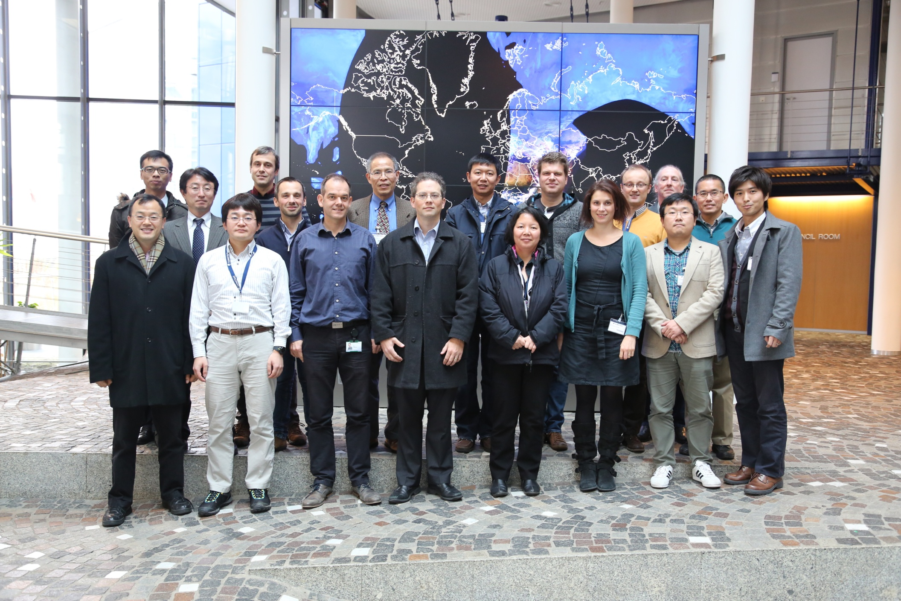
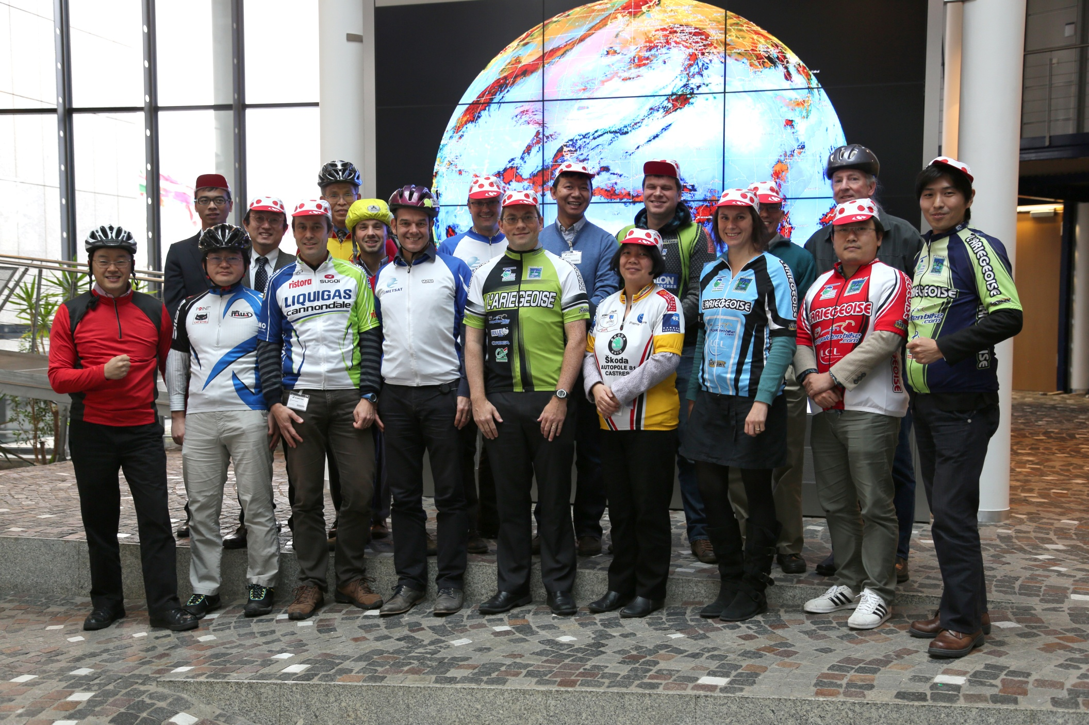
Outcome from the Lunar Calibration Workshop
EUMETSAT HQ, 1-4 December 2014
14 agencies and departments attended the joint GSICS – CEOS/IVOS lunar calibration workshop (including remote attendees through Webex)
Potentially 25 instruments + future and (some) past missions

Slide 5
Instruments
Team | Satellite | Sensor | G/L | Dates | Number of obs (GSICSdataset) | Phase angle range (°)
CMA | FY-3C | MERSI | LEO | 2013-2014 | 9 | [43 57]
CMA | FY-2D | VISSR | GEO | 2007-2014
CMA | FY-2E | VISSR | GEO | 2010-2014
CMA | FY-2F | VISSR | GEO | 2012-2014
JMA | MTSAT-2 | IMAGER | GEO | 2010-2013 | 62 | [-138,147]
JMA | GMS5 | VISSR | GEO | 1995-2003 | 50 | [-94,96]
JMA | Himawari-8 | AHI | GEO | 2014- | -
EUMETSAT | MSG1 | SEVIRI | GEO | 2003-2014 | 380/43 | [-150,152]
EUMETSAT | MSG2 | SEVIRI | GEO | 2006-2014 | 312/54 | [-147,150]
EUMETSAT | MSG3 | SEVIRI | GEO | 2013-2014 | 45/7 | [-144,143]
EUMETSAT | MET7 | MVIRI | GEO | 1998-2014 | 128 | [-147,144]
CNES | Pleiades-1A | PHR | LEO | 2012 | 10 | [+/-40]
CNES | Pleiades-1B | PHR | LEO | 2013-2014 | 10 | [+/-40]
NASA-MODIS | Terra | MODIS | LEO | 2000-2014 | 136 | [54,56]
NASA-MODIS | Aqua | MODIS | LEO | 2002-2014 | 117 | [-54,-56]
NASA-VIIRS | NPP | VIIRS | LEO | 2012-2014 | 20 | [50,52]
NASA-OBPG | SeaStar | SeaWiFS | LEO | 1997-2010 | 204 | (<10 , [27-66])
NASA/USGS | Landsat-8 | OLI | LEO | 2013-2014 | 3 | [-7]
NASA | OCO-2 | OCO | LEO | 2014
NOAA-STAR | NPP | VIIRS | LEO | 2011-2014 | 19 | [-52,-50]
NOAA | GOES-10 | IMAGER | GEO | 1998-2006 | 33 | [-66, 81]
NOAA | GOES-11 | IMAGER | GEO | 2006-2007 | 10 | [-62, 57]
NOAA | GOES-12 | IMAGER | GEO | 2003-2010 | 49 | [-83, 66]
NOAA | GOES-13 | IMAGER | GEO | 2006 | 11
NOAA | GOES-15 | IMAGER | GEO | 2012-2013 | 28 | [-52, 69]
VITO | Proba-V | VGT-P | LEO | 2013-2014 | 25 | [-7]
KMA | COMS | MI | GEO | 2010-2014 | 60
AIST | Terra | ASTER | LEO | 1999-2014 | 1 | -27.7
ISRO | OceanSat2 | OCM-2 | LEO | 2009-2014 | 2
ISRO | INSAT-3D | IMAGER | GEO | 2013-2014 | 2
Instruments with lunar observation capabilities, with the minimum number of Moon observations expected to be provided to the Lunar Calibration Dataset (more observations may be available).

Slide 6
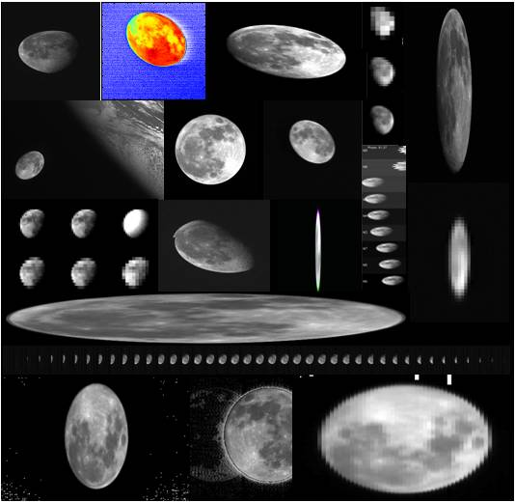
Examples of Moon observations from participating instruments

Slide 7
Outcome from the Lunar Calibration Workshop
All groups prepared input to the GIRO and provided results
First version of the GSICS lunar observation dataset
GIRO in agreement with the latest ROLO version over validation test dataset
A few discrepancies observed when instruments had both GIRO and older ROLO results (in particular beyond 2μm)
Most important differences related to the definition of the ROLO version at USGS ➔ ROLO = ROLO_{USGS} + Driver_{USGS}
ROLO_{USGS} = fixed version number (v311g)
Driver_{USGS} has changed!
➔ Need for version control to ensure software traceability
Oversampling factor + dark signal estimation = critical
Sensitivity analysis + uncertainty budget initiated
Need for establishing a data policy and a GIRO usage policy

Slide 8
List of actions
Source: https://gsics.nesdis.noaa.gov/wiki/Development/GsicsOperationsPlan
GLCWS_14.1 | NASA and USGS to interact to process the MODIS data with the latest driver to check the agreement with the GIRO. Two methods are tested for the irradiance integration (original MODIS data as provided to USGS initially, and the processing as done for the GIRO). USGS and NASA are invited to report at the next GSICS annual meeting. | 18 Mar 2015
GLCWS_14.2 | NASA and NOAA to interact on the VIIRS lunar data to check the result consistency and to compare their oversampling factor estimates. | 01 Dec 2015
GLCWS_14.3 | EUMETSAT, NASA (VIIRS + Landsat teams) and USGS to interact and investigate the discrepancies observed in the 2.2 microns band. | 01 Dec 2015
GLCWS_14.4 | CNES had the possibility to do dedicated Moon acquisitions with PARASOL. CNES is invited to present the results of the analysis at a further meeting (web meeting or GSICS annual meeting). | 18 Mar 2015
GLCWS_14.5 | All participants to provide lunar irradiances from the missing instruments to the common lunar calibration data set. | 01 Dec 2015
GLCWS_14.6 | EUMETSAT to circulate a draft for a data sharing and GIRO usage policy to the workshop participants. This should include the requirements for newcomers to join the community and get access to the data and the GIRO. | 01 Dec 2015
GLCWS_14.7 | GSICS Data Working Group to identify a suitable mechanism for sharing the lunar calibration dataset. | 01 Dec 2015
GLCWS_14.8 | All participants to report any restrictions on the use of their datasets in relation to the proposed data sharing policy. | 18 Mar 2015
GLCWS_14.9 | Establish a proposal for the way forward on a comparison of instruments with similar SRFs and phase angles. EUMETSAT will circulate a proposal to the Lunar Calibration Workshop participants by mid January. | 01 Dec 2015
GLCWS_14.10 | The GSICS Data Working Group is asked to develop a procedure for verifying users’ implementation of GIRO. | 01 Dec 2015
GLCWS_14.11 | EUMETSAT should implement a systematic bias on the irradiance in the GIRO PERT. | 18 Mar 2015
GLCWS_14.12 | EUMETSAT should implement the proposed formulation for the calculation of the effective wavelength (see the minutes of the Lunar Calibration Workshop). | 18 Mar 2015
GLCWS_14.13 | EUMETSAT to revisit the change of the SRF shape in order to be more realistic. | 18 Mar 2015
☑

☑

☑
☒
☑
☑

Slide 9
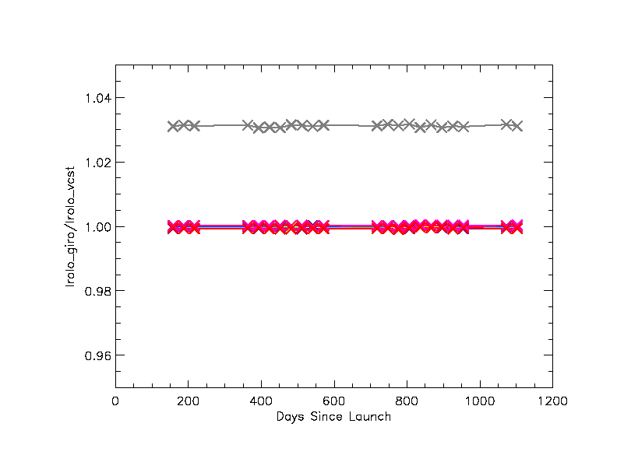
Discrepancy beyond 2.0 microns – NPP VIIRS results
Ratio between GIRO and ROLO (VCST) results
M11 (2.2µm)
Using GIRO 4th Release
Courtesy J. Fulbright – NASA VCST

Slide 10
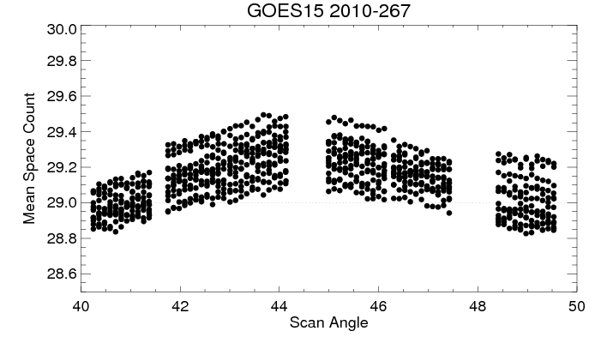
Additional benefits of this collaborative effort
Among others:
Allows a more comprehensive understanding of the irradiance model
Strengthen the verification and the validation of the GIRO against the ROLO.
Discrepancy observed with NPP VIIRS beyond 2 μm = relevant to other missions such as Himawari/AHI, GOES-R, MTG/FCI, EPS-SG/MetImage, etc.
Mission preparation ➔ we can anticipate and be ready
New acquisition mechanisms in place for EUMETSAT future missions (3-axis stabilisation for FCI, similarities between MetImage and VIIRS, etc.) ➔ lessons learnt from existing instruments
Mission preparation ➔ we can anticipate and be ready
Courtesy F.Yu - NOAA

Slide 11
Conclusions

Slide 12
Conclusions and future work
Conclusions:
GIRO = endorsed as official publicly available reference model for lunar calibration
Lunar calibration community supporting the current collaborative framework
Traceability to the USGS implementation needs to be formalised
Version 1.0.0 released (issue beyond 2 μm solved!)
Future work:
Still need to agree about the GIRO usage and GSICS Lunar Observation Dataset policy
Set-up the infra-structure to distribute the GIRO (exec + sources) + GLOD ➔ Support from GDWG
Expected improvement of the ROLO + publication = end 2015 / early 2016 ➔ implementation in the GIRO + new release.
Organisation of another Lunar Calibration Workshop in 2016 (TBD)
Developing inter-calibration using the Moon as a transfer target within GSICS
Continuing collaboration between agencies

Slide 13
For more information:
https://gsics.nesdis.noaa.gov/wiki/Development/LunarCalibrationWorkshop
https://gsics.nesdis.noaa.gov/wiki/Development/LunarWorkArea

Slide 14
ROLO/GIRO and absolute calibration
KNOWN DEFICIENCIES OF THE CURRENT REFERENCE
SI traceability
Absolute scale uncertainty (5 – 10 % uncertainty in absolute irradiance scale)
Residual geometry dependencies
Multi-band spectral coverage
ESTABLISHING THE REQUIREMENTS
Defining potential improvements and requirements on user applications
Independent method to verify that operational visible calibration meets requirements
Support climate applications and past instruments (e.g. no onboard calibration available)
GOAL
Getting absolute uncertainties to under ~1%
Surface stability + predictability of the Moon’s brightness = lunar reflectance model valid for all times
Level of accuracy of 0.5% is achievable
WHAT IS NEEDED?
Need for a new lunar measurement program (= many years of observations, to characterize the variations of the lunar brightness with phase and librations)
Minimum 3 years to capture the libration dependence within the bounds of its relative effect (ROLO operated for more than 8 years)
Traceable high-spectral resolution observations over several years with specific measurements to validate the atmospheric correction.
FUNDING: Currently under investigation (inter-agency [international] collaboration?)

Slide 15
Back-up slides

Slide 16
Time line
Time line | Organisers | Participants
24/06/2014 | Kick-off lunar calibration workshop web meeting
July – August | Development / Finalisation of the GIRO application Documentation on GSICS / Lunar Calibration Wiki | Participants to prepare input data (extraction / reformatting)
September | Provided the GIRO application
 |  | Feedback / Output
September / October | Updates / Support
November | Output screening / Feedback to participants | Re-processing if needed
01/12/2014 - 04/12/2014 | Lunar calibration workshop at EUMETSAT Darmstadt, Germany

Slide 17
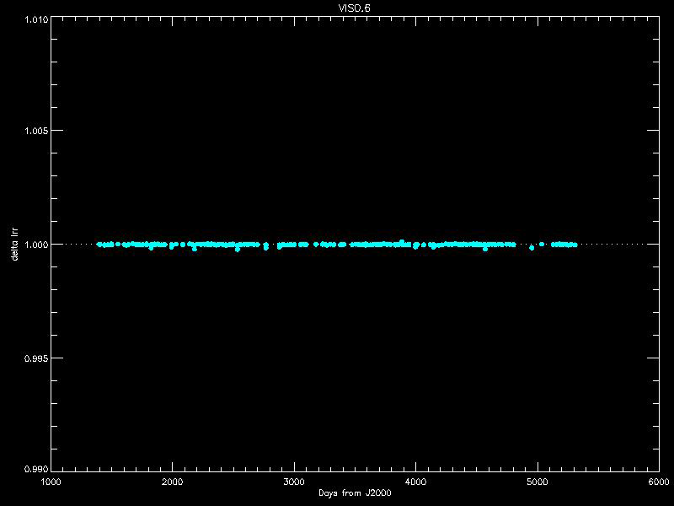
GIRO version 1.0.0 – Verification against ROLO as implemented at USGS

Slide 18
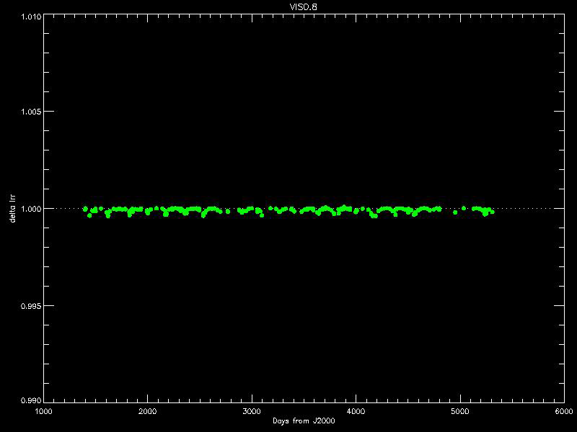
GIRO version 1.0.0 – Verification against ROLO as implemented at USGS

Slide 19
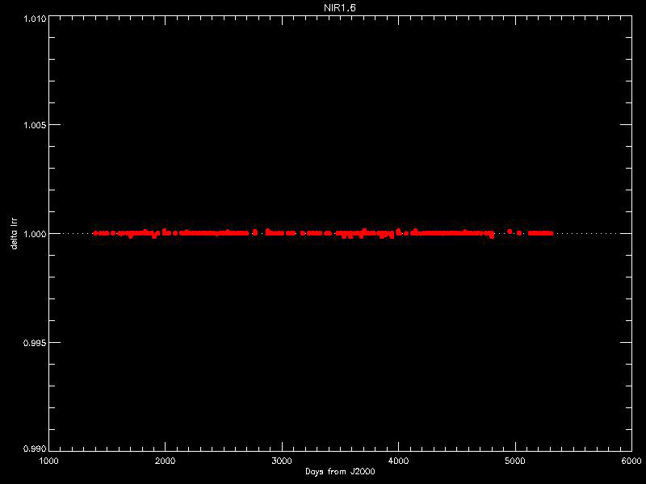
GIRO version 1.0.0 – Verification against ROLO as implemented at USGS

Slide 20
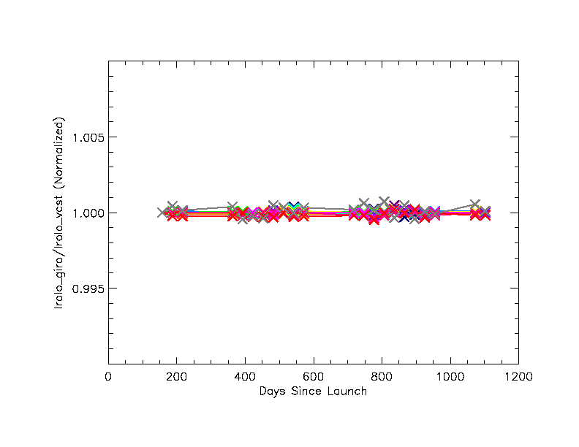
Discrepancy beyond 2.0 microns – NPP VIIRS results
Normalised results = good trending
M11 (2.2µm)
Using GIRO 4th Release
Courtesy J. Fulbright – NASA VCST

Slide 21
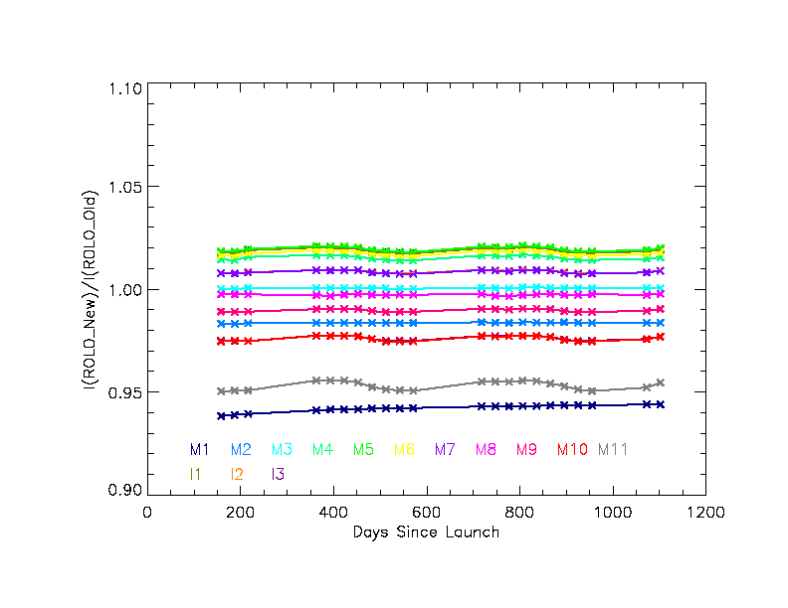
Impact of changes in the ROLO driver
S-NPP VIIRS results
(courtesy J. Fulbright – NASA VCST)

Slide 22
Accuracy and Climate Trends – Courtesy B. Wielicki (NASA - CLARREO)
Climate Sensitivity Uncertainty
is a factor of 3 (IPCC) which =
a factor of 9 uncertainty in climate
change economic impacts
Climate Sensitivity Uncertainty =
Cloud Feedback Uncertainty =
Low Cloud Feedback =
Changes in Short Wave Cloud Radiative Forcing/decade
(y-axis of figure)
Higher Accuracy Observations =
CLARREO reference intercal of
CERES = narrowed uncertainty
15 to 20 years earlier
High accuracy is critical to more rapid understanding of climate change

