Slide 1
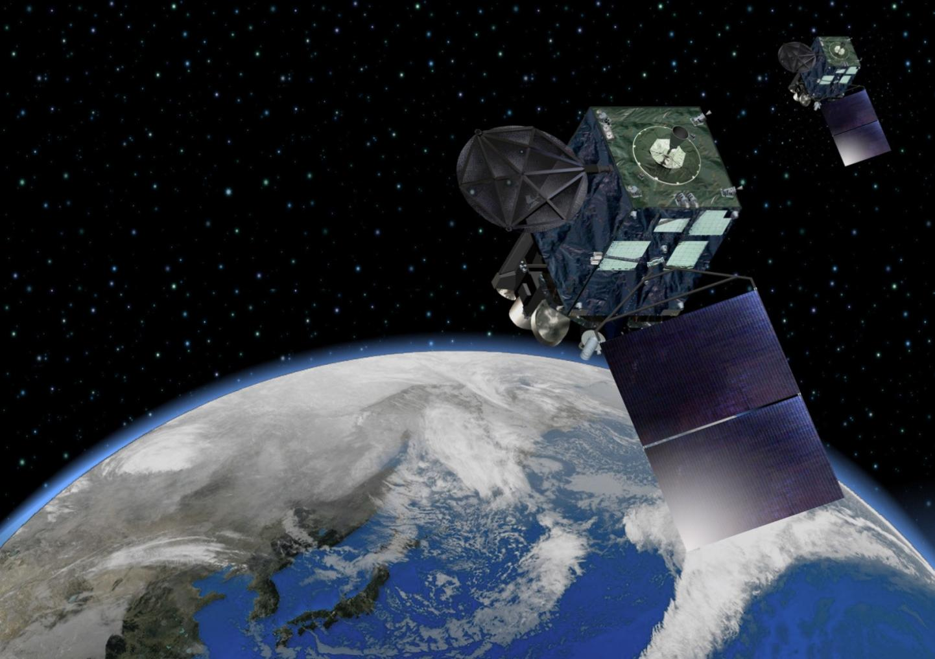
Application of GIRO to Himawari-8/AHI
Himawari-9
(will be launched in 2016)
Hidehiko Murata and Masaya Takahashi
Meteorological Satellite Center,
Japan Meteorological Agency
Himawari-8
In collaboration with EUMETSAT and NOAA

Slide 2
Contents
Introduction
Himawari-8 and AHI
Lunar observation/calibration
Overview of the Moon observation
First results of the AHI lunar calibration
Summary and future plans

Slide 3
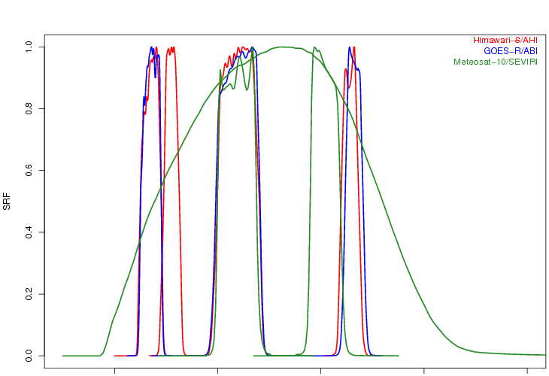
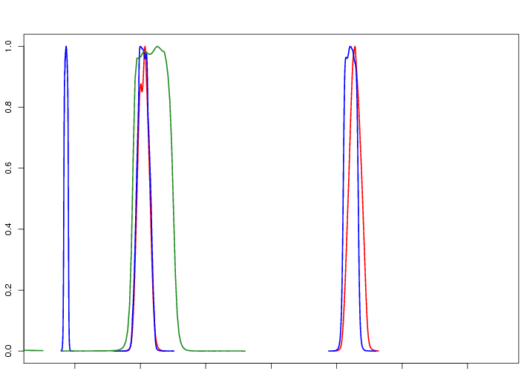
Himawari-8/AHI VIS/NIR bands
AHI VIS/NIR spec.
Band | Central Wavelength [μm] | Spatial Resolution [km] | # of detectors (*) | Digital count quantization level [bit]
1 | 0.47 | 1 | 676 (3) | 11
2 | 0.51 | 1 | 676 (3) | 11
3 | 0.64 | 0.5 | 1460 (3) | 11
4 | 0.86 | 1 | 676 (6) | 11
5 | 1.6 | 2 | 372 (6) | 11
6 | 2.3 | 2 | 372 (6) | 11
Himawari-8/AHI
GOES-R/ABI
Meteosat-10/SEVIRI
0.4 0.6 0.8 1.0 1.2 1.4 1.6 1.8 2.0 2.2 2.4 [µm]

Slide 4
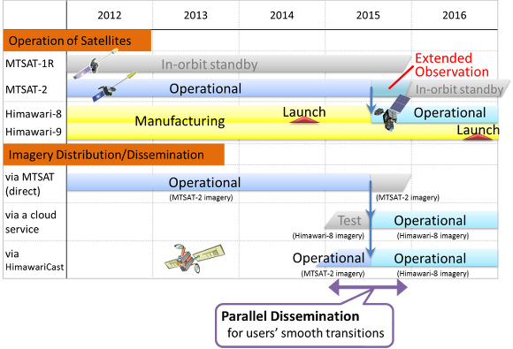
Timeline of JMA GEO satellites operation

Slide 5
Himawari-8/9 AHI observations in 10 minutes time frame
These “super-rapidscans” (every 30 seconds)
will also be used for the lunar observations
Full Disk Observation
every 10 min.
Region 1
(NE Japan)
Every 2.5 min.
Region 2
(SW Japan)
Every 2.5 min.
Region 3
(Target Area)
Every 2.5 min.
Region 4
(Landmark Area)
Every 30 sec.
Region 5
(Landmark Area)
Every 30 sec.

Slide 6
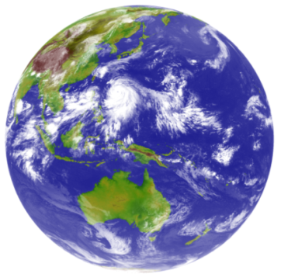
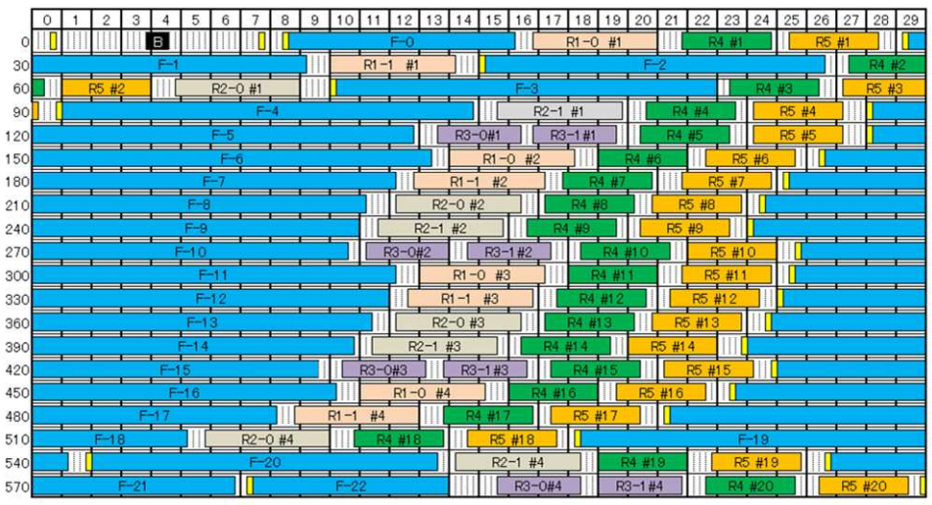
Observation timeline (10 min.)
Full Disk | Region 1 (NE Japan)
BB Obs. | Region 2 (SW Japan)
Space Look | Region 3 (Target Area)
 | Region 4 (Landmark Area)
 | Region 5 (Landmark Area)
One scan (swath)
[sec]
[sec]
(based on Yokota and Sasaki 2013)

Slide 7
Himawari-8/AHI lunar observation/calibration

Slide 8
Himawari-8/AHI lunar observation
The Moon acquisition by super-rapidscan mode / 30 sec
Performed based on the Moon position prediction
Dec 2014: fixed observation position within the 10 minutes obs. frame
Jan 2015~: predict the Moon position for each observation
~400 lunar observations applicable to GIRO in Dec 2014 and Jan 2015 (have been already shared w/ EUMETSAT)
Lunar observation netCDF
Will be shared within the lunar calibration community
One swath for the Moon observation
Pre-operational phase: Dec. 2014 - mid 2015
Observation domain of super-rapidscan
Moon
Targeting observation size: ~0.8 x 1.6 [deg]
Moon apparent diameter: ~0.5 [deg]
Band1 (0.47μm)
2014-12-28T19:05:24-19:56:55
Band5 (1.6μm)
2015-01-12T08:29-18-08:34:27

Slide 9
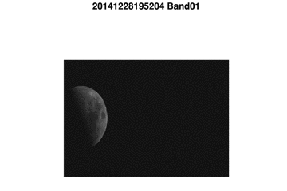
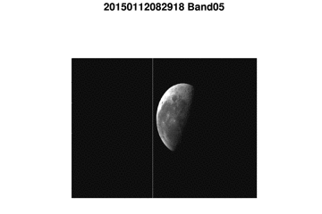
Himawari-8/AHI lunar observation
The Moon acquisition by super-rapidscan mode / 30 sec
Performed based on the Moon position prediction
Dec 2014: fixed observation position within the 10 minutes obs. frame
Jan 2015~: predict the Moon position for each observation
~400 lunar observations applicable to GIRO in Dec 2014 and Jan 2015 (have been already shared w/ EUMETSAT)
Lunar observation netCDF
Will be shared within the lunar calibration community
One swath for the Moon observation
Pre-operational phase: Dec. 2014 - mid 2015
Observation domain of super-rapidscan
Moon
Targeting observation size: ~0.8 x 1.6 [deg]
Moon apparent diameter: ~0.5 [deg]
Band1 (0.47μm)
2014-12-28T19:52:24-19:56:55
Band5 (1.6μm)
2015-01-12T08:29-18-08:34:27
2015 GSCIS annual meeting, 16-20 March, 2015, New Delhi, India

Slide 10
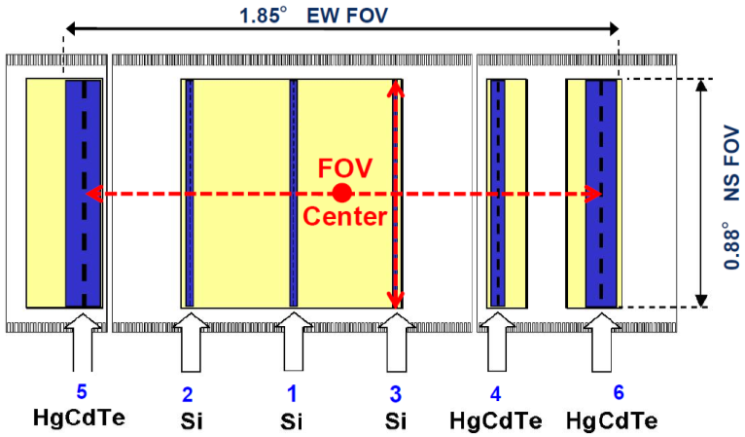
AHI lunar observation – the Moon positions in a imagette
2014-12-29T20:44:56
Band1
(0.47um)
Alignment of the AHI VIS/NIR bands
Band2
(0.51um)
Band3
(0.64um)
Band4
(0.86um)
Band5
(1.6um)
Band number
ITT EXELIS(2013): AHI-8 EQUIPMENT MANUAL 2
CALIBRATION AND ALIGNMENT HANDBOOK Rev. J
Band6
(2.3um)

Slide 11
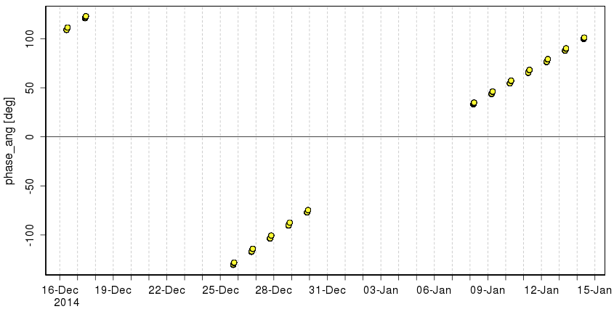
Time series of AHI lunar observations
The Moon phase angles applicable to the GIRO will be covered in the next few months
~ 1 month
GIRO (ROLO) applicable range
Observations within one day

Slide 12
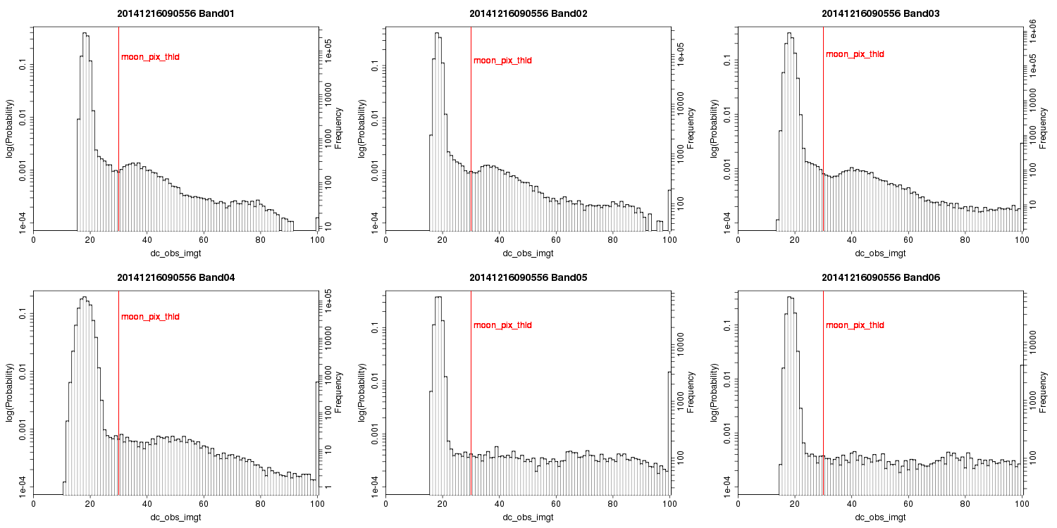
Histogram of AHI digital counts
The Moon mask threshold will be investigated further
2014-12-16T09:05:56Z
Band1
(0.47um)
Band2
(0.51um)
Band3
(0.64um)
Band4
(0.86um)
Band5
(1.6um)
Band6
(2.3um)

Slide 13
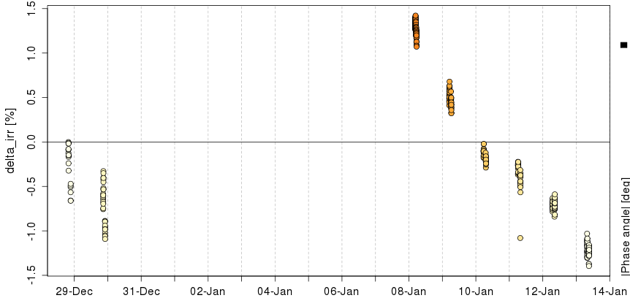
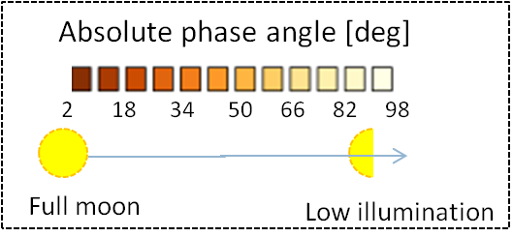
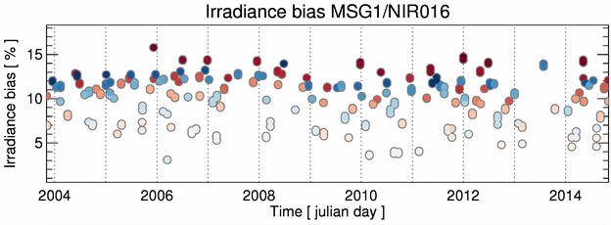
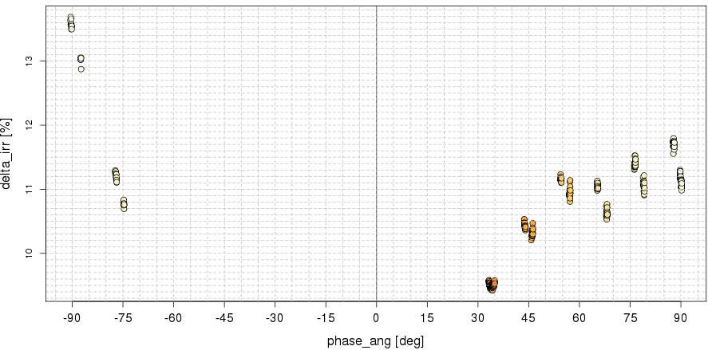
Himawari-8/AHI lunar calibration: First results
Difference of lunar irradiance between the observation and GIRO [%], rescaled at the first result
Time series of ΔIrr for Band3 (0.64um)
MSG1/SEVIRI NIR1.6 result
by Bart at the Lunar calibration Workshop in Dec. 2014
16 days
Δirr (Y-axis) vs. lunar phase angle (X-axis) for Band5 (1.6um)
NOTE: time scale is completely different between these two instruments’ results

Slide 14
Summary and future plans
Himawari-8
Operation: mid 2015~
All the Moon images within the FoR would be observed
AHI lunar observation netCDF: to be shared within the lunar calibration community
Future plans
Comparison with other calibration results
On-board calibration by a solar diffuser
DCC inter-calibration, RTM vicarious calibration, Ray-matching, etc.
Investigation of
GIRO (ROLO) irradiance stability (relative precision)
phase angle dependence of the GIRO (ROLO) irradiance
scan angle dependence on the lunar calibration

Slide 15
Thanks for your attention!

Slide 16
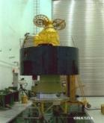
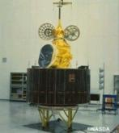
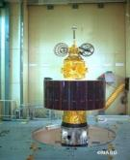
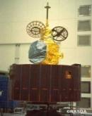
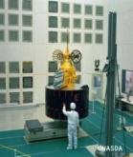
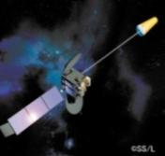
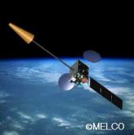
JMA geostationary satellites
GMS (Geostationary Meteorological Satellite)
GMS
GMS-2
GMS-3
GMS-4
GMS-5
(GOES-9)
(Himawari)
(Himawari-2)
(Himawari-3)
(Himawari-4)
(Himawari-5)
Back-up operation of GMS-5 w/ GOES-9 by NOAA/NESDIS:
2003/05/22-2005/06/28
Satellite | Operation period
GMS | 1978 – 1981
GMS-2 | 1981 – 1984
GMS-3 | 1984 – 1989
GMS-4 | 1989 – 1995
GMS-5 | 1995 – 2003
GOES-9 | 2003 – 2005
MTSAT-1R | 2005 – 2010
MTSAT-2 | 2010 – 2015
Himawari-8 | 2015 – 2022
Himawari-9 | 2022 – 2029
ⒸNASDA
ⒸNASDA
ⒸNASDA
ⒸNASDA
ⒸNASDA
Jul 1977
Aug 1981
Aug 1984
Sep 1989
Mar 1995
MTSAT (Multi-functional Transport SATellite )
MTSAT-1R
MTSAT-2
(Himawari-6)
(Himawari-7)
Himawari
Himawari-8
Himawari-9
launched on 7 Oct. 2014
Operation: mid 2015~
2014
2016
ⒸSS/L
ⒸMELCO
Feb 2005
Feb 2006

