Slide 1
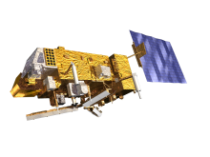
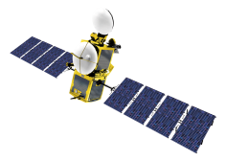
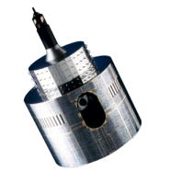
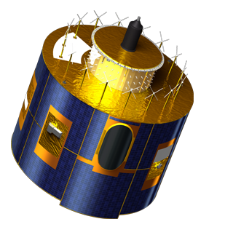
GIRO usage and GSICS Lunar Observation Dataset Policy
S. Wagner

Slide 2
Scope and objectives
GIRO:
Executable
Sources
Data (GSICS Lunar Observation Dataset = GLOD):
Spectral Response Functions
GIRO Input (compulsory ones)
Objectives:
Traceable international reference for lunar calibration/inter-calibration/cross-comparisons
Reference dataset for validation and comparisons

Slide 3
GIRO executable + sources
1. Users of the GIRO shall not distribute copies of the GIRO (executable or code) outside their organization. Access requests shall be made through EUMETSAT’s point of contact (see Section 4).
2. Only the GIRO version as provided by GSICS shall be referred to as the GIRO reference.
3. Reference to the GIRO shall state the number of the version used for data processing.
4. For operational needs, agencies may implement their own version of the GIRO. This version shall NOT be referenced as the GIRO but as the agency’s implementation. A clear distinction shall be made in order to preserve traceability and prevent confusion.
5. In the eventuality of a local implementation of the GIRO, an assessment of the associated uncertainties is recommended and should be made available to the Lunar Calibration Community in order to maintain calibration traceability.
6. Modifications to the source code shall be reviewed. A written review shall be made available to the Lunar Calibration Workshop community. The modified code shall be validated using the checking procedure (#ADD REFERENCE) and the test dataset (#ADD REFERENCE) provided by GSICS.

Slide 4
GLOD
Access to the GIRO and to the GLOD is granted exclusively upon the provision of these files for each instrument the GIRO is applied to. In the case of future missions (it means that no data is available yet), users are expected to fulfill this requirement once the mission is launched upon a gentlemen’s agreement. The lunar observation data shall be representative of typical lunar observations made by the instrument and cover the range of typical observed phase angles.
1. Users of the GLOD shall not distribute copies of the dataset outside their organization. Access requests shall be made through EUMETSAT’s point of contact (see Section 4).
2. Users of the GLOD are granted access to all existing lunar observations and spectral response function files.
3. When using data from different instruments, users shall send for review to the respective data owners a copy of any publication coming out from their work to ensure data are used in an appropriate manner.
4. Co-authorship might be offered in case of an extensive use of specific instrument datasets.
5. Acknowledgement to the data providers is required as a minimum.
6. Acknowledgement to GSICS is required for making the GIRO and the GLOD available.

Slide 5
Extending the GLOD
Existing instrument datasets may also be modified when image processing is improved. In order to keep track of the changes, a version number will be assigned to each contribution to the GLOD.
Comments:
Bart: I think it would be better to specify that any change in the preparation of the GLOD data that affects any of the fields of the NetCDF file should be documented in a release note which complements the release of a new version of a specific dataset (similarly to what has been done for the GIRO releases)
Seb: we should add somewhere in the document that dataset versions should be indicated when presenting results using the GIRO or local implementations of the GIRO (similar to MODIS’ collections). GDWG advice? ➔ Traceability

Slide 6
Additional comments?
Comments:

Slide 7
Requesting access to the GIRO and the GLOD
An email shall be sent to EUMETSAT’s representative of the GSICS Data Working Group (as defined on the WMO website) to request access to the GIRO and to the GLOD. A short description of the intended work should be provided to support the application. This application will be reviewed before access is provided. The approval of a request to access the GIRO and to the GLOD is upon the acceptance of the present GIRO and GLOD usage and sharing policy.
Definition of a review board
Emphasis is put on the participation to the collaborative effort. Providing / exchanging data is one way. Maybe not the only one…

Slide 8
Modifying the policy
Policy can change…
Do we agree that changes are upon approval of the establish Lunar Calibration Community as defined in the current document?

Slide 9
Conclusions and discussion
Need to agree about the GIRO usage and GSICS Lunar Observation Dataset policy
Are all aspects covered by the current draft?
Set-up the infra-structure to distribute the GIRO (exec + sources) + GLOD ➔ Support from GDWG
Time line?
Remaining actions:
GLCWS_14.5 | All participants to provide lunar irradiances from the missing instruments to the common lunar calibration data set. | 01 Dec 2015
GLCWS_14.6 | EUMETSAT to circulate a draft for a data sharing and GIRO usage policy to the workshop participants. This should include the requirements for newcomers to join the community and get access to the data and the GIRO. | 01 Dec 2015
GLCWS_14.7 | GSICS Data Working Group to identify a suitable mechanism for sharing the lunar calibration dataset. | 01 Dec 2015
GLCWS_14.8 | All participants to report any restrictions on the use of their datasets in relation to the proposed data sharing policy. | 18 Mar 2015
GLCWS_14.10 | The GSICS Data Working Group is asked to develop a procedure for verifying users’ implementation of GIRO. | 01 Dec 2015

