Slide 1
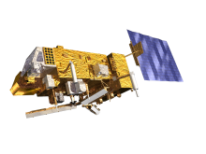
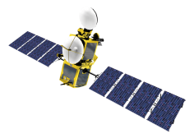
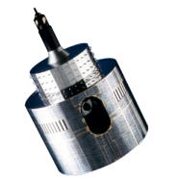
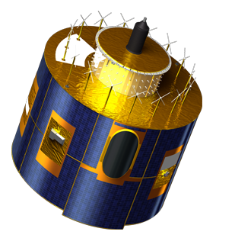
Proposal for a way forward on inter-calibration using the Moon
S. Wagner, T. Hewison

Slide 2
From the Lunar Calibration Workshop
Acquisitions from 30 sensors
20 years of acquisitions from 1995 to 2014
~ 60% of sensors providing data in the last 2 years – common period
For all the reflective spectral domain
broad or narrow bands
including a common red band (narrow of broad)
Covering the entire lunar phase range
the full range for GEO (but within GIRO’s range of applicability), more limited for LEO

Slide 3
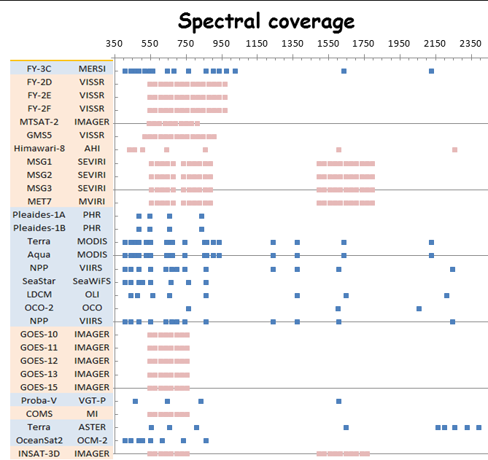
Courtesy B. Fougnie, CNES
LEO (CWL)
GEO (band)
Landsat-8
According to OSCAR (WMO)

Slide 4
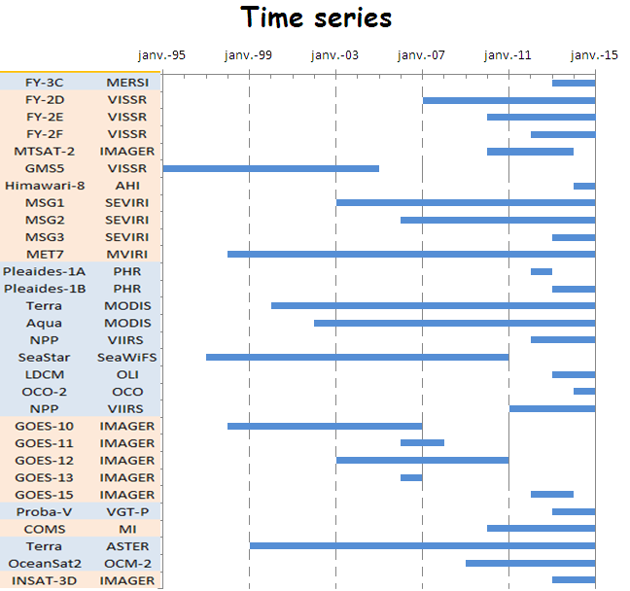
Courtesy B. Fougnie, CNES
LEO
GEO
Landsat-8

Slide 5
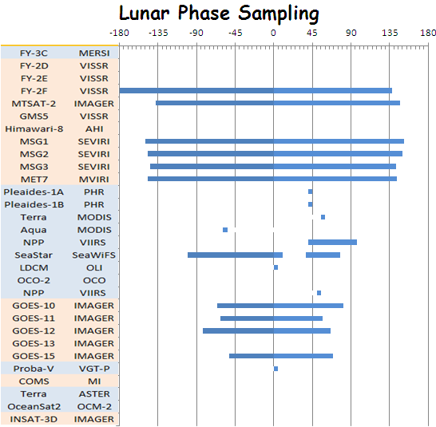
Courtesy B. Fougnie, CNES
LEO
GEO
Landsat-8

Slide 6
Proposal for activities to address inter-calibration using the Moon
In EUMETSAT’s proposal, points to be addressed:
Estimating the over-sampling factor
Drift correction
Estimation of the SBAFs from GIRO and verification of the results.
Establishing an absolute scale for lunar calibration
Medium and long term activities on lunar calibration
Do you see other important topics to be addressed?

Slide 7
A. Estimating the over-sampling factor
Propose a formulation of the over-sampling factors for all imagers while observing the Moon.
Derive the over-sampling factors for the current and the past instruments.
Comments from CMA: Very important. Now for Fengyun satellite this parameter is a constant provided by the instrument manufacturer
➔ Can we provide an alternative estimate to verify the official value?

Slide 8
B. Drift correction
Using the available information on instrument calibration and drift estimates, the lunar irradiance observed by the instruments in the Lunar Calibration Dataset should be corrected for the instrument drift. A corrected dataset shall be produced.
➔ Description of the drift correction:
Which methods are used?
What are the uncertainties?
Do we need to correct for phase-dependence first?

Slide 9
C. Accounting for spectral differences between instruments
Using the Lunar Calibration Dataset, estimate for all instruments and bands available in the dataset the SBAF with respect to Aqua MODIS bands.
The generated SBAF must be validated using hyper-spectral observations. Possibly, more hyper-spectral dataset should be used. The current hyper-spectral instruments with lunar capabilities are SCIAMACHY, HYPERION and GOME-2.
The results should be compared with equivalent data derived above other targets such as DCCs, ocean targets, etc.

Slide 10
D. Establishing an absolute scale for lunar calibration
Analyse the current lunar calibration dataset to investigate the possibility to put the current ROLO/GIRO on an absolute scale using the 0.6.µm observations as a common wavelength
Using the current knowledge on the various instruments’ inter-band calibration, investigate the possibility to have set the ROLO/GIRO on an absolute scale for other channels.
Investigate the uncertainties on the instrument inter-calibration caused by the use of inter-band calibration information.
Comments from CMA:
Comparisons between Aqua/MODIS and ROLO/GIRO.
Check if SBAF is constant of a function of the phase angle
Comparisons with equivalent data derived above other targets such as DCCs, ocean targets, etc.

Slide 11
Additional comments
How to decide the reference instrument? The radiometric calibration accuracy of reference instrument should be evaluated by other methods?
Using hyperspectral observations: does the spatial resolution matter? (SCIAMACHY, GOME-2, HYPERION)
SBAF are target-dependent.
??

Slide 12
E. Medium and long term activities on lunar calibration
Investigate the possibility to participate to an international consortium to fund dedicated measurement campaigns.
Review planned activities in this area:
CMA?
CNES?
ESA: interest in contributing but no existing mechanism for such an international funding. Further investigations needed.
EUMETSAT: no existing mechanism for international funding but possibility still under investigation. Action set on Science Working Group to define users requirements.
ISRO? IMD?
JMA: no possibility for funding
KMA?
NASA?
NOAA?
CEOS/IVOS members: AIST, JAXA, KIOST, VITO?

Slide 13
Who wants to do what?
Agency | Activity 1 | Activity 2 | Activity 3 | Activity 4 | Activity 5 | Any other topic
CMA |  |  |  |  |  | Use of alternative soil reflectance spectra + Independent estimate of the OS factor(?)
CNES
EUMETSAT | A.1/A.2 | B.1 | C.1/C.2 (with GOME-2)/C.3 | D.1/D.2/D.3 | E.1 (TBD)
ISRO/IMD
JMA
KMA
NASA
NOAA
USGS
AIST
JAXA
KIOST
VITO

Slide 14
Expectations
Timeline?
Regular email exchange to check the status of the work (following actions/activities) + web meetings to present progresses
In conjunction with other lunar calibration activities (ROLO/GIRO enhancements, new results, etc.) ➔ web meetings + 2nd Lunar Calibration Workshop (Q1 2016?)
Goal 1 = establish an inter-calibration procedure based on lunar observations
Goal 2 = promote this method into GSICS activities (independent product or blending?)

