Slide 1
GSICS Products' Content Access Study Proposal
Zhe(Thomas) Xu , CMA
CMA, CNES, EUMETSAT, ISRO, IMD, JAXA, JMA, KMA, NASA, NIST, NOAA, ROSHYDROMET, USGS, WMO

Slide 2
Overview and Purpose
Overview
Existing GSICS products
Now: GEO-LEO-IR (NRTC/RAC)
Future: More catalogue, Lunar/MW, etc.
File Format: NetCDF (Structure content file)
Free Database
Idea: Shall we use free database (like MySQL) as the container for GSICS product?
Advantage and Disadvantage
Purpose of this presentation
To discuss the possibility of using MySQL to storage GSICS product as a parallel method to organize GSCIS products
Investigation Plan of CMA GDWG

Slide 3
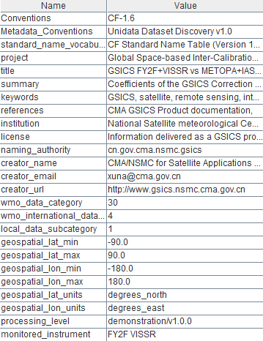
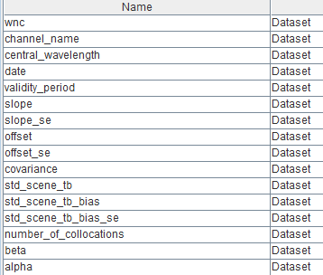
Existing GSICS Products Format
NC:NRTC Product
Attributes
Metadata of the file
Static information
Datasets
Variables
1-2 dimension array
………...

Slide 4
Database Utilization
Possibility
NetCDF is Structure file format
Attributes→Static Table
Datasets→Records
Build relationship between static table and records.
Generate/Update new file → Insert Record
Just like the updating of the RAC product

Slide 5
Database Utilization
Advantage
Reduce the complicated of the product catalogue
Existing Catalogue=Satellite*Instrument*Channel*Calibration method*Time attribute(NRTC or RAC)
Query the data by using standard SQL
Get the time series data easier compare with RAC file
Easy to generate file format on demand
NetCDF, HDF, CSV, etc
Archive
Just backup the Database
Disadvantage
Can not access the data directly
Plug in/Interface needed to provide to users
Data exchange
Database Maintain
Plotting tool need update

Slide 6
CMA GDWG Investigation Plan
Continue the generation of GOE-LEO NRTC/RAC NetCDF product
Follow the convention of GSICS
Support the validation of GSICIS product generation framework developed by EUMETSAT
RAC product will be available soon
In parallel, investigate to use MySQL to storage CMA RAC product
Database tables structure design
CMA RAC product value insert to database
Develop value query tool under the requirement of CMA GRWG
Package insert/query tools and MySQL database together to delivery
Report to GDWG members when the investigation has result

Slide 7
End of Presentation: Thank you for your attention
WMO GSICS Portal
http://gsics.wmo.int
GSICS Coordination Centre - http://www.star.nesdis.noaa.gov/smcd/GCC/index.php
GSICS Product Catalog - http://www.star.nesdis.noaa.gov/smcd/GCC/ProductCatalog.php
CMA’s Data and Management Server
http://gsics.nsmc.cma.gov.cn/thredds

