Slide 1
Proposal of Satellite Data Center
India Meteorological Department
A.K.Sharma (Chairman), Virendera Singh (Member), R.K.Giri (Member) and N.Puviarasan (Member Secretary)

Slide 2
Outline
Brief of existing Data center
Shortcoming
Vision of Proposed Data Center
Web Portal
System Characteristics
Solution Frame work
Logical View
Benefits of Proposed System
Operational Deployment
Product Mapping
Web portal Interface
Suggestions from GSICS

Slide 3
Existing Data Center (OCT 2005 – SEP 2014)
Proposed in 2002
Established in 2005
Intended for archival of INSAT data and products present and past (since 1984 onwards) in h5 format.
Through web portal, registered user can access data availability (From 2005) and place the order .

Slide 4
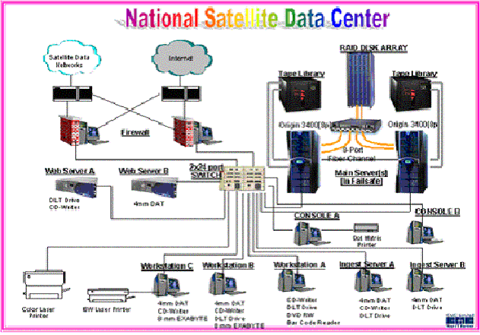
Layout (2005 – 2014)

Slide 5
Vision of Proposed Data Center
Near Real-time Information sharing with experts, research institutes and others
Interactive, Easier, efficient way to Analyse, Visualize and Share the data
All time data availability (past and present)
Reduce and gradually eliminate the dependencies over data formats

Slide 6
Web Portal support the following capabilities:
  Portal to allow Search, Visualization, Analytics, Modeling, Download, Online Payment if any
  Collect and Manage Level 0, 1, 2 of INSAT Image and Sounder Data
  Data validation or quality control at each phase
  Process data for Analysis including Flagging, Refining, Transformation etc
  Store processed data, based on category, grouping, metadata tagging etc
  Ability to convert the data output in different formats based on user requirement
  Share information through Portal to internal and external stakeholders
  Visualize with the use of GIS system

Slide 7
System Characteristics
Flexibility to visualize data in various forms through Portal
Performance is the key while processing large volume of data to fulfill user/customer request
Reliability
Efficient usability
Scalable Architecture
Open Standards based solution
Protection of Data
Flexibility in solution to configure as and when required
Archival and Retrieval of Data

Slide 8

Solution Framework
Internet/Intranet , ISRO, IMD, Depts, Other Agencies
Presentation Services
Business/Application Services
Information/Data Services
Existing Source
Metadata + Application Data
Registration
Visualization
FTP
Online Payment
Analytical & Modeling Services
Level 1 & 2 Source Data
Search
Unstructured Data - files
Data Processing
Data Access & Visualization
Geo-Physical Product processing
FTP
Access Mgmt
Data Format Conversions
Data Download Service
Analytical Database
Raw Data and Images
Security and System Management

Slide 9



Logical View
Internet, User community
Users (Internet/Intranet)
Web Portal
Search
Registration
Custom Applications
Data Processing
Data Download Service
QC Module
Visualization
Data Grouping / Flagging
Existing IMDPS
Reports
Modeling
Application Server
Reports Engine
GIS Engine
SAT 1
Security Services
SAT 2
FTP
Unstructured Data - files
SAT …
Analytical Data
Data Processing
Data
Models
Structured & Unstructured Data

Slide 10
Benefits of Proposed Solution
Integrated System with capability to Store, Integrate, Transform, Model, Analyze, Visualize and Share (RAPID – ISRO, MIAS-ISRO)
Support Online & Offline facility to retrieve and process data as per user requirement
Reduce the dependency on data formats: Ingestion and conversion of Data from various sources
Users can also simultaneously visualize other Meteorological products (RADAR, NWP, Surface, upper air data if available
Provide flexibility to provide data in end user desired format
Enterprise Architecture: scalable, reliable, manageable & secure
Open Standards based

Slide 11

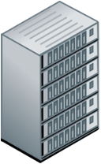
Typical Operational Deployment
Portal + Custom Application Server
HTTP server
Security servers
Management Server
Backup Server
WWW
Fire wall-A/ Redundant (Standby)
Fire wall-B/ Redundant (Standby)
Switch -2 /Redundant (Standby)
Switch -1
RDBMS server
Disaster
Recovery
Site
Data Replication
Data Download Server
SMTP Gateway
Ingestion + DPS
NAS/SAN
IMDPS/GNSS Data
Robotic
Tape Lib or Virtual Tape Library?

Slide 12
Product Mapping
Solution Component | COTS Product
Web Portal, Registration, Online Payment | Third party integration of Giovanni tools and GDWG of GSICS
Search Services | Third party
Visualization Service | RAPID (ISRO), MIAS (ISRO) and third party software
Format Conversions | ISRO or WMO Standard
Analytical and Statistical Modeling | Third party , IMD or ISRO or from user community
Data Processing (Ingestion, QC, Product etc) | WMO Standard
Data Download Service | Third party
Structure Data Management | Third party (ORACLE)
Unstructured Data Management | Third party
User Security & Access Management | Third party
IT Infra Management | Third party
Data Backup Services | Third party
Application/Hardware Servers | Third party

Slide 13
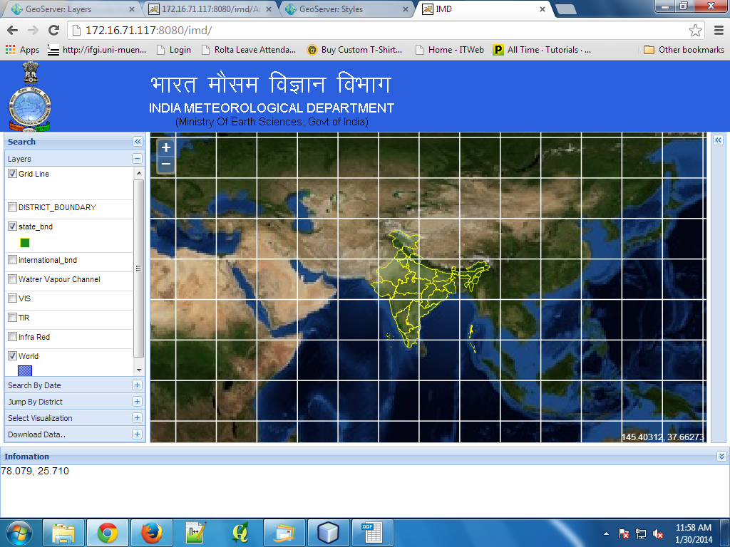
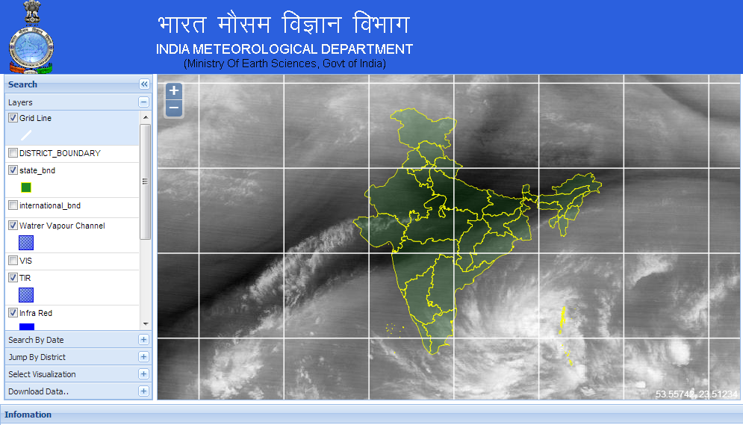
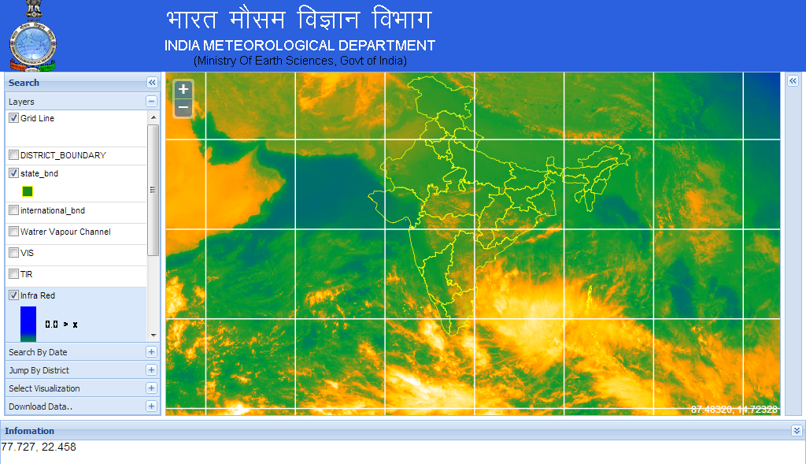
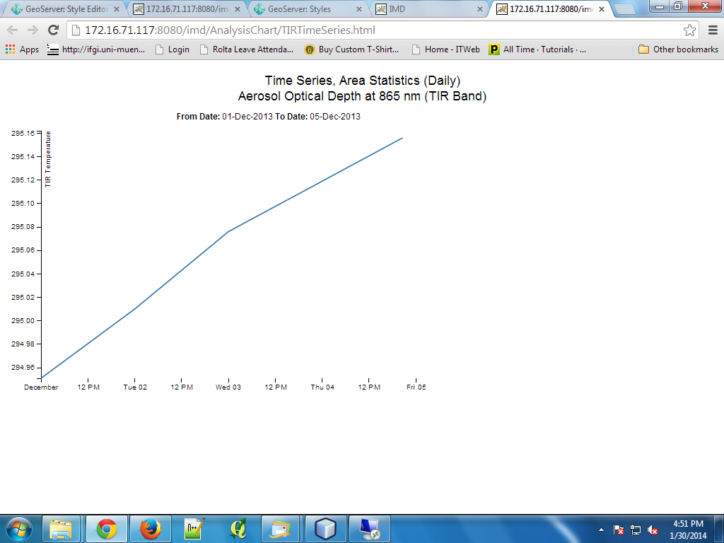
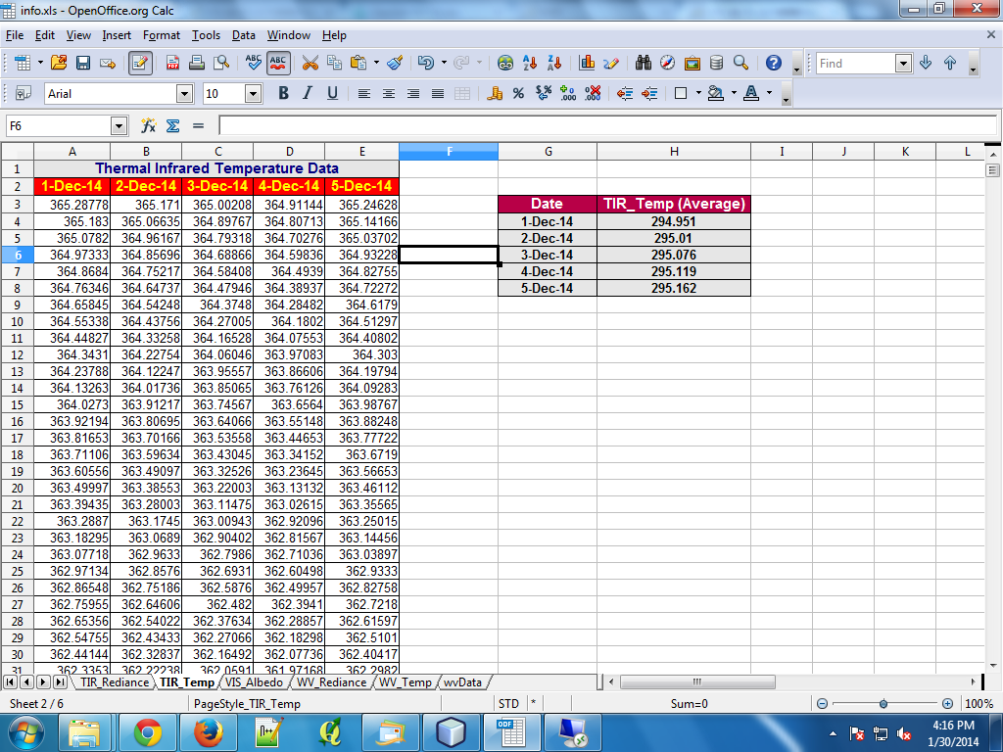
WEB Portal Interface
eospatial Mat Portal
Water Vapour Temperature
Thermal Infrared from RAPID/MIAS

Slide 14
IMD requirement – Propose action for NASA
IMD require code sharing from http://disc.sci.gsfc.nasa.gov/giovanni, to create similar type of web portal tools on propose data center.

Slide 15

Suggestions ….
Expectation of GSICS from IMD?
Notes:
15
15

