Slide 1
2015 GSICS Annual Meeting (23-27 Mar 2015) @New Delhi, India
COMS WV Analysis
Dohyeong KIM, Hyesook Lee and Minju GU
National Meteorological Satellite Center
Korea Meteorological Administration

Slide 2
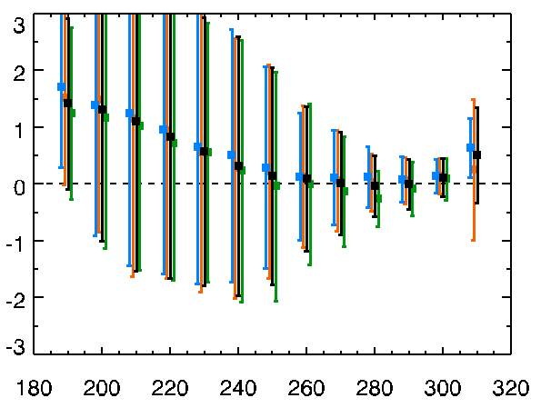
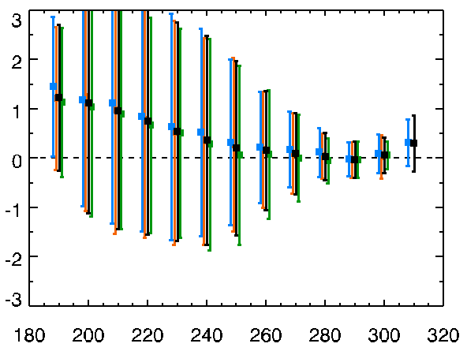
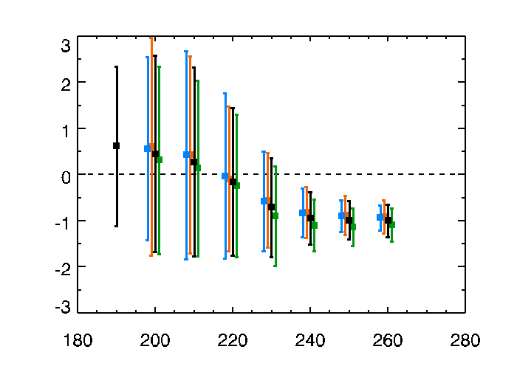
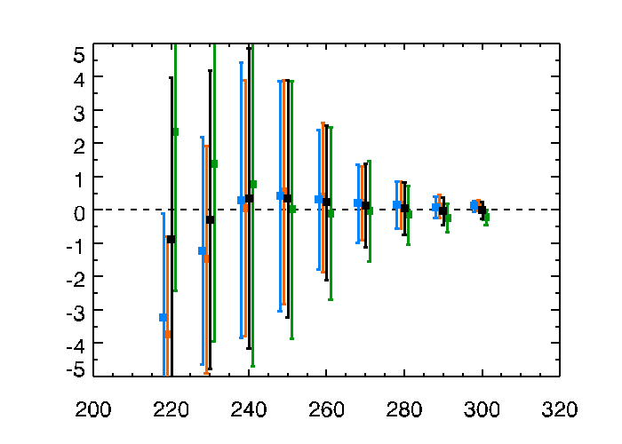
Trend of TB Bias
AIRS IASI_A IASI_B TOTAL
trend of TB bias for COMS IR TBs
period: 2011.04 – 2014.12(IASI_A, AIRS), 2013.08 – 2014.12(IASI_B)
RMSE 1.3806
RMSE 1.5041
IR2
IR1
IR2
TB Bias (K)
large negative bias for warm temperature
Bias 0.2237 0.2859 0.3296 0.2694
Bias 0.2175 0.2186 0.2753 0.2312
RMSE 1.1780
RMSE 2.6635
WV
SWIR
TB Bias (K)
Bias -1.0005 -0.7485 -0.7652 -0.8614
Bias 0.1811 0.0374 0.0506 0.0905
COMS TB (K)
COMS TB (K)

Slide 3
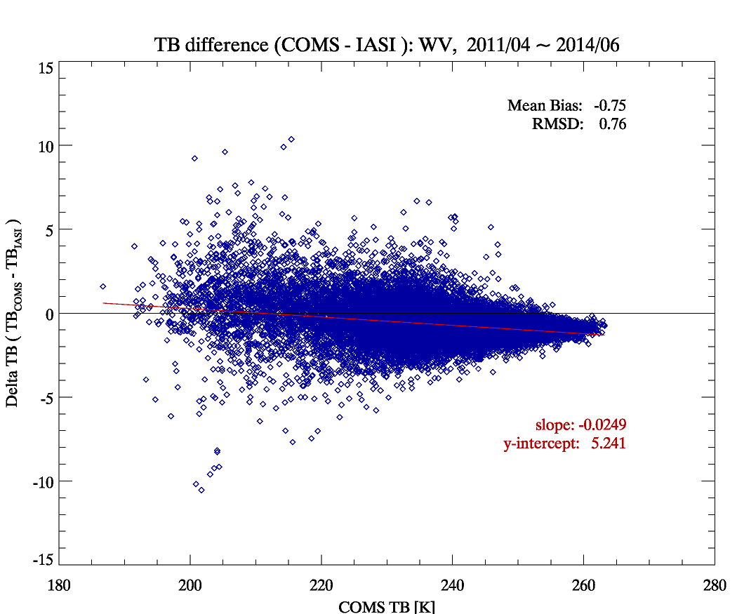
Trend of TB Bias
(+) bias with high variability in low TB
Systematic (-) bias with low variability in high TB
TB(IASI) < TB(COMS)
TB(IASI) > TB(COMS)

Slide 4
Method : SRF shift
Assume that the impact of SFR shape can be neglected
Sensitivity test using RTM (Modtran vs LBLRTM)
TB change analysis with varying the central wavelength of SRF for the case with or without cloud
Reproduce the comparable IASI Brightness with COMS/MI SRF shift Temperature
※ Preliminary analysis made following Wu&Yu(2013, IEEE) about Brigtness Temperature, Blackbody emissivity, Nonlineariry, Scan mirror emissivity, Midnight effect and Water Ice contamination

Slide 5
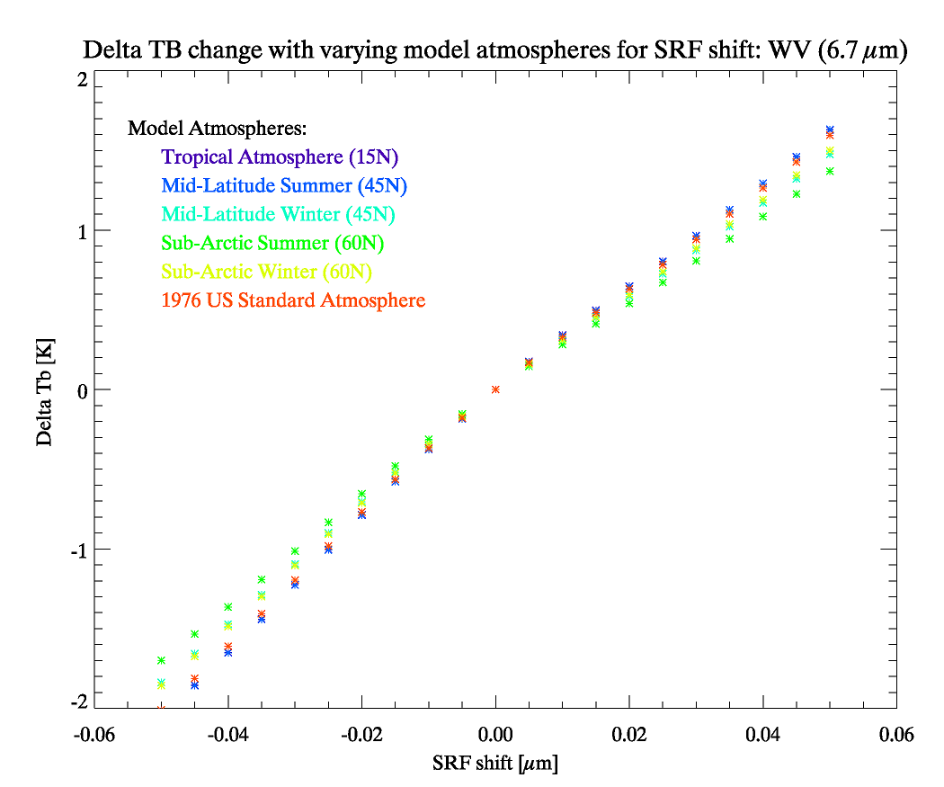
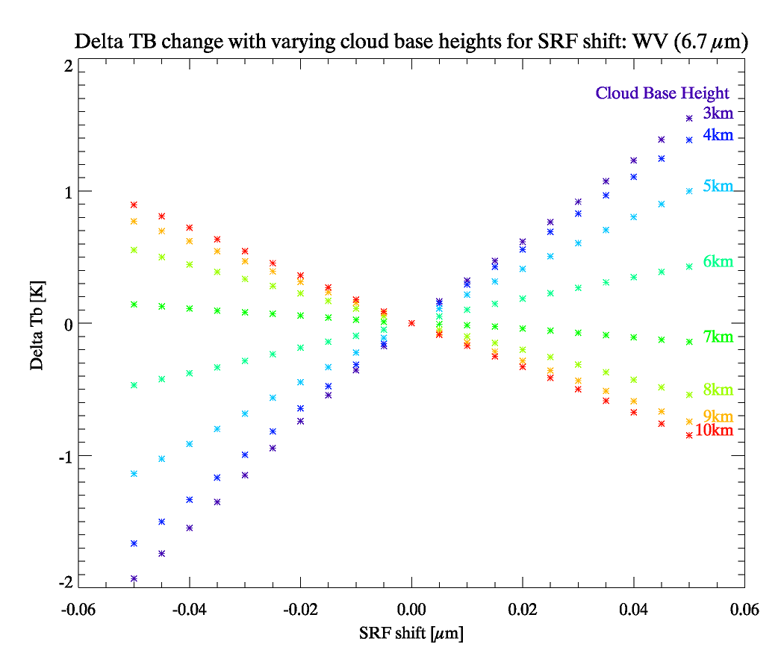
TB bias Test with SRF Shift
SRF shift with the various atmosphere model
SRF shift with the various cloud base height
6~7km
Mean Δν: 2.5 cm⁻¹ (-0.0114 μm),

Slide 6
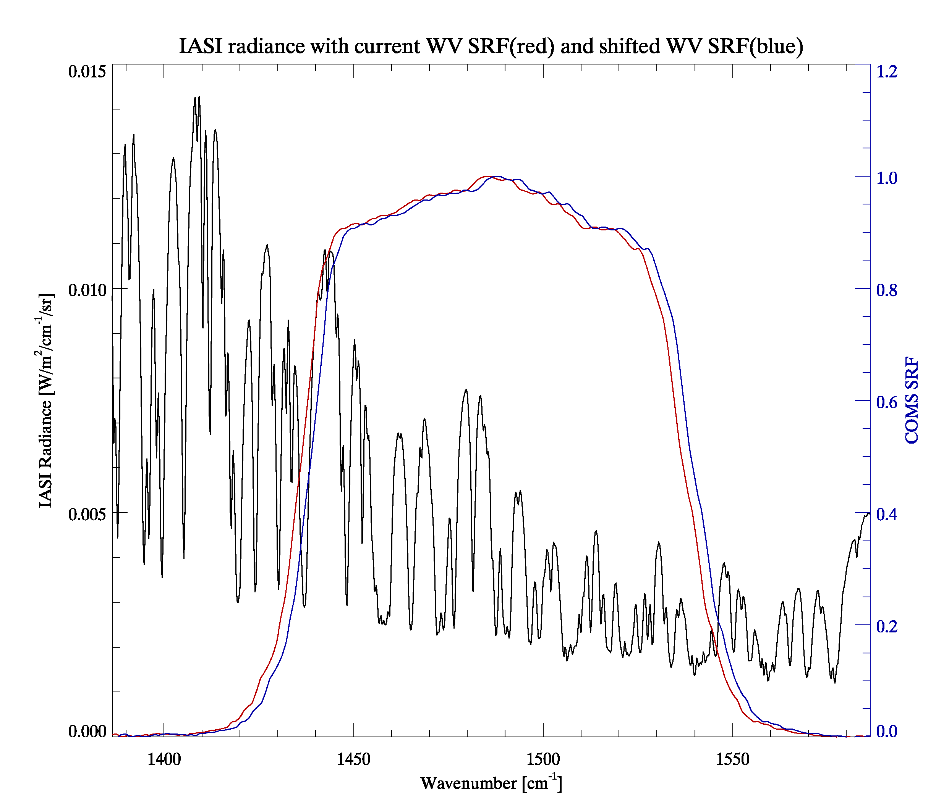
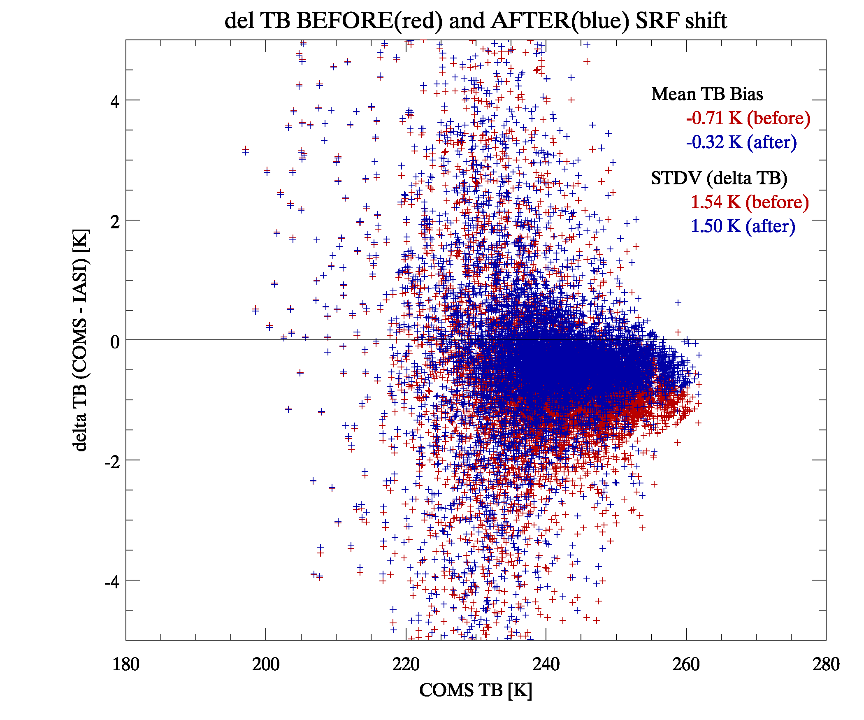
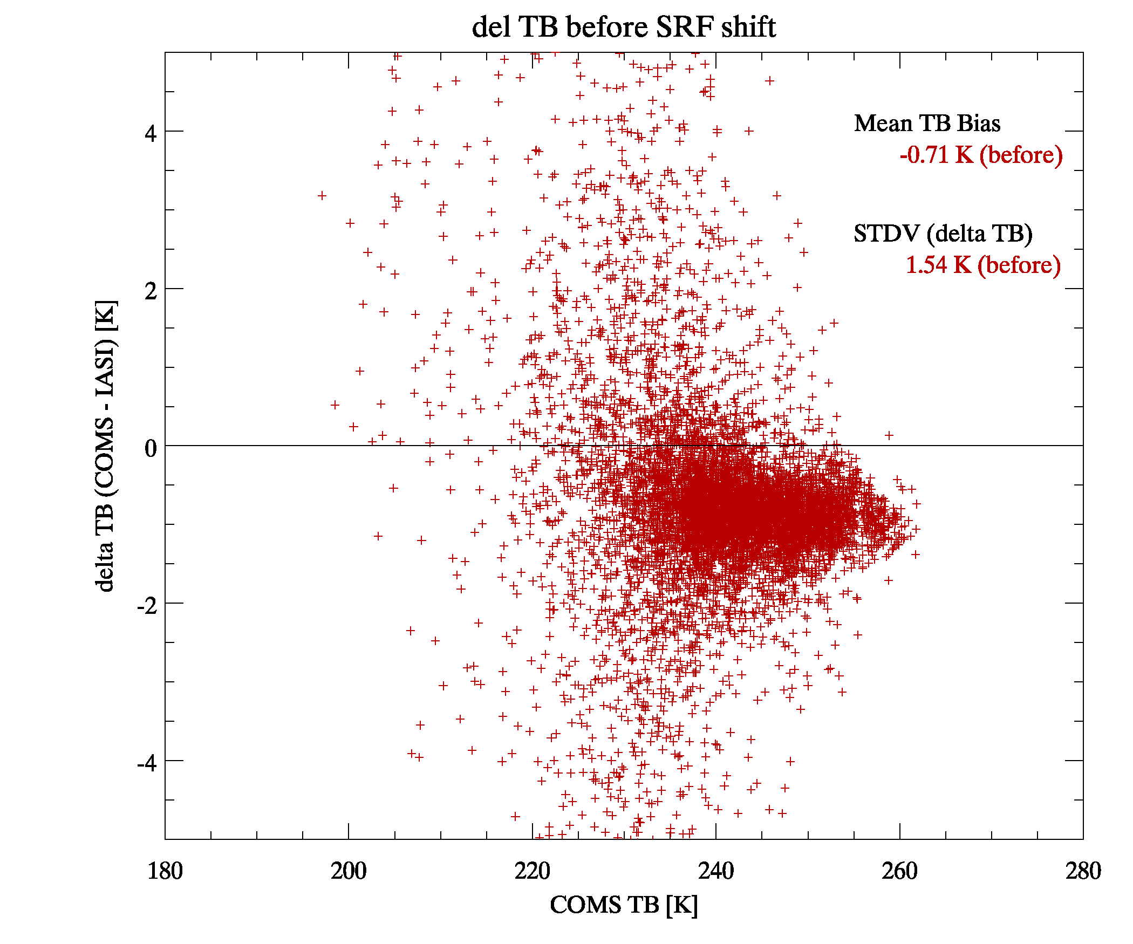
TB Bias correction using SRF shift
TB bias(COMS-IASI) reduced by 0.4K(-0.71K → -0.32K)

Slide 7
Thank you ☺

