Slide 1
IR Calibration Around Midnight for 3-Axis Stabilized Geo
X. Wu
Based on work by many people/years

Slide 2
Outline
What is it?
Why is it?
What has been done?
What else?
Conclusions

Slide 3
What is it
GEO Diurnal

Slide 4
Instrument Monitoring
GOES-8 Imager
M. Weinreb et al

Slide 5
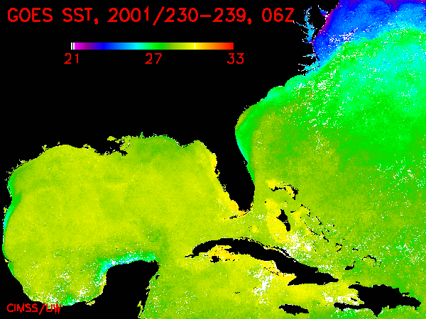
Product Impacts
UW/CIMSS

Slide 6
Product Impacts
UW/CIMSS

Slide 7
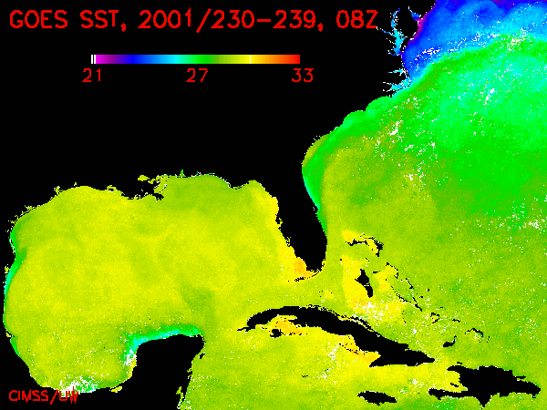
Product Impacts
UW/CIMSS

Slide 8
Product Impacts
UW/CIMSS

Slide 9
Product Impacts
UW/CIMSS

Slide 10
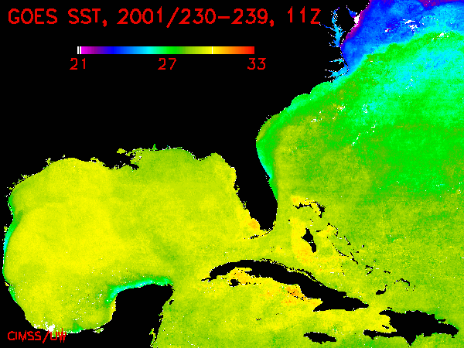
Product Impacts
UW/CIMSS

Slide 11
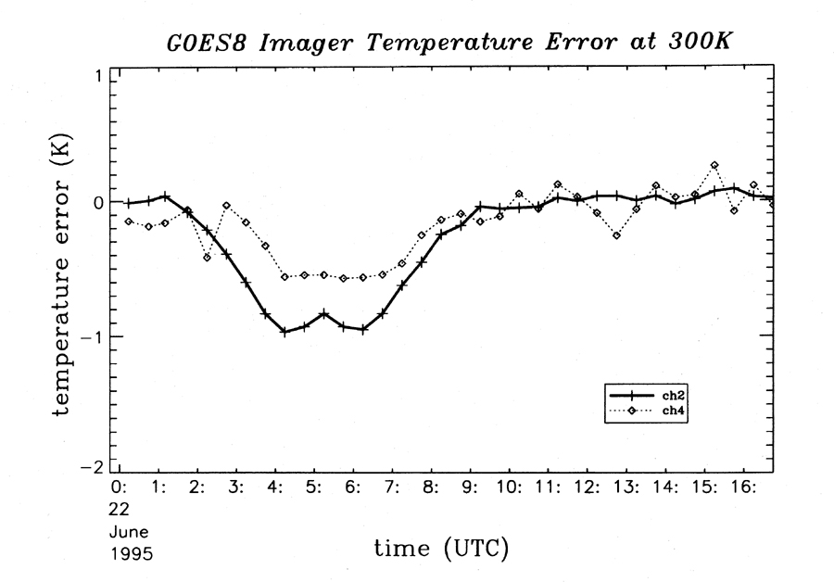
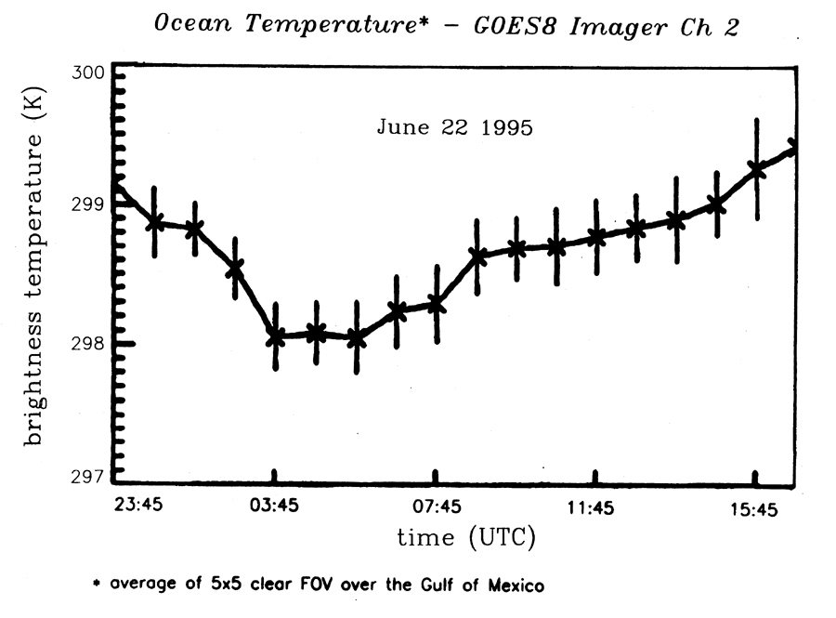
Simulation and Confirmation
M. Weinreb et al
UW/CIMSS

Slide 12
Why is it
GEO Diurnal

Slide 13
Root Cause - Thermal Stress …
One Week
One Month
~60ºK some other days
~40ºK “now”
Complicated seasonal variations of diurnal heating
Long term trend
D. Han
One Year
One Satellite
D. Han et al
Goes-12 Scan Mirror Temperature

Slide 14
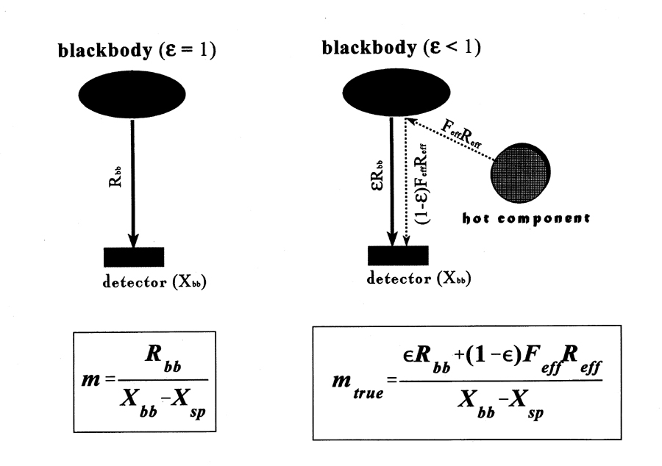
… coupled with blackbody …
T_{BB}
Not a problem without this varying radiator
M. Weinreb et al

Slide 15
… that is less than black
T_{BB}
T_{BB}
OK if ε=1 or T_{env}=T_{BB}
Less true for GOES
T_{env}
M. Weinreb et al

Slide 16
What has been done
GEO Diurnal

Slide 17
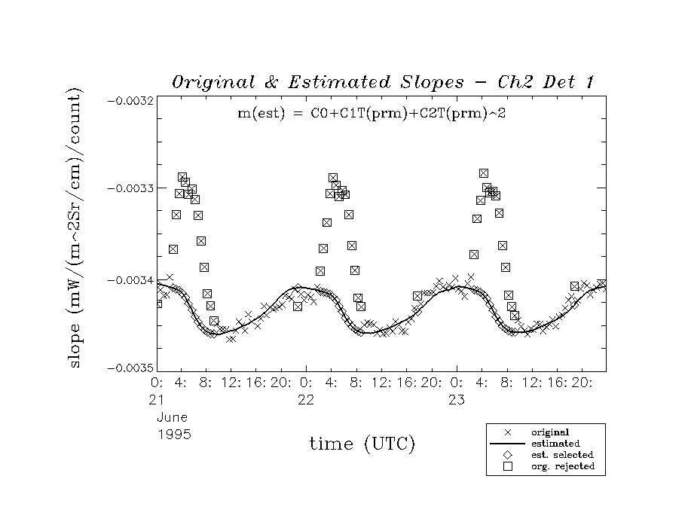
Correction (MBCC) …
GOES-8 Imager
M. Weinreb et al

Slide 18
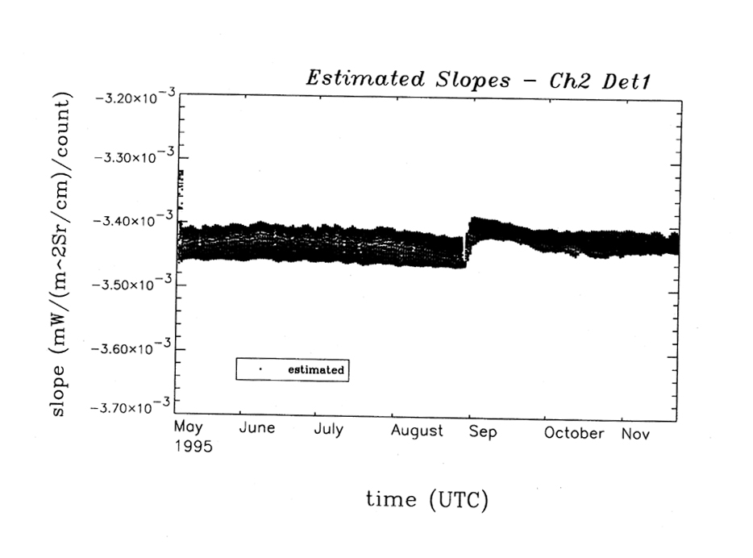
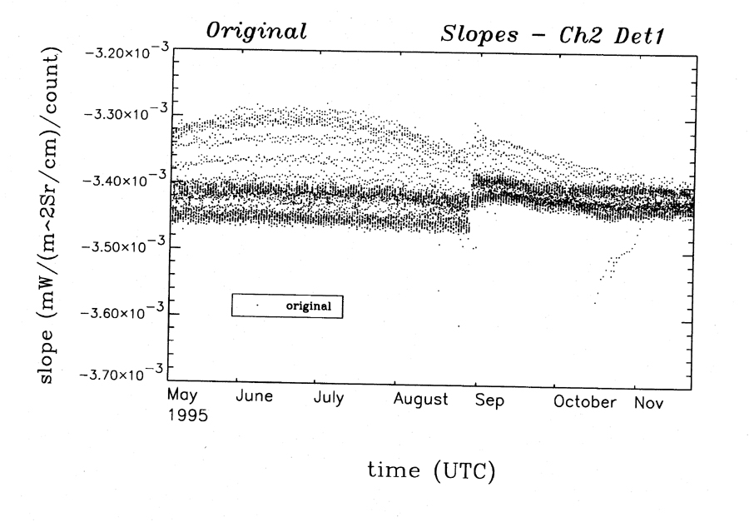
… and effects
M. Weinreb et al

Slide 19
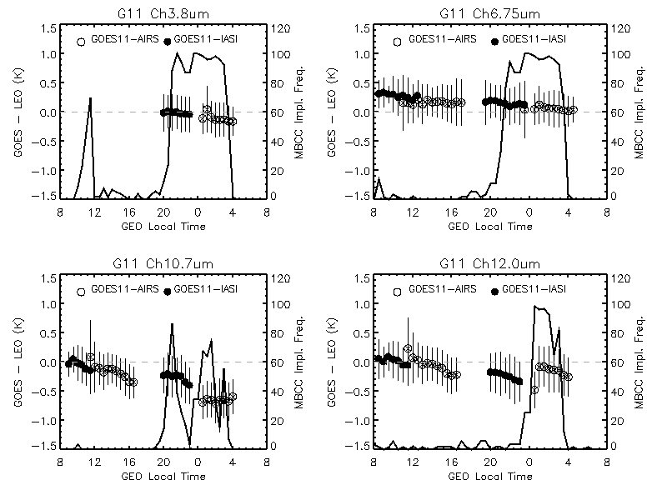
15 years later …
assuming
MBCC correction was not always turned on around the midnight time at different channels
Yu and Wu 2013, TGRS

Slide 20
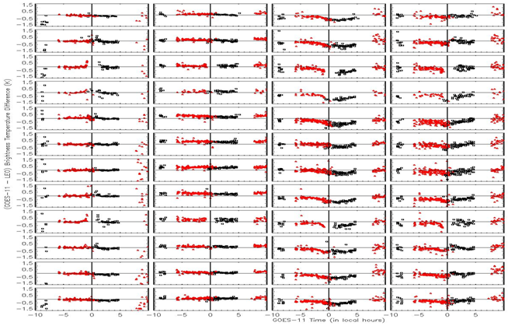
MBCC Performance Evaluation – GOES-11 Imager IR Channels
Ch2 Ch3 Ch4 Ch5
Jan
Feb
Mar
Apr
May
Jun
Jul
Aug
Sep
Oct
Nov
Dec
Jan
Feb
Mar
Apr
May
Jun
Jul
Aug
Sep
Oct
Nov
Dec
R. Mundakkara et al.
Diurnal variation varies at different channel and different season

Slide 21
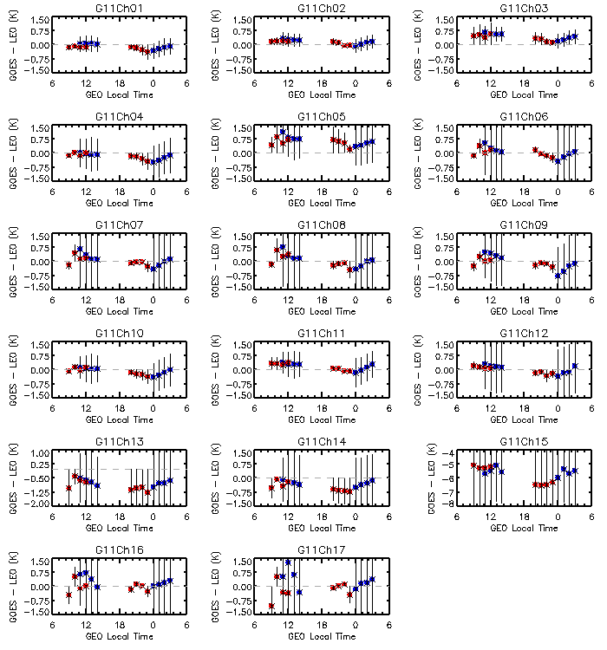
No MBCC applied to the Sounder IR channels
Impact of the midnight calibration anomaly for GOES-11 Sounder IR channel 1 through Ch17. ΔTb_{4:00am,0:00am} = ΔTb_{4:00am} - ΔTb_{0:00am}
Channel | ΔTb_{4:00am,0:00am} (K) | Channel | ΔTb_{4:00am,0:00am} (K) | Channel | ΔTb_{4:00am,0:00am} (K)
Ch1 | +0.25 | Ch7 | +0.54 | Ch13 | +0.33
Ch2 | +0.22 | Ch8 | +0.49 | Ch14 | +0.38
Ch3 | +0.25 | Ch9 | +0.67 | Ch15 | +0.61
Ch4 | +0.37 | Ch10 | +0.39 | Ch16 | +0.28
Ch5 | +0.24 | Ch11 | +0.44 | Ch17 | +0.51
Ch6 | +0.51 | Ch12 | +0.53
Yu and Wu, 2013 TGRS

Slide 22
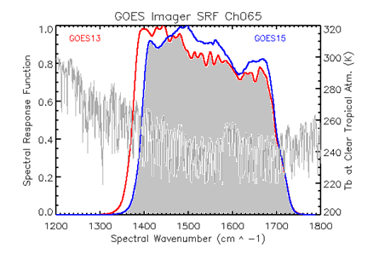
GEO-GEO IR Inter-Calibration
1)
- D. Tobin et al. 2005 JGR
2)
This algorithm can be applied to Sounder IR data. However, due to the application of MBCC calibration slope and smoothing of the radiance, it is challenging to apply to Imager IR channels
New SRF
3)
Where and are the simulated GEO1 and GEO2 radiances using various atmospheric profiles. Could have large uncertainty at the sounding channels
Yu

Slide 23
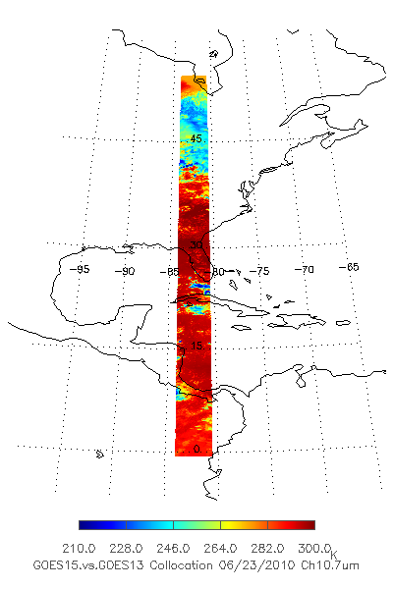
GEO-GEO Direct Inter-Comparison during GOES-15 PLT Period
GEO-GEO collocation
Spatial collocation
Temporal difference: < 5 minutes
Geometric alignment: viewing zenith angle difference < 1%
GOES 13: -75º
GOES-15: -89.5º
Yu

Slide 24
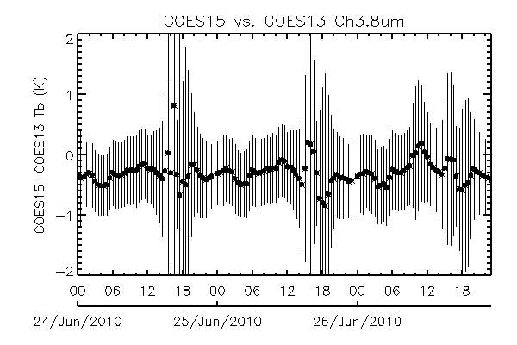
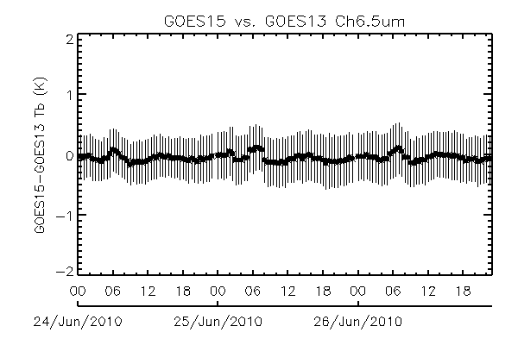
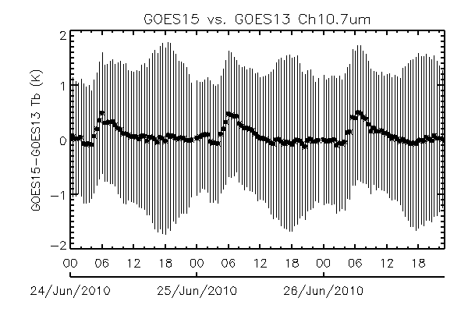
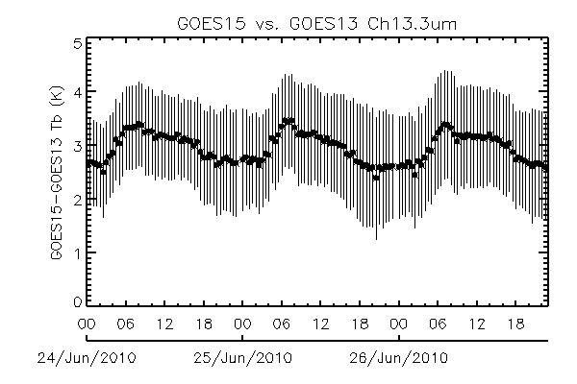
Direct GEO-GEO IR inter-comparison
No correction was made for SRF difference
Midnight
Midnight
BRDF
Midnight
Midnight
Yu
Note: the GEO-GEO inter-comparison was conducted before the SRF shifts for G15 Ch3 and Ch6

Slide 25
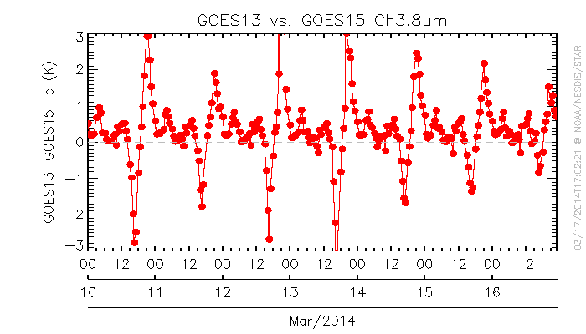
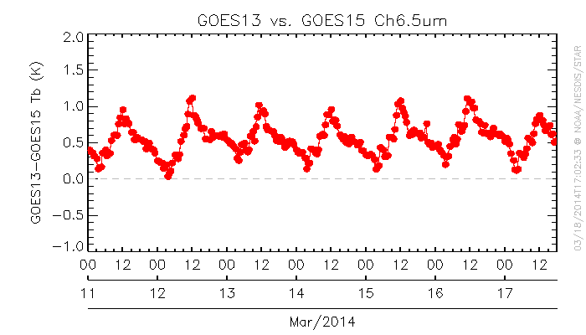
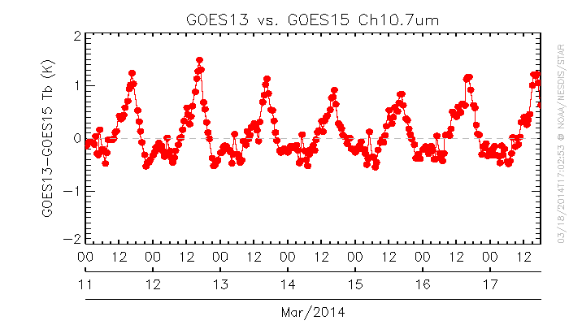
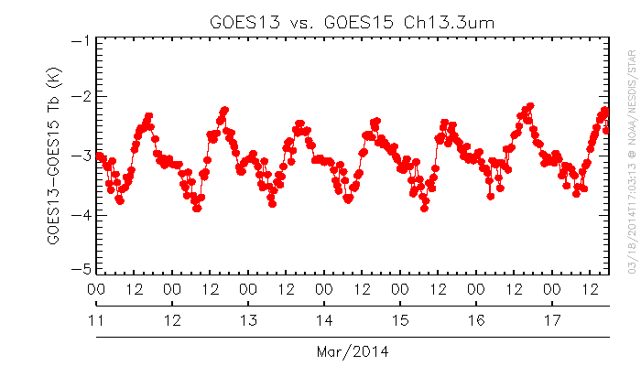
Direct GEO-GEO Inter-Comparison – radiance quality monitoring
Yu

Slide 26
What else
GEO Diurnal

Slide 27
Not Much
Best to improve the root cause correction
Little hope to improve predicting skills.
Had several thoughts in the past 10+ years.
Technically, cannot “retrieve” original data.
Program-wise, no priority / resources.
International collaboration with agency that
Are interested
Can extract original data

Slide 28
conclusion
GEO Diurnal

Slide 29
Conclusions
The issue of IR calibration of instrument on 3-axis stabilized geostationary satellite around satellite midnight is reasonably well understood.
Midnight Blackbody Calibration Correction (MBCC) has been implemented in several Imager-type instruments.
MBCC may be improved, however the lack of original data made it very difficult (if possible).
No mandate for NOAA to act further.
May be advanced via international collaboration.

