Slide 1
Document Management System
Manik Bali , Neal Kaske and Larry Flynn
GSICS Coordination Center, NOAA
GSICS Annual Meeting 2015, New Delhi

Slide 2
Outline
Introduction
Current status of GSICS Documents
Requirements for GSICS Documents
Possible Solutions
Option-1
Option-2
Templates for GSICS Documents
Conclusion

Slide 3
GSICS Introduction
GSICS Annual Meeting 2014 the health of GSICS Documents was discussed at length.
It was felt that documents prepared by GSICS member agencies
GSICS does not have a uniform policy to publish the documents and make it accessible free via web.
Documents do not follow a uniform template across agencies.
GCC identified this as an action item requiring investigation and it resulted in two actions
GCC shall provide a Document Management Plan (for example NOAAs) to the GDWG so that GSICS has a framework to publish documents.
GCC shall take a look at WMO/CGMS documents to prepare templates for GSICS documents and provide these to the GDWG for discussion.

Slide 4
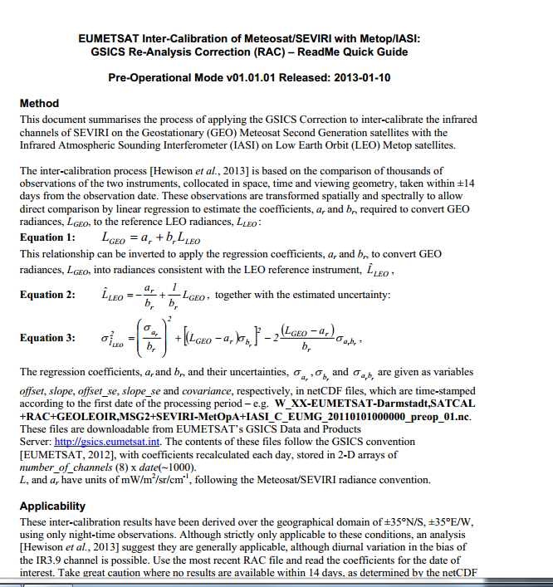
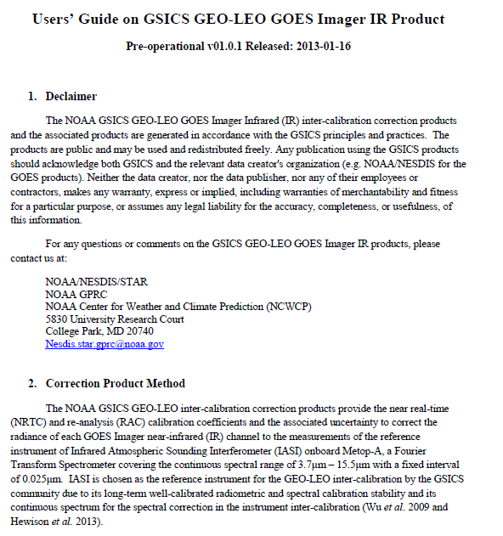
Current GSICS Product Documents Simple Example
Document publishing
EUMETSAT DOCS
NOAA DOCS
GSICS Needs
EUMETSAT NOAA

Slide 5
GSICS Requirements
Documents to be published ( we already do some)
Ability to work on versions simultaneously ( partly done by MS1 or GD)
Visible via the WWW ( already do some )
Discoverable through publishing catalogues such as worldcat/member sat agencies. ( not done )
Documents need to made using a common template (AI).
Documents assigned a doi /ISBN number.
Document has a landing page
…..More…..
Documents discoverable via a single catalog and prepared in a predictable template

Slide 6
Possible solutions ( @NOAA )
Option-1
Document is accepted into NOAA library catalog.
It becomes discoverable in the worldcat too
Document can be assigned
However issues such as copyright needs to be ironed out ( a letter from author can wave it off)
Author’s webpage can point to the catalog.

Slide 7
Option-2
ENDNOTE is a Document Management System. It has NOAA wide license
Neal can you fill in here the endnote features and how it compares with the NOAA Catalog options
Templates for GSICS Documents
Requested Templates from WMO. Evaluating templates from NOAA. Post them
on the server for comments

Slide 8
THANK YOU

Slide 9
Templates for GSICS Documents
Documents have to be classified. Is it an
ATBD
User Manuel, Uncertainty Document related to the Product
A GSICS baseline algorithm document or Traceability document
Any other

