Slide 1
Discussion Inter-Channel Calibration
X. Wu

Slide 2
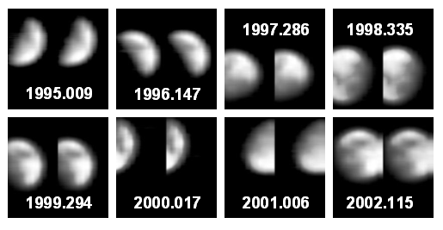
Inter-Channel – VNIR
Long history
Vermote et al (199x). AVHRR VIS & NIR.
Cao et al. (2009) Band ratio.
Padula et al. (2011) Hyperion lunar
Potential applications
Check for consistency
Transfer calibration, e.g., star.
Discouraged by the spectral dependence of lunar reflectance on phase angle and libration.
Alternative reference – DCC, desert, …?
AVHRR lunar observations in the space view can be used to study instrument response and lunar band ratio drifts for climate change detection Cao (2009)

Slide 3
Discussions
Fred presented previous work (previous slide). He noted that, though discouraged, the band ratio of lunar radiance over long term should still be stable, just noisier due to phase angle and libration. It remains to be seen whether this method is viable.
Tim stated that the inter-channel consistency can also be applied to IR, e. g., in relation to the Planck’s function.
Fred reported that his NOAA colleagues (A. Pearlman and R. Datla) detected reflected radiance from cold BB during ABI pre-launch test using an argument based on Planck’s function. Work is ongoing to verify on-orbit performance.

