Slide 1
Calibration information in OSCAR/Space and other OSCAR developments
Jérôme Lafeuille
(WMO Space Programme)

Slide 2
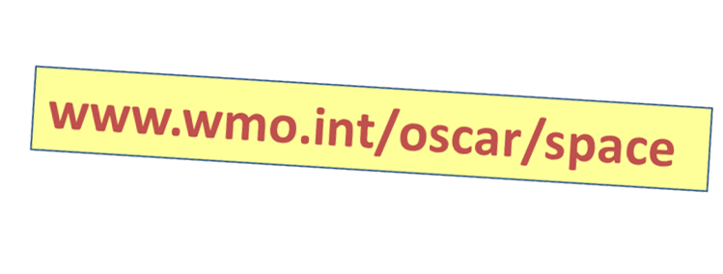
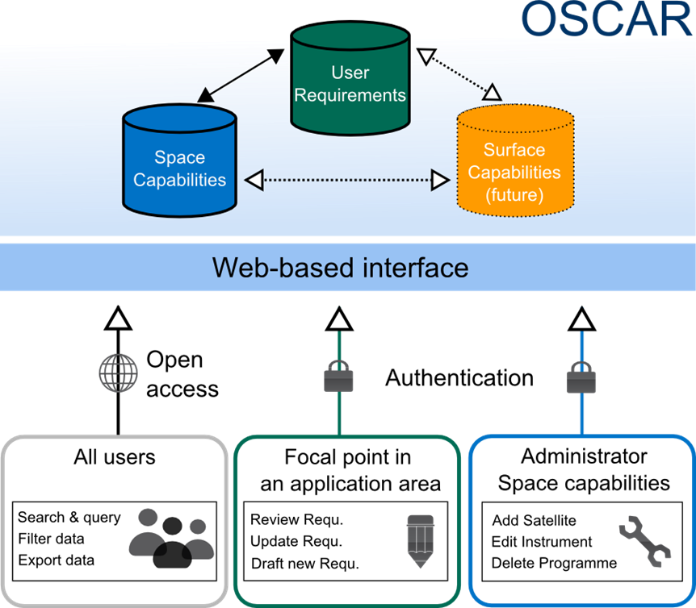

Slide 3
Two updates in OSCAR
Introducing calibration information
«Expert System» for instrument/variable mapping

Slide 4
Linking instrument records to calibration info
Not possible in OSCAR where instruments are considered in a generic sense
«IASI» rather than «IASI-A», «IASI-B»
Instruments are assumed available from satellite launch to satellite loss (not applicable to ISS instruments !)
OSCAR data model is being updated : individual instrument attributes can now be defined
Commissioning date (≠ satellite launch date)
Status (active, degraded, failed) and status history index
Data access information and link to data
Link to landing pages for calibration and detailed status
Allows more realistic «Gap analysis»
Accounting for instrument commissioning period, instrument failure

Slide 5
Updated version is now in test
Demo: http://www.wmo-sat.info/oscar-staging/
I would welcome feedback. Depending on feedback, update can be implemented this month
Please provide information (including Landing pages) to populate the new fields…
Please remember to inform WMO when any URL is changed

Slide 6
Two updates in OSCAR
Introducing calibration information
«Expert System» for instrument/variable mapping

Slide 7
Information in OSCAR/Space
Factual information
> 600 satellites for Earth observation or space weather
> 800 instruments (including ~ 260 for space weather)
Regularly updated based on input from space agencies
Expert assessments
Mapping of instruments with variables with rating of degree of relevance (1 to 5)
Mapping with target capabilities defined by WMO with rating (1 to 5)
Notes:
Inventory of factual information ,
The responsibilty for Maintenance of this part is with the WMO Space Programme

Slide 8
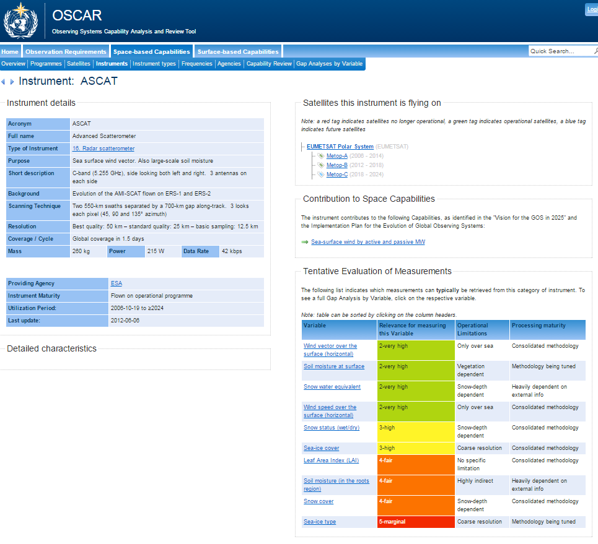
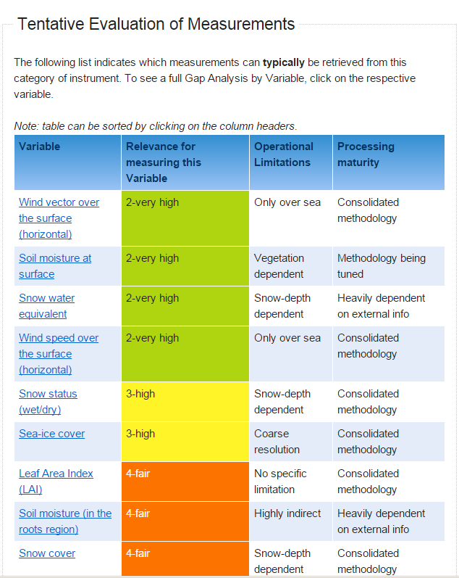
Instrument view

Slide 9
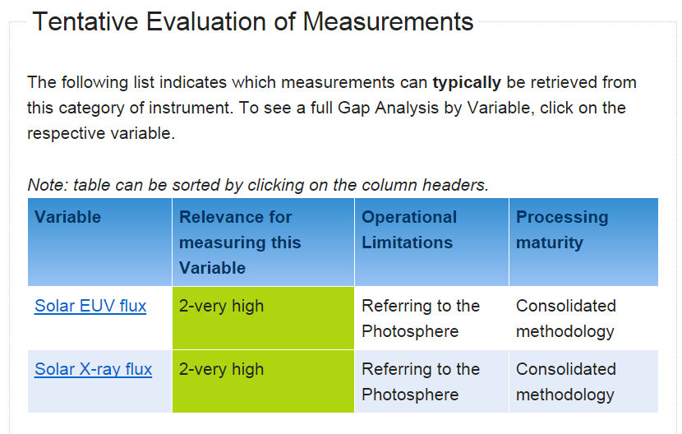

Slide 10
Measurement Timeline for Solar EUV flux

Slide 11
Expert assessment is needed to map instruments to variables
From an instrument: which variables can I derive?
For a given variable: which instruments can I use? Essential to perform a gap analysis
The answers are not trivial !
Instrument-variable is not a one-to-one relationship
Various degrees of relevance
Different users may have different views (requirements depending on applications)

Slide 12
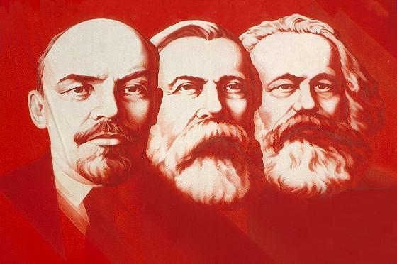
Abolishing the classes… for an expert system
Current approach
Instruments are clustered in classes of similar design and performances
The relevant variables are linked «manually» to each class based on an implicit scientific rationale
Excellent results for Earth Observation instruments ( ̴600 instruments, ̴200 classes)
Unpractical for Space Weather instruments (too diverse).
Heavy to manage when the number of classes increases
The new approach is based on the application of expert rules to each instrument
Facilitates scientific maintenance: Rules are independent of the software itself
Transparency: the rules can be displayed and submitted to external reviews
Enables collaborative improvement of the knowledge basis

Slide 13
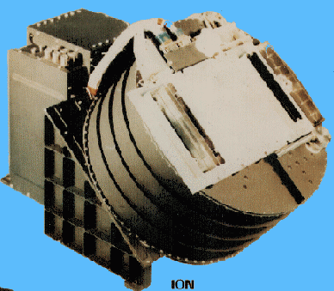
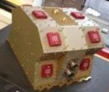
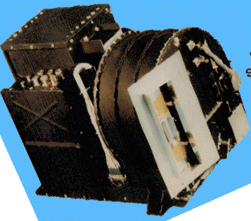
Instrument-variable mapping principle
Variable 1
Variable 2
Variable 3
Variable 4
Rules
Variable x
Design features e.g:
Spectral bands
Bandwidth
No of channels
Polarization
Etc..
Variable y
XX
X
X
X
XX
X
X
X
X
XX
X
X
X
X
XX
X
X
X
X
X
XX
X
X
X
XX
X

Slide 14
Examples of rules
For this Variable | With this type of instrument | If the following conditions are true | Then the relevance is
Sea Surface Temperature | Microwave Radiometer | >=2 two-polarisations frequencies in 4-8 GHz >=1 multi-polarisation frequency in 8-12 GHz | Very good
Atmospheric temperature | Radio-occultation | Receiver for >=3 GNSS constellations has 2 antennas (fore/aft) | Very good
High energy Electron flux density energy spectrum | Particle detector | Detects electrons, in 300 keV - 8 MeV range, over 2π solid angle, energy resolution <10%, angular resolution <20% Time resolution < 10 s | Excellent
Solar wind velocity | Particle detector | Detects protons, in 0-10 keV, Over 2π solid angle, sun pointing Energy spectral resolution <10% Angular resolution <0.2π sr Time resolution <10 s | Excellent

Slide 15
Proof of concept
The mapping of instrument classes to variables has been translated into a set of expert rules (~ 1800 rules)
The ~ 600 EO instruments have been assessed
Proof of concept in EXCEL
To demonstrate the approach
To validate initial rules and instrument properties
To refine the rules
To support the specification of software development for integration into OSCAR (e.g. editor interface) Test version expected to be available in 2015

Slide 16
Expected benefits
Will enable engaging expert groups to review the rules related to their fields of competence
Potential improvement, better understanding and shared ownership
Increase the value of OSCAR/Space as reference tool for RRR and to support studies and applications
Interactive Capability Exploration could be developed
Search function based on instrument properties and similar rules
Possible training tool
working on the rules for a variable, virtual instruments…

Slide 17
Thank you for your attention! Please visit: www.wmo.int/oscar Your feedback is welcome jlafeuille@wmo.int
www.wmo.int

Slide 18
Next steps (proposal)
Scientific aspects
Complete the validation/adjustment of EO instrument rules
Develop properties and rules for space weather
Software aspects
Optimize the representation of properties
User interface for Interactive Capability Exploration
Interface for edition of rules and properties
Implement in a beta-testing version (OSCAR-2.0)
User uptake
Promote the experimental version to science groups
Investigate partnership with training entity (COMET ?)
Make a decision on what should be public/restricted material
Replace OSCAR by OSCAR 2.0

