Slide 1
Comments on Template & Document Management System for GSICS
Manik Bali and Larry Flynn
GSICS Coordination Center, NOAA
GSICS

Slide 2
Outline
Introduction
Current status of GSICS Documents
Requirements for GSICS Documents
Comments on WMO - Templates
Possible Solutions for Document Management
Option-1
Option-2
Conclusion

Slide 3
GSICS Introduction
GSICS Annual Meeting 2014 the health of GSICS Documents was discussed at length.
It was felt that
GSICS does not have a uniform policy to publish the documents and make it accessible free via web.
Documents do not follow a uniform template across agencies.
GCC identified this as an action item requiring investigation and it resulted in two actions
GCC shall provide a Document Management Plan (for example NOAAs) to the GDWG so that GSICS has a framework to publish documents.
GCC shall take a look at WMO/CGMS documents to prepare templates for GSICS documents and provide these to the GDWG for discussion.
Following the annual meeting in Delhi, Jerome (WMO) has created document template for GSICS that are under discussion.
Critical need to have a Document Management System ( either at WMO or at GCC) to manage the documents and publish them

Slide 4
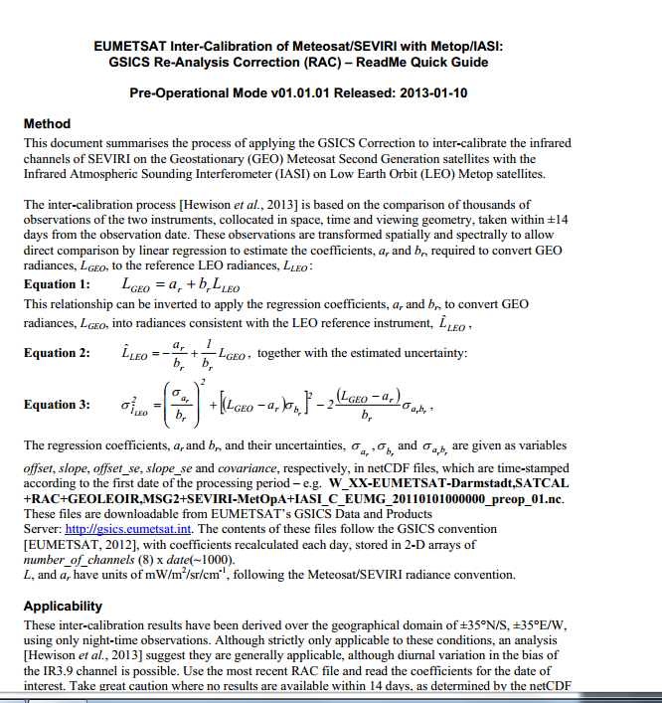
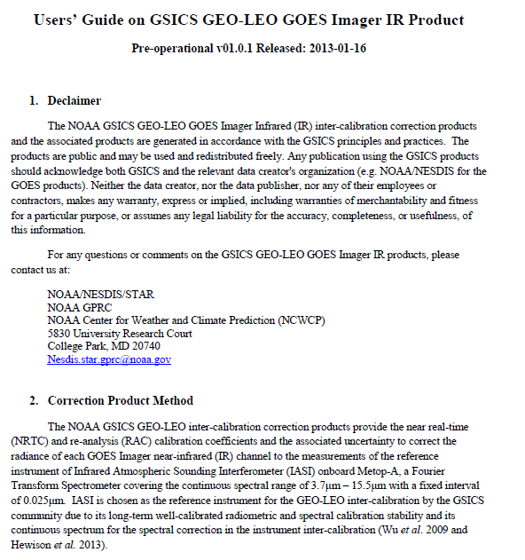
Current GSICS Product Documents Simple Example
Document publishing
EUMETSAT DOCS
NOAA DOCS
EUMETSAT NOAA

Slide 5
GSICS Requirements
Documents to be published ( we already do some)
Ability to work on versions simultaneously ( partly done by MS1 or GD)
Visible via the WWW ( already some do)
Discoverable through publishing catalogues such as worldcat/member sat agencies. ( not done )
Documents need to made using a common template (AI, Jerome seeking to do).
Documents assigned a doi /ISBN number.
Document has a landing page
…..More…..
Documents discoverable via a single catalog and prepared in a predictable template

Slide 6
More requirements since GSICS is an element of WIGOS
The new Manual on WIGOS requires calibration along GSICS standards
WIGOS/OSCAR will contain links to GSICS calibration information
GSICS scope, activity and structure need to be formally documented could ultimately be referred to in a WIGOS Architecture Document
A Guide to GSICS Products is needed and would be referred to the future Guide to WIGOS
GSICS should be articulated with User Requirements
Reference measurement standards (in orbit and on ground) should be in the Vision of WIGOS Space-based Component in 2040
GSICS should contribute as a building block of the Architecture for Climate Monitoring from Space promoted by WMO, CEOS and CGMS
Slide curtesey Jerome presentation
Annual Meeting in Delhi
In response Jerome has suggested templates.

Slide 7
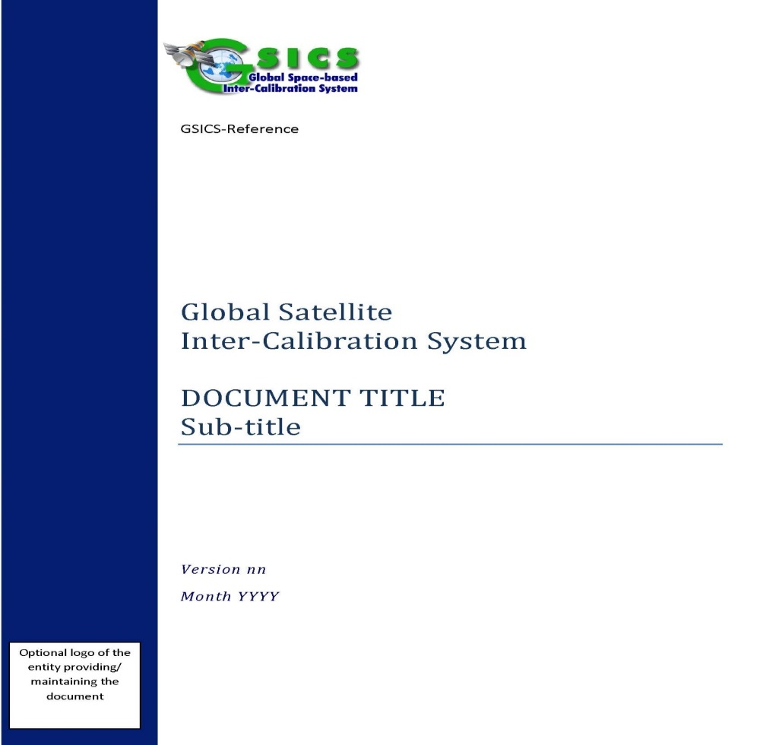
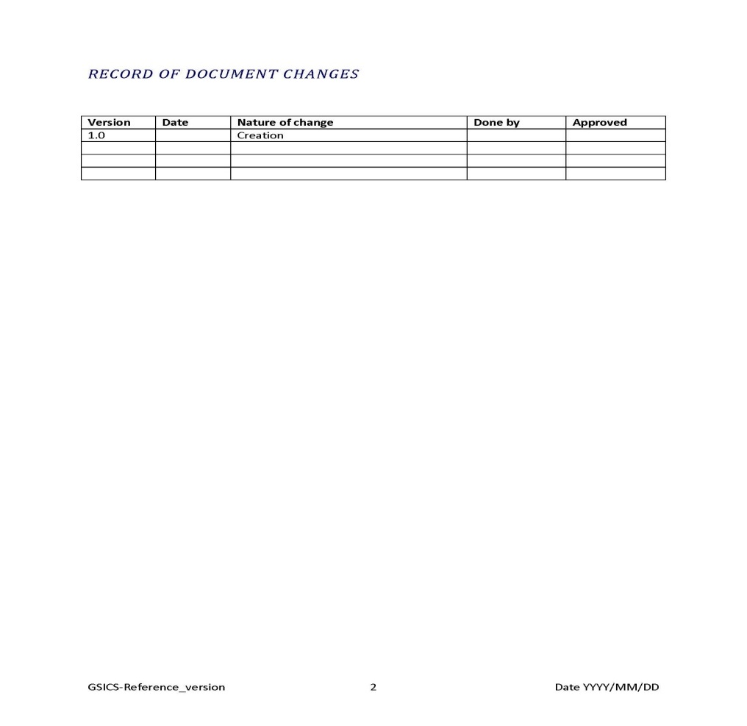
Proposed document template

Slide 8
Comments on WMO Templates
GSICS-User Requirement Document ( URD)
Comments
Who can create a requirement? Who is responsible for collecting them? How is a requirement reasonableness or cost/benefit evaluated? Some desired performance may be practically impossible to achieve while others are just very expensive.
Who is responsible for providing a product to meet the requirement or are the requirements only on existing products?
Larry’s Email

Slide 9
Comments on WMO Templates
GSICS-User Guide
The GSICS Coordination Centre (GCC) coordinates the definition of GSICS products and services, it maintains a repository of GSICS practices, procedures and tools, it coordinates the acceptance procedure of new products and coordinates the exchange of information with the user community.
Comments
Maturity of the User Guide is achieved in the GPPA
Recently Tim Hewison provided a format of User guide to the GCC for review and GCC has accepted it with minor suggestions.
Larry’s Email

Slide 10
Comments on WMO Templates
Maturity of the templates is an iterative process and there are no show stoppers.
We need feedback from users of these templates .
Suggestion: KMA is currently making their product, it might be usefull to give them the template of User Guide to fill out.
We can get a feedback from them how easy/difficult it is to fill the info they want. Alignment with GPPA could also be tested then.
Larry’s Email
Higher maturity of templates can be achieved after we put them up for use and request feedback from users.

Slide 11
Documents Management System
Would WMO should be book keeping/archiving the GSICS documents ?
Should the responsibility be given to NOAA( upon EP’s direction ) NOAA has a DMS framework ( still need to figure out operational mechanism and resources )

Slide 12
Possible solutions ( @NOAA )
Option-1
Document is accepted into NOAA library catalog.
It becomes discoverable in the worldcat too.
Document can be assigned .
However issues such as copyright needs to be ironed out ( a letter from author can wave it off).
Author’s webpage can point to the catalog.
Library can assign doi for the document.
Option-2
ENDNOTE is a Document Management System, however need to work on licensing and accessibility outside NOAA.
Allows global edits

Slide 13
Conclusions
WMO has presented excellent set of templates for GSICS
This will help harmonize GSICS work with contemporary organizations and within GSICS in the times to come.
No showstoppers, but need feedback from users.
A DMS on the lines implemented at NOAA has been suggested.

Slide 14
THANK YOU

Slide 15
Templates for GSICS Documents
Documents have to be classified. Is it an
ATBD
User Manuel, Uncertainty Document related to the Product
A GSICS baseline algorithm document or Traceability document
Any other

