Slide 1
Report from the GSICS Research Working group (GRWG)
Special Issue of the IEEE TGRS on “Inter-Calibration of Satellite Instruments”:
Special Issue of the IEEE TGRS on “Inter-Calibration of Satellite Instruments”:
Tim Hewison
(EUMETSAT) (GRWG Chair)

Slide 2
Overview
Highlights of 2015 Annual Meeting
Other progress in 2014/15
Issues for Executive Panel & GSICS Users
Potential Future GSICS Deliverables
GRWG Chair & Vice-chair
2016 Annual meeting
Issues for GSICS Users

Slide 3
Overview of Agenda or 2015 GRWG/GDWG Annual Meeting
Monday: Opening Ceremony + Mini Conference
Tuesday: Chairs’ + Agency Reports + Briefings
Wednesday: GRWG: VIS/NIR: DCC + Lunar
Wednesday: GDWG
Thursday: GRWG: IR (nb no UV or MW this time)
Thursday: GDWG
Friday am: GRWG + GDWG
Friday pm: Wrap-up (Plenary)
All presentations online on GSICS Wiki

Slide 4
Selected Highlights
Opening/Closing Ceremonies
Definition of GSICS Deliverables
Inter-Calibration Product Development for Geostationary Imagers
Globalisation of GSICS
Cultural Tour
Full draft minutes available in Word Online

Slide 5
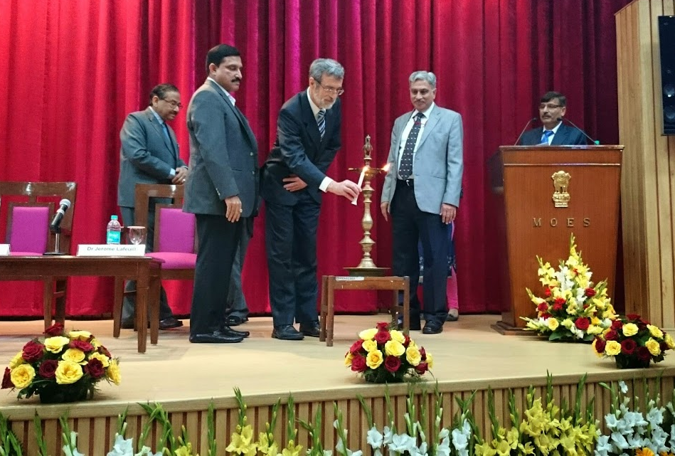

Slide 6
Definition of GSICS Deliverables
Agreed on terminology:
GSICS Deliverables include GSICS Products, Tools, Algorithms and Documents:
GSICS Tools for use by inter-calibration developers, (GIRO, SBAF, …)
GSICS Products for users of satellite data, including calibration corrections/coefficients
GSICS Algorithms, which describe inter-calibration processes, (described by ATBD)
GSICS Documents, including Guidelines, Reports, …
GSICS Recommended Standards, including Solar spectrum, …
See Jerome’s presentation for more details

Slide 7
Requirements for generating FCDRs
Rob provided a preliminary review of the inter-calibration requirements for various climate application project
Action: EUMETSAT to circulate Rob’s review of FCDR inter-calibration requirements to GRWG/GDWG,
identifying which type of inter-calibration product could meet each of these.
Action: GCC to review these FCDR inter-calibration requirements
in the framework of the GSICS User Product Guidance, to identify where common inter-calibration types, which are not specialised to specific applications, and report to GRWG. These could be considered as potential future GSICS products.

Slide 8
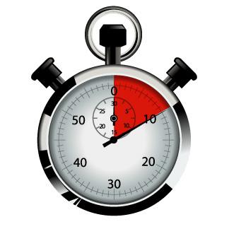
Routine Generation of GSICS Products
Decision: GSICS should aim to provide users with the most recent available calibration data
at the highest available update frequency,
allow users to decide how to apply it for their applications.
For example:
users interested in trends may not want artificial jumps in the calibration time series, which could be avoided by applying frequent calibration updates
near-time applications may want to minimise additional calibration noise by using the most accurate, stable calibration.
Action: Tim to propose this approach (issuing frequent GSICS corrections) to the Exec Panel and Users Workshop.

Slide 9
Inter-Calibration Product Development for Geostationary Imagers
In 2015 we will have GSICS Corrections for all IR channels of current geostationary imagers
(excluding ROSHYDROMET)
Started planning impact assessments
In 2015 we will have first GSICS Corrections for VIS channels of some current geostationary imagers
Based on Deep Convective Clouds
Developing lunar inter-calibration algorithm
Will combine results from both methods

Slide 10
Making GEO-LEO IR Operational
Action: Tim to cooperate with the GDWG to develop a version control document [Closed]
Action: Manik Bali to review User Guide for SEVIRI-IASI products [Closed]
Action: EUMETSAT to update the GEO-LEO IR ATBD and operational implementation to inflate the coefficient uncertainties to obtain consistency with time series estimates of the random component.
Recommendation: all GPRCs to consider the update of the GEO-LEO IR ATBD in their uncertainty assessment following the EUMETSAT example of adjusting uncertainty estimates to obtain consistency with time series statistics.

Slide 11
Uncertainty Analysis
Hewison, T. J., 2013: An Evaluation of the Uncertainty of the GSICS SEVIRI-IASI Inter-Calibration Products", IEEE Trans. Geosci. Remote Sens., vol. 51, no. 3, Mar. 2013,doi:10.1109/TGRS.2012.2236330.
Type B Uncertainty analysis
Review of “all” process introducing random & systematic uncertainties to final corrected radiances
Based on Demonstration products
Validated with Type A analysis of random components (day-to-day variations):
Random components underestimated by 2-4x

Slide 12
Updated Analysis
Re-did analysis of the uncertainties on the PreOp dataset, using a new method
Variogram, sampling at 29d intervals
But with the same conclusions:
Uncertainty coefficients in GSICS Corrections underestimate random by a factor of ~2-4.

Slide 13
Updated Error Budget
Table 1 Summary Statistics of Pre-Operational GSICS Re-Analysis Correction for Meteosat-9/SEVIRI in Full Disc Scanning in the period 2011-06-01/2012-11-01 (All Uncertainties are k=1)
Meteosat/ SEVIRI Channel IR | 3.9 | 6.2 | 7.3 | 8.7 | 9.7 | 10.8 | 12.0 | 13.4 | mm
Standard Scene Radiance (as Tb) | 284 | 236 | 255 | 284 | 261 | 286 | 285 | 267 | K
Mean Bias (SEVIRI-IASI) for Standard Tb | -0.02 | -0.12 | +0.15 | +0.03 | -0.02 | +0.04 | +0.03 | -1.91 | K
Standard Deviation of Bias for Standard Tb | 0.07 | 0.04 | 0.03 | 0.04 | 0.06 | 0.02 | 0.03 | 1.78 | K
Median Uncertainty of Bias for Standard Tb | 0.01 | 0.01 | 0.01 | 0.01 | 0.01 | 0.01 | 0.01 | 0.01 | K
Random Uncertainty estimated from Bias variograms over 29d* | 0.05 | 0.02 | 0.03 | 0.04 | 0.06 | 0.02 | 0.02 | 0.04 | K
Total Systematic Uncertainty from [Hewison, 2013] | 0.008 | 0.003 | 0.002 | 0.002 | 0.002 | 0.003 | 0.003 | 0.004 | K
*Calculated as RMSD(29d RAC)/sqrt(2)

Slide 14
New Prime GSICS Corrections
Define one Primary GSICS Reference
For each spectral band/application
By consensus agreement within GSICS
Use others as Transfer References
Blend corrections from all references
After modifying Corrections to Primary GSICS Reference
Ensures long-term continuity
Without calibration jumps
Ensures Traceability
back to single Primary Reference
Simplifies users’ implementation
Could also blend multiple methods?

Slide 15
Correcting the Corrections and Blending References
Reference-1 (Primary)
Monitored Instrument
Reference-2
(Secondary)
GSICS Correction, g₁ Mon➔1
GSICS Correction, g₂ Mon➔2
-
Derived by GSICS
Delta
Correction, g_{1/2}
2➔1
+
Modified
Correction, g_{2,1/2}
Mon ➔2➔1
g̅
Prime GSICS Correction, g₀ Mon➔1
Mon➔Ref1
Applied
by User

Slide 16
Users’ Application of Prime GSICS Correction
Monitored Instrument
Prime GSICS Correction, g₀ Mon➔1
Mon➔Ref1

Slide 17
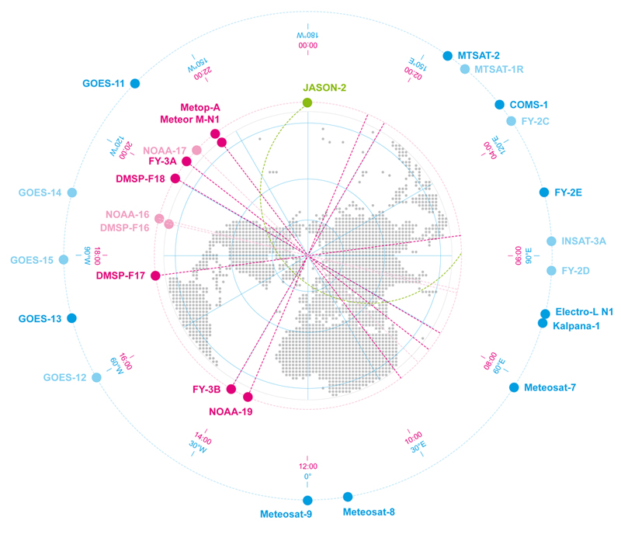
Linking the GEO ring
Schematic Example of GEO and LEO Earth Observing Satellite
Showing GEO sub-satellite longitude and equator crossing time for sun-synchronous LEO satellites

Slide 18
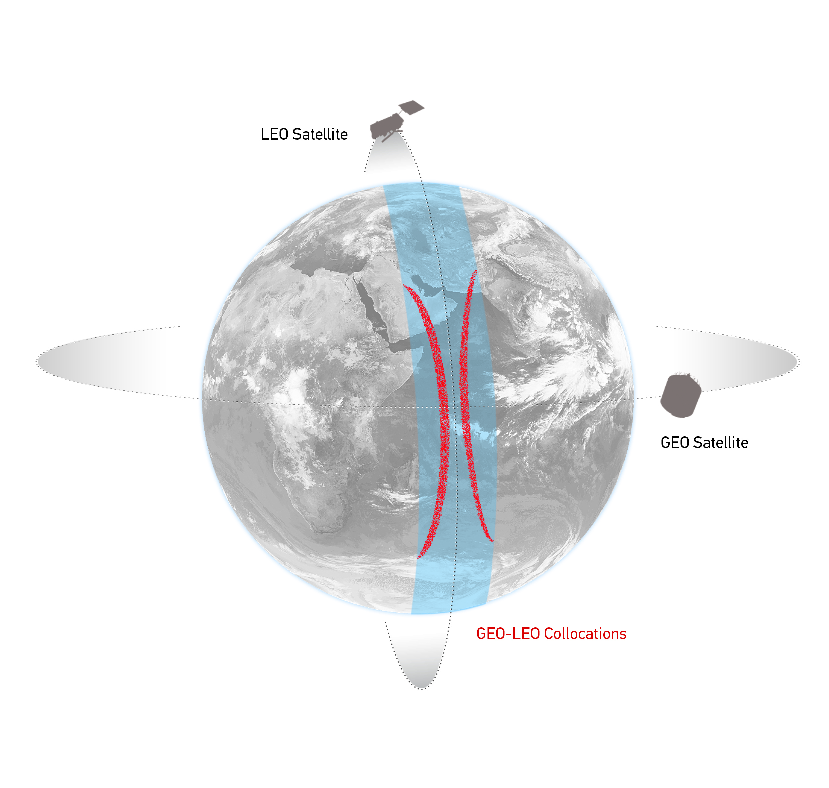
GEO-LEO IR - Hyperspectral SNO
Simultaneous near-Nadir Overpasses
of GEO imager and LEO sounder
Select Collocations
Spatial, temporal and geometric thresholds
Schematic illustration of the geostationary orbit (GEO) and polar low Earth orbit (LEO) satellites and distribution of their collocated observations.

Slide 19
Linking the GEO ring
GSICS Corrections for GEO-LEO IR
All using Metop/IASI as hyperspectral references
Solid lines = Pre-Operational
Dashed lines = Demonstration
Dotted lines = Prototype

Slide 20
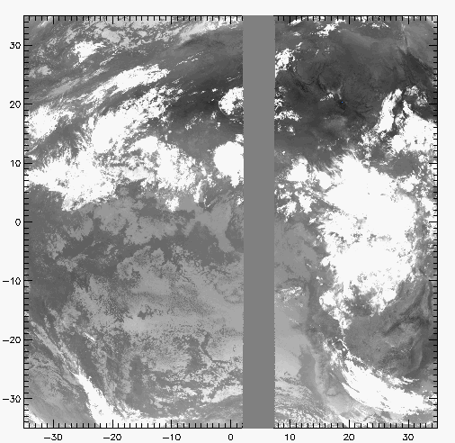
GEO-GEO IR – Broadband SNO
Simultaneous near-Nadir Overpasses
of GEO imager pairs
Select Collocations
Spatial, temporal and geometric thresholds
Narrow longitudinal strip of collocations
Allows continuous comparisons 24/7
Investigate midnight calibration problems
Non-identical Spectral Responses
Need Spectral Band Adjustment Factor
Based on IASI observations
Or reference profiles + RTMs
Example Image of Meteosat-9 10.8μm Channel Grey area shows collocated MSG2-MSG1 pixels

Slide 21
Linking the GEO ring
GEO-GEO Comparisons
Based on collocated observations
GEO imager pairs
Need SBAFs

Slide 22
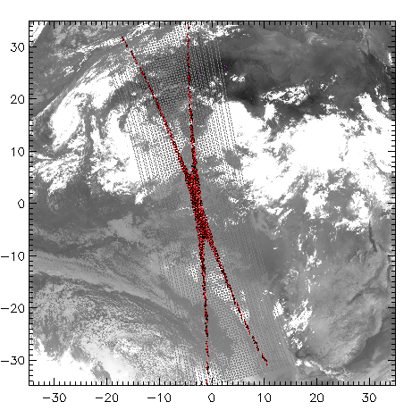
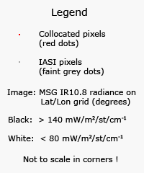
Collocation Criteria
Simultaneous near-Nadir Overpasses
Only night-time data ΔLat<35° ΔLon<35° Δt< 5 min Δsecθ < 0.01
GEO-LEO
GEO-GEO
Restricted to ~tropics
~1000 collocations/orbit/night
Restricted to narrow strip
Can extend to cover 24hr
Example Image of Meteosat-9 10.8μm Channel Red points show collocated MSG-IASI pixels
Example Image of Meteosat-9 10.8μm Channel Grey area shows collocated MSG2-MSG1 pixels

Slide 23
Linking the GEO ring
Comparing GEO-LEO and GEO-GEO Differences
To Validate Uncertainty estimates
Ensure consistency
Generate global L2 products
Ensure consistency

Slide 24
Strategy for closing the GEO Ring
First step: Identify one date which is common to all GEOs
(without stray light or midnight effect)
Second step: to investigate the GEO-GEO comparison across the GEO ring.
Rob mentioned that the climate community would test the result of this work.
Action: Tim to ask ECMWF for double differencing of geostationary ring.
Action: IMD/ISRO to contact the IMD NWP and NCMRWF about the same topic.
Action: Tim to conduct a survey to identify a date among GPRC so that they produce the GSICS corrections for that date and provide them to Dave.
Dave suggests taking 0/3/ 6/9 GMT for that date.
Action: Dave to report on the analysis of these data.
Action: Tim to provide SBAF tool to support this analysis
CMA are interested to compare the FY-2 observations to other instruments.

Slide 25
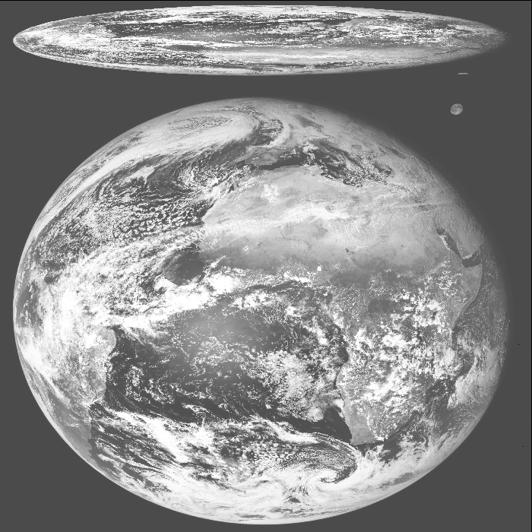
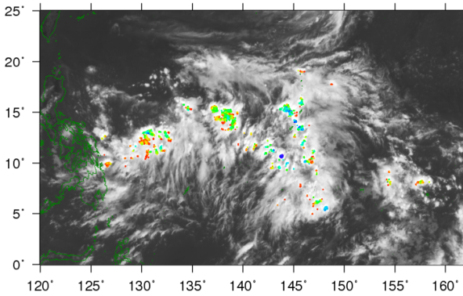
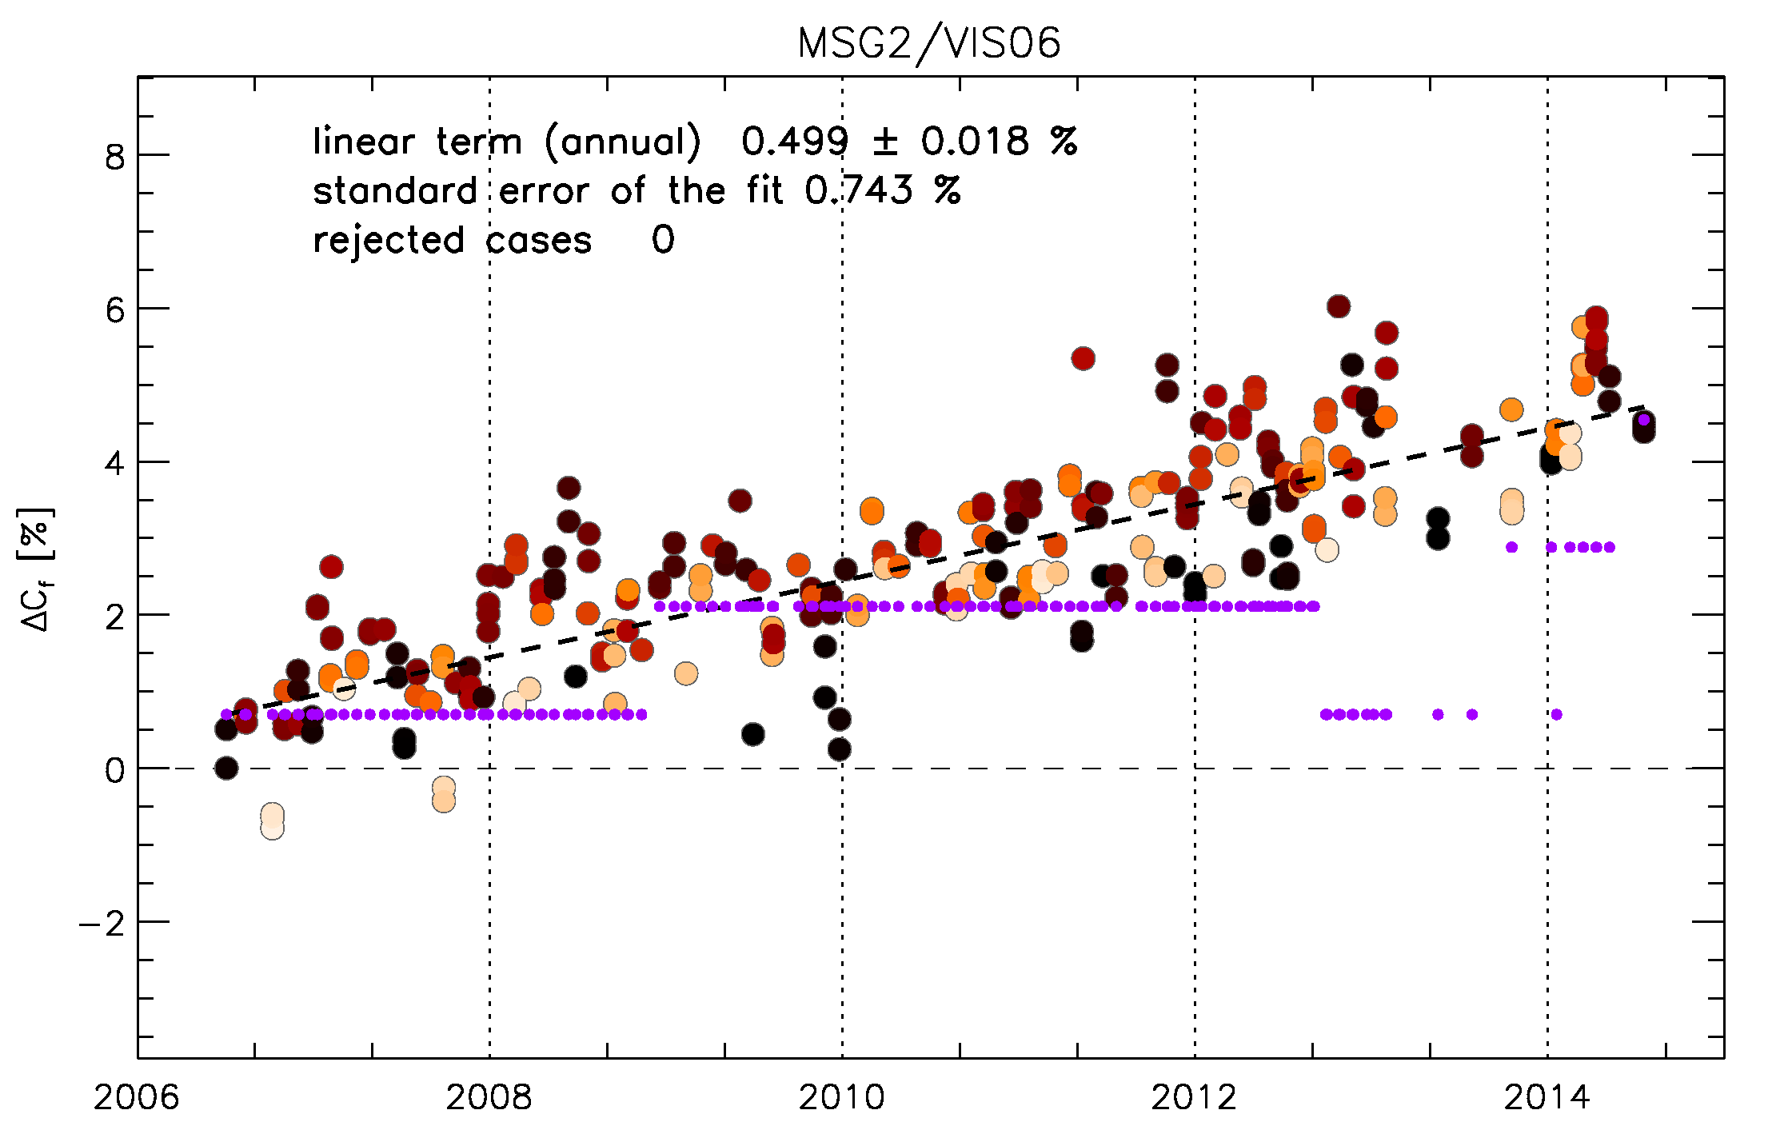
GEO-LEO VIS/NIR
Currently two main activities on-going:
Inter-calibration of GEO imagers with MODIS using Deep Convective Clouds as transfer target
Lunar calibration and using the Moon for inter-calibration.
SEVIRI L1.0 image
MTSAT-2 DCC detection 2012-07-01T04
10.8μm TB [K]
Meteosat-9/VIS06 Bias Change
wrt ROLO Model Lunar Irradiance
(after phase angle correction)

Slide 26
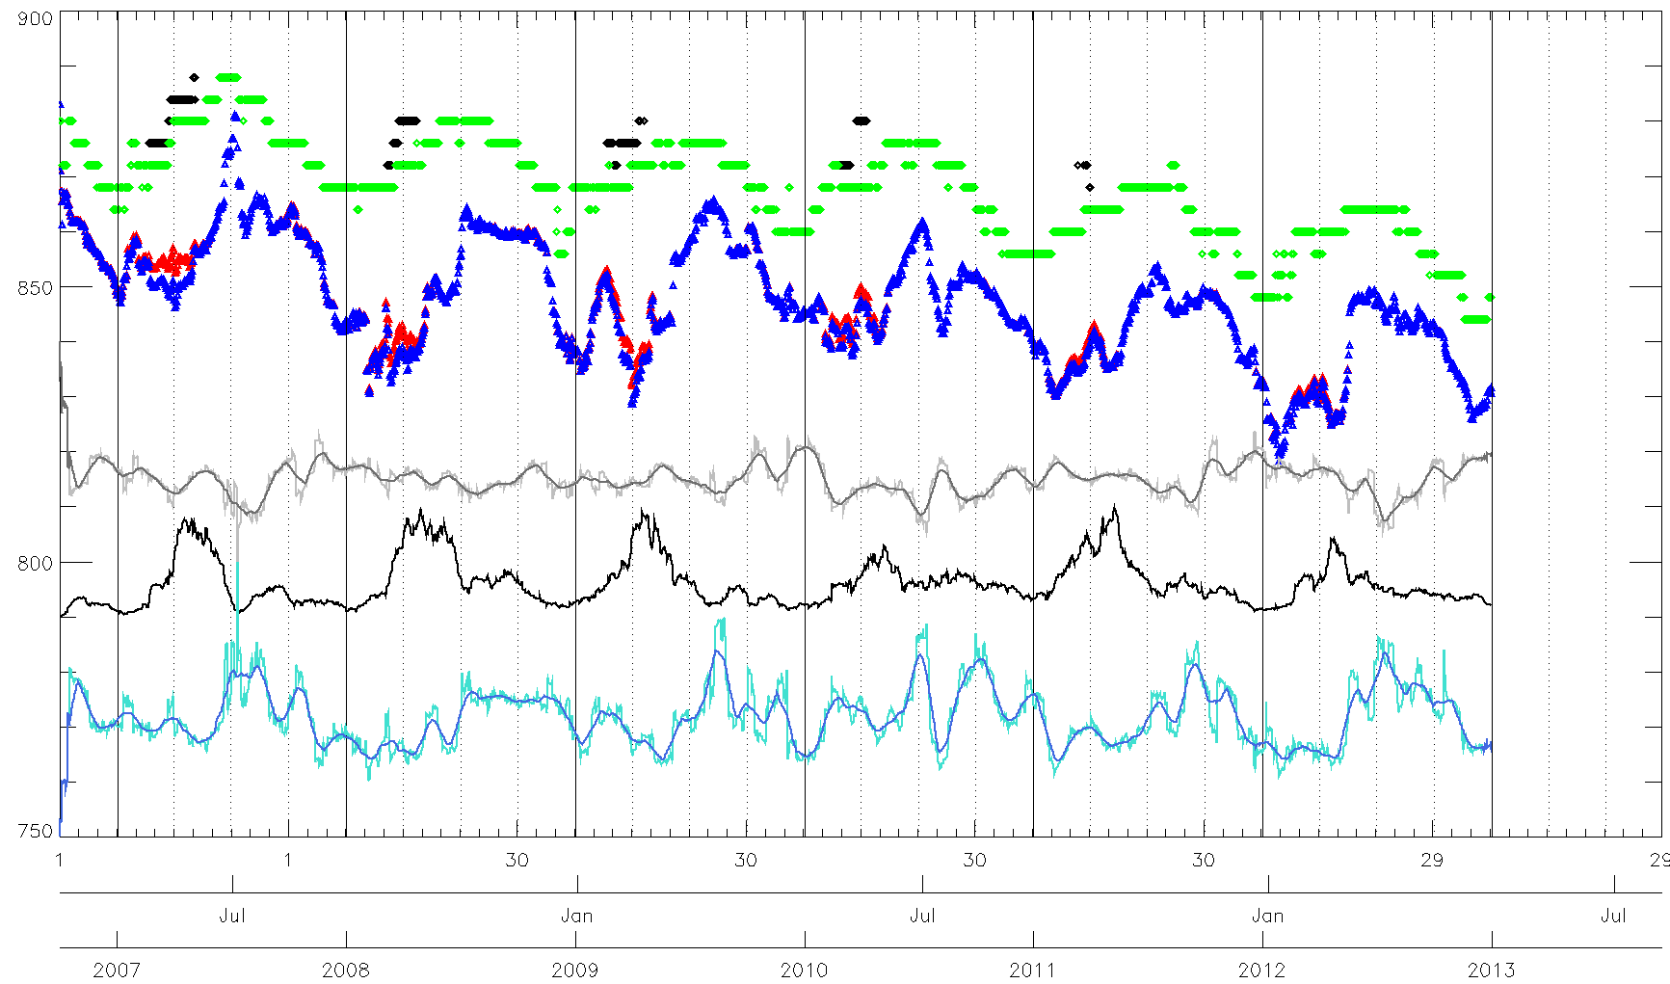
DCCs
MODE
NRTC – 30 days
SKEWNESS + smoothed over 30 days
MODE – No saturation
Number of DCCs
MEAN
MEAN – No saturation
K-K0
KURTOSIS + smoothed over 30 days

Slide 27
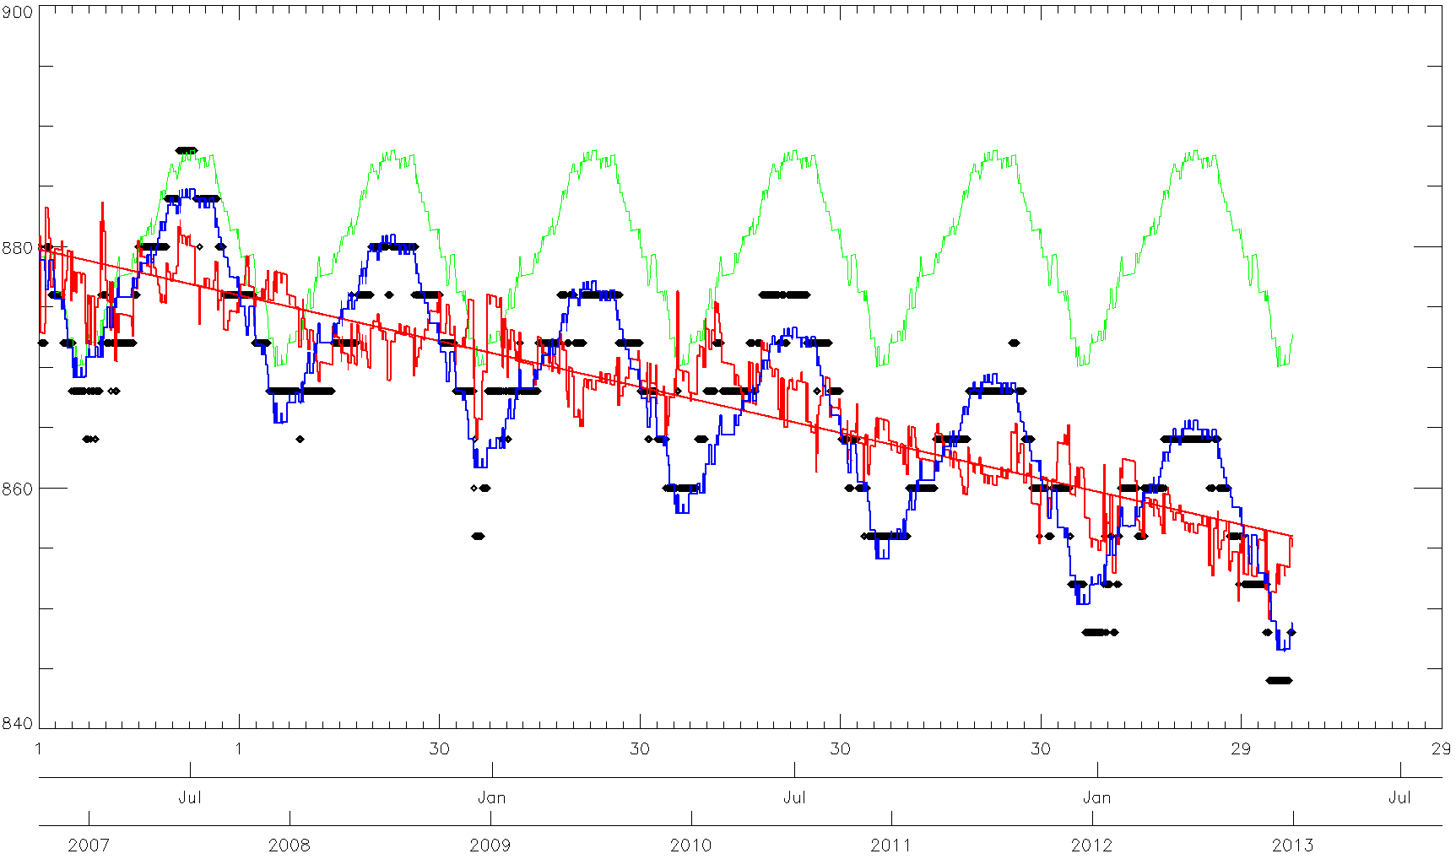
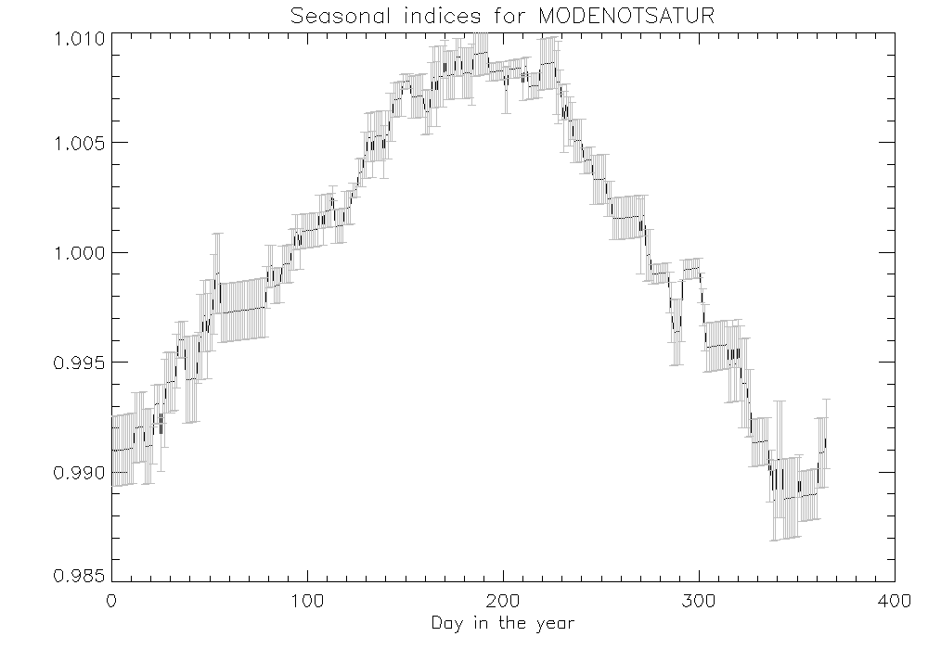
DCCs
Seasonality affects differently GEO imagers (amplitude, periodicity, presence of a seasonal signal, etc.) ➔ Various methods to address it:
EUMETSAT: approach based on estimating seasonal factors + choice of a model ➔ Multiplicative: Seasonalized = Deseasonalized * Seasonal factors
NOAA: seasonal cycle removed using a prediction model
CMA: will implement EUMETSAT approach (with a different smooth approach, based on a Gaussian filter)

Slide 28
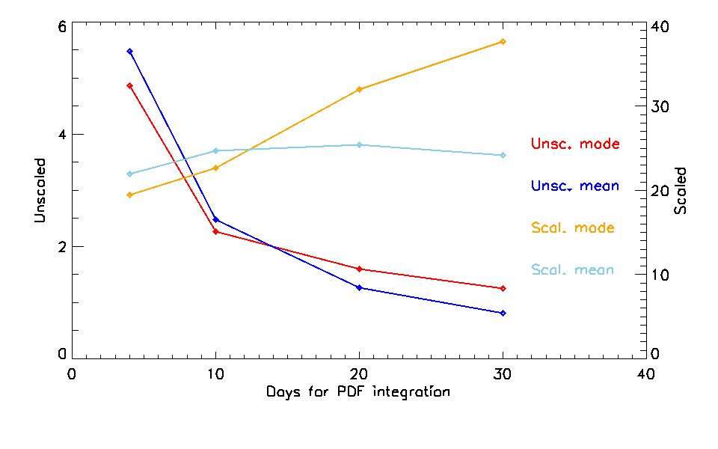
DCCs
Update frequency ➔ Different purposes = Quick jump detection in time series / reducing noise (climate application)
Impact on the definition of a VIS/NIR GSICS product as noise reduction implies further processing
Further testing on deseasonalisation methods (EUMETSAT/NOAA/CMA)
For consistency, similar processing to the reference ➔ Can be tested by EUMETSAT on MODIS reference data set
Preparation of a demo product for 2015 for VIS06 and NIR16 (?)
What about VIS08? MODIS saturates!
Alternative = VIIRS
Needs for defining a method to move from Aqua MODIS to NPP VIIRS (similarly to the IR) ➔ Action on NASA

Slide 29
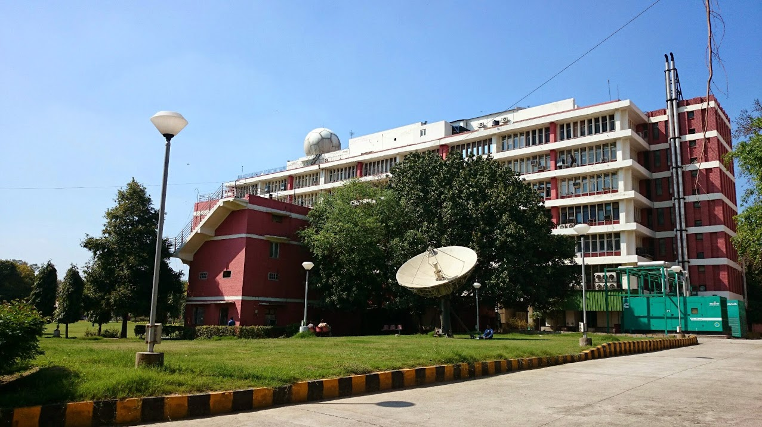
Technical Tour of IMD Satellite Centre

Slide 30
Lunar Calibration
ISRO, JMA and KMA presented updated results using GIRO.
Very large amount of Himawari-8 acquisitions ➔ Useful for preparing MTG/FCI
Main discussions:
GIRO and GLOD policy + infrastructure set-up ➔ need another iteration to take comments and suggestions on board. Deadline = May 2015
Moving towards inter-calibration (using Aqua MODIS / NPP VIIRS as references)
Uncertainty analysis still to be addressed

Slide 31
Lunar Inter-Calibration
A plan was presented with the list of actions to be addresses:
Estimating the over-sampling factor
Drift correction
Accounting for spectral differences between instruments
Establishing an absolute scale for lunar calibration
(Medium and long term activities on lunar calibration)
EUMETSAT will commit to all of them (E. is for the moment addressed only by an action on SWG to identify user requirements).
Spectral differences between instruments: validation of the estimates derived from GIRO, using hyper-spectral instruments with Moon observations (GOME-2, Hyperion, SCIAMACHY)
➔ Some activities covered by an external study

Slide 32
Potential Future GSICS Deliverables
Decision(?): Retrieved SRFs could be considered as a GSICS Product, if they are derived on an ongoing basis, as a result of inter-calibration. However, it was recognised that adjustments can be made during commissioning as a result of GSICS algorithms and it would be difficult to review these through the GPPA on a useful timescale.
Recommendation: The PIs of inter-calibration algorithms are encouraged to attend the annual GRWG/GDWG meeting.
Action: GRWG Chair to add a meeting on NWP in the agenda of the next GSICS web meetings in 2015/2016.
Actions: NASA to investigate the use of MIIC to generate data for near-real-time processing of DCC using VIIRS and potential to transfer the MIIC technology to other data centres.

Slide 33
Strategy for Calibration References

Slide 34
Reference Instrument Selection/Migration
GSICS products need an inter-calibration reference
Inter-calibration → Reference is one instrument
Other instruments may be used as transfer references
We need a way to select the reference
From a list of candidates
First question should be: “Is it suitable at all?”
Does it meet minimum threshold requirements (availability, coverage, ...)
Started asking “How good is it as a Reference?”
Impact on overall uncertainty
Score scheme

Slide 35
Example for SEVIRI-IASI IR
Scoring Scheme for GSICS Re-Analysis Correction for SEVIRI IR Channels
 |  | Threshold |  | Saturation |  |  | MetopA/IASI
 | Unit | Min | Max | Min | Max | Weight | Min | Max | OK? | Perfect | Score
Date Range | Year | 2013 | 2013 | 2006 | 2030 | 90 | 2007 | 2020 | Pass | 54% | 48.8
Geographic Coverage: Lat | deg | -10 | 10 | -90 | 90 | 2 | -90 | 90 | Pass | 100% | 2.0
Geographic Coverage: Lon | deg | -10 | 10 | -180 | 180 | 2 | -180 | 180 | Pass | 100% | 2.0
Dynamic Range | K | 270 | 300 | 180 | 330 | 5 | 180 | 310 | Pass | 87% | 4.3
Spectral Range | cm-1 | 746 | 2564 | 650 | 2800 | 10 | 645 | 2760 | Pass | 98% | 9.8
Geometric Range: VZA | deg | 5 | 15 | 0 | 90 | 2 | 0.5 | 55 | Pass | 61% | 1.2
Geometric Range: VAA | deg |  |  |  |  | 0 |  |  | Pass |  | 0.0
Geometric Range: SZA | deg |  |  |  |  | 0 |  |  | Pass |  | 0.0
Geometric Range: SAA | deg |  |  |  |  | 0 |  |  | Pass |  | 0.0
Geometric Range: Pol | deg |  |  |  |  | 0 |  |  | Pass |  | 0.0
Diurnal Coverage | hr | 9 | 10 | 0 | 12 | 20 | 7.8 | 11.2 | Pass | 28% | 5.6
Field of View | km |  | 300 |  | 3 | 1 |  | 12 | Pass | 100% | 1.0
Number of obs/day | /d |  |  |  |  | 0 |  |  | Pass |  | 0.0
Number of Collocations | /d | 1 |  | 10000 |  | 5 | 30000 |  | Pass | 100% | 5.0
Geolocation accuracy | km |  | 10 |  | 0.1 | 10 |  | 3.3 | Pass | 3% | 0.3
Polarisation knowledge | deg |  |  |  |  |  |  |  | Pass |  | 0.0
Radiometric Stability | K/yr |  | 1 |  | 0.001 | 10 |  | 0.05 | Pass | 2% | 0.2
Orbital Stability | hr/yr |  | 12 |  | 0.1 | 0 |  | 0.001 | Pass | 100% | 0.0
Radiometric Noise | K |  | 10 |  | 0.1 | 1 |  | 0.15 | Pass | 67% | 0.7
Uncertainty from SBAF | K |  | 1 |  | 0.01 | 20 |  | 0.008 | Pass | 100% | 20.0
Spectral Resolution | cm-1 |  | 100 |  | 0.5 | 0 |  | 0.25 | Pass | 100% | 0.0
Spectral Stability | cm-1/yr |  | 2 |  | 0.01 | 0 |  | 2E-06 | Pass | 100% | 0.0
SBAF Uncertainty | K |  | 1 |  | 0.001 | 10 |  | 0.15 | Pass | 1% | 0.1
Absolute Calibration Acc | K |  | 1 |  | 0.001 | 10 |  | 0.05 | Pass | 2% | 0.2
Inter-channel calibration | K |  |  |  |  | 2 |  |  | Pass |  | 0.0
Data Availability |  | 1 |  |  |  |  | 1 |  | Pass
Documentation |  | 1 |  |  |  |  | 1 |  | Pass
Community adoption |  | 1 |  |  |  |  | 1 |  | Pass
Traceability |  | 1 |  |  |  |  | 0 |  | Fail
Total |  |  |  |  |  | 200.0 |  |  | 96% | 51% | 101.1
OneDrive Spreadsheet
All values for illustration only
And subject to change
Some variables more important for different inter-cal products
Timeliness important for NRTC
Date range critical for Archive Re-Calibration
Assumed time-stamp is correct!
Scheme needs road testing with other References

Slide 36
Expanding WMO OSCAR Capabilities
WMO OSCAR
Observing Systems Capability Analysis and Review Tool
Adding Landing Pages with links to:
Instrument Specifications, Calibration Events, Data Outages, Instrument Monitoring
WMO expanding OSCAR
automatically assess instruments’ capability to address requirements
Based on pre-defined Expert Rules
Could be used to assess GSICS References
Action: Manik to interact with Jérôme to push forward the development of the expert system as a tool to select inter-calibration reference instruments

Slide 37
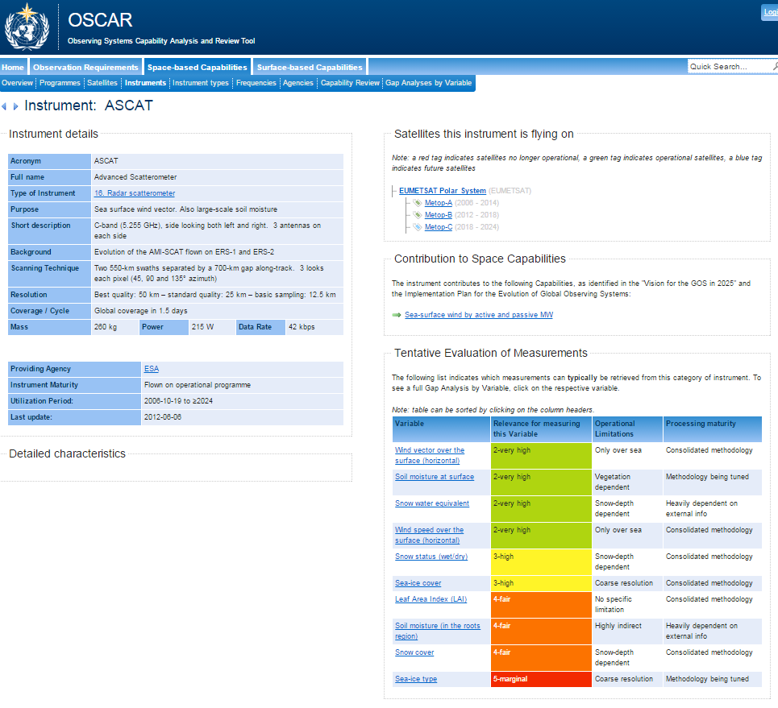
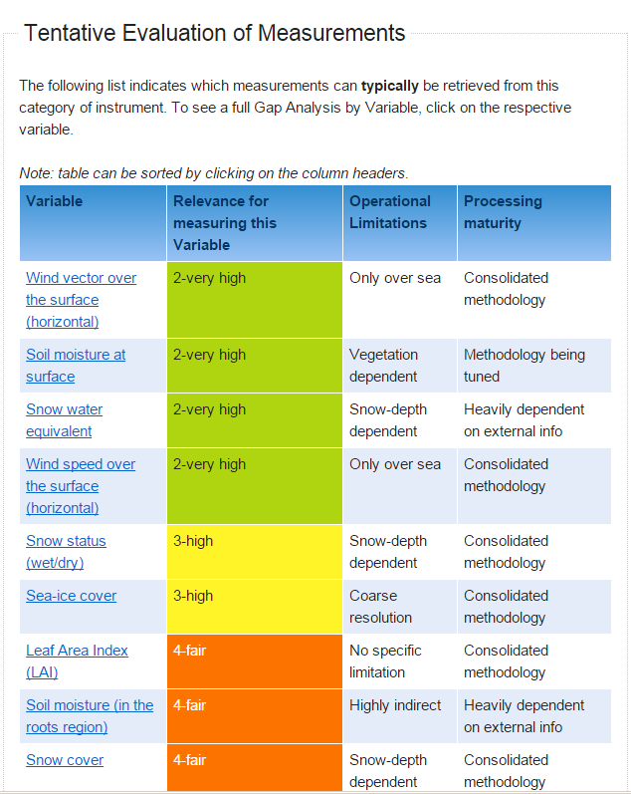
Instrument view

Slide 38
Globalisation of GSICS

Slide 39
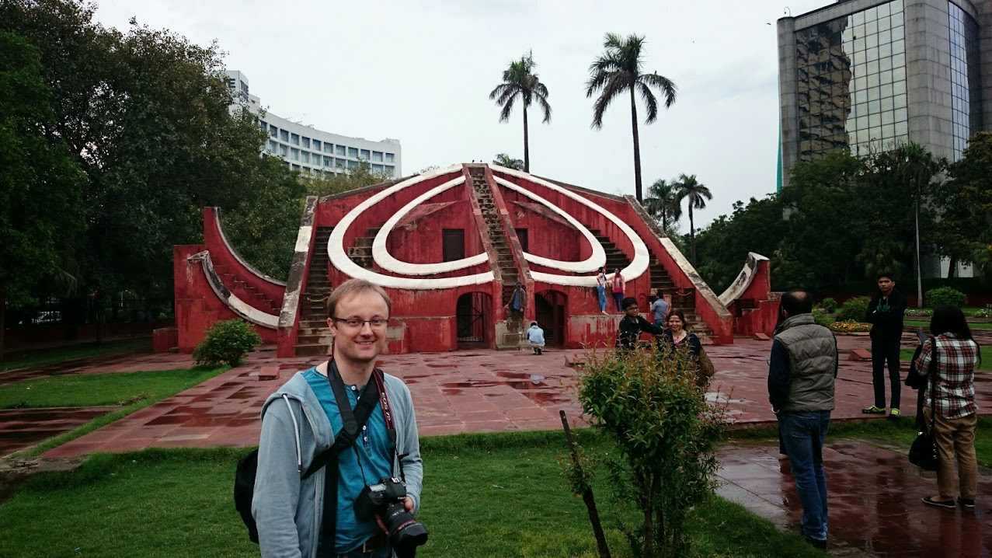
300 years of Observations to help forecasting

Slide 40
Globalisation of GSICS
IMD involvement
Calibration test sites
Support for SCOPE-CM reprocessing of archive data
Coordination with ISRO to provide data
ISRO involvement
Will submit 1st product to GSICS Acceptance Procedure GEO-LEO IR GSICS Corrections for INSAT-3D & Kalpana-2 Imagers, based on IASI
Application of GIRO for lunar calibration of INSAT-3D/Imager
Application of DCC algorithm?
Indian Ministers attended opening ceremony

Slide 41
Globalisation of GSICS
Greater CMA involvement
Many remote attendees
Considering nomination of Scott Hu as vice-chair of GRWG
Really active in data working group – new GSICS Server
Post-meeting:
KMA nominated of Dohyeong Kim as GRWG Chair
Recognition at WMO
Secretary General (Michael Jarraud) attended closing
2016 GRWG/GDWG Annual Meeting
Action: JMA and JAXA to investigate the possibility to organise the next GRWG/GDWG annual meeting.

Slide 42
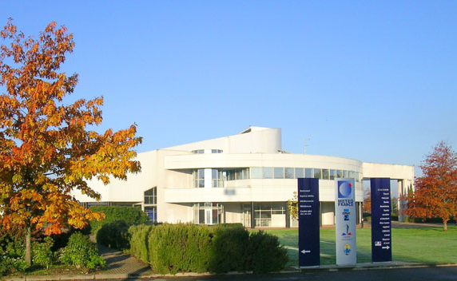
2015 GSICS Users Workshop
At EUMETSAT Conference
At MeteoFrance, Toulouse,
22 September 2015 13:00-17:30
Collocated with SPIE European Remote Sensing Conference
Introductions to GSICS
and its deliverables
Soliciting input from potential users on GSICS products
Managing User Expectations
International Conference Center of the Météo-France Campus

Slide 43
Conclusions
GSICS is maturing into a system for generating inter-calibration products
suitable for integrating into operational processing
First products soon to be declared operational
Continuing to develop new inter-calibration products
While cooperating with related activities
To integrate GSICS into WIGOS
To support Architecture for Climate Monitoring from Space

Slide 44
Thank You
Notes:
44

