Slide 1
Report from the GSICS Data Management Working Group
Peter Miu / Masaya Takahashi
Boulder, USA
CMA, CNES, EUMETSAT, ISRO, IMD, JAXA, JMA, KMA, NASA, NIST, NOAA, ROSHYDROMET, USGS, WMO

Slide 2
Overview
GDWG Joint Meeting Highlights
GDWG Data Management Systems Status
A New Approach for Collaboration
GDWG Challenges
GDWG Work Plan 2015/2016

Slide 3
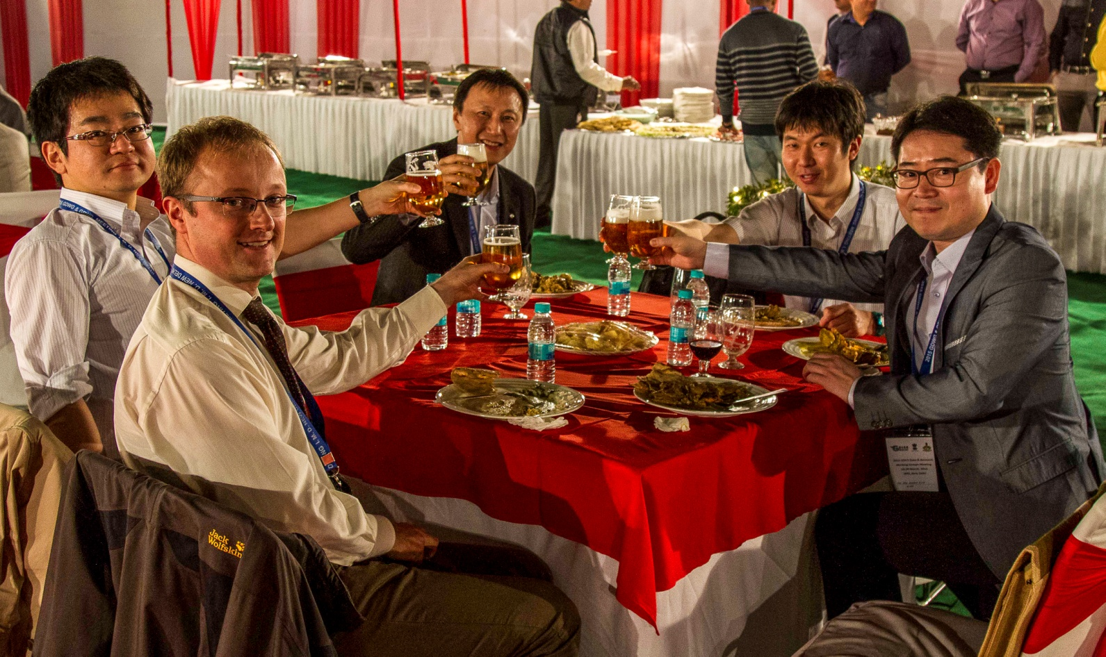
Highlights 2015
First GSICS Meeting to take place in India.
Great Organisation & Hospitality from IMD.

Slide 4
Data Management System Statuses
Collaboration Servers major updates:
Product directory restructuring.
Introduction of new GSICS products.
Mirroring of products across servers.
Bias Plotting Tool major updates:
Updates to support final changes to the GSICS products before operations.
Updates to support new collaboration servers and new products.

Slide 5
A New Approach to Collaboration
Cloning...

Slide 6
Why do we need a better approach?
Improves overview of collaboration activities.
Supports the quantification of resources needed to gauge the commitments required so that clear statements can be made to GDWG members what their obligations are to support the Data Management collaboration effort.
Identify if there is the need to propose initiatives to support GDWG members to take the lead for actions.
Goal is to “Make Progress” and to “Manage Expectations” regarding GDWG activities as well as keep GSICS members and users informed.

Slide 7
Current view of activities
The following table shows the number of attendees for all GSICS joint meetings (taken from the minutes and my memory). The numbers for the 2015 are look “good”.
This table provides interesting data but the information it contains is unclear. For example, the 8 actions from the 2008 meeting at NOAA included the development of the collaboration servers and the definition of the GSICS data management guidelines, conventions and standards.
Whereas, the 54 actions in the 2011 meeting were recording minor cosmetic updates to websites.
In addition to this, attendee number is also mis-leading as contribution to these meetings can be from the same members.
Thus we need a better approach to looking at this information to support the collaboration process.
 | 2007 | 2008 | 2009 | 2010 | 2011 | 2012 | 2013 | 2014 | 2015
Where | EUM | NOAA | JMA | CNES | KMA | CMA | NOAA | EUM | IMD
GDWG attendance | 7 | 6-7 | 9 | 7-11 | 3-6 | 9-10 | 4-6 | 5-9 | 10-18
Actions | 8 | 8 | 23 | 15 | 54 | 33 | 26 | 16 | 36
Notes:
Note, from memory the attendee number is also data as typically the contribution to these meetings were from the same members.

Slide 8
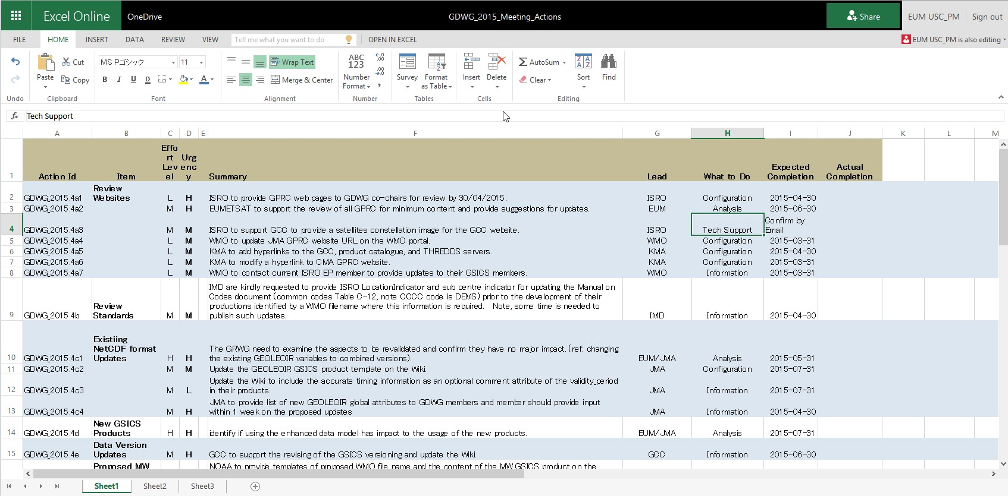
Improving the Overview (1)
Actions are now recorded in an online spreadsheet with new categorisations. This is available to all members to view and the chairs to update. An original version is kept by the chair(s).

Slide 9
Improving the Overview (2)
Members are the working groups are encouraged to take a look at the action list especially if they have open actions.
The Working Group Chair(s) is expected to check the action list and kindly request the status of open actions.
If progress is made, then the chair closes the action.
If progress is not made according to the proposed completions date (this was agreed with the actionee), then working group members can be asked to provide support.
Working in this way should spread out the GSICS work over the time between GSICS joint meetings as well as maintain regular contact with other members.
Maybe a future task of the GDWG is to automate this process.

Slide 10
Quantification of resources
Initially a simple approach is taken to provide a effort measure needed to perform an action.
The effort measure can then be used to provide an expectation and used together with subjective “urgency wish” support planning.
This qualification maybe refined in the future based on use cases.

Slide 11
Task Categorisation to indentify an Effort Measure
Type | Description | Effort Measure
Analysis | Examining a subject and reporting if it is suitable/applicable for GSICS. | 3
Configuration | Updates to websites, documentation and/or data files for GSICS Data Management systems. | 3
Implementation | The development of a GSICS Data Management System. | 5
Information | Provision of existing known material for use in GSICS. | 1
Specification | The development of a GSICS Data Management Concept. | 4
Tech Support | Provision of existing known material that requires tailoring for use in GSICS. | 2

Slide 12
Actions Analysis - 2015
 | CMA | CNES | EUM | ISRO | IMD | JAXA | JMA | KMA | NASA | NIST | NOAA | ROSH | USGS | WMO
At Meeting | 1-3 | 0 | 1-3 | 1-2 | 3-6 | 0 | 1 | 1 | 0 | 0 | 1 | 0 | 0 | 1
Action Lead | 3 | 0 | 7 | 2 | 1 | 0 | 5 | 3 | 0 | 0 | 2 | 0 | 0 | 2
Action Support | 1 | 0 | 5 | 1 | 2 | 0 | 6 | 1 | 0 | 0 | 0 | 0 | 0 | 0
Anal(3) | 3 | 0 | 4 | 0 | 0 | 0 | 1 | 0 | 0 | 0 | 1 | 0 | 0 | 0
Config(3) | 0 | 0 | 1 | 1 | 0 | 0 | 1 | 2 | 0 | 0 | 0 | 0 | 0 | 1
Imple(5) | ¼ | 0 | 1 | 0 | 0.25 | 0 | 0.25 | 0.25 | 0 | 0 | 1 | 0 | 0 | 0
Info(1) | 0 | 0 | 0 | ½ | 1.5 | 0 | 3 | 1 | 0 | 0 | 0 | 0 | 0 | 1
Spec(4) | 0 | 0 | 3 | 0 | 0 | 0 | 2 | 0 | 0 | 0 | 0 | 0 | 0 | 0
Tech(2) | 0 | 0 | 0.5 | 1 | 0 | 0 | 0.5 | 0 | 0 | 0 | 0 | 0 | 0 | 0
Total Effort | 10.25 | 0 | 33 | 5.5 | 2.75 | 0 | 19.25 | 8.25 | 0 | 0 | 8 | 0 | 0 | 4
Notes:
GCC – Anal 1, Config 1, Information 2 = 8
Note – this is not including the GSICS tools updates are not included here!

Slide 13
Challenges (1)
Resources:
Finding sufficient reliable long term human resources to support the current and future GSICS Data Management activities. At present there is no clear reference addressing this need.
A proposal was discussed in the past years to include clear statements in the GSICS roles’ Terms of Reference. These statements specify the minimum number of days to be spent by the role and this reference is expected to be realised by members when this are proposed to support the GSICS collaboration effort.
A suggestion was to re-use existing text from other WMO projects. For example:
Simon is looking for the text...
The EP members are invited to comment on this proposal.

Slide 14
Challenges (2)
Tech Skills:
Data Management working group members must be able to support computing related activities. This is essential otherwise resources are wasted in providing “education” on computing fundamentals.
Technology Support:
The Computing technologies currently used in GSICS Data Management deliverables is complex. Support in information flow should be encouraged through exchange visits to cooperatively work on GSICS tasks. Some exchange visits have already taken place and these have proved to be fruit full towards the sharing of information to support in the GSICS collaboration effort.

Slide 15
Work plan 2015/2016 (1)
Notable New Action Items (see action spreadsheet for all actions):
GSICS product generation framework; validation and usage of a framework to support the development of GSICS products.
GSICS products’ templates; all GSICS products of a particular type shall be formatted according to these templates.
Product Format Validation Tool; automated syntactic validation of GSICS products using the products’ templates.
Code Storage Proposal; what mechanism to use to store code for Data Management Systems to facilitate collaboration.

Slide 16
Work plan 2015/2016 (2)
Notable New Action Items (see action spreadsheet for all actions):
Event logging support; landing pages definition and input to CGMS team.
Provision of User access to GIRO software and GSICS lunar observation data components.
Specification of a subscription service for GSICS Products; development of a tool to automatically download GSICS products. Tool is also used for mirroring on GSICS servers.
Specification of the Archiving Strategy for GSICS products.

Slide 17
End of Presentation: Thank you for your attention

