Slide 1
Documenting GSICS as an element of the WMO Integrated Global Observing System
Jérôme Lafeuille
(WMO Space Programme)

Slide 2
GSICS is an element of WIGOS
The new Manual on WIGOS requires calibration along GSICS standards
WIGOS/OSCAR will contain links to GSICS calibration information
GSICS scope, activity and structure need to be formally documented could ultimately be referred to in a WIGOS Architecture Document
A Guide to GSICS Products is needed and would be referred to the future Guide to WIGOS
GSICS should be articulated with User Requirements
Reference measurement standards (in orbit and on ground) should be in the Vision of WIGOS Space-based Component in 2040
GSICS should contribute as a building block of the Architecture for Climate Monitoring from Space promoted by WMO, CEOS and CGMS

Slide 3
WIGOS
Space-based component
Surface-based component
Manual on WIGOS
Functional architecture
Guide to WIGOS
WIGOS Info. Resource (OSCAR)
Functions/ Organization
Product User Guide
User Requirements
GSICS

Slide 4
GSICS Reference Documents
Need document template
Documentation procedure
Documentation plan
Proposed at next Exec Panel
User Require-ments
GSICS Vision
Strategic guidance
Standards Procedures Guidelines Tools
Functions Organiza-tion
User documentation & information
GSICS User Guide
GSICS Product Catalogue
Technical guidance & governance

Slide 5
Proposed document template (1/2)

Slide 6
Proposed document template (2/2)

Slide 7
Documentation Plan
Strategic reference docs
Functions & organization
Vision for GSICS
GSICS User Requirements
GSICS Product User Guide
Science Plan (TBC)
Other reference docs
Product catalogue
Procedures (e.g. GPPA)
Standards (e.g. NetCDF impl)
Guidelines
Outreach material
Operations plan
Other (not maintained)
Technical reports
Publications
GSICS Quarterly
Meeting reports, progress reports

Slide 9
Documenting GSICS
The Vision is an existing document approved by EP in Nov 2013
This version 1.1 is presented in the new template
Minor edits are proposed in sections 1 and 2

Slide 10
Some edits to the Vision for GSICS in 2020s
The aim of the Global Space-based Inter-calibration System (GSICS) is to organize coordinate the production of satellite inter-calibration information to enable with improved and consistent accuracy among space-based observations worldwide (…)
This production is however part of a comprehensive strategy, which involves a broad range of activities including:
instrument bias monitoring
Level 1 data quality control and validation
In-orbit instrument Level 1 data monitoring
On-orbit In-orbit instrument intercomparison with references and calibration,
Routine generation of intercalibration corrections for near real-time applications
Traceability to absolute calibration standards,
Metadata provision (provenance, lineage),
Provision of algorithms Enabling recalibration of archived data,
Pre-launch instrument characterization
Documenting state-of-the-art calibration techniques.

Slide 11
Reference Document: Functions & Organization
This document is proposed to replace the initial «GSICS Implementation Plan»
Would be used as a reference to define GSICS in the WIGOS Architecture.

Slide 12
GSICS functions and organization (1/4 )
Scope of the document
GSICS and WIGOS background
Purpose of GSICS
In-orbit calibration information
Calibration strategy
Importance and challenges of in-orbit calibration
GSICS functions/deliverables
Intercomparison of space-based instruments with GSICS references, and operational calibration adjustments or algorithms
Documentation and information
Measurement references, software tools, data sets, infrastructure
Standard procedures and best practices

Slide 13
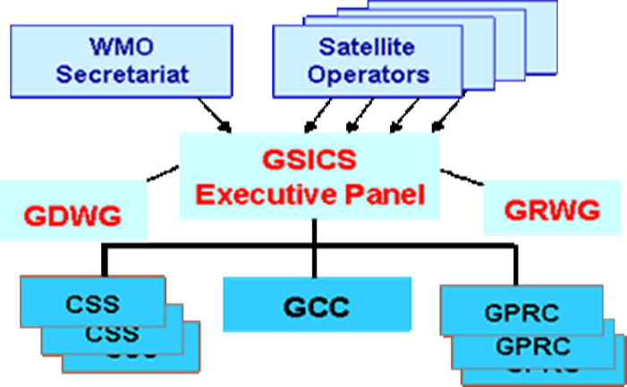
GSICS functions and organization (2/4 )
GSICS users
Satellite data user community, NRT or climate applications
GSICS Member agencies: capacity building, sharing development resources and tools, improvement of calibration approaches
GSICS in the Architecture for Climate Monitoring from Space
GSICS structure
CGMS Members: GPRC, CSS
GCC, EP, GRWG, GDWG
Partners
Intercalibration information
Calibration references and tools
Intercalibration procedures
Corrected calibration
Environment
Data acquisition (Level 0)
Operational calibration (Level 1)
Observations

Slide 14
GSICS functions and organization (3/4 )
Calibration references (Needs to be reviewed/expanded)
GSICS production (Needs to be reviewed)
GSICS principles (community references, common methodologies, international standards, best practices, traceability, NRT/retrospective, free and open access)
Product Acceptance Procedure
SNO/SCO approach
GSICS Product Categories, Catalogue (Refer to Guide for details)
GSICS Data Management Services and Tools
Data servers, plotting tool, download service
GIRO/GLOD, development framework
GSICS User Services
WMO GSICS portal, GCC website, GPRC websites
GSICS User Messaging Service, GSICS Quarterly, GSICS User Workshop

Slide 15
GSICS functions and organization (4/4 )
GSICS Reference Documents
GSICS Documentation Plan
GSICS Functions and Organization
Vision for GSICS in 2020s
GSICS User Requirements
Guide to GSICS Products
Catalogue, Procedures, Standards, Guidelines, Operations Plan
Annexes
Accession, members, observers
GCC role, implementation
Exec Panel composition, TOR, Chair
GDWG composition, TOR, Chair
GRWG composition, TOR, Chair

Slide 16
GSICS Product Categories (Table 1 in Section 7)
 |  |  | NRT Correction | Retrospective correction | Recalibration algorithm
Monitored instrument | Reference instrument | Domain
GEO - LEO |  | IR | ● | ● | ●
GEO - LEO |  | VIS | ● | ●
GEO - LEO |  | UV | ● | ●
GEO - GEO |  | IR | ● | ● | ●
LEO - LEO |  | IR | ● | ● | ●
LEO - LEO |  | VIS | ● | ●
LEO - LEO |  | UV | ● | ●
LEO - LEO |  | MW |  |  | ●

Slide 17
Reference Document: GSICS User Guide
A Guide is needed to describe our products for the users who are not familiar with GSICS
and to illustrate the practical outcome of GSICS activities, for our masters and partners

Slide 18
Proposed outline of a Guide to GSICS (1/2)
Purpose of the document
Scope of GSICS
High-level goals and strategy (like in the Functions and Organization doc)
Challenges of satellite calibration (input from the initial GSICS IP)
GSICS users
Deliverables
Calibration references (like in the Functions and Organization doc)

Slide 19
Proposed outline of a Guide to GSICS (2/2)
GSICS intercalibration methodology
GSICS principles, GPPA
SNO/SCO summary ATBD and illustrations
Methodology for solar channels, MW
GSICS Product Overview
Product categories
NRT and retrospective corrections
Algorithms for archive recalibration
Summary characteristics of GSICS products
Using GSICS products
Access and tools, application examples
User information services
Annexes: Structure, GCC, contacts, glossary, references

Slide 20
Reference Document: URD
A User Requirements Document is needed to clarify which user needs we are aiming to serve
Essential to justify the resources put in GSICS and the priorities
To be approved by the EP as a key strategic management element
Requirements sources?
User Workshops, surveys
«Beta users» reports
Formal statement of needs
Include examples of impact?

Slide 21
Summary of points for discussion (1/2)
Document template
Document plan (scope, maintenance, approval)
Minor updates to the Vision
GSICS Functions and Organization
Overall outline
Sect. 3: four types of deliverables
Sect. 5: Calibration function in the architecture for climate monitoring
Sect. 7: Calibration references
Sect.8: Is the SNO description too specific?
Sect.8: Product categories
Annex 2: Role of the GCC
Annex 3: ToR of GDWG

Slide 22
Summary of points for discussion (2/2)
GSICS User Guide
Title
Overall outline
Appropriate level of detail for product description ?
Make sure all (potential) product types are covered
Make sure that product access is fully covered (for all forms of products including «corrected calibration coefficients» if relevant)
Roadmap to finalize the document
GSICS User Requirements
Outline (which should include requirements and feedback on impact)
Roadmap to populate this document

Slide 23
Comments welcome !

Slide 24
Strategy towards an Architecture for Climate Monitoring from Space Decomposition of "Create and Maintain Long-term Climate Data Records
Intercalibration information
Calibration references and tools
Intercalibration procedures
Corrected calibration
Environment
Data acquisition (Level 0)
Operational calibration (Level 1)
Observations

