Slide 1
GMI Calibration Update
Rachael Kroodsma
UMD ESSIC / NASA GSFC
rachael.a.kroodsma@nasa.gov

Slide 2
GMI Calibration Updates
GPM Core underwent several calibration attitude maneuvers in May and Dec. 2014
Fixed pitch upwards to view cold space
  No evidence of an emissive reflector
Fixed pitch downwards to view nadir
  Should be no polarization difference
    GMI is good to approximately 0.3 K
Inertial hold
  Allows a view of the Earth through the antenna backlobe
  Evaluation of the APC spillover coefficients

Slide 3
The following slides are courtesy of David Draper of Ball Aerospace

Slide 4
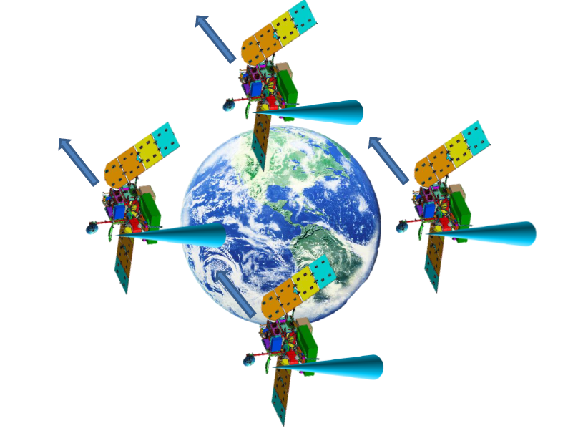
“Inertial Hold” Affords Evaluation of the Antenna Pattern Correction
In an inertial hold, the spacecraft does not attempt to maintain geodetic pointing, but rather maintains the same inertial position throughout the orbit
  The result is that the spacecraft appears to pitch from 0 to 360 degrees around the orbit
Two inertial holds were performed with the GPM spacecraft
  May 20, 2014
  Dec 9, 2014
The inertial hold affords a view of the earth through the antenna backlobe
The antenna “spillover” correction may be evaluated based on the inertial hold data

Slide 5
Antenna Pattern Correction for dual-polarization channels
The Antenna Pattern Correction for dual-polarization channels consists of 3 steps:
  Spillover (η_{v}, η_{h}):
  Antenna Reflectivity (R):
  Cross-polarization (a_{vh}, a_{hv})
The spillover values for 166 GHz are currently set to “1”, meaning no correction is performed
2344649 GMI Calibration Databook Rev F

Slide 6
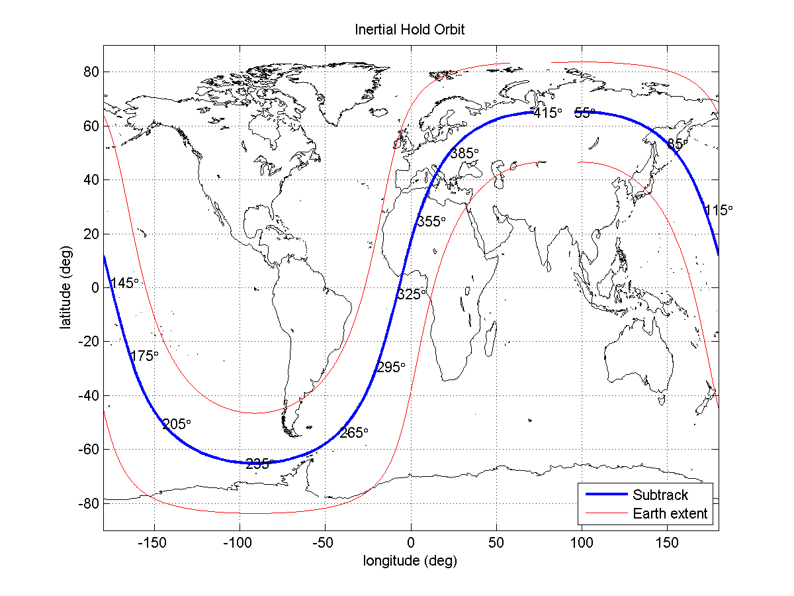
Inertial Hold #1 Orbit

Slide 7
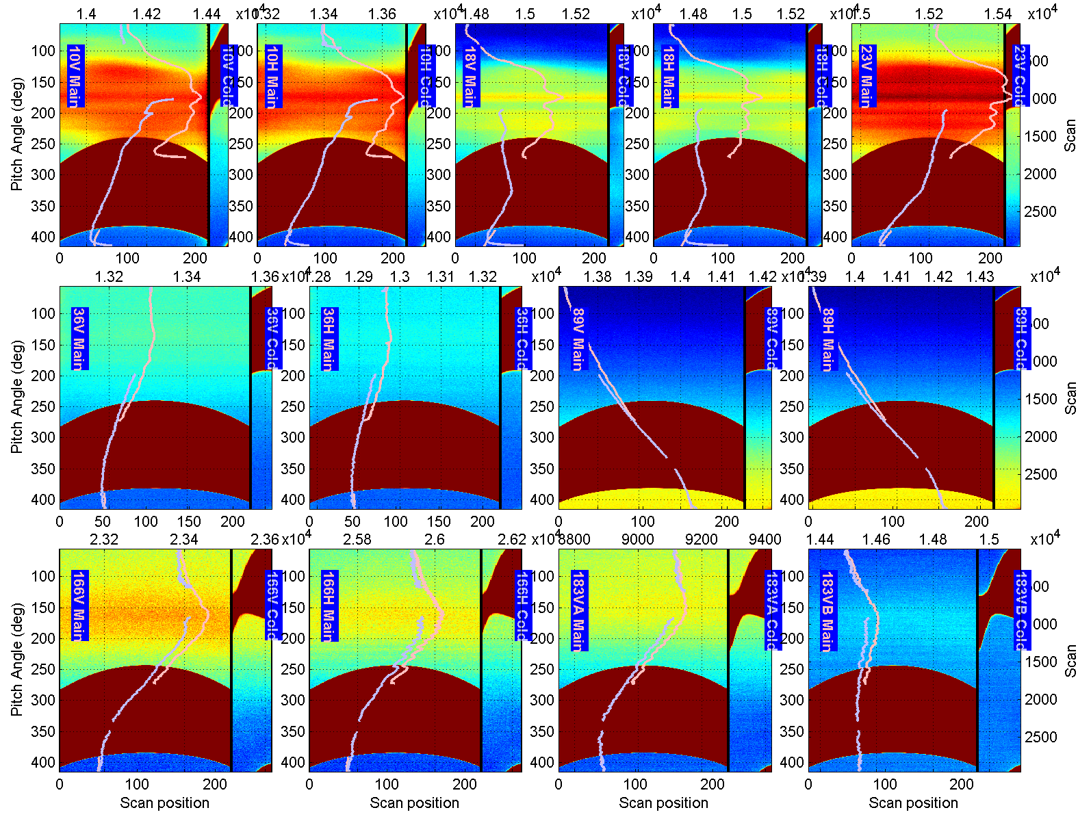
Inertial Hold #1 Raw Data shows earth intrusion into the Cold View
Main Beam View
10V
10H
18V
18H
23V
Cold View
Cold View Intrusion
36V
36H
89V
89H
Main Beam
Average
Cold View Average
166V
166H
183VA
183VB
(Color Scale Set to just show cold space data)

Slide 8
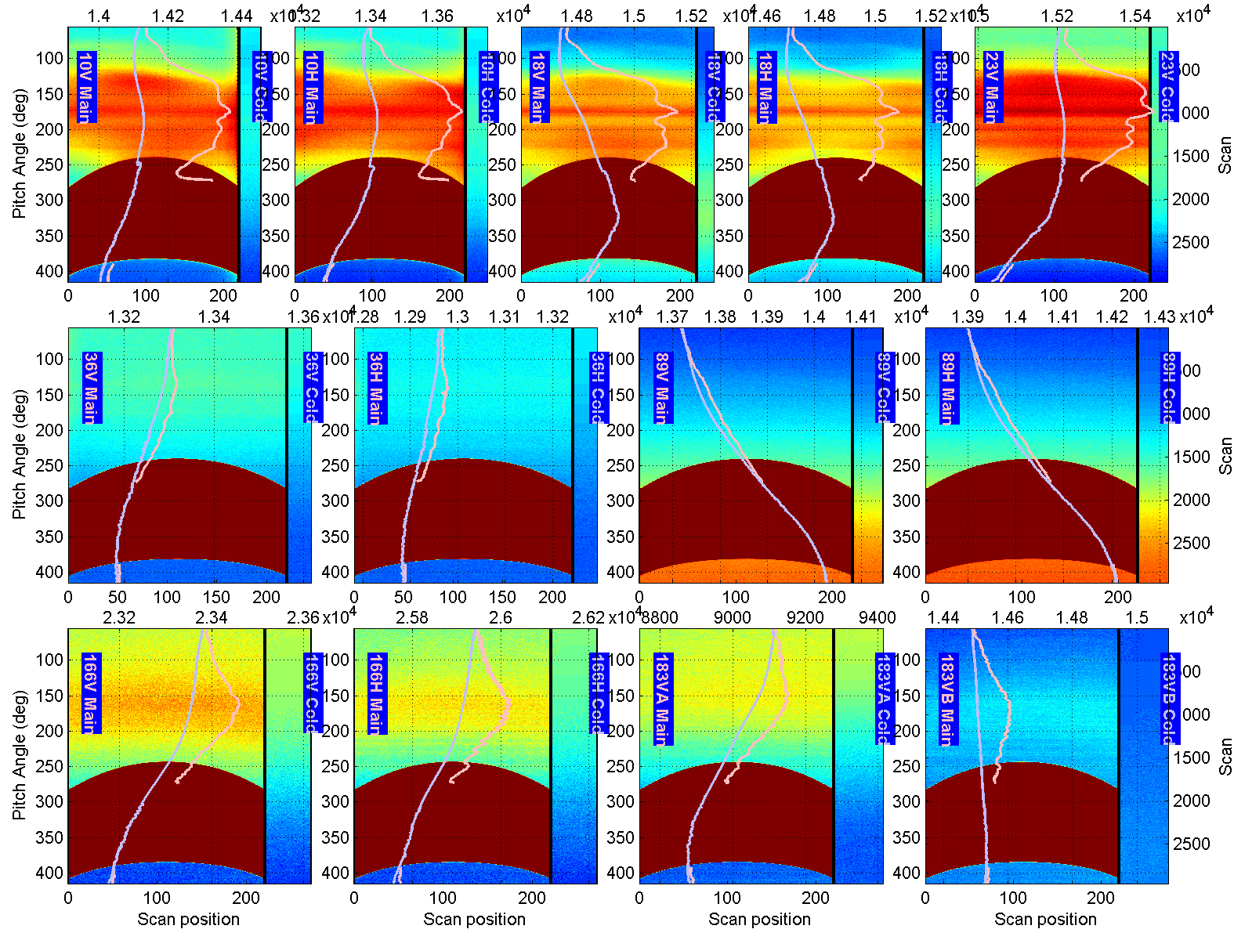
Inertial Hold #1 After Repairing Cold View
Cold View has been Repaired by filling in or adjusting values in the corrupted range
10V
10H
18V
18H
23V
36V
36H
89V
89H
166V
166H
183VA
183VB

Slide 9
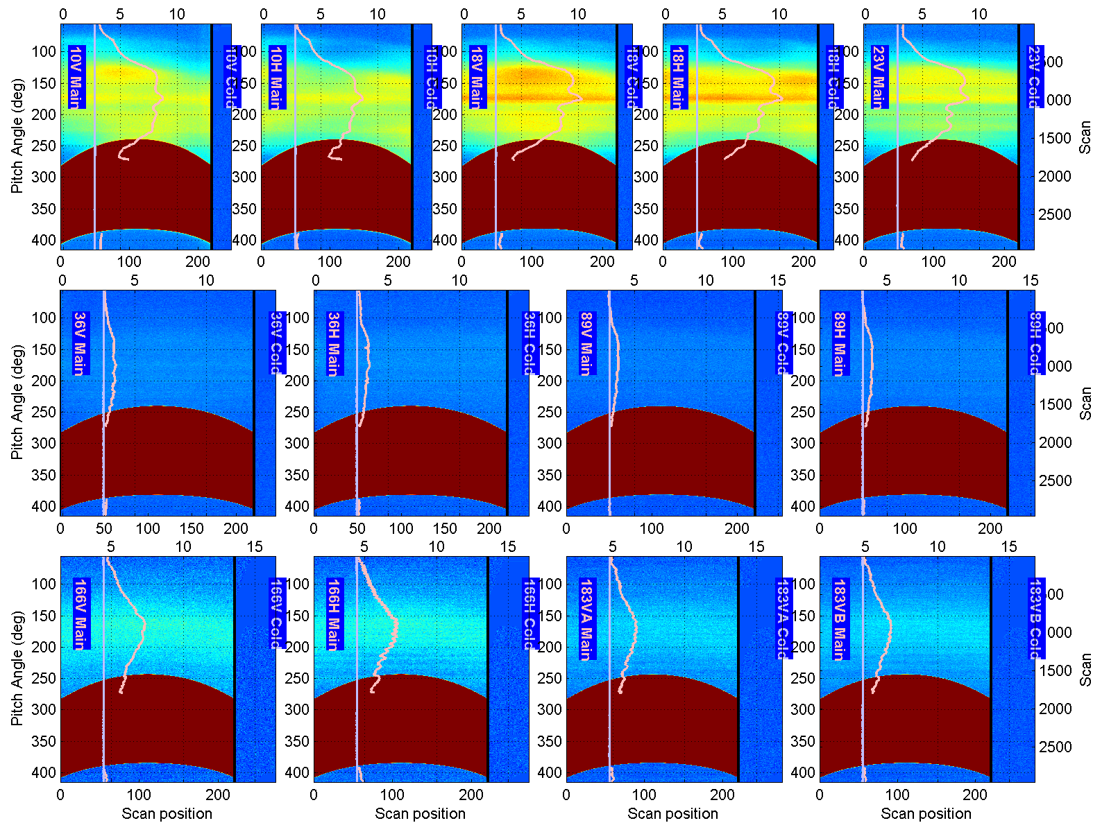
After calibrating to get TA, the earth intrusion coming through the GMI backlobe is evident
The difference between the cold and main beam views is caused from the earth coming through the GMI backlobe/sidelobes.
10V
10H
18V
18H
23V
36V
36H
89V
89H
166V
166H
183VA
183VB

Slide 10
Estimating the Antenna Spillover from the inertial hold data
When the spacecraft is “upside down”, the antenna temperature can be approximated as,
Solving for the spillover coefficient, we get
The T_{A–upsidedown} is the measured TA from the inertial hold data
The T_{b–earth} is the brightness temperature of the earth at the earth incidence angle of the backlobe
We have verified that the error due to the Rayleigh-Jeans law approximation is negligible.

Slide 11
New GMI APC Spillover Coefficients (η)
Channel | Pre-Launch | Ball April 2015
10.65V | 0.94435 | 0.95404
10.65H | 0.94369 | 0.95404
18.7V | 0.93968 | 0.95603
18.7H | 0.94082 | 0.95603
23.8V | 0.96601 | 0.97075
36.64V | 0.99590 | 0.99535
36.64H | 0.99590 | 0.99535
89.0V | 0.99810 | 0.99734
89.0H | 0.99810 | 0.99734
166V | 1.00000 | 0.98814
166H | 1.00000 | 0.98814
183.31V | 1.00000 | 0.99212

Slide 12
GMI Inter-Cal:
New Calibration vs. Current Version
GMI – WindSat
 | 10v | 10h | 18v | 18h | 23v | 36v | 36h
Current DD | 2.84 | 1.54 | 2.73 | 0.03 | 0.00 | -1.52 | -1.56
New Cal DD | 1.14 | 0.57 | -0.55 | -1.92 | -1.06 | -1.40 | -1.48
Diff | 1.70 | 0.97 | 3.28 | 1.95 | -1.06 | -0.12 | -0.08
GMI – MetOp-B MHS
 | 89v | 89h | 166v | 166h | 183+/-3 | 183+/-7
Current DD | 0.07 | 1.07 | -3.21 | -2.96 | -2.18 | -2.51
New Cal DD | -0.22 | 1.04 | -0.10 | 0.18 | 0.30 | -0.34
Diff | 0.29 | 0.03 | -3.11 | -3.14 | -2.48 | -2.17
*Numbers courtesy of Tom Wilheit*

Slide 13
Future Plans
X-Cal meeting in Fort Collins, CO, June 3-4
  Lots to discuss!
  Preparing for September reprocessing
    New GMI calibration
    All constellation radiometers adjusted to GMI
IGARSS 2015
  Will be good X-Cal representation

