Slide 1
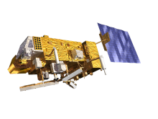
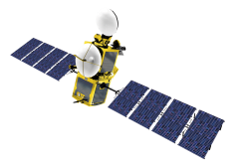
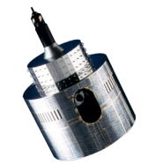
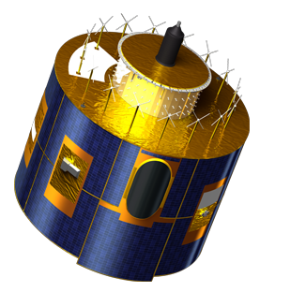
Microwave Sub-Group Updates
Tim Hewison

Slide 2
Outstanding GSICS Actions related to Microwave inter-calibration

Slide 3
GSICS Actions related to Microwave inter-calibration
GSICS Operations Plan: https://gsics.nesdis.noaa.gov/wiki/Development/GsicsOperationsPlan

Slide 4
Actions from Previous Web Meetings
https://gsics.nesdis.noaa.gov/wiki/Development/20150113:
ALL - Edit and finalize meeting minutes/actions
Ralph - Contact NASA Ice group about SMMR L1 archive
Tim - Explore possibility of remote session in India (Closed!)
Cheng-Zhi - Develop a joint list of topics with CEOS MW sub group and also potential meeting dates and location
Larry, Manik, Ralph, Tim, Masaya - Develop user requirements, what our group can do to meet these, and how these can fit within existing GSICS conventions and systems.
https://gsics.nesdis.noaa.gov/wiki/Development/20140826
What is needed to move the Calibration Coefficients used to generate the CM-SAF SSM/I FCDR to a GSICS data product and what would a time frame be?
Organize a SMMR tiger team to discuss calibration concerns?

Slide 5
Update from GRWG Annual Meeting

Slide 6
Definition of GSICS Deliverables
Agreed on terminology:
GSICS Deliverables include GSICS Products, Tools, Algorithms and Documents:
GSICS Tools for use by inter-calibration developers, (GIRO, SBAF, …)
GSICS Products for users of satellite data, including calibration corrections/coefficients
GSICS Algorithms, which describe inter-calibration processes, (described by ATBD)
GSICS Documents, including Guidelines, Reports, …
GSICS Recommended Standards, including Solar spectrum, …

Slide 7
Requirements for generating FCDRs
Rob provided a preliminary review of the inter-calibration requirements for various climate application project
Action: EUMETSAT to circulate Rob’s review of FCDR inter-calibration requirements to GRWG/GDWG,
identifying which type of inter-calibration product could meet each of these.
Action: GCC to review these FCDR inter-calibration requirements
in the framework of the GSICS User Product Guidance, to identify where common inter-calibration types, which are not specialised to specific applications, and report to GRWG. These could be considered as potential future GSICS products.

Slide 8
Humidity Sounder inter-calibration - Potential GSICS Product?

Slide 9
EUMETSAT activities
EUMETSAT Planned activity for past instruments:
FCDR of microwave humidity sounders L1 data (SSM/T2, AMSU-B, MHS) (FIDUCEO project, funded through EU H2020 programme)
4 year project starting 1 March 2015

Slide 10
FIDUCEO core concept
Develop and apply a rigorous metrology of Earth observation for climate data records
Metrology is the science of measurement and measurement uncertainty
The project is focused on the uncertainty budget
comprehensive and realistic
communicated using internationally agreed standards
traceable from detector to gridded geophysical product. (Traceability here we talk about the property of a measurement result whereby the result can be related to a reference through a documented unbroken chain of calibrations, each contributing to the measurement uncertainty)
Note reference does not have to be SI, only community agreed
propagated rigorously across product levels
Notes:
Ideally SI , but could be ceos

Slide 11
Fiduceo Aims
Harmonised FCDRs with full L1 uncertainty estimates;
To derive CDRs/new datasets from the new FCDRs for four ECVs, as valuable exemplars
To provide widely re-usable, open and free access, tools and documentation.

Slide 12
Fiduceo Aims - FCDRs
Harmonised FCDRs with full L1 uncertainty estimates;
To develop and apply new harmonisation techniques across sensor-series and wavelength domains to maximise consistency of visible (Meteosat First Generation), infra-red (AVHRR and HIRS) and microwave (SSM/T2, AMSU-B, MHS) FCDRs
To link thermal infra-red FCDRs (AVHRR-, HIRS- and ATSR-series) to Sentinel 3 SLSTR
Common “easy-FCDR” + community standard formats
Widely re-usable, open and free access, read tools

Slide 13
Fiduceo Aims - FCDRs
FCDR datasets
AVHRR, IR & reflectance, 1982 to 2016
HIRS, IR, 1982 to 2016
SSM-T2 / AMSU-B / MHS, MW, 1992 to 2016
Meteosat 2 to 7, VIS with improved SRFs, 1982 to 2016

Slide 14
Update from CEOS WGCV Plenary

Slide 15
GSICS – CEOS Interactions
A lot of existing and planned interactions were already identified in this meeting.
Albrecht will compile the bullet points from the reports given at this meeting, which describe the interactions between GSICS and WGCV into a document.
He will send this around the sub-group chairs, asking for a couple of sentences on each proposed activity.
This will be reported to the 6th workshop in September and the CEOS Plenary.

Slide 16
GSICS Organisation
CGMS
WMO
GSICS Exec Panel
GSICS Coordination Center
GSICS Research Working Group
GSICS Data Working Group
UV Sub-Group
IR Sub-Group
WGCV IVOS
WGCV MWSG
GPM X-CAL
CEOS ACC
WGCV ACSG
VIS/NIR Sub-Group
Microwave Sub-Group

Slide 17
Microwave Sub-Group Priorities – Xiaolong Dong
Standards for MWR & SCAT L1, MWR, ALT
(noise source, RAM, BB, buoy) + pre-launch char
Discuss with GSICS MWSG for potential coordination
Prepare a joint meeting - either November 2015 or May 2016. Topics:
Currently available calibration/inter-cal algorithms at GSICS MWSG
Currently available calibration/inter-cal algorithms at WGCV MWSG
Microwave standard procedure/definitions
Exchange ideas and collaborations
New instruments and future directions
Interferometric MWR calibration - highly sensitive to extra-terrestrial
Requirements from CDR: antenna characterization, on-board calibrator characterisation, near-field

Slide 18
2015 GSICS Users Workshop

Slide 19
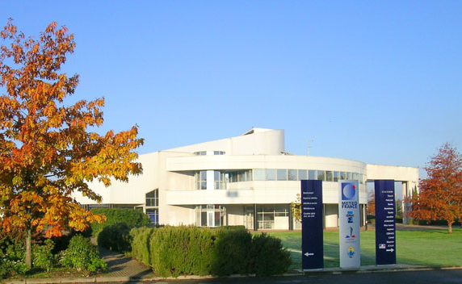
2015 GSICS Users Workshop
At EUMETSAT Conference
At MeteoFrance, Toulouse,
22 September 2015 13:00-17:30
Collocated with SPIE European Remote Sensing Conference
Introductions to GSICS
and its deliverables
Soliciting input from potential users on GSICS products
Managing User Expectations
International Conference Center of the Météo-France Campus
Agenda: https://gsics.nesdis.noaa.gov/wiki/Development/UsersWorkshop2015

Slide 20
Defining User Requirements for GSICS Products
GCC to solicit input from beta testers of
Near-real-time applications
Climate applications

Slide 21
Product Update Philosophy
Decision (TBC): GSICS should aim to provide users with the most recent available calibration data, at the highest available update frequency, and allow users to decide how to apply it for their particular application. For example, users interested in trends may not want artificial jumps in the calibration time series, which could be avoided by applying frequent calibration updates - whereas near-time applications may want to minimise additional calibration noise by using the most accurate, stable calibration.
Action: Tim to propose this approach (issuing frequent GSICS corrections) to the Exec Panel and Users Workshop.

Slide 22
FCDRs
Review new User Product Guidance from GCC
To discuss the proposal: GSICS to provide inter-calibration algorithms to support reprocessing activities and the generation of FCDRs, rather than to provide the datasets themselves.

Slide 23
Definition of GSICS Deliverables
Agreed on terminology:
GSICS Deliverables include GSICS Products, Tools, Algorithms and Documents:
GSICS Tools for use by inter-calibration developers, (GIRO, SBAF, …)
GSICS Products for users of satellite data, including calibration corrections/coefficients
GSICS Algorithms, which describe inter-calibration processes, (described by ATBD)
GSICS Documents, including Guidelines, Reports, …
GSICS Recommended Standards, including Solar spectrum, …

Slide 24
Requirements for generating FCDRs
Rob provided a preliminary review of the inter-calibration requirements for various climate application project
Action: EUMETSAT to circulate Rob’s review of FCDR inter-calibration requirements to GRWG/GDWG,
identifying which type of inter-calibration product could meet each of these.
Action: GCC to review these FCDR inter-calibration requirements
in the framework of the GSICS User Product Guidance, to identify where common inter-calibration types, which are not specialised to specific applications, and report to GRWG. These could be considered as potential future GSICS products.

Slide 25
GSICS Spectral Corrections
Decision(?): Retrieved SRFs could be considered as a GSICS Product, if they are derived on an ongoing basis, as a result of inter-calibration. However, it was recognised that adjustments can be made during commissioning as a result of GSICS algorithms and it would be difficult to reviewthese through the GPPA on a useful timescale.
It was discussed whether Inter-calibration algorithms themselves could be considered as potential GSICS products. This would require them being reviewed through the GPPA, which would require the algorithms to be applied to test datasets to check their quality. Larry clarified that this is limited to operational flows.
Recommendation: GSICS sub-groups should consider promoting approved transfer standards and tools to the community, endorsed as being suitable for inter-calibration.

Slide 26
Update for GSICS Exec Panel GRWG Report!

Slide 27
Microwave Sub-Group
Web meetings
August 2014, Jan 2015, May 2015
GDWG proposed netCDF standards for microwave products
Need to establish link to Users
And their requirements for NRT and climate applications
Special Session at microwave conference?
Following discussion on GSICS deliverables
Algorithms for FCDRs
X-Cal new calibration
will reprocess GPM archive for release in Sept 2015
Joint meeting with CEOS-WGCV Microwave Sub-Group:
2 day meeting in March/April 2016
Before/after GRWG/GDWG meeting in Japan (JMA/JAXA)

