Slide 1
Visit to Centre for Atmospheric and Oceanic Science Indian Institute of Science Bangalore India
Manik Bali and Lawrence E Flynn
MW Subgroup Meeting
April, 2015

Slide 2
Outline
Introduction
Indian Institute of Science ( IISc)
Presentation and Interaction at IISc
Conclusions

Slide 3
Introduction
Outreach to the calibration community is a key element of the GCC TOR.
Meteorology Research in India is Monsoon Centric.
Reflected in Calibration studies in India too.. Where cross calibration of L1 radiances has been used for sometime now for Monsoon studies.
I was invited to the Centre for Atmospheric and Oceanic Sciences (CAOS), Indian Institute of Science , Banglaore ( http://caos.iisc.ernet.in/).
.
About Indian Institute of Science ( 1 NL, not less than 2 NL’s Affiliated )
Ranked 11 in the world in terms of Research Citations per faculty.
The Divecha Center at CAOS leads research in Remote Sensing.
Consists of Faculty and Students

Slide 4
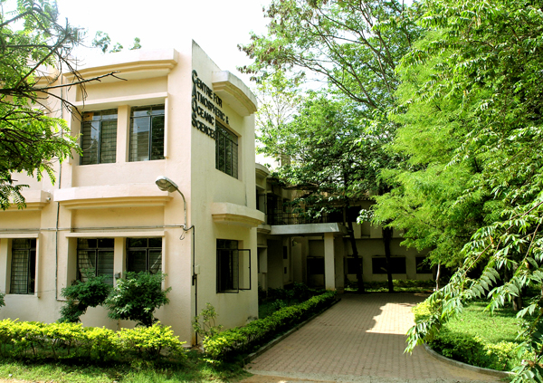
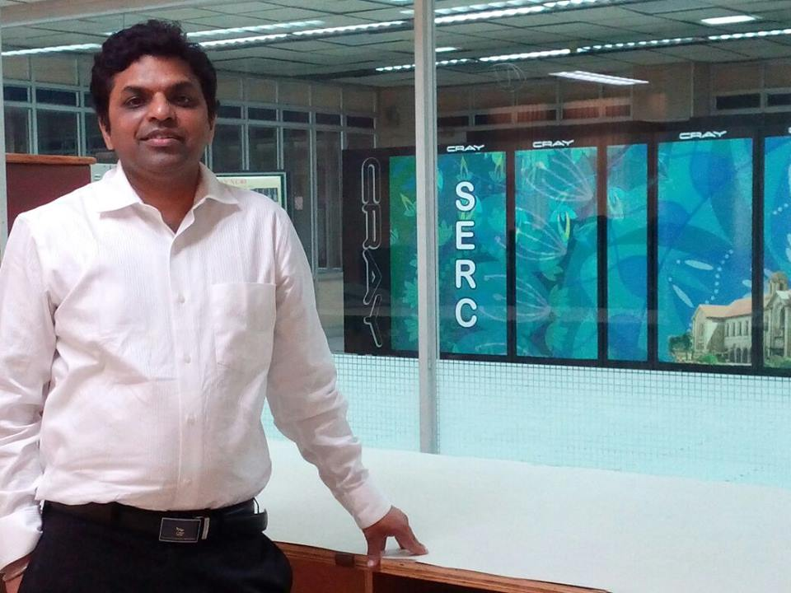
Resources at IISc Divecha Center
CAOS/Divecha Center has Access to latest data and computing facilities.
Faculty has wide experience in remote sensing.

Slide 5
Discussions
Gave a Presentation on GSICS at IISc.
Nearly all CAOS faculty/students attended the presentation.
Following the presentation, I was asked questions about
SNO comparison method
Enormous interest in Microwave
How can we compare two precipitation measuring instruments
that operate on different spatial resolutions
( SAPHIR and TRMM)
How can students connect and benefit from GSICS activities?

Slide 6
Discussions Contd…
Center’s research Monsoon and Computing Centric
Use cross calibration for Monsoon studies for example….
Comparison of radiative fluxes at the top of the atmosphere from INSAT and ERBE By Arindam Chakraborty and J Srinivasan, Mausam, 2003
2. Systematic Bias in the NOAA Outgoing Longwave Radiation Dataset? By Sulochana Gadgil Asha Guruprasad J. Srinivasan, JCL,1992

Slide 7
Discussions Contd…
Members found GSICS activities are interesting to the CAOS/Divecha Center.
Key use for Monsoon studies.
Chairman J Srinivasan has communicated through me an invitation to MW Chair Ralph Ferraro to deliver talk on GSICS MW activities and identify areas of common interest.
Chairman has also proposed a regional GSICS Workshop wherein countries from the South East Asian region could be invited and members trained on usage of cross calibration products.

Slide 8
THANK YOU

