Slide 1
GSICS Users Workshop Preparations
Manik Bali, Tim Hewison and Lawrence E Flynn
April, 23, 2015

Slide 2
Outline
Introduction
Past GUWs – a review.
Agenda of past two GUW.
Lessons learnt.
Venue and Date of GUW 2015.
Aims and Proposed themes for 2015.
Suggestions.

Slide 3
Introduction
GSICS Users Workshop (GUW)
Encourage participation of user and receive their feedback.
Past GUW’s - A review
2009 Bath, UK (1 day, 17 + participants, Users gave plans)
2010 Cordoba, Spain (1 day, Needs of SCOPE-CM, Impact on UTH, CTH)
Showcase GSICS product demo ( Mitch Goldberg)
Interactions with Users ( Use of GSICS to Improve Op Calib, by Yu )
Product Development Plan (Tim Hewison, Likun W, S Ackerman)
2011 Oslo , Norway
Feedback on Current Products.
User Requirements for future products (Cooperation with CDR and NWP entities)

Slide 4
Introduction- Past GUWs- a review
2012 Sopot, Poland
Update on GSICS Product development
User feedback on demonstration GSICS products
GSICS data management and availability to users
Update on Instrument Event Logs
Plans for inter-comparison of Metop-B/IASI with Metop-A/IASI
Update on GSCIS developments concerning microwave sensors
Testing impact of GSICS Correction of GEO WV channels on Upper Tropospheric
Humidity
Interaction with GHRSST
GSICS scope, principles and vision
2013 NOAA, USA
Update on GSICS Product development * Users' feedback and requests on GSICS products * GSICS data management and availability to users * Future satellite inter-calibrations * Interaction with SCOPE-CM projects * Interaction with GHRSST * Debates on SSU measurements * Proba-V project * Users' feedback on GSICS vision

Slide 5
Introduction- Past GUW’s - A review
2014 Shanghai, China
GSICS User Workshop merged with Asia Oceania Met Users Conference.
Extended the outreach of GSICS products top

Slide 6
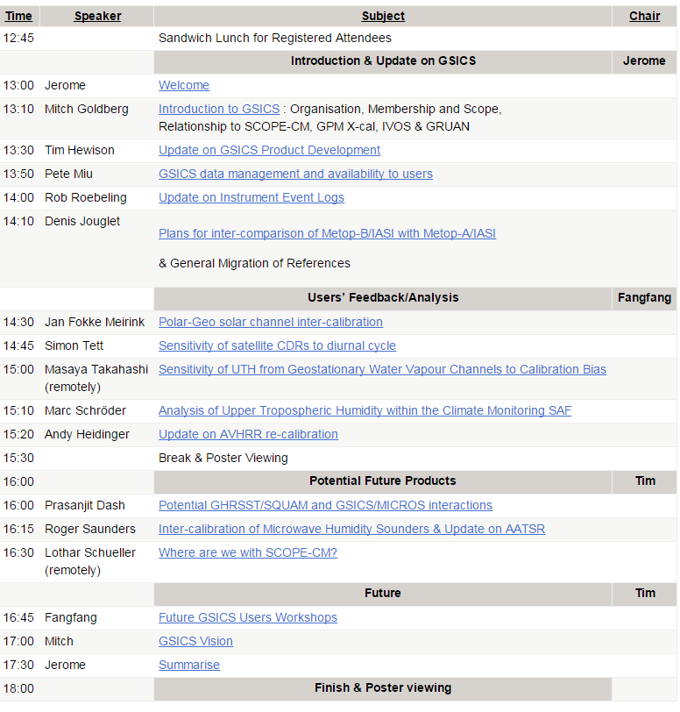
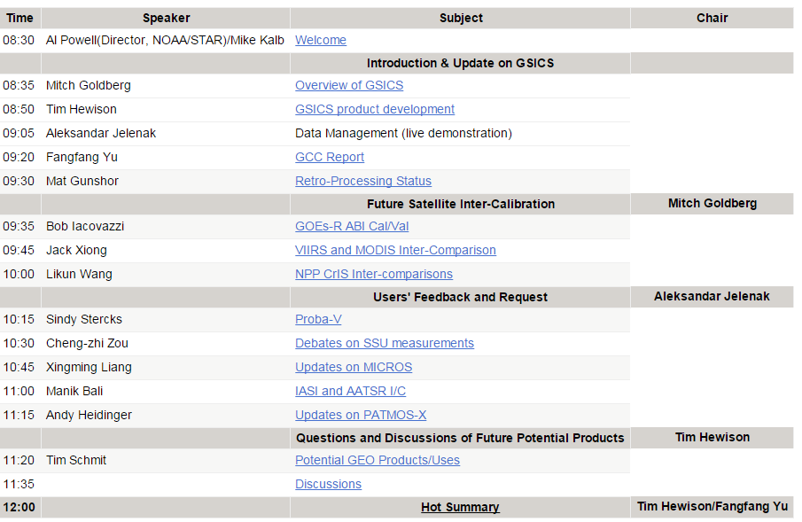
Format of Past two GUWs
EUMETSAT 2012
NOAA 2013
½ Day Session
16 Participants ( presentations ~15 Mins duration ) Cover 3-4 themes.

Slide 7
Lessons learnt
Topics to be presented by Invitees.
Agenda of the EUMETSAT Sat Meeting
Agenda that GSICS suggests
GUW agenda is at the intersection of …..
Agenda of the main conf.
Topic presented by invitees
GSICS suggested agenda
GUW Agenda
Lessons learnt…..
We may not get the agenda that we want.
GSICS is expanding, applications are more but no permanent users who participate in GUW.
Need to balance between discussion time and presentation time.

Slide 8
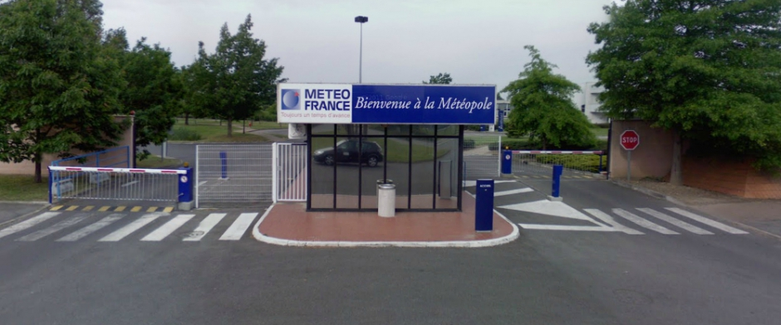
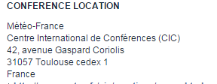
Venue and Date of GSICS Users Workshop 2015
The 2015 GSICS Users Workshop (GUW) will be held with the EUMETSAT Meteorological Satellite Conference. This conference will be held from 21 to 25 September in Toulouse, France and will be collocated in space and time (not exactly!) with the SPIE European Remote Sensing Conference.
The GUW will take place on the afternoon of Tuesday 22 Sept. 2015@ Météo-France

Slide 9
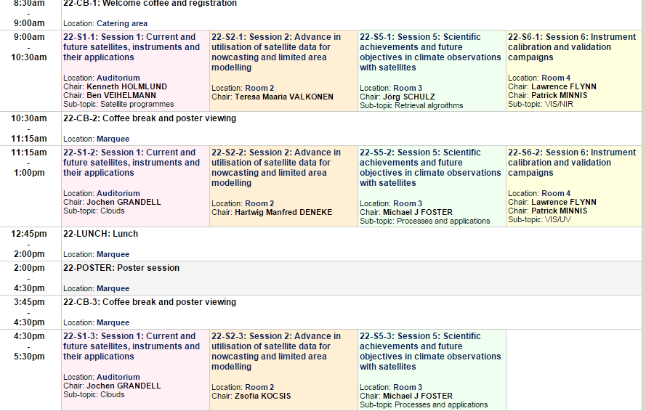
Tentative Agenda for 22 Sep 2015

Slide 10
Aims for 2015 GUW-Proposed themes
Defining User Requirements for GSICS Products (WMO and/or GCC)
New GSICS Demonstration Products (ISRO +CMA +KMA+NASA+ NOAA+EUMETSAT)
Product Update Philosophy
NetCDF Convention Changes
FCDR
GSICS Spectral Corrections ( GCC/M.Bali)
Set up focus groups for each “class” of (potential) deliverables
Key goal of GUW to ….
Kick-off the ‘process’ of defining formal user requirements for GSICS deliverables.

Slide 11
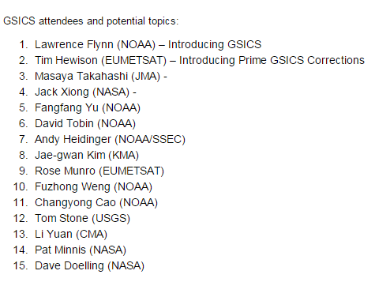
Proposed - Invites
To a large extent Attendees influence the final agenda
Web access and possibility to still make it to the EUMETSAT conf gives a wider opportunity to participants.
Shall we have more discussions and less presentations ( or vice versa).
Whom to invite and topics to cover.
How much place do we have for posters.
Suggestions /ideas ??

Slide 12
THANK YOU

