Slide 1
2015 GSICS Users Workshop Logistics
Special Issue of the IEEE TGRS on “Inter-Calibration of Satellite Instruments”:
Special Issue of the IEEE TGRS on “Inter-Calibration of Satellite Instruments”:
Tim Hewison
(EUMETSAT) (GRWG Chair)

Slide 2
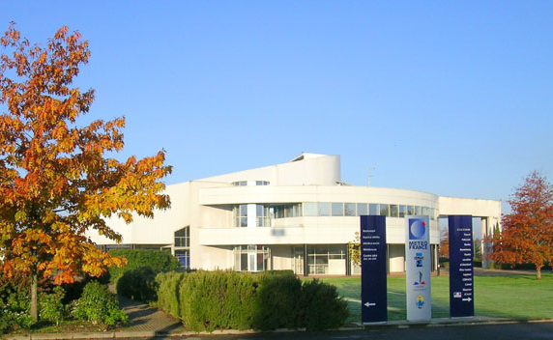
2015 GSICS Users Workshop
At EUMETSAT Conference
Don’t need to register to only attend GSICS User Workshop
At MeteoFrance, Toulouse
7km SW of centre
Shuttle buses provided
Collocated with SPIE European Remote Sensing Conference
Same Week, Same City
Doubles our potential audience
Accommodation busy
Simultaneous Conference Overpass
International Conference Centre of the Météo-France Campus

Slide 3
Timing of Workshop
Tuesday 22 September 2015
Instrument Cal/Val session
Tues am: Chaired by Pat Minnis + Larry Flynn
09:00-10:30 VIS/NIR
11:00-12:30 VIS/UV
12:30-13:00 Lunch
GSICS Users Workshop
13:00-17:30
Cannot over-run!
Last bus leaves around 17:45

Slide 4
Timing after Workshop
Wednesday 23 September 2015
Instrument Cal/Val session
Tues am: Chaired by Chris Barnet + Tim Hewison
09:00-12:30 IR
14:00-16:30 Posters
16:30-17:30 Calibration Facilities + Marine Cal/Val
Wed am: Chaired by Roger Saunders/Tim Hewison
09:00-13:00 Microwave

Slide 5
Registration
No need to register for conference if only attending GSICS User Workshop
But please register in advance
With whom? Manik/Tim?
By when? Friday 18 September?

Slide 6
Remote Access
Will be offered by Webex
Audio not tested
Interest?

Slide 7
General Aims of Workshop
Introductions to GSICS
and its deliverables
Soliciting input from potential users on GSICS products
Managing User Expectations
Draft Agenda on GSICS Wiki

Slide 8
Expected GSICS Attendees
Lawrence Flynn (NOAA) – Introducing GSICS
Tim Hewison (EUMETSAT) – Introducing Prime GSICS Corrections
Alex Ignatov (NOAA) - Potential of NWP Bias Monitoring for Satellite Inter-Calibration using MICROS
Masaya Takahashi (JMA) -
Jack Xiong (NASA) -
Fangfang Yu (NOAA)
David Tobin (NOAA)
Andy Heidinger (NOAA/SSEC)
Jae-gwan Kim (KMA)
Rose Munro (EUMETSAT)
Dave Doelling (NASA)
Fuzhong Weng (NOAA)
Changyong Cao (NOAA)
Tom Stone (USGS)
Li Yuan (CMA)
Pat Minnis (NASA)
Alexander Uspensky

Slide 9
Possible User Attendees
Reto Stöckli (MeteoSwiss?) - CDOP3 requirements for recalibration
Ewa Kwiatkowska - Ocean Turbidity Product requirements for SEVIRI VIS/NIR calibration and testing demo products
Tom Wilheit
Roger Saunders
Karsten Fennig
Hank Revercomb
William Ingram (UKMO)
Marc Shröder (DWD)
Helen-Marie Hanlon (UKMO) - Microwave FCDR
Timo Hanschmann (DWD)
Terhikki Manninen (FMI) - albedo FCDR
Niolas Ghilain (RMIB) - LandSAF?+CMSAF land energy & turbulent flux
Lucrezia Ricciardulli (RSS)
Xavier Calbet (EUMETSAT)
Rüdiger Lang (EUMETSAT)
Eric Stocker
Brown (UKMet)
Carey (ERT, NOAA)
Zhou (NOAA)
Best (NOAA/SSEC)
Camy-Peyret (IPSL)
Coppens (EUMETSAT)
Dufour (Noveltis)
Polyakov (St.Petersburg)
Revercomb (NOAA/SSEC)
Tsamalis (UKMet)
Wang (Univ. Maryland)
Gambacorta (STC)

Slide 10
Possible User Attendees – cont.
Anderson (Northrop Grumman)
Brogniez (LATMOS)
Kunkee (Aerospace)
Tian, M. (ERT, NOAA)
Yang (Univ. Maryland)
Zou, X. (Univ. Maryland)
Krijger (SRON)
Sihler (Max-Planck)
Uprety (Colorado St.)
Yuan, L. (NSMC)
Griffith (Exelis)

Slide 11
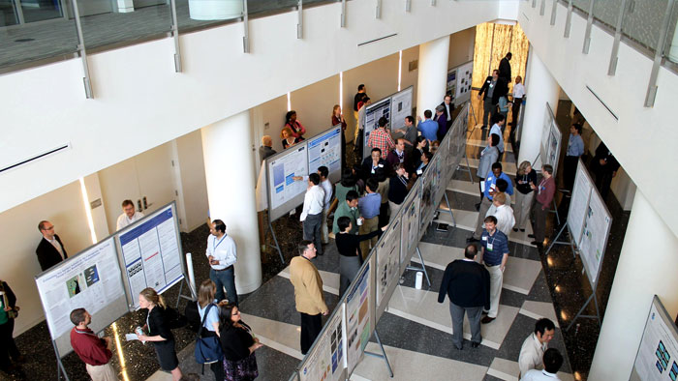
Posters
Conference poster sessions
Tuesday afternoon
(During GSICS User Workshop)
Wednesday afternoon
In a market outside conference centre
NSC 2013 poster presentations

Slide 12
Thank You
Notes:
12

