Slide 1
Formation of IR Sub-Group and Reference Selection
Special Issue of the IEEE TGRS on “Inter-Calibration of Satellite Instruments”:
Special Issue of the IEEE TGRS on “Inter-Calibration of Satellite Instruments”:
Tim Hewison
(EUMETSAT) (Outgoing GRWG Chair)

Slide 2
Overview
Scope of IR Sub-Group
Membership
Self-introductions
Chairing the IR Sub-Group
Possible Projects
Discussion: Priorities, contributions, PIs

Slide 3
Overview
Scope of IR Sub-Group
Membership
Self-introductions
Chairing the IR Sub-Group
Possible Projects
Discussion: Priorities, contributions, PIs

Slide 4
Revised Vision for GSICS in 2020s
The aim of the Global Space-based Inter-calibration System (GSICS) is to coordinate the production of satellite inter-calibration information enabling the use of space-based observations with improved and consistent accuracy for climate monitoring, weather forecasting and environmental applications(…)
The focus of this activity is the systematic generation of in-orbit (…)
This production is, however ,part of a comprehensive strategy, which involves a broad range of activities including:
Instrument Level 1 data monitoring
In-orbit instrument comparison with references
Routine generation of intercalibration corrections for near real-time applications
Provision of algorithms enabling recalibration of archived data,
Traceability to absolute calibration standards,
Pre-launch instrument characterization
Documenting state-of-the-art calibration techniques.

Slide 5
GSICS functions/deliverables
Intercomparison of space-based instruments with GSICS references, and operational calibration adjustments
Algorithms for such comparisons or corrections (NRT or archive)
Documentation and information
Measurement references, software tools, data sets, infrastructure
Standard procedures and best practices

Slide 6
GSICS Organisation
CGMS
WMO
GSICS Exec Panel
GSICS Coordination Center
GSICS Research Working Group
GSICS Data Working Group
UV Sub-Group
IR Sub-Group
WGCV IVOS
WGCV MWSG
GPM X-CAL
CEOS ACC
WGCV ACSG
VIS/NIR Sub-Group
Microwave Sub-Group

Slide 7
Scope of IR Sub-Group
Counterpart of VIS/NIR, Microwave and UV Sub-Groups
For satellite instruments channels in thermal infrared
To establish user requirements for inter-calibration
Cooperate with instrument calibration groups
To communicate relevant information to the users
To help them understand the root cause of observed biases and develop fixes
Review existing, or Develop new inter-calibration
algorithms, procedures, corrections, etc.
to meet these
To define and promote calibration standards, tools and datasets, and best practices
Including selection of inter-calibration reference

Slide 8
Overview
Scope of IR Sub-Group
Membership
Self-introductions
Chairing the IR Sub-Group
Possible Projects
Discussion: Priorities, contributions, PIs

Slide 9
Membership
All GRWG members can participate
External experts can also join
Please introduce yourself!
In particular, planned activities related to GSICS

Slide 10
Overview
Scope of IR Sub-Group
Membership
Self-introductions
Chairing the IR Sub-Group
Possible Projects
Discussion: Priorities, contributions, PIs

Slide 11
Selection of IR Sub-Group Chair
From https://gsics.nesdis.noaa.gov/wiki/Development/RolesAndResponsibilities:
Understanding users’ requirements for inter-calibration products
Identifying existing products that could meet those requirements
Providing direction in the development of new inter-calibration products and enhancement of existing ones
Promoting these products towards operational status
by coordinating reviews through the GSICS Procedure for Product Acceptance
Coordinating with other groups (such as WGCV Sub-Groups) to generate standards and best practices
Define and chair portions of the agenda of the GRWG meeting, if possible
Chair occasional teleconference meetings on specific topics of interest to the Sub-Group
Agree actions and recommendations from above meetings, and follow these up
Report to GRWG and Exec Panel, if possible

Slide 12
Nomination of IR Sub-Group Chair
Nominations accepted:
Chair: Tim Hewison (EUMETSAT)
Vice-chair: Likun Wang (NOAA)
Period: Initially 2 years
Thereafter every 3 years – to not be simultaneous with GRWG chair

Slide 13
Overview
Scope of IR Sub-Group
Membership
Self-introductions
Chairing the IR Sub-Group
Possible Projects
Discussion: Priorities, contributions, PIs

Slide 14
Possible IR Sub-Group Projects
Promote GEO-LEO IR products to Operational! – Support & Further Development
For IR channels of GEO imagers – Tim, Masaya, Dohyeong, Hyesook, Minju, Manik, Fangfang
GEO IR Sounders (broad-band) , Fangfang
Preparation for hyperspectral IR?
Development of LEO-LEO IR products for
imagers – Likun, Manik (MetopA/AVHRR), Tim, Fred ?, Fangfang
Hyperspectral IR - Likun
Deployment of Prime GSICS Corrections – Tim , Masaya, Fangfang
Diurnal calibration variations - Masaya , Fangfang, Dohyeong, Hyesook, Minju
Report on Reference Sensor Traceability and Uncertainty – Tim, Likun,
Development of NWP inter-calibration method , Fangfang
GEO-GEO comparisons - Dave, Hidehiko, Dohyeong, Hyesook, Minju , Fangfang
Instrument specification, pre-launch characterisation, cal/val testing - Likun , Fangfang
Broadband Reference IR inter-calibration – Dave, Rob, Likun
Spectral Response Function retrieval - Manik

Slide 15
GSICS Corrections for GEO-LEO IR
In 2015, 6 GPRCs are preparing for their GEO-LEO IR GSICS products to enter new modes:
EUMETSAT and NOAA -> Operational mode
JMA -> pre-operational mode
ISRO, CMA, KMA -> demonstration mode
For the first time we will be able to inter-calibrate the geostationary ring to the same reference!

Slide 16
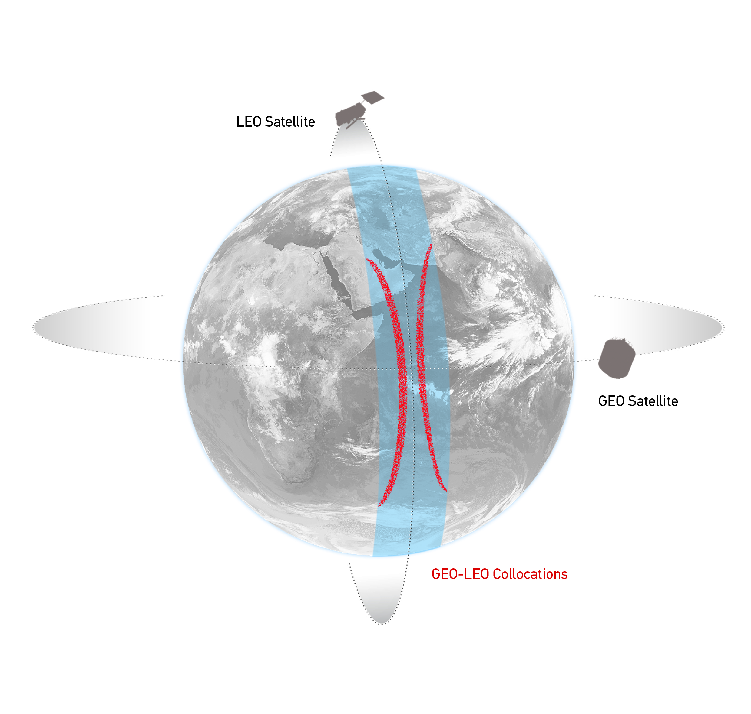
GEO-LEO IR - Hyperspectral SNO
Simultaneous near-Nadir Overpasses
of GEO imager and LEO sounder
Select Collocations
Spatial, temporal and geometric thresholds
Schematic illustration of the geostationary orbit (GEO) and polar low Earth orbit (LEO) satellites and distribution of their collocated observations.

Slide 17
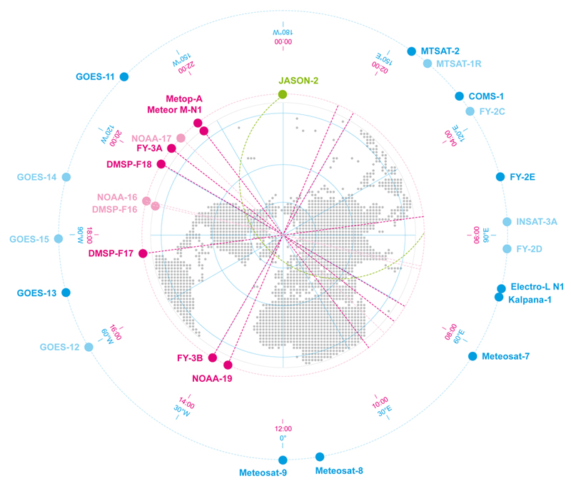
Linking the GEO ring
Schematic Example of GEO and LEO Earth Observing Satellite
Showing GEO sub-satellite longitude and equator crossing time for sun-synchronous LEO satellites

Slide 18
Linking the GEO ring
GSICS Corrections for GEO-LEO IR
All using Metop/IASI as hyperspectral references
Solid lines = Pre-Operational
Dashed lines = Demonstration
Dotted lines = Prototype

Slide 19
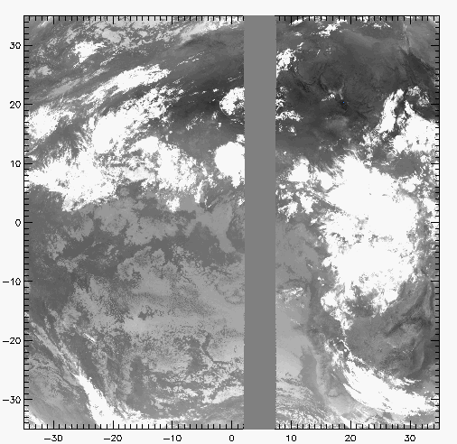
GEO-GEO IR – Broadband SNO
Simultaneous near-Nadir Overpasses
of GEO imager pairs
Select Collocations
Spatial, temporal and geometric thresholds
Narrow longitudinal strip of collocations
Allows continuous comparisons 24/7
Investigate midnight calibration problems
Non-identical Spectral Responses
Need Spectral Band Adjustment Factor
Based on IASI observations
Or reference profiles + RTMs
Example Image of Meteosat-9 10.8μm Channel Grey area shows collocated MSG2-MSG1 pixels

Slide 20
Linking the GEO ring
GEO-GEO Comparisons
Based on collocated observations
GEO imager pairs
Need SBAFs

Slide 21
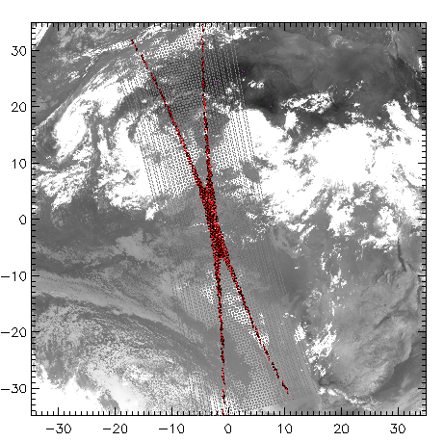
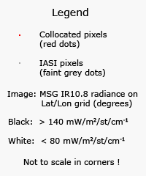
Collocation Criteria
Simultaneous near-Nadir Overpasses
Only night-time data ΔLat<35° ΔLon<35° Δt< 5 min Δsecθ < 0.01
GEO-LEO
GEO-GEO
Restricted to ~tropics
~1000 collocations/orbit/night
Restricted to narrow strip
Can extend to cover 24hr
Example Image of Meteosat-9 10.8μm Channel Red points show collocated MSG-IASI pixels
Example Image of Meteosat-9 10.8μm Channel Grey area shows collocated MSG2-MSG1 pixels

Slide 22
Linking the GEO ring
Comparing GEO-LEO and GEO-GEO Differences
To Validate Uncertainty estimates
Ensure consistency
Generate global L2 products
Ensure consistency

Slide 23
Strategy for closing the GEO Ring
First step: Identify one date which is common to all GEOs
(without stray light or midnight effect)
Second step: to investigate the GEO-GEO comparison across the GEO ring.
Rob mentioned that the climate community would test the result of this work.
Action: Tim to ask ECMWF for double differencing of geostationary ring.
Action: IMD/ISRO to contact the IMD NWP and NCMRWF about the same topic.
Action: Tim to conduct a survey to identify a date among GPRC so that they produce the GSICS corrections for that date and provide them to Dave.
Dave suggests taking 0/3/ 6/9 GMT for that date.
Action: Dave to report on the analysis of these data.
Action: Tim to provide SBAF tool to support this analysis
CMA are interested to compare the FY-2 observations to other instruments.

Slide 24
Managing IR Sub-Group Projects
All by Sub-Group chair?
Or delegate to Principle Investigators, assigned to each project?

Slide 25
Overview
Scope of IR Sub-Group
Membership
Self-introductions
Chairing the IR Sub-Group
Possible Projects
Discussion: Priorities, contributions, PIs

Slide 26
Thank You
Notes:
26

