Slide 1
GRWG Web Meeting: Best Practice for defining SBAFs
Special Issue of the IEEE TGRS on “Inter-Calibration of Satellite Instruments”:
Special Issue of the IEEE TGRS on “Inter-Calibration of Satellite Instruments”:
Tim Hewison
(EUMETSAT) (Outgoing GRWG Chair)

Slide 2
Agenda
Tim Hewison (EUMETSAT) - Introduction
Ben Scarino (NASA) - NASA SBAF web page
Ben Scarino (NASA) - The use of IASI to define SBAFs for IR channels
Tom Stone (USGS) – How ROLO accounts for different Spectral Response Functions
Sebastien Wagner (EUMETSAT) – GIRO SBAFs
Tim for Viju John - Meteosat-HIRS SBAFs
All - Discussion on whether we can recommend standard methods to define SBAFs and their uncertainties

Slide 3
Introduction to SBAF Definition - Can we define a Best Practice?
Special Issue of the IEEE TGRS on “Inter-Calibration of Satellite Instruments”:
Special Issue of the IEEE TGRS on “Inter-Calibration of Satellite Instruments”:
Tim Hewison
(EUMETSAT) (Outgoing GRWG Chair)

Slide 4
Revised Vision for GSICS in 2020s
Action: GRWG Chair to set up an additional web meeting on SBAF determination
Other SBAF actions:
GWG_13.26 | Ben Scarino to analyse SBAFs for each GEO imager and supply to GPRCs, together with the uncertainty due to DCC variation - due by 2nd DCC web meeting. | BenScarino? | 01 Jun 2013
GRWG_15.52 | Tim to provide SBAF tool to support the analysis of GEO-GEO double-differences | TimHewison | 29 Feb 2016

Slide 5
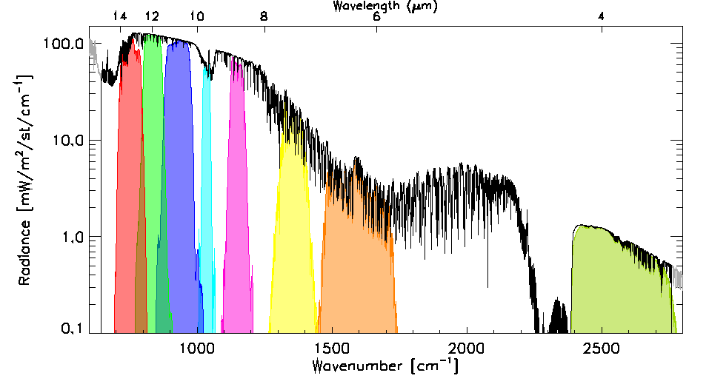
Background
Comparisons with Hyperspectral references
Can synthesise any SRF
With negligible uncertainty*
Need no SBAFs
*Confirmed by uncertainty analysis

Slide 6
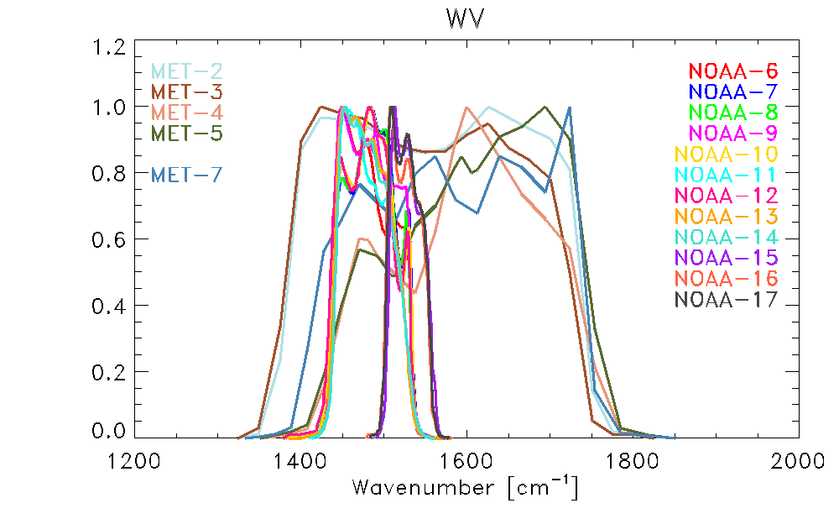
Background
Comparisons with Hyperspectral references
Can synthesise any SRF
With negligible uncertainty
Need no SBAFs
Comparisons with Broad-band reference instruments
Different SRFs
Different sensitivity to scene radiance spectral
Need SBAF to project between channel spaces
HIRS -2
MET
HIRS-3/4

Slide 7
Motivation for Systematic SBAF Definition
Now starting to generate GSICS products using broadband reference instruments
VIS/NIR: DCC and Lunar Using Aqua/MODIS
Microwave
IR: GEO-HIRS
SBAFs can be defined in many ways
Can we define a generic procedure as a best practice to define the SBAF?

Slide 8
Basic Approaches
Regression using training dataset
Radiances from monitored and reference instruments
What form of regression?
Linear – between pairs of channels
Multiple – between combinations of channels
What combinations?
Weighted?
Non-linear?
In radiance/reflectance/brightness temperature?

Slide 9
Training Datasets
Synthetic }
Empirical }- Observations from monitored and reference instruments
Semi-synthetic}
Need to cover full range of target inter-calibration
Radiances
Viewing geometry
Atmospheric conditions LARGE!
Geographic (lat, lon, surface type, ...)

Slide 10
Synthetic Training Datasets
Synthetic
E.g. Radiative Transfer Models
Need to include atmosphere (clear, cloud, aerosol, ppt)
And Surface (sea/land/ice,...)
From Radiosondes/NWP
May include model biases
Difficult to ensure representative
Estimate uncertainties by perturbing inputs (e.g. Monte Carlo method)

Slide 11
Empirical Training Datasets
Observational
E.g. Pairs of collocated observations
Need to account for instrumental biases
Can ensure representative using large real dataset
Estimate uncertainties from regression statistics

Slide 12
Semi-Synthetic Training Datasets
From Hyperspectral Observations
Convolved with SRFs of monitored and reference instruments
May include inter-band instrumental biases? Small?
Can ensure representative using large real dataset
Estimate uncertainties from regression statistics

Slide 13
Uncertainties
Need to estimate uncertainty
Error propagation difficult
Using validation dataset
Independent from training dataset

Slide 14
Agenda
Tim Hewison (EUMETSAT) - Introduction
Ben Scarino (NASA) - NASA SBAF web page
Ben Scarino (NASA) - The use of IASI to define SBAFs for IR channels
Tom Stone (USGS) – How ROLO accounts for different Spectral Response Functions
Sebastien Wagner (EUMETSAT) – GIRO SBAFs
Tim for Viju John - Meteosat-HIRS SBAFs
All - Discussion on whether we can recommend standard methods to define SBAFs and their uncertainties

Slide 15
Can we recommend standard methods to define SBAFs and their uncertainties?
Special Issue of the IEEE TGRS on “Inter-Calibration of Satellite Instruments”:
Special Issue of the IEEE TGRS on “Inter-Calibration of Satellite Instruments”:
Tim Hewison
(EUMETSAT) (Outgoing GRWG Chair)

Slide 16
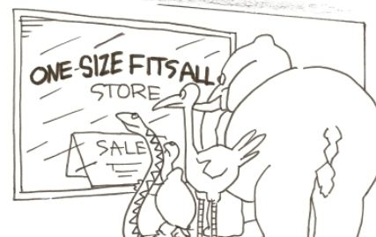
Is one approach the best?
How to select best approach:
Just compare uncertainties?
Try each approach and perform independent validation?
How?
Repeat for different inter-calibration classes
GEO-LEO IR/VIS/NIR
LEO-LEO?

Slide 17
Next Steps?
Do we take this further?
If so, how?
Who to lead?
Timescale?

