Slide 1
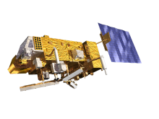
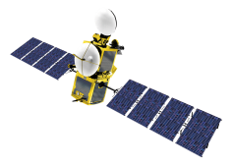
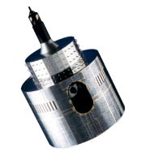
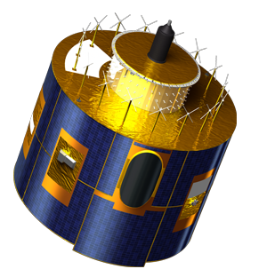
Deriving SBAFs using the GIRO
S. Wagner, B. Viticchie, T. Hewison
Notes:
EUM/STG-SWG/36/14/VWG/15

Slide 2
Method
Run the GIRO on MSG1 dataset with admissible phase angles ( = phase angle ranging from -92 to +92)
Fake the MSG1 SRFs with MODIS equivalents (Band 1 for VIS06, Band 2 for VIS08 and Band 6)
Run the GIRO on MSG1 dataset with faked MSG1
Check the ratio between the modelled GIRO irradiance with MSG1 SRFs and the modelled GIRO irradiance with MSG1-Modis-like SRFs
Same for Meteosat 7

Slide 3
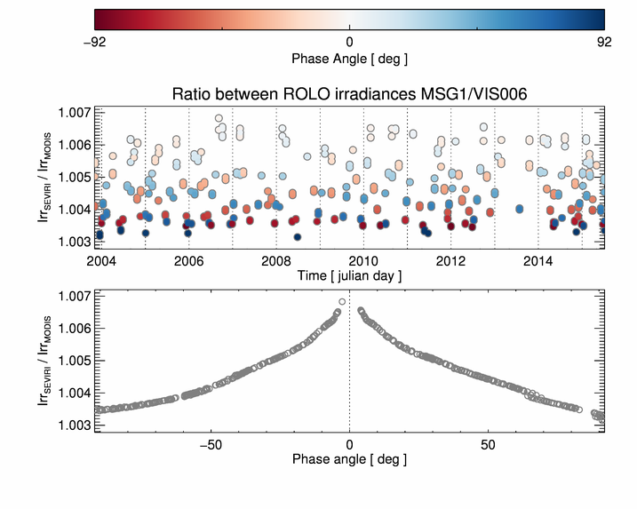
Results – MSG1 VIS06 – MODIS Aqua Band 1
For DCCs MSG1 – MODIS Aqua Band 1: 1.015 using NASA tool, 1.017 using data from GSICS ATBD

Slide 4
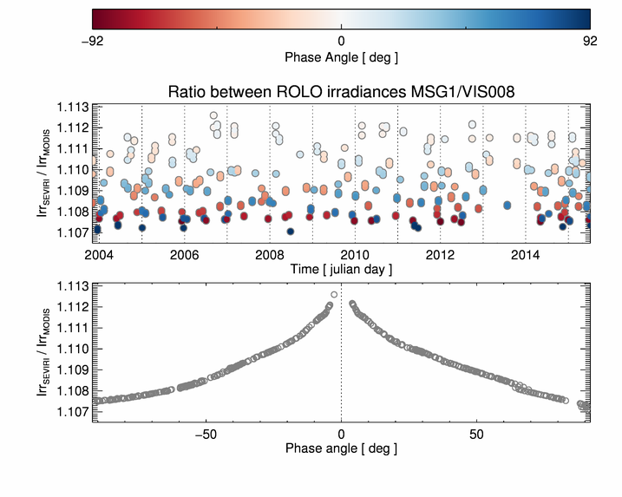
Results – MSG1 VIS08 – MODIS Aqua Band 2

Slide 5
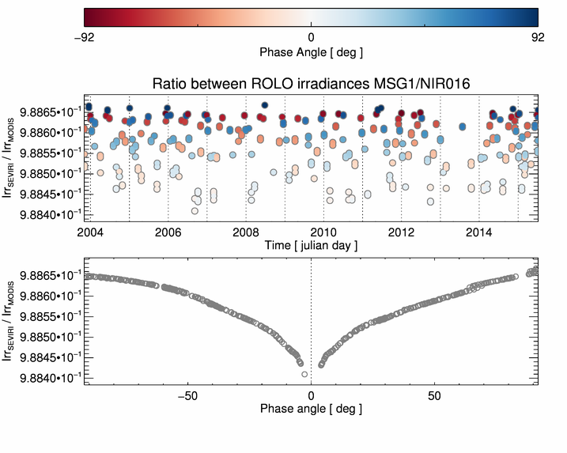
Results – MSG1 NIR16 – MODIS Aqua Band 6

Slide 6
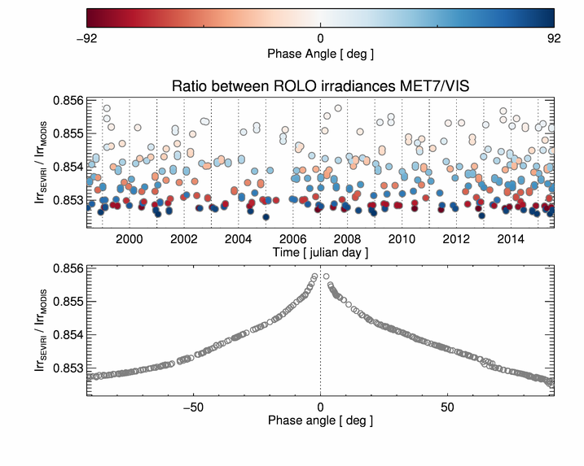
Results – Meteosat 7 – VIS – MODIS Aqua Band 1
For DCCs MET7 – MODIS Aqua Band 1: 0.874 using NASA tool, 0.873 using data from GSICS ATBD

Slide 7
Conclusions
SBAFs change with the scenes
GIRO preliminary calculation show some dependency (~0.5% max)
Uncertainties should be given in the products. Shall we have SBAFs in the GSICS VNIR products for each individual method?
How can we decrease the uncertainties?

