Slide 1
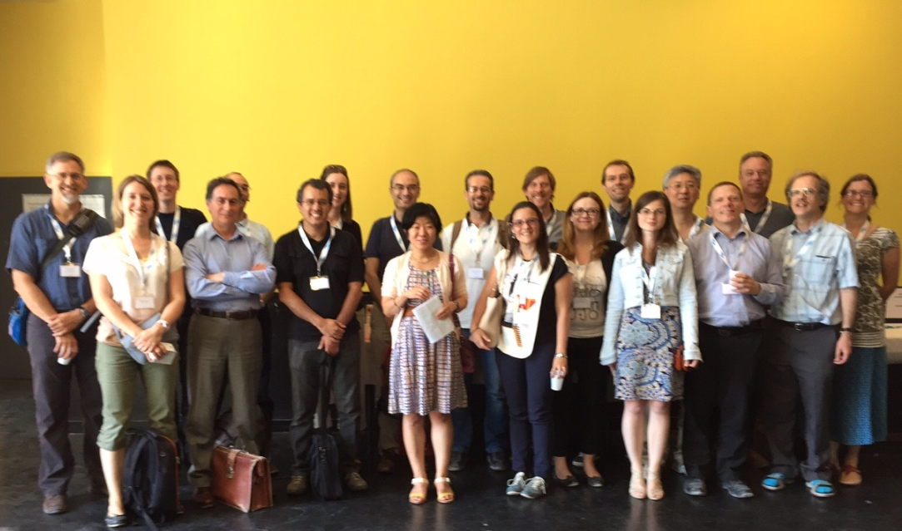
High points from the workshop
organizing committee Hélène Brogniez, Stephen English, Jean-François Mahfouf and Sophie Cloché
Many thanks to Hélène for helping setting up these slides

Slide 2
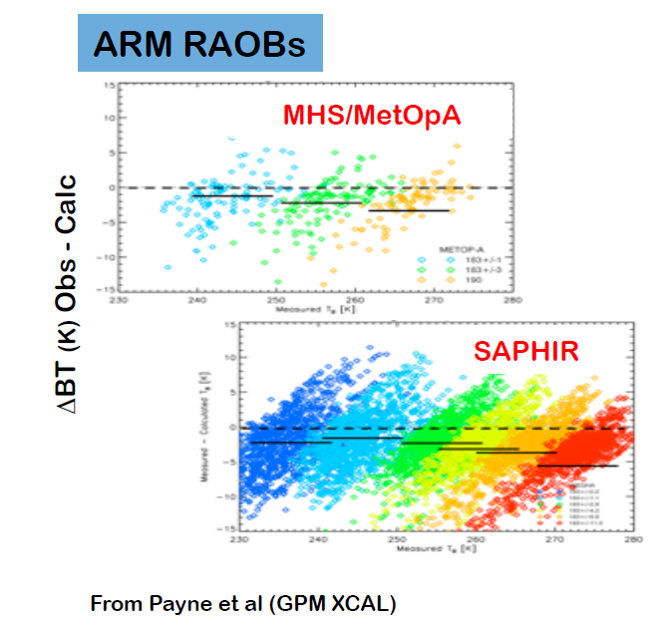
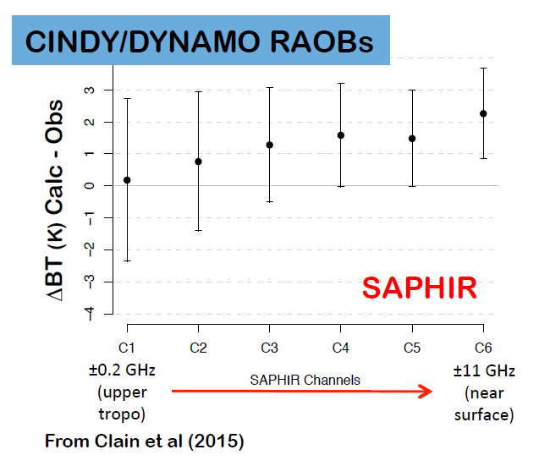
The workshop aimed at identifying possible explanations for biases observed between measured and simulated 183GHz data.
Comparisons of brightness temperatures measured by the SAPHIR instrument on Megha-Tropiques, ATMS on Suomi-NPP and MHS on Metop-A&B with values calculated using radiative transfer models such as RTTOV and ARTS, using both radiosonde and NWP short range forecasts input data, have shown biases in the wings of the 183 GHz line.
wrt RAOBs
183 ±1
183 ±3
190
Courtesy of Helene Brogniez
Notes:
Recent comparisons between observed BTs in the 183GHz line and calculated BTs exhibit a pattern, wrt RAOBs, when assimilated for NWP purposes

Slide 3
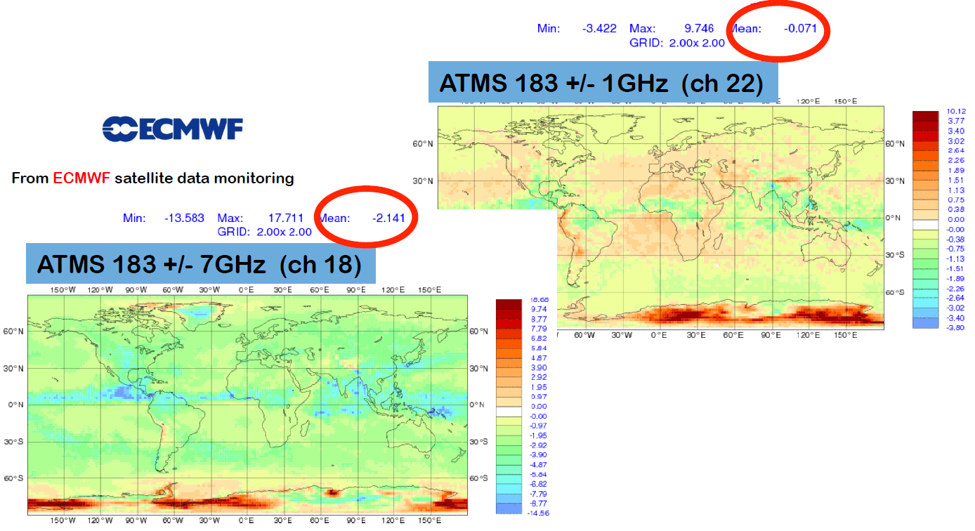
Also when assimilated for NWP purposes: ΔBT (K) Obs – First Guess
Courtesy of Hélène Brogniez

Slide 4
The workshop was formatted around some introductory presentations followed by working group (WG) discussions that addressed errors and uncertainties for:
WG1: "in situ" water vapor measurements (to assess the absolute and relative accuracy of references: i.e. RAOBs, GNSS, lidars, measurements of RH; errors in the comparison between in-situ and space-borne measurements)
WG2: space-borne instruments (absolute calibration of instruments; sensor intercomparison)
WG3: spectroscopy and radiative transfer (uncertainty in spectroscopic lineshapes and lineshape parameters; RTM uncertainties; microwave and IR)
WG4: errors from analysis techniques (assess difference in the time/space scales of measurements; uncertainties and errors linked to retrieval methods (NWP models & “Level 2” retrievals), uncertainty arising from undetected clouds)
What is the contribution of each element to the overall biases?

Slide 5
High points from WG1: in situ measurements
Radiosondes: Uncertainties in RH arise mainly from the calibration procedures, the calibration corrections, time-lags and (for some probes) the solar radiation heating of the sensor (dry bias and on temperature cooling heating effect); day/night difference.
Error in lower troposphere RH profiles is 2-5% , small enough not to have an impact at 183 GHz;
Errors in higher levels of the profiles are larger → radiosonde errors could only explain biases near the line centre (corresponding to upper tropospheric humidity);
A systematic bias in the observed-calculated BT difference can be attributed to a spatial and temporal mismatch between the satellite measurements and the reference station (radiosonde/GNSS/lidar)
GNSS receivers: GNSS estimations of the atmospheric precipitable water (PW) have a mean uncertainty of ~2% (<1.0mm) (Tong et al., 2015). , Recent studies showed a dry bias in the GNSS values (~2.0mm in PW) at moist conditions (Ciesielski et al., 2014)
Lidar systems: Two types of lidars can be used to measure water vapour profiles, Differential absorption lidars (DIAL) and Raman lidar: accuracy < 5%
Notes:
Radiosondes: Uncertainties in RH arise mainly from the calibration procedures, the calibration corrections, time-lags and (for some probes) the solar radiation heating of the sensor 9dry bias and on temperature cooling heating effect).

Slide 6
High points from WG2: biases in space-borne observations
The calibration status of the 183 GHz channels of GPM GMI and of the other sensors was presented by Wesley Berg, while William Ingram discussed the homogenisation procedures of microwave humidity sounders.
Non linearity: until GMI only characterized pre-launch. Now can be done post-launch using noise diodes (low channels) : very small, around 0.1 K
Intercomparison among different instruments gives 0.5 K among the various channels, with no trend (see better from Rachel and Isaac presentations)
Antenna pattern errors in sounders do not explain the biases

Slide 7
WG2: suggestions and recommendations
For future instruments strongly encourage recording of digital data and meta data of Spectral Response Functions (SRF), antenna patterns etc; a number of different agencies are currently working on providing this: GOES Chem, WMO SATURN, ITWG.
Supporting continuation of “calibration” satellite manoeuvres: spacecraft pitch manoeuvres (for correcting scan-dependent biases) and deep space manoeuvres (AP and back lobe).
Determine how best to combine pass bands for the double-side bands; sideband asymmetry.
TB vs Radiance in products: ATMS will release radiance; MWI/ICI will release radiance; MWS will release TB and Radiance. Conversion from radiance to TB should be done consistently or could create systematic differences.
Notes:
-knowing the exact SRF and frequency shift
Ed Kim:
SI-TRACEABLE Microwave TB Standards FOR MICROWAVE RADIOMETER INTER-CALIBRATION
No SI-traceable radiance standards exist (until now)
NWP are requesting radiances

Slide 8
High points from WG3: spectroscopy and radiative transfer
Spectroscopy has multiple components to explain only part of the biases : line shape (for WV); Spectroscopic parameters (line width); continuum, cutoff; microwave/infrared inconsistencies
in the MW, use of MonoRTM, with HITRAN database and MT_CKD 2.4 continuum (large differences wrt other models as Rosenkranz and Liebe)
uncertainty estimates for parameters at 183 GHz:
Impact of the ozone line: 0.2-0.3 K in the opposite direction
Good consistency between MW and IR
Parameter | Uncertainty | comment
183 GHz intensity | 0.5 % | Well known
183 GHz air-broadened half-width | 3% | Error in one can be compensated by an opposite error in the other
183 GHz T-dependence of air-broadened half-width | 15%
Foreign H2O continuum | 4% | Error in one can be compensated by an opposite error in the other
Self H2O continuum | 4%
Notes:
25% in the continuum would produce 1.5 K at ±7 and 0.5 K at ±3

Slide 9
High points from WG4: methodological biases
NWP model analysis:
Because of assimilation and the weight given to radiosonde observation (anchor measurements), it is possible that humidity analyses share similar bias characteristics to radiosondes, which might explain some of the consistency between the spectral gradient-dependent bias found with both in situ measurements and NWP simulations
Space variability of the bias is not an issue (bias quite homogeneous)
Undetected clouds impact can be significant (0.5K at 183±3 GHz and 183±7 GHz)
For channels near the line, 5% reduction in UTH would reduce the bias
Hydrometeor-Impacted Spaceborne Microwave Data: Instrument uncertainty and bias small compared to uncertainty in macro- and microphysical assumptions
Notes:
Use of AVHRR and SEVIRI for cloud screening
Assimilation: combine together observations with different bias characteristics into a forecast model that itself may be biased compared to the truth.
In the ECMWF system, for example, bias correction is applied to the AIREPs and satellite observations (as well as to other observation types not connected to humidity). In order to anchor the bias corrections and the final the humidity analysis, RAOBS are not bias corrected with VarBC (although corrections are applied to standardize them to night-time RS92 observations; see Agusti-Panareda et al. 2009). Hence it is possible that humidity analyses share similar bias characteristics to radiosondes, which might explain some of the consistency between the spectral gradient-dependent bias found with both in situ measurements and NWP simulations. More investigations would be needed to test the impact of this anchoring.
An issue that affects most comparisons between 183 GHz observations and a reference is cloud detection, because the effects of clouds and precipitation are not usually included in radiative transfer simulations. The presence of clouds and precipitation will naturally reduce 183 GHz brightness temperatures in the lower-peaking channels, either by scattering or by absorption, which increases the altitude of the weighting function

Slide 10
What is the contribution of each element to the overall biases?
It appears to be a combination of multiple error sources:
Undetected clouds;
Surface contamination in the low peaking channels;
Spectroscopy has multiple components to explain some of the biases;
Instrument errors;
………………
Towards recommendations and actions
Improve the quantification of the effect of undetected cloud is needed for MW instruments. The use of cloud masks derived from visible-IR algorithms must account for sampling biases.
Reinforce the links between instrument designers and spectroscopy experts.
Encourage cross comparisons of water vapor measurements by lidar, RAOBS and models.
The knowledge of the spectral response functions of the instruments is mandatory, as well as the record of digital data and meta data of SRF, antenna patterns etc.
To WMO: the SATURN portal (http://www.wmo.int/pages/prog/sat/index_en.php) should include a point of contact for each instrument listed in the database.
Whilst recognizing the high confidence in spectroscopic parameters there is a clear need for new and continuing laboratory measurements to confirm the uncertainty levels for the main parameters. It is thus important to discuss funding opportunities for new 183 GHz spectroscopic measurements during the HITRAN meetings.
Test impact of new spectroscopic data sets from the Russian laboratory work on 183 GHz calculations

