Slide 1

SBUV/2 Calibration Lessons Over 30 Years: 1985-2015
Liang-Kang Huang, Matthew DeLand, Steve Taylor
Science Systems and Applications, Inc. (SSAI) /
NASA Goddard Space Flight Center
GSICS GRWG-UVSG Meeting
College Park, MD
8-9 October 2015

Slide 2
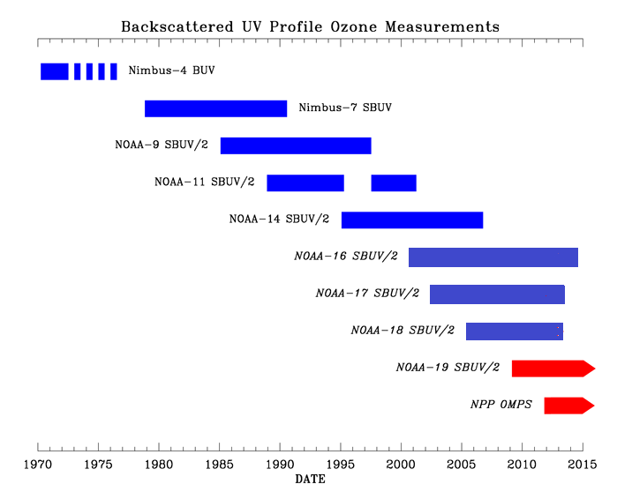
Overview
Backscattered ultraviolet (BUV) profile ozone data record began in 1970. Includes 7 SBUV/2 instruments covering 1985-present.
Similar instrument design allows use of common analysis techniques for all instruments, but each SBUV/2 also has unique characteristics.
Consistent instrument calibration and accurate long-term characterization are needed to produce ozone data sets that can be merged for trend studies.
Notes:
.

Slide 3
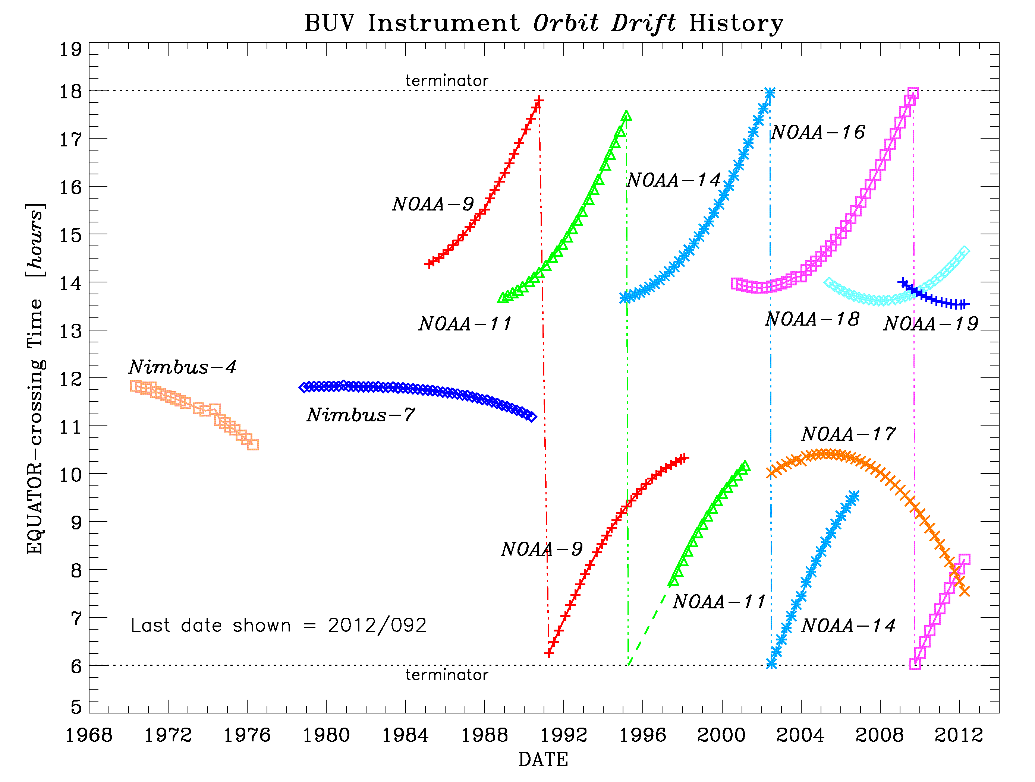
Approach
Evaluate Day-1 photometric calibration and time-dependent characterization for each instrument.
Satellite orbits drift in local time complicates comparisons due to trace gas diurnal change and difference in measurement solar zenith angle.
Overlapping data records provide best opportunity for intercalibration.
Evaluate inter-instrument calibration using radiances, rather than retrieved ozone.
Notes:
.

Slide 4
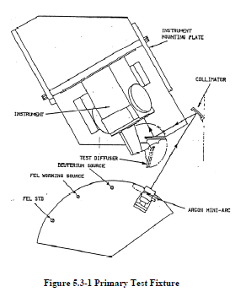
Prelaunch Radiometric Calibration
Prelaunch radiance and irradiance calibration tests use same NIST irradiance lamp standards.
Solar and test diffusers are deployed at the same position consecutively and repeatedly.
Accuracy of albedo (sun-normalized radiance) calibration therefore depends on BRDF of laboratory diffuser.
Notes:
.

Slide 5
Instrument Characterization
Many laboratory characterization tests are validated on-orbit using different types of measurements (both calibration and science):
  Wavelength calibration: Mercury lamp, solar spectrum.
  Electronic offset (dark signal): Sensor door closed, night side Earth view.
  Electronic gain ratio: Selected Earth view scenes with overlapping valid signals in two gain ranges.
  Solar diffuser goniometry: Monochromatic solar measurements (elevation angle response, wavelength dependence).
  Non-linearity: Monochromatic Earth view.
Notes:
.

Slide 6
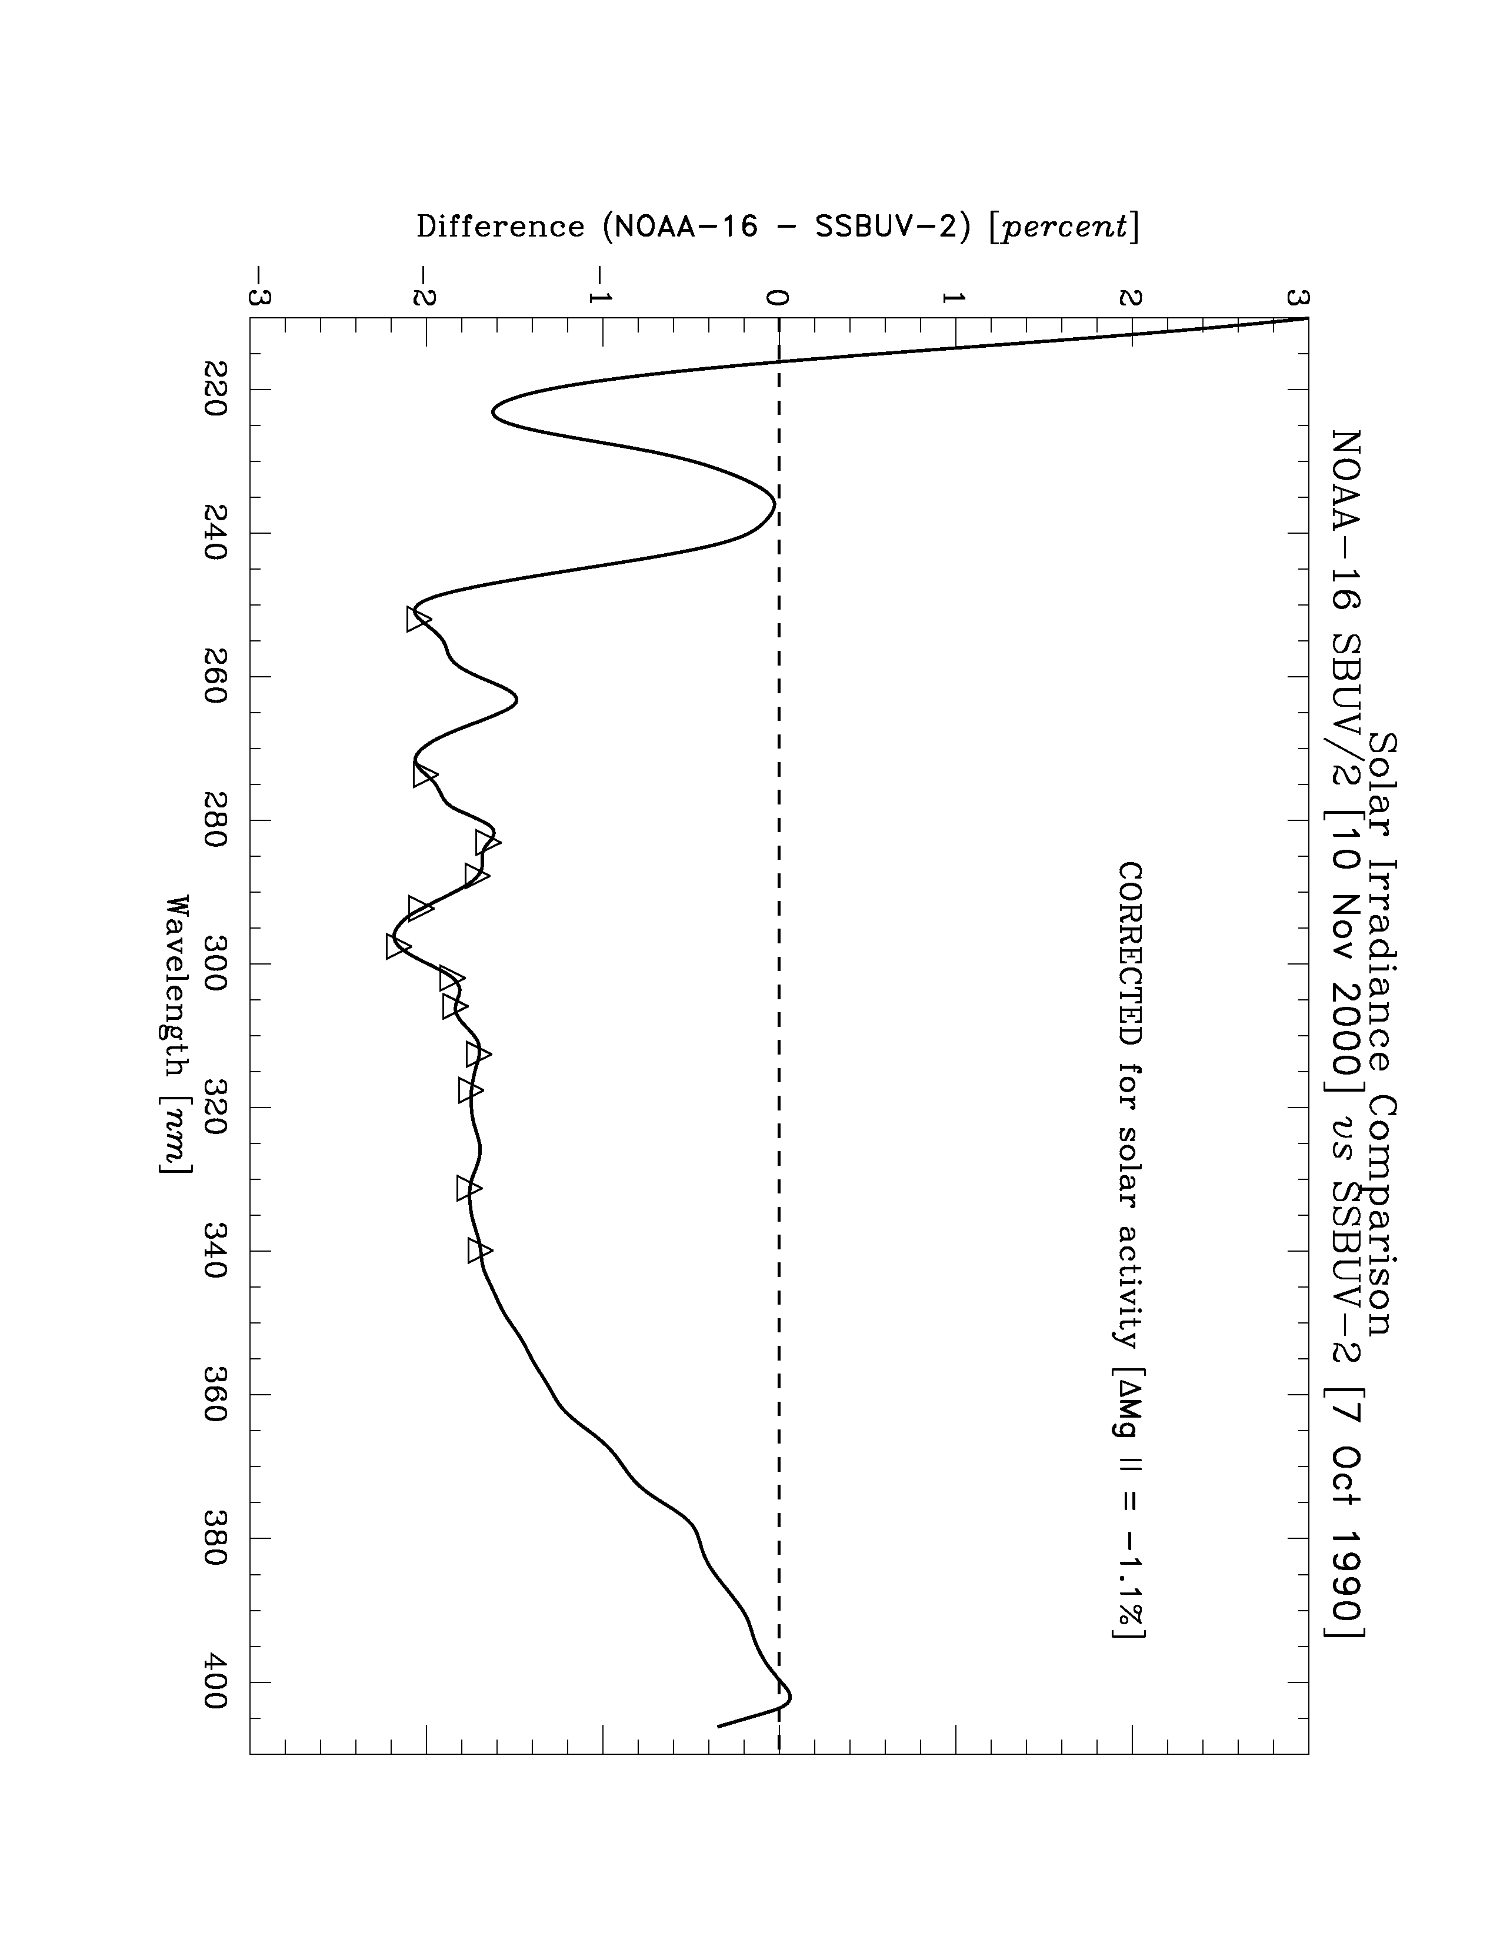
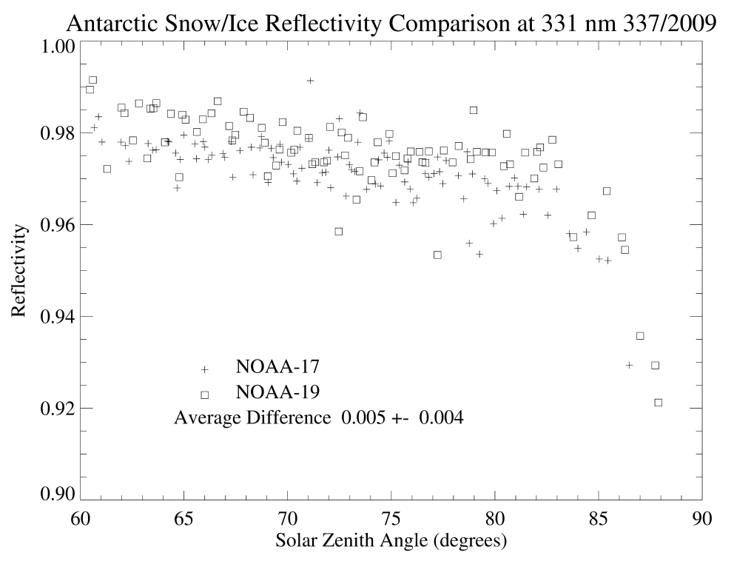
Absolute Calibration – On-Orbit Validation
Diffuser reflectivity: On-board mercury lamp data from prelaunch, before solar exposure, to weekly schedule.
Irradiance: “Day 1” solar measurement vs. reference data set.
Normalized Radiance: Antarctic reflectivity (bright scene) should be very consistent between instruments.
Notes:
.

Slide 7
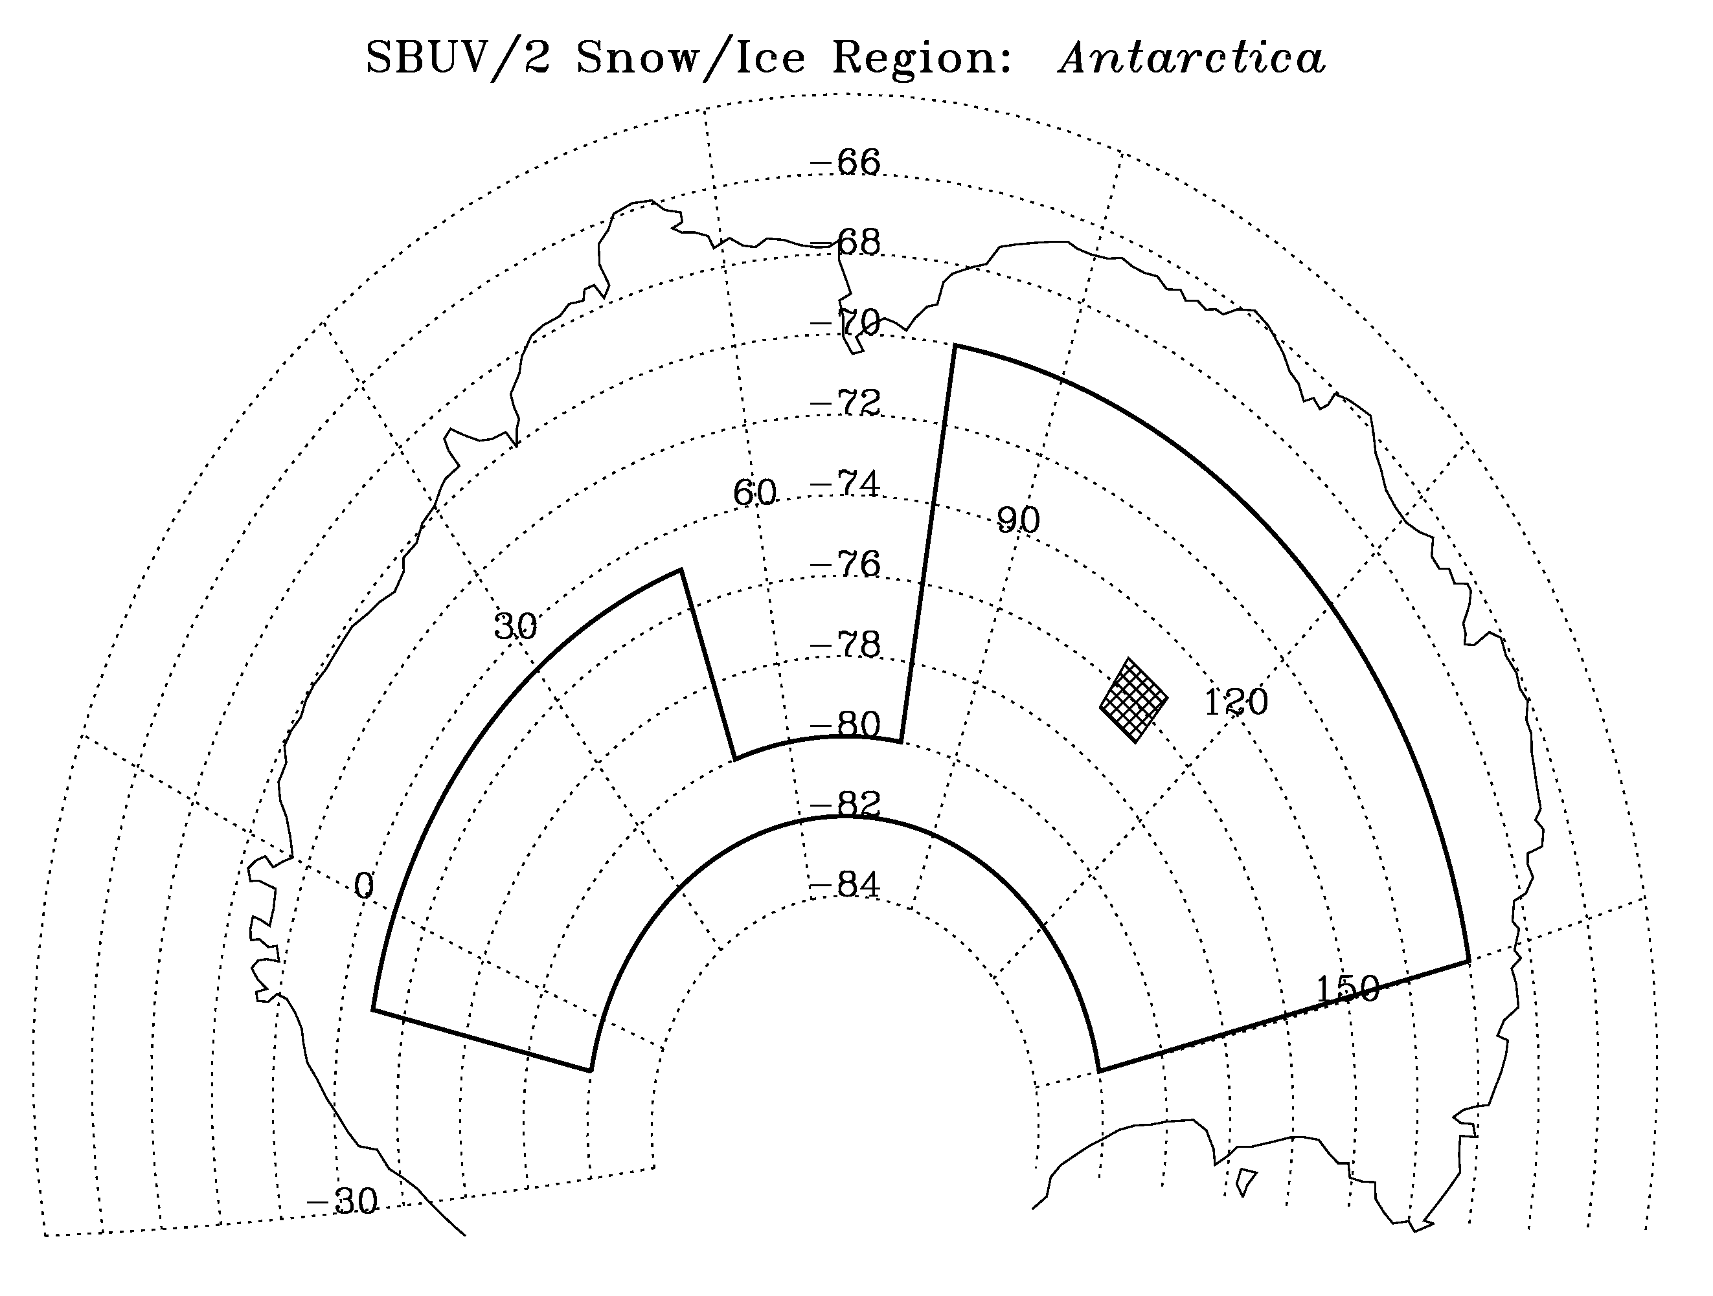
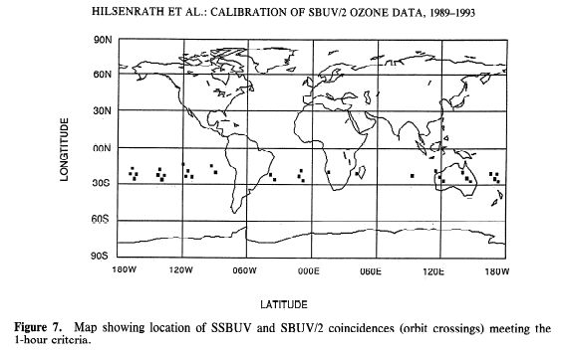
Absolute Calibration - Intercomparison
Early SBUV/2 instruments (NOAA-9, NOAA-11, NOAA-14) used coincidence analysis with SSBUV flights to transfer laboratory-validated calibration to on-orbit instrument.
Later instruments compare seasonal average reflectivity at 340 nm, using Antarctic snow/ice high plateau regions with low surface relief and distant from coast. NOAA-17 & 19 retains prelaunch calibration, NOAA-16 & 18 adjusted to NOAA-17.
Notes:
.

Slide 8
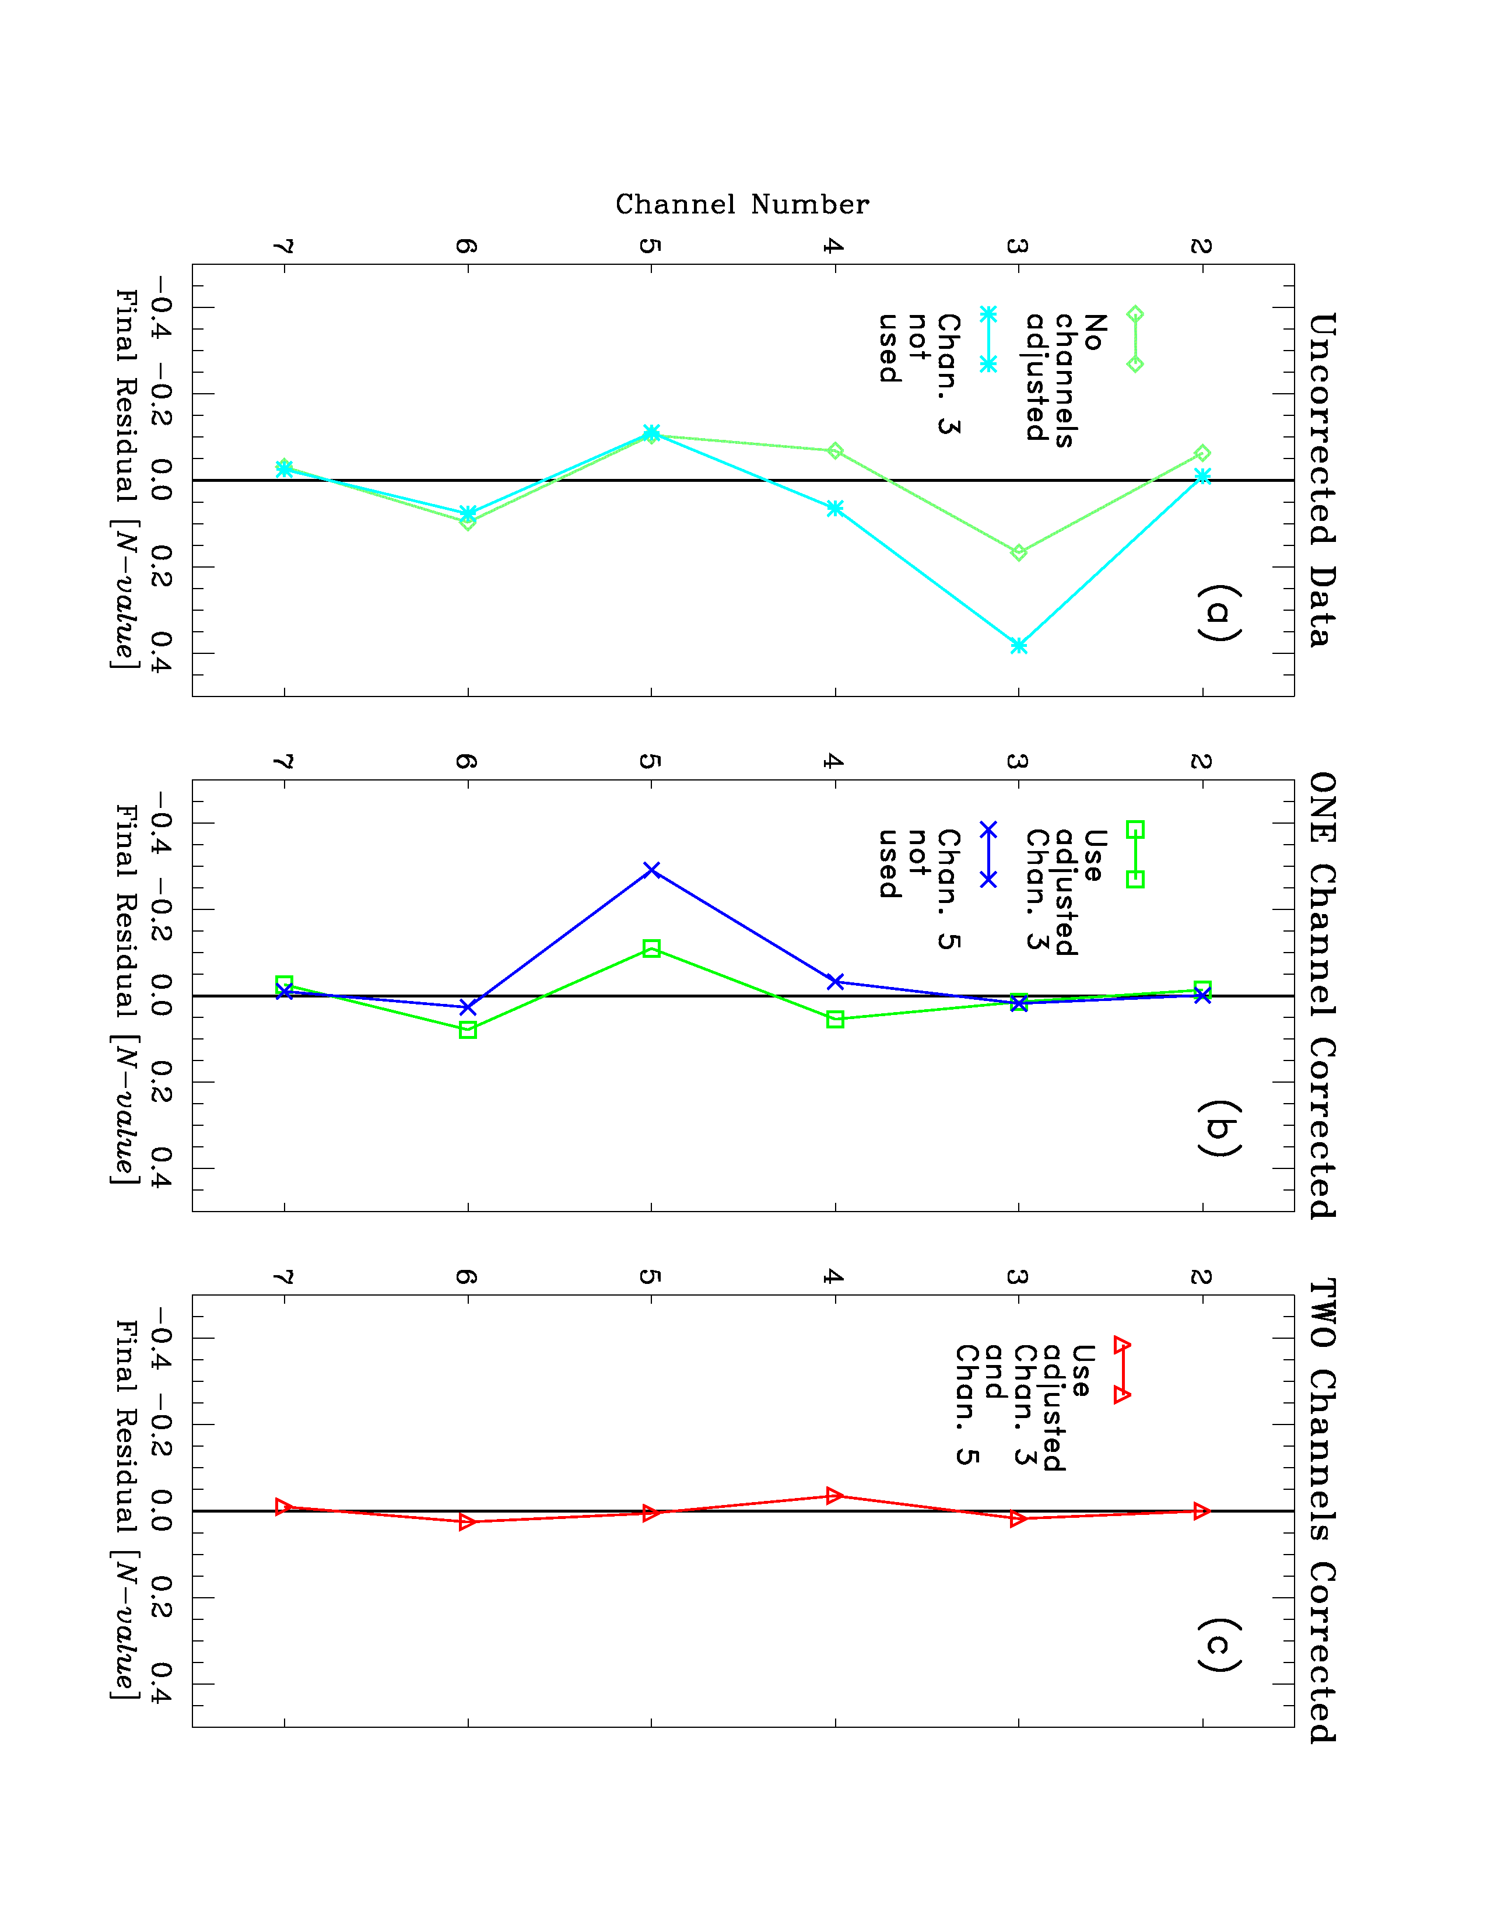
Channel-to-Channel Calibration
Wavelength dependence is based lab standards (1% uncertainty).
Calibration error in single SBUV channel can propagate retrieved ozone profile errors beyond nominal weighting function altitude range for that channel.
Use radiance residual values produced by retrieval algorithm.
Estimate adjustment value for worst channel by running retrieval algorithm without using that channel.
Adjust albedo calibration and iterate process to determine specific (self-consistent) set of adjustments for all profile wavelengths to apply in ozone processing.
Notes:
.

Slide 9
Channel-to-Channel (more)
Short wavelengths (273-302 nm) are adjusted with 5º equatorial zonal means with low surface reflectivity.
Long wavelengths (306-318 nm) are adjusted at mid-high latitudes where retrieved ozone profiles with an extra longer wavelength channel are consistent with those without that channel.
Goal is to have all final residuals below threshold of ±0.1 N-value.
Final set of adjustments is not unique, and may include any errors in forward model radiative transfer calculations.
Notes:
.

Slide 10
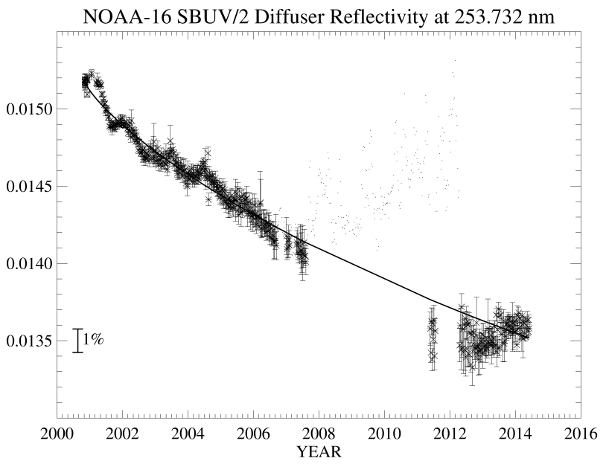
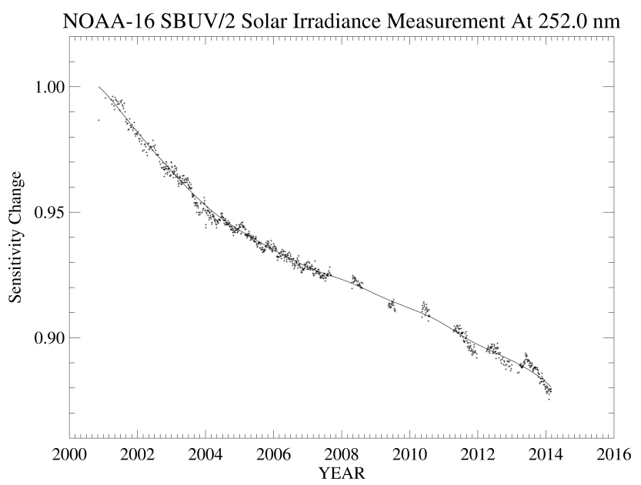
Time-Dependent Calibration – Solar Irrandiance
SBUV/2 on-board calibration system uses mercury lamp to monitor relative changes in diffuser reflectivity at emission line wavelengths.
Diffuser degradation-corrected solar measurements then capture time-dependent and wavelength-dependent instrument response changes.
Need estimated adjustment for solar activity at λ < 300 nm.
Long-term accuracy is ≤0.2% per year.
Notes:
.

Slide 11
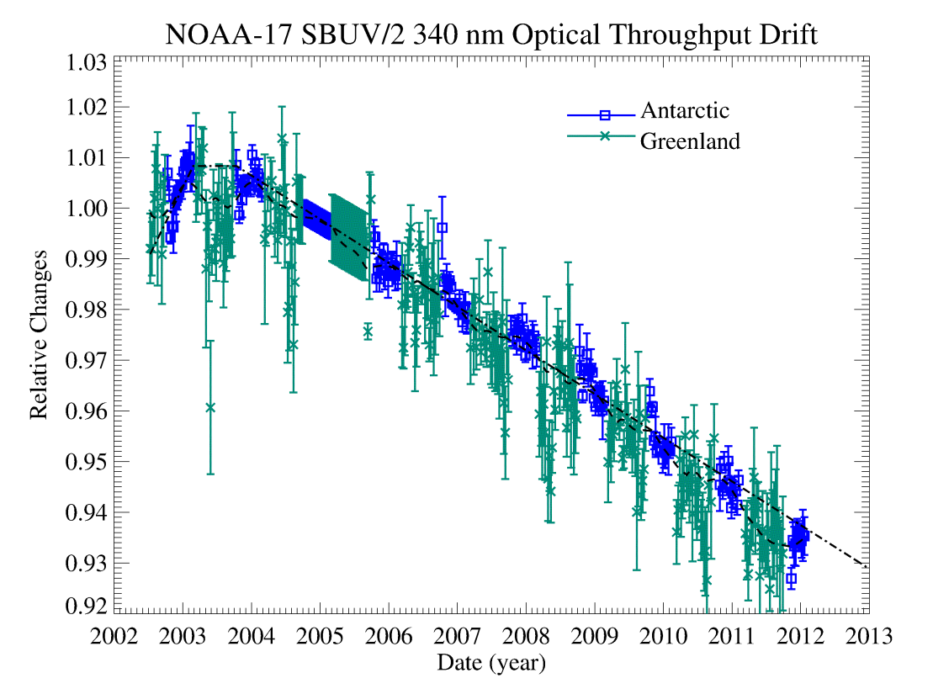
Time-Dependent Calibration - Reflectivity
Assume that surface reflectivity of Antarctic and Greenland snow and ice-covered regions (at 340 nm) remains constant with time.
Choose reference year to de-seasonalize short-term variations due to SZA.
Correct for small ozone absorption.
This procedure gives instrument throughput changes to ≤0.5% uncertainty.
Notes:
.

Slide 12
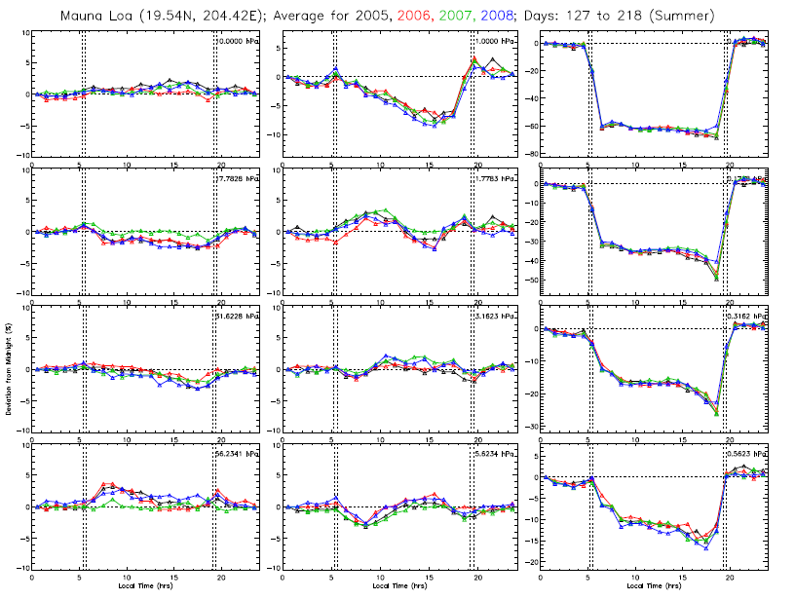
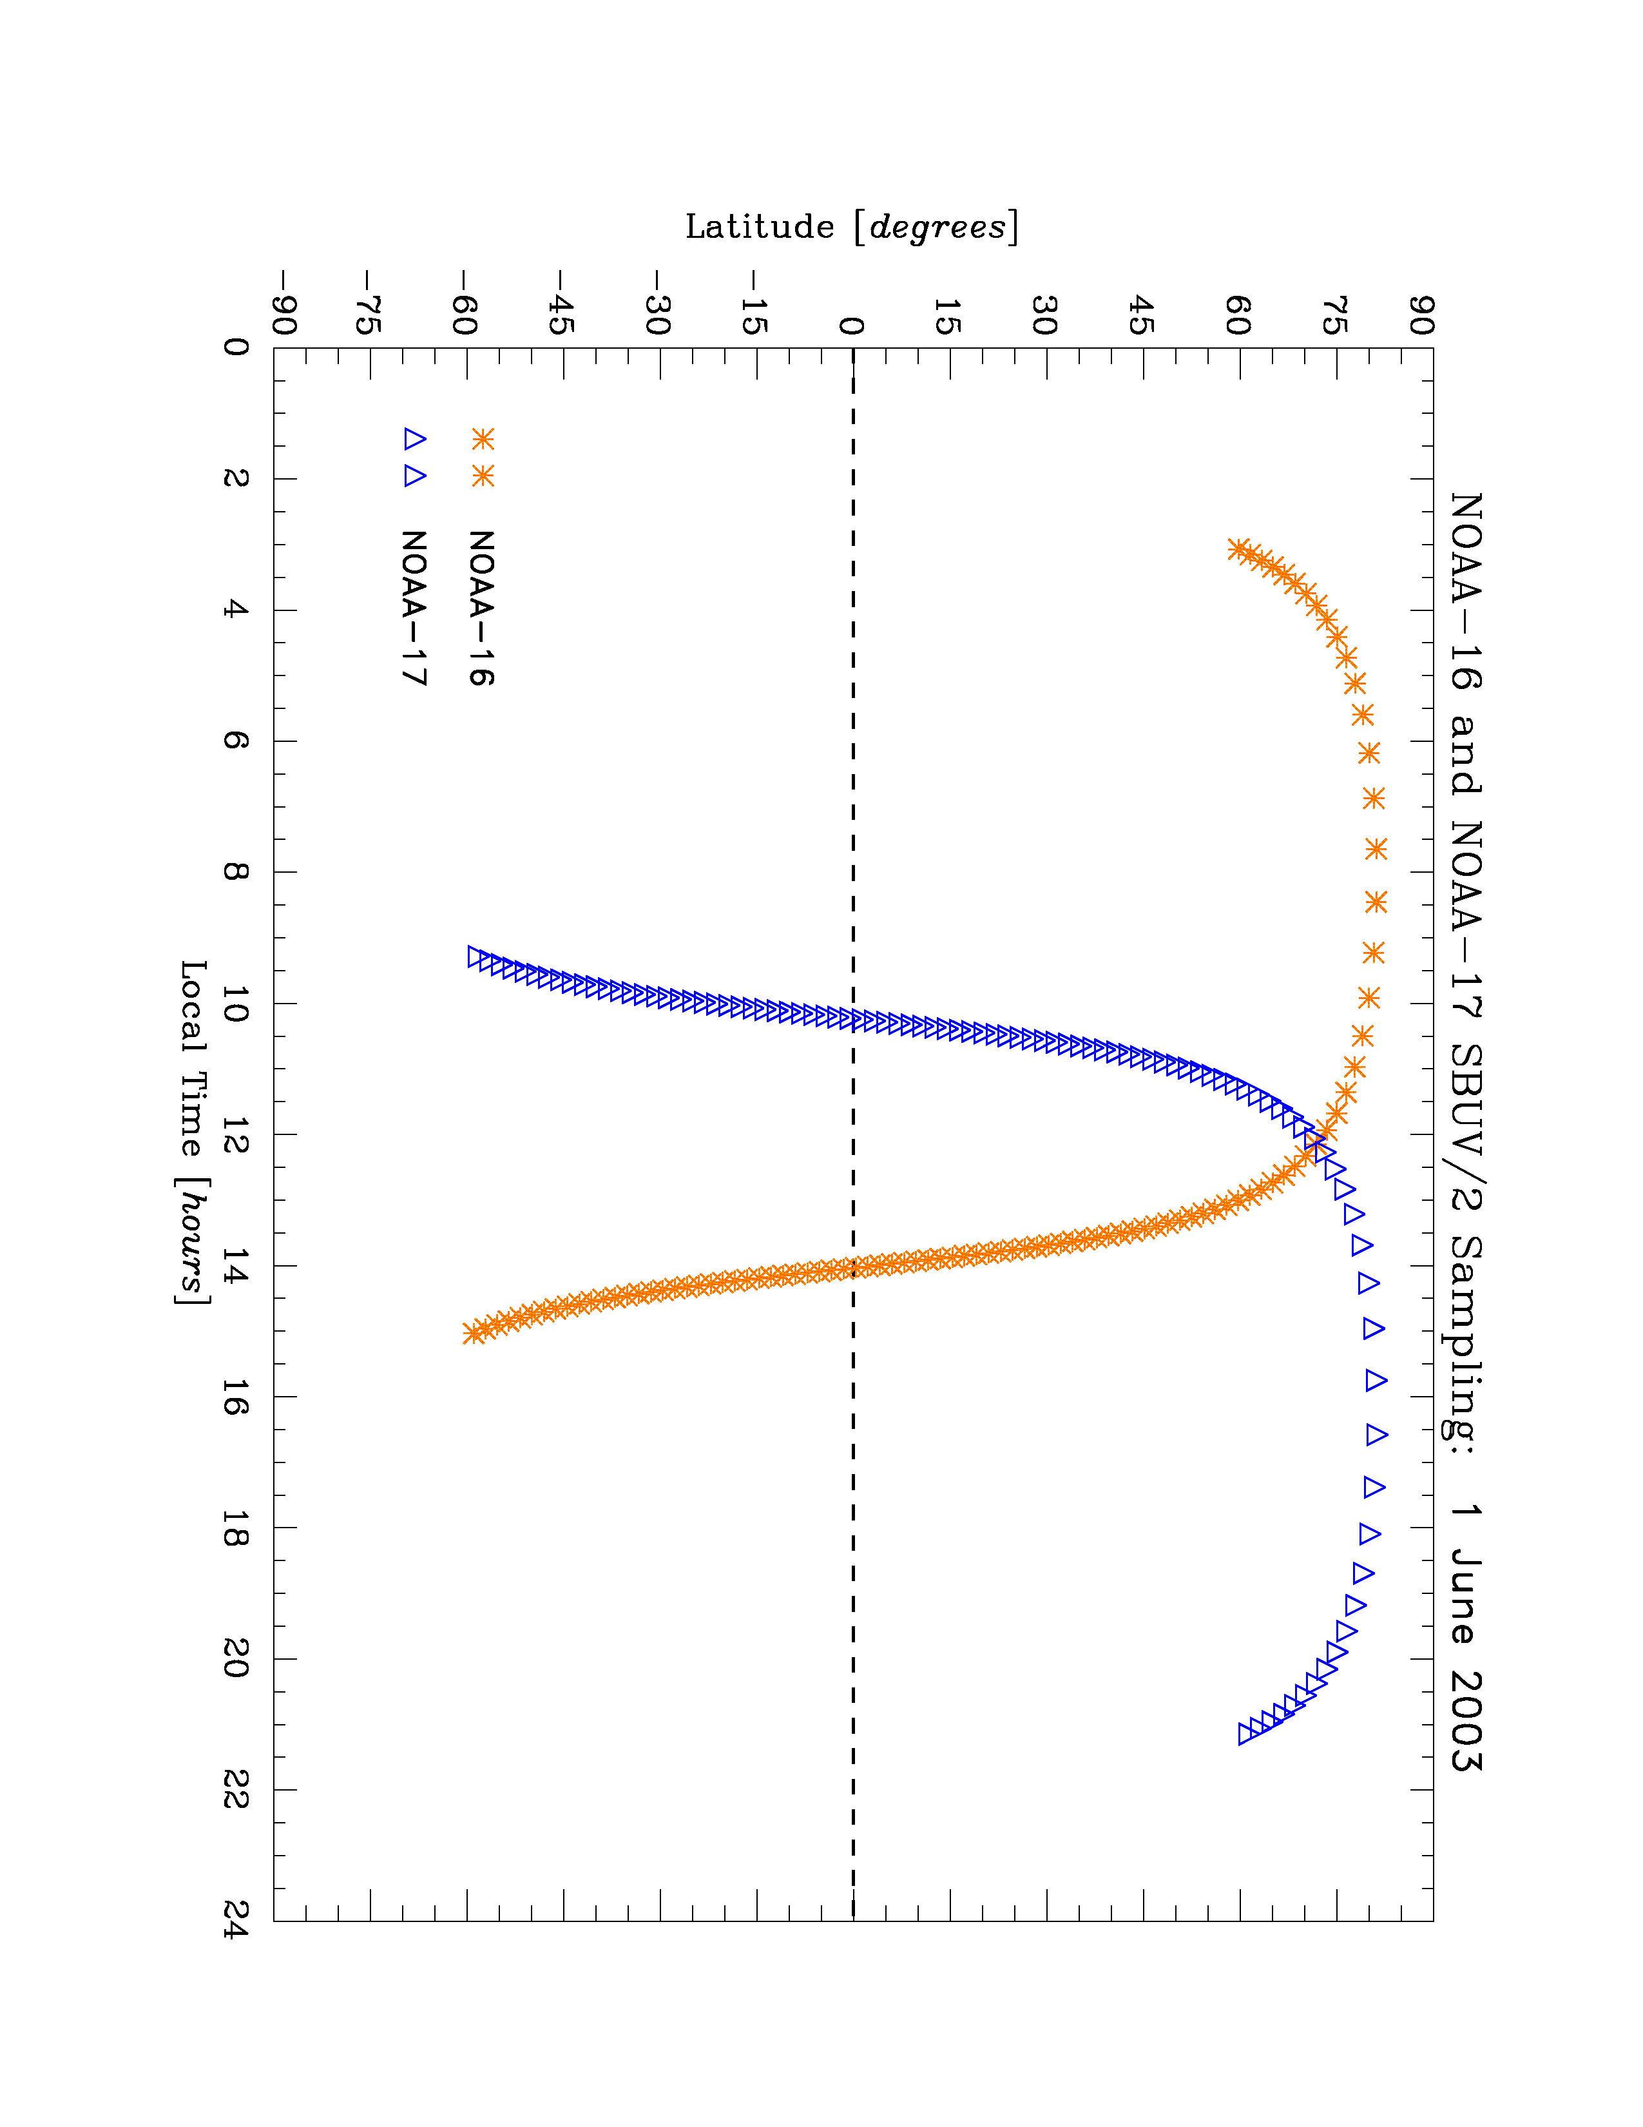
Intercalibration of Instruments - 1
Original philosophy was to evaluate calibration differences at Equator, where ozone variability is smaller.
SBUV/2 orbit drift leads to local time differences in coincidence match-ups → Diurnal ozone variations (during daytime hours) will affect radiance comparisons.
Select coincidence data based on no local time difference (typically at high latitudes) and consistent total ozone to derive inter-instrument adjustments.
Notes:
.

Slide 13
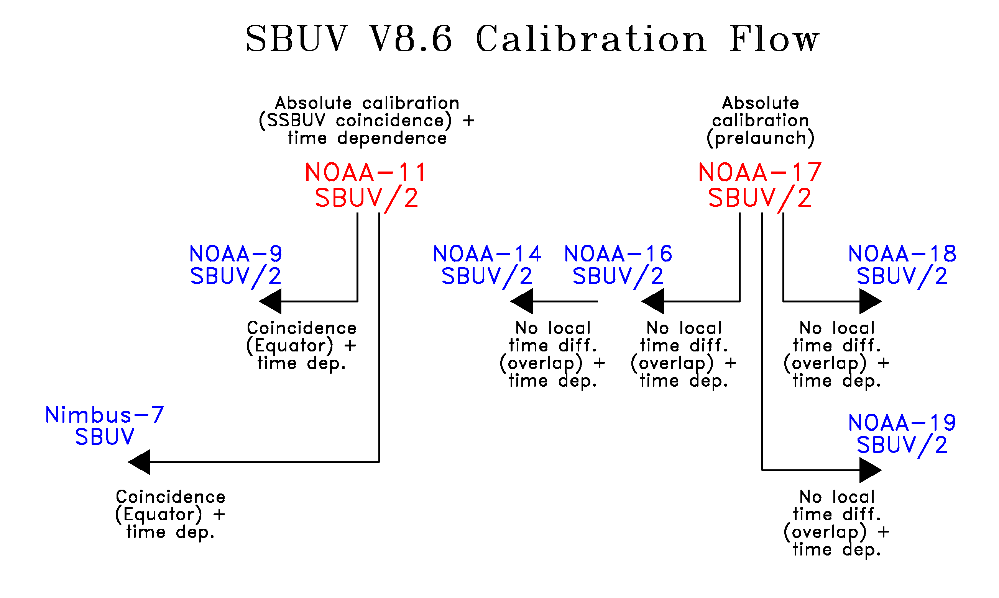
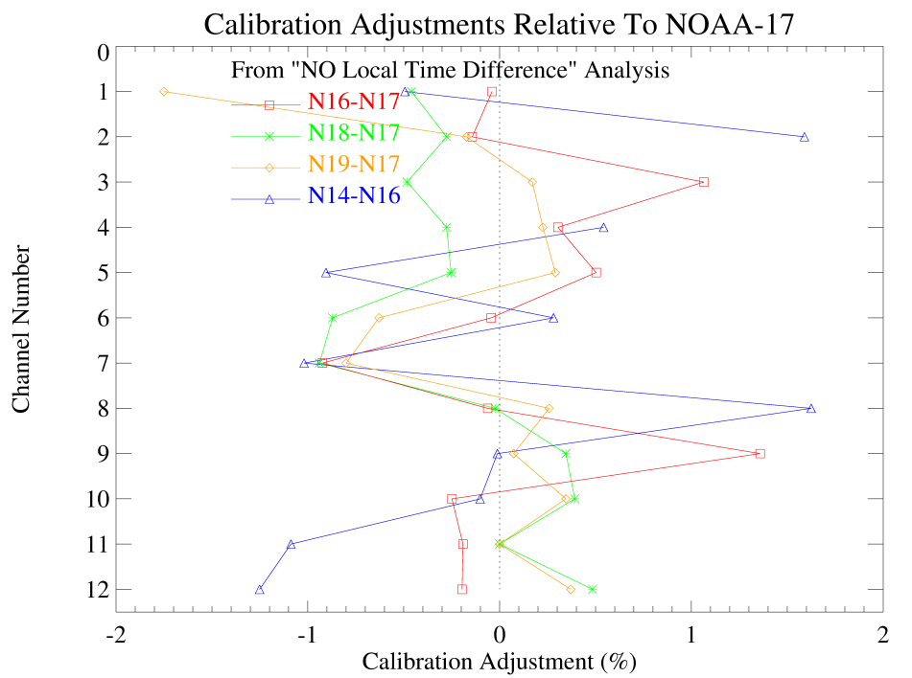
Intercalibration of Instruments - 2
Creation of SBUV Version 8.6 data sets used two methods.
NOAA-11 data (adjusted based on SSBUV comparisons) were used as reference to derive individual channel adjustments for Nimbus-7, NOAA-9.
NOAA-17 was used as reference instrument to derive individual channel adjustments for NOAA-14 through NOAA-19.
Notes:
.

Slide 14
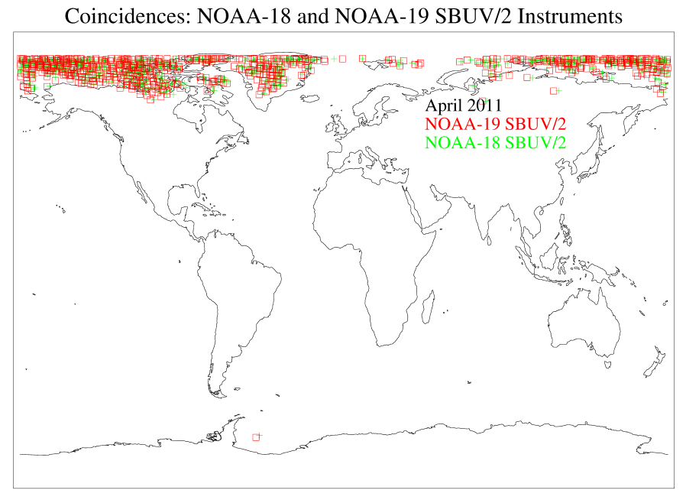
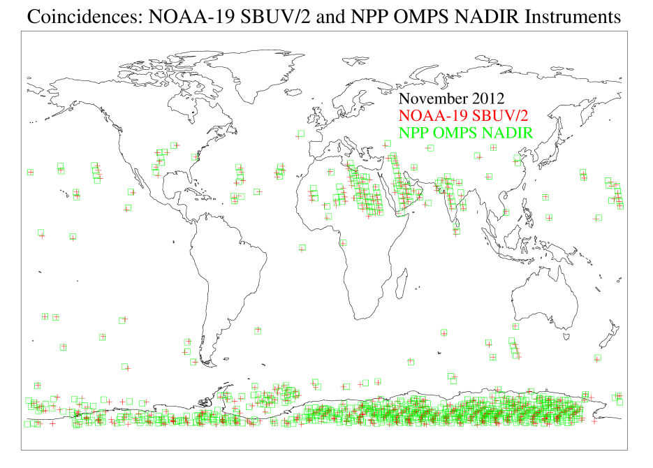
Coincidence Comparison
SBUV/2 Monochromator scans 12 channels with 1.25 s/channel integration time and 32s cycle. No identical views between two instruments.
Take normalized radiance measurements within 100km and 1 hour distance.
Screen for low ozone gradient (<20DU) and small scene reflectivity change (<0.04).
Use TOMRAD and a retrieved set of ozone profile and scene cloud to compute radiance difference between two instruments for SZA and wavelength differences.
Large number of samples for better statistics.

Slide 15
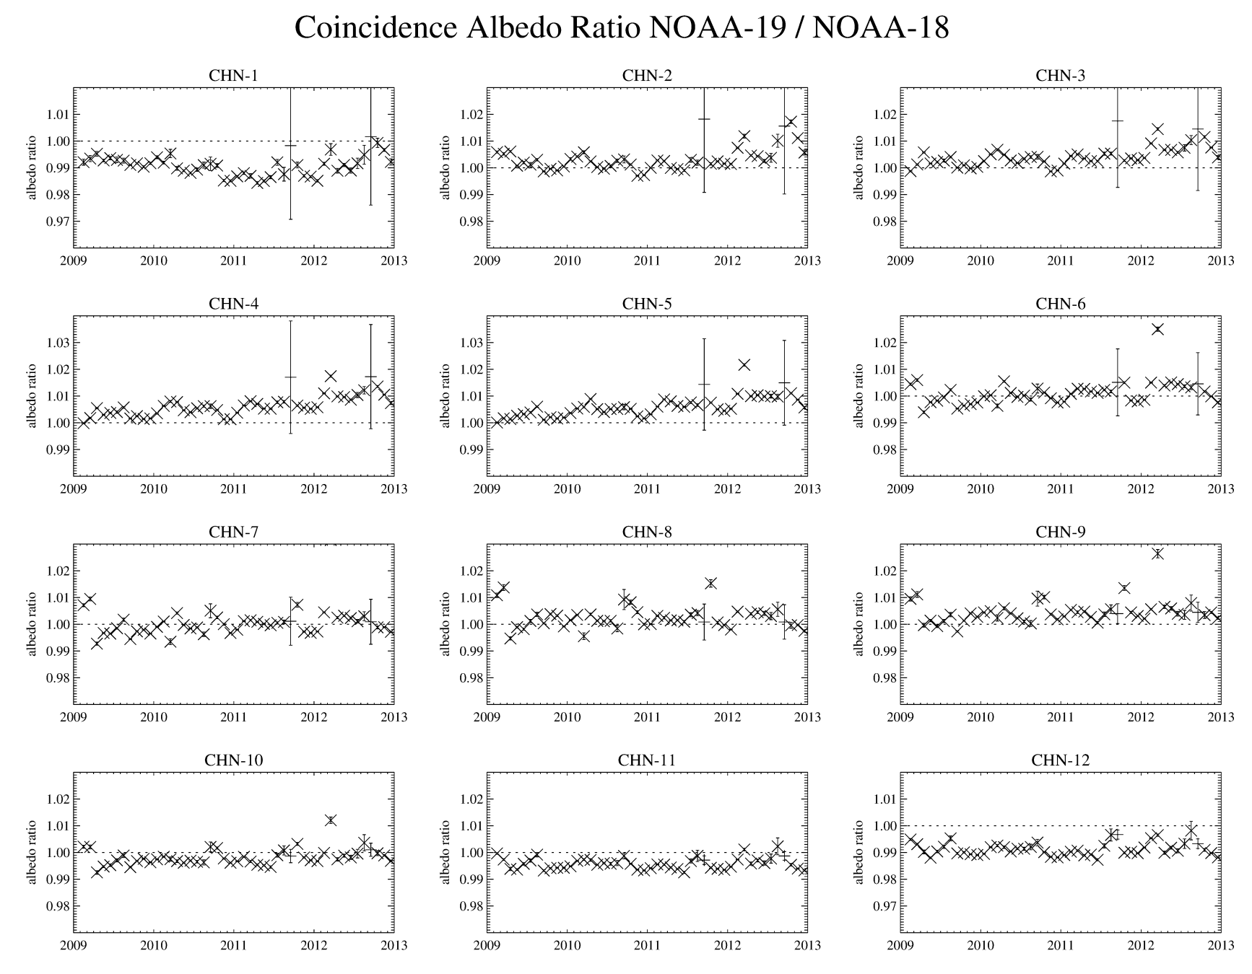
Coincidence Comparison -N19 stability

Slide 16
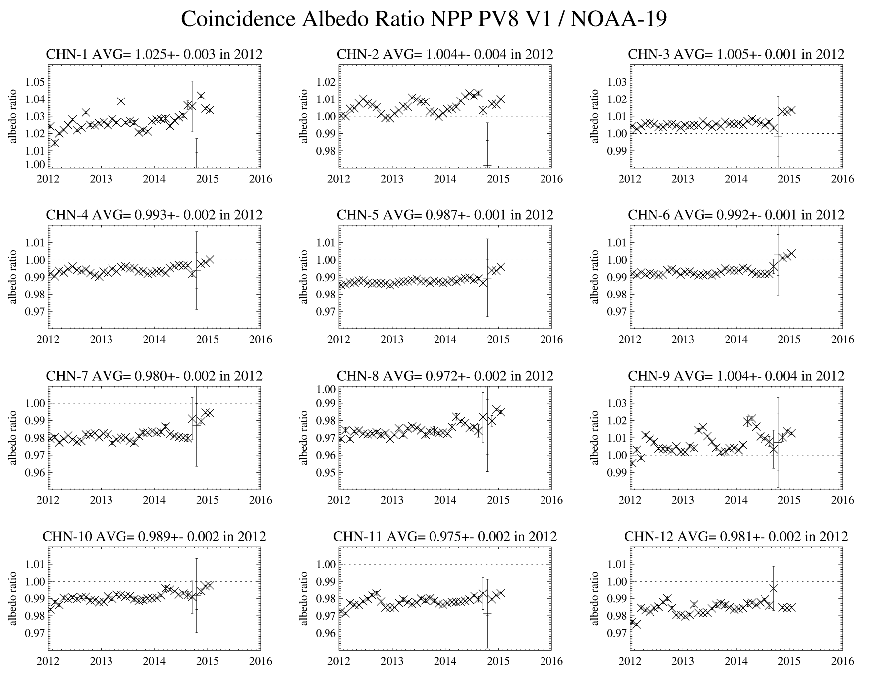
Coincidence Comparison – OMPS NP

Slide 17
Summary
All SBUV/2s use laboratory tests as the basis for albedo (channel-to-channel) wavelength dependence.
Use polar snow/ice target to make wavelength independent adjustment to some (N16 & N18) prelaunch albedo calibration.
On-board lamp for diffuser reflectivity calibration, solar irradiance measurement and polar snow/ice radiance measurement together provide instrument sensitivity time dependence.
Adjustments based on inter-instrument comparison lead to more consistent ozone profile products among SBUV/2s.
Coincidence comparison among instruments is also used to validate their albedo calibrations.
Notes:
.

Slide 18
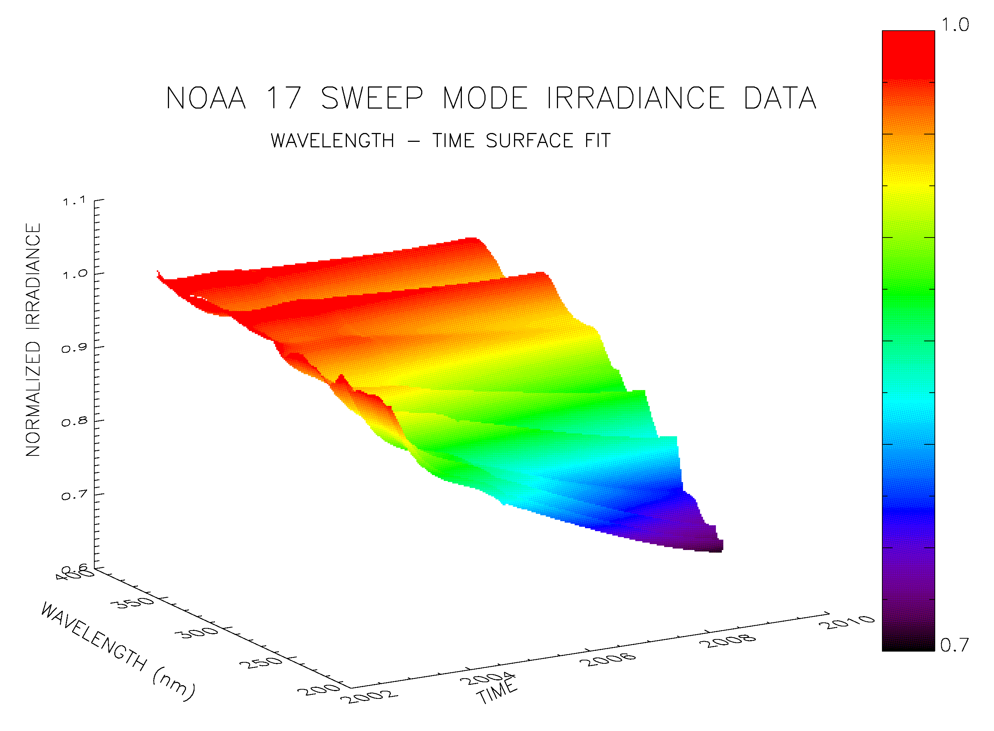
Time-Dependent Calibration –
Solar Irradiance (backup)
SBUV/2 on-board calibration system uses mercury lamp to monitor relative changes in diffuser reflectivity at emission line wavelengths.
Diffuser degradation-corrected solar measurements then capture time-dependent and wavelength-dependent instrument response changes.
Need estimated adjustment for solar activity at λ < 300 nm.
Long-term accuracy is ≤0.2% per year.

