Slide 1
Which Measurement Characterization are the Most Important for UV Instruments?*
*That depends on your application.
L. Flynn
With slides from NASA and NOAA OMPS and OMI Teams

Slide 2
Ground Measurements
Radiance/Irradiance Calibration
  Key Measurement quantity
Diffuser
  Angle and wavelength dependence
Measurements in Vacuum
  True Operating environment, Outgassing and other changes
Polarization
  Demonstrate Performance, create corrections
Stray Light
  Demonstrate performance, Generate corrections
Bandpass
  Key Measurement quantity
  Thermal effects on wavelength scale and bandpass
Wavelength scale
  Key Measurement quantity
  Thermal effects on wavelength scale and bandpass
Non-linearity
  Demonstrate performance, create corrections
Absorption spectra
SNRs
  Confirm performance
Darks
  Confirm performance

Slide 3
Need to share/compare resources
Integrating spheres
Target diffusers
Goniometry apparatus
Reference sources
Tunable sources
Vacuum chambers

Slide 4
What can we estimate in orbit?
Radiance/Irradiance Absolute Calibration
  Truth plus RT Forward models
Wavelength scale
  Solar features and correlation of shifts with temperature sensor measurements
Bandpass
  Difficult – broadening or narrowing of solar features.
Stray Light
  Correlation of variations for sources and targets, EOFs
Diffuser
  Bootstrap angles over a measurement
Polarization
  Without a dedicated measurement, this is tough. RT Models
Non-linearity
  Use internal source and integration time to produce intensity
  Bias versus signal levels (Shift in distribution)
Measurements in Vacuum
  No choice – a lot can go on from ground to orbit
SNR
  Difference methods, EOFs
Darks
  Door closed measurements
Reflectivity and wavelength dependence of biases
  Range, targets, cross-track, Aerosol Indices
Absorption patterns
  NO2 in Solar, DOAS, EOFs

Slide 5
Nadir Mapper & Profiler
The instruments measure radiance scattered from the Earth’s atmosphere and surface. The detectors are actively-cooled 2-D CCD arrays with one spectral and one spatial dimension.
The instruments also make solar measurements using pairs of diffusers. Judicious operation of working and reference diffusers allows analysts to track the diffuser degradation. The solar measurements also provide checks on the wavelength scale and bandpass. The instruments regularly perform their internal dark and nonlinearity calibration sequences and have completed over three full years of solar measurements.
Main
Electronics
Limb
Profiler
Diagram from Ball Aerospace and Technology Corporation
Entrance Aperture
Entrance Aperture
Earth
Mode
Solar
Mode
Diffuser
Each instrument can view the Earth or either of two solar diffusers; a working and a reference.
Notes:
The OMPS instruments (Nadir Mapper, Nadir Profiler, and Limb Profiler) are designed to take a set of measurements to allow analysts to maintain the instrument characterization and calibration.[2] For each of the instruments, this task can be broken into two components, tracking the performance of the CCD array detectors and electronics, and tracking the performance of the optical components, that is, the telescopes and spectrometers. The instruments make measurements on the night side of orbits with the apertures closed. One set is made without any sources and is used to track CCD array dark currents. Another set is made with illumination by an LED and is used to track CCD non-linearity and pixel-to-pixel non-uniformity response. The instruments also make solar measurements using pairs of diffusers. Judicious operation of working and reference diffusers allows analysts to track the diffuser degradation. The solar measurements also provide checks on the wavelength scale and bandpass. The instruments have completed multiple passes through their internal dark and nonlinearity calibration sequences and are beginning to make regular solar measurements.

Slide 6
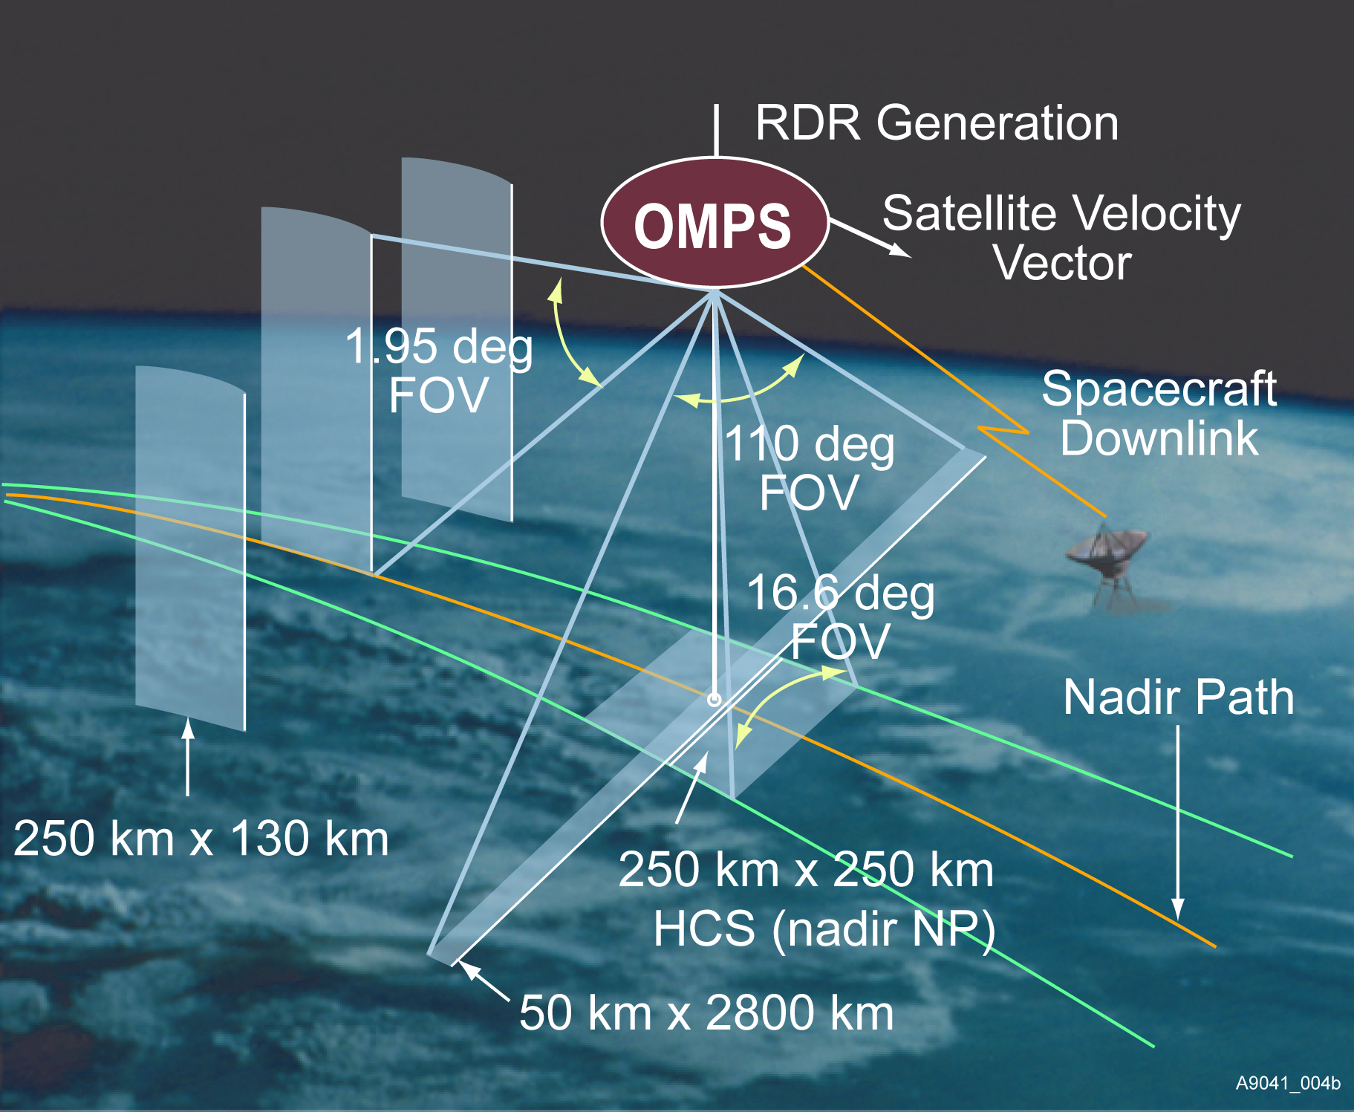
OMPS
Ozone Mapping & Profiler Suite
Global daily monitoring of three dimensional distribution of ozone and other atmospheric constituents.
Continues the NOAA SBUV/2, EOS-AURA OMI and SOLSE/LORE records.
Nadir Mapper (NM)
Grating spectrometer, 2-D CCD
110 deg. cross track,
300 nm to 380 nm spectral,
1.1nm FWHM bandpass
Nadir Profiler (NP)
Grating spectrometer, 2-D CCD
Nadir view, 250 km cross track,
250 nm to 310 nm spectral,
1.1 nm FWHM bandpass
Limb Profiler (LP)
Prism spectrometer, 2-D CCD
Three vertical slits, -20 to 80 km,
290 nm to 1000 nm
The calibration systems use pairs of working and reference solar diffusers.
L. Flynn
Notes:
Updated schematic from Scott Asbury
Some changes in numbers (2.23 degrees to 1.9 degrees) and position of components.
Old instrument picture.

Slide 7
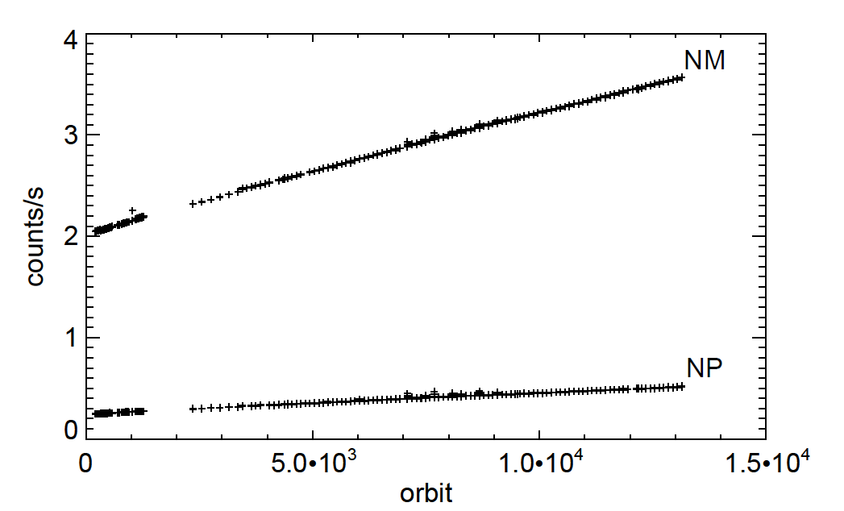
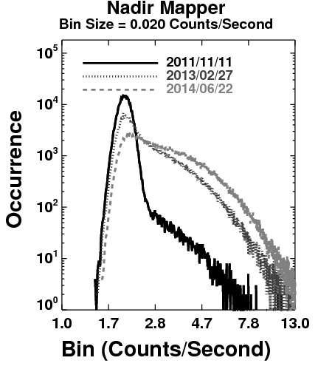
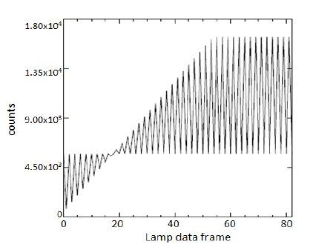
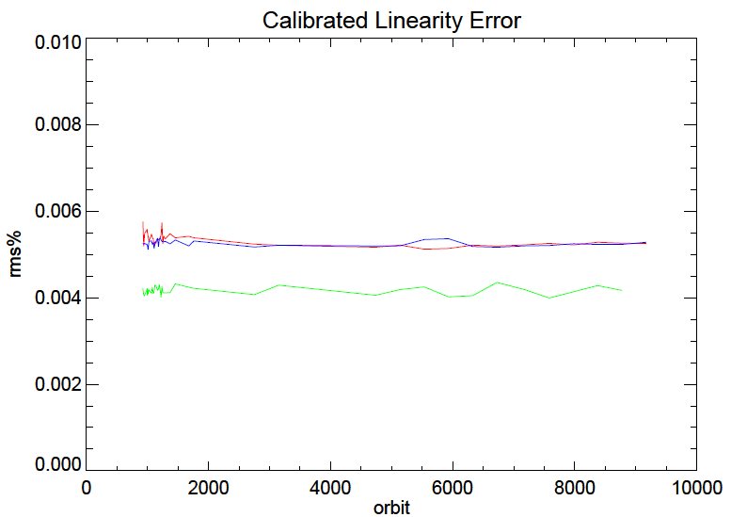
CCD and Electronics Performance
The actively cooled CCD detectors have expected increases in darks.
Weekly updates to dark corrections maintain good performance.
Nonlinearity is monitored on-board by using LEDs and varying integration times. It has been very stable.
Image smear and bias offsets are corrected by using overclocked measurements.
Signal to noise ratios meet performance requirements.
Counts
Mean dark counts time series
Orbit #
Saturation
NM Left Half CCD
NM Right Half CCD
NP CCD
Counts
RMSR, %
Non-linearity error
after on-board correction
Orbit #
LED Data Frame #
NP SNR 200:1
NM SNR 1000:1
RMSR, %
RMSR, %
Wavelength, nm
Wavelength, nm
Notes:
Figures and analysis from NASA PEATE and NOAA STAR monitoring.

Slide 8
Comparing Solar
Given what we know, we should be doing more than we are on determining relative calibration of solar measurements.
Wavelength dependence of Solar variations are well known. Mg II Indices are available to set the levels.
We know our wavelength scale shifts well.
We should be able to establish biases between different instruments and track their time dependencies.

Slide 9
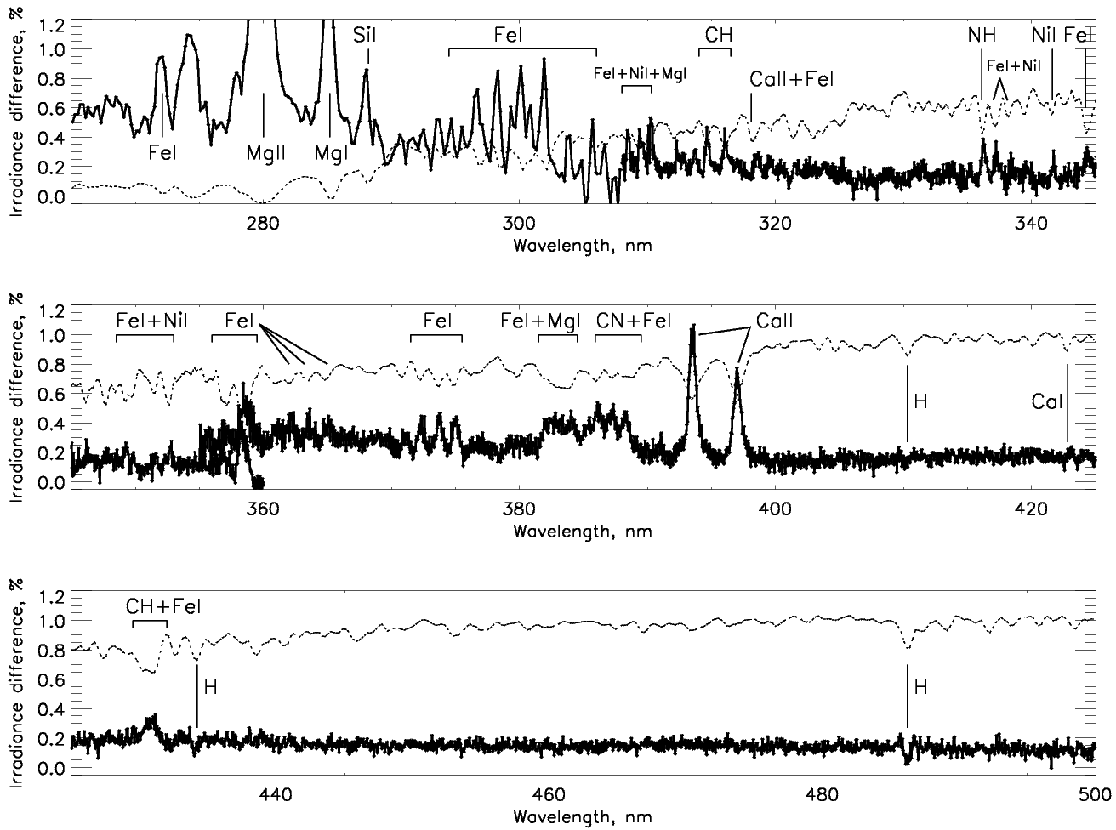
Time-averaged irradiance differences: (mid-y2012+y2013) vs.
(mid-y2007+y2008+mid-y2009)
Sun as a star Aura OMI: spectral irradiance changes in Cycle 24, S. Marchenko, M. DeLand
Dotted line: scaled Solar spectrum
Notes:
9

Slide 10
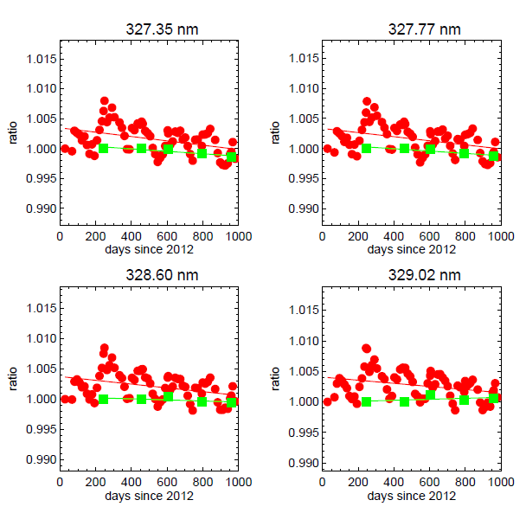
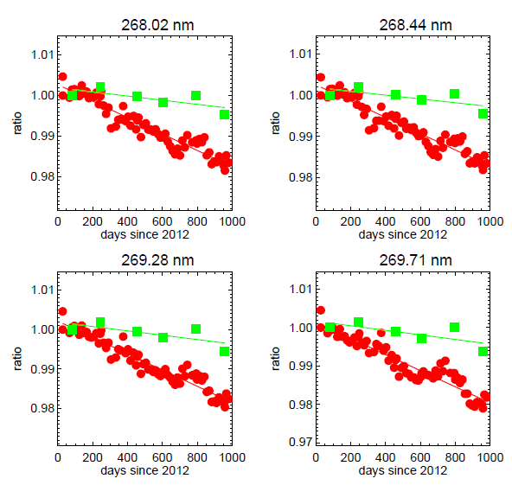
Optical Degradation and Solar Diffusers
The dual diffuser systems with a reference diffuser used twice a year at the same viewing angles and a working diffuser used every other week provide good information on the instrument and diffuser degradation.
The is very little → degradation for the OMPS Nadir Mapper.
0.5 %
Reference Diffuser Measurements
Working Diffuser Measurements
There is small degradation for the OMPS Nadir Profiler ← up to 0.5% over the first three years for the shorter wavelength channels.
1.0 %
Notes:
C. Pan, L. Flynn and X. Wu, “Solar Observation of OMPS Nadir System during the First 3 Year of On-Orbit Operation”, Accepted July 22, 2015 by the Journal of Applied Remote Sensing.

Slide 11
Description of results in NP_SOL_fit.pdf
The first analysis was designed to find the scale factors, the wavelength shifts, and the trends in the Working Diffuser Solar measurements. We can now use the scale factors and the wavelength shift pattern to see how the reference diffuser measurements compare. (We can also check to see if the wavelength shifts are in common between the working and reference.) I agree that even without this analysis the reference spectra evolution looks fairly flat which implies that the trend is mainly from changes in the Working Diffuser, not the instrument throughput. That may not be the entire case. Since the reference measurements are paired with working measurements close in time, we can also compute the relative trends with just two pairs as is done in the second set of results in the figure on bottom of Page 3.
We've continued the analysis with both working and reference. We first normalize the spectra by using the average of the working measurements
Nsolar(w,t) = Solar(w,t)/AWSolar(w) - 1.
We then compute an estimate of the wavelength shift pattern by using quadratic fits of three consecutive AWSolar(w) values and taking the slope at the midpoint as an estimate of the change in radiance per pixel shift. We then normalize these value to make them relative shifts. This gives us a shift(w) pattern. We then fit each Nsolar(w) with shift(w) to get a single shift estimate for each full spectrum relative to the average one. The first page of the attached files shows the relative shift pattern as %/one-pixel-shift on the top plot, and the shifts for each spectrum on the bottom plot. The three *'s are for the Reference Diffuser. There is good agreement in the timing of the shifts between the Working, +'s, and Reference even though the Working spectra are used to find the normalizing spectrum and shift pattern. Notice the suggestion of an annual cycle in the wavelength shifts.
Multiple regression is now used for the normalized, shift-removed spectra including both Working and Reference. The model is
NSRSolar(w,t) = HW*c1(w)*t + c2(w)*mg2(t) + HW*c3(w) + HR*c4(w)*t + HR*c5(w)
where HW is 1 for working diffuse measurements and 0 for reference and HR is the opposite, and the Mg2 Indices are proportional changes relative to the average (the Mg II indices for the Reference were adjusted to remove a bias with the working index computations.)
The Mg II scale factors, c2(w) term from the regression model, are in the top plot on Page 2. The Mg II indices, mg2(t) term from the model, are in the bottom plot. Notice that the Reference Diffuser measurements are taken at times with very different solar activity.
The third page shows the trend terms from the model on the top figure. The upper line is the Reference Diffuser trend term, c4(w), and the lower line is the Working Diffuser trend term, c1(w). If we assume that the reference diffuser is stable, then the c4(w) pattern represents instrument throughput changes. The lower plot shows the difference in the Working and Reference trends, c1(w)-c4(w). The dotted line is the simple direct calculation one can do with double difference of the Day 81 paired diffuser measurements versus the Day 450 pair, namely, Work(w,450)/Work(w,81) - Ref(w,450)/Ref(w,81).
The fourth page just shows the two constant terms from the multiple regression; working, c3(w), on the top and reference, c5(w), on the bottom. These are related to the choice of a Day 0, the use of the Mg II Index average to get deviations, and the use of the Working diffuser average for the normalization.
The plot on the top of the fifth page shows the measurements and model results for the 11th wavelength. All the spectra were normalized by the average for the 29 working measurements. The data values in this figure are also after the wavelength shift adjustments have been applied. While one would expect that the three reference measurements (+ measured; * modeled) shown here would give a slightly positive trend, the two later measurements occur at peaks in the solar activity. The dashed lines show the measured data if we adjust for solar activity, that is, subtract the c2(w)*mg2(t) term. The change for the three reference data points is dramatic.
The bottom figure on the fifth page shows sample spectra and models for the working diffuser. The spectra have been normalized relative to the working average and the wavelength shift adjustment has been applied.
The sixth page shows sample spectra and models for the working diffuser (top figure) and reference diffuser (bottom figure).
Both spectra are normalized but without the wavelength shift applied. They are compared to the model plus the fit wavelength shift. The model in the lower figures includes the separate offset (to account for the use of the working average as normalization) and trend calculations for the reference spectra.

Slide 12
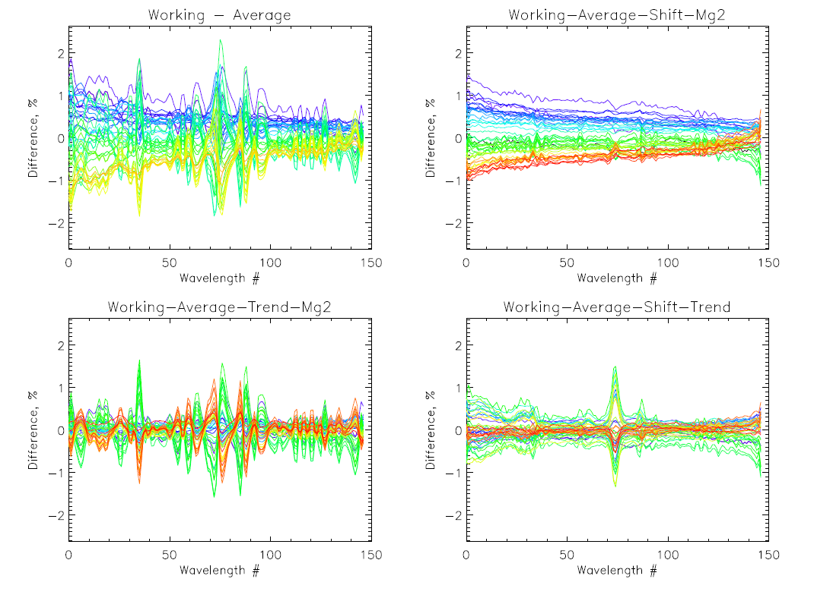

Multiple Linear Analysis of NP Solar Measurements for the Working Diffuser
All Variations
Instrument and Working Diffuser Degradation
Wavelength Shift Effects < 1%
Solar Activity Effects < 1%
Retrieval Channel Locations
First Last

Slide 13
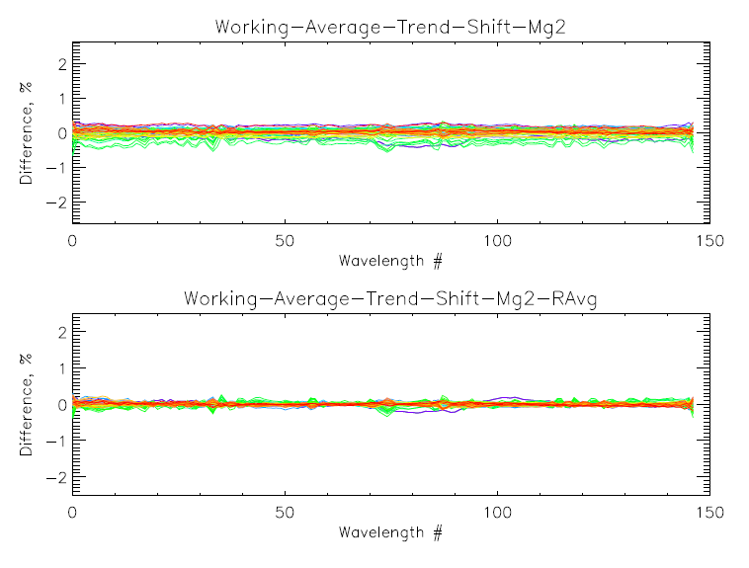
OMPS NP Working Solar residuals after fits

Slide 14
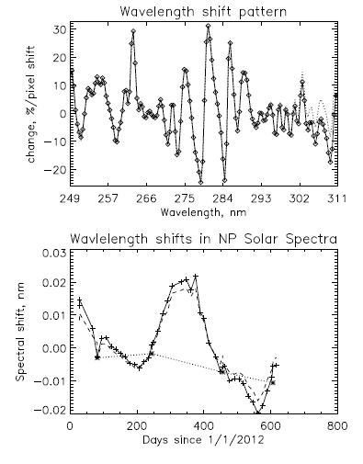
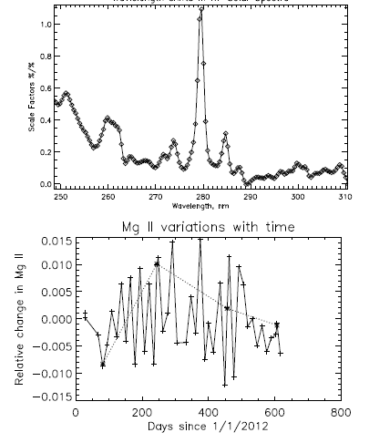
Spectral Patterns and Their Temporal Coefficients
Solar activity pattern

Slide 15
Absolute Calibration of Reflectivity Channels
Antarctic and Greenland Ice
  Complications: BRDF/SZA, cloud free?, stability
Desert Sites
  Complications: aerosols, surface variability
Ocean or land minima
  Complications: Determining cloud free scenes, wavelength dependence, sun glint, aerosols
DCC
  Complications: wavelength dependence, cloud top pressure, long-term stability
Distribution/range over the globe

Slide 16
Reflectivity and Aerosol Channels 340 nm to 400 nm
Effective Reflectivity and Aerosol Indices are already in use to track calibration stability for GOME-2, OMI and OMPS (LEO to LEO, Rayleigh Scattering over targets)
e.g., www.star.nesdis.noaa.gov/icvs/prodDemos/proOMPSbeta.php
Absolute Radiance/Irradiance check
  Ice, desert and open ocean targets
reflectivity range/distribution, 1-percentile open ocean values
Wavelength Dependence – Aerosol Indices
Complications
  Surface pressure
  Partially Cloudy scenes
  Viewing and Solar angle considerations
  Sun Glint
  Ring Effect
  Polarisation
  Stray Light

Slide 17
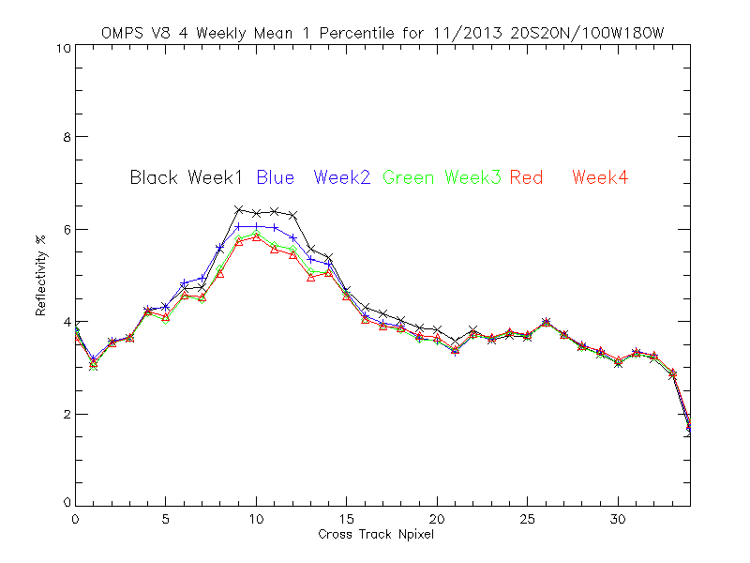
The lines show the S-NPP OMPS weekly, one-percentile effective reflectivity values for the Version 8 algorithm (331-nm channels) for November 2013 for all the data in a latitude/ longitude box in the Equatorial Pacific versus cross-track view position. (17 is the nadir position and 0 and 34 are the extreme viewing angles.) We expect the one-percentile effective reflectivity values to be approximately 4% for this region of the globe from climatological measurements made by other instruments. The cross-track variations for positions 5 to 15 are related to sun glint effects. Consistent deviations by position are from imperfections in calibration coefficients across the CCD array and intra-orbit wavelength scale shifts.

Slide 18
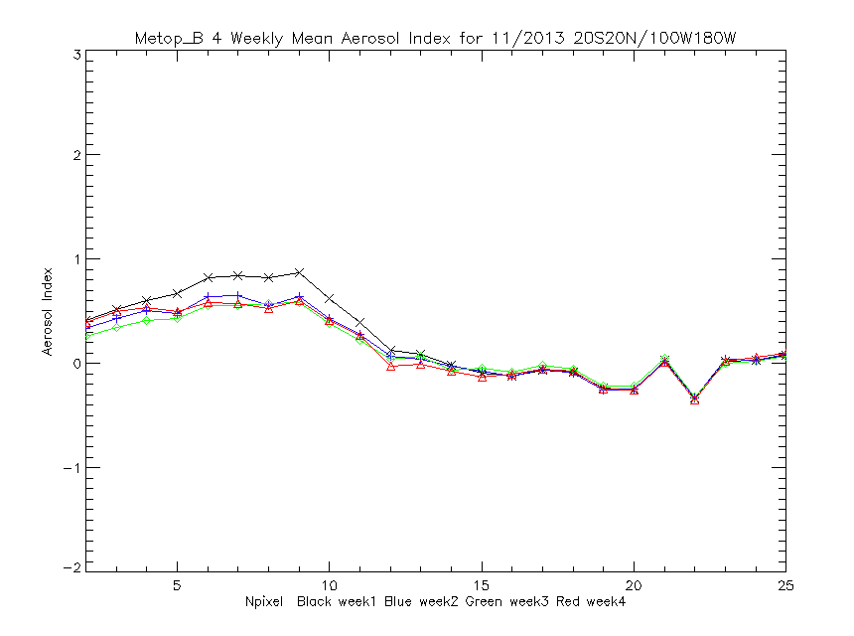
The lines show the MetOP-B GOME-2 weekly aerosol index values for the Multiple Triplet algorithm (measurement residuals for wavelengths in the 360-nm range using effective reflectivity calculated for the 331-nm range) for November 2013 for all the data in a latitude/ longitude box in the Equatorial Pacific versus cross-track view position. (12/13 are the nadir position and 2 and 25 are the extreme viewing angles.) We expect the aerosol index values to be approximately zero N-values for this region of the globe. The cross-track variations for positions 4 to 10 are related to sun glint effects. Consistent deviations by position are probably from calibration imperfections but are surprising given the scanning nature of GOME-2.
Notes:
Spatial aliasing?

Slide 19
Pacific Box Comparisons
Product statistics and cross-track variations are monitored in an uneventful region of the globe extending from 20°S to 20°N and 100°W to 180°W.
The following figures each show four weekly means for March 2015 versus cross-track view position.
The highly repetitive patterns are produced by cross-track channel biases.
These will be removed by soft calibration adjustments using the Calibration Factor Earth tables.

Slide 20
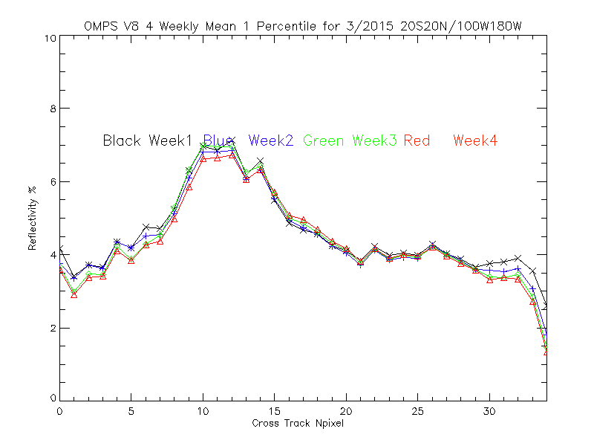
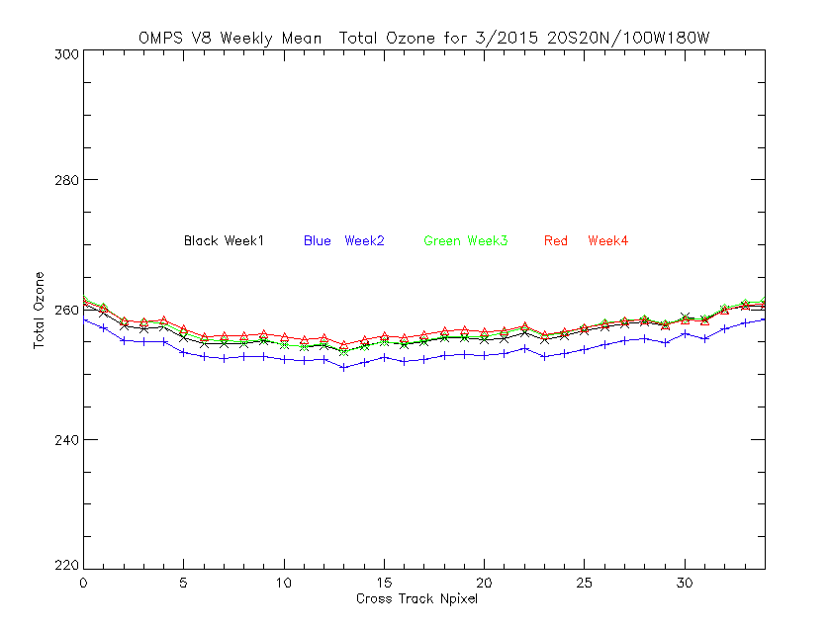
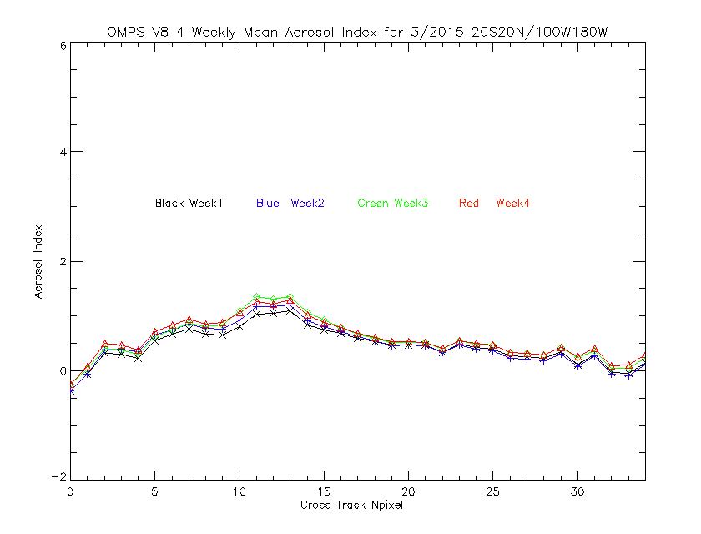
Internal Consistency
Weekly Total Ozone, 1-percentile Effective Reflectivity and Aerosol Index values, for March 2015 for a latitude / longitude box in the Equatorial Pacific versus cross-track pixel. Internal Consistency and Vicarious Calibration / Validation Generation of soft calibration coefficients (CFE) – Will use Minimum Reflectivity = 4.5%, no aerosols, no SO2, and Ozone set to EOS OMI mean.
2 Percent
4.5%
1-Percentile Reflectivity
Sun Glint Angles
Cross-Track Position
Black Week 1
Blue Week 2
Green Week 3
Red Week 4
UV Absorbing Aerosol Index
1 N-Value
Total Column Ozone
0
10 DU
Cross-Track Position
Cross-Track Position
Notes:
Figures from OMPS product ICVS site:
http://www.star.nesdis.noaa.gov/icvs/prodDemos/proOMPSbeta.php

Slide 21
Using V8TOz dN/dR and dN/dΩ to determine soft calibration adjustments
The V8TOz output contains a variety of useful parameters in addition to the total column ozone estimates. In particular, the retrieval sensitivities, dy/dx can be used to give soft calibration estimates of the N-value changes to remove reflectivity and ozone bias. If you want to increase the effective reflectivity, R, and the total column ozone, Ω, by ΔR and ΔΩ then you should increase the N-values by
ΔN318 = ΔR dN318/dR + ΔΩ dN318/dΩ
ΔN331 = ΔR dN331/dR + ΔΩ dN331/dΩ
where dNλ/dR is the rate of change of the N-value, Nλ, for wavelength, w, with respect to changes in the effective reflectivity, R, and dNλ/dΩ is the rate of change of the N-value, Nλ, for wavelength, λ, with respect to changes in the total column ozone, Ω.
Ω is total ozone in DU, R is effective reflectivity, and
N is -100*log10(Radiance/Irradiance)
Notes:
H. J. Eskes and K. F. Boersma, (2003) Averaging kernels for DOAS total-column satellite retrievals, Atmos. Chem. Phys., 3, 1285–1291, 2003, www.atmos-chem-phys.org/acp/3/1285/.
X. Liu et al., (2009) Ozone profile retrievals from the Ozone Monitoring Instrument, Atmos. Chem. Phys. Discuss., 9, 22693–22738, 2009, www.atmos-chem-phys-discuss.net/9/22693/2009/.

Slide 22
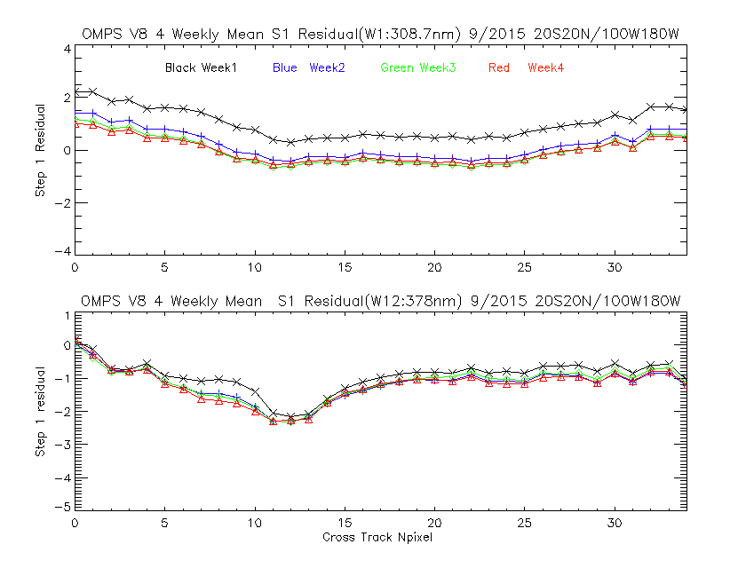

Slide 23
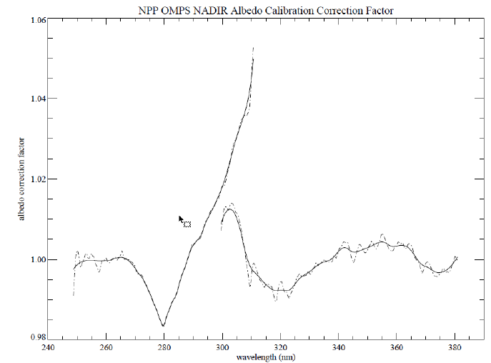
Estimates of Adjustments for
S-NPP OMPS NM and NP Calibration
Revised calibration parameters are under development.
1. OMPS NP Albedo (Rad/Irrad) biases between 300 nm and 310 nm exceed 2% required performance limits.
2. Inconsistencies between NP and NM between 300 nm and 310 nm exceed 2% .
3. Estimates of wavelength-dependent OMPS NM Albedo (Rad/Irrad) biases between 320 nm and 360 nm are at the limit of required performance.
2
1
3
Overlap
NP Coverage
NM Coverage
Notes:
Form NASA PEATE presentation 12/04/2014.

Slide 24
Wavelength Scales from Solar Features
Mg II Core (or other line) location
Comparison of Solar to Synthetic with removal of low frequency variations.
We know how to shift a synthetic spectrum by 0.01 nm. The pattern of changes from such a shift can be used a template in a multiple regression. This can give us the relative scale changes in orbit very well.
We can look for correlations with thermal changes.

Slide 25
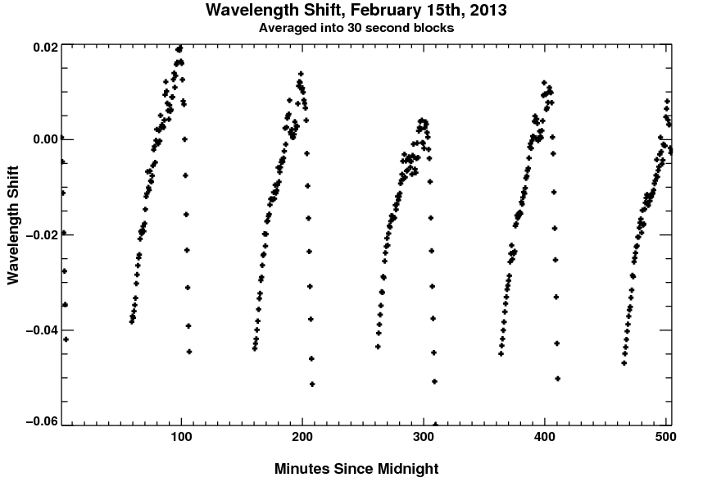
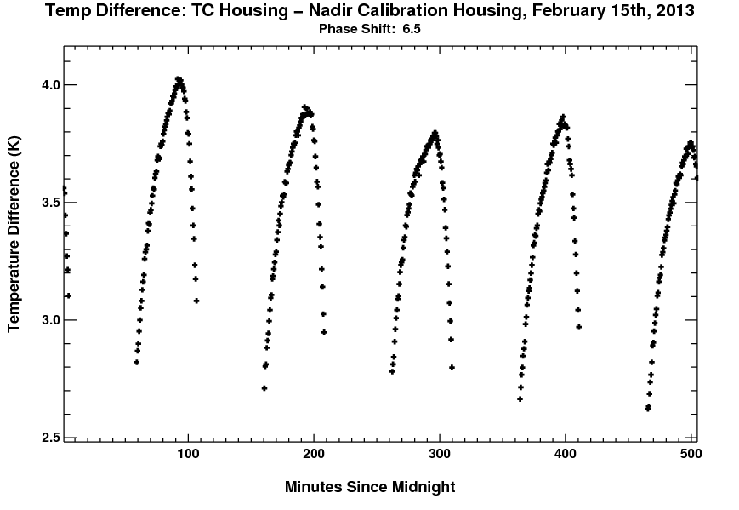
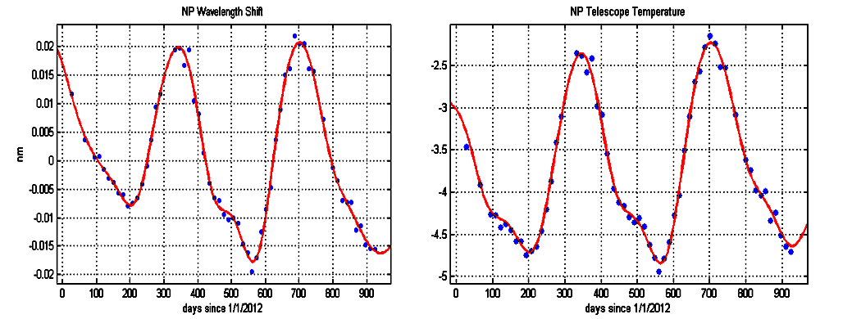
Wavelength Scales
The full spectral measurements provide information on the stability of the wavelength scales.
0.02 nm
The OMPS Nadir Mapper has an intra-orbit wavelength scale variation correlated with the instrument temperature gradient variations.
The OMPS Nadir Profiler has an annual wavelength scale variation correlated with the annual cycle of the instrument temperature.
0.5 K
Minutes in Day, GMT (4+ Orbits)
0.01 nm
1.0 K
Days Since 1/1/2012 (2+ Years)
Notes:
Shift and temperature figures from ICVS and PEATE monitoring sites.

Slide 26
Stray Light
We know a pattern of stray light changes as 1/solar .
Additive signal error signature can be confused with Ring Effect or solar activity changes.
Ghosts need to be well-characterized

Slide 27
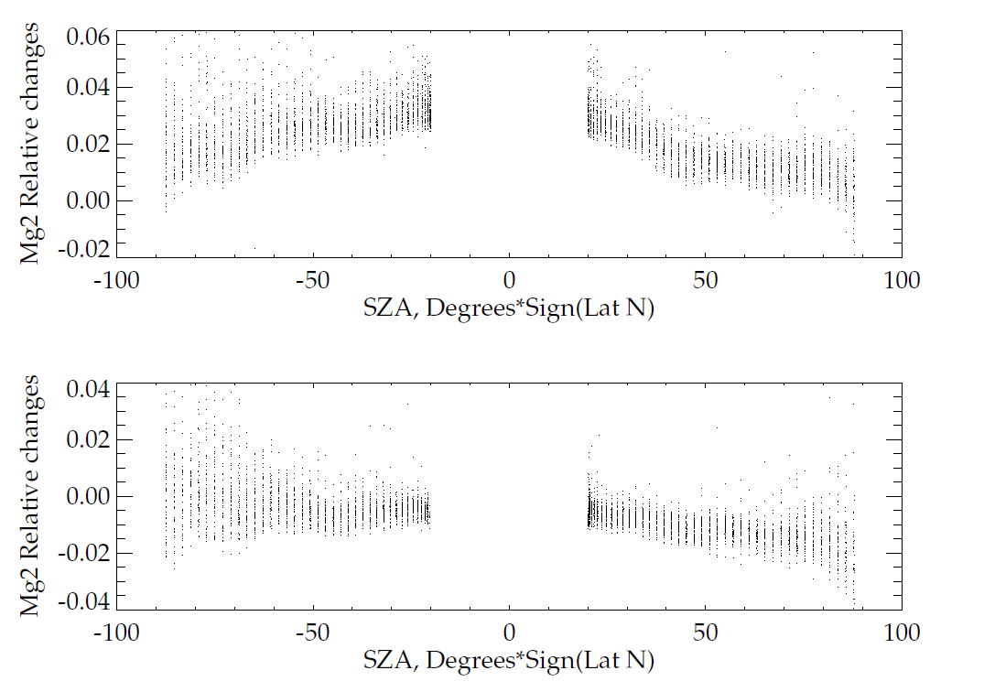
Improved OMPS NP Stray-Light Correction (2/2)
Earth-view Mg II Index for March 2014
Change in EV Mg II index reflects stray light correction.
Mg II index varied with SZA before the NP stray light correction. Stray light contamination caused up to -1. ~ 5.% errors in EV radiance
The errors are within ±2% for the most of the channels after stray light correction was applied.
Before stray light correction
After stray light correction

Slide 28
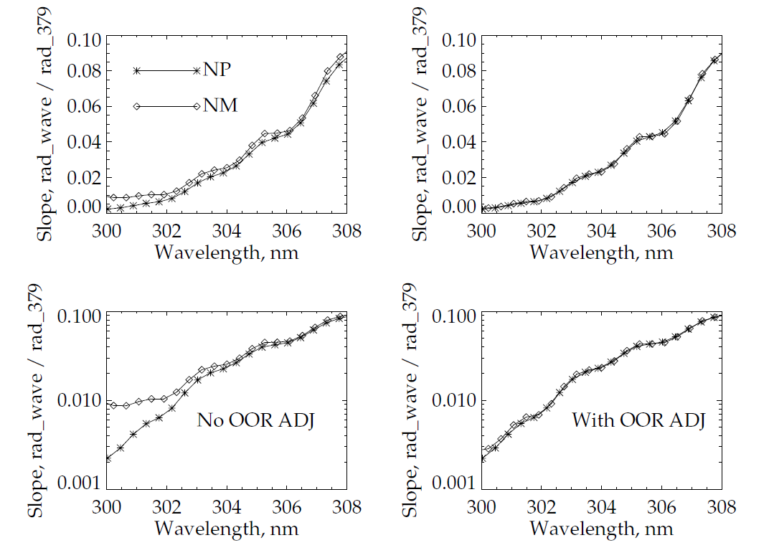
Stray Light
Stray light was well characterized prelaunch and the measurements were used to develop a scene-based source → target correction. Correlation analysis confirms the removal of most stray light errors. The figures below show the without and with Out-Of-Range corrections results for the OMPS Nadir Mapper compared to the OMPS Nadir Profiler correlations. The OMPS Nadir Profiler measurements are taken after passing through a dichroic filter.
✴ OMPS NP
◊ OMPS NM

Slide 29
Adjustments using A, K, and Dy
The Averaging Kernel, A, is the product of the Jacobian of partial derivatives of the measurements with respect to the ozone profile layers, K, and the measurement retrieval contribution function, Dy:
A = Dy # K
For a linear problem, the retrieved profile, Xr, is the sum of the A Priori Profile, Xa, plus the product of the Averaging Kernel, A, times the difference between the Truth Profile, Xt, and Xa:
Xr = Xa + A # [Xt – Xa]
The measurement change, ΔM, is the Jacobian times a profile change, ΔX:
ΔM = K # ΔX
The retrieval change, ΔXr, is the contribution function times a measurement change, ΔM:
ΔXr = Dy # ΔM

Slide 30
+ ΔXr
* Dy # ΔM
Comparison of actual differences in annual tropical zonal mean profiles retrieved by NOAA-16 and NOAA-17 SBUV/2 for 2003 with those predicted by their differences in their initial residuals. The “+” symbols are ΔXr computed directly and the * symbols are Dy ΔM with ΔM computed from the initial residuals. We can produce vary homogeneous Climate Data Records by determining the ΔM values.
Notes:
Dy, measurement contribution function; deltaM, difference in annual tropical zonal mean initial measurement residuals.

Slide 31
252 nm
273 nm
302 nm
306 nm
S1*α1 = S2* α2, Si = 1 + sec(SZAi) for nadir viewing
Notes:
Figure 2. Normalized weighting functions for SBUV/2 measurements for a standard 325 DU (0.325 atm.-cm.) ozone profile for two SZAs (Eight wavelengths from 252, 273, 283, 288, 292, 298, 302 to 306 nm)
The normalized single-scattering weighting functions, which show how sensitive the measurements are to ozone changes as functions of pressure, are given for eight wavelengths (252, 273, 283, 288, 292, 298, 302, and 306 nm) in Figure 2. The two sets of curves from top to bottom are for the wavelengths from short to long. This shows, for example, that the measurement by a space-based instrument looking down on a sunlit atmosphere of the radiance at 252 nm is primarily affected by changes in the ozone above 2.0 mbar while the measurement at 306 nm is affected by changes in ozone throughout the stratosphere. Ozone profile retrieval algorithms make use of this physical difference in the spectral measurements to obtain estimates of vertical ozone profiles.
The information at wavelengths measured by a BUV instrument shifts upward as the Solar Zenith Angle (SZA) or the Satellite Viewing Angle (SVA) increases and the path length of photons through the atmosphere increases. For the example in Figure 2, at 70° SZA, the 273 nm measurements responds to changes in the ozone vertical profile in almost the same manner as the 252 nm measurements do at 30° SZA. Notice that the second highest dotted curve and the highest dashed curve almost coincide.
The eight wavelengths in Figure 2 are the standard profiling wavelengths for normal SBUV/2 observations. They provide good coverage of the stratosphere. The gradual decrease in the weighting function (the lack of sharp cutoffs) limits the resolution of the vertical profile information. Even these eight wavelengths have some redundancy in their information and it remains to be seen how much new information will be obtained by denser spectral coverage.
Hyperspectral algorithms for profile retrievals are under development. The duplication of measurement information both spectral and spatial, should help to provide internal consistency and calibration checks. It will also help with methods for radiance comparisons between measurements for Cal/Val work.
Limb viewing produces a geometric magnification of layer response compared to nadir viewing, but with at the cost of a large increase in the optical path.

Slide 32
Outline of an Approach for Comparisons of radiance/irradiance ratios from 240 nm to 300 nm
Compute the measurement residuals using a forward model with the effective scene reflectivity of the clouds and surface determined from longer channel measurements, and the ozone profile prescribed by the Version 8 a priori climatology. Viewing geometries and bandpasses are as reported for each instrument.
Compare residuals for channels λ1 and λ2 where S1*α1 = S2* α2, where S values give the path lengths and α values give the ozone absorption cross sections. That is, works with pairs of wavelengths where the measurement contribution functions are similar.
Perform comparisons (statistical trade off in quantity of matchups vs. quality)
  Simultaneous nadir overpass matchups
  Zonal means (and No-local-time differences zonal means)
  Opportunistic Formation Flying / Chasing orbits
  Benign geographic regions (e.g., Equatorial Pacific Box)
  Ascending/descending zonal means (In the Summer hemisphere, the same latitude is observed twice so one can obtain a set of internal comparisons.)
Forward model and measurements
  V8 SBUV/2 forward model and A Priori as transfer for Viewing conditions
  Complications from real diurnal variations in the ozone profiles.
  Total ozone or reflectivity uncertainties will affect longer profiling wavelengths.
  Measurement residuals’ correlation with scene reflectivity can disclose stray light contamination.
Notes:
Bhartia, P. K., S. Taylor, R. D. McPeters, and C. Wellemeyer (1995), Application of the Langley plot method to the calibration of the solar backscattered ultraviolet instrument on the Nimbus 7 satellite, J. Geophys. Res., 100(D2),2997–3004, doi:10.1029/94JD03072.
I believe a similar method was used to check the GOME long-term calibration by assuming stable equatorial ozone profiles.

Slide 33
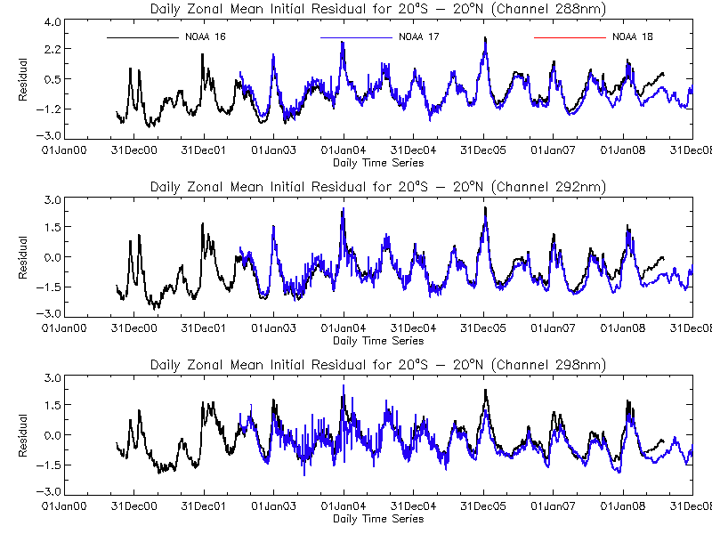
The figures show the initial measurement residuals for three profile wavelengths (Top 288 nm, Middle 292 nm, and Bottom 298 nm) for the V8PRO product for the equatorial daily zonal means (20N to 20S). The two sets of data are for the NOAA-16 SBUV/2 and the NOAA-17 SBUV/2. The units are N-values (~2.3%). The Version 8 algorithm a priori ozone profiles and forward model have been used to allow direct comparison of the radiance/irradiance ratios for the two instruments. NOAA-16 was an afternoon satellite and NOAA-17 was a morning satellite during this period. By the end of the record, the NOAA-16 satellite was in a late afternoon orbit.
Notes:
http://www.star.nesdis.noaa.gov/icvs/prodDemos/index.php

Slide 34
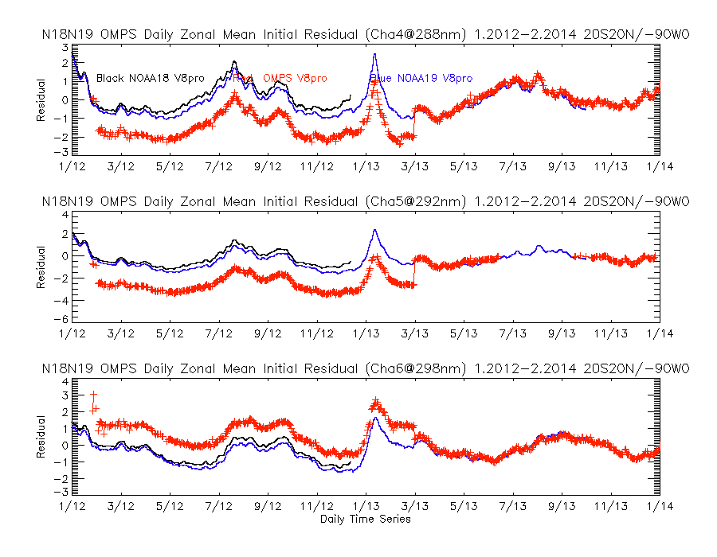
Notes:
Figures from NOAA ICVS OMPS Product site (W. Yu, E.Beach)
http://www.star.nesdis.noaa.gov/icvs/prodDemos/proOMPSbeta.php
See the following reference for information on intercalibration of SBUV(/2) component records:
DeLand, M. T., Taylor, S. L., Huang, L. K., and Fisher, B. L.: Calibration of the SBUV version 8.6 ozone data product, Atmos. Meas. Tech., 5, 2951-2967, doi:10.5194/amt-5-2951-2012, 2012. f

Slide 35
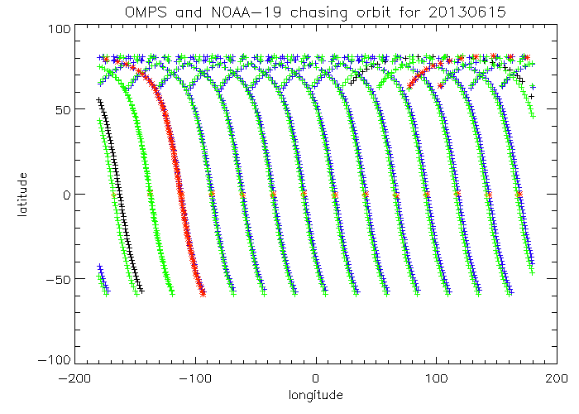
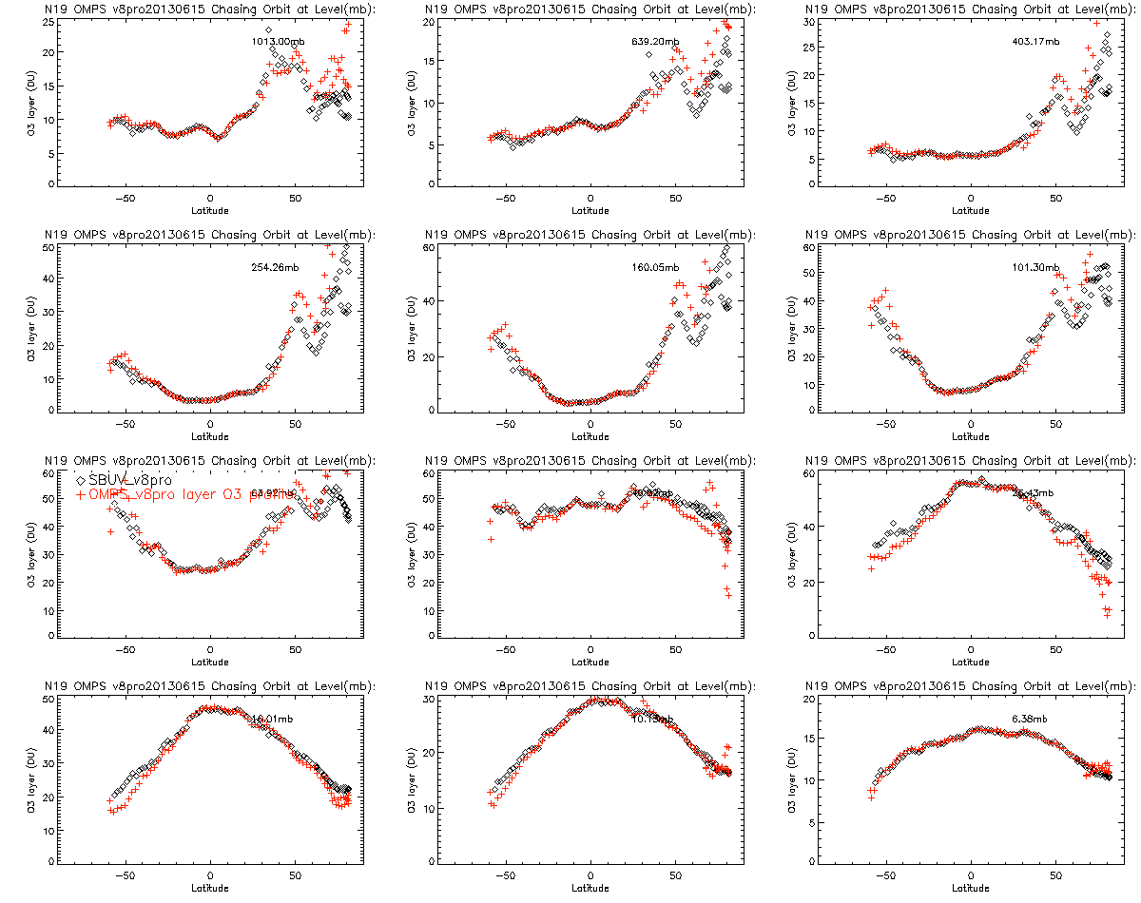
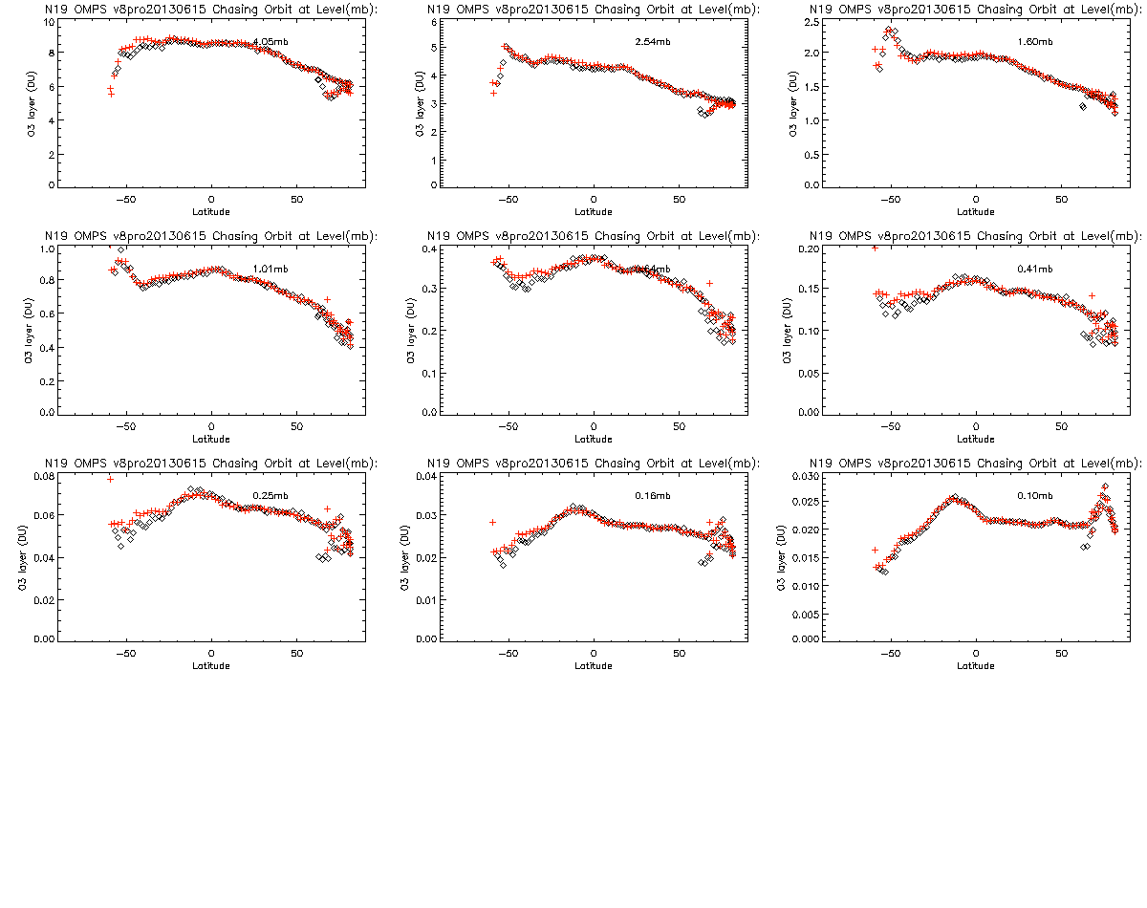
Chasing Orbit Comparisons to SBUV/2
Approximately every 12 days, the orbital tracks for the NOAA-19 and S-NPP spacecrafts align and allow comparisons of products for similar locations with small viewing time differences. The top figure shows convergence of the orbital paths.
Products and residuals from the same retrieval algorithms for SBUV/2 and OMPS NP can be compared directly. The bottom figures shows ozone amounts for nine layers for the two Version 8 retrievals with the top left for the lowest layer and the bottom right for the highest layer.
Additional monitoring plots provided at
http://www.star.nesdis.noaa.gov/icvs/prodDemos/proOMPSbeta.O3PRO_V8.php
show that the ozone profile differences are consistent with the initial measurement residuals computed relative to the first guess profiles.
16 hPa
10 hPa
6.4 hPa
4.0 hPa
2.5 hPa
1.6 hPa
1.0 hPa
0.64 hPa
0.4 hPa
Notes:
Figures from NOAA ICVS OMPS Product site (W. Yu, E.Beach, Z. Zhang, J. Niu)
http://www.star.nesdis.noaa.gov/icvs/prodDemos/proOMPSbeta.php

Slide 36
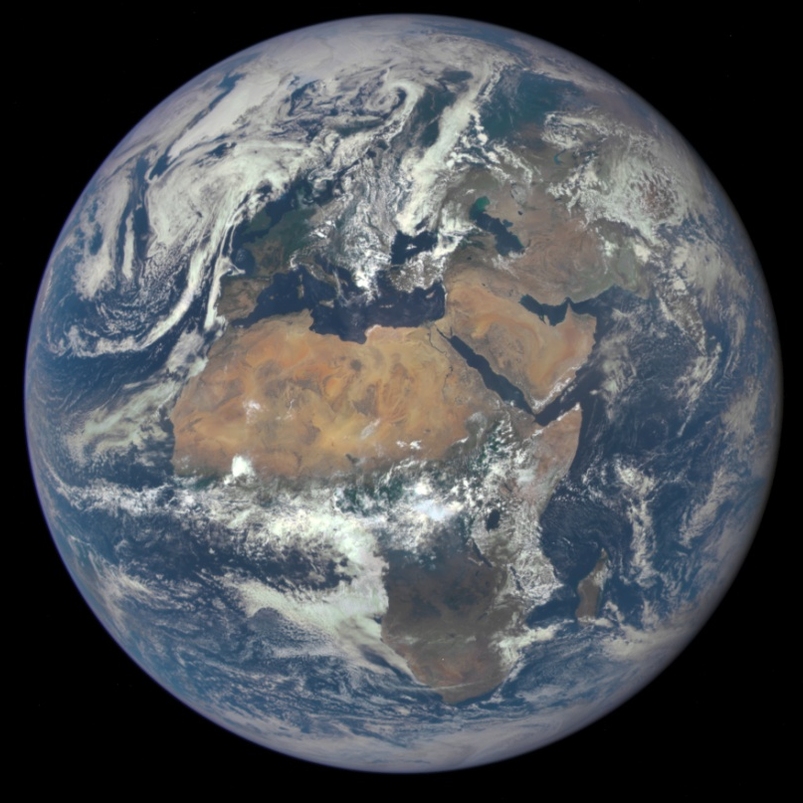
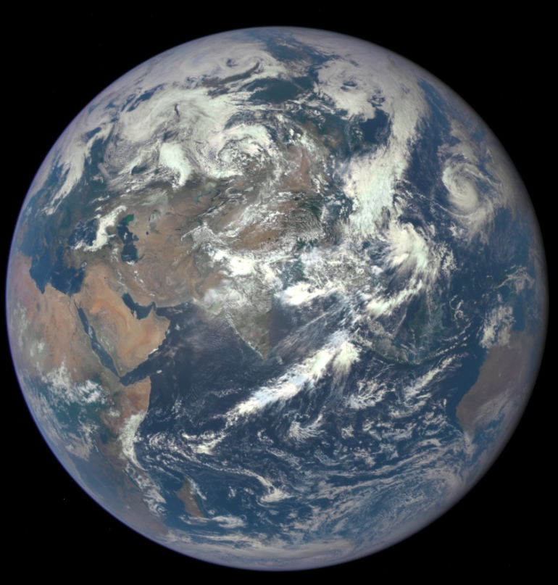
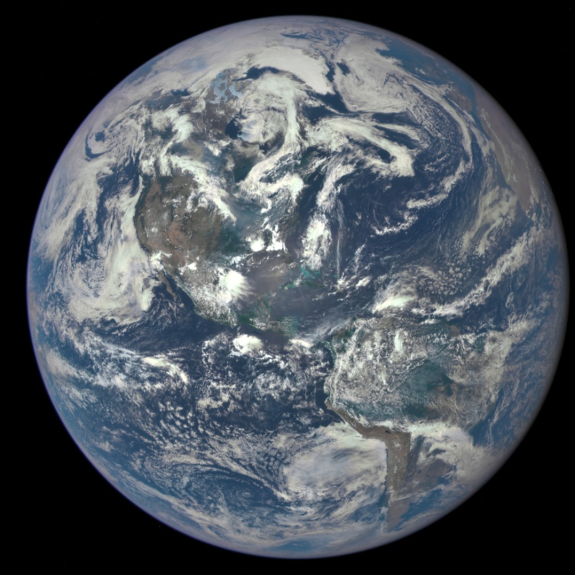
DSCOVR EPIC
Photo Gallery

Slide 37


Slide 38
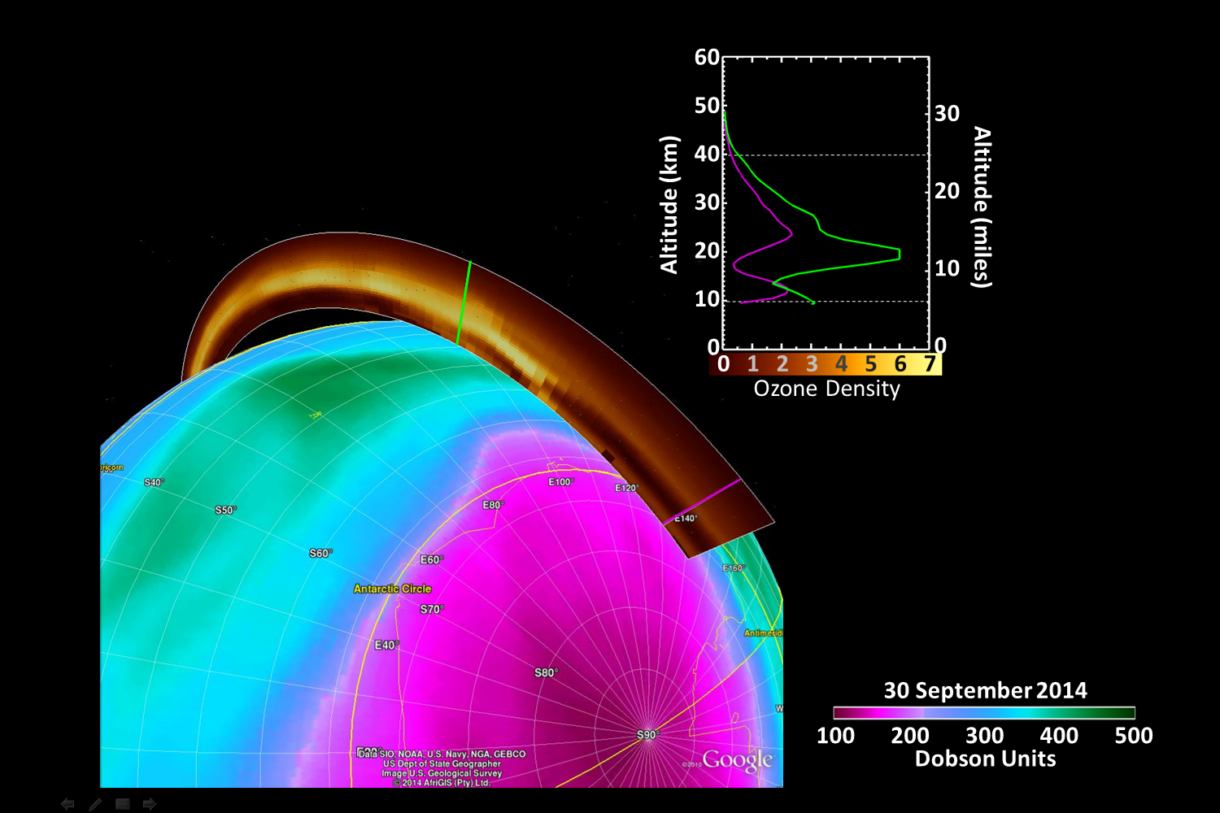
Continuing the Record of
Ozone Monitoring from
NOAA Satellite Instruments
EUMETSAT 2015 Conference
L. Flynn and C. Pan
with contributions from other members of
the NOAA and NASA OMPS S-NPP Teams
Notes:
25-S7-1: Session 7: Atmospheric Composition
· 25 Sep 2015: 9:00am-10:30am · Location: Room 3
Figure provided by Colin Seftor, NASA GSFC (SSAI)

Slide 39
Abstract
The Ozone Mapping and Profiler Suite (OMPS) is designed to make measurements of scattered solar UV and visible radiance with three separate CCD detectors. The measurements contain information on atmospheric ozone and other trace gases. This talk reports on the performance of the instruments and the validation of the ozone products with particular attention to their ability to provide ozone monitoring. The OMPS measurements are well on the way to being fully validated with on-board calibration system performing as desired and thorough characterizations of stray light, wavelength scale shift, throughput degradation, non-linearity and dark current to provide models to correct for these effects. The Version 8 Ozone Profile and Total Ozone Algorithms used to create the earlier parts of the corresponding long-term records have been adapted to produce similar products from OMPS measurements. Comparisons with NOAA-19 SBUV/2 and EOS Aura OMI products show excellent consistency. The OMPS Limb Profiler products are advancing with improved modeling and better estimates of stray light and pointing errors.

Slide 40
Outline
Detectors
  Dark Currents, Linearity, Smear, Bias Offset, SNR
Diffusers+Stable orbit
  Solar Stability for NM
  Solar Model for NP
Wavelength Scale and bandpass
Stray Light
Internal Consistency Cross-track
V8 Parameters and soft calibration
Validation (Chasing Orbits 12 and 8 days)
Comparisons to ground-based

Slide 41
OMPS NP: Error Impacts on Precision/Accuracy
The sensitivity of the ozone retrievals to radiance/irradiance ratio errors is approximately 1.6%::1% .
Wavelength scale errors produce radiance variations of ±1%
  1.6%/1% x 1% = 1.6% O3 effects
and ozone cross-section, alpha, of ±0.4 %,
  0.02 nm x 100%/5 nm x 1%/1% = 0.4% O3 effects
Solar activity produces irradiance variations of ±1%
  1.6%/1% x 1% = 1.6% O3 effects
Instrument degradation is -0.5%/(3 years) at 253 nm
  1 year x 1.6%/1% x 0.5%/(3 years) = 0.3% O3 effects
  (assuming annual updates to Calibration Factor Earth tables)
Stray light errors are now approximately 1/3 of the original errors with radiance variations of ±1%
  1.6%/1% x 1% = 1.6% O3 effects
Notes:
Differences 1.54 0.13 -0.06 0.06 0.14 0.00 -0.08 -0.06 -0.01 0.00 0.05 -0.17 -0.18 nm.

Slide 42
Version 8 Total O3 Algorithm
The Version 8 total O3 algorithm (V8TOZ) is the most recent version of a series of BUV (backscattered ultraviolet) total O3 algorithms that have been developed since the original algorithm proposed by Dave & Mateer [1967], which was used to process Nimbus-4 BUV data. These algorithms have been progressively with better understanding of UV radiation transfer, internal consistency checks, and comparison with ground-based instruments. However, all algorithm versions have made two key assumptions about the nature of the BUV radiation that have largely remained unchanged over all these years. Firstly, we assume that the BUV radiances at wavelengths greater than 310 nm are primarily a function of total O3 amount, with only a weak dependence on O3 profile that can be accounted for using a set of standard profiles. Secondly, we assume that a relatively simple radiative transfer model that treats clouds, aerosols, and surfaces as Lambertian reflectors can account for most of the spectral dependence of BUV radiation, though corrections are required to handle special situations. The recent algorithm versions have incorporated procedures for identifying these special situations, and apply semi-empirical corrections, based on accurate radiative transfer models, to minimize the errors that occur in these situations.
Notes:
https://ozoneaq.gsfc.nasa.gov/media/docs/SBUV2_V8_ATBD_020207.pdf
Wellemeyer, C. G., S. L. Taylor, C. J. Seftor, R. D. McPeters, and P. K. Bhartia (1997), A correction for the Total Ozone Mapping Spectrometer profile shape errors at high latitude, J. Geophys. Res., 102, 9029-9038, doi:10.1029/96JD03965.
McPeters, R. D., et al., Nimbus 7 total ozone mapping spectrometer (TOMS) data products user's guide, NASA Ref Publ., 1384, 1996.
Dave, J. V., C. L. Mateer, A preliminary study on the possibility of estimating total atmospheric ozone from satellite measurements, J. Atmos. Sci., 24, 414–427, 1967.
Carlton L. Mateer, Donald F. Heath, and Arlin J. Krueger, 1971: Estimation of Total Ozone from Satellite Measurements of Backscattered Ultraviolet Earth Radiance. J. Atmos. Sci., 28, 1307–1311.
doi: http://dx.doi.org/10.1175/1520-0469(1971)028<1307:EOTOFS>2.0.CO;2

Slide 43
V8TOZ Details
The inverse algorithm consists of a 3-step retrieval procedure.
In the first step, a good first estimate of effective reflectivity (or effective cloud fraction) and total O3 is made by using the 21 standard profile radiance tables and the measured radiance to irradiance ratios at 318 nm and 331 nm.
In step 2, this estimate is corrected by using the Jacobians and seasonally and latitudinally varying O3 and temperature climatology. These corrections typically change total O3 by less than 2%.
In the final step, scenes containing large amounts of aerosols, sea glint, volcanic SO2, or with unusual O3 profiles are detected by using an approach based on the analysis of residuals (differences between measured and computed radiances at wavelengths not used in the first two steps). We use pre-computed regression coefficients applied to these residuals to correct for these effects. These coefficients are generated by off-line analysis of the relationship between retrieval errors and residues computed by accurately modeling radiances for a representative set of interfering species/events. An important benefit of this approach is that unusual events are easily flagged so they can be identified later for careful analysis. Past analyses of such events led to the discovery of a new method of studying aerosols by using BUV radiances.
Notes:
Wellemeyer, C. G., S. L. Taylor, C. J. Seftor, R. D. McPeters, and P. K. Bhartia (1997), A correction for the Total Ozone Mapping Spectrometer profile shape errors at high latitude, J. Geophys. Res., 102, 9029-9038, doi:10.1029/96JD03965.
McPeters, R. D., et al., Nimbus 7 total ozone mapping spectrometer (TOMS) data products user's guide, NASA Ref Publ., 1384, 1996.
Dave, J. V., C. L. Mateer, A preliminary study on the possibility of estimating total atmospheric ozone from satellite measurements, J. Atmos. Sci., 24, 414–427, 1967.
Carlton L. Mateer, Donald F. Heath, and Arlin J. Krueger, 1971: Estimation of Total Ozone from Satellite Measurements of Backscattered Ultraviolet Earth Radiance. J. Atmos. Sci., 28, 1307–1311.
doi: http://dx.doi.org/10.1175/1520-0469(1971)028<1307:EOTOFS>2.0.CO;2

Slide 44
Using V8TOz dN/dR and dN/dΩ to determine soft calibration adjustments
The V8TOz output contains a variety of useful parameters in addition to the total column ozone estimates. In particular, the retrieval sensitivities, dy/dx can be used to give soft calibration estimates of the N-value changes to remove reflectivity and ozone bias. If you want to increase the effective reflectivity, R, and the total column ozone, Ω, by ΔR and ΔΩ then you should increase the N-values by
ΔN318 = ΔR dN318/dR + ΔΩ dN318/dΩ
ΔN331 = ΔR dN331/dR + ΔΩ dN331/dΩ
where dNλ/dR is the rate of change of the N-value, Nλ, for wavelength, w, with respect to changes in the effective reflectivity, R, and dNλ/dΩ is the rate of change of the N-value, Nλ, for wavelength, λ, with respect to changes in the total column ozone, Ω.
Ω is total ozone in DU, R is effective reflectivity, and
N is -100*log10(Radiance/Irradiance)
Notes:
H. J. Eskes and K. F. Boersma, (2003) Averaging kernels for DOAS total-column satellite retrievals, Atmos. Chem. Phys., 3, 1285–1291, 2003, www.atmos-chem-phys.org/acp/3/1285/.
X. Liu et al., (2009) Ozone profile retrievals from the Ozone Monitoring Instrument, Atmos. Chem. Phys. Discuss., 9, 22693–22738, 2009, www.atmos-chem-phys-discuss.net/9/22693/2009/.

Slide 45
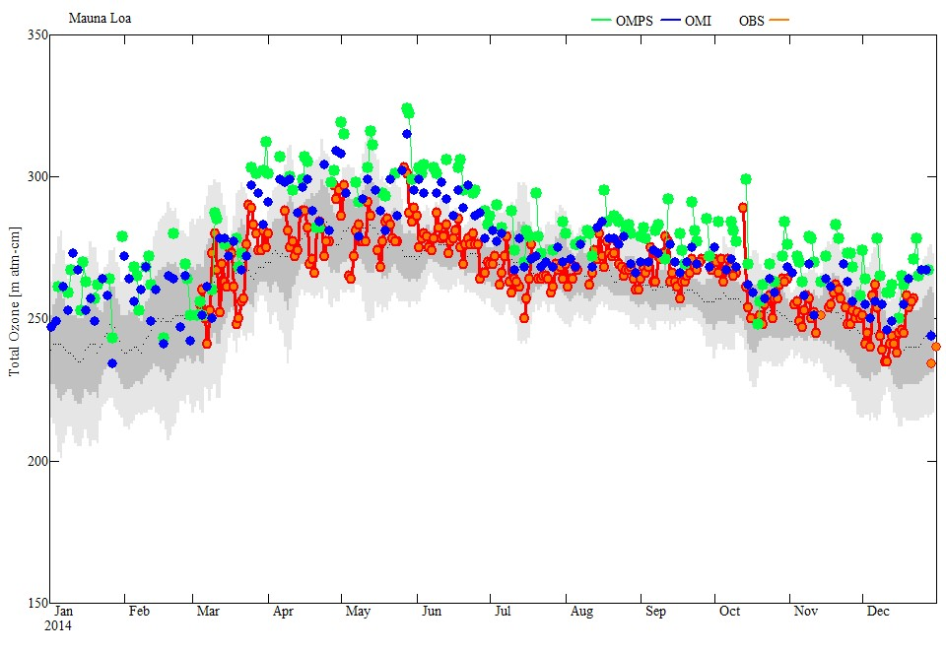
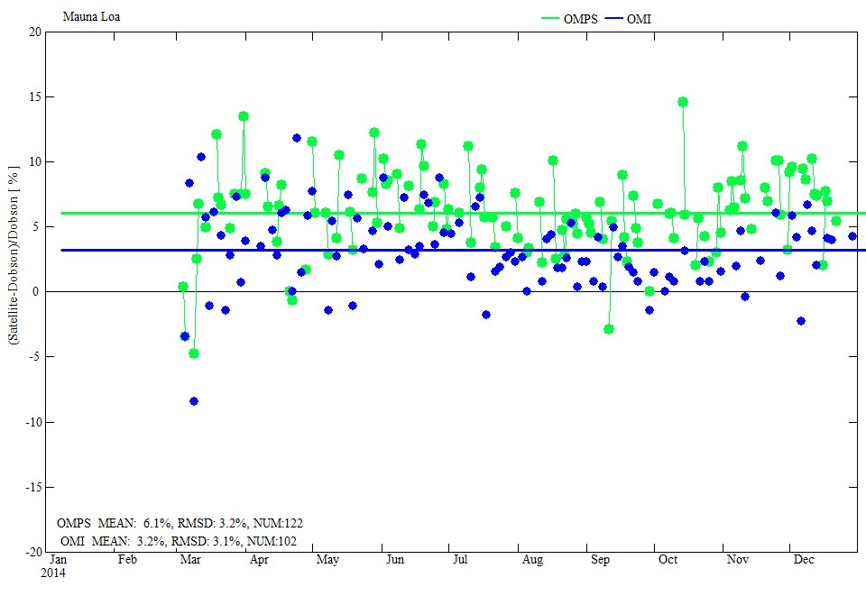
Comparison with Dobson Total Ozone
Daily total ozone values from the Dobson Spectrophotometer (red dots) on Mauna Loa, Hawaii are plotted with co-incident ozone values from Aura/OMI (blue) and JPSS/OMPS satellite data (green). Apparent annual ozone cycle in Dobson measurements is shown with dark line (smoothed). The climatological ranges fro Dobson MLO are shown in grey.
Mauna Loa, 2014
Dobson
OMI
OMPS
2014
The lower figure shows the differences for the matched data in the top plot. The satellite values have not been adjusted for the field-of-view (FOV) differences; The Dobson instrument is near the top of the mountain while the satellite FOVs contain some open ocean.
OMI – Dobson
OMPS – Dobson
5%
Notes:
Figures from NOAA OAR.

Slide 46
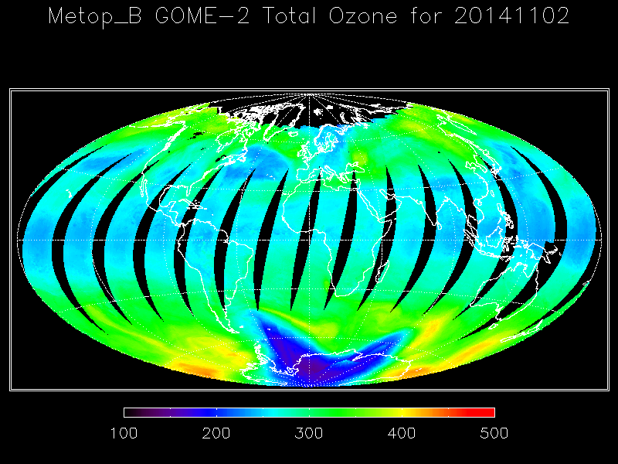
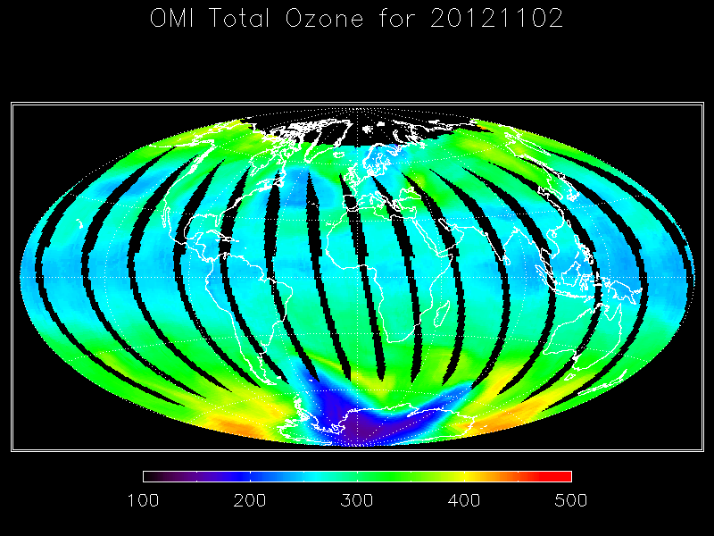
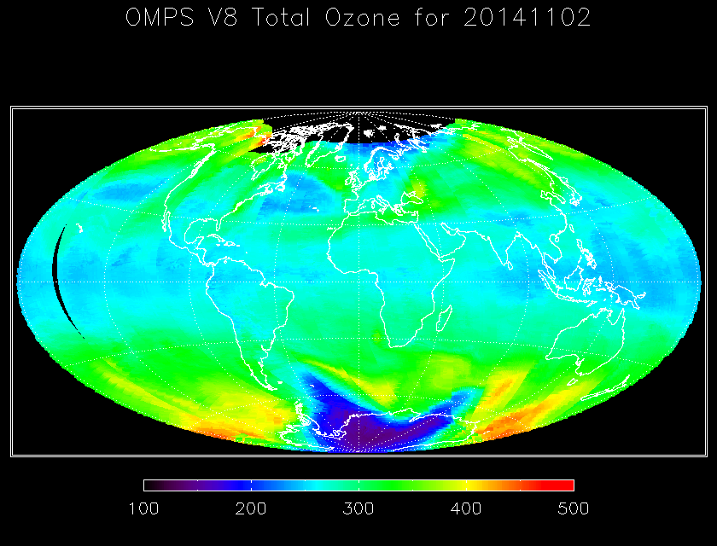
Comparisons among Total Column Ozone Products from MetOp-B GOME-2 (NOAA Version 8 algorithm), NASA EOS Aura OMI (NASA Version 8.6 algorithm) and S-NPP OMPS-NM (NOAA Version 8 algorithm) for November 2, 2014.
Notes:
Figures from NOAA ICVS OMPS Product site (W. Yu, E.Beach)
http://www.star.nesdis.noaa.gov/icvs/prodDemos/proOMPSbeta.php

Slide 47
Version 8 Profile Retrieval Algorithm
The spectral measurements from the OMPS Nadir Profiler and Nadir Mapper of the radiances scattered by the Earth’s atmosphere are used to generate estimates of the ozone vertical profile along the orbital track by using the Version 8 Ozone Profile retrieval algorithm (Bhartia et al. 2013). The algorithm uses ratios of Earth radiance to Solar irradiance at a set of 12 wavelengths (at approximately 252, 273, 283, 288, 292, 298, 302, 306, 313, 318, 331 and 340 nm) with eight from the Nadir Profiler and four from the Nadir Mapper to obtain estimates of the ozone vertical profile in 21 3-km Layers by using an optimal estimation retrieval algorithm. The radiances for the four longer wavelength are obtained from the 25 Nadir Mapper FOVs co-located with a single Nadir Profiler FOV. The longer channel radiance/irradiance ratios are used to generate estimates of the total column ozone and scene effective reflectivity.
The algorithm has been used to generate a long-term ozone profile record from the SBUV(/2) series of instruments (Deland et al., 2012; Labow et al.; 2013, McPeters et al, 2013, Kramarova et al., 2013).
We have good overlap with NOAA-19 SBUV/2 at the start of the OMPS record and will be using the ozone profile estimates from OMPS to continue the SBUV(/2) record
Notes:
Bhartia, P. K., McPeters, R. D., Flynn, L. E., Taylor, S., Kramarova, N. A., Frith, S., Fisher, B., and DeLand, M.: Solar Backscatter UV (SBUV) total ozone and profile algorithm, Atmos. Meas. Tech., 6, 2533-2548, doi:10.5194/amt-6-2533-2013, 2013.
DeLand, M. T., Taylor, S. L., Huang, L. K., and Fisher, B. L.: Calibration of the SBUV version 8.6 ozone data product, Atmos. Meas. Tech., 5, 2951-2967, doi:10.5194/amt-5-2951-2012, 2012.
Labow, G. J., R. D. McPeters, P. K. Bhartia, and N. Kramarova (2013), A comparison of 40 years of SBUV measurements of column ozone with data from the Dobson/Brewer network,J. Geophys. Res. Atmos., 118, 7370–7378, doi:10.1002/jgrd.50503.
McPeters, R. D., P. K. Bhartia, D. Haffner, G. J. Labow, and L. Flynn (2013), The version 8.6 SBUV ozone data record: An overview, J. Geophys. Res. Atmos., 118, 8032–8039, doi:10.1002/jgrd.50597.
Kramarova, N. A., S. Frith, P. K. Bhartia, R. McPeters, S. Taylor, B. Fisher, G. Labow, and M. DeLand (2013b),Validation of ozone monthly zonal mean profiles obtained from the Version 8.6 Solar Backscatter Ultraviolet algorithm, Atmos. Chem. Phys. Discuss., 13, 2,549–2,597, doi:10.5194/acpd-13-2549-2013.

Slide 48
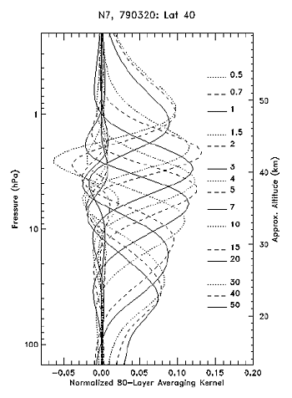
Version 8 Averaging Kernels
Averaging Kernels (AKs) (for fractional changes in ozone) at the 15 pressure levels. The short horizontal lines on the right side of the graph show the pressure levels and point to the corresponding AK. The horizontal and AK lines’ styles correspond. In general, the (fractional) variation in the mixing ratio reported by SBUV at a given pressure level is a weighted average of the (fractional) variation of the mixing ratio at surrounding altitudes, relative to the a priori profile. Since the SBUV V8 a priori profiles have no inter-annual variation, the AKs also show how the algorithm would smooth a long-term trend in ozone mixing ratio. Note, however, that individual SBUV profiles usually have structures that are finer than those implied by the AKs; these structures come from the assumed a priori profile, rather than from the measurements themselves. This figure shows typical AKs at the 40ºN. The AKs show best resolution of ~6 km near 3 hPa, degrading to ~10 km at 1 and 30 hPa. Outside this range the retrieved profiles have little information. For example, the (fractional) variation in ozone mixing ratio seen at 0.5 hPa actually represents the (fractional) variation from the region around 1 hPa, and the variation around 50 hPa represents the variation from around 40 hPa.

Slide 49
Summary and Conclusions
Characterization of darks, non-linearity, stray light and wavelength scales provide good adjustments.
The OMPS Nadir Instruments are performing as designed and the reference solar diffuser measurements show stable throughput.
The OMPS Nadir Profiler has experienced a small amount of degradation for the shortest wavelengths but it is accurately determined.
The retrievals algorithms are well-suited for the measurements and compliment soft calibration adjustment strategies.
The ozone products are validated by comparisons to those from ground-based and other space-based systems.
A full reprocessing is underway and will provide a new component of the long-term atmospheric ozone monitoring record.

Slide 50
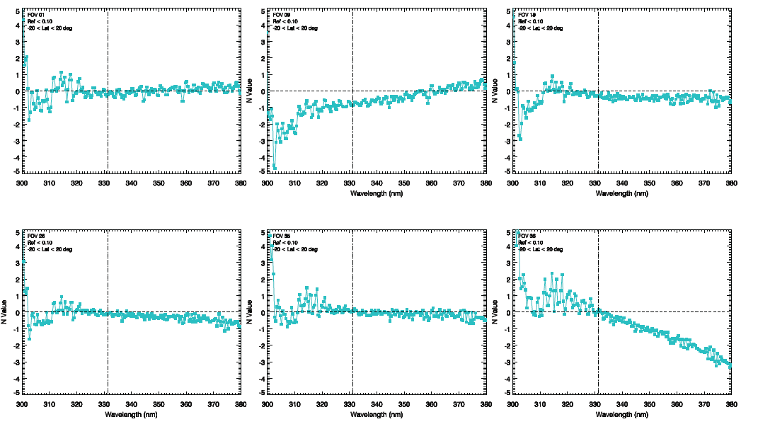
e
Cross-Track Difference
for Earth View N-Value or Radiance
Wavelength-dependent Cross-Track Normalized Radiance Error Meets Requirement
Normalized radiance error is percent difference between OMPS and MLS via. TOMRAD
Figures shows the errors for 6 different cross-track (CT) positions
Errors were minimized < 2% for most of the channels.
Except ion is CT#36 on wavelength > 360 nm. Soft calibration are being implemented to eliminate this residual error.
CT position #1
CT position #9
CT position #19
CT position#26
CT position#35
CT position #36
Wavelength-dependent normalized radiance errors are within 2% (except for FOV 36)
which meets the performance requirement.

