Slide 1

The application of data driven methods for the monitoring of calibration and data quality of Earth Observation sensors
May 2015
Steve Mackin

Slide 2
Question addressed
What external methods and measurements do you use to maintain your instrument’s calibration in orbit? (SNO measurements, Ground-based products, other satellite products, reflectivity target sites)

Slide 3
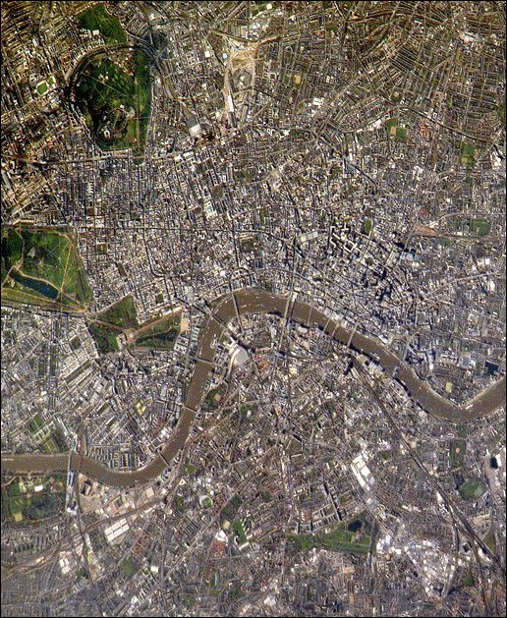
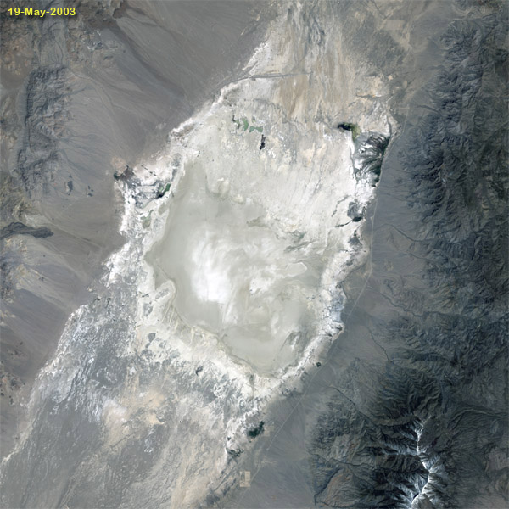
Which image is more useful for calibration and data quality assessment?
Railroad Valley, Nevada
London, UK

Slide 4
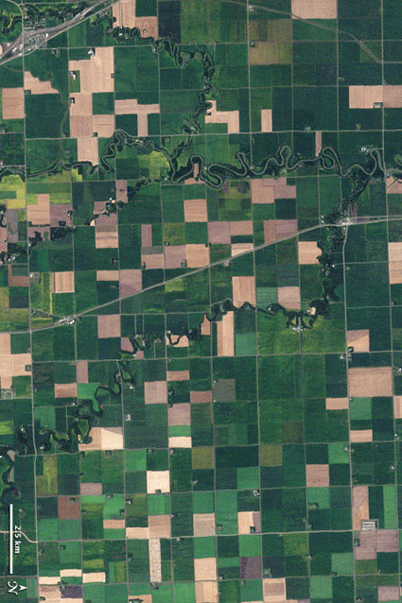
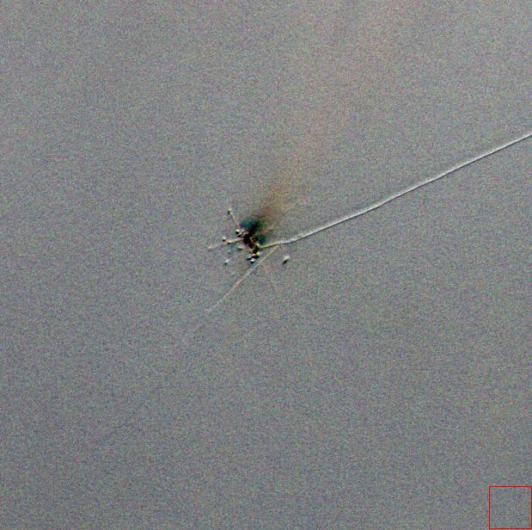
Which image is more useful for calibration and data quality assessment?
Cropland
Snow

Slide 5
Every image has more or less the same information…
Signal to Noise Ratio (SNR)
Relative Calibration
    Detector non-uniformity
    Vignetting effects
Spatial Resolution (Modulation Transfer Function – MTF at Nyquist)
Relationship between raw signal level and incoming radiant energy
Instrumental or processing artefacts

Slide 6
Is it feasible to find all these things in heterogeneous images?

Slide 7
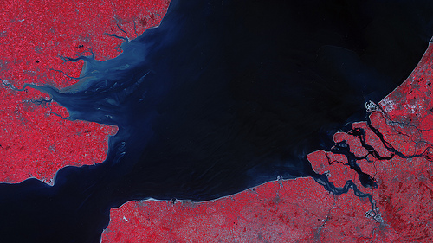
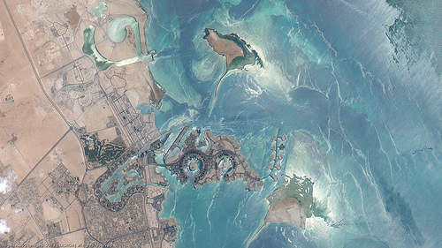
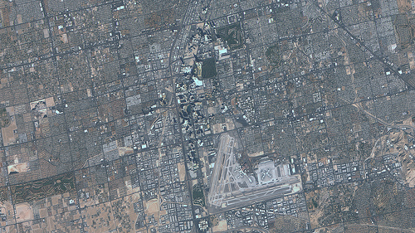
What do I mean by heterogeneous images ?
Normally collected images of any target type.

Slide 8
Why not just keep using established techniques?

Slide 9
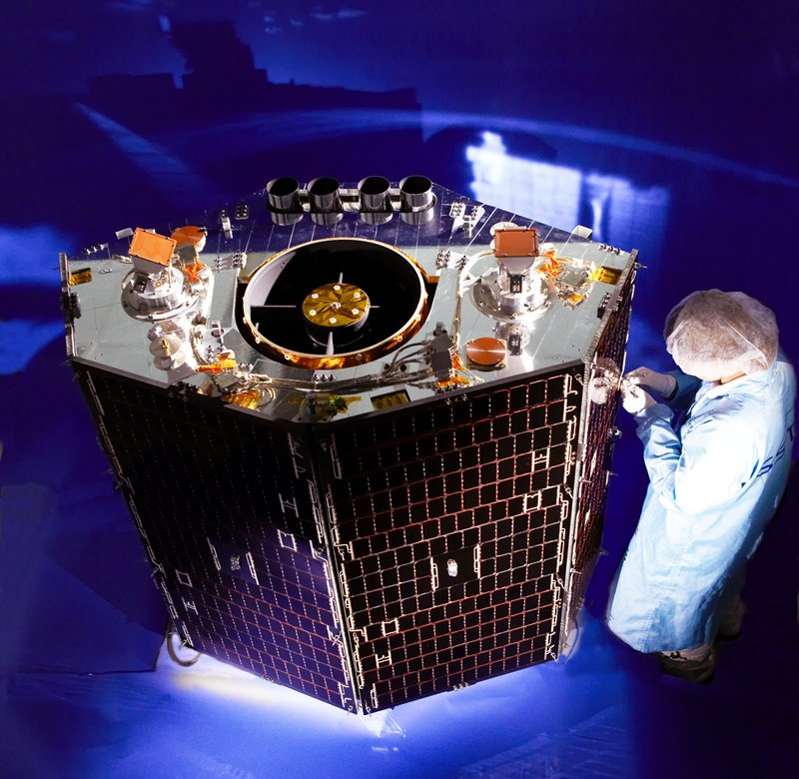
Origins of the ideas
Worked with small-satellites (no on-board calibrator)
Multiple satellites (at one time five)
We could spare 6% of our time (two people part time)
Always a commercial push not to occupy the sensor with Calibration images

Slide 10
Used “traditional” methods of calibration
Dark Images over the Pacific Ocean at Night
White images (in the footsteps of AVHRR – Loeb) over Dome-C and Greenland
Reflectance method over Railroad Valley (RRV) Kurt Thome.
So with this we could remove Calibration Bias, Equalise Detectors and get an absolute value for each spectral band.
However, the reflectance method proved expensive especially for five satellites (sorry Arizona). So we needed a replacement
Cross-calibration against Landsat 7 and now Landsat 8 over Libya 4 and Dome-C which are both CEOS endorsed calibration sites.

Slide 11
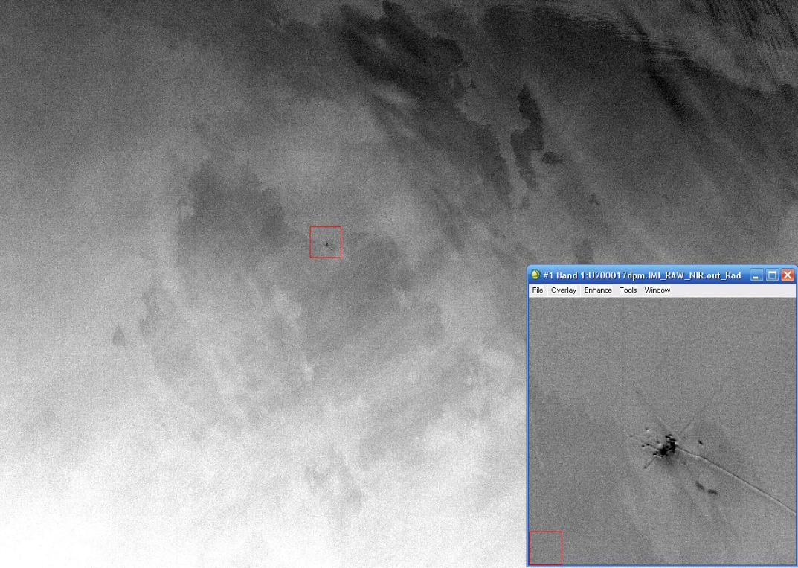
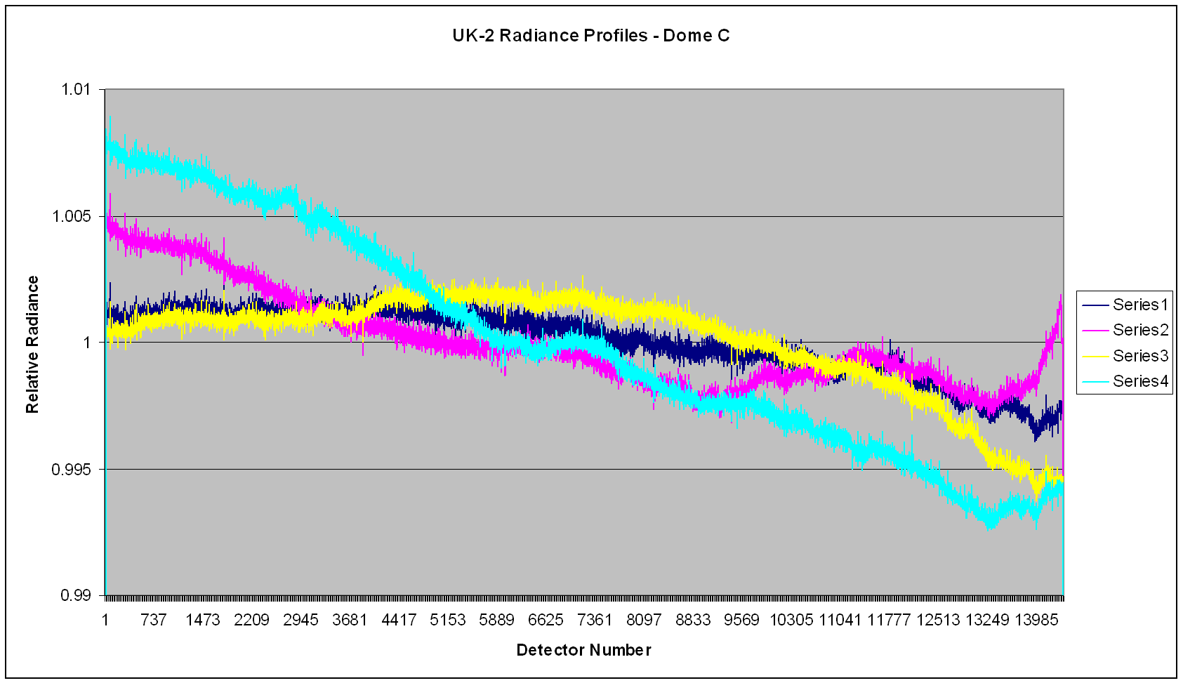
“Traditional” unfortunately meant time consuming
Multiple white images over Antarctica or Greenland to derive relative gain terms, yawing the spacecraft, removing scenes with clouds or hoar frost effects.

Slide 12
Traditional results may be conflicting
Vicarious methods applied by two groups may be in conflict, depending on how the procedure is carried out, but usually the results are within the defined uncertainties.

Slide 13
On-board systems may give variable results

Slide 14
Decided to develop methods based on data alone – “Data Driven” methods
Idea is that all these features, striping, banding and calibration drift are present in all images.
Once we have this basic assumption, then we can use all images, including heterogeneous images to isolate, understand and remove or compensate for them.

Slide 15
Simplified Calibration Equations (1)
Radiance = (Counts – Calibration Bias) * Calibration Gain
Assume linear relationship
for detectors.
Counts
Bias
Radiance
Only additional complexity is the electronic gain factor (Standard/ Target)

Slide 16
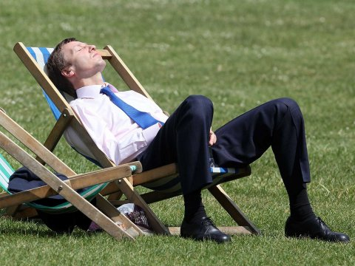
What it would be nice to do…!
Just collect images
Automate all the processing
Produce regular updates of relative calibration curve, signal to noise ratio, calibration drift and correct for single pixel defects and then update the coefficients automatically.
Not a single calibration image and no extra work

Slide 17
Current status (IDEAS+ and ALTS projects, ESA)
Algorithms in operation Signal to Noise Ratio (Level 1 Radiance, no geometric resampling)
  Relative Calibration Curve (Level 0, calibration bias subtracted and Level 1)
  Absolute Calibration Drift (Level 0, calibration bias subtracted)
Algorithms in testing
  Find Focus (MTF) algorithm (Level 1 Radiance, no geometric resampling)
  Single Detector Anomalies (Level 0 or Level 1, no geometric resampling)
Algorithms under development
  Spectral shifts (hyperspectral devices)
  Spectral features quantification (due to on-board diffuser speckle effects)

Slide 18
Signal to Noise Ratio (SNR)
Not a new idea, deriving SNR from normal Images – (JACIE 2012) Automated Measurement of SNR of High Resolution Satellite Images (Satrec Initiative).
However, our approach requires no pre-processing (for example selection of the most homogeneous parts of the image)
Uses simple statistics to determine if a point has validity. Should not over or underestimate the SNR.
Tested using modelling, it is now operational and has provided useful insights for correction of observed SNR issues.

Slide 19
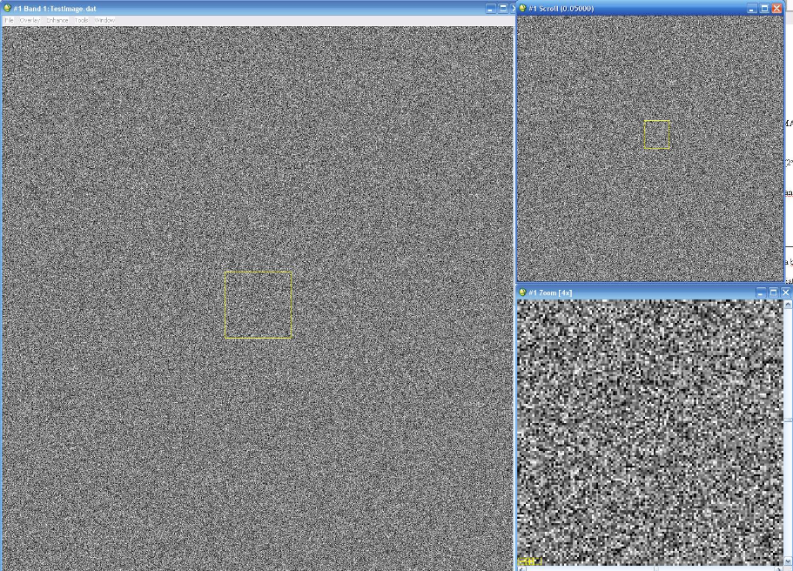
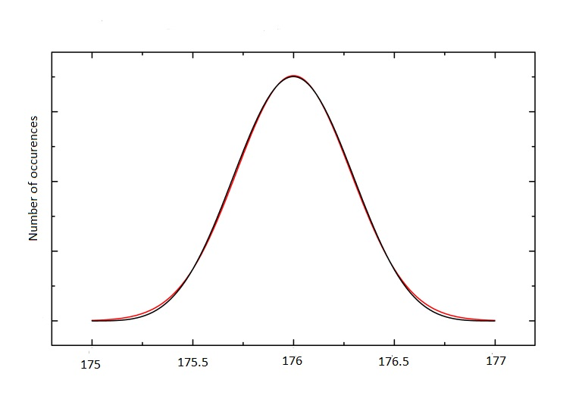
SNR Measurement
SNR = Mean / Standard Deviation

Slide 20
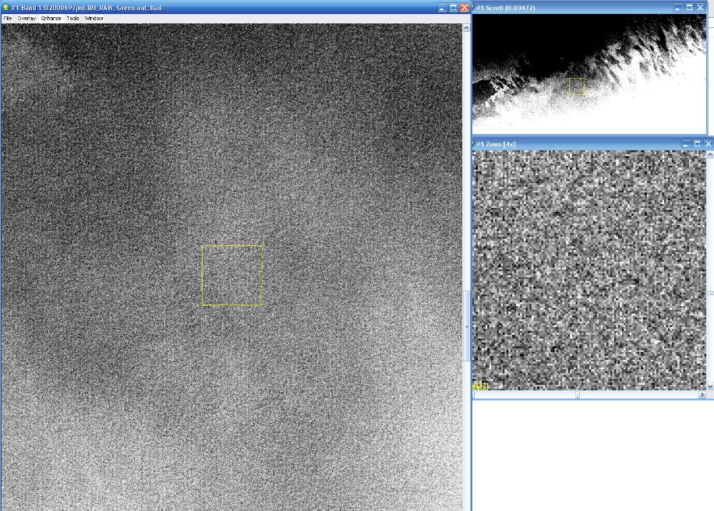
SNR Modelling and Measurement
1 – Create an artificial snow scene and use a real snow scene (Dome-C)
Mean 100, standard deviation 0.6395
Mean 175, standard deviation 0.67
Standard deviation known as input to simulation (left) or manually measured (right)

Slide 21
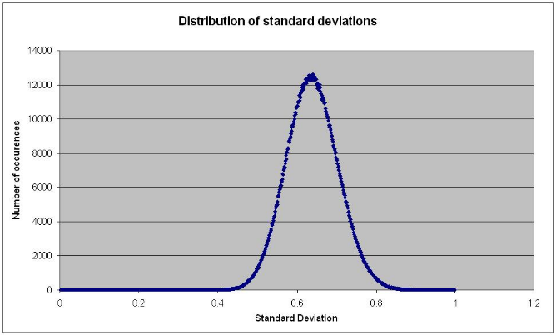
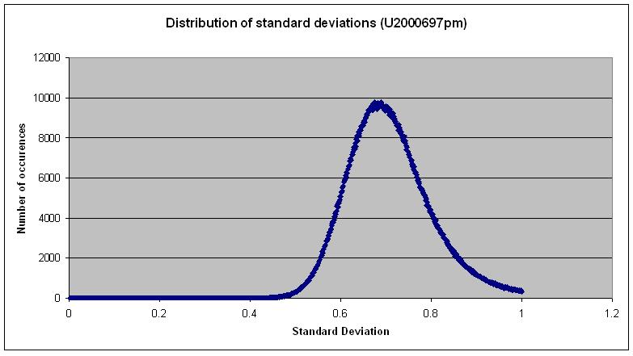
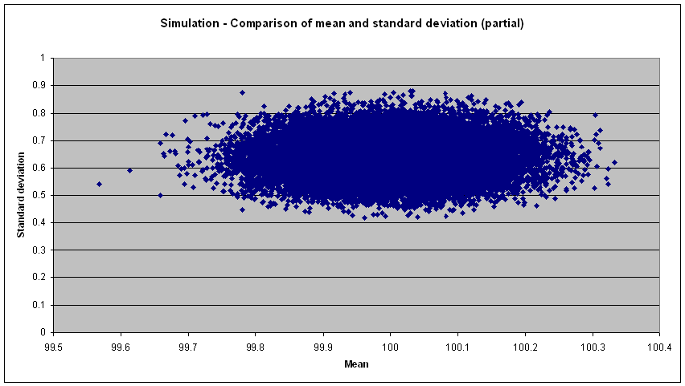
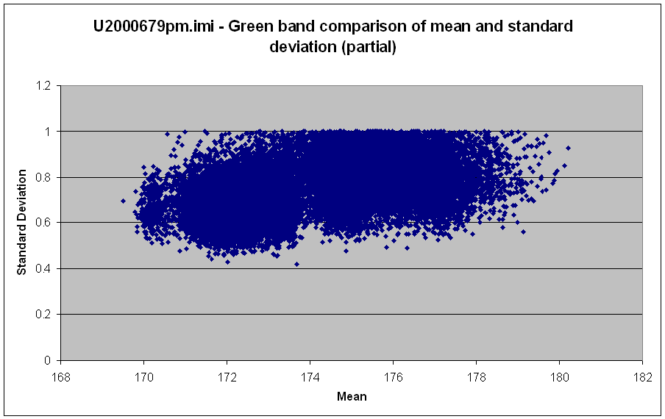
SNR Modelling and Measurement
2 – Look at statistics

Slide 22
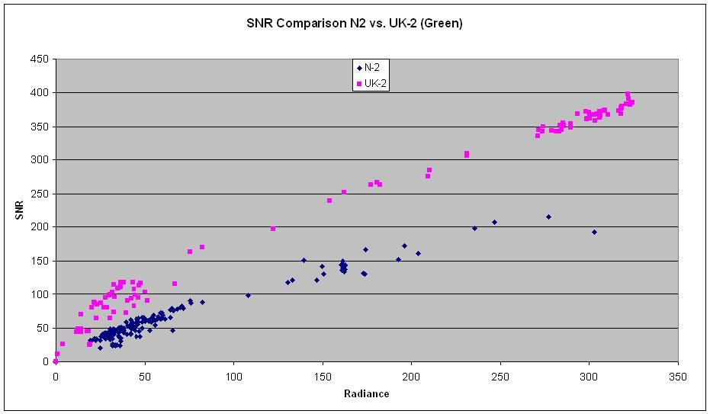
SNR Modelling and Measurement
3 – Test on real data and validate
As system responsivity drops we can see changes in SNR

Slide 23
Future plans for SNR
Exploring modelling individual detectors
This would provide lifetime stats and also information for estimating pixel level uncertainties in imagery as required by QA4EO (http://www.qa4eo.org/)
So end users with imagery wanting to use them in applications, don’t just get a “MODIS has an overall uncertainty of better than 2%”, but has a knowledge of the uncertainties including that at the pixel level due to system noise.
This feeds directly into higher level product uncertainties or in combining uncertainties from time series evaluation or combining data from multiple sources.

Slide 24
Relative Calibration Curve
In theory all the information you need is in a single image, just need to unravel it. We tend to reduce the problem by using “flat-field” images, but in principle all the data is present in heterogeneous images.
There are alternatives for estimating relative gain, so lets go through them….

Slide 25
Relative Calibration using “flat-fields”
Multiple white images over Antarctica or Greenland to derive relative gain terms, yawing the spacecraft, removing scenes with clouds or hoar frost effects.

Slide 26
Relative Calibration using “Side Slither”
PROBLEMS :
Landsat 8 has a 15 degree FOV and the CCD relative azimuth to the sun will vary depending on acquisition. Many surfaces will show BRDF effects.
The Landsat 8 FPA has staggered arrays with around 1.5 degrees difference. This means you are looking at two targets and inducing a small BRDF difference.

Slide 27
Relative Calibration using the on-board diffuser
As long as the diffuser does not vary spatially it should work.
The sensitivity to changes in the BRDF of the diffuser with time may be difficult to detect

Slide 28
Relative Calibration Curve – Heterogeneous images
Again not a new idea (Relative Gain Characterization and Correction for Pushbroom Sensors Based on Lifetime Image Statistics (SDSU) – JACIE 2010)
Currently we use 50 to 100 images. Ultimate aim is to get down to a handful of images to derive the relative gain curve.

Slide 29
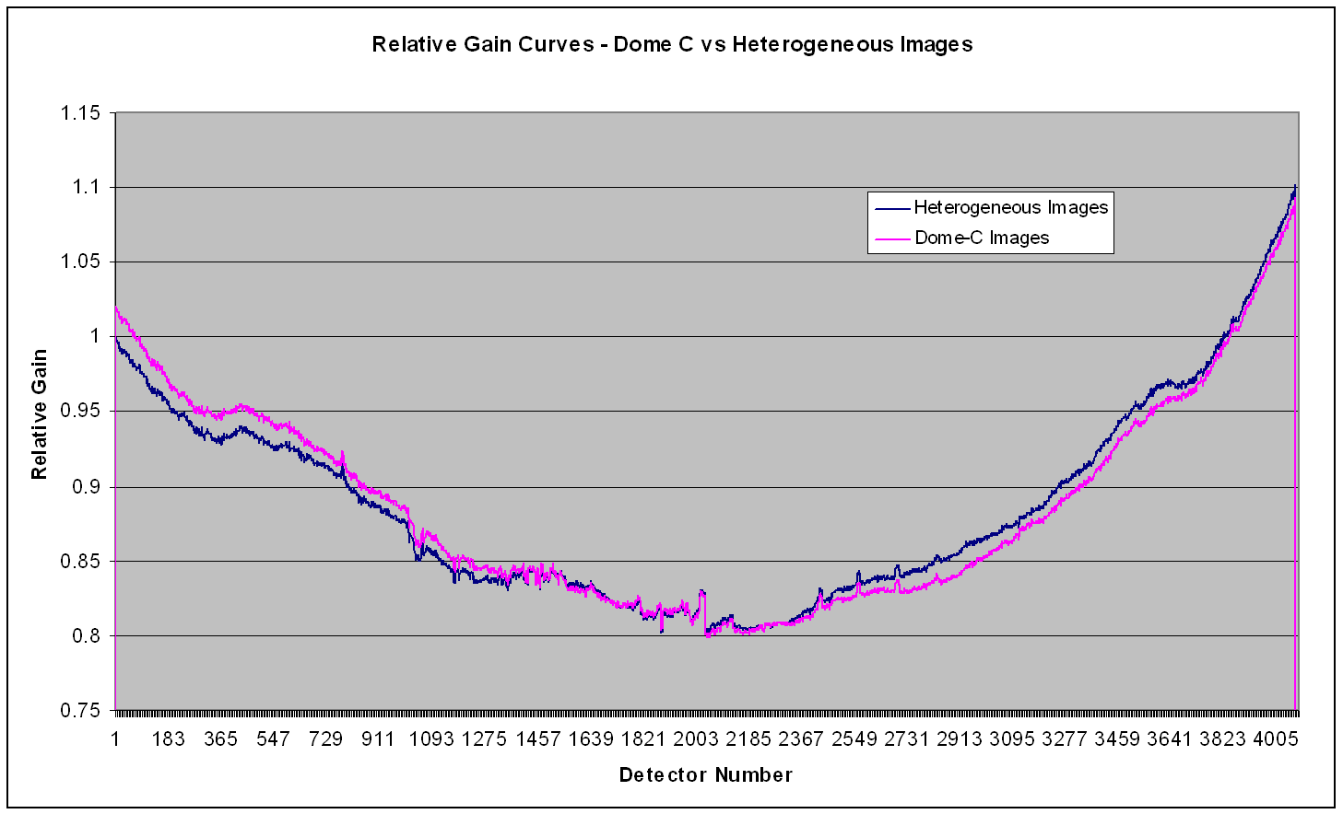
Relative Calibration Curve
Established approach using averages of many images to create a “virtual” flat-field
Usually 50+ images are used.

Slide 30
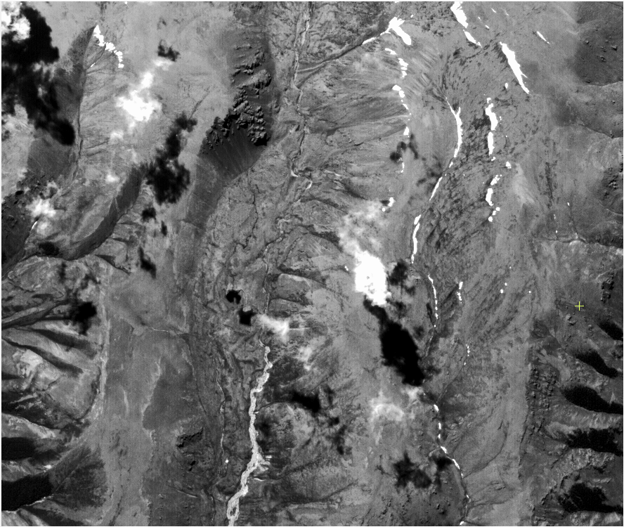
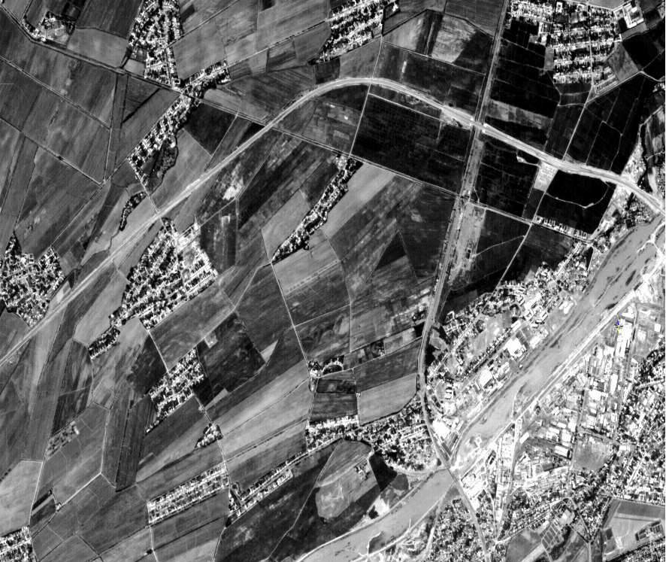

Can we get a relative calibration curve for every image?
In theory…yes…!!
Every image contains all the artefacts and deficiencies of the sensor
We need to forget the averages and think about our data differently

Slide 31
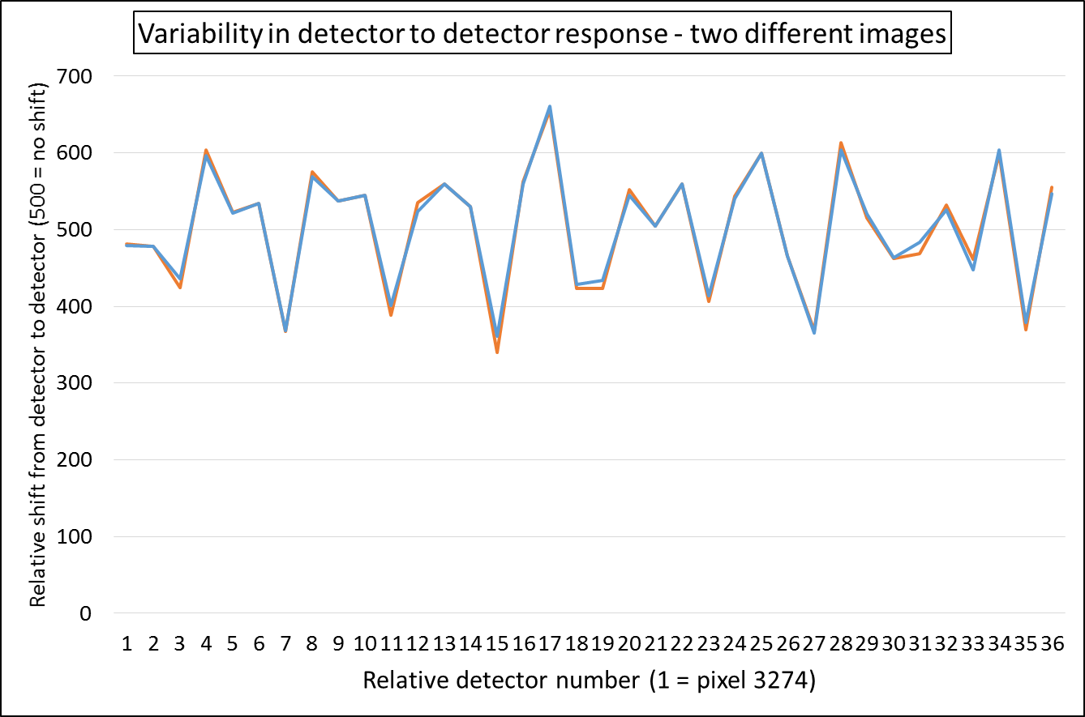
If we look at the data differently, forget averages…
The two images on the previous slide generated the following relative detector responses (part of CCD)
Repeatability is excellent (down at the 0.05% level)
Content does have an effect, we need to understand it.
Next step generating the correction from a handful of images…!

Slide 32
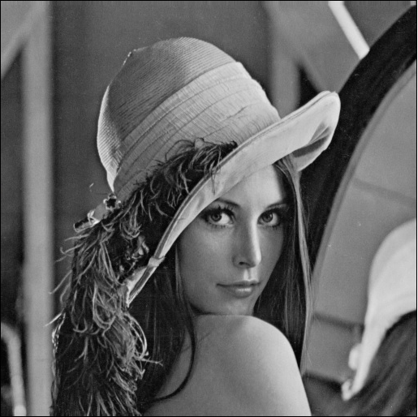

Instrument focus and MTF
Algorithm that uses any image to try and determine “best” focus

Slide 33
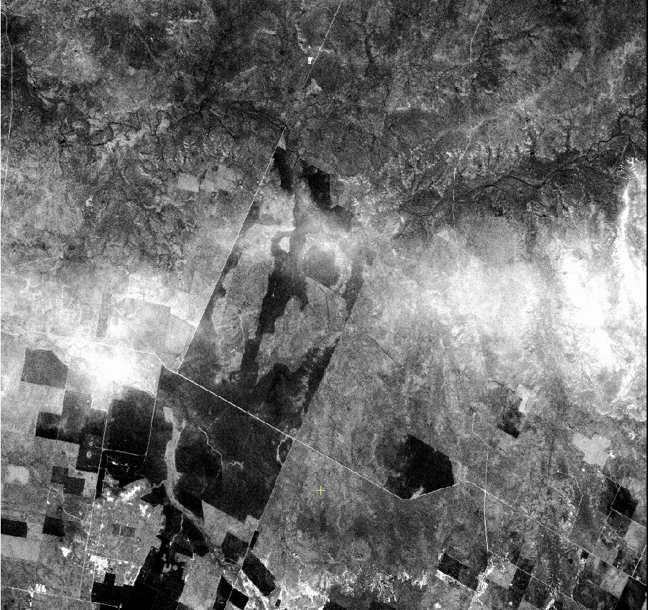
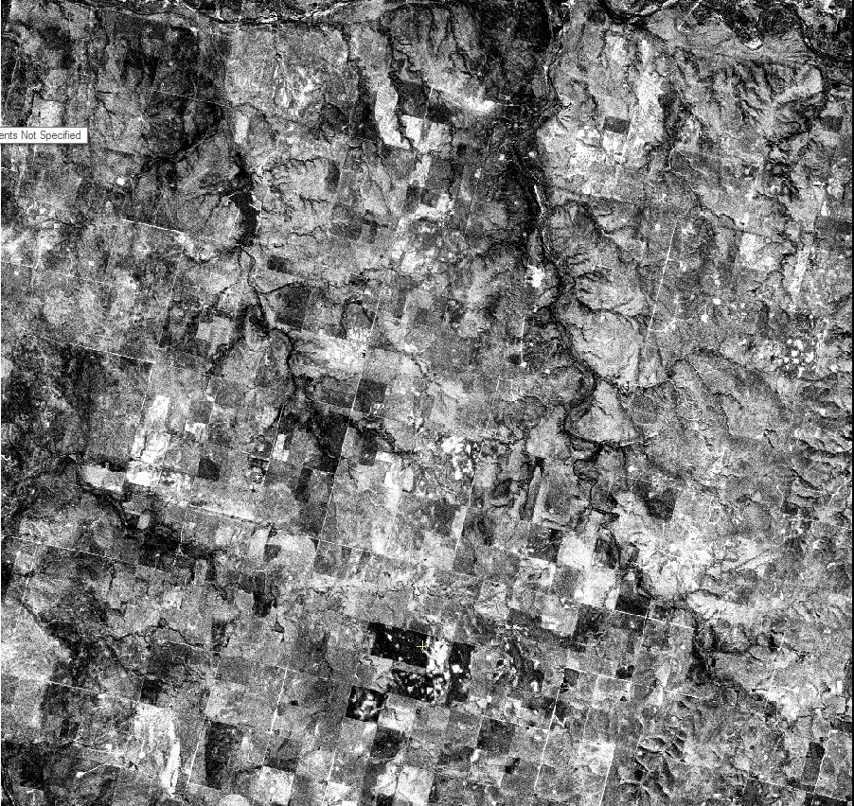
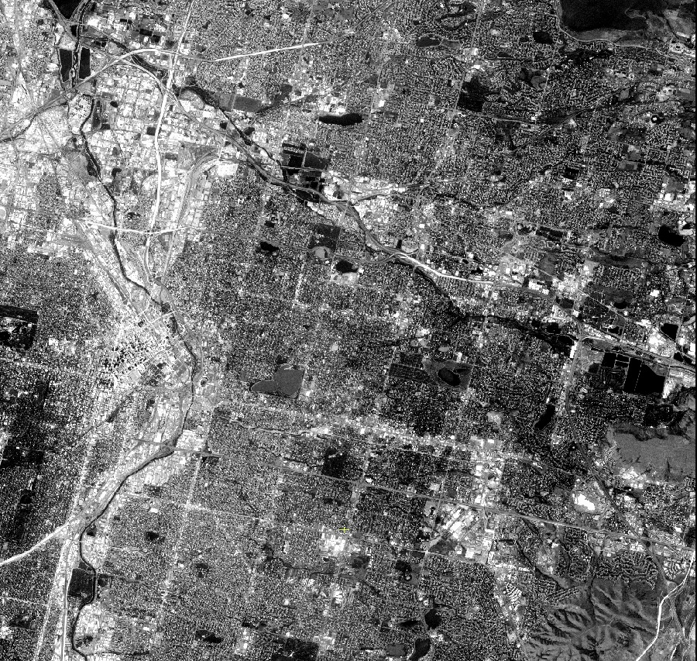
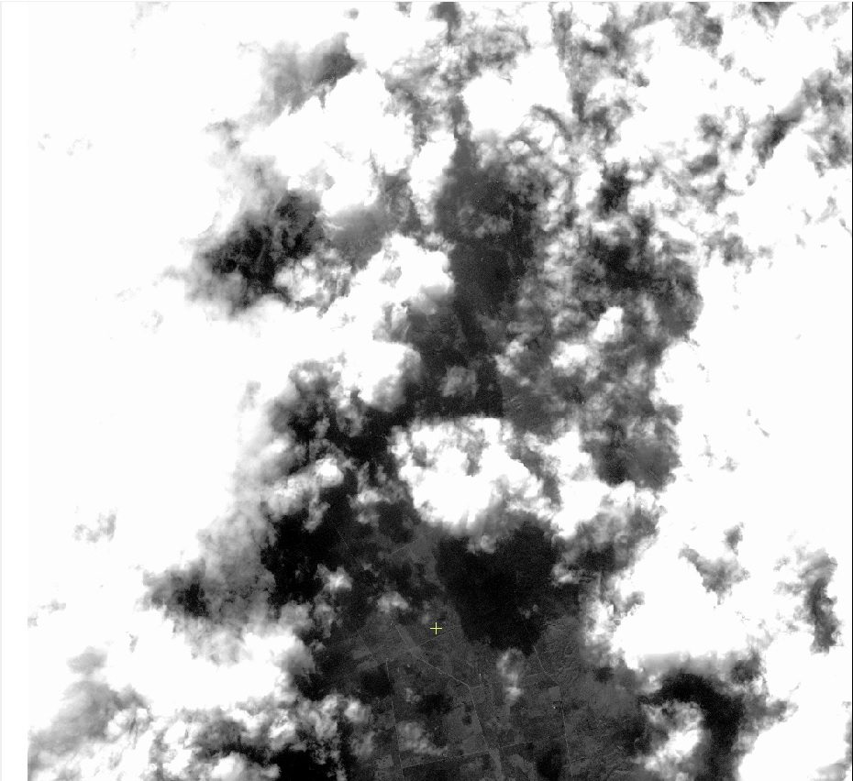
Instrument focus and MTF
These are the images we use, far more difficult.
There is no pre-selection (currently), so all these blue band images have been used in the analysis.
The bottom right image presents particular challenges, as you can imagine the atmospheric conditions do reduce the effective focus.

Slide 34
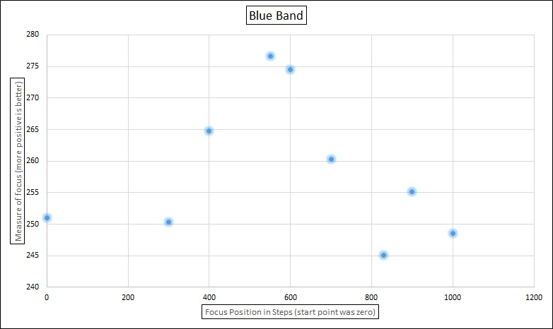
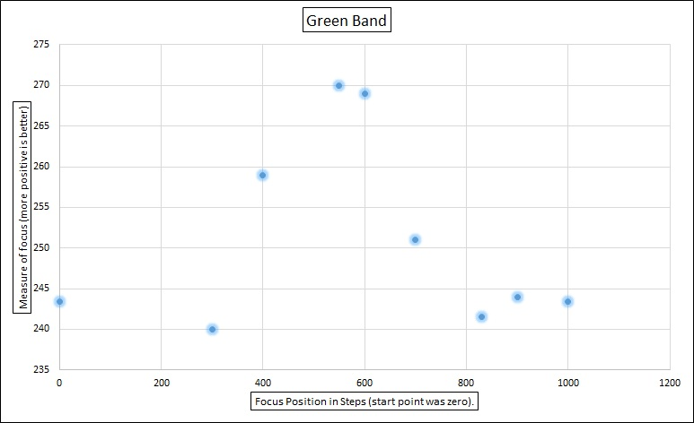
Instrument focus and MTF
Study to determine best focus from a sequence
Uses all images. The values shown are averages of all images for a focus position.
There is scatter for any single focus position, some of which seems to be related to the path length (off-pointing) while some seems related to atmospheric condition, the algorithm can be expected to improve with further research.

Slide 35
Instrument focus and MTF
Cross-track variation in Focus
In focus
position
In focus
position
CCD Pixel 1
CCD Pixel 14436
1
2
3
4
5

Slide 36
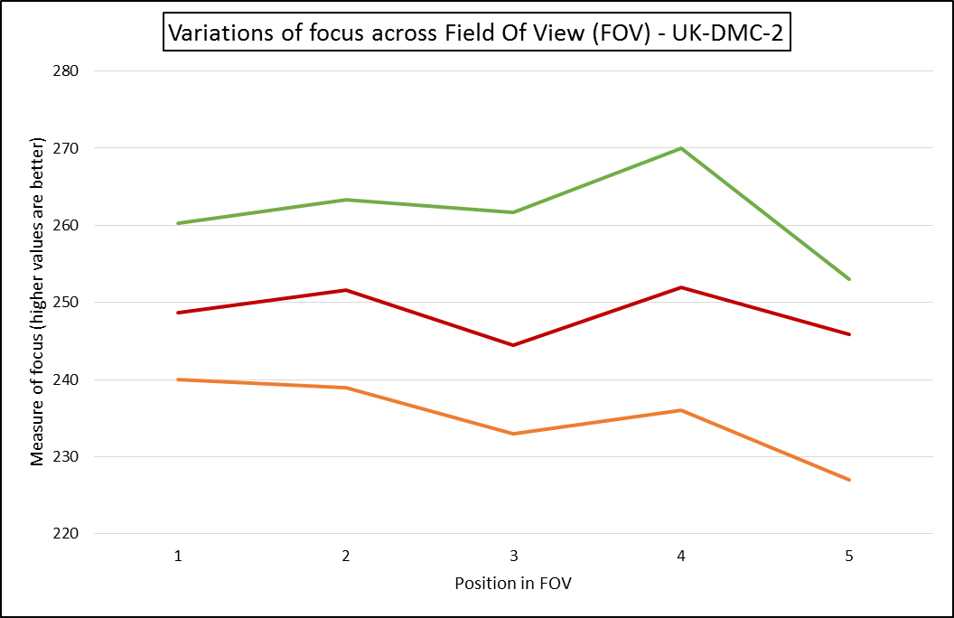
Instrument focus and MTF
Green
Red
NIR

Slide 37
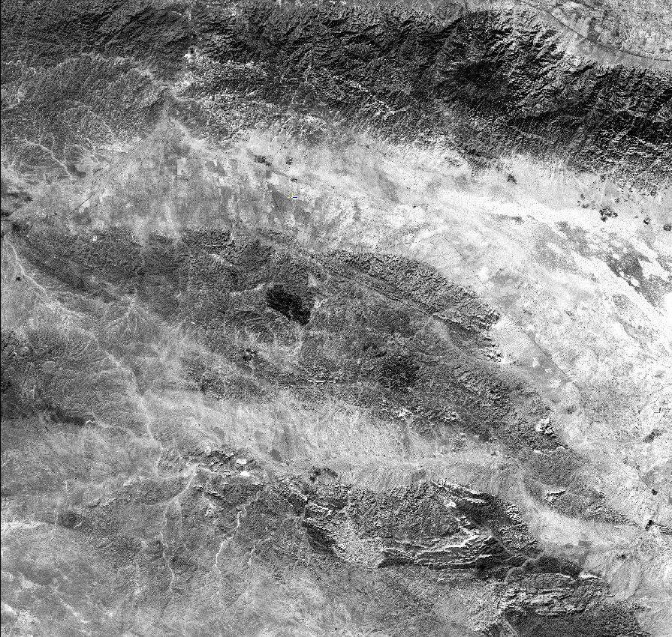
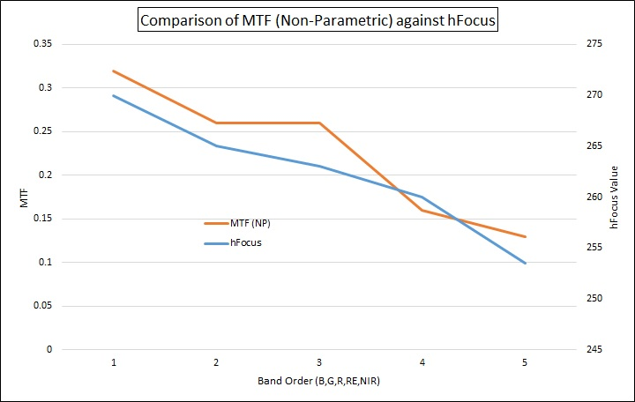
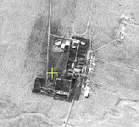
Instrument focus and MTF
Roll (11.65°)

Slide 38
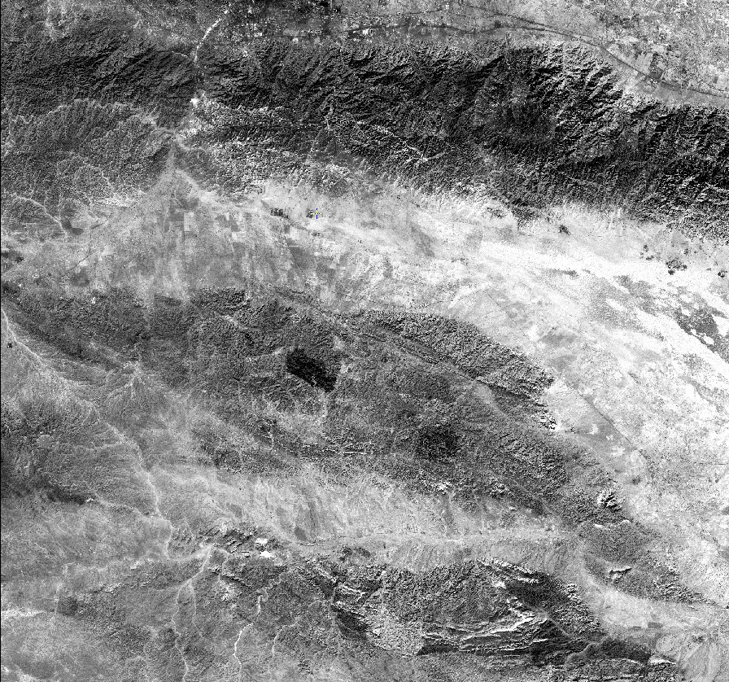
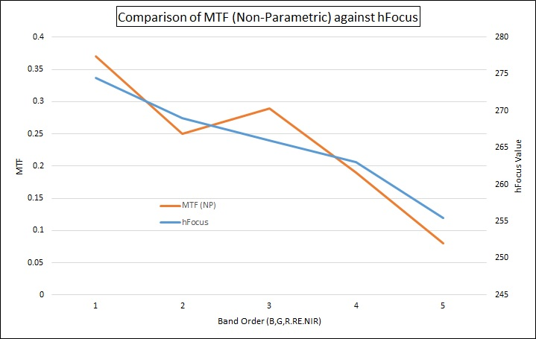
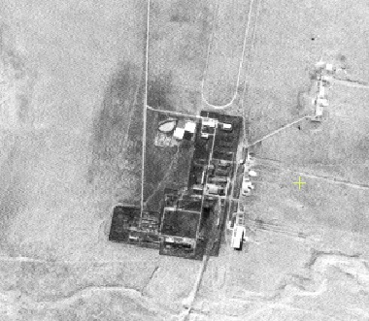
Instrument focus and MTF
Roll (0.43°)

Slide 39
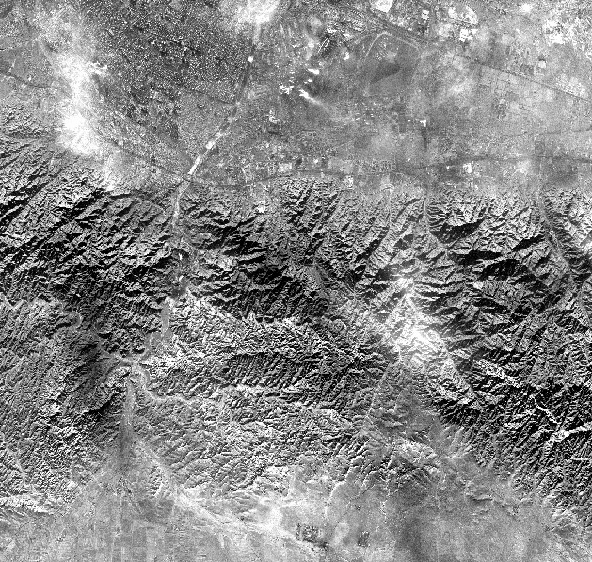
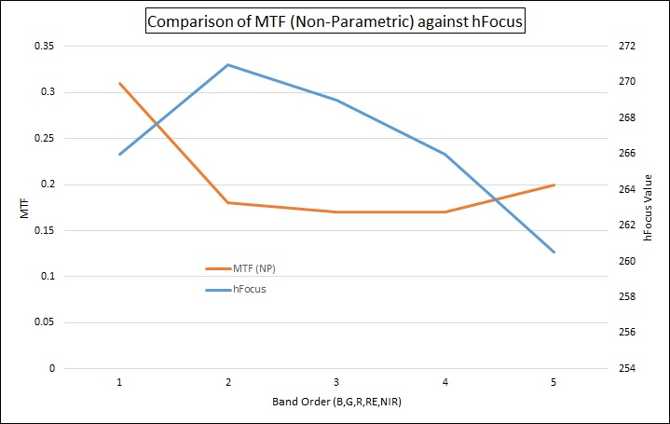
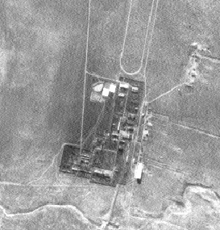
Instrument focus and MTF
Roll (23.01°)

Slide 40
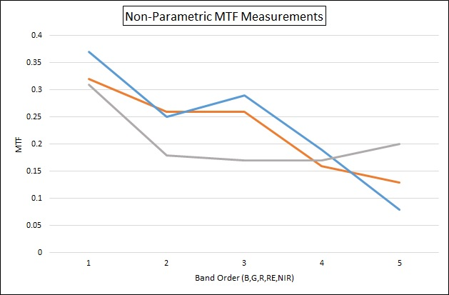
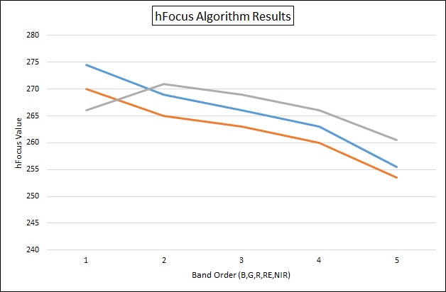
Instrument focus and MTF
Comparison of hFocus curves and MTF curves for this site

Slide 41
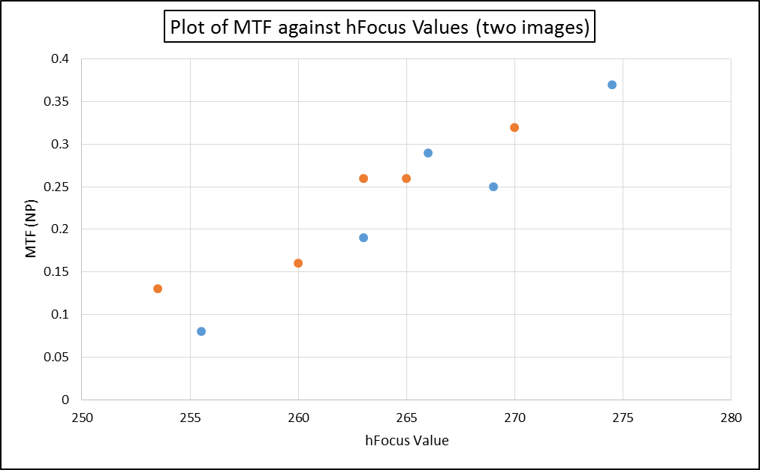
Instrument focus and MTF
Can we convert hFocus values into an MTF equivalent ?

Slide 42
What else could we do with this?
Some sensors use TDI to improve SNR of higher resolution instruments http://www.imagesensors.org/Past%20Workshops/1991%20Workshop/1991%20Papers/Sun%202%20Wong.pdf

Slide 43
MTF change with TDI sensors
MTF can vary with velocity changes or attitude variation during the extended acquisition period

Slide 44
Atmospheric effects
As the atmosphere varies we can see the effects in the hFocus value, currently we are using this information to determine which are the best images to use for our focus analysis.
However, we can also monitor variations in the atmospheric conditions from scene to scene and by spectral band, as the value varies with both.
Early in the research of this one, but an interesting future research project.

Slide 45
Micro-vibration
0.1 Pixel Shift
? 46 95
14 55 ?
? 46 95
10
50
100

Slide 46
Micro-vibration
In theory we can extract multiple frequencies, limited to the readout time of the detectors.
Best to do the side slither over urban areas to get good contrast between pixels.
You may need to use multiple column averages to beat down the noise, so remember to use “absolute” values (negative changes become positive), otherwise you will cancel out the variation as depending on direction they can be positive or negative.

Slide 47
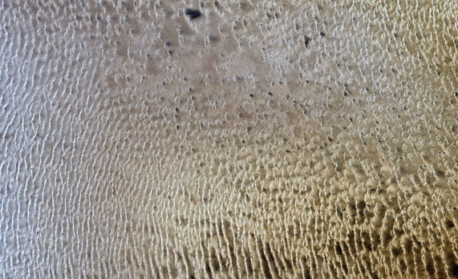
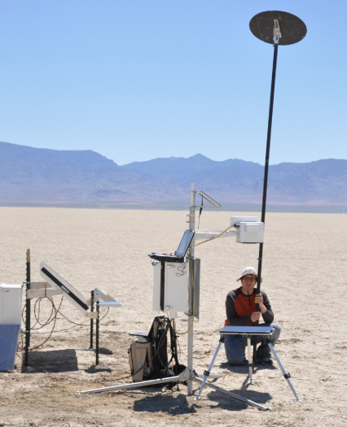
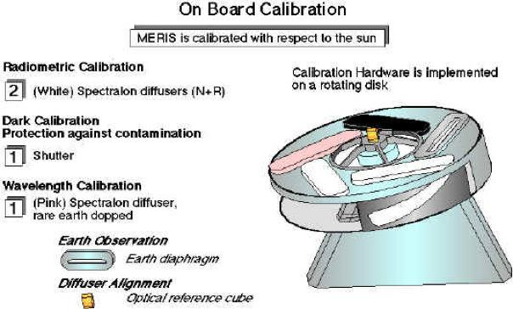
Absolute Calibration drift
Normally measured against a reference

Slide 48
Absolute Calibration drift
On-board calibrators drift with time
Reflectance method (RRV) needs (often infrequent) repeated observations with ground teams (although RadCalNet may change that).
Pseudo-Invariant Calibration Site requires numerous steps, has infrequent sampling.
Is there an easier way?

Slide 49
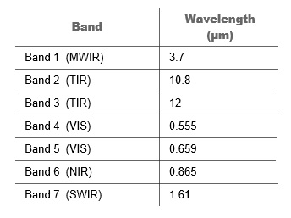
Absolute Calibration drift
AATSR Spectral Bands
In 2014 EOSense received a contract to determine how acceptable were the procedures used to calibrate the reflectance channels (Bands 4 to 7) of AATSR
Applied the “data driven” approach, use a large amount of data in the simplest possible analysis. In this case 24Tb of Level 0 “counts”.

Slide 50
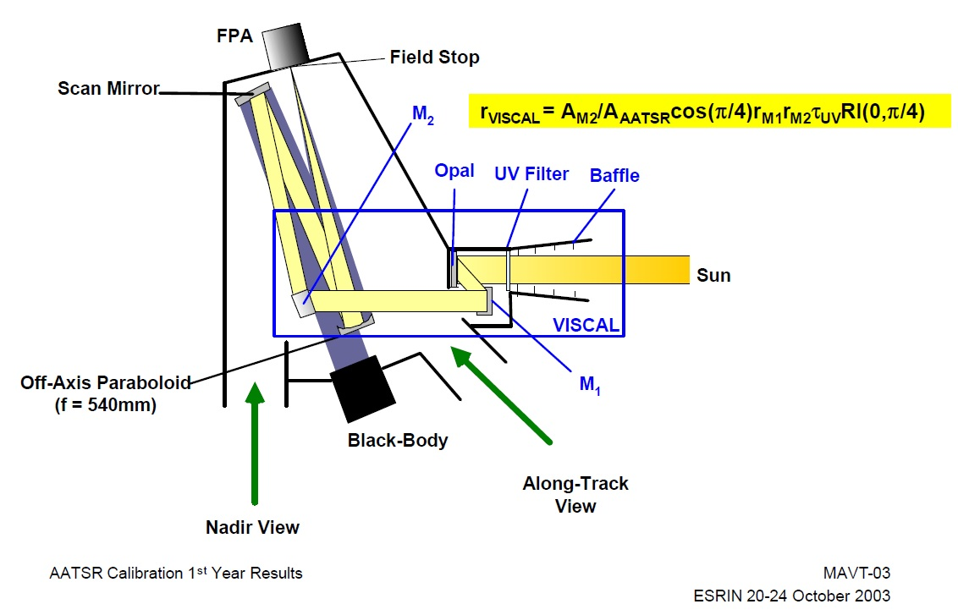
On-board calibration - VISCAL
VISCAL is a calibration device for the visible bands and the 1.6 um band.
Piece of OPAL characterised by NPL in the lab under 0°/45° conditions.
Photodiode placed by mirror M2 to monitor the signal, VISCAL data and photodiode information both recorded.

Slide 51
Simplified Calibration Equations (1)
Radiance = (Counts – Calibration Bias) * Calibration Gain
Assume linear relationship
for InSb detectors.
Counts
Bias
Radiance
Only additional complexity is the electronic gain factor (Standard/ Target)

Slide 52

Simplified Calibration Equations - VISCAL
For VISCAL θ = 0
Cos 0 = 1
We can rewrite the equation to be
L (Radiance) = (VISCAL Reflectance) / d²
As all the rest of the items are constants.
Now since we know
Radiance = (Counts – Calibration Bias) * Calibration Gain
Then if assume the calibration gain is fixed and calibration bias is fixed, then we can see that the number of counts should vary with the earth-sun distance squared, assuming nothing changes.

Slide 53
Standard Calibration Equations – SCENE (TARGET)
Over a whole orbit we can assume we get an average
= Constant. So (Esun Cos θ) becomes a constant.
If we assume the earth’s albedo is constant then
We can rewrite the equation to be
L (Radiance) = (Earth’s albedo) / d²
As all the rest of the items are constants.
Now since we know
Radiance = (Counts – Calibration Bias) * Calibration Gain
Then if assume the calibration gain is fixed and calibration bias is fixed, then we can see that the number of counts should vary with the earth-sun distance squared, assuming nothing changes.

Slide 54
Level 0 Processing
So the counts we measure for the VISCAL instrument and the counts we measure for our surface (assuming the earths albedo does not change) should be consistent.
If either the earths albedo changes or the VISCAL changes we should see a drift.
Used external information to assess changes in earths albedo between 2003 and 2012, the peak to peak variation was given as 0.8% (a one sigma value would be smaller).

Slide 55
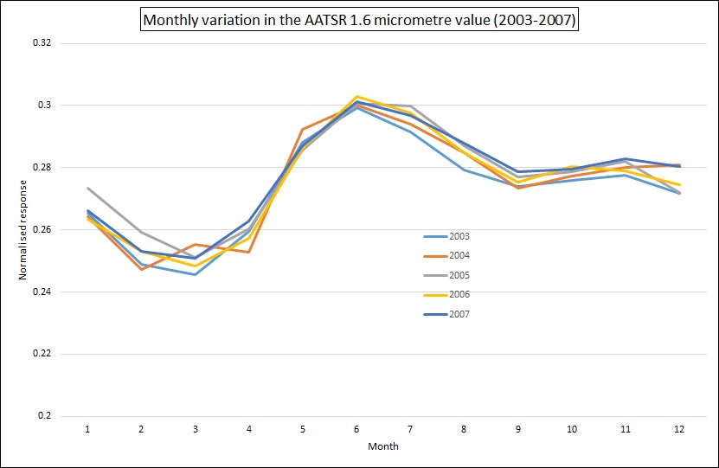
Can we treat the Earth’s albedo as a constant?

Slide 56
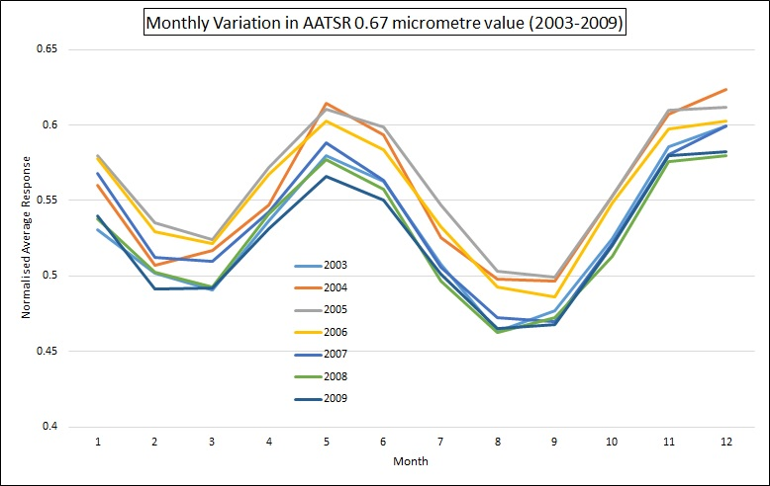
So what’s happening here?

Slide 57

AATSR Drift Analysis – performed using data collected over PICS
To obtain drift we compare measured BRF against reference BRF for all sites
Trend is obtained by averaging drift for all sites of 90 day window filtering for values <2 sigma from mean.
AATSR drift does not follow linear trend as originally expected – suggests a more complex model for drift
Results provide input to drift correction look-up-table
Notes:
Add some description

Slide 58

First results

Slide 59

Results – using most recent drift table

Slide 60



Results – All bands

Slide 61
possibilities
The method should validate the calibration drift of sensors with on-board calibration devices that have global or near global coverage
  MODIS
  Landsat 7 ETM, Landsat 8 OLI
  Sentinel-2 MSI
  Sentinel-3 OLCI
  Sentinel-3 SLSTR
  ENVISAT MERIS
  ENVISAT AATSR
Advantage of using multiple sensors, enables extension of the technique to finer sampling (monthly, weekly?)

Slide 62
Conclusions
It has proven possible to evaluate a range of data quality parameters using “normal” heterogeneous images alone, with a level of accuracy of the same order of traditional methods.
It has proven possible to develop automated methods that use the extracted parameters to correct for various data quality issues.
Data driven methods provide a very powerful method for determining calibration of sensors with global or near global coverage, which is being extended to more local scales at monthly observation frequency.
This combined with initiatives such as RadCalNet and TRUTHS provides a powerful way to automate the calibration and data quality procedures for the user community.

