Slide 1
DCC Product Requirements for GSICS Plotting Tool
Masaya Takahashi
Japan Meteorological Agency

Slide 2
GSICS Calibration Products Plotting Tool
http://gsics.tools.eumetsat.int/plotter/
GPRCs have their own product monitoring/plotting websites
“GSICS Plotting Tool” has been developed at EUMETSAT
Common look and feel (easy comparison among multiple products)
Dynamical plotting (no need to prepare lots of figures)
Now, only single file is supported (i.e., RAC which contains all time series info.)
At present, GEO-LEO-IR is only supported

Slide 3
Brief Demonstration

Slide 4
GEO-LEO-VNIR requirements for the plotting tool
Requirement documentation is necessary to visualize GEO-LEO-VNIR product (e.g. DCC method)
Element(s) to be plotted
Primary user of the plotting tool: product users, NOT developers
Low priority to plot detailed information which is useful for GSICS R&D (e.g. DCC mode/mean, variogram)
Decision at the 2015 annual meeting in Delhi
a
Option 1 ) Calibration coefficients (e.g. gain) vs. nominal (official) calibration slope (%)
Could be useful for validating official calibration
Option 2) Calibration coefficients in original unit (e.g. W/m²/sr/μm)
Could be useful for validating instrument degradation trend
To compare multiple instruments, scaling (e.g. at the first calibration result) is necessary
Agenda Item: 3j Data requirements for DCC demo products – 12:10 (20 minutes)
Presenter | Masaya Takahashi - JMA
Decision: Key plotting variable = Percentage bias with respect to nominal calibration coefficient

Slide 5
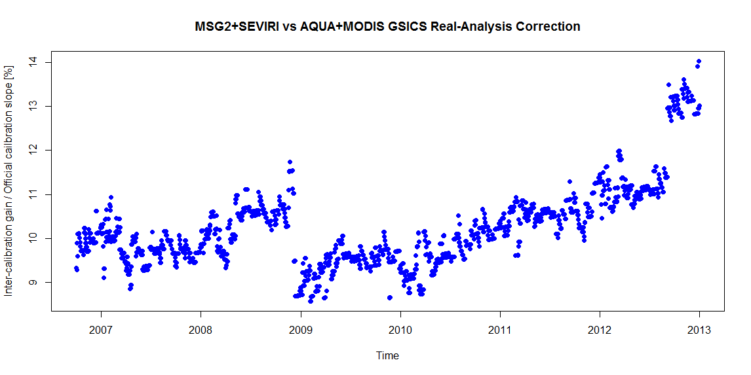
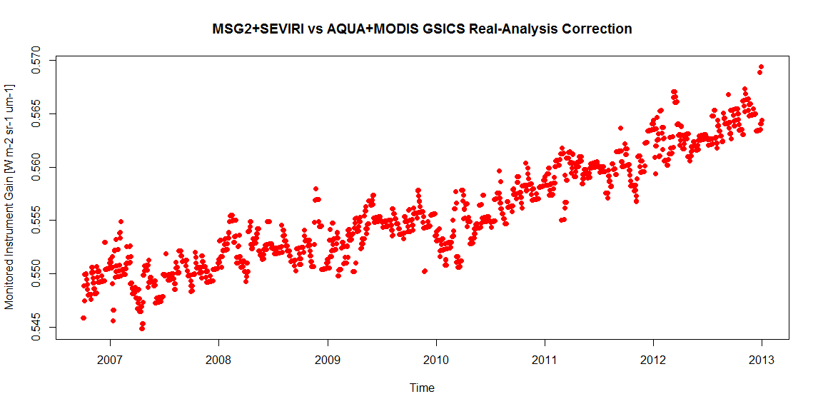
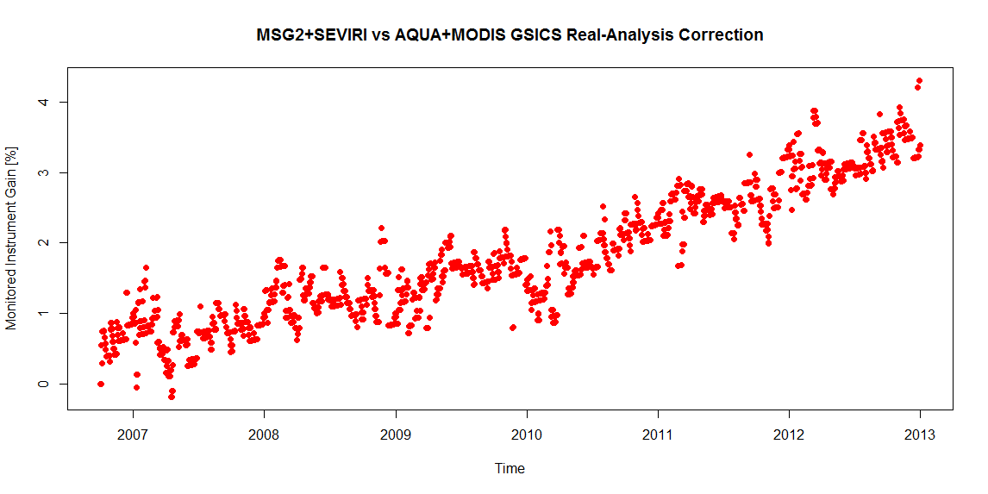
Examples of plotting elements
Time series of MSG-2/SEVIRI vs. Aqua/MODIS DCC RAC product by EUMETSAT (Sebastien Wagner)
GRWG decision in Delhi
Option 1)
Inter-calibration gain / nominal calibration slope
[%]
Option 2-A)
Inter-calibration gain
[W/m²/sr/μm]
[%]
Option 2-B)
Inter-calibration gain, scaled at the first result
[%]

Slide 6
Discussion
1) Plotting element(s)
Do we agree to plot inter-calibration coefficients (e.g. inter-calibration gain) with respect to nominal calibration coefficients?
2) Requirement document for plotting tool
Who will lead?
3) Technical details (e.g. netCDF contents) would be discussed via email

