Slide 1
GSICS DCC calibration update
Nov 3, 2015

Slide 2
Outline
GSICS DCC plotting tool
DCC QC during processing
DCC update frequency
Next DCC web meeting topics
Improvements in MODIS/GEO ray-matching
To validate the DCC algorithm to transfer the MODIS calibration reference

Slide 3
GSICS plotting tool
Plot the gain over time
Do we also plot the monthly PDFs?
For internal QC

Slide 4
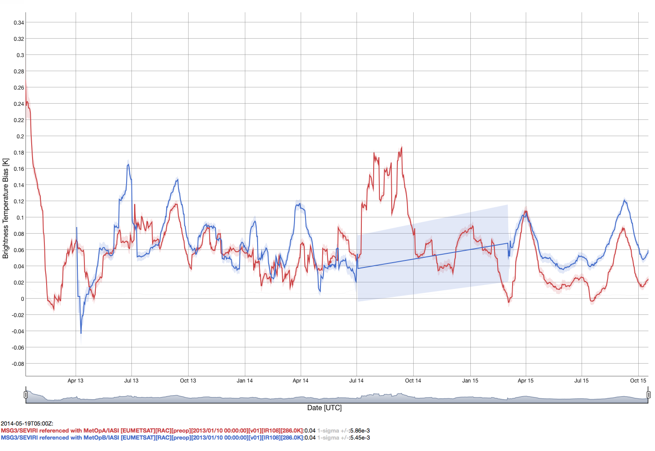
Met-10 10.8µm @286K
Metop-A pre
Metop-B pre

Slide 5
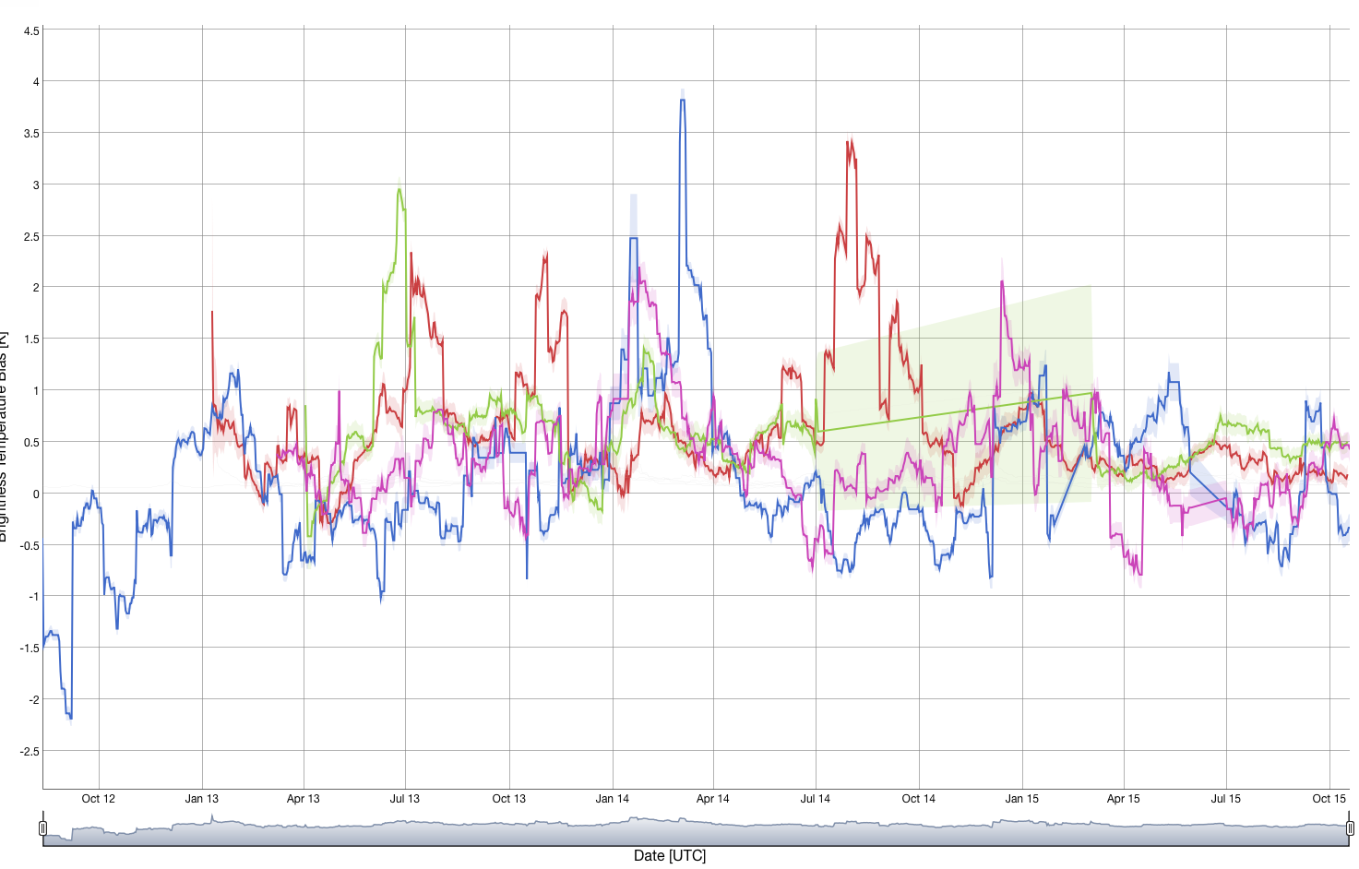
Met-10 10.8µm @205K
Metop-A pre
Metop-A Demo
Metop-B pre
Metop-B Demo

Slide 6
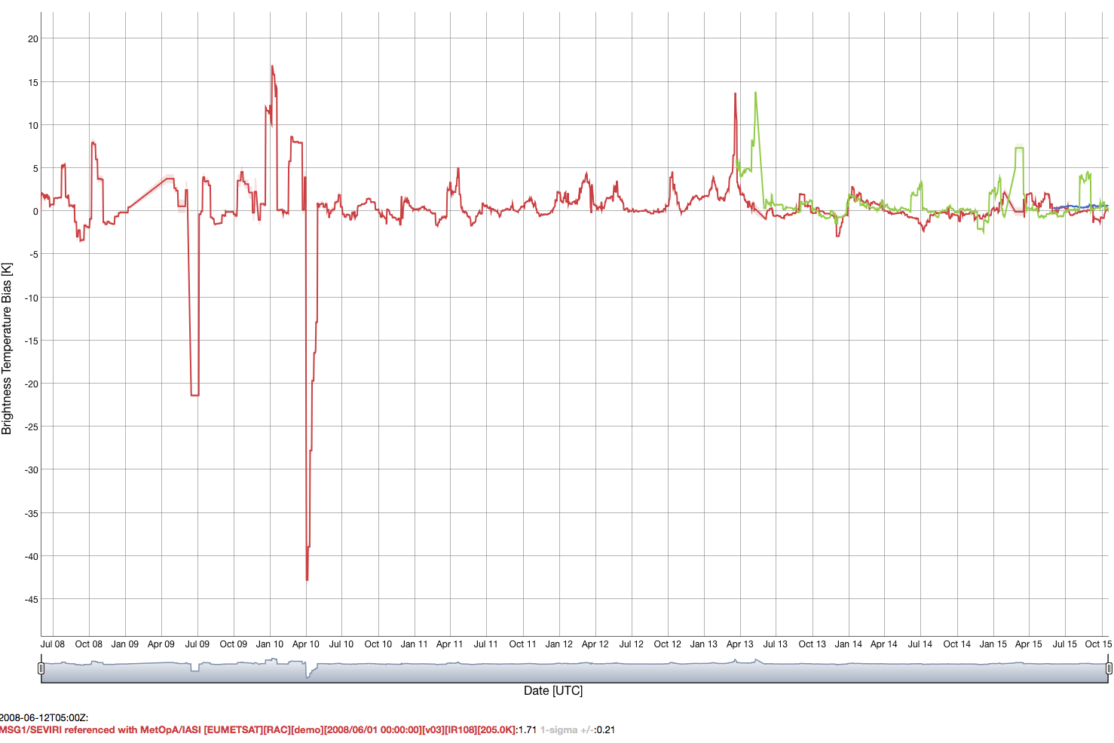
Met-8 10.8µm @205K
Metop-A pre
Metop-B pre
• Do we have some kind of quality control?
• In this case there is probably sparse sampling and a lack of dynamic range (Apr 2010)

Slide 7
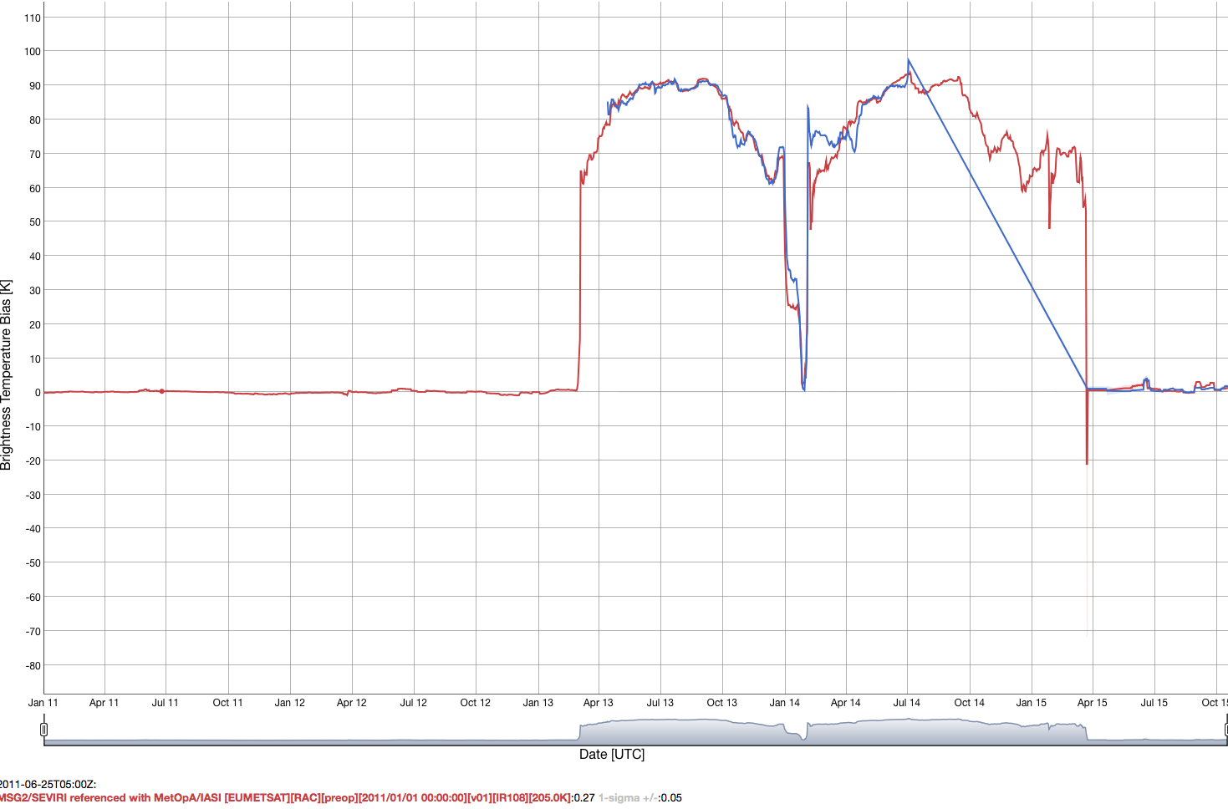
Met-9 10.8µm @205K
Metop-A pre
Metop-B pre

Slide 8
DCC methodology
The DCC methodology must have some QC
Sampling threshold
PDF shape, based on PDF statistics
3 sigma outlier
If insufficient sampling or noisy PDFs then
Combine previous month and current month
If GSICS data product causes artifacts in the users algorithms or exceeds the valid range, which causes their programs to terminate they will not use the calibration coefficients.
The dataset can be perfect 99%, but the 1% will upset users
Users rely on dataset providers for QC
CERES code is 50% exception handling

Slide 9
DCC update frequency

Slide 10
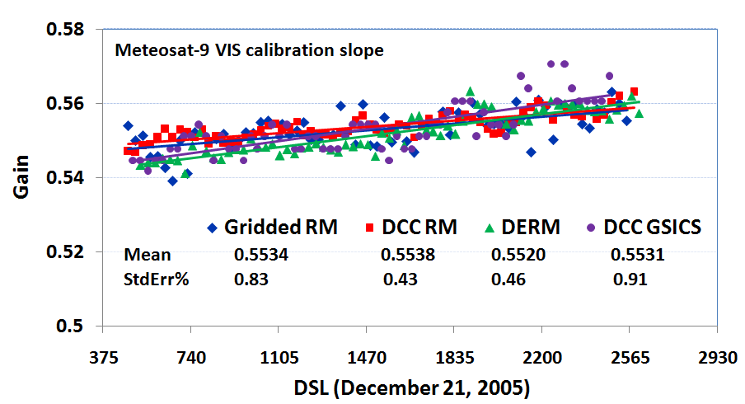
Met-9 calibration gains
Ray-matching
All scenes
Ray-matching
DCC
Libya-4
DCC
• All of the calibration gains within 0.2% over the record
• All transferred the Aqua-MODIS calibration succesfully
• There is residual methodology noise and invariant site natural variability
• Use deseasonalization to remove known oscillations
• Even after all know oscillations are removed, noise will remain.
• Best to use a temporal trend to mitigate measurement noise

Slide 11
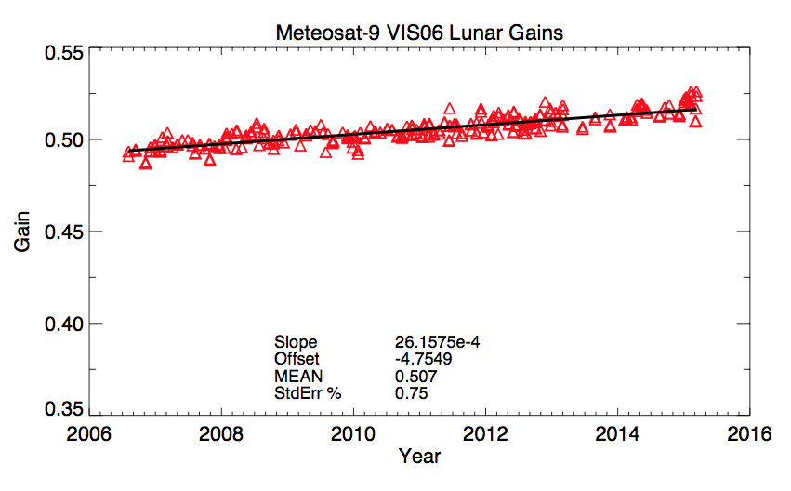
Next DCC meeting topics
Data from EUMETSAT
• In this case there is no seasonal cycle, but yet a linear regression makes the most sense
• Do we use the every measurement as the update frequency?
• An instrument anomaly would have to exceed 2*sigma to be detected by this method

Slide 12
NOAA Implementation
Monthly Statistics
Removal of predictable oscillations
For a single calibration method, we stop at trend fitting
Trending fitting
Normalized to a common Day1 reflectance
Outlier removal performed with all calibration methods
Combining the Normalized Data
Wu GSICS 2015 annual meeting

Slide 13
Visible degradation of optics
We expect the optics to degrade gradually
We expect no sudden discontinuities
For satellites with solar diffusers
Does GSICS calibrate the visible count level data? Solar diffuser just another calibration method
Or is the level 1 data calibration coefficients applied first, similar to the MODIS product

Slide 14
Next DCC meeting topics
DCC method applied to other bands
There will be enough months of Himawari-8 to perform DCC algorithm for the next web meeting
Also reexamine MSG 1.6µm channel
Seasonal cycle mitigation
KMA BRDF model
More Lambertian part of BRDF
Need to work with the month with the least sampling

Slide 15
DCC algorithm Aqua-MODIS calibration transfer uncertainty
We have been concentrating on refining the DCC calibration algorithm for stability
We assume that the long-term Aqua-MODIS PDF mode radiance is equal to the GEO PDF mode radiance observed during the Aqua-MODIS overpass
MODIS and GEO would observe the same DCC systems but not under the same angular conditions, rely on the DCC BRDF to remove angular differences
Need to determine uncertainty of this assumption
What is the natural variability of the DCC invariant target?
This method can then characterize DCC as an absolute calibration target
Use Aqua-MODIS/GEO ray-matched radiance pairs as the truth
Use two ray-matching methods to improve the individual algorithms and reduce the overall uncertainty
Aqua-MODIS or NPP-VIIRS ray-matching also introduces the MODIS or VIIRS calibration anomalies (scan angle dependencies) into the GEO record

Slide 16
Improvements in MODIS/GEO ray-matching

Slide 17
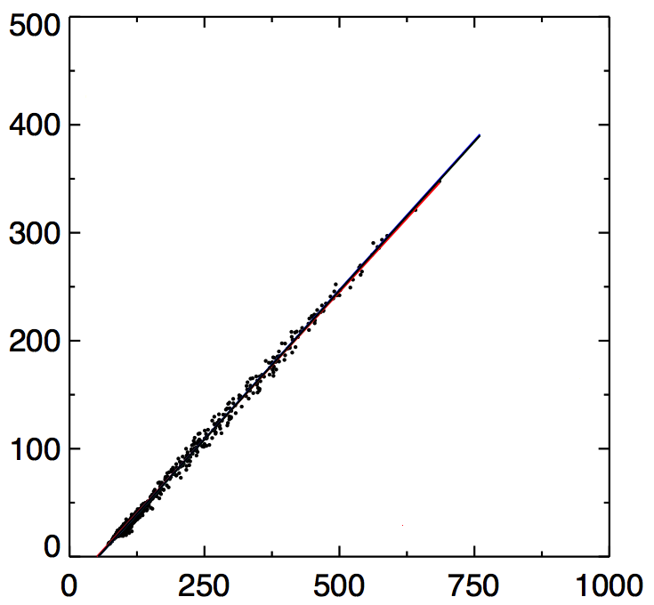
Graduated Angle Matching (GAM)
July 2007
• Baseline ray-matching
ΔSZA< 5° (15 minutes), ΔVZA<15°, ΔRAZ < 15°, ΔSCAT< 15°, no sunglint
• Note most of the points are in clear-sky (dark radiances) where the conditions are most anisotropic
• The least number of points occur over bright clouds that are most isotropic
• Then a more restrictive angle matching can be applied to the dark radiances, while retaining sufficient dynamic sampling
Aqua-MODIS 0.646 µm Radiance (Wm⁻²sr⁻¹µm⁻¹)
MET9 0.64µm, CNT (10 bit)

Slide 18
Graduated Angle Matching (GAM)
July 2007
ΔVZA < 15, ΔRZA < 15
Aqua-MODIS 0.646 µm Radiance (Wm⁻²sr⁻¹µm⁻¹)
ΔVZA < 10, ΔRZA < 10
ΔVZA < 5, ΔRZA < 5
MET9 0.64µm, CNT (10 bit)
• Split the Aqua-radiance domain into 3 sections, increase the angular restriction in the lowest 2 sections

Slide 19
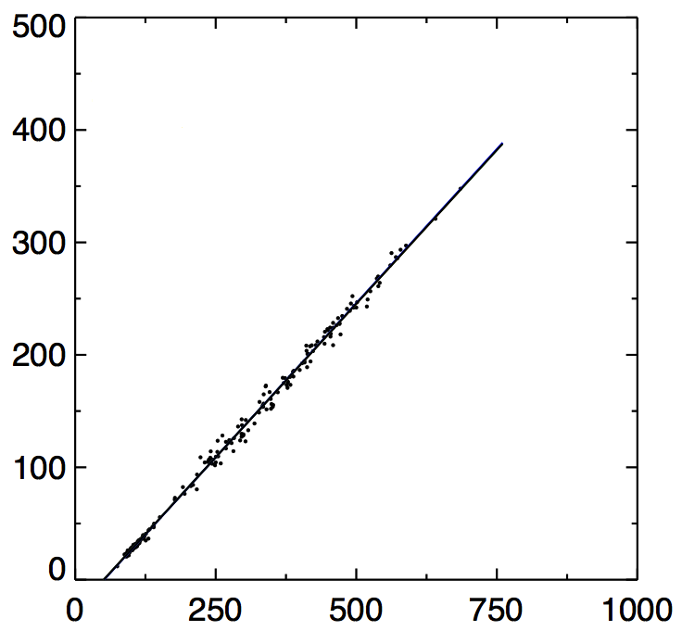
Graduated Angle Matching (GAM)
NO GAM
GAM
Aqua-MODIS 0.646 µm Radiance (Wm⁻²sr⁻¹µm⁻¹)
Xoff = 53.3
STDerr% = 5.57
NUM = 918
Xoff = 51.0
STDerr% = 4.13
NUM = 231
MET9 0.64µm, CNT (10 bit)
MET9 0.64µm, CNT (10 bit)
• The X offset or the linear regressed offset is closer to the true space count of 51 using the GAM method

Slide 20
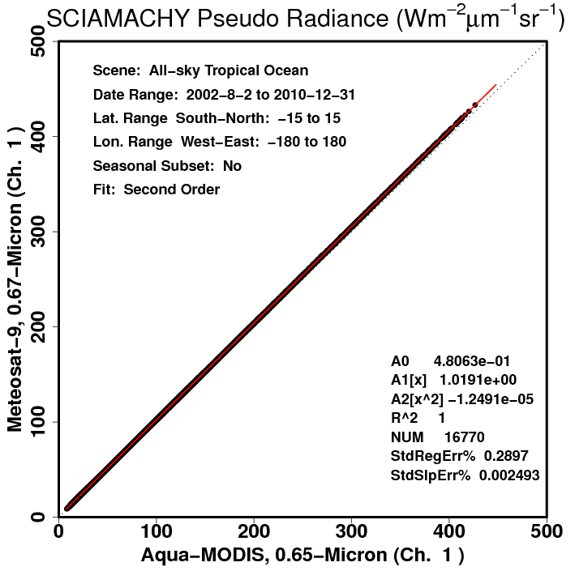
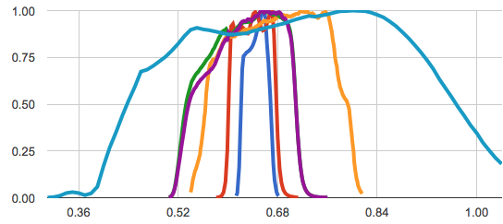
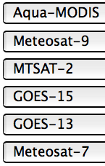
Spectral Band Adjustment Factor (SBAF)
MODIS/GEO spectral responses
SCIAMACHY Met-9/MODIS SBAF
• Convolve the footprint SCIAMACHY hyper-spectral radiances with the Met-9 and MODIS spectral response functions. Regress the SCIAMACHY pseudo radiances over the ray-matching domain. Apply the SCIAMACHY SBAF to the MODIS radiances.

Slide 21
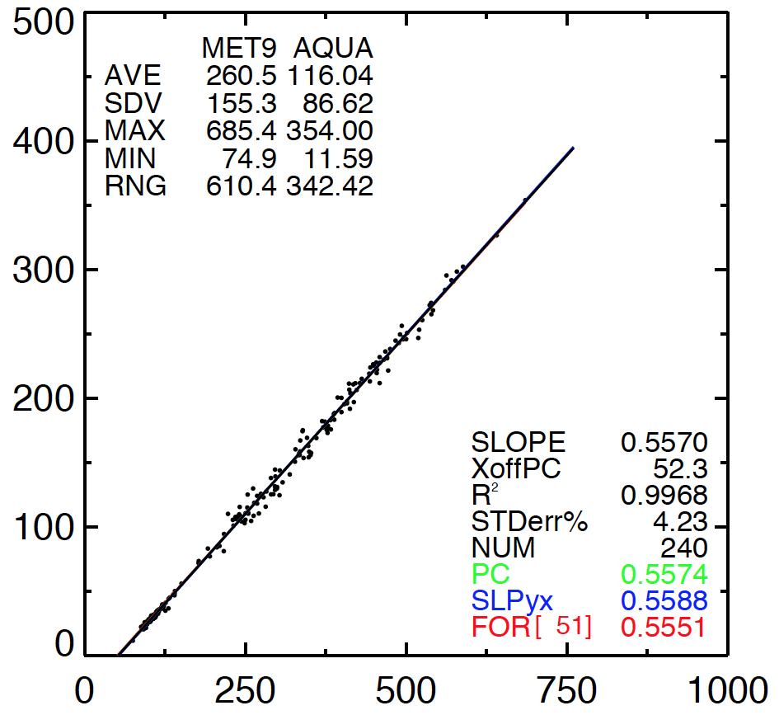
SBAF Comparison
Solar Constant Ratio
SCIAMACHY SBAF
Aqua-MODIS 0.646 µm Radiance (Wm⁻²sr⁻¹µm⁻¹)
Xoff = 52.3
STDerr% = 4.23
NUM = 240
Xoff = 51.0
STDerr% = 4.13
NUM = 231
MET9 0.64µm, CNT (10 bit)
MET9 0.64µm, CNT (10 bit)
• Apply the SBAF to the Aqua-MODIS radiances
• The X offset or the linear regressed offset is closer to the true space count of 51 using the SCIAMACHY SBAF

Slide 22
GAM and SCIAMACHY SBAF validation
•The mean timeline GEO space count based on the monthly linear regressions of Aqua-MODIS radiances and GEO count ray-matched pairs.
• The published space count is the operational GEO maintained of the residual or space count.
• Both the application of GAM and the SCIAMACHY SBAF causes the monthly linear regression offsets to become closer to the GEO instrument maintained space count

Slide 23
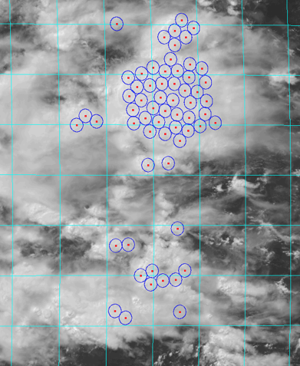
DCC ray-matching algorithm
• Find Aqua equatorial crossings in GEO DCC domain (±40° E/W, ±20° N/S of GEO sub-satellite point)
• Identify the MODIS DCC pixels and predict the GEO angles
• Aggregate MODIS pixel data into 30-km FOV
• Use MODIS pixel lat/lon to locate GEO pixels, and aggregate pixel data into 30-km GEO count and MODIS radiance pairs
• Systematically locate the coldest MODIS pixel centers, by finding the FOV with the coldest temperature and then removing all other DCC identified pixels within the FOV and repeating
• Normalize the cosine SZA, apply SCIAMACHY SBAF factor, perform monthly linear regressions to derive monthly gains
DCC Parameter | Threshold
σVS | <0.2%
σIR | <7.5K
ΔAngle | ΔRZA<25, ΔVZA<15
ΔTime | 15 min
Temp | <220 K
Angles | VZA<40, SZA<40
FOV | 30-km

Slide 24
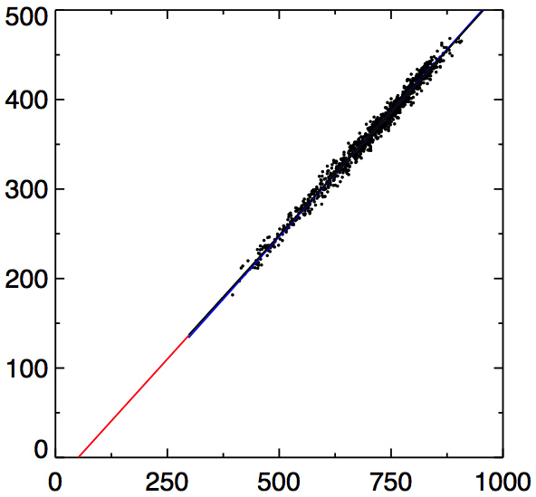
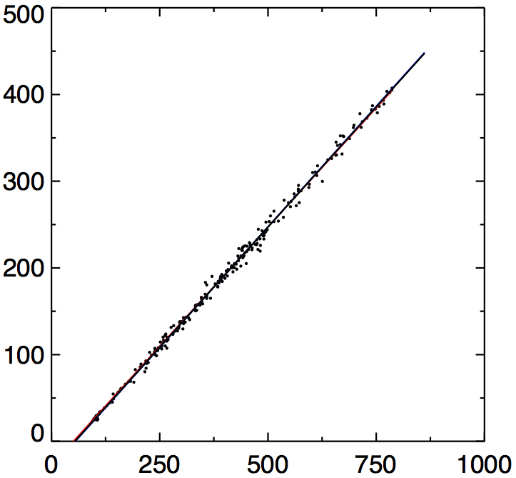
Comparison of DCC and gridded ray-matching, May 2009
DCC Ray-matching
Gridded Ray-matching
AQUA 0.646 µm Radiance (Wm⁻²sr⁻¹µm⁻¹)
Xoff 51.3
STDerr% 1.70
NUM 1242
Xoff 54.3
STDerr% 2.90
NUM 241
MET9 0.64µm, CNT (10 bit)
MET9 0.64µm, CNT (10 bit)
• The monthly standard error of the linear regression is smaller for the DCC
• DCC are the most Lambertian Earth targets allowing for the greater angular tolearance, with the least SBAF uncertainty

Slide 25
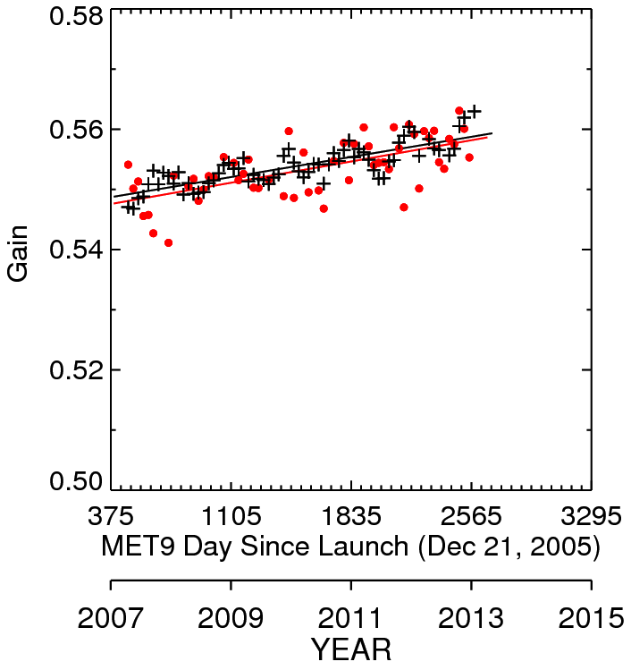
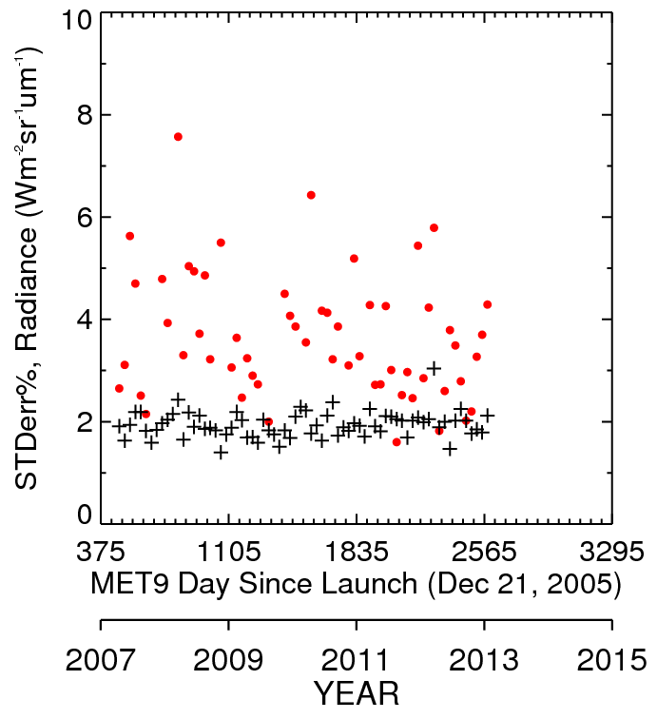
Comparison of DCC and gridded ray-matching Met-9 2007-2013
Gridded DCC
Gain 0.5534 0.5538
STDerr 0.83% 0.43%
• DCC have both the least monthly and temporal standard errors.
• Both methods give a timeline gain within 0.1%

Slide 26
Comparison of DCC and gridded ray-matching algorithm GEO gains
 | Gridded Gain | Gridded STDerr | DCC Gain | DCC STDerr | % difference
Met-9 | 0.5534 | 0.83% | 0.5538 | 0.43% | 0.1%
GOES-15 | 0.7781 | 0.86% | 0.7760 | 0.35% | 0.3%
GOES-13 | 0.7857 | 0.88% | 0.7842 | 0.42% | 0.2%
Met-7 | 0.6127 | 0.85% | 0.6146 | 0.60% | 0.3%
MTSAT-2 | 0.5838 | 1.20% | 0.5901 | 0.39% | 1.1%
• DCC have the least monthly and temporal standard errors.
• DCC and gridded ray-matching timeline gains agree within 0.3% except for MTSAT-2
• Still investigating MTSAT-2
• In order reduce the GEO calibration gain uncertainty below 2% the SBAF and matching errors must be accounted for.

Slide 27
Conclusions
Initial disagreement between gridded and DCC ray-matching gains prompted improvements in both procedures
Both the SCIAMACHY SBAF and GAM gridded ray-matching methodologies were validated by comparing the linear regression offset to the true space count
Both DCC and gridded ray-matching relies on sufficient monthly sampling during all months of the year. The thresholds were derived using the months with the least DCC and gridded matches
The GEO ray-matched calibrations will be used to validate the GSICS DCC calibration ability to transfer the Aqua-MODIS reference calibration

