Slide 1
Development of the Performance and Health Monitoring System (PAHMS) of FENGYUN Satellites
Yuan Li, Xiuqing Hu, Ping Qi, Shuze Jia
NSMC/CMA

Slide 2
Catalogue
Requirements
Targets
Stage Progress
Some results
Currently problems

Slide 3
Requirements
International needs (OSCAR landing page)
The upgraded WMO-OSCAR data model will facilitate to store one stable link for each satellite/instrument direct the users to a landing page created by each operator .
Operational monitoring requirements
Instrument performance monitoring, operation status monitoring.
Instrumental analysis requirements
Status variation analysis of the instrument.
Scientific application requirements
Summarizing the variation trend and the influence of the performance parameters, and assistant the optimization design of the instrument.
Instrument Specifications (static information describing instrument characteristics)
Calibration Events (information on the most important geometric and radiometric calibration events)
Data Outages (optional, can also be part of the calibration events database)
Instrument Monitoring (optional, for present missions this is done by some space agencies)

Slide 4
Targets
Data collection
Collect the performance related remote sensing data (OBC file) and the telemetry data of FY satellite
Performance tracking
Results sharing
Share monitoring results to the hierarchy, operational control system, external users and WMO-OSCAR page on different level defined by data sharing policy.
Achieve performance monitor function, alert automatically when abnormal phenomenon occurred.
Performance monitoring and alert
Achieve the tracking function of the major parameters which characterize the instrument performance, the orbit control, the calibration update, and the operating status.

Slide 5
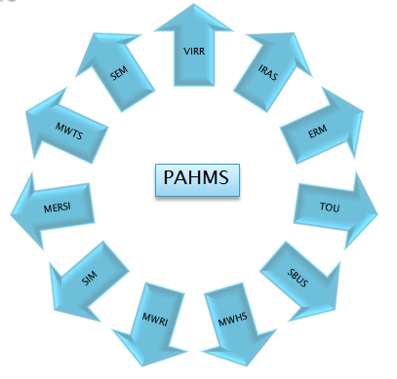
Stage Progress
Dec. 2012
Ground application system of second batch of FY-3
The performance analysis subsystem
System operational control monitoring subsystem
Oct. 2013
Start to build the performance analysis subsystem of on orbit instrument of FY-3C
Dec. 2014
Start to build OSCAR CMA landing page
Jan. 2015
FY-2 on orbit status information collection
Jan. 2015
PAHMS was lifted to a key task of CMA
11 instruments (FY-3) are under monitor by the L1 data file
Jan. 2015
Oct. 2015
PAHMS pushing forward meeting of NSMC
Nov. 2015
The required software and hardware environment was built and submitted to use.
Nov. 2015
Application software migration and debugging were completed, Start to test operation.
Nov. 2015
Start to analysis of satellite telemetering data (instrument and platform) .
Nov. 2015
Start to coordinate the instrument responsible person to carry out the instrument condition definition and identification work.
Oct. 2015
All the FY-3C telemetering data were collected.
Frequently activities since Oct.

Slide 6
Collection of FY-2 on orbit status information
Upgrade and maintenance
Calibration Switch
Earth shadow
Lunar shadow
Solar transit
Intense observatory
Attitude and orbit control
AB switch

Slide 7
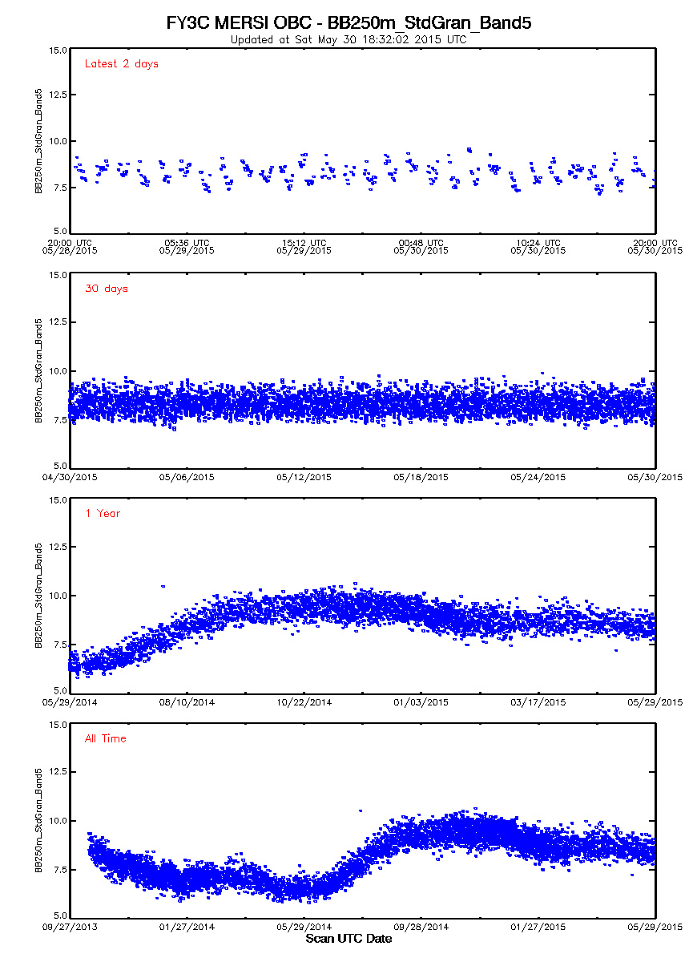
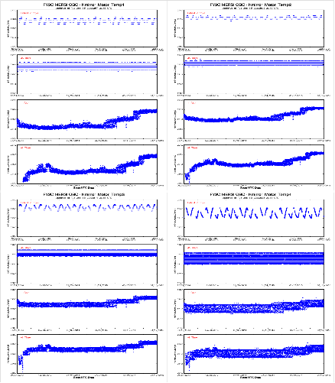
Some monitoring results of MERSI
BB250m STD
show the sensitivity is improved
K mirror motor temperature
show the temperature is gradually rising

Slide 8
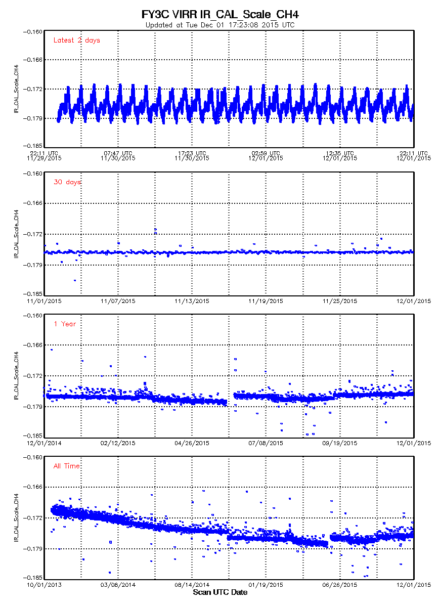
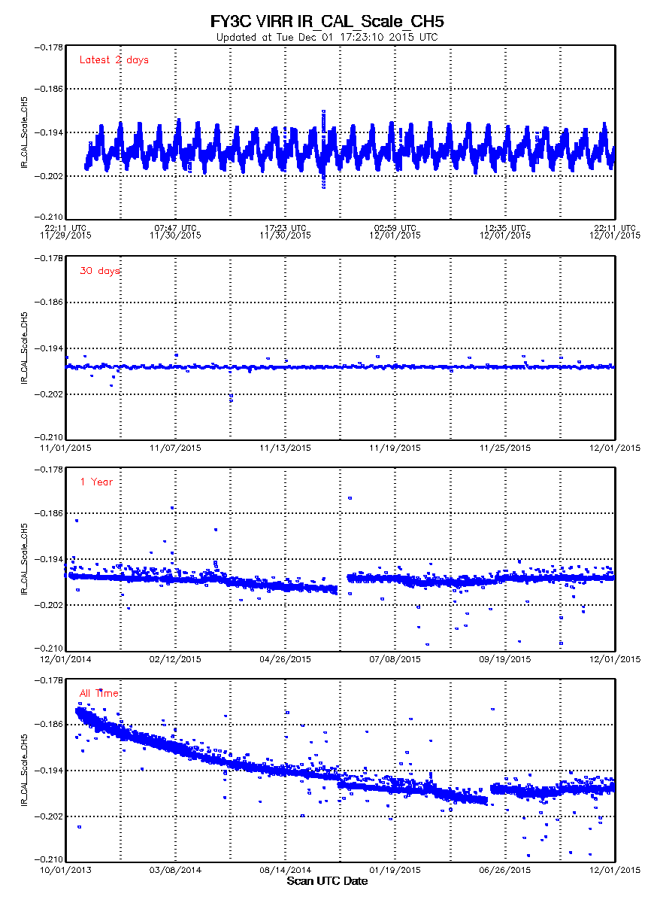
Some monitoring results of VIRR
Around Oct. 20, 2014, the temperature conversion coefficient was replaced. A breakpoint could be found in the figure above.
From May 31, to Jun. 6, 2015, power error of FY-3C, data lost.
A decay trend of the performance was also illustrated in the figure.

Slide 9
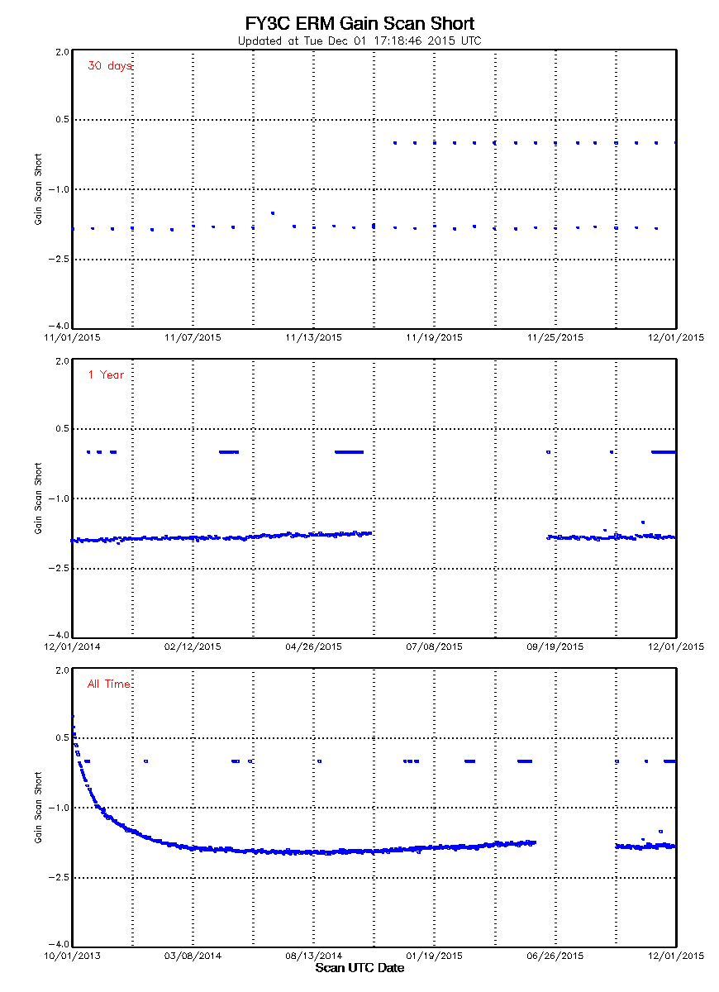
Some monitoring results of ERM
Temporal variation of calibration intercept of shortwave ERM
There is a drift at 0 point count.
The gain of the shortwave ERM
tends to be stable since launch.

Slide 10
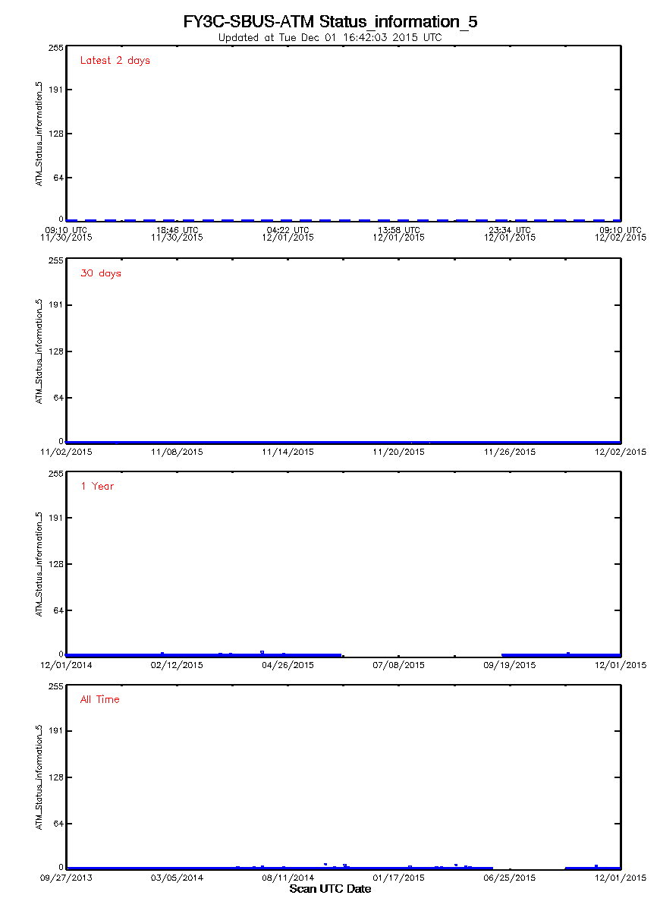
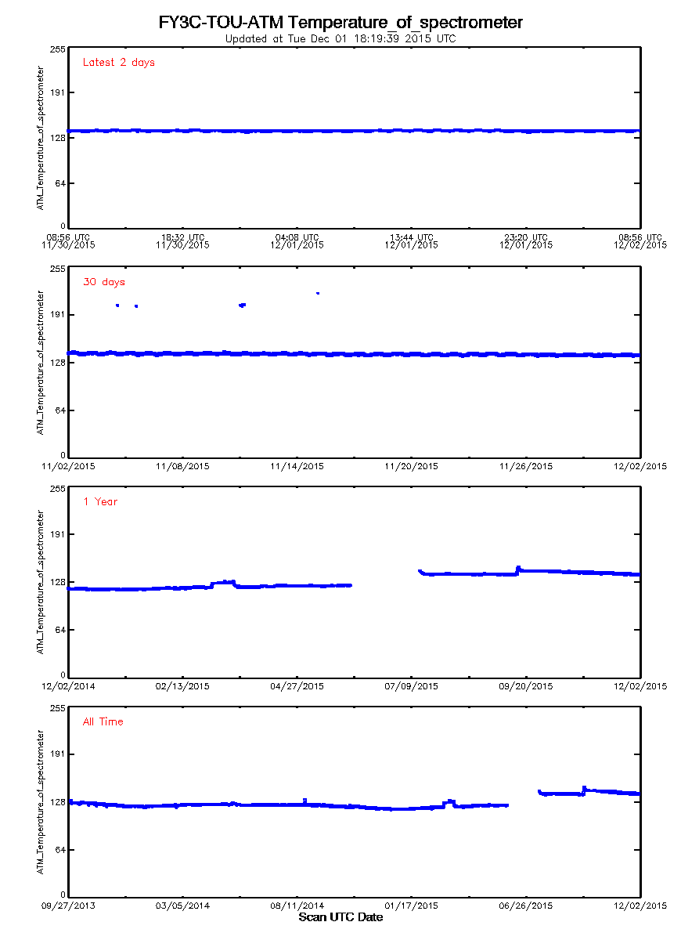
Some monitoring results of SBUS and TOU
Information of diffuse panel
0x03 presents normal, 0x0C error. As can be found from the figure, the value was normal.
Temperature of spectrometer
The value has a slight vibration downward trend since launch.
There had a slight shifting after the power error.

Slide 11
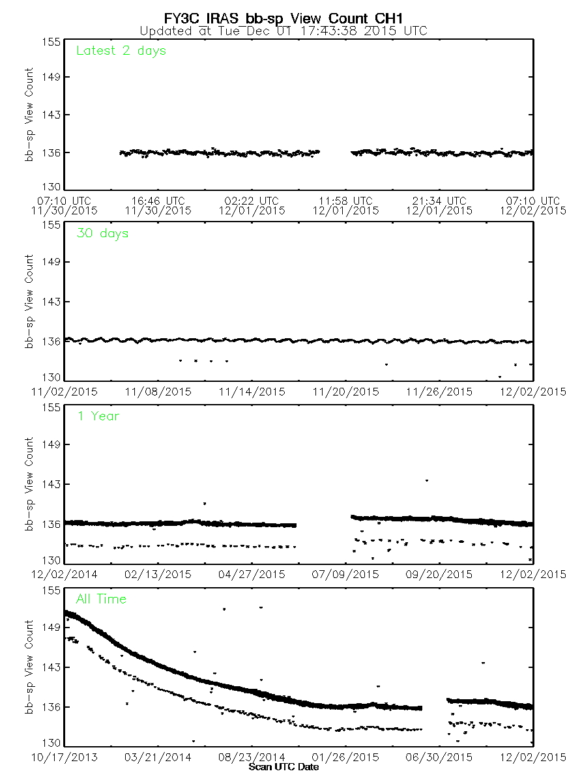
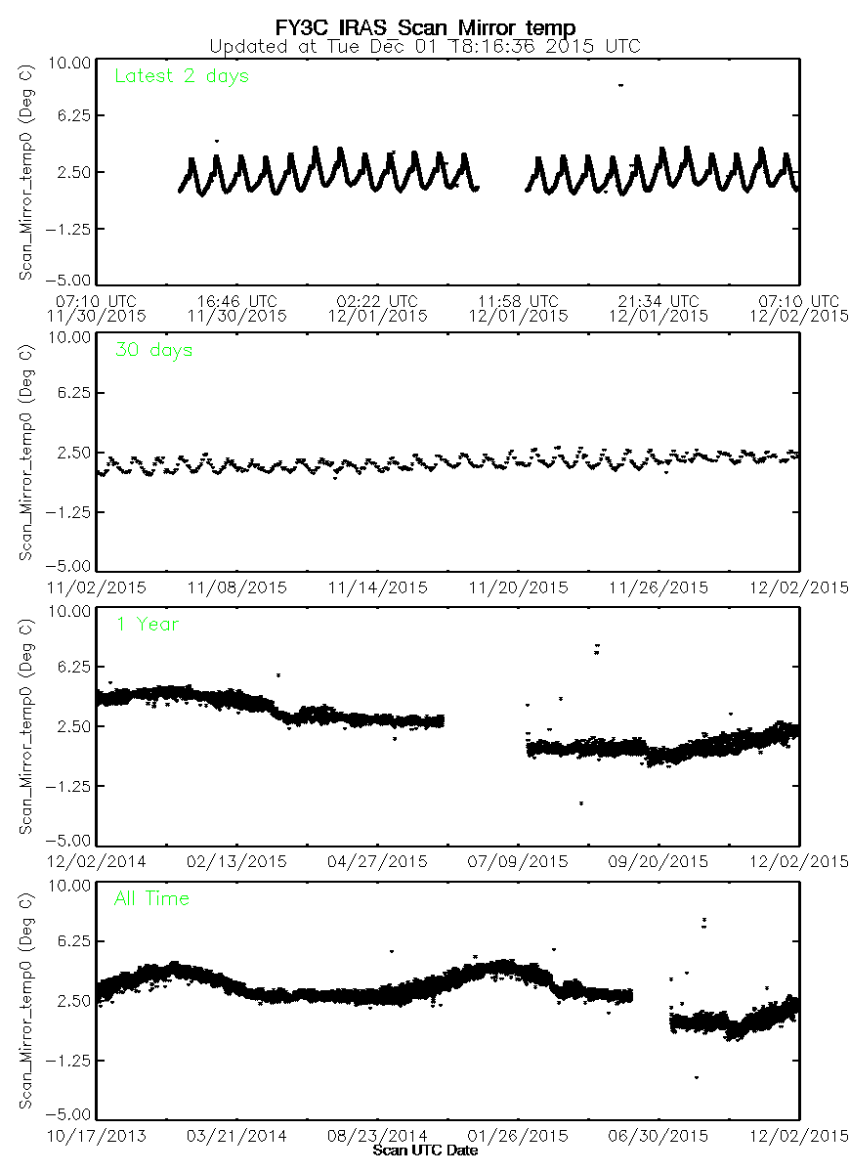
Some monitoring results of IRAS
The difference between the black body and the cold air
continuously descend, which indicates that the signal detection range of the instrument is getting narrower and narrower.
Scanning mirror temperature
a small increase and downward trend with the seasons in one year.

Slide 12
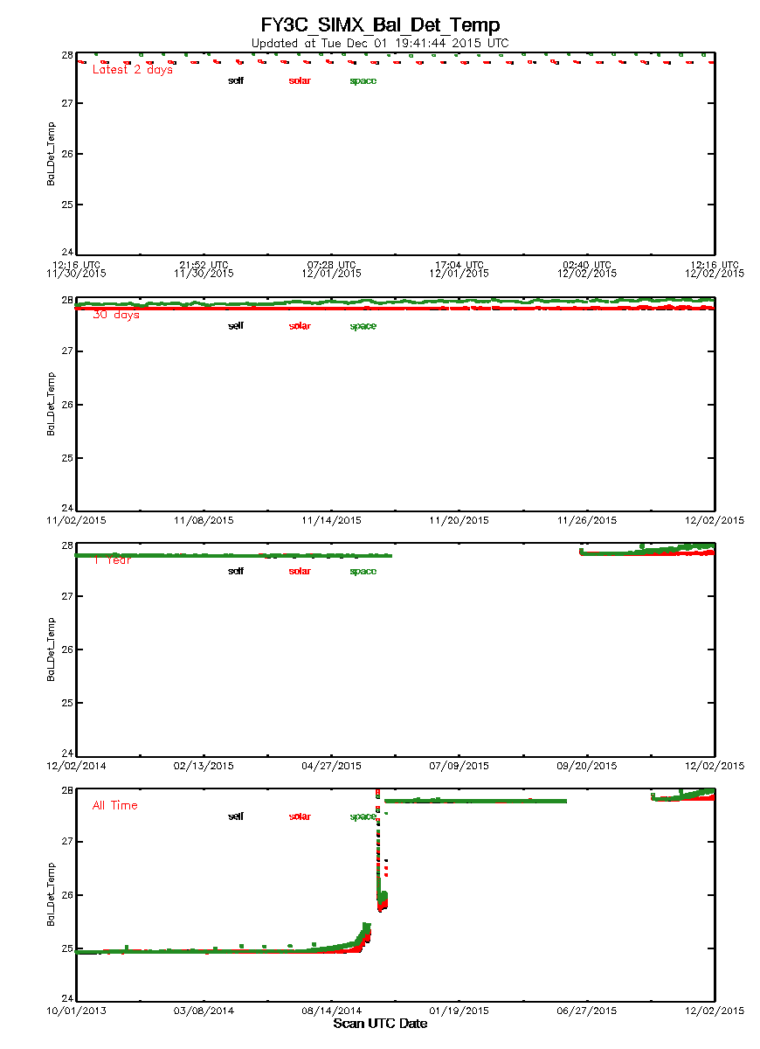
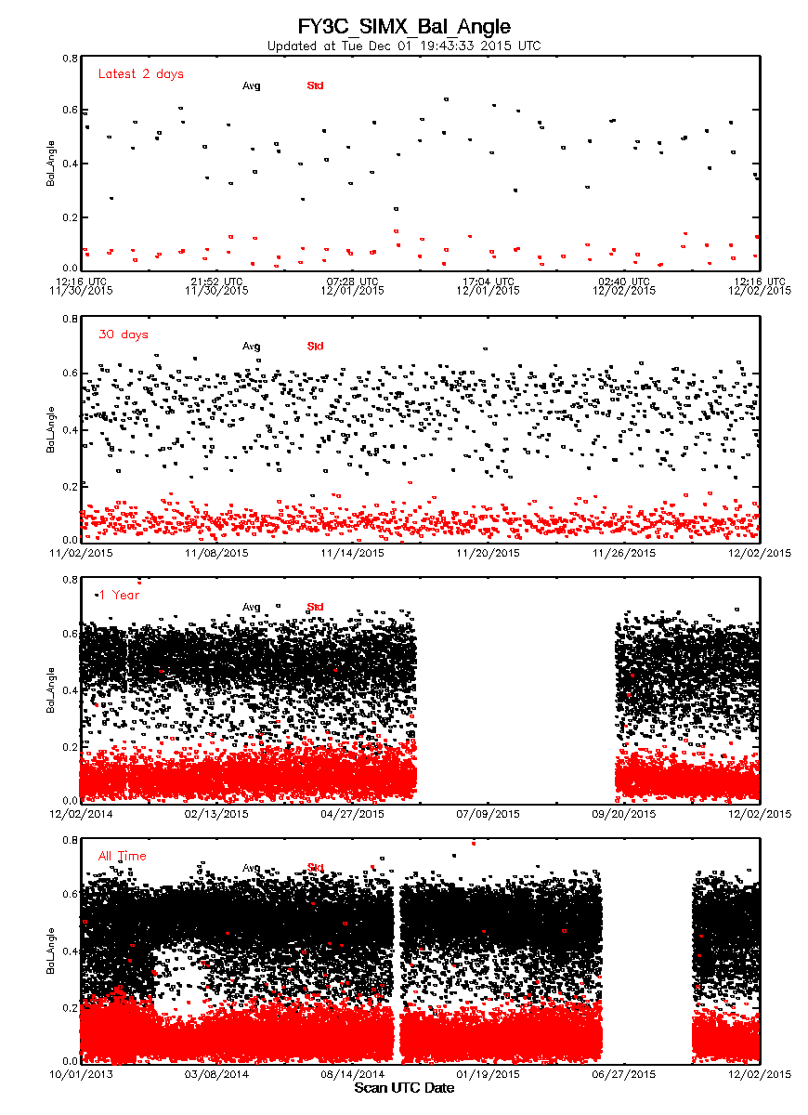
Some monitoring results of SIM
Balance detector temperature
the balance was abnormal in Oct. 2014. After re adjust, the temperature reached a stable state.
After the power error, the space temperature is keep raising. These phenomenon was caught in time by PAHMS.
The mean value of balance angle
the tracking angle of the instrument maintained in a stable state in one year and the whole life.

Slide 13
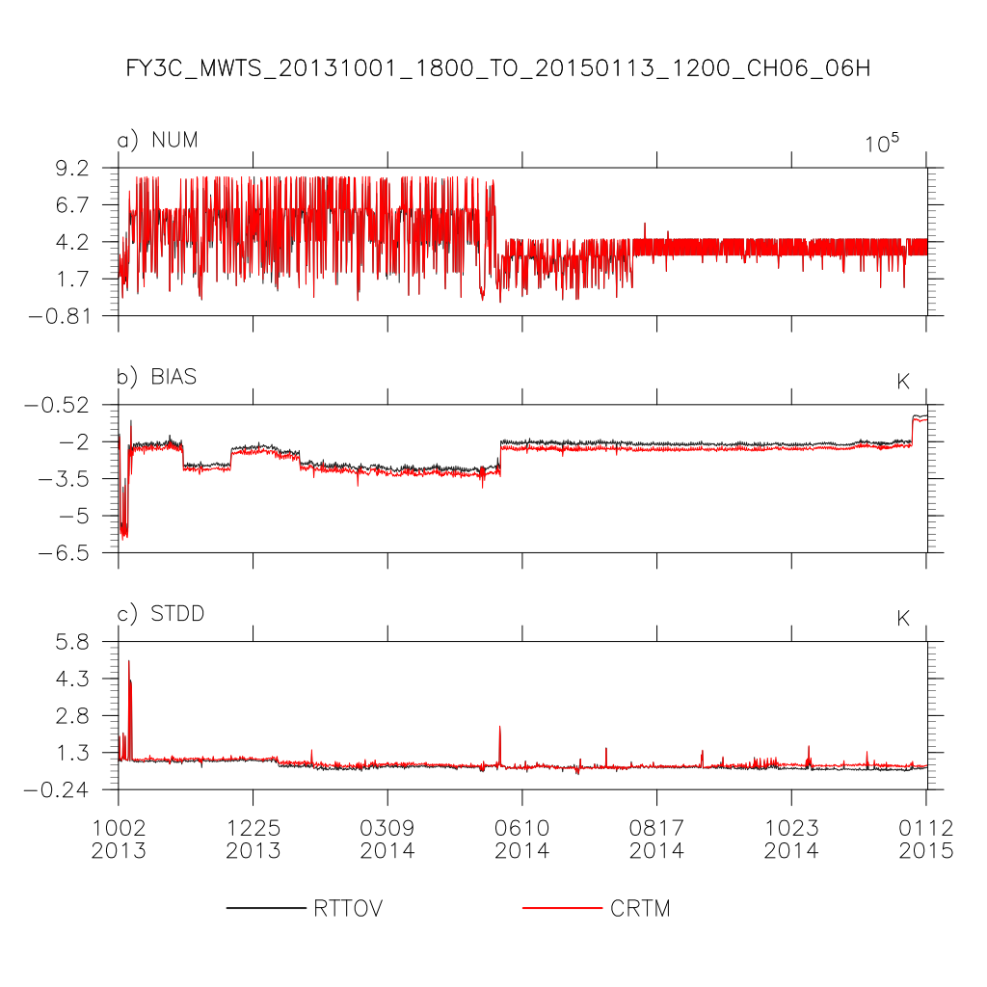
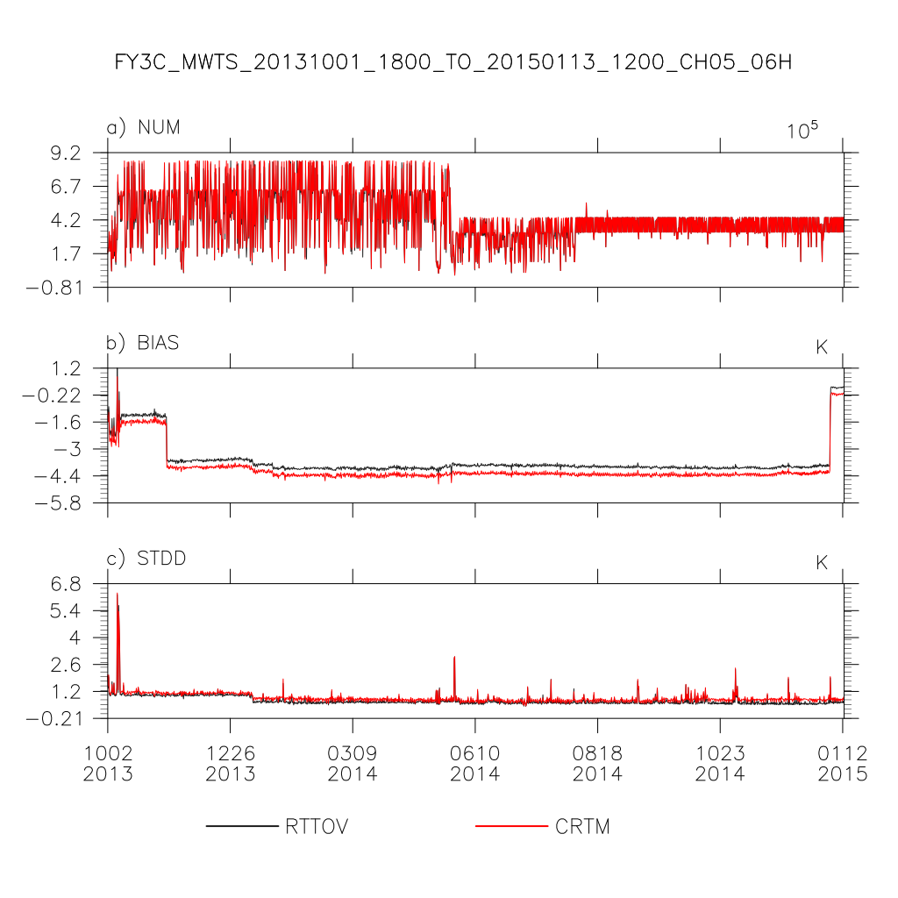
Some monitoring results of MWTS
Long time series of MWTS brightness temperature:
a few days after the calibration, the deviation from -3k, -4k decreased to 1k in the middle atmospheric temperature detection channel.

Slide 14
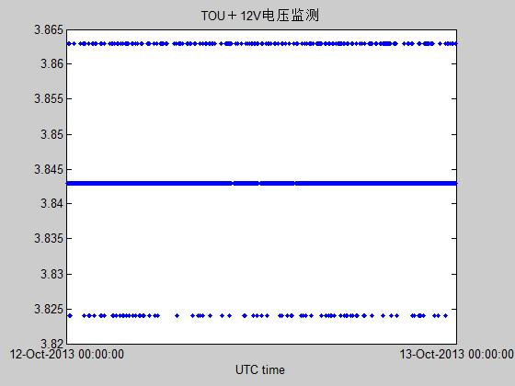
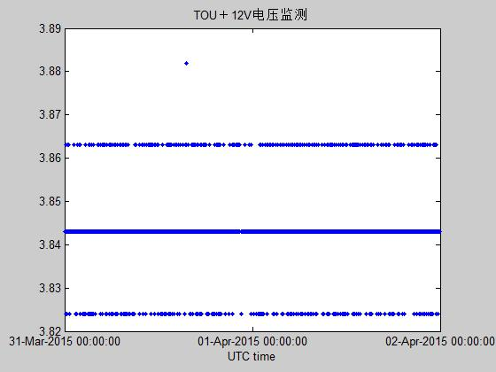
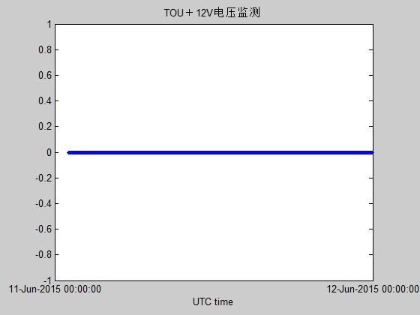
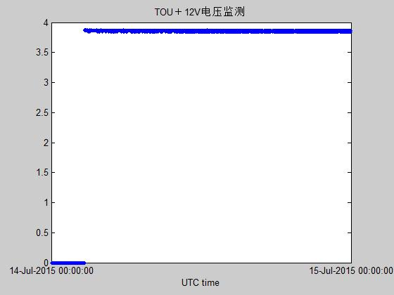
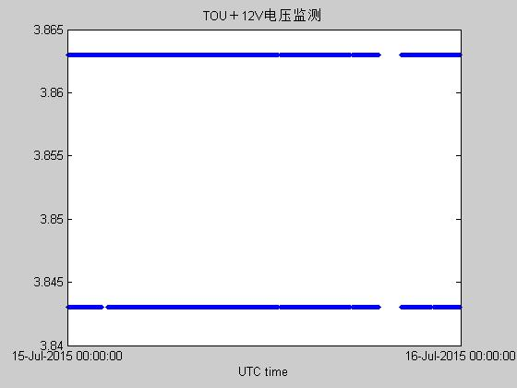
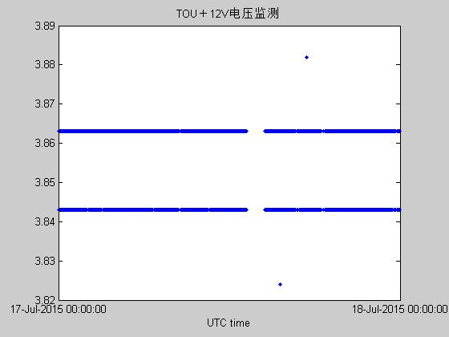
Analysis telemetry data
Normal data
Abnormal data
Shutdown
Startup
Initial startup
Abnormal data
FY-3C/TOU +12V voltage monitoring by telemetry data

Slide 15
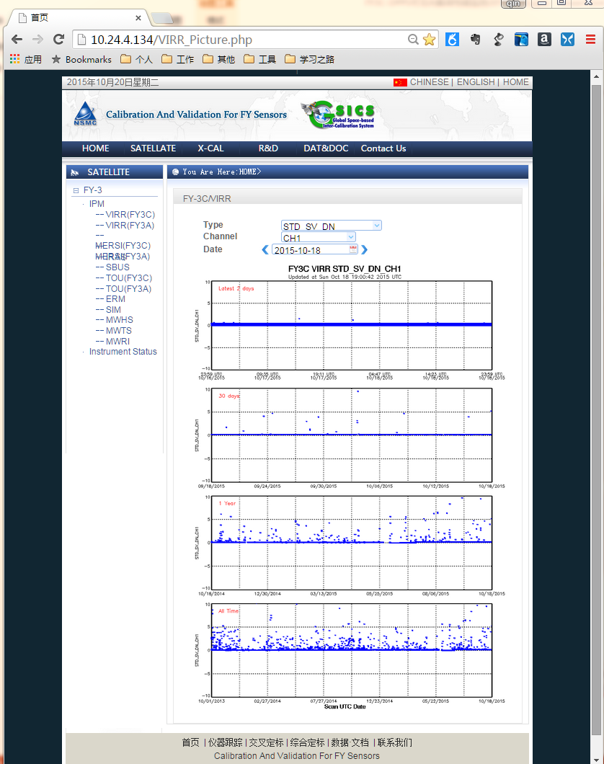
Performance monitoring page (under develop)

Slide 16
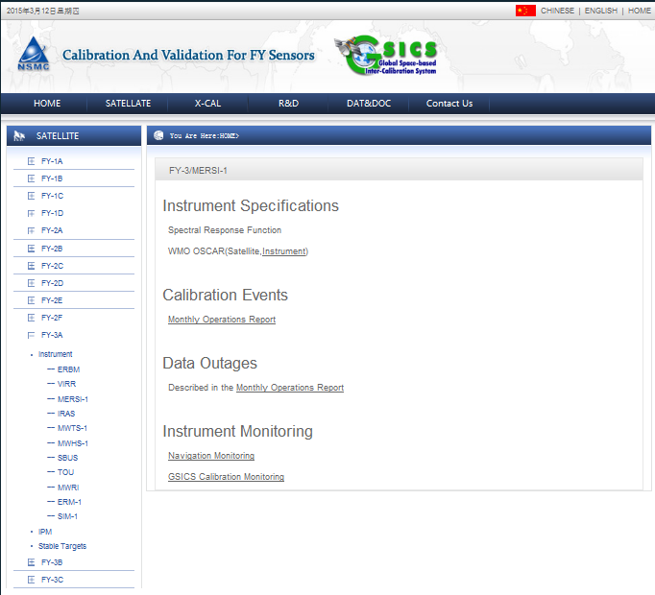
CMA’s Landing Pages (under develop)

Slide 17
Currently problems
How to determination of the threshold: a threshold analysis is used to diagnose the status of the instrument.
Be determined by the instrument responsible person
Analyzed automatically by the PAHMS system
Hint the potential risks in unknown relationship between the various on orbit environment and the instrument performance.

Slide 18
Thank you!

