Slide 1
GSICS MW products and a path forward.?
Manik Bali, Ralph Ferraro Larry Flynn, and Cheng-Zhi Zou
MW Subgroup Meeting
January 6, 2016

Slide 2
Outline
Introduction
Results of the User Feedback
MW In-Orbit references
What are potential GSICS Products?
Summary

Slide 3
Results of User Feedback survey
To begin with → Need a platform for providing corrected radiances
Platform could consist of in-orbit references & algorithm to meet
& backed by tools such as ICVS to enable root cause analysis.

Slide 4
Introduction
Do we currently have MW cross calibration products ? NO
The MW subgroup was re-formed in 2013.
The GPM-X Cal and the CEOS-WGCV are closely linked with GSICS MW subgroup activities.
Currently the subgroup has no products but discussions to identify products and deliverables are underway.
GSICS Goals
User Requirements
Vision of GRWG
=+
Commitment from agency
A verification/validation report.
-impact assessment ->
How does the product help the agency
A Review Board report.
Factors that help in identification of MW products

Slide 5
In-orbit references
Do we currently have in-orbit references for MW ? NO
The AMSU/MSU L1B FCDR for O₂ bands resembles a typical in-orbit reference that is stable and accurate.
Has scan angle corrected radiances
Trends have been removed
Undergone stringent quality assurance test
Real time quality flags for each pixel come with the product

Slide 6
AMSU/MSU FCDR as a reference: Current progress
Coded and Setup an AMSU – ATMS inter-comparison SNO algorithm
NOAA-GDWG has helped AMSU FCDR resemble a typical MW orbit file – scan time stamps that can be used to generate SNO’s, uniformity of file format (NetCDF4) across time spans has been achieved.
Computed AMSU footprint size
Created a three month database of AMSU-FCDR – ATMS collocations.
Scan angle corrected BT included that resemble RVS corrected IASI/VIIRS radiances and are used as reference.
Next steps- analyze the collocations data set
Once we have an in-orbit reference we can generate in-orbit cross calibration products

Slide 7
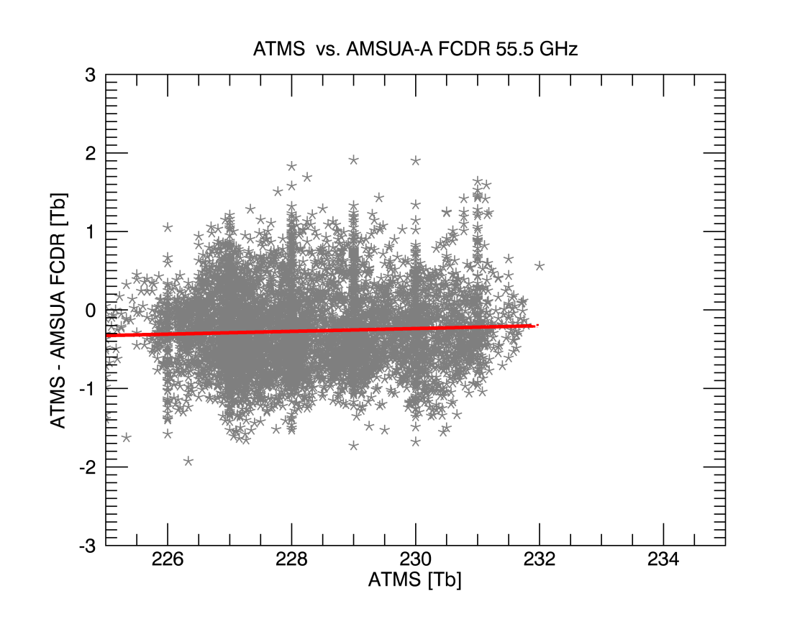
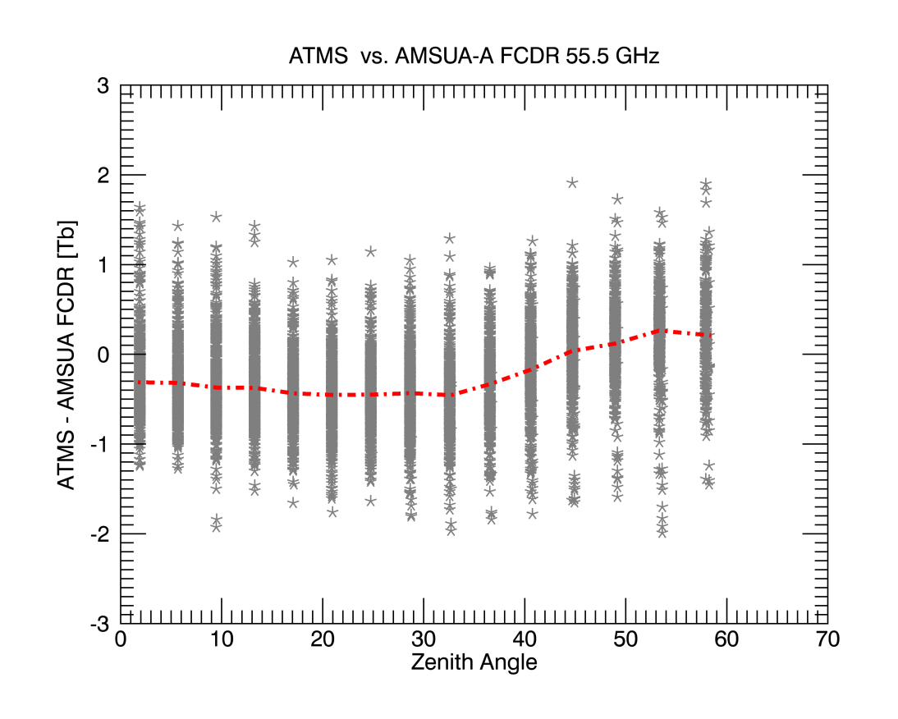
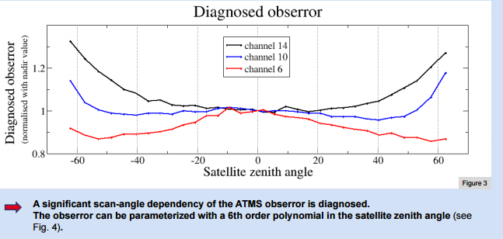
SATMS –AMSU-A 55.5 GhZ bias [NOAA-18]
Offset = -0.29 K
Oct 15- 31, 2015 data
Stable temperature dependent bias
Zenith angle dependence similar to model calculations
Reference Plot Curtsey
https://cimss.ssec.wisc.edu/itwg/itsc/itsc19/program/posters/1p_11_delrio_faulwetter.pdf

Slide 8
Potential GSICS MW Products
MW products come in two classes:
Retrospective type products (FCDR “components” – geolocation, scan biases, intersatellite corrections, etc.)
Forward looking (quasi-real time) products
A possible path forward:
Determine from users what specific MW products they would like to see from GSICS (A question posed in last User’s Meeting)
User Response from survey
Larry, GSICS Annual Meeting, Delhi, April 2015
Can we consider corrected radiances (and corrections) for AMSU, ATMS, GMI, MHS as GSICS products?

Slide 9
More possible MW deliverables and products
Level 1 adjustments and corrections (Result in Classical products)
Methods (e.g., SNO or double difference)
Need to address
References, transfers, stability
Spectral region idiosyncrasies
Satellite and Instrument Data Bases
OSCAR (SRF -> product, etc.)
Provide Geolocation and FOVs
Identify and catalog anomalies and periods of coverage
FCDRs and ECVs
Users for reanalysis versus real time
Components, homogenization approach (Documented, reviewed algorithms)
MW FCDR to GSICS Product example for discussion
References (These cover all spectral regions not just MW.)
Solar
Lunar (ROLO and GIRO)
DCC (radiance levels, frequencies?)
Targets (Surfaces emissions and reflectivities?)
Tools (SNO identifier, Display Graphics, Communication, Notification …)
Documents (Journal articles, ATBDs, Users’ manuals)
RTMs (Vicarious calibration, Error analysis, O-B bias, and comparisons studies)
Stability versus Traceability
Larry, EP -16+
Range of deliverables can be identified
Notes:
In looking over old presentations on GSICS products, Manik provided me with a couple on the GSICS Information Services and Products Roster (GISPR). I'm attaching one to show that we are just following a natural evolution. I do want to make it clear that I am not proposing that most of these all go through the GPPA or other reviews or become named, blessed, hosted GSICS products.
http://www.star.nesdis.noaa.gov/smcd/GCC/documents/GRWG/200901/DAY1_1445_Iacovazzi_GCC_GISPR.pdf

Slide 10
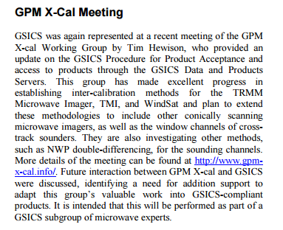
Interaction with GPM-X Cal and CEOS WGCV
In terms of developing GSICS Products for Microwave instruments, the considerations should be:
1. What are the user’s requirements for inter-calibration products?
2. What can we do to meet the desired performance?
3. Can we make products that fit within existing GSICS Conventions and systems?
Cheng-Zhi Zou leading the interaction with WGCV
MWSG Chair to have a communication with GSICS on how WGCV can offer support on best practices.
WGCV Secretariat to send out the list of potential GSICS-WGCV Cooperation items outlined by GSICS to each subgroup chair
WGCV (Completed) Subgroup Chairs to identify and prioritize specific activity areas for interaction with GSICS.
MW subgroup has close links with GPM-X Cal and CEOS-WGCV and will focus on building these relationships in 2016

Slide 11
Summary
Efforts are underway to identify in-orbit references to open the gates for inter- comparisons and inter- comparison product generation.
Provide algorithms and data bases to the MW community (GCC working on a GPPA stamp to deliverables).
Identify best practices for Pre and Post flight characterization .
Ties with GPM-X and WGCV can be further strengthened.
A package for root cause analysis/analytics on the ICVS can be delivered.
For those who may be coming to the GRWG/GDWG, we can focus on these and other topics during planned ½ day meeting of MW Sub-Group

Slide 12
THANK YOU

