Slide 1
GPM XCAL Team Status and Plans
Presented by
Rachael Kroodsma
Results from the GPM XCAL Team
Wesley Berg, Tom Wilheit, Linwood Jones, Darren McKague, Rachael Kroodsma, Steve Bilanow, Ruiyao Chen, Saswati Datta, David Draper, Hamideh Ebrahimi, Spencer Farrar, Vivienne Payne and John Xun-Yang

Slide 2
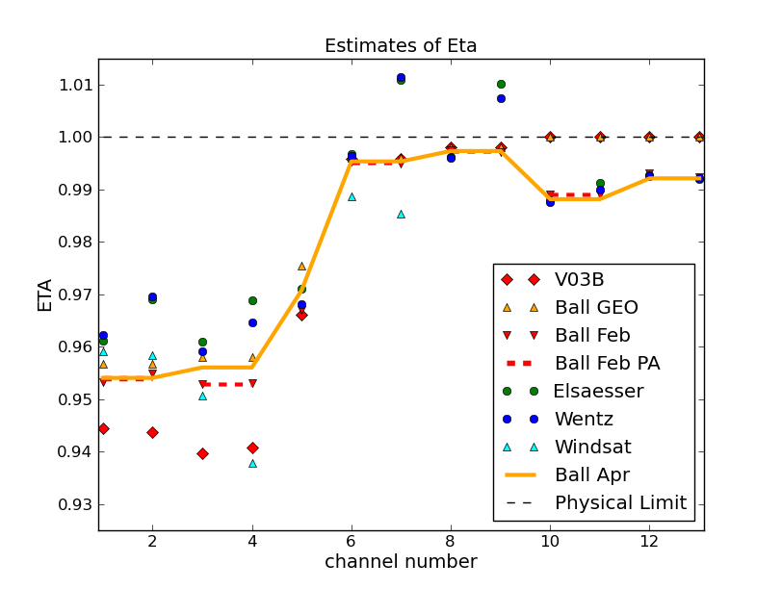
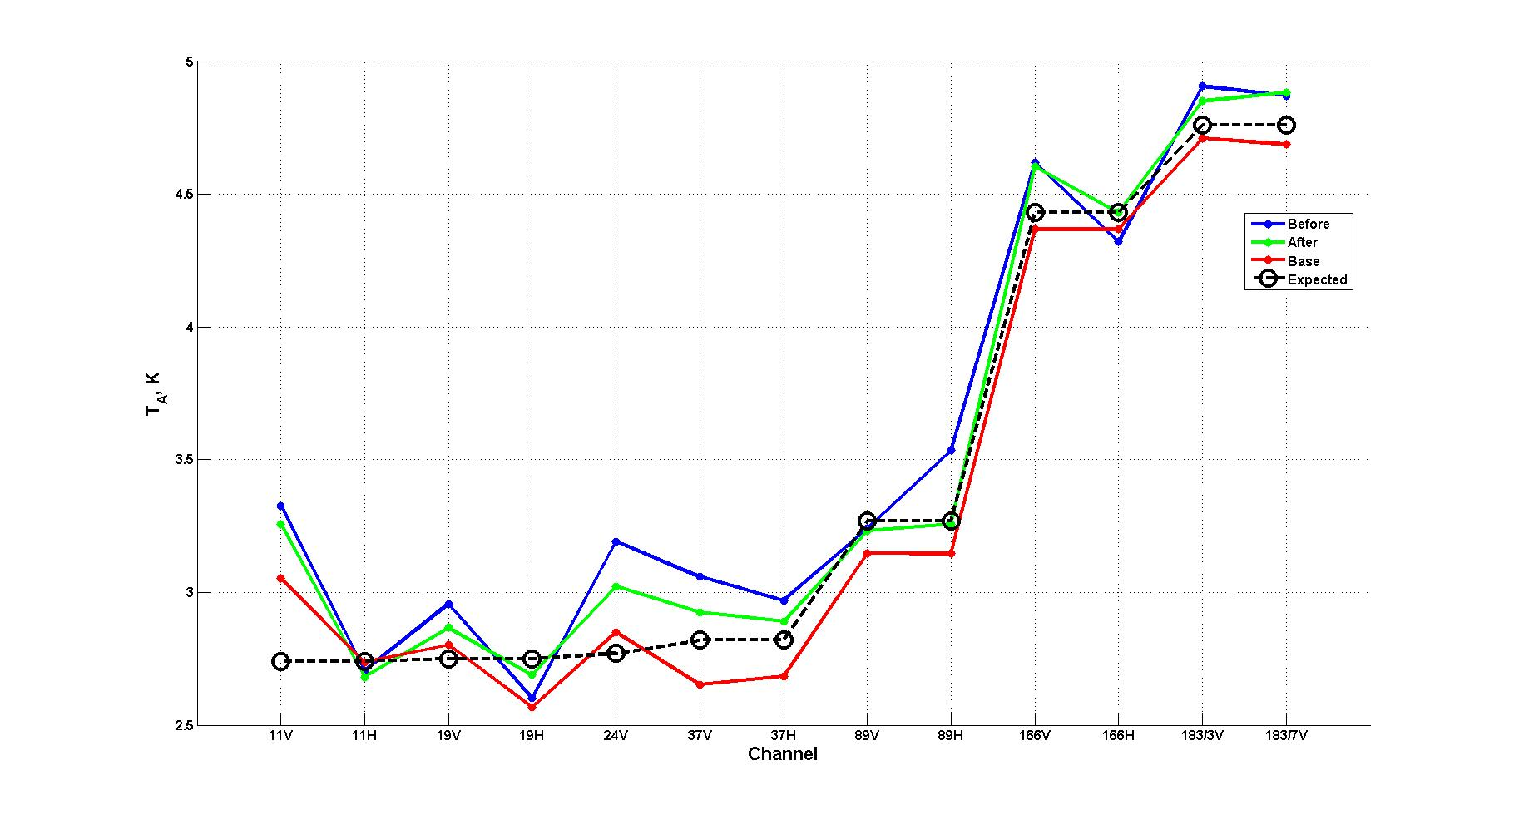
GMI Calibration Summary
5.0
Observed vs. Expected GMI Cold Space Ta
Channel | Previous (η_{F}) | Final (η_{G}) | ΔTb (ocean) | Total Error
10v | 0.94435 | 0.95404 | 1.7 | 0.45
10h | 0.94369 | 0.95404 | 1.0 | 0.24
18v | 0.93968 | 0.95603 | 3.3 | 0.61
18h | 0.94082 | 0.95603 | 2.0 | 0.42
23v | 0.96601 | 0.97075 | 1.1 | 0.42
36v | 0.99590 | 0.99535 | -0.1 | 0.14
36h | 0.99590 | 0.99535 | -0.1 | 0.10
89v | 0.99810 | 0.99734 | -0.2 | 0.12
89h | 0.99810 | 0.99734 | -0.2 | 0.11
166v | 1.00000 | 0.98814 | -3.2 | 0.26
166h | 1.00000 | 0.98814 | -3.2 | 0.26
183±3v | 1.00000 | 0.99212 | -2.1 | 0.24
183±7v | 1.00000 | 0.99212 | -2.1 | 0.24
4.5
4.0
Ta (K)
3.5
2.5
Rev G (Final)
2.0
10v 10h 18v 18h 23v 36v 36h 89v 89h 166v 166h 183±3 183±7
10v 10h 18v 18h 23v 36v 36h 89v 89h 166v 166h 183±3 183±7
Change in spillover correction (eta) based on inertial hold analysis (Courtesy David Draper, Ball Aerospace).
Various estimates for spillover correction (eta) for each GMI channel. Final values are indicated by solid yellow line (Courtesy Tom Wilheit).
Observed vs. expected antenna temperatures by channel based on analysis of data from deep space calibration manuever (Courtesy Spencer Farrar, Univ. Central Florida).
Cold calibration
No evidence of emission from either the main reflector or cold calibration subreflector. See figure on the left. (based on analysis by Spencer Farrar at UCF)
Magnetic anomalies
Along-track magnetic anomalies due to spacecraft flying through Earth’s magnetic field
Cross-track magnetic anomalies due to magnetic latches for GMI cover (10H worst effect)
Correction developed and applied. Residual anomalies are very small.
Polarization check based on nadir view
Analysis of nadir view looks by Spencer Farrar found differences between V & H Ta within ~0.3K over ocean and ~0.2K over land (consistent with expectation for no polarization difference at nadir)
Land nadir polarization difference provides strong constraint on any calibration adjustment as it would have to leave cosmic background temperature unchanged. Remaining options include adjustment to warm load and/or spillover correction
Spillover Corrections
Majority of the antenna pattern missing the Earth is in the spillover region (i.e. the radiation from behind antenna that comes in around the edges of the main reflector into the feed horns.
Forward part of antenna pattern measured by Ball at near field range pre-launch, but spillover region could not be measured so they used two different models, which gave different answers.
Initial spillover corrections (Eta) for 166 and 183 channels were 1.0 (unphysical)
Data from 2 inertial hold maneuvers were analyzed by David Draper at Ball Aerospace, who derived new Eta values for all of the channels.
The resulting Eta values (see table/figure on the left) are based on physical observations rather than models (as used initially). These values are also not tuned to match any radiative transfer model.
Summary
The GMI calibration appears to be at least as good and likely better than any other window-channel radiometer.
A conservative estimate for the absolute calibration errors of the GMI window channels are < 1K
Comparisons of the GMI 166 and 183 GHz channels with the MHS cross-track sounders show differences of < 0.5K

Slide 3
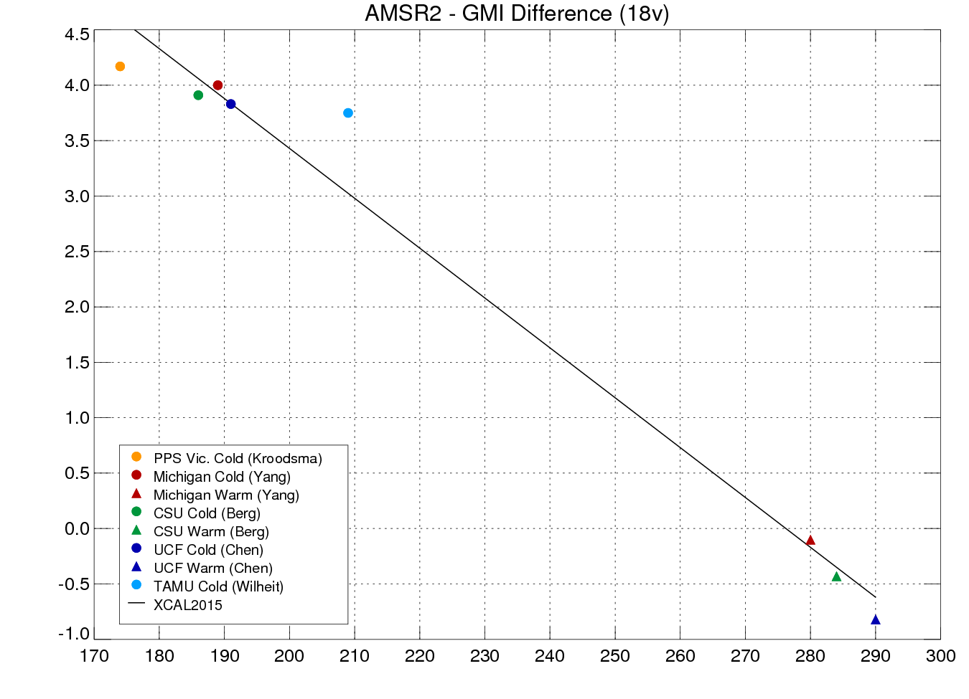
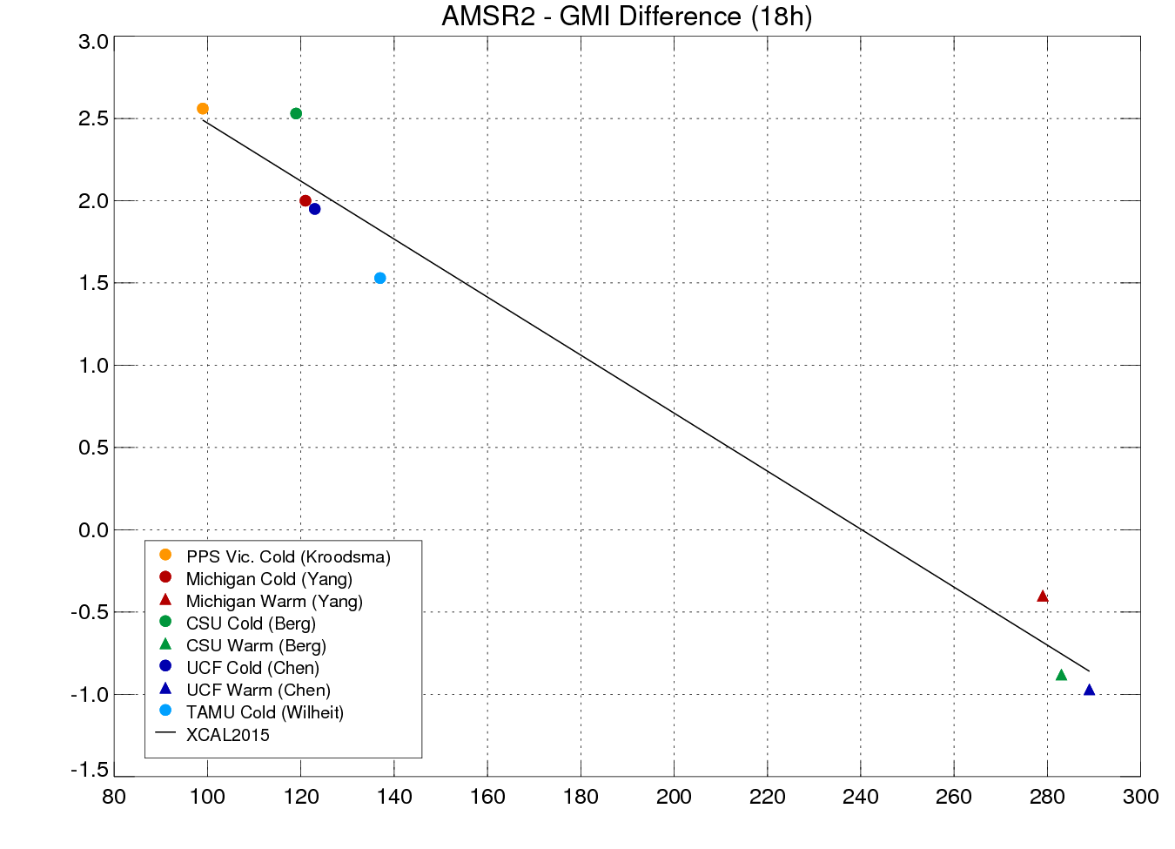
Intercalibration vs. GPM GMI
Merging Results from Multiple Independent Approaches
A key aspect of the XCAL team intercalibration approach is the application of multiple independent approaches by team members.
Comparisons are made between different group’s results to identify outliers. An attempt is made to track down and understand the reason(s) for significant discrepancies.
If an error is identified, it is fixed and rerun. Otherwise, outlier may be excluded or prompt further investigation.
Mean and uncertainty are calculated for both cold and warm scenes. The above plot shows the individual and composite results for the AMSR2 18 GHz channels versus GMI.

Slide 4
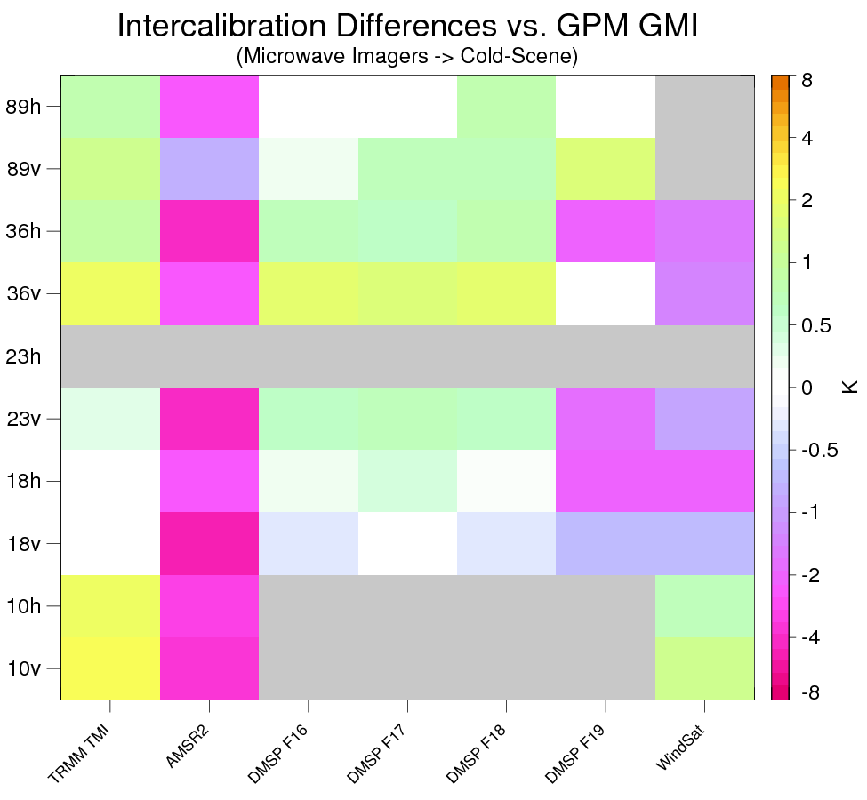
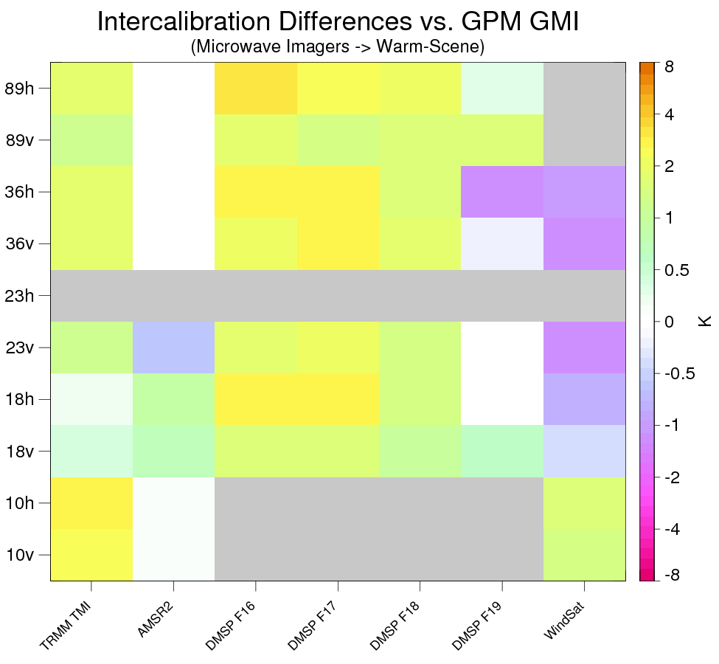
XCAL Imager Calibration (Window Channels)
TRMM TMI:
Calibration differs a bit from GMI, but is very stable
AMSR2:
AMSR2 calibration is significantly colder than GMI for all channels, varying from ~1K for 89v to almost 5K for 18v.
AMSR2 also exhibits significant scene temperature-dependent calibration differences (i.e. warm vs. cold scenes
Remote Sensing Systems derived substantial nonlinearity in the AMSR2 calibration (very different than the JAXA adjustments).
DMSP SSMIS:
Calibration vs. GMI generally within a few K, but vary by sensor
Significant corrections are applied to all of the SSMIS sensors for emissive reflector, solar intrusions, cross-track biases.
F16 and F17 have large emissive reflector issues, but solar intrusion and thermal issues also impact F18 and F19
WindSat:
Not currently part of GPM constellation. Calibration is generally very consistent with GMI with largest difference of 2K for 18 GHz H-Pol channel.

Slide 5
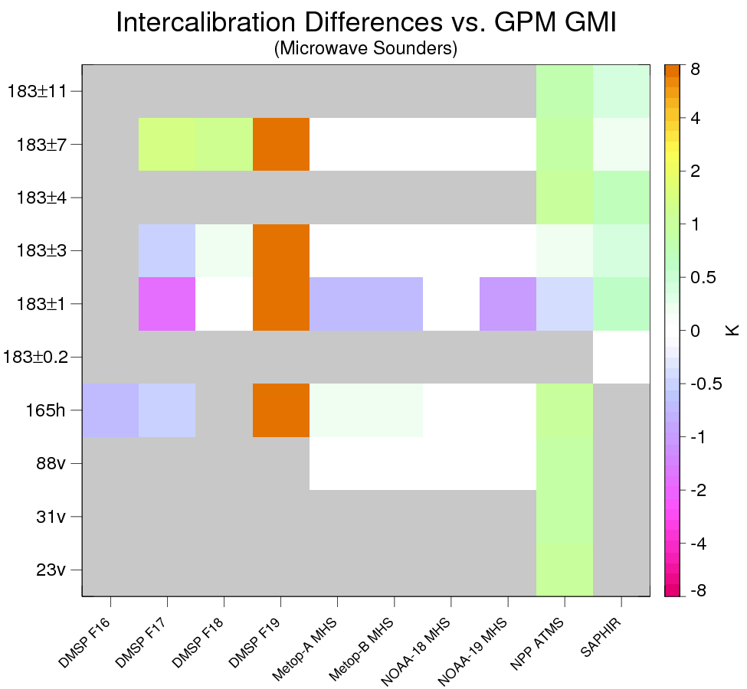
XCAL Sounder Channel Calibration
MHS and SAPHIR:
Differences between GMI and the MHS/SAPHIR sensors are all less than 1K and most < 0.5K. This lends credence to the calibration of GMI, all the MHSs and SAPHIR
ATMS:
The water vapor channels look good
23, 31, and 88 GHz appear to have scan-related errors (possibly due to polarization alignment for 88 GHz and beam blockage for 23 an 31 GHz).
DMSP F16:
183 channels started to drift significantly starting around Dec 1, 2013 so Tb were set to missing
150 GHz channel failed in May 2015
DMSP F17:
Correction applied for large calibration errors (up to ~10K peak to peak) due to emissive reflector (larger impact than for imager channels).
DMSP F18:
Sounder channels look reasonably good with small calibration differences versus GMI
DMSP F19:
The 150/183 GHz feedhorn apparently has debris in it resulting in temperatures that are 8-11K colder than GMI/MHS.

Slide 6
Summary
Current and Future Plans
GPM GMI is extremely well calibrated and stable, providing an ideal calibration reference for the constellation radiometers.
The XCAL team delivered intercalibration tables for all of the GPM constellation imagers and sounders September 2015 for the V04 reprocessing.
Monitoring of constellation radiometers is critical to identify problems impacting the precipitation estimates. Recent examples include failure of F16 high-frequency channels and SAPHIR geolocation issues.
TRMM Reprocessing
TMI Version 8 updates (emissive reflector, geolocation etc.)
Constellation sensors (SSM/I F11, F13, F14 and F15, AMSR-E, and AMSU-B on NOAA-15, NOAA-16 and NOAA-17)
Constellation Changes and Monitoring
New Sensors: Metop-C MHS, DMSP F20 SSMIS?
Monitoring: http://rain.atmos.colostate.edu/XCAL
Consistency of Simulated and Observed GMI Tb
Radiative transfer: Investigating model differences (Ocean emissivities above 90 GHz, Atmospheric absorption).
Atmospheric and surface states: Improved geophysical retrieval algorithms.
Error Assessments
Radio Frequency Interference (RFI)
Time-Dependent Variability (TMI Stability).
Dealing with channels with no nearby GMI equivalent (e.g. 23.8 GHz H-Pol, 183±1 GHz)
Other Applications

