Slide 1
GRWG Web Meeting, 4 February, 2016
COMS MI
DCC results from SNU and NASA methods
2016. 2. 4.
Tae-Hyeong Oh, Dohyeong Kim, Hyesook Lee
National Meteorological Satellite Center (NMCS)
Korea Meteorological Administration (KMA)

Slide 2
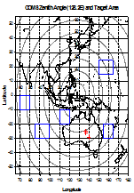
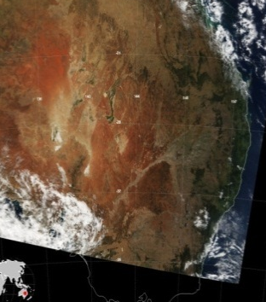
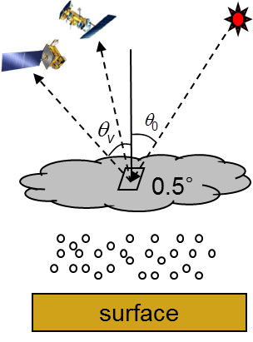
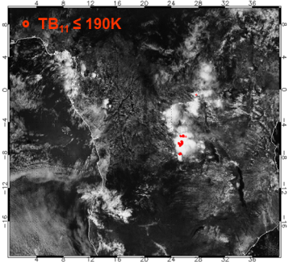
GSICS Activity of KMA for visible channel
KMA Installed vicarious calibration system for visible channel using 5 targets.
ocean, desert, water cloud, deep convective cloud (DCC), and Moon
We have tested with these target data since 2011.
Target | Ocean | Desert | Water cloud | Deep convective cloud | Moon
Period | Sep. 2011 ~ Present
Source | Regular observation |  |  |  | Special obs. (twice a month)
Obs. | - Pacific Ocean - Indian Ocean | - Simpson Desert in Australia | - Over ocean regions - Overcast clouds | - High reaching overcast clouds | - moon

Slide 3
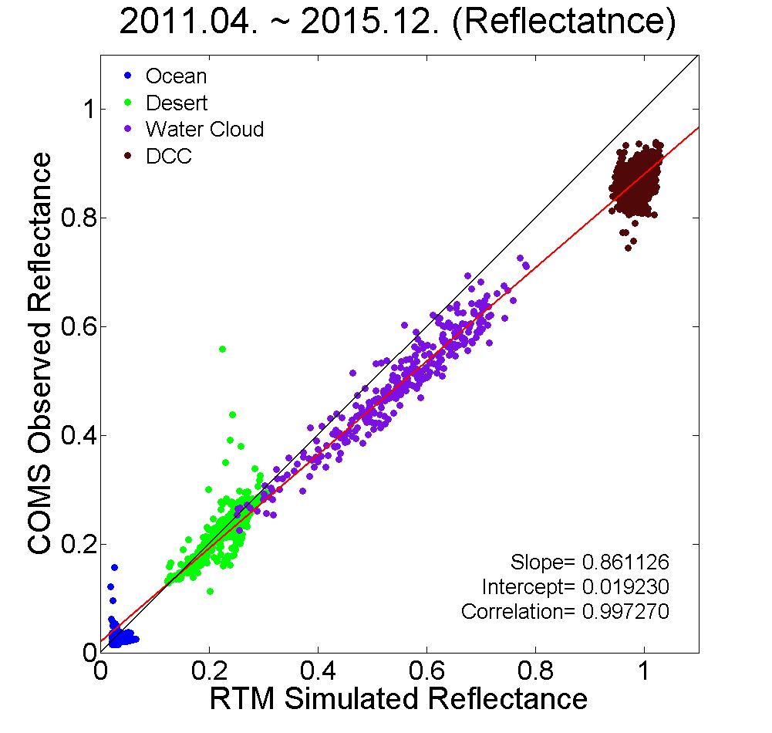
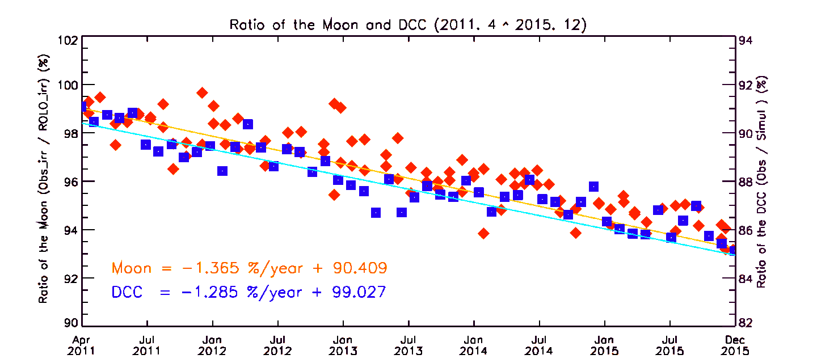
GSICS Activity of KMA for visible channel
Result from DCC target is consistent with other target data, making linear regression line with high correlation.
The degradation are about 5.80% (1.23%/year) from the moon and 5.47% (1.17%/year) from the DCC from Apr. 2011 to Dec. 2015.
Result of GSICS is displayed on KMA’s homepage
http://nmsc.kma.go.kr/html/homepage/en/gsics/gsicsMain.do

Slide 4
vicarious calibration algorithm using DCC
Sohn et al. 2009, Ham and Sohn 2010
Satellite data
Visible band (0.67 μm)
Same FOV
Well-calibrated
IR band (10.8 μm)
TB₁₁
1
Threshold conditions
No
3
Yes
Assumption of input parameters
COT=200, r_{e} = 20 μm,
Cloud height = 1~15km
Tropical profiles
Selected DCC pixels
2
Cloud Radiative transfer modeling
Observed visible radiances
Simulated visible radiances
Vicarious calibration

Slide 5
Part 1: Selection of DCC targets
Threshold conditions to select the overshooting DCCs
convective clouds whose tops extended from 14 to 19 km with extremely high reflectivity
target pixel
Solar geometry |  | SZA ≤ 40º
Viewing geometry |  | VZA ≤ 40º
 | - geometry criteria: to minimize navigation errors and 3-D radiative effects
Surface type |  | No restriction
 | - no restriction of surface type: less influence on reflectance of DCC targets
Cloud conditions (1) |  | target pixel: TB₁₁ ≤ 190 K
 | - only temperature criterion: overshooting DCCs represent cloud top temperature lower than the TTL temperature (~190 K)
Cloud conditions (2) |  | environmental pixel: STD(TB₁₁) ≤ 1K
 |  | environmental pixel: STD(R_{0.6})/Mean(R_{0.6}) ≤0.03
 | - two types of homogeneity checks: to avoid selection of cloud edge or small-scale plumes
STD,
STD/Mean
9 x 9
environmental pixels
TB₁₁: brightness temperature at 10.8 μm, R_{0.6}: reflectance at 0.67 μm, STD: standard deviation in environmental (9x9) pixels

Slide 6
Part 2: cloud RTM description (1/2)
SBDART (Santa Barbara Disort Radiative Transfer) model (Ricchiazzi et al. 1998) - based on DISORT (Discrete Ordinates Radiative Transfer) model - capable up to 32 streams - relatively accurate and efficient RTM for cloudy atmosphere
KMA used some options as follows:
phase function: delta-fit method (Hu et al. 2000) - bulk phase function: strong forward peak and thousands of Legendre polynomials - needed to truncate method for the phase function in the forward direction - to reduce the computational burden without degrading accuracy
gases absorption: correlated-k-distribution (CKD) method (Kratz 1995; Kratz and Rose 1999) - gaseous absorption associated with Rayleigh scattering
sfc. info.: oceanic surface properties for any surface type

Slide 7
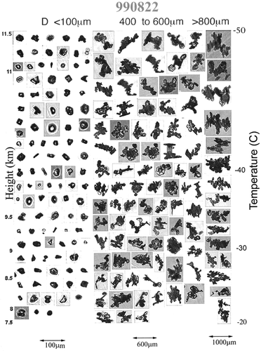
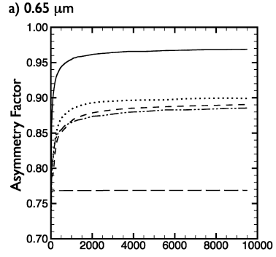
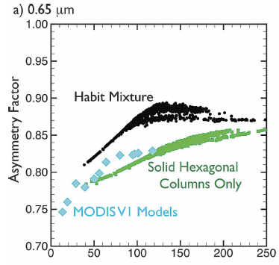
Part 2: cloud RTM description (2/2)
Scattering properties: Baum model Baum et al. (2005a and 2005b) for non-spherical ice particles
- based on in-situ measurements to obtain habit fractions (Heymsfield et al., 2002) - use single scattering properties of droxtals, hexagonal plates, hollow columns, solid columns, bullet rosettes, and aggregates
(Yang and Liou, 1996a and 1996b; Yang et al., 2003a and 2003b) - band averaged scattering properties with respect to r_{e} by integration of single scattering properties
Q_{ext} (extinction efficiency), ω₀ (Single scattering albedo),
g (asymmetry factor), P(Θ) (phase function), f_{d} (delta transmitted energy)

Slide 8
Part 2: RTM inputs
RTM input parameters for COMS calibration using DCC target
# of streams | 20 | Cloud conditions | Ice phase (use Baum scattering model)
Simulation wavelength | 0.57488 μm – 0.77992 μm |  | COT = 200
 | (interval: 0.04101μm) |  | Effective radius = 20 μm
Filter function | rectangular filter |  | Cloud top-height = 15 km
Geometry | SZA, VZA, SAA, VAA (Observed pixels information) |  | Cloud depth = 14 km
surface type (BRDF) | Ocean
atmosphere | Tropical standard profile
uncertainty ranges
in Appendix of Sohn et al. (2009)
Input |  | Sfc. | Atmos. | AOT | Cloud
Parameters |  | albedo | profiles | At 0.55 μm | COT | re | Zc | Zc
Reference value |  | Oceanic | TRO | 0 | 200 | 20 μm | 15 km | 14 km
Input range |  | 0 – 0.4 | MLS | 0 – 3 | 100 – 400 | 10 – 30 | 12 – 18 | 10 – 14
Maximum uncertainty | SZA = 0º | 0.09% | 1.29% | 0.14% | 4.79% | 1.64% | 0.15% | 0.24%
 | SZA = 10º | 0.09% | 1.29% | 0.14% | 4.79% | 1.96% | 0.16% | 0.24%
 | SZA = 20º | 0.09% | 1.29% | 0.14% | 4.74% | 2.35% | 0.18% | 0.24%
 | SZA = 30º | 0.09% | 1.30% | 0.14% | 4.60% | 3.02% | 0.21% | 0.24%
 | SZA = 40º | 0.08% | 1.30% | 0.13% | 4.41% | 3.02% | 0.21% | 0.24%

Slide 9
Part 3: Methodology for DCC BRDF test
BRDF structure
Test plan
- geometry (degree)
- SZA = [10, 20, 30, 40]
- VZA = [0, 5, 10, … 55, 60]
- RAA = [5, 15, 20, … 170, 175]
tangential axis
RAA
270º
radial axis
VZA
60º
40º
20º
RAA: relative azimuth angle between SAA and VAA
(0 ≤ RAA <180)
0º
180º
- cloud parameter
- COT = [50, 75, 100, 200, 400]
- Re = [10, 20, 30, 40] (μm) - cloud top height = 15 km - cloud base height =1 km
incident radiation
SZA
90º
- other inputs
- COMS ch.1 (0.675 μm), MODIS ch.1, 2, 3, 4
- tropical standard profile

Slide 10
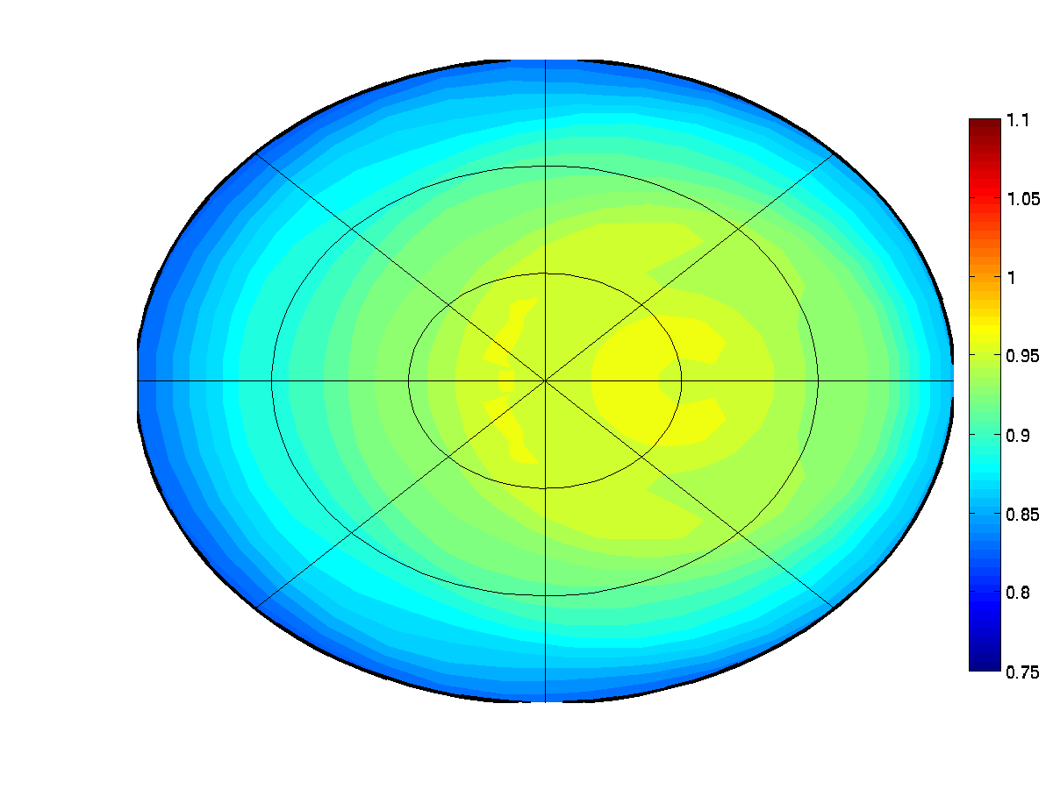
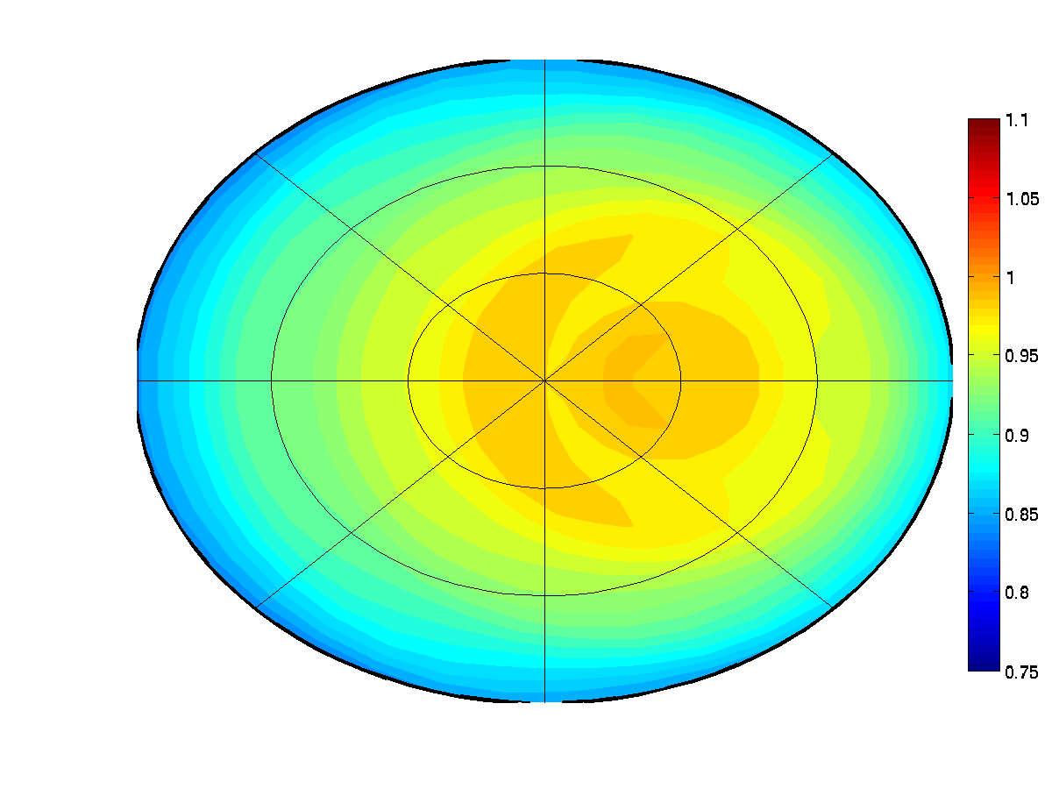
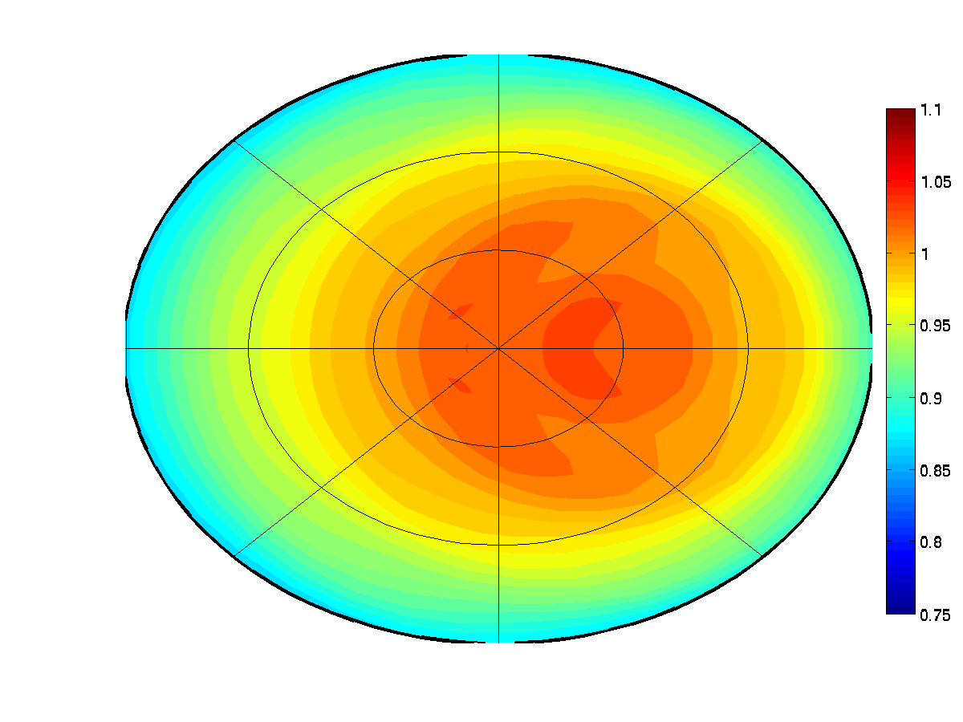
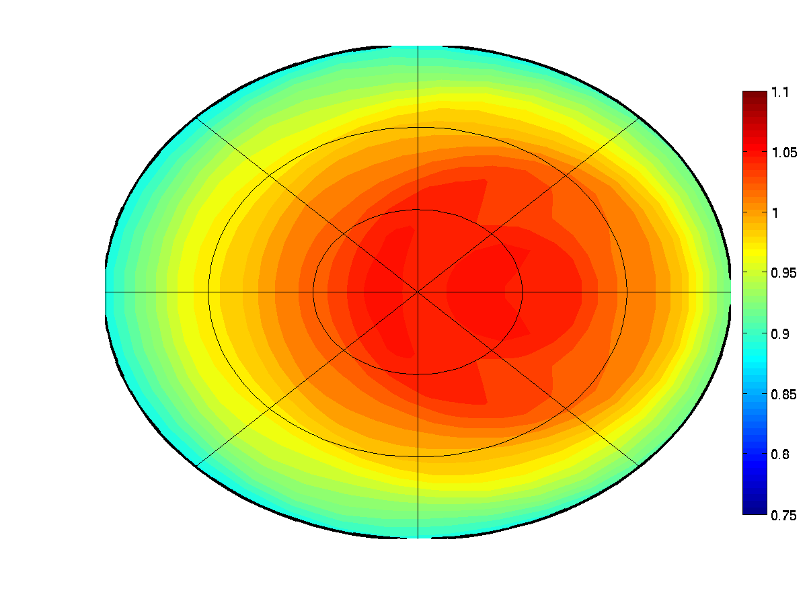
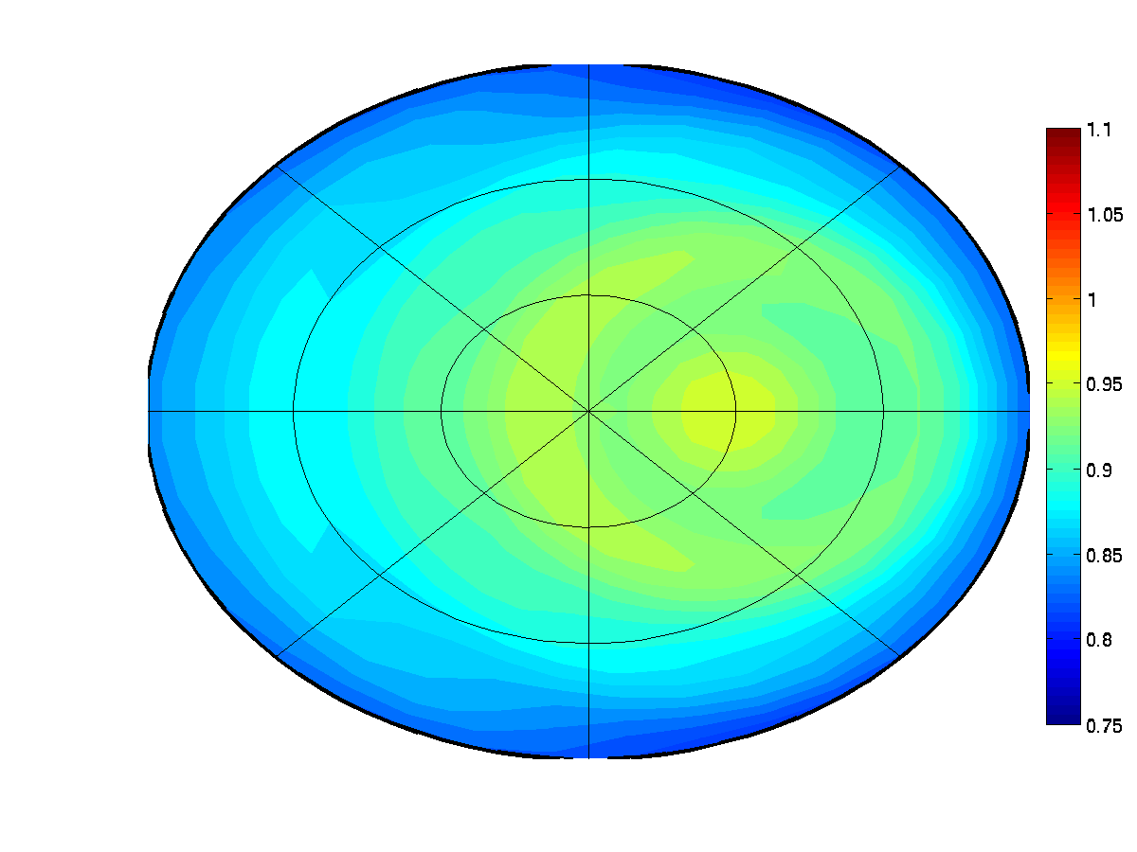
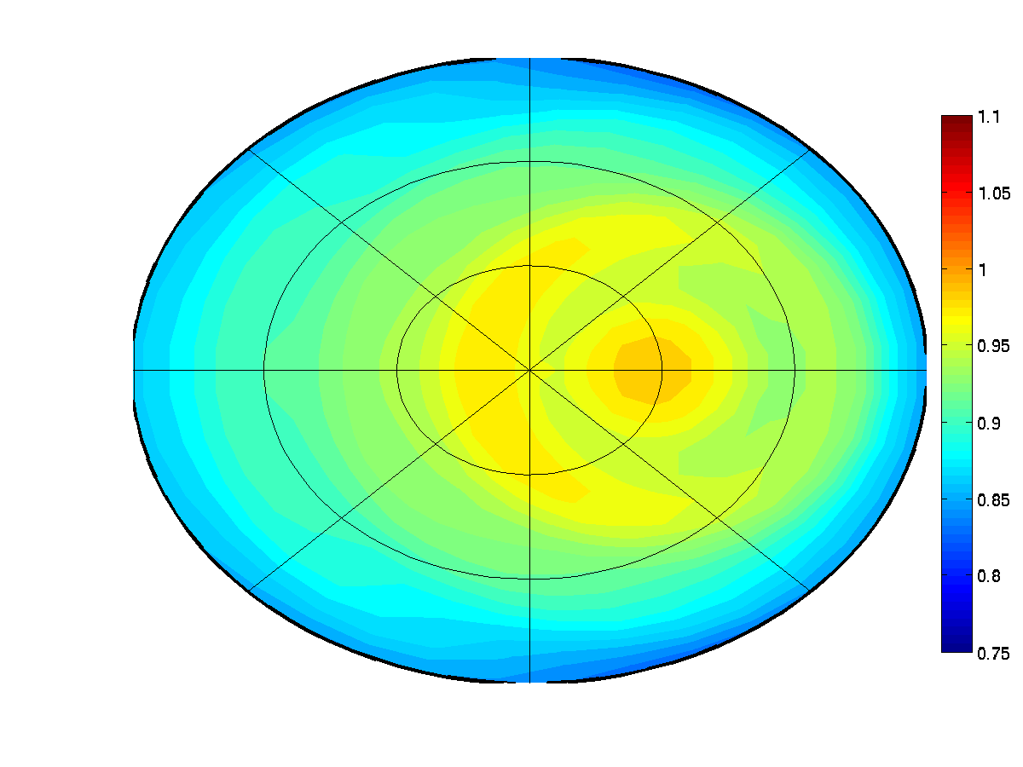
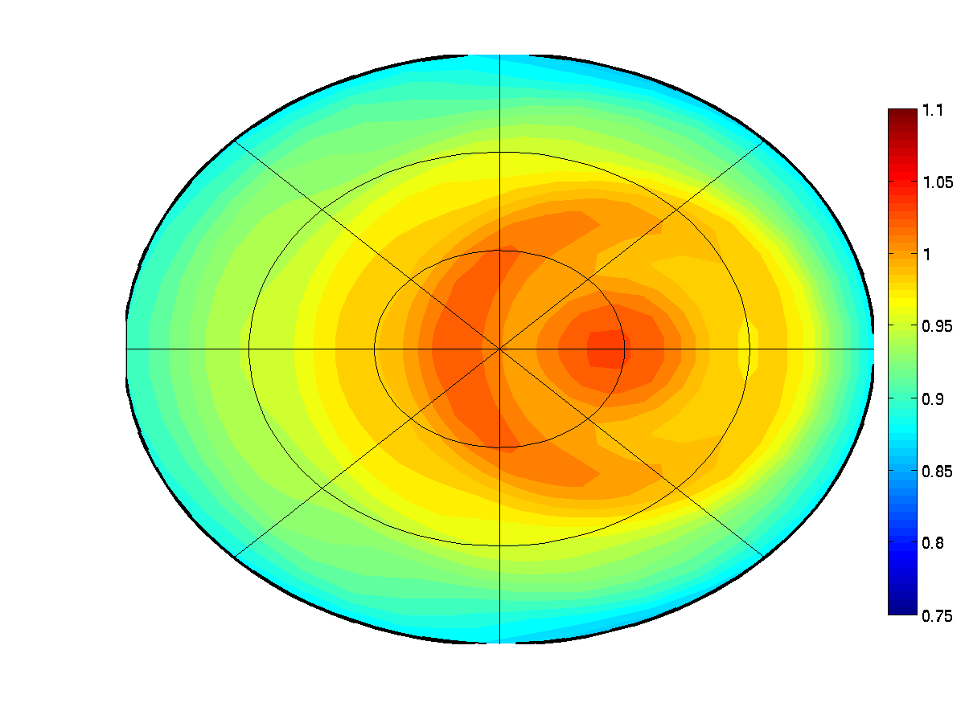
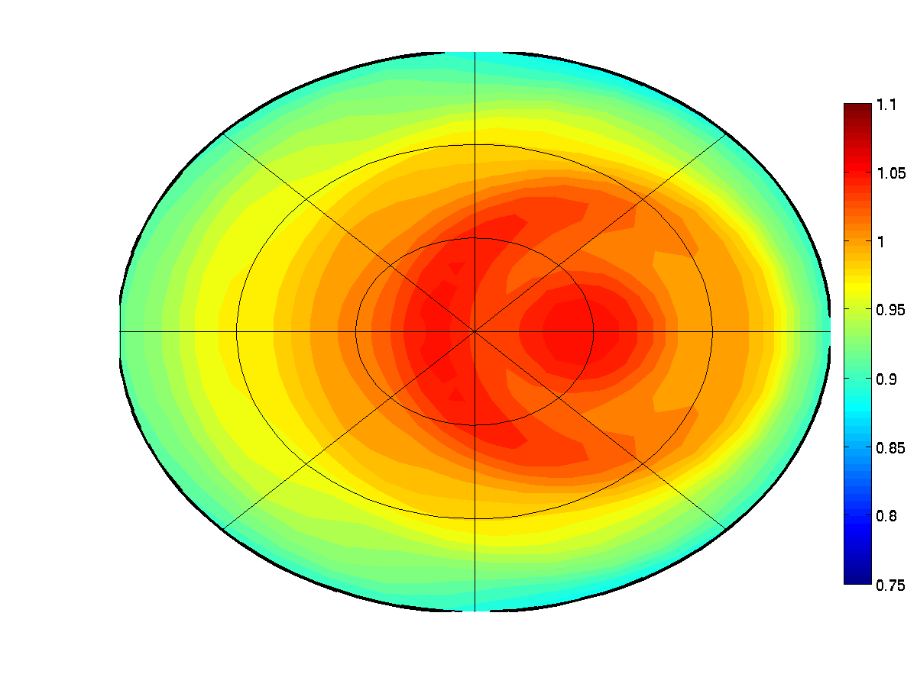
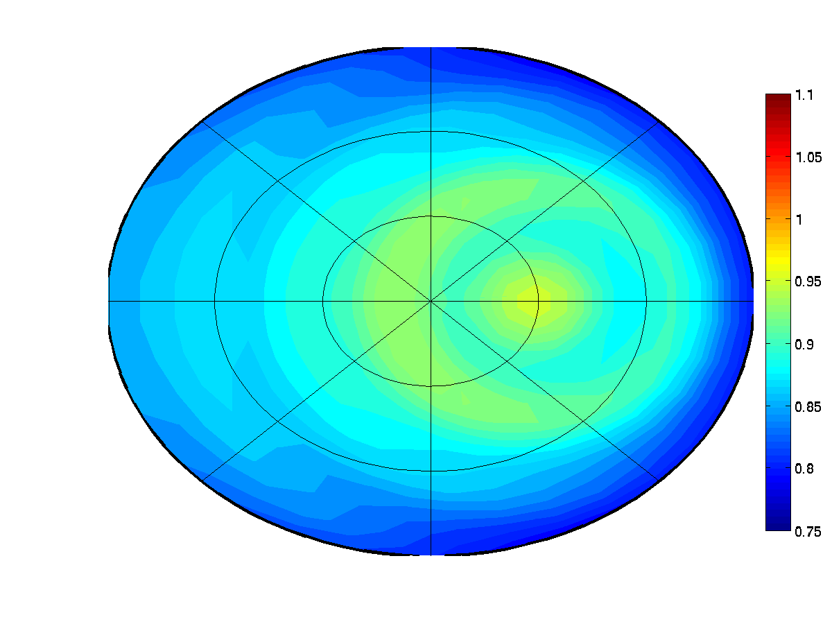
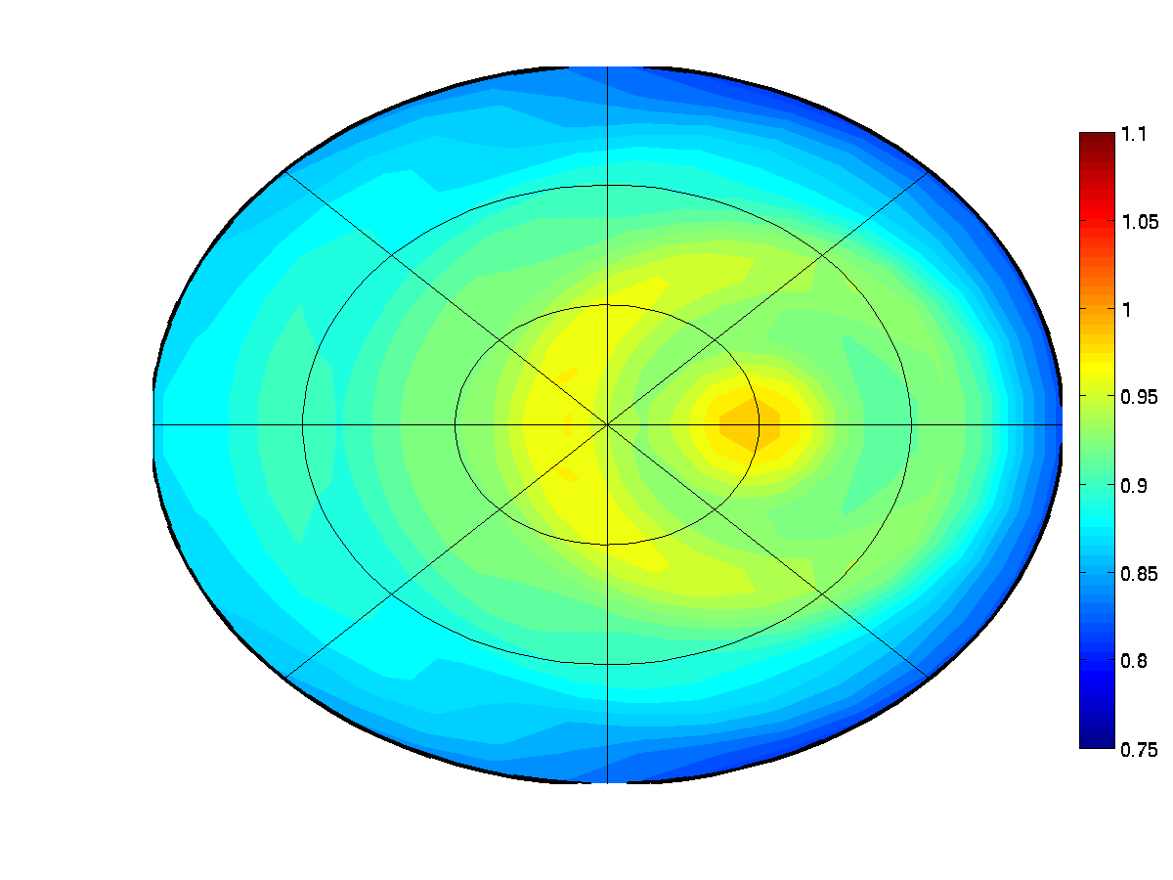
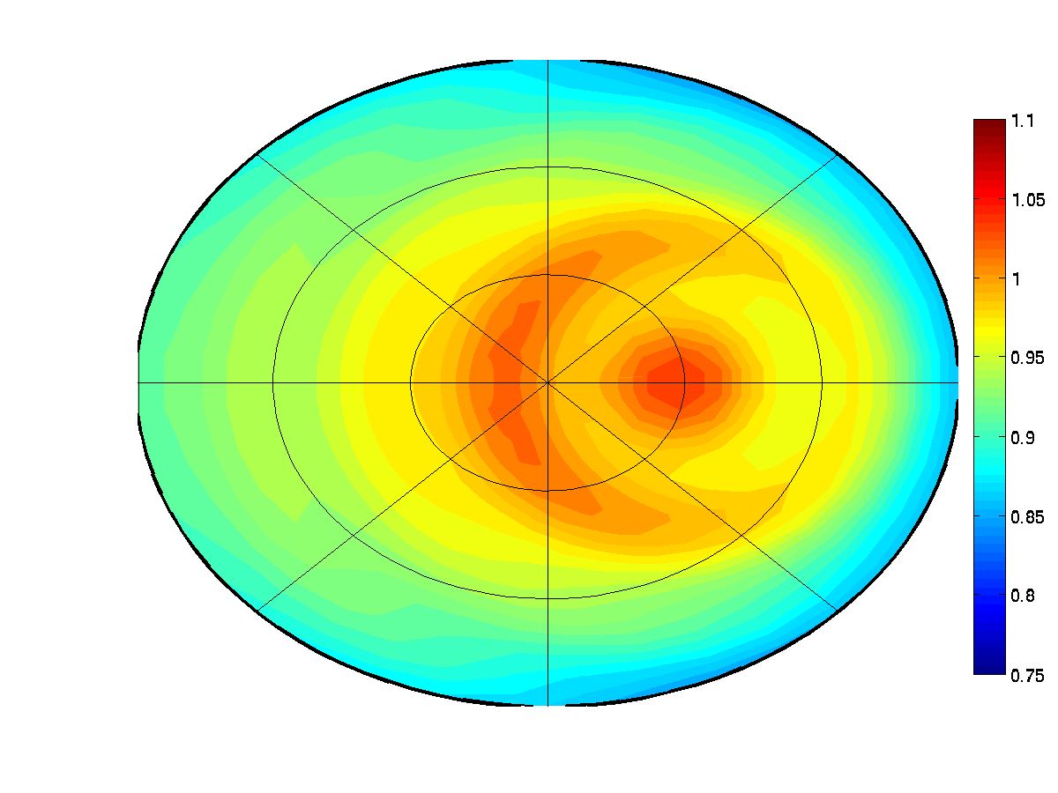
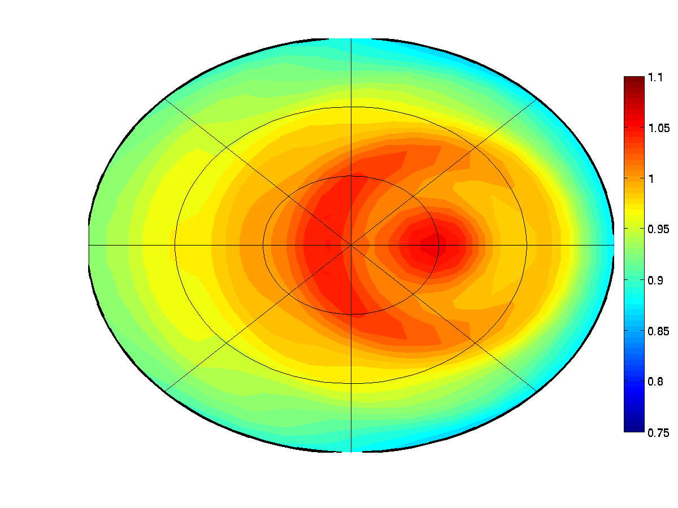
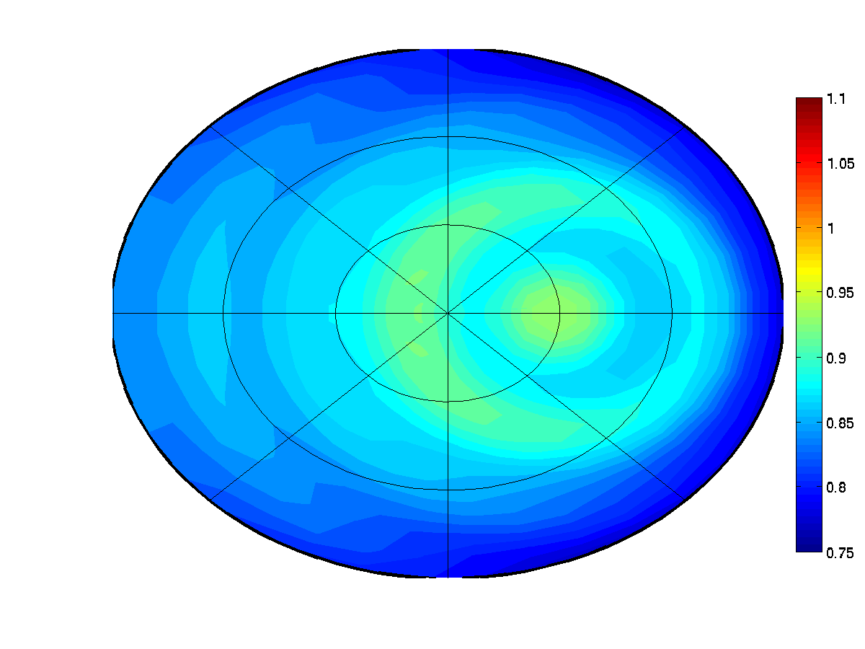
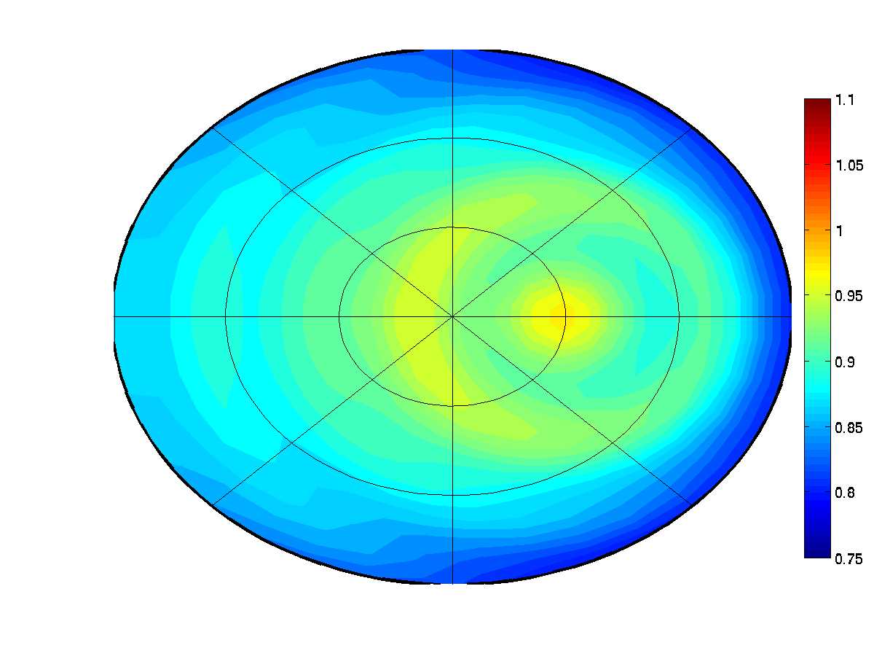
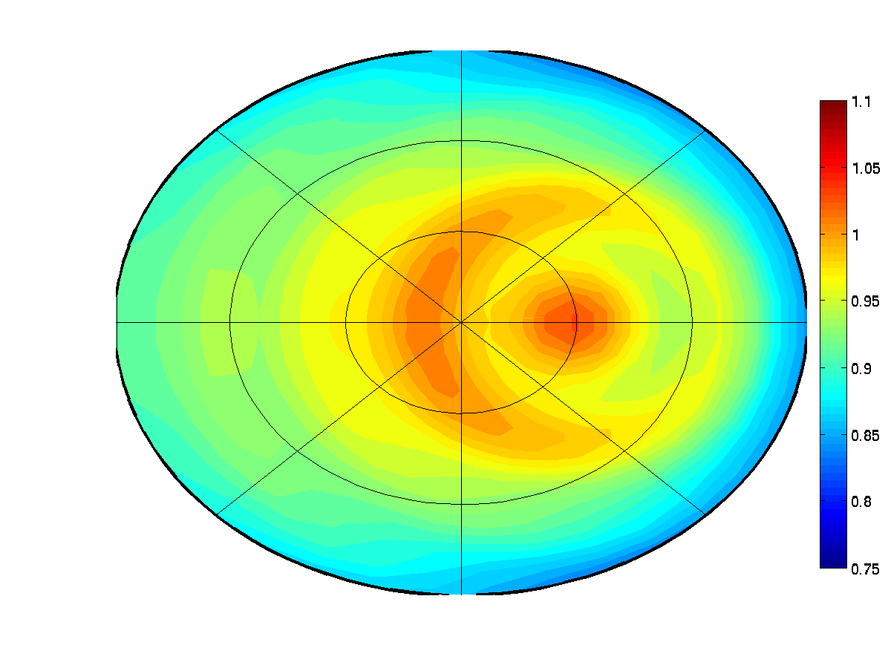
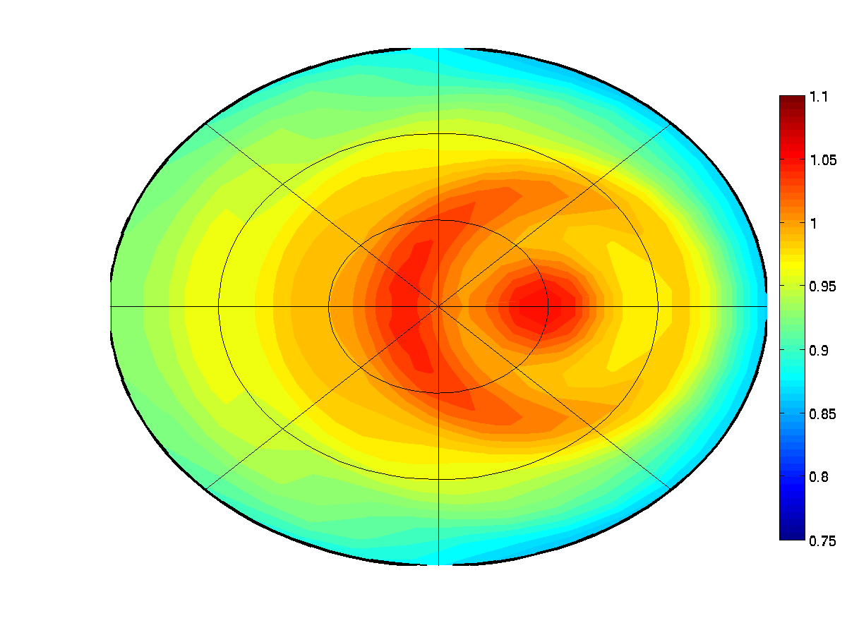
Part 3: Results 1
(SZA = 20º)
part 3: Methodology for DCC BRDF test
75
100
200
400
10 μm
270º
60º
40º
20 μm
20º
0º
180º
90º
30 μm
40 μm

Slide 11
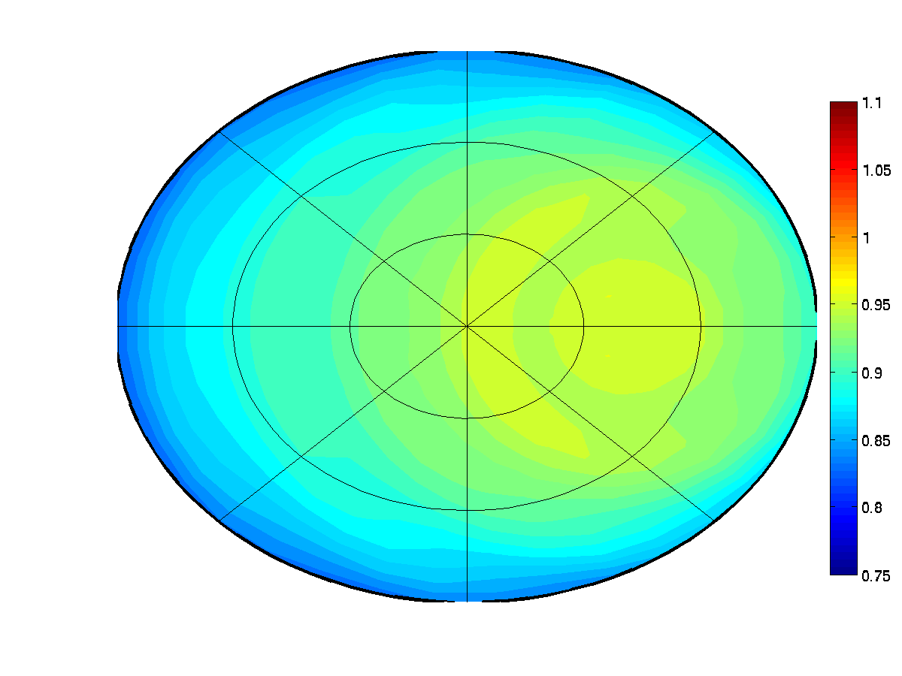
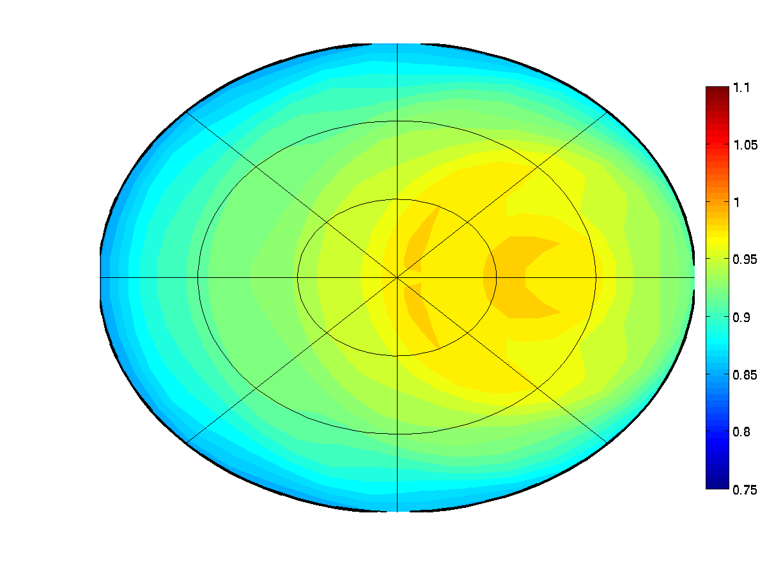
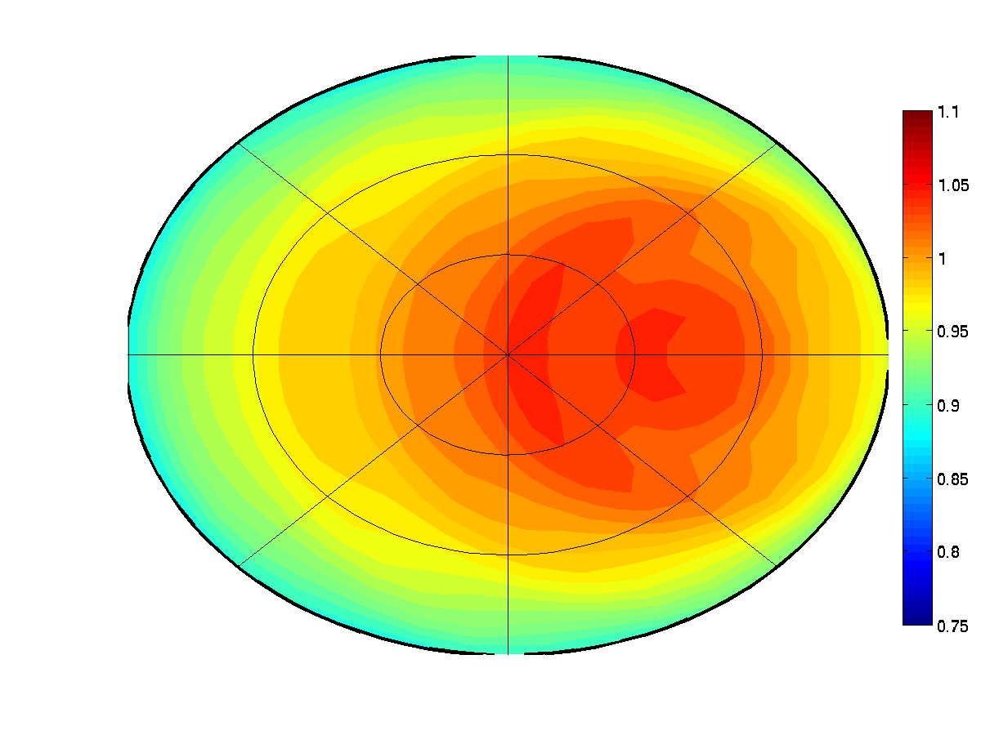
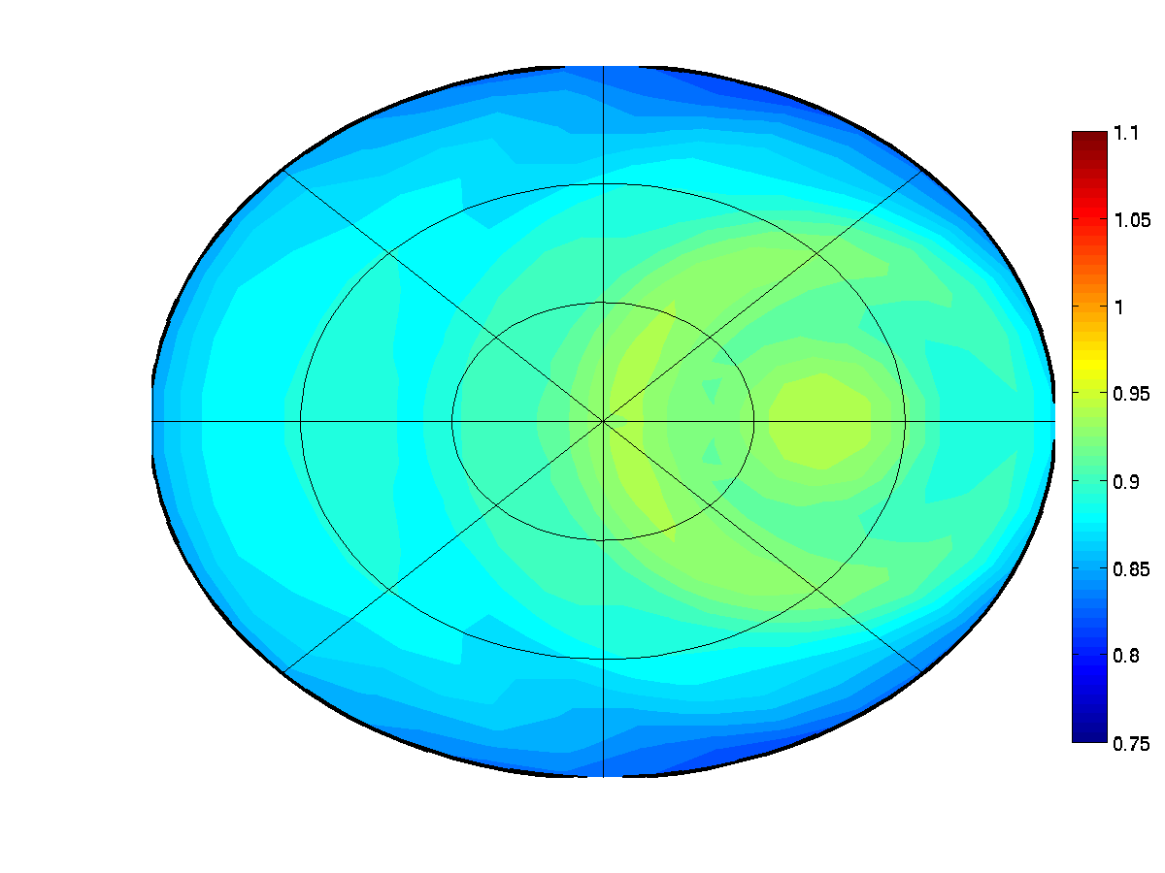
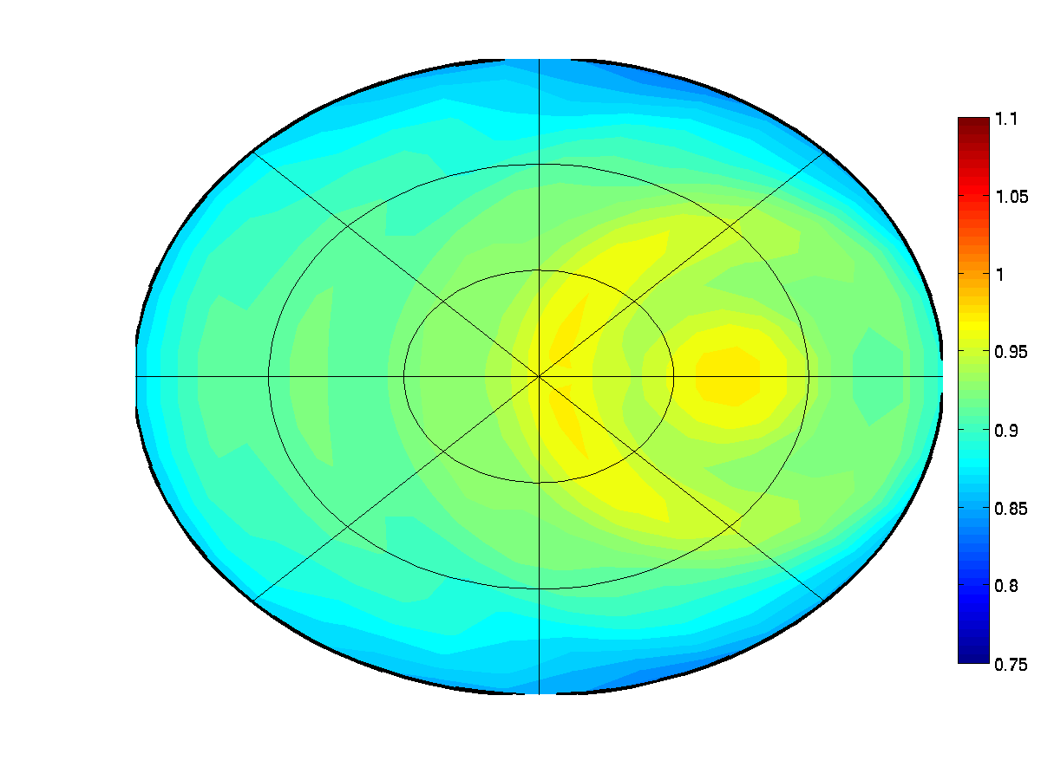
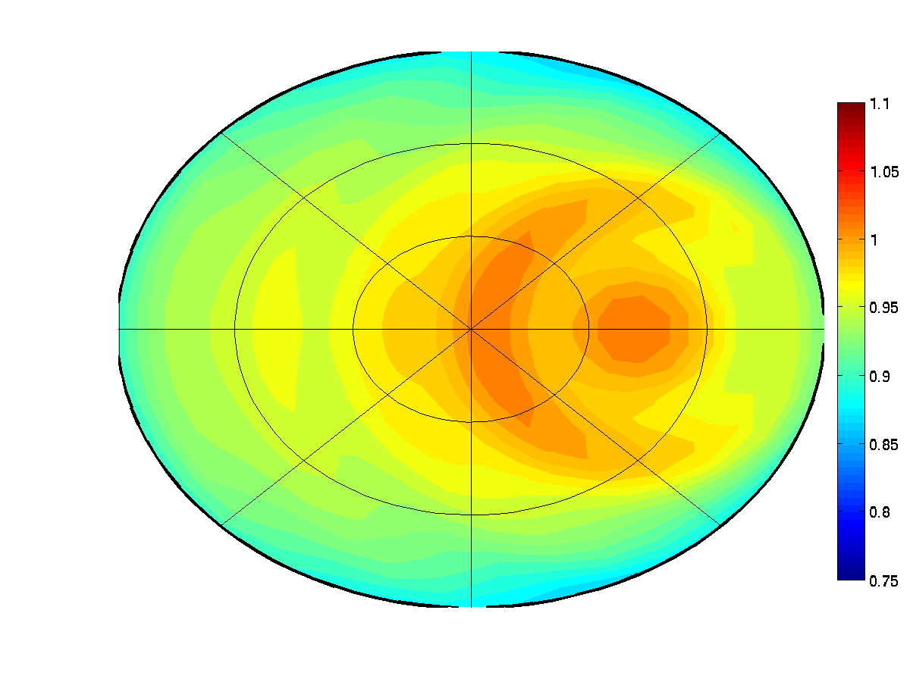
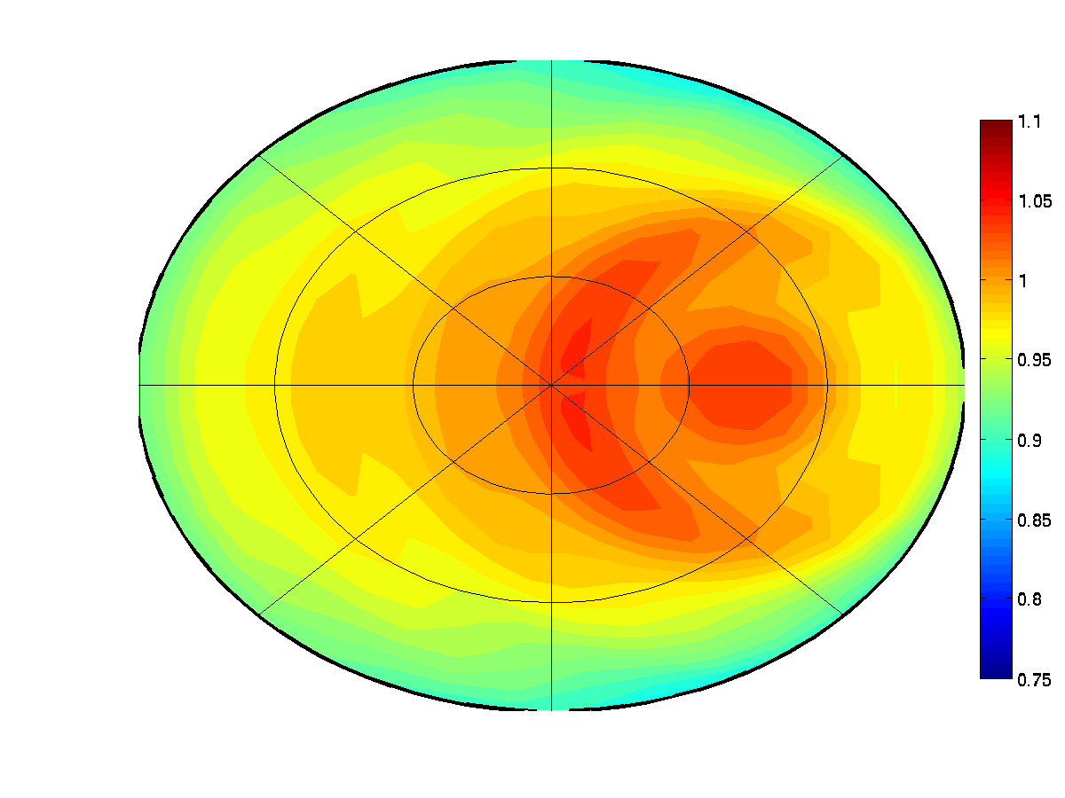
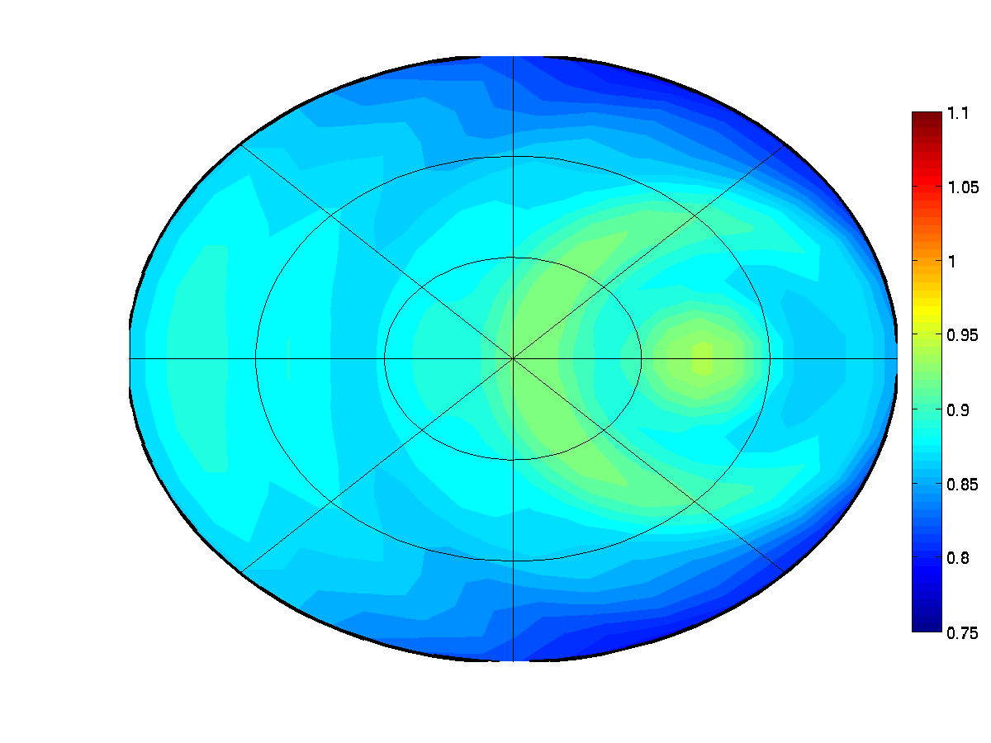
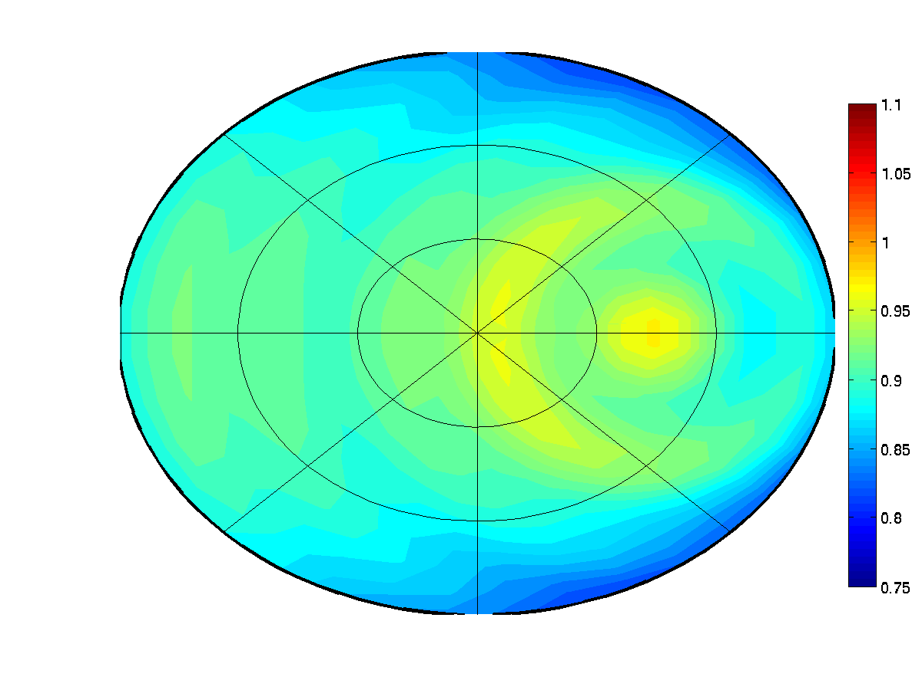
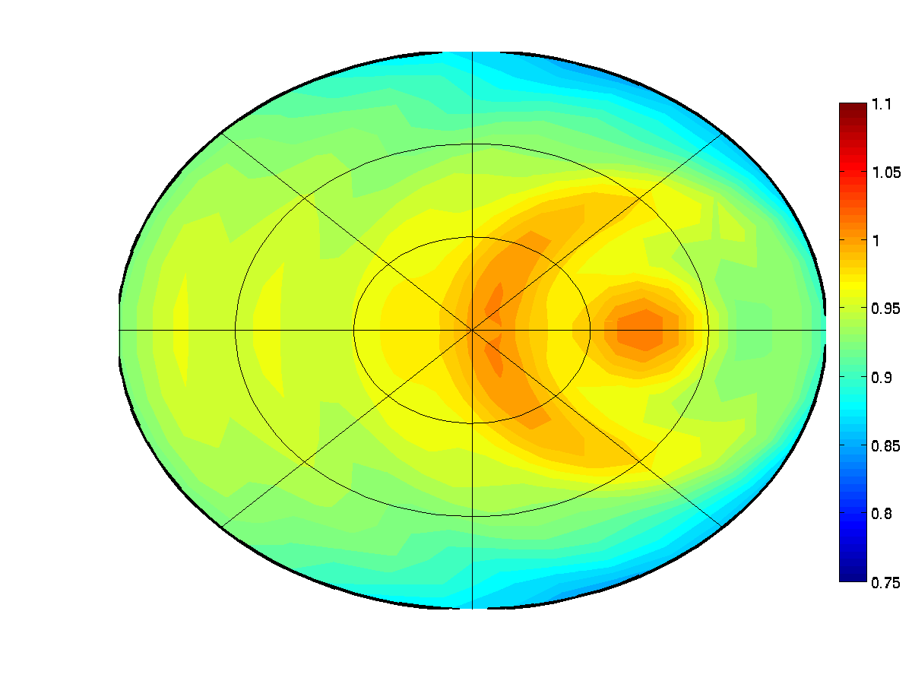
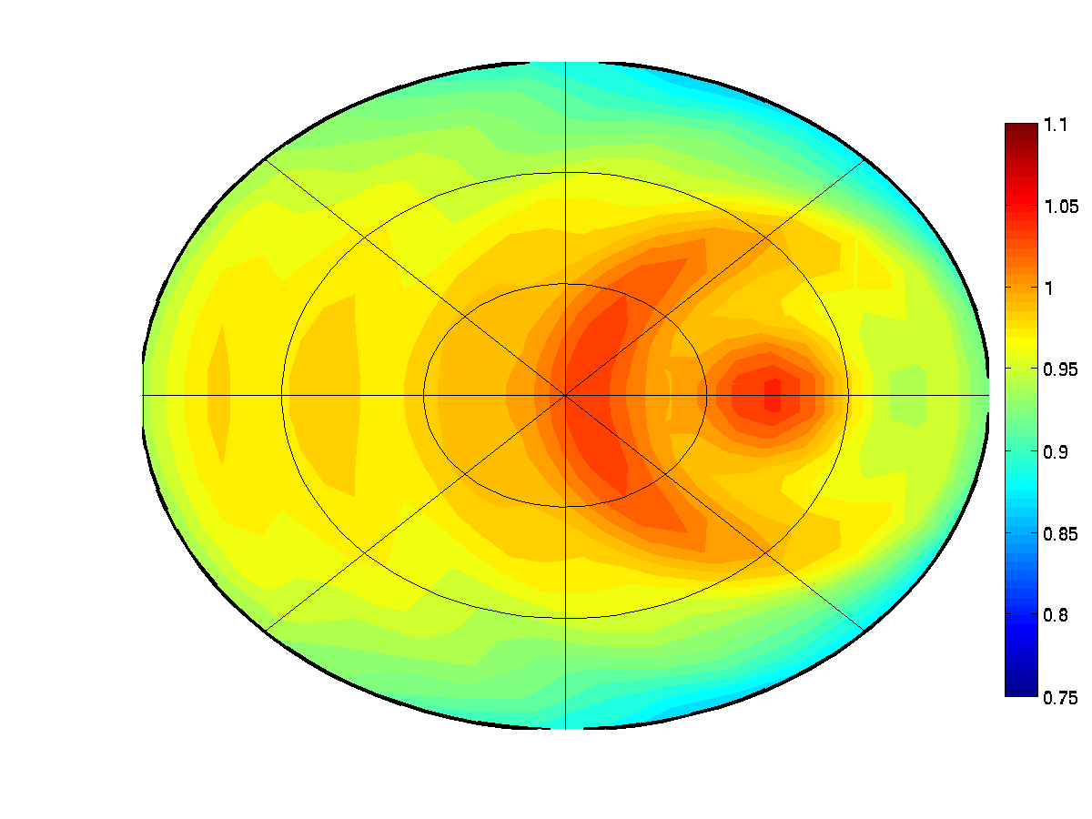
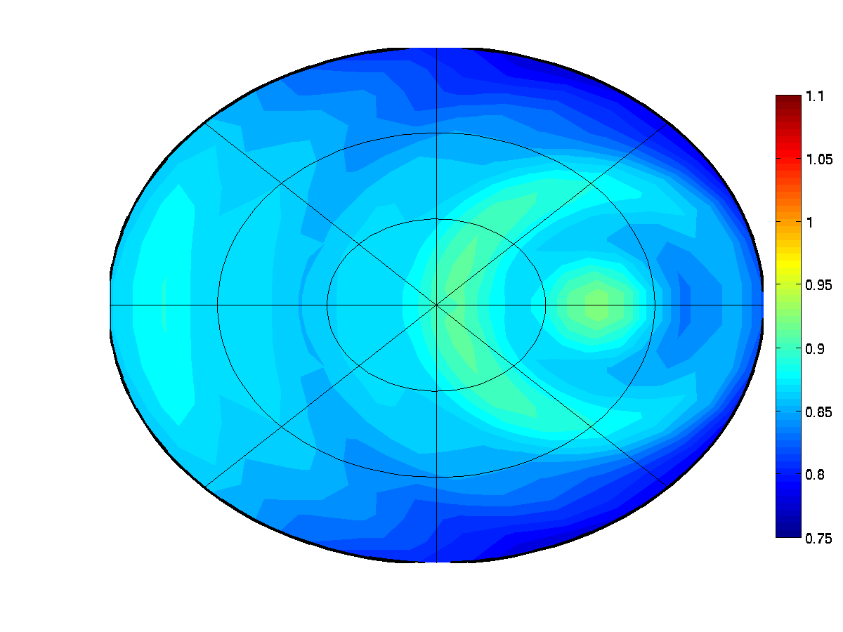
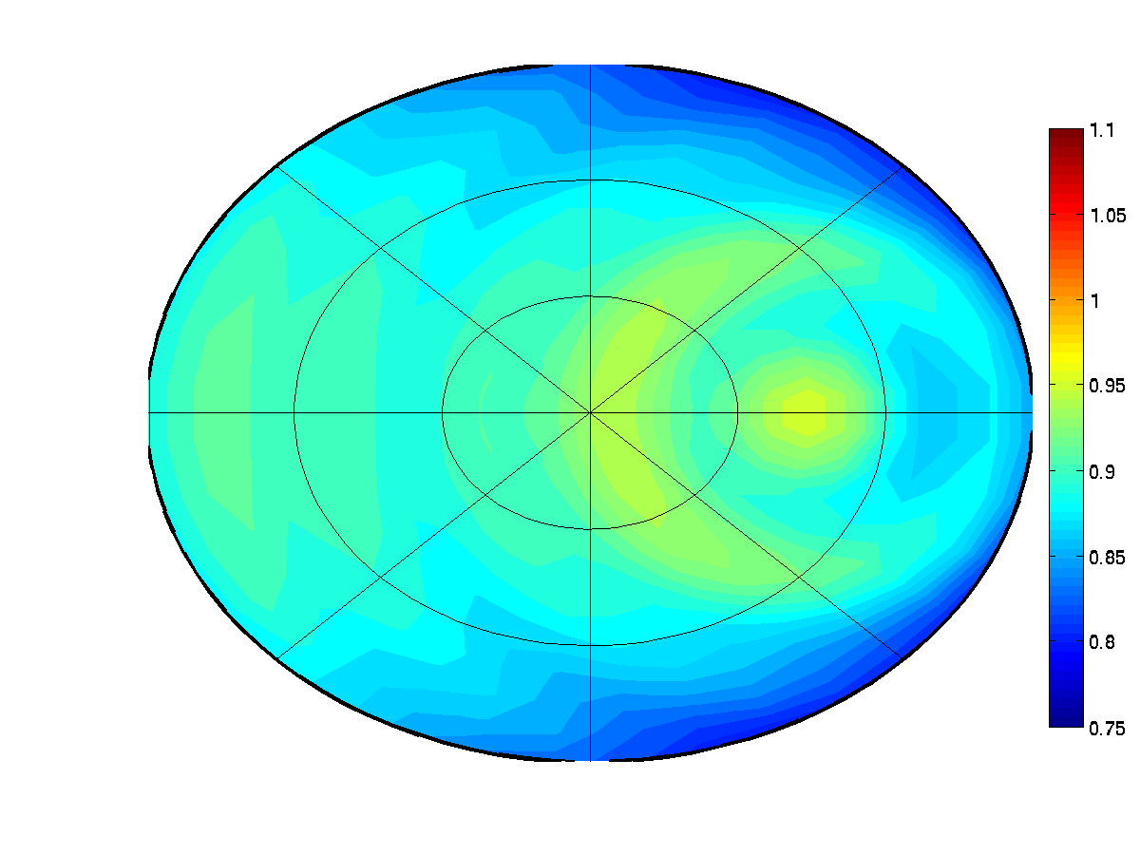
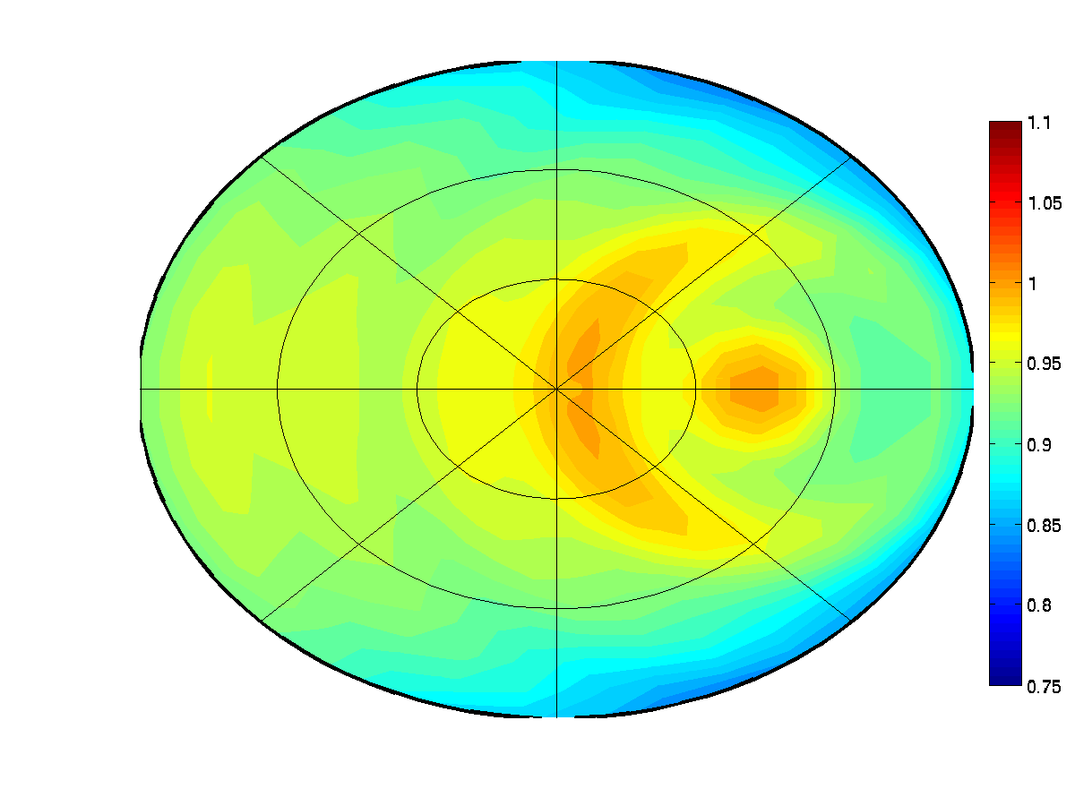
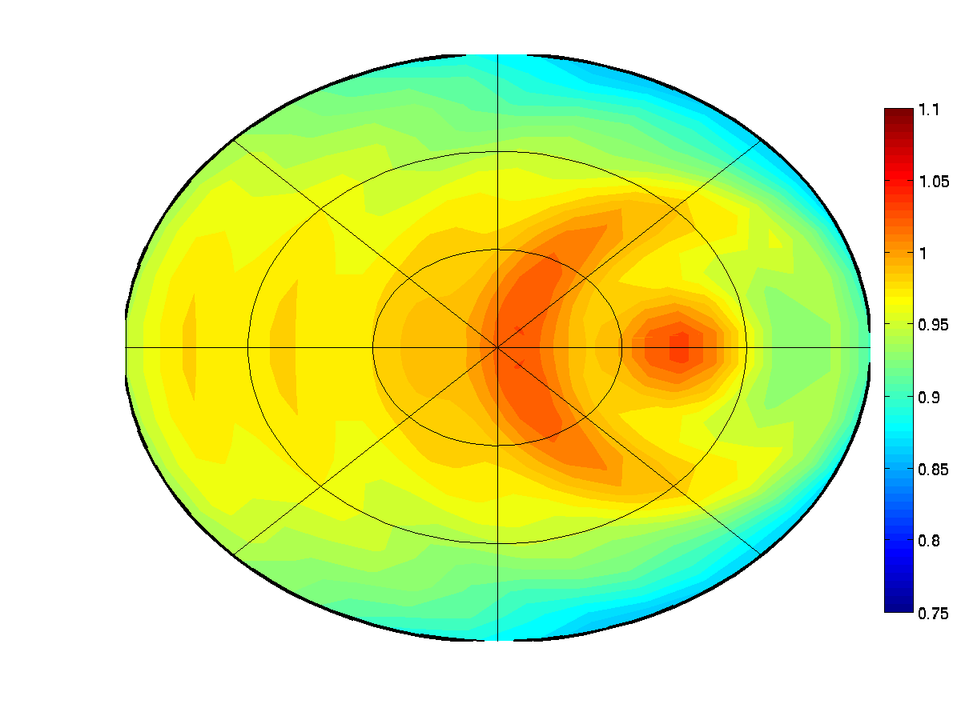
Part 3: Results 2
(SZA = 30º)
part 3: Methodology for DCC BRDF test
75
100
200
400
10 μm
270º
60º
40º
20 μm
20º
0º
180º
90º
30 μm
40 μm

Slide 12
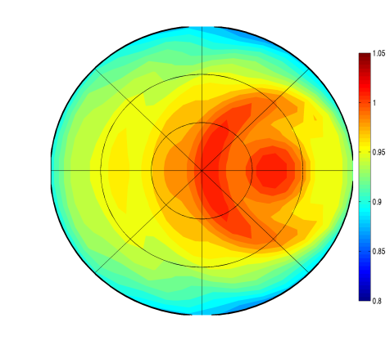
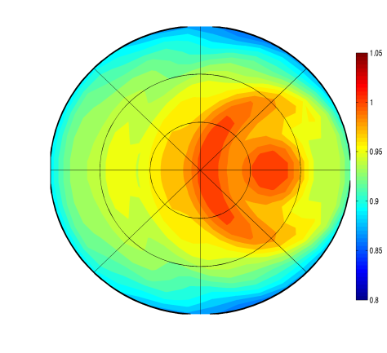
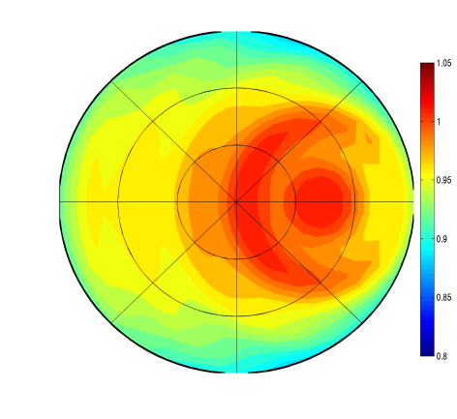
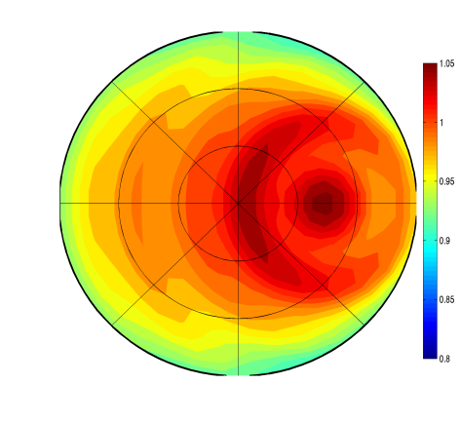
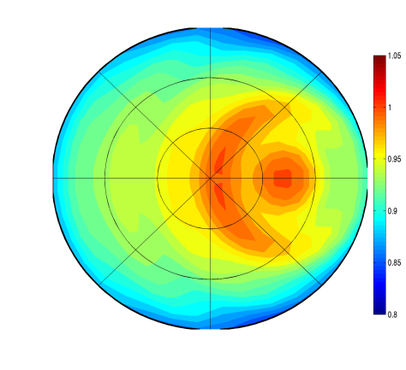
Part 3: Result 3
SZA = 20º, COT = 200, Re = 20 μm
0.94 – 1.00
270º
270º
270º
270º
270º
60º
60º
60º
60º
60º
40º
40º
40º
40º
40º
20º
20º
20º
20º
20º
0º
180º
0º
180º
180º
180º
0º
0º
0º
180º
90º
90º
90º
90º
90º
COMS ch.1
(0.675 μm)
MODIS ch.1
(0.645 μm)
MODIS ch.2
(0.847 μm)
MODIS ch.3
(0.466 μm)
MODIS ch.4
(0.554 μm)
Q_{ext} | 2.0022 | 2.0019 | 1.9963 | 2.0038 | 1.9942
ω₀ | 1.0000 | 1.0000 | 0.9999 | 1.0000 | 1.0000
g | 0.8118 | 0.8118 | 0.8124 | 0.8100 | 0.8105

Slide 13
Result
SBDART model could be constructed bi-directional reflectance distribution structure above cloud layer with respect to various input parameters and wavelength of channels, not implying Lambertian surface.
simulated reflectance using SBDART for COMS vicarious calibration is ranging from 0.93 to 1.02.
DCC BRDF is highly dependent on scattering parameterization of RT model.
Vicarious calibration for COMS using DCC target has been conducted well in spite of dependency on the result of RT model simulation.
Result from DCC target is consistent with other target data and the degradation are about 5.47% (1.17%/year) from Sep. 2011 to Dec. 2015.

Slide 14
NASA DCC method for COMS MI
DCC selection thresholds : same as Doelling et al. (2013) except for homogeneity check for MODIS data
Use nominal date (MYD021KM) in this analysis
DCC domain: (COMS : 128.2〫E)
20〫S < latitude < 20〫N
108.2〫E < longitude < 148.2〫
COMS DCC threshold | parameter | NASA DCC threshold
TB₁₁ ≤ 190 K | Window brightness temperature | BT11μm < 205°K
STD(TB₁₁) ≤ 1K | Brightness temperature homogeneity | Standard deviation of 3x3 pixels BT11μm < 1°K
STD(R_{0.6})/Mean(R_{0.6}) ≤0.03 | Visible radiance homogeneity | Standard deviation of 3x3 pixels visible radiance < 3%
SZA < 40° | Solar zenith angle | SZA < 40°
VZA < 40° | View zenith angle | VZA < 40°
 | Local time range at GEOSat longitude | 12:00 PM < image time < 3:00 PM

Slide 15
DCC selection
Comparison of DCC counts between COMS DCC and NASA DCC method
Operational COMS DCC
MODIS DCC on NASA method
COMS DCC on NASA method

Slide 16
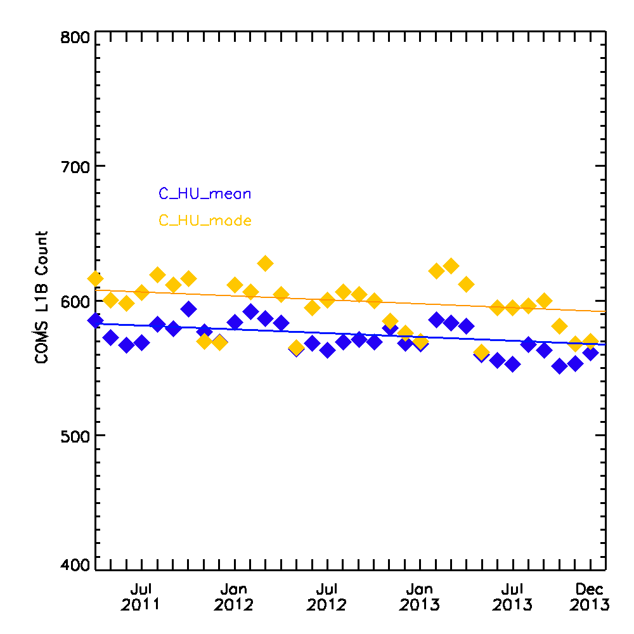
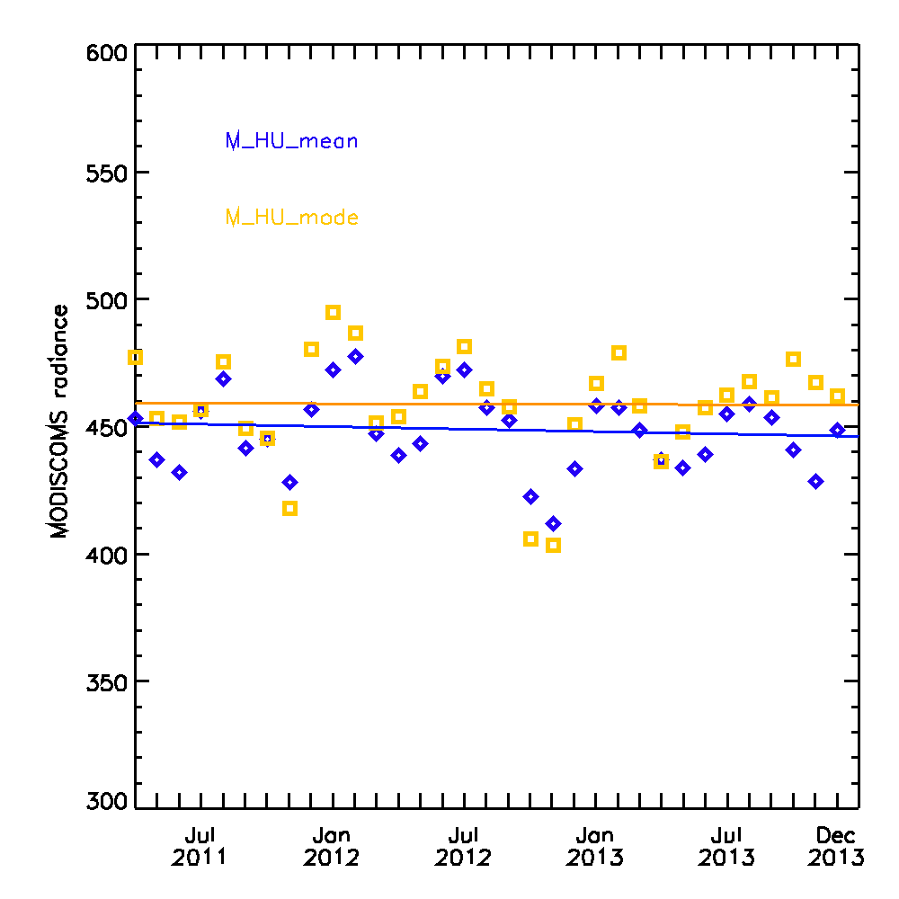
Results of NASA DCC method
Good agreements with the ATBD or those of other GEO satellites
Time series of mode and mean of DCC pixels
Mode : DN = 0.02 x Day + 623.020
Mean : DN = 0.03 x Day + 582.859
Mode : DN = 0.00 x Day + 459.336
Mean : DN = 0.00 x Day + 451.500

Slide 17
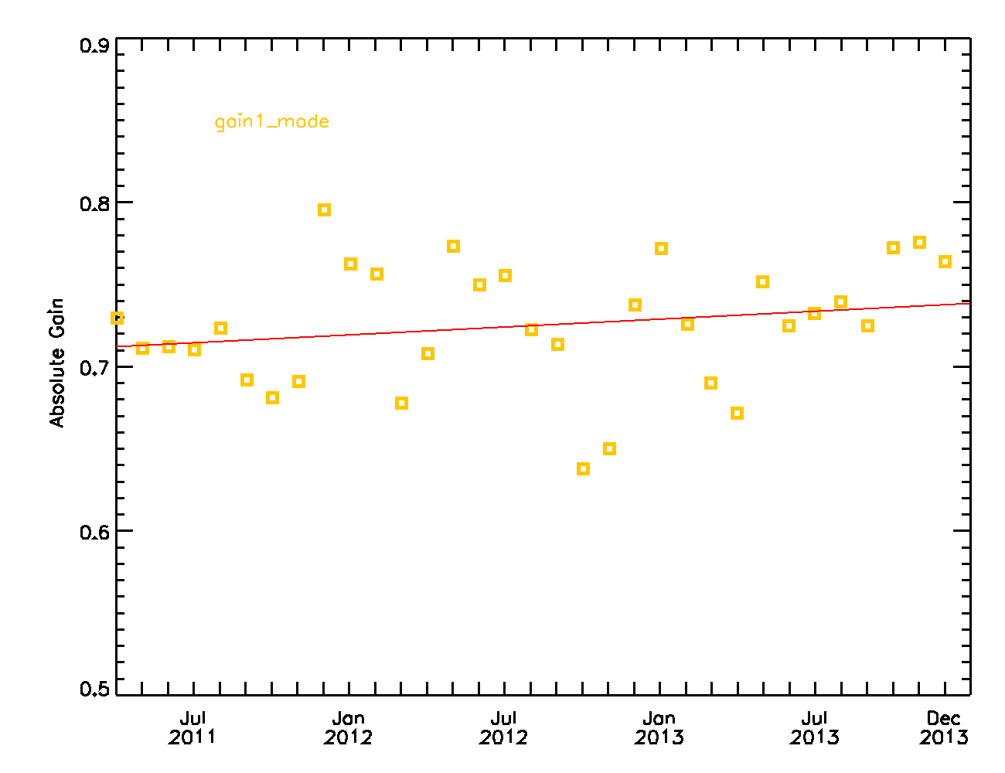
Monthly Gain
SBAF for COMS : 0.9427 (DCC web meeting in June 5, 2015)
Need to compare with the results based on RT simulation method
Usage of other SBAF or that calculated ourselves will also be considered
Gain : 2.6797e-05 x Day + 0.712

Slide 18
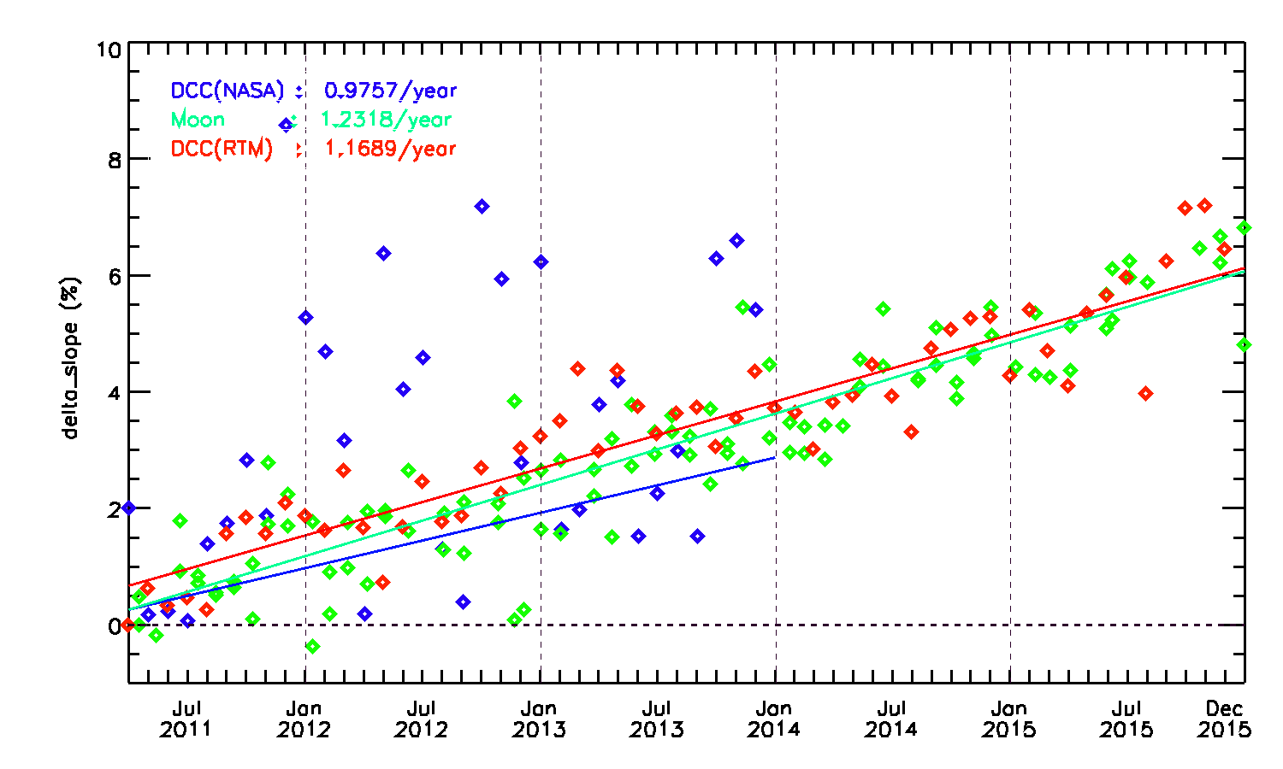
Comparison other results
Comparison with lunar, DCC(RTM) and DCC(NASA method)
DCC(RTM) : 1.1689/year, Moon : 1.2318/year, DCC(NASA):0.9757/year
Need more investigation for the DCC result with NASA method

Slide 19
Summary and Future Plans
Summary
Implementation of NASA’s DCC method to COMS MI
- good agreement with the ATBD
Need a modification for the DCC data processing
Future plans
Investigate the impact of BRDF and SBAF on the calibration results
Comparison of the results with those based on RT simulation method
Uncertainty evaluation
Creation of netCDF intermediate data which contain selected DCC pixels for replication (and GSICS Correction netCDF)

Slide 20
Thank you

Slide 21
vicarious calibration algorithm using DCC
MODIS Cloud Pixels
(N=1, τ_{c,0.646}≥ 10)
Collocation
AIRS
MODIS QA 1km
Phase Flag
MODIS P_{c}
MODIS τ_{c,0.646}
MODIS Lat./Lon.
P(z)
T(z)
ρ_{H2O} (z)
ρ_{O3}(z)
Ice
Water
Baum Scattering Data
(Q_{ext}, g, ω, P(Θ), f_{d} )
Mie Scattering Data
(Q_{ext}, g, ω, P(Θ), f_{d} )
MODIS Land Cover Type
(0.05° grid data)
P(z)
CKD
Interpolation
with respect to r_{e}
Ocean pixels
Q_{ext}
Q_{ext}, g, ω, P(Θ), f_{d}
τ_{c,λ}
A_{s}
MODIS
Geometry, T_{s}
Z_{c}
τ_{g}
RTM
Sohn et al. 2009, Ham and Sohn 2010
Simulated Radiances
Observed Radiances

