Slide 1
DCC inter-calibration of Himawari-8/AHI VNIR bands
Masaya Takahashi
Meteorological Satellite Center,
Japan Meteorological Agency

Slide 2
DCC data used in this study (Mar.-Dec. 2015)
1) DCC selected using GSICS standard algorithm (“standard DCC”)
Based on Doelling et al. (2011)
SSP +/- 20 deg. (20S-20N, 120.7E-160.7E), IR (Band13: 10.4μm) < 205K, solar/satellite viewing angle < 40 deg., Smoothed pixels based on 3x3 pixels stdv
Hu BRDF
S-NPP/VIIRS: not implemented yet
2) DCC from Himawari-8/AHI vs. S-NPP/VIIRS ray-matched data (“ray-matched DCC”)
Based on Doelling et al. (2011)
Δt < 5 minutes, difference of solar/satellite zenith angle, azimuth angle < 10 deg., etc.
Spatial averaging (e.g. 0.5 deg. bin) is NOT applied
SBAF for DCC (derived from NASA Langley SBAF website)
Channels used for inter-comparison
Himawari-8/AHI | Band1 (0.47) | Band2 (0.51) | Band3 (0.64) | Band4 (0.86) | Band5 (1.6) | Band6 (2.3)
S-NPP/VIIRS | M3 (0.488) | M3 (0.488) | I1 (0.640) | M7 (0.865) | M10 (1.61) | M11 (2.25)

Slide 3
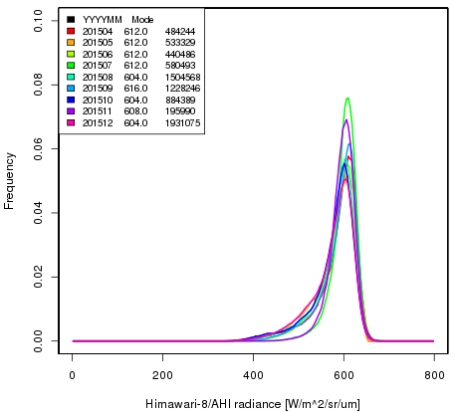
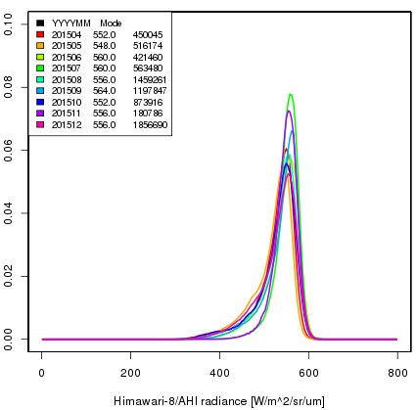
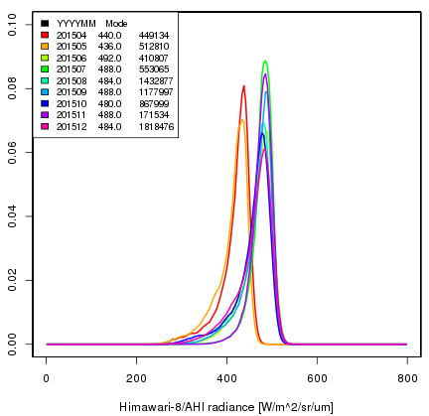
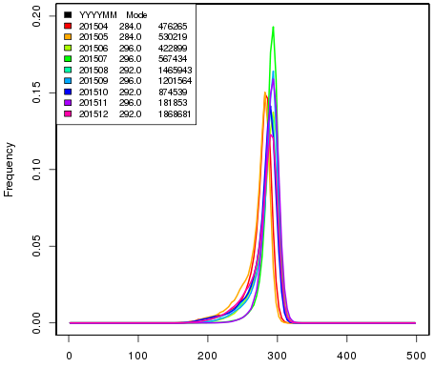
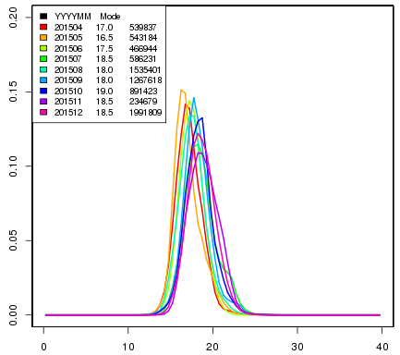
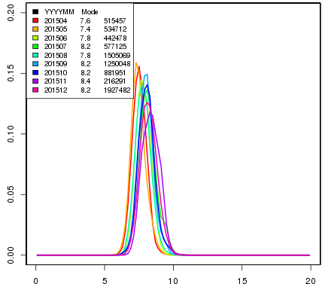
“Standard DCC” : monthly AHI radiance PDFs
Band 1 (0.47μm) Band 2 (0.51μm) Band 3 (0.64μm)
Data before calibration slope updates
stable
stable
stable
Band 4 (0.86μm) Band 5 (1.6μm) Band 6 (2.3μm)
stable
seasonality?
seasonality?
Radiance [W/m²/sr/um]
Radiance [W/m²/sr/um]
Radiance [W/m²/sr/um]

Slide 4
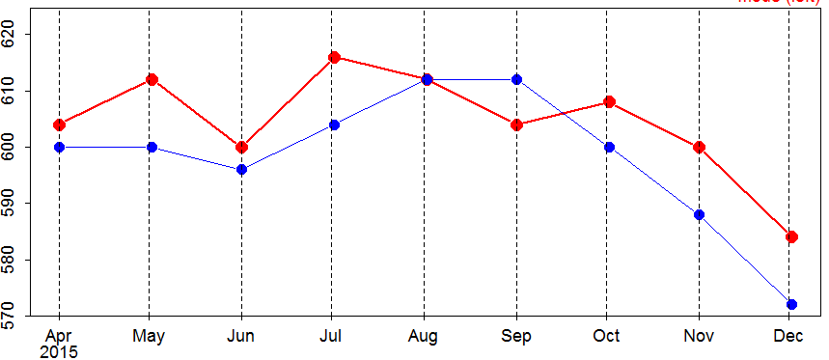
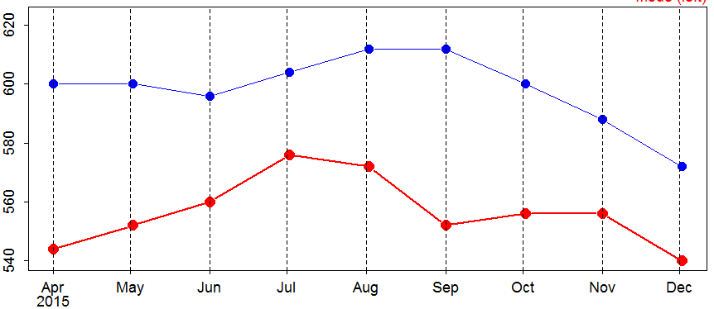
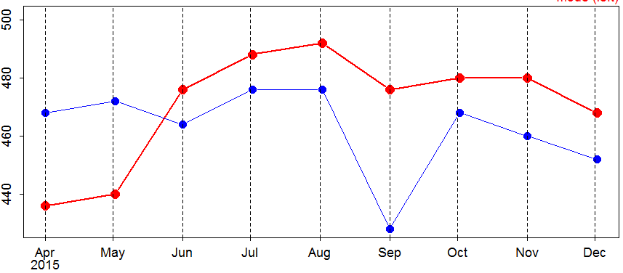
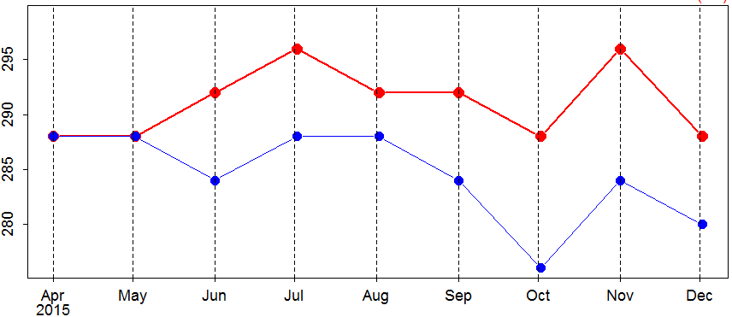
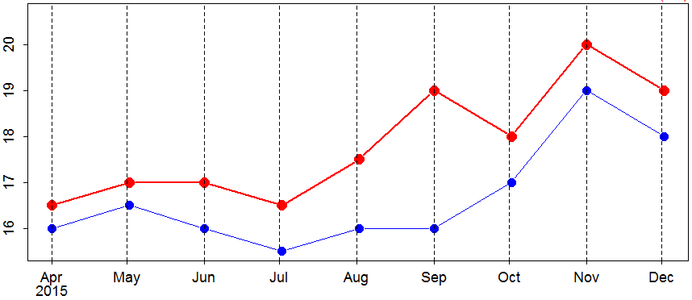
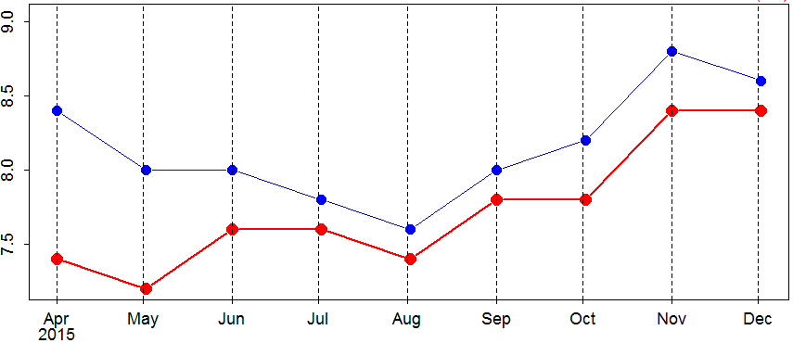
AHI/VIIRS “Ray-matched DCC”
In general, both DCC modes show similar trend/variation
Most collocations are over the ocean
Discrepancy (e.g. VIIRS I1 in Sep 2015) could be caused by small sample size
Time series of AHI/VIIRS radiance mode
AHI Band1 (0.47μm), VIIRS M3 (0.488 μm) AHI Band2 (0.51μm), VIIRS M3 (0.488 μm) AHI Band3 (0.64μm), VIIRS I1 (0.640 μm)
Radiance [W/m²/sr/μm]
AHI Band4 (0.86μm), VIIRS M7 (0.865 μm) AHI Band5 (1.6μm), VIIRS M10 (1.61 μm) AHI Band6 (2.3μm), VIIRS M11 (2.25 μm)
Radiance [W/m²/sr/μm]

Slide 5
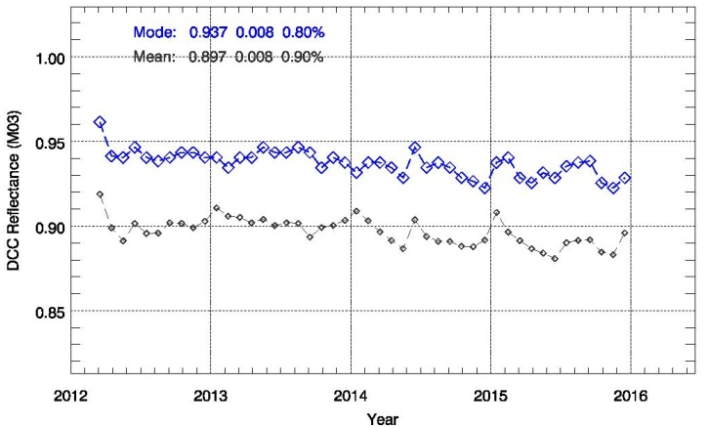
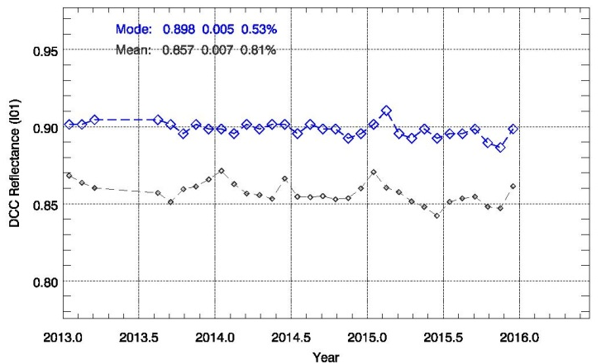
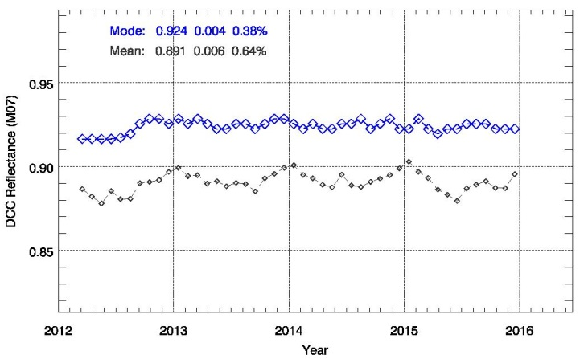
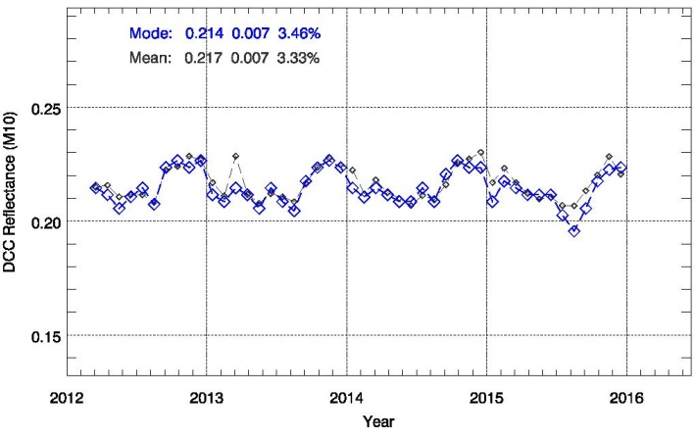
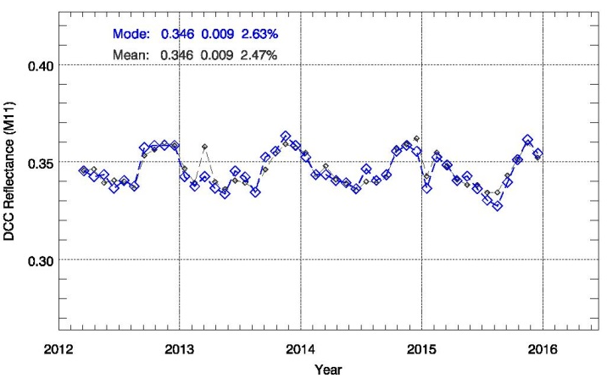
Comparison of DCC results by NOAA
(VIIRS Validation Site: http://ncc.nesdis.noaa.gov/VIIRS/VSTS.php)
M3 (0.488 μm) I1 (0.640 μm)
M7 (0.865 μm) M10 (1.61 μm) M11 (2.25 μm)
VIIRS M10
VIIRS M11
from ray-matching data

Slide 6
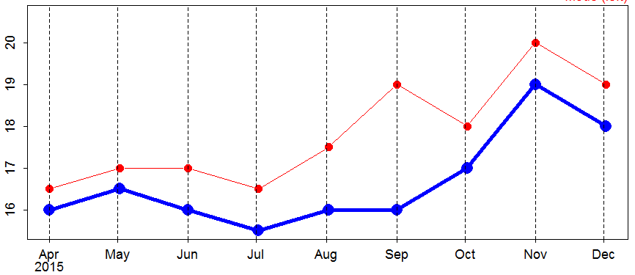
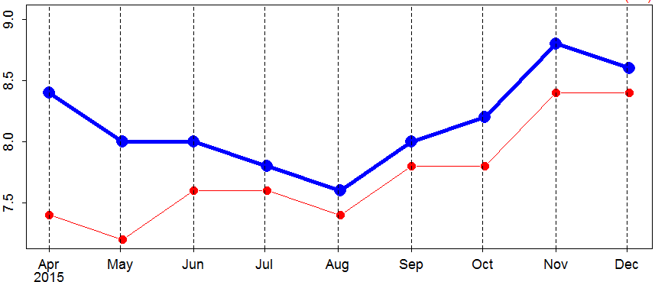
Comparison of DCC results by NOAA
(VIIRS Validation Site: http://ncc.nesdis.noaa.gov/VIIRS/VSTS.php)
M3 (0.488 μm) I1 (0.640 μm)
M7 (0.865 μm) M10 (1.61 μm) M11 (2.25 μm)
Aug 2015
Aug 2015
Compared with NOAA results…
M10: Radiance mode in Aug 2015 is not small
M11: Similar trend
VIIRS M10
VIIRS M11
VIIRS M10
VIIRS M11
from ray-matching data
from ray-matching data
Aug 2015
Aug 2015

Slide 7
Comparison of multiple calibration methods
VNIR bands calibration slope: updated on 8 June 2015 based on solar diffuser observation
Calibration accuracy: reduced (except for Band 5) after the update
Slight degradation (~1%) after June 2015
Outlier of ray-matching DCC result in Sep. 2015: could be caused by small sample size (~5000)
Time series of “ray-matched DCC”, Ray-matching and RT simulation results
Band1 (0.47μm) Band2 (0.51μm) Band3 (0.64μm)
Cal. Coef. updated
Band4 (0.86μm) Band5 (1.6μm) Band6 (2.3μm)

Slide 8
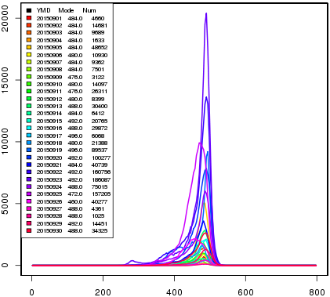
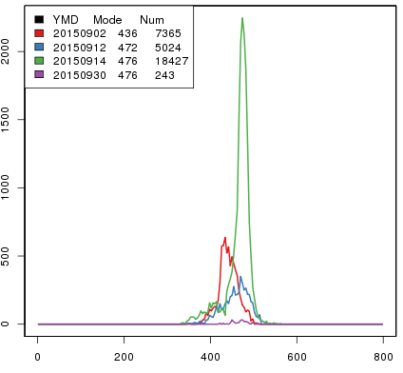
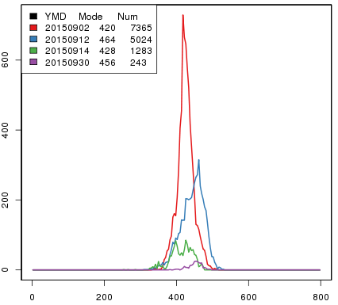
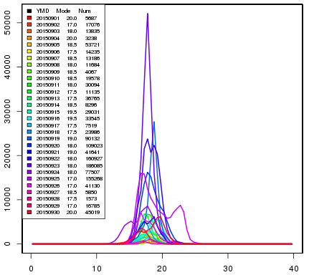
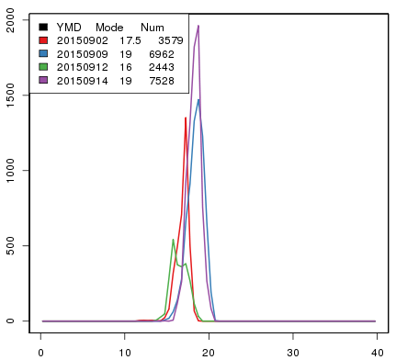
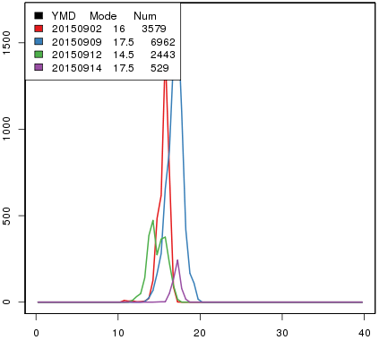
Day-to-day variation of DCC PDF statistics (Sep 2015)
PDF shape differs day to day
Standard AHI DCC Ray-matched AHI DCC Ray-matched VIIRS DCC
Band3
(0.64 μm)
Band3
(0.64 μm)
M3
(0.640 μm)
# of DCC data
# of data:
~7000
# of data:
~5000
1.6 μm 0.6 μm
Band5
(1.6 μm)
Band5
(1.6 μm)
M10
(1.61 μm)
# of data:
~4000
# of DCC data
# of data:
~7000
Radiance [W/m²/sr/um] Radiance [W/m²/sr/um] Radiance [W/m²/sr/um]

Slide 9
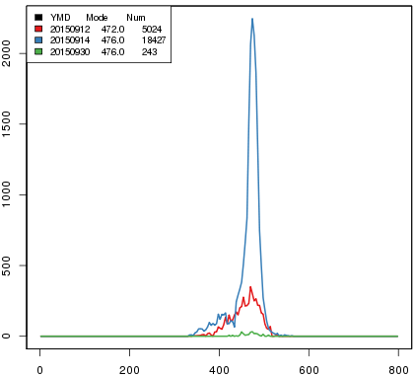
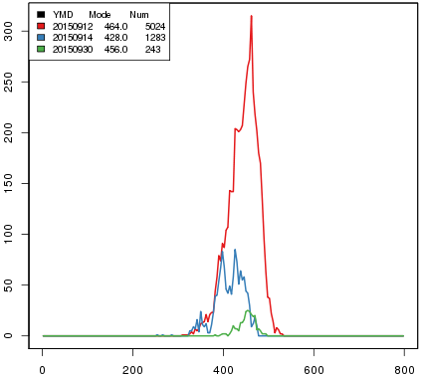
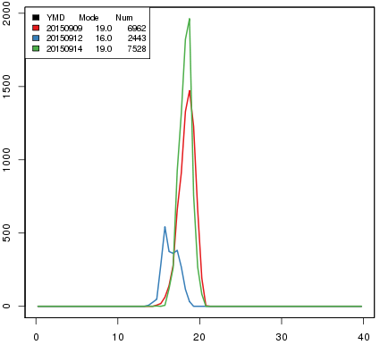
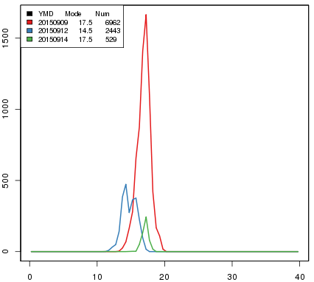
Day-to-day variation of DCC PDF statistics (Sep 2015)
Ray-matched AHI/VIIRS DCC: data on 2 September are removed
Standard AHI DCC Ray-matched AHI DCC Ray-matched VIIRS DCC
Band3
(0.64μm)
Band3
(0.64μm)
M3
(0.640μm)
# of DCC data
1.6 μm 0.6 μm
Band5
(1.6μm)
Band5
(1.64μm)
M10
(1.61μm)
# of DCC data
Radiance [W/m²/sr/um] Radiance [W/m²/sr/um] Radiance [W/m²/sr/um]

Slide 10
Comparison of multiple calibration methods
Ray-matched AHI/VIIRS DCC: data on 2 September are included
Time series of “ray-matched DCC”, Ray-matching and RT simulation results
Band1 (0.47μm) Band2 (0.51μm) Band3 (0.64μm)
Cal. Coef. updated
Band4 (0.86μm) Band5 (1.6μm) Band6 (2.3μm)

Slide 11
Comparison of multiple calibration methods
Ray-matched AHI/VIIRS DCC: data on 2 September are removed
Discrepancy from other methods: reduced
Band2: discrepancy remains because data on 2 September is not critical
Need to revisit ray-matching implementation at JMA in order to derive stable results
Time series of DCC from ray-matched data, Ray-matching and RT simulation results
Band 1 (0.47μm) Band 2 (0.51μm) Band 3 (0.64μm)
Band 4 (0.86μm) Band 5 (1.6μm) Band 6 (2.3μm)

Slide 12
AHI solar diffuser calibration
SD Observation : ~once every 2 weeks
Data before the end of Feb 2015: not reliable due to incorrect inputs for cal. slope calculation
Degradation: ~1% / year in Bands 1-4, not clear in Bands 5 and 6
Generally consistent results with other calibration methods
Degradation of SD will be evaluated in the near future
Time series of inverse of calibration slope w.r.t. day 1 SD observation
Band 1 (0.47μm) Band 2 (0.51μm) Band 3 (0.64μm)
1%
Band 4 (0.86μm) Band 5 (1.6μm) Band 6 (2.3μm)

Slide 13
Summary
1) DCC based on NASA algorithm Stable results in all VNIR bands (0.47, 0.51, 0.64, 0.86, 1.6, 2.3 μm)
Difference of DCC statistics over land/ocean will be investigated
MODIS, VIIRS will also be implemented
2) DCC from Himawari-8/AHI vs. S-NPP/VIIRS ray-matched data
Show similar trends other calibration methods: ray-matching incl. water clouds pixels, RT simulation, solar diffuser
DCC method could be applicable to all AHI VNIR bands
Implementation will be revisited to derive stable results
Future plans for all VNIR calibration methods
To continue comparison of multiple calibration methods
To integrate calibration methods

