Slide 1
GOES DCC Deseasonalization &
AHI DCC Calibration
Fangfang Yu and Xiangqian Wu

Slide 2
De-seasonalization Algorithms
Action from 2015 GSICS annual meeting: Fred to implement Sebastien's deseasonalisation method and compare with Fangfang's and report back.
CMA: Gaussian Filter
  MTSAT data
EUMETSAT: Seasonal Index
  Smoothing(Trending) with Variogram due to saturation of DCC pixels in the early mission life
  Average of the daily ratio between time-series reflectance and smoothed value
  Instrument degradation trending after de-seasonalization with seasonal index
NOAA: Fourier Transfer Function (FFT)
  Trending with prior degradation function derived from other vicarious methods.
  Fourier transfer function to develop the de-seasonalization functions
  Instrument degradation trending after de-seasonalization

Slide 3
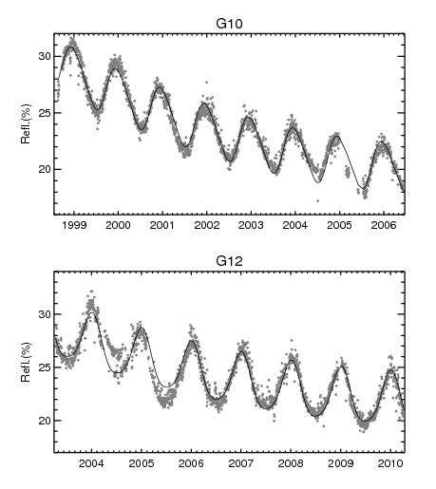
Different methods….
Initial trending (or smoothing) of the DCC reflectance
  CMA:?
  EUMETSAT: Variogram + smoothing
  NOAA: prior-defined sensor degradation function (quadratic)
De-seasonalization
  CMA: Gaussian
  EUMETSAT: Seasonal index
  NOAA: FFT (used in the desert data)
Sensor degradation trending (could be a new algorithm) after the removal of seasonal variation
  CMA: ?
  EUMETSAT: linear
  NOAA: quadratic
NOAA applied the same three procedures for the Sonoran desert data
Yu et al. 2014, Inter-calibration of GOES Imager visible channels over the Sonoran Desert, J. Geophysical Research, 119, doi:10.1002/2013JD020702

Slide 4
CMA – Gaussian Filter
MTSAT data
Courtesy of Y. Chen, presented in 2015 GSICS annual meeting

Slide 5
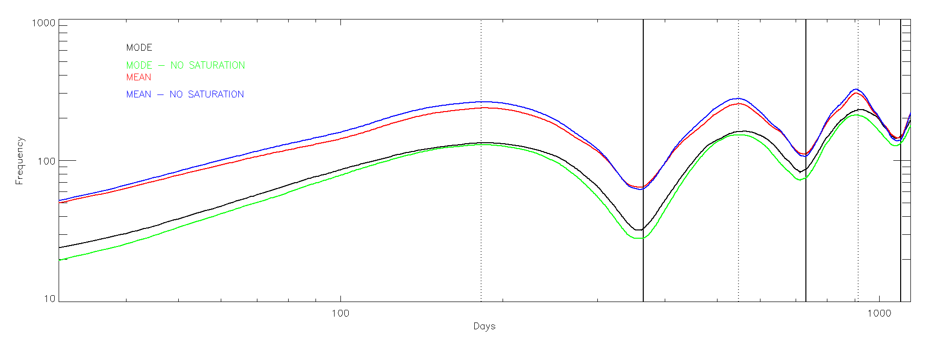
EUMETSAT: Variogram analysis of the time series
Variogram
30 days (interval used for the NRT product)
Courtesy of S. Wagner, presented in 2015 GSICS annual meeting

Slide 6
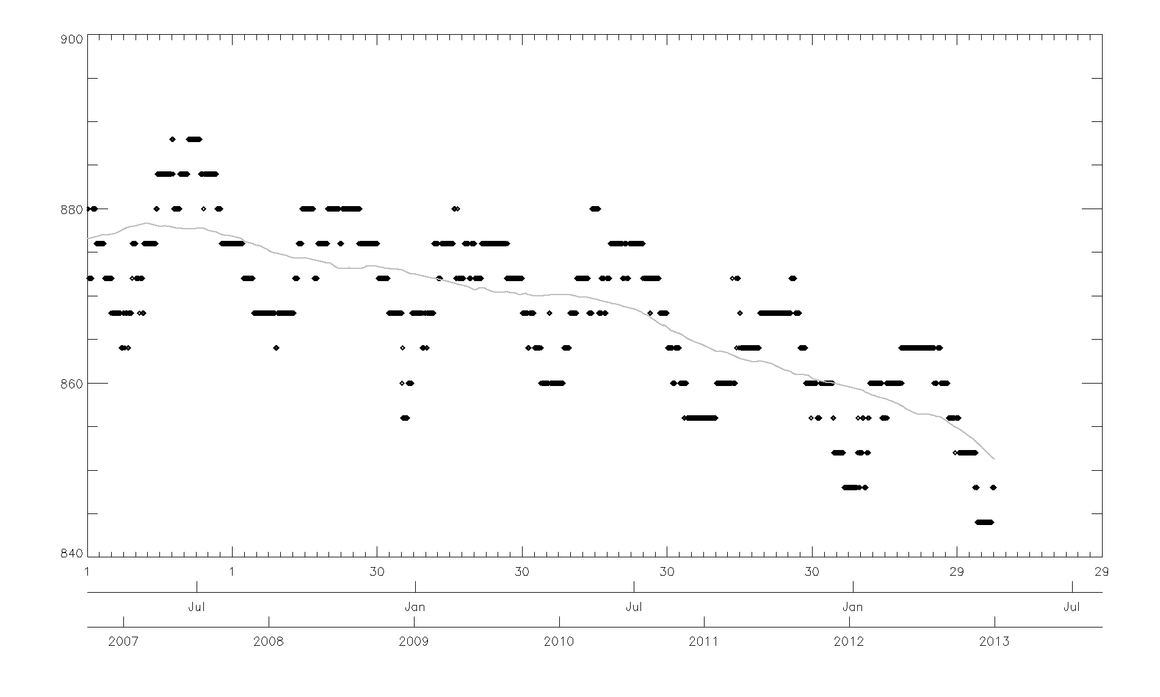
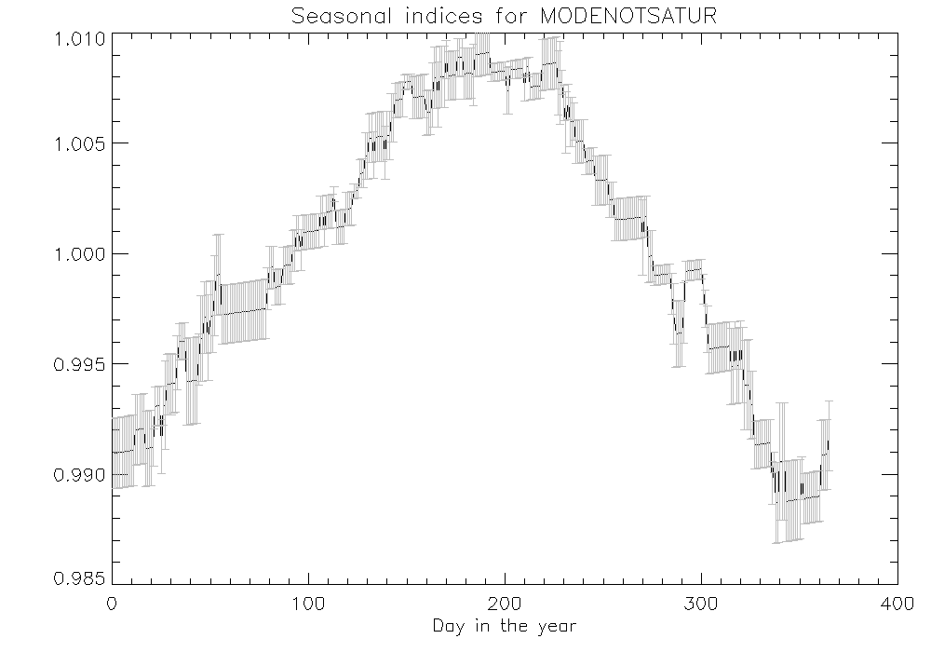
EUMETSAT: Variogram Analysis
Use variogram algorithm to derive the trending pattern (smoothed data)
Seasonal index:
  Ratio between the mode time series and the smoothed data.
  Calculating the seasonal indices:
    For each day of the year, average all the ratio values (Step A) for that day across the years (for leap years I adjust it to 365 equivalent) ➔ year of seasonal indices. However, average value ≠ 1.
    Normalization of the ratios by the mean value over the year è 365 seasonal indices.
Courtesy of S. Wagner, presented in 2015 GSICS annual meeting

Slide 7
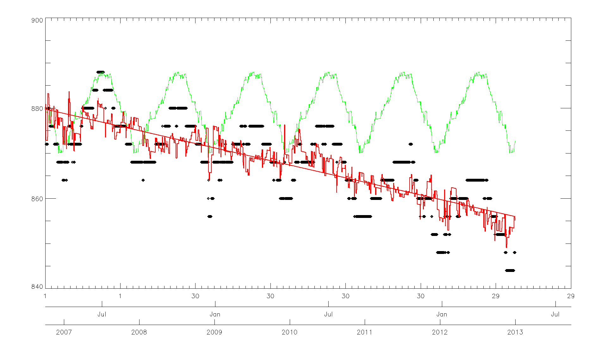
EUMETSAT: De-seasonalization with Seasonal Index
Deseasonalization of the time series by dividing each value from the original time series by the seasonal indices
Fitting the de-seasonal data with a linear regression
Courtesy of S. Wagner, presented in 2015 GSICS annual meeting

Slide 8
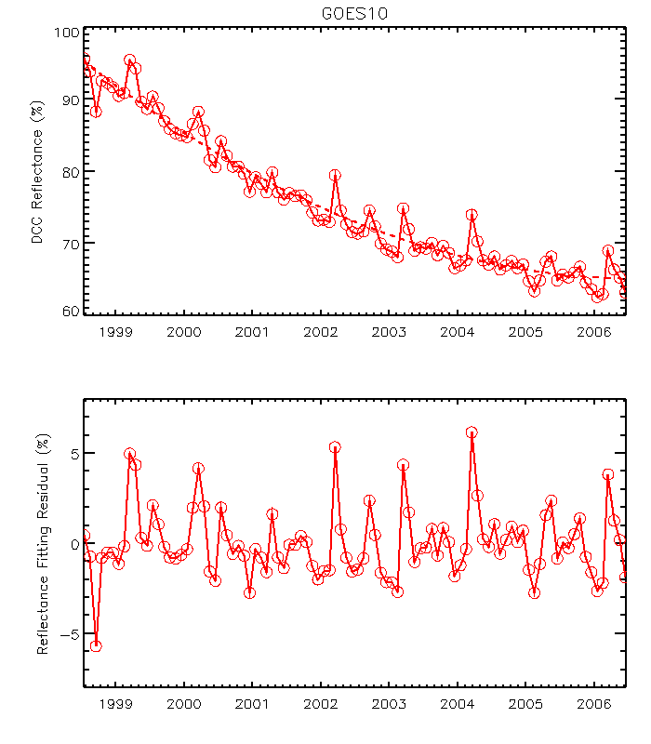
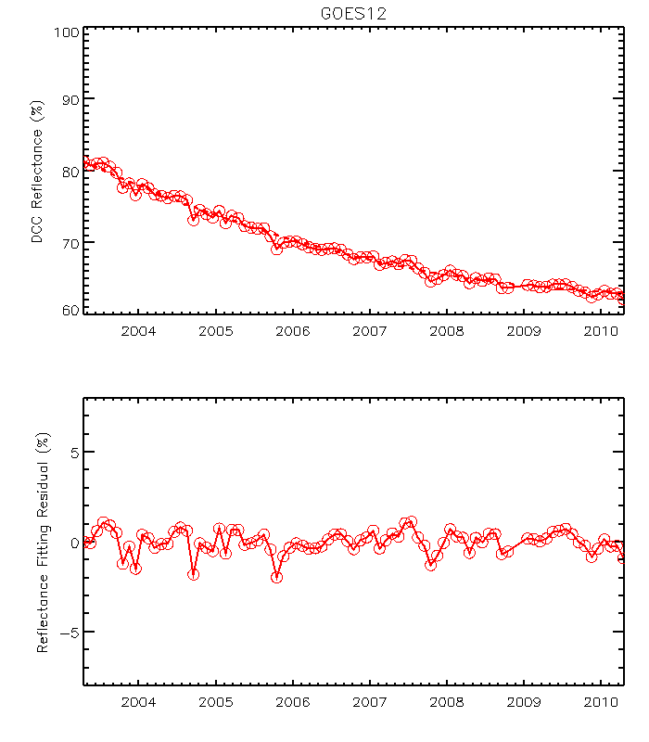
NOAA: GOES-10/12 Time-series DCC Reflectance
GOES satellites do not have strong seasonal variations as METEOSAT satellites!

Slide 9
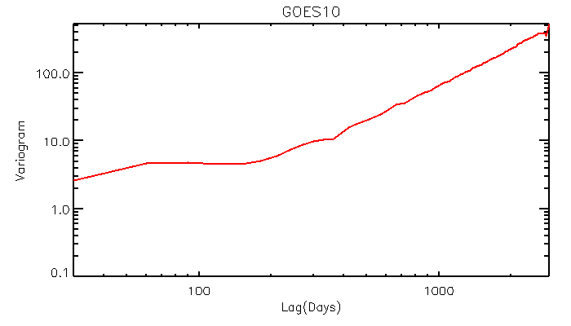
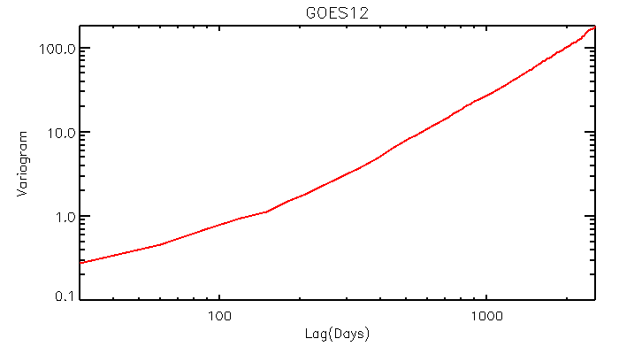
GOES-10/12 Variogram Analyses

Slide 10
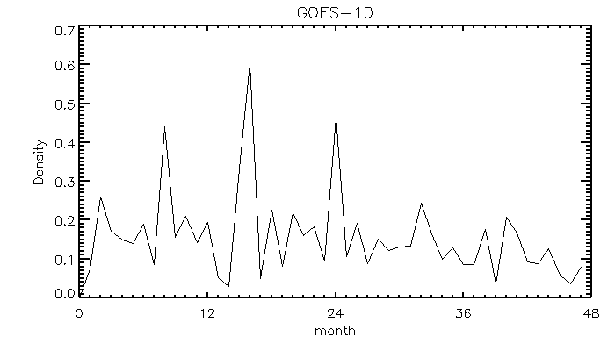
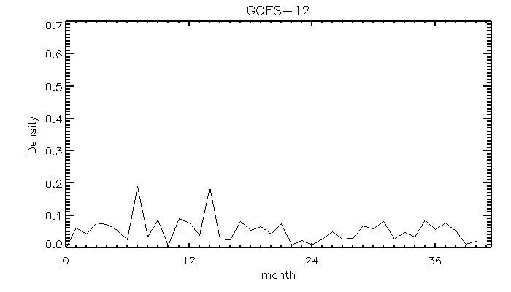
Power Spectrum Density
N=15,16
N=24
N=8
N=7
N=14

Slide 11
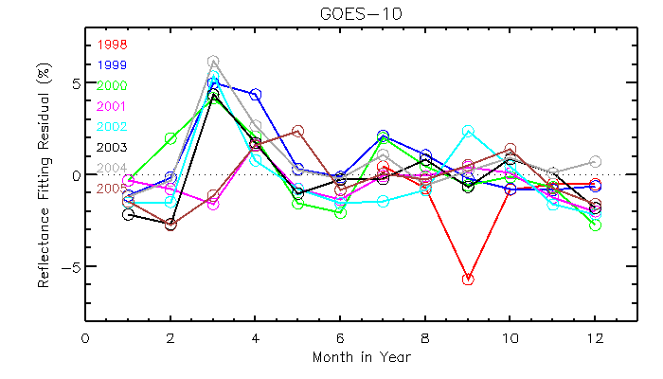
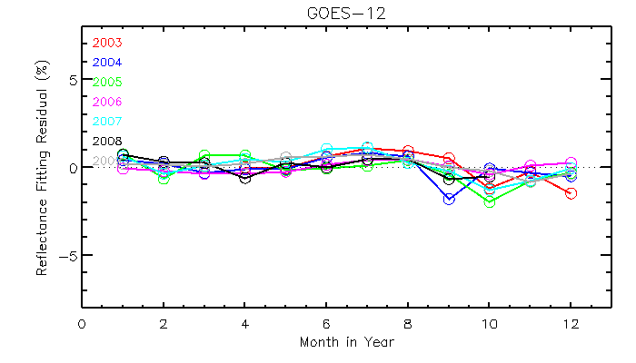
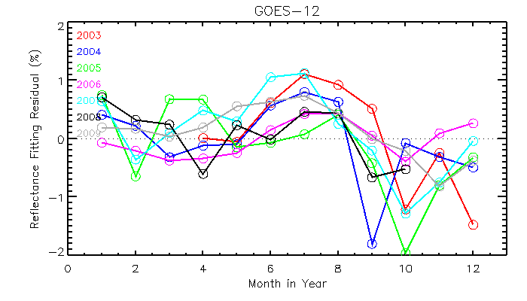
Intra-Annual Variation
ITCZ
1998, 2001, 2005
El Nino Effect?
Why data in 1998 is different from those in 2001 and 2005?
2004, 2005, El Nino

Slide 12
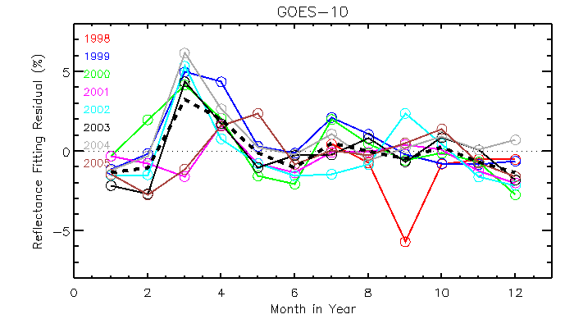
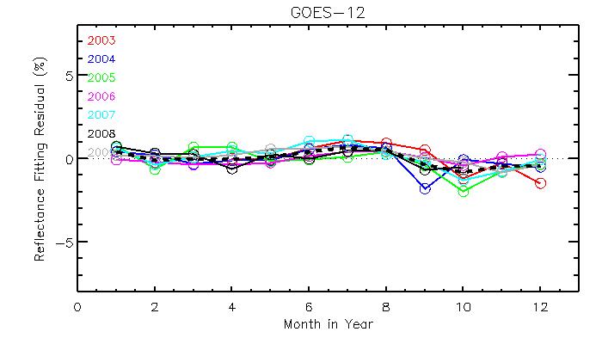
Seasonal Index

Slide 13
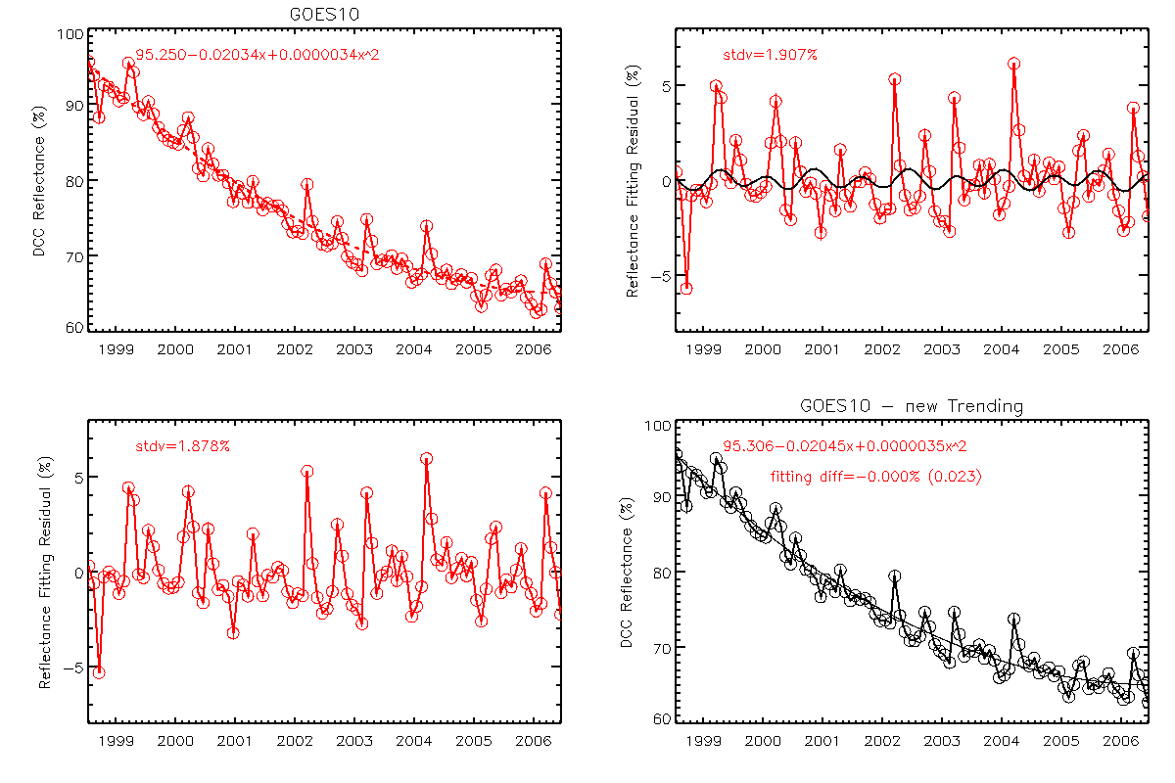
GOES-10 DCC - FFT
No significant change in uncertainty (1.907% vs. 1.878%)
No change in fitting function (Δ =0.000(±0.025)%

Slide 14
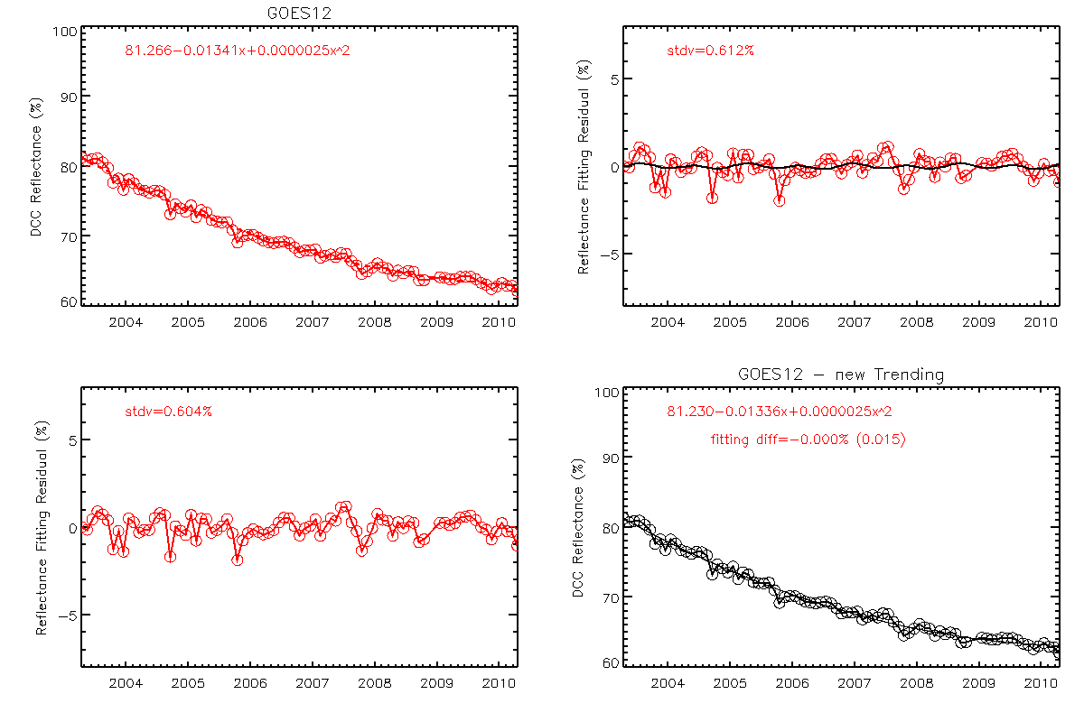
GOES-12 DCC - FFT
No significant change in uncertainty (0.612% vs. 0.604%)
No change in fitting function (Δ =0.000(±0.015)%

Slide 15
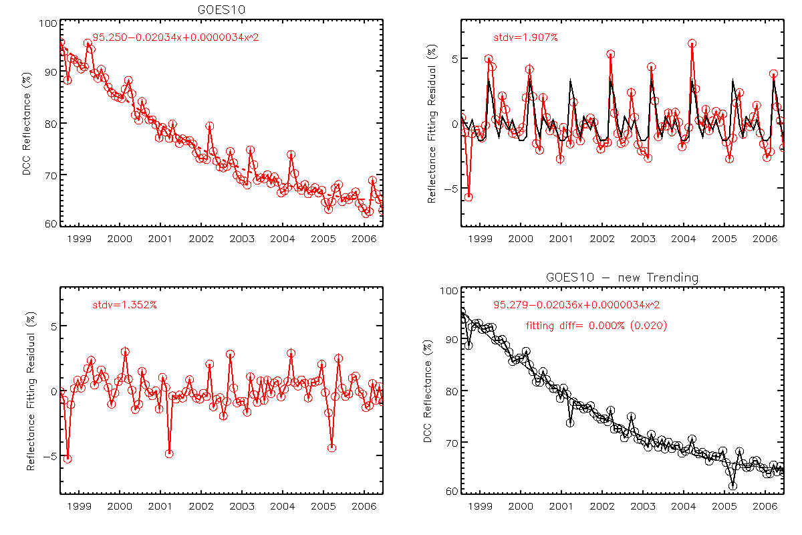
GOES-10: Seasonal Index
Reduced uncertainty (1.907% vs.1.352%)
No change in fitting function (Δ =0.000(±0.020)%

Slide 16

GOES-12: Seasonal Index
Reduced uncertainty (0.612% vs. 0.433%)
No change in fitting function (Δ =0.000(±0.007)%

Slide 17
Summary – For the Re-analysis Data
Suggest applying three procedures for de-seasonalization
  1: Initial detrending to derive the time-series of reflectance variation
  2: Use of the de-seasonalization algorithm to remove the seasonal variation
  3: Final sensor degradation trending
De-seasonalization algorithm for GOES Imager
  GOES-West (G10) has stronger variation than GOES-East (G12)
  El Nino effect is more apparent on GOES-West than GOES-East
  Consistent abnormal variations in certain month – ITCZ activity
  FFT analysis can display the inter-annual variation frequency
Intra-annual variations after initial detrending can help to understand DCC performance and its physical properties withinn the satellite spatial domain
Seasonal Index can reduce the trending uncertainty
  Both FFT and Seasonal Index methods essentially do not change the trending functions
Suggest different agencies to compare different de-seasonalization methods
  eg. Wavelet for GOES?

Slide 18
Questions for Discussion
How about Near Real-Time Analysis?
  One possible solution is to generate the seasonal index after 2-3 years in-orbit and update it every month afterwards
  Uncertainty?
How to handle data in anomalous (e.g. El Nino) years?
  Use the seasonal index derived from long-term data (normal + abnormal years).
  Other methods?

Slide 19
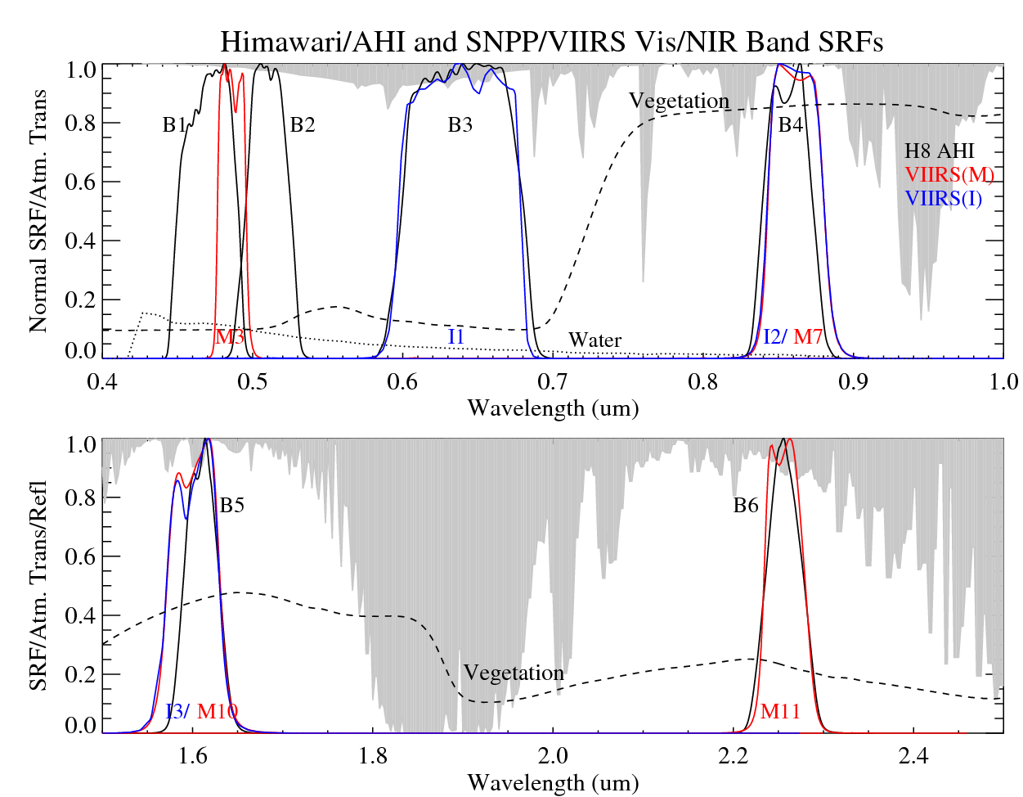
AHI vs. VIIRS Raymatching vs. Collocated DCC inter-Calibration
Raymatching
Collocated DCC
Yu, F. and X. Wu, Remote Sensing, accepted with minor revisions

Slide 20
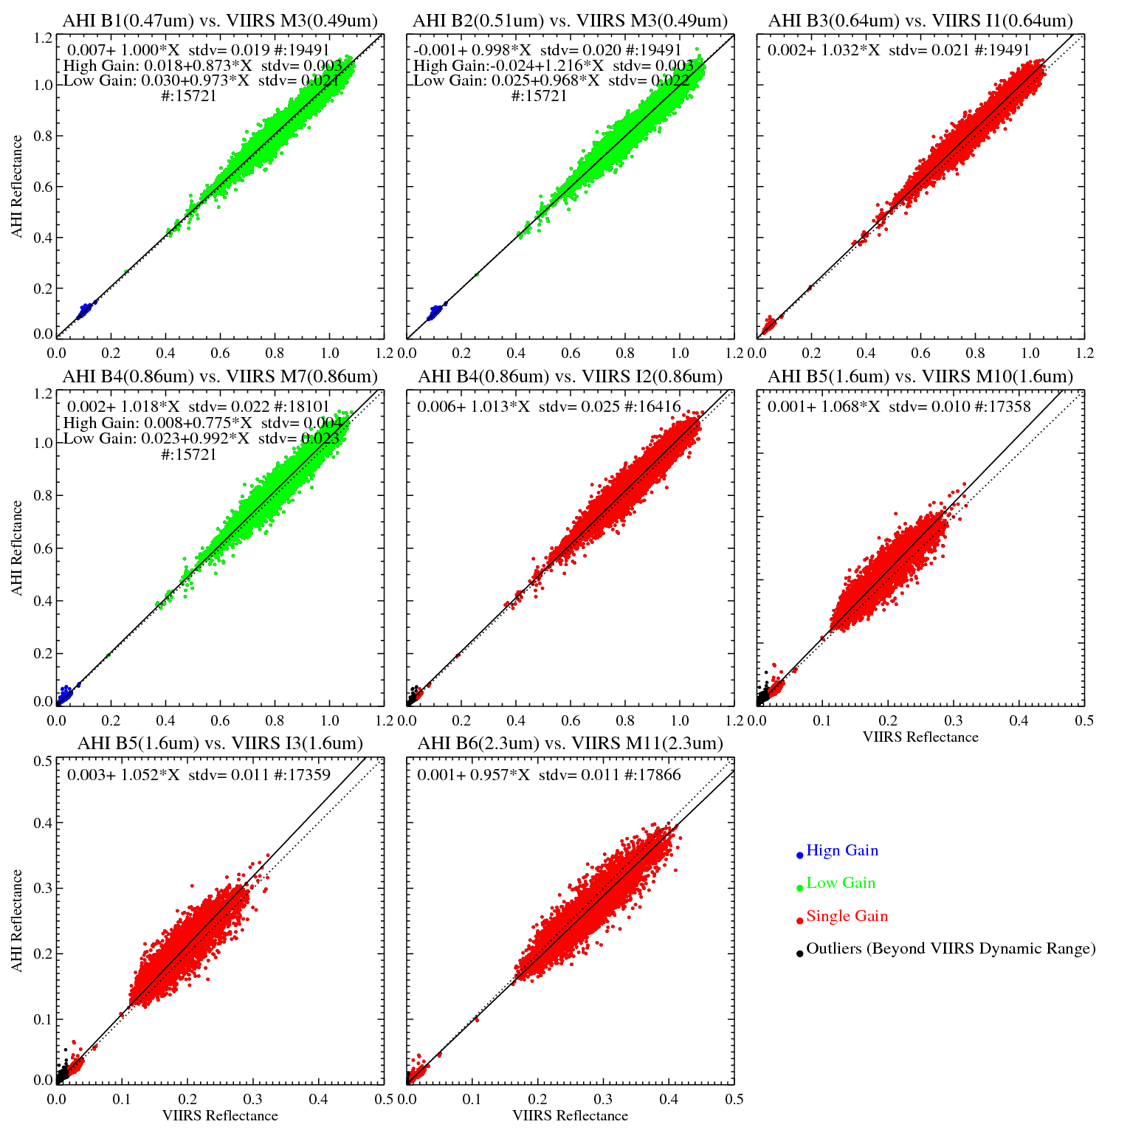
Ray-matching

Slide 21
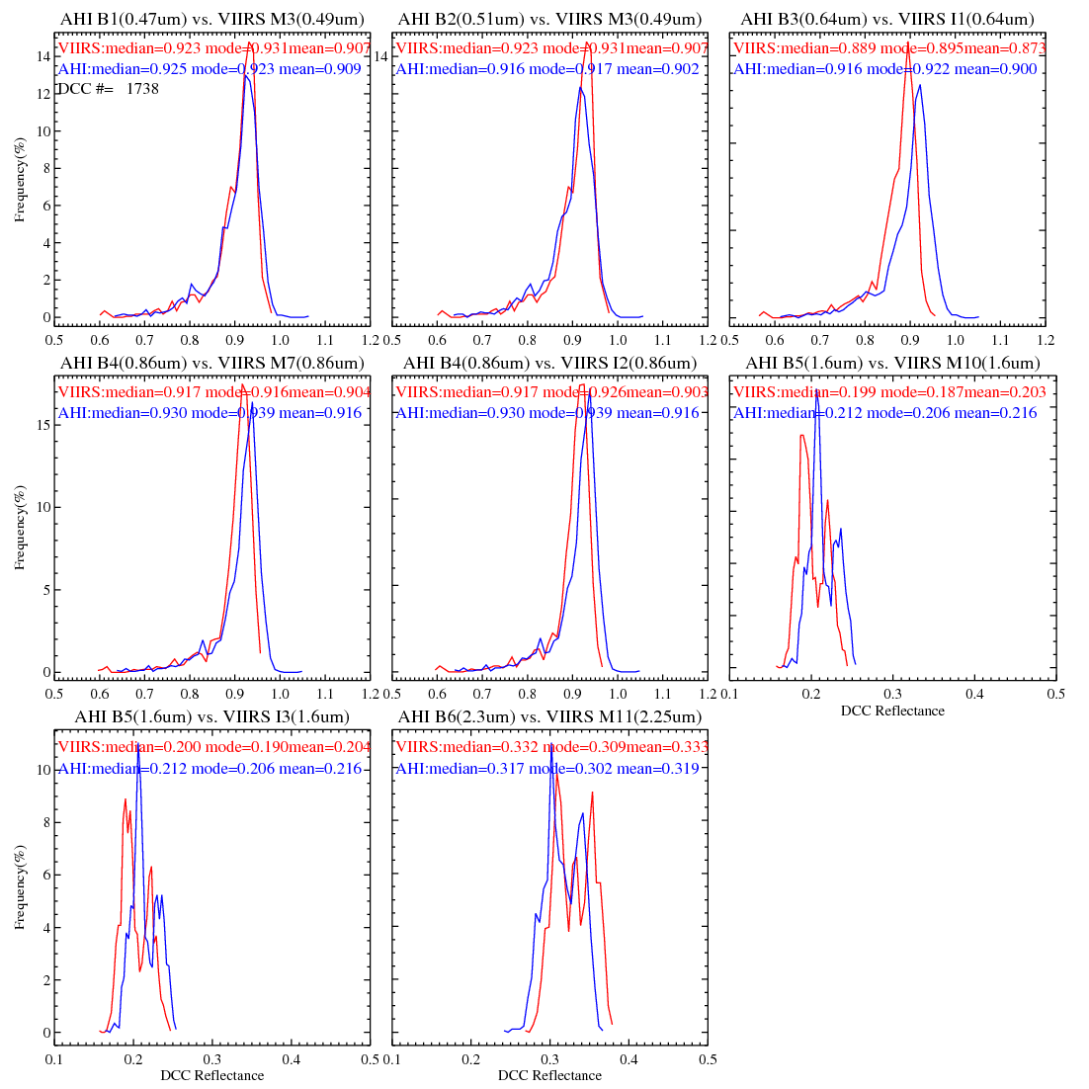
Collocated DCC

Slide 22
Inter-calibration uncertainty
Reflectance ration between AHI and VIIRS
AHI |  | B1 (0.47um) | B2 (0.51um) | B3 (0.64um) | B4 (0.86um) |  | B5 (1.6um) |  | B6 (2.3um)
VIIRS |  | M3 |  | I1 | M7 | I2 | M10 | I3 | M11
Ray-matching |  | 1.010 (±0.026) | 0.999 (±0.028) | 1.037 (±0.030) | 1.021 (±0.029) | 1.022 (±0.032) | 1.079 (±0.058) | 1.073 (±0.065) | 0.963 (±0.045)
DCC | Median | 1.002 | 0.992 | 1.031 | 1.014 | 1.015 | 1.067 | 1.061 | 0.955
 | Mode | 0.992 | 0.985 | 1.030 | 1.024 | 1.014 | 1.102 | 1.084 | 0.977
 | Mean | 1.003 | 0.994 | 1.031 | 1.014 | 1.015 | 1.064 | 1.058 | 0.958
 | Statistics* | 1.003 (±0.024) | 0.995 (±0.026) | 1.032 (±0.028) | 1.015 (±0.024) | 1.015 (0.025) | 1.065 (±0.030) | 1.059 (±0.032) | 0.959 (±0.026)
* mean and standard deviation of the reflectance ratios for all the collocated DCC scenes at each paired bands.

Slide 23
Summary: DCC vs. Raymatching inter-calibration
Similar uncertainty at visible bands (AHI Band1-3)
DCC has less uncertainty at NIR bands (AHI B4-6), even with bi-mode histograms at B5 and B6.
  Very encouraging to apply the DCC method at NIR bands
  Need more NIR DCC studies (e.g. How frequency is the bi-mode? What are the possible causes? Can we remove it?)
  Need to compare the results from collocated DCC and DCC methods

Slide 24
Backup slides

Slide 25
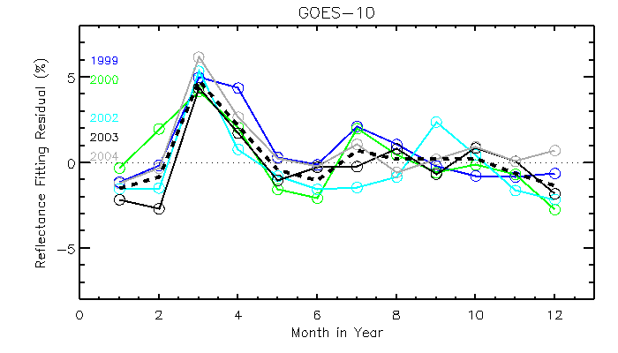

Slide 26
GOES-10: Seasonal Index
Reduced uncertainty (1.907% vs.1.352%)
No change in fitting function (Δ =0.000(±0.020)%

Slide 27
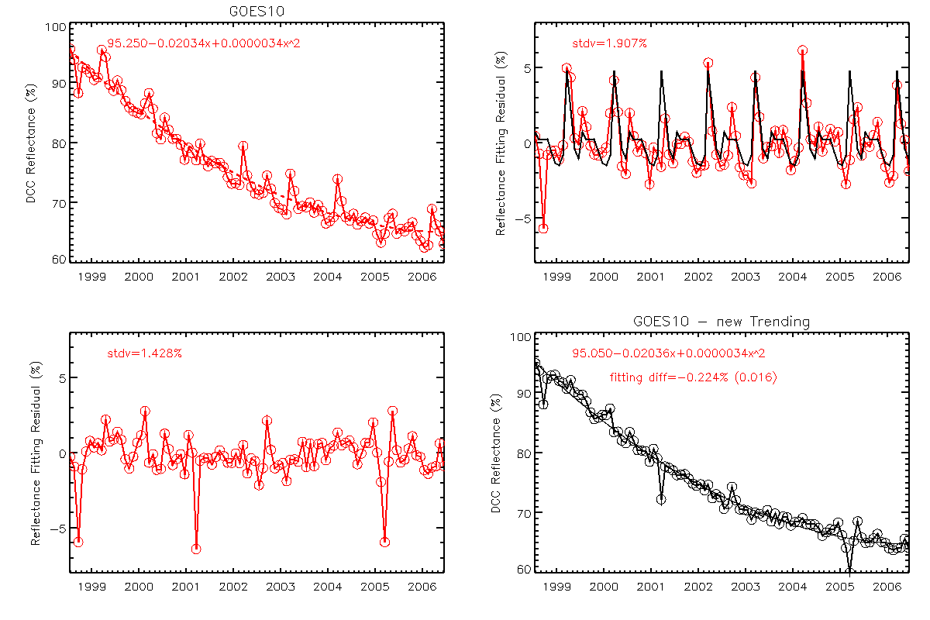
GOES-10: Seasonal Index without El Nino Year Data

