Slide 1
Introduction to Mini Conference & GSICS
Special Issue of the IEEE TGRS on “Inter-Calibration of Satellite Instruments”:
Special Issue of the IEEE TGRS on “Inter-Calibration of Satellite Instruments”:
Tim Hewison
(EUMETSAT) (GRWG Chair)

Slide 2
Global Space-based Inter-Calibration System
What is GSICS?
Global Space-based Inter-Calibration System
Initiative of CGMS and WMO
Effort to produce consistent, well-calibrated data from the international constellation of Earth Observing satellites
What are the basic strategies of GSICS?
Improve on-orbit calibration by developing an integrated inter-comparison system
Initially for GEO-LEO Inter-satellite calibration
Being extended to LEO-LEO
Using external references as necessary
Best practices for calibration & characterisation
This will allow us to:
Improve consistency between instruments
Reduce bias in Level 1 and 2 products
Provide traceability of measurements
Retrospectively re-calibrate archive data
Better specify future instruments
EUMETSAT | CNES | JMA
NOAA | CMA | KMA
ISRO | NASA | WMO
USGS | NIST | JAXA
ROSHYDROMET | IMD | ESA
Notes:
2
Well, what is GSICS?
The Global Space-based Inter-Calibration System (GSICS) is an initiative of CGMS and WMO, which aims to ensure consistent calibration and inter-calibration of operational meteorological satellite instruments.
One of the basic strategies of GSICS is to develop an integrated on-orbit cal/val system - initially by LEO-GEO Inter-satellite/inter-sensor calibration.
This will then allow us to provide corrections to improve the consistency between instruments, produce less biased level 1, and therefore, level 2 data, and ultimately, retrospectively re-calibrate archive data, which is of great interest in the climate monitoring community

Slide 3
GSICS Principles
Systematic generation of inter-calibration products
for Level 1 data from satellite sensors
to compare, monitor and correct the calibration of monitored instruments to community references
by generating calibration corrections on a routine operational basis
with specified uncertainties
through well-documented, peer-reviewed procedures
based on various techniques to ensure consistent and robust results
Delivery to users
Free and open access
Adopting community standards
To promote
Greater understanding of instruments’ absolute calibration, by analysing the root causes of biases
More accurate and more globally consistent retrieved L2 products
Inter-operability for more accurate environmental, climate and weather forecasting products
TRACEABILITY / UNBROKEN CHAINS OF COMPARISONS

Slide 4
CGMS satellite operators
CGMS satellite operators
CGMS satellite operators
CGMS satellite operators
WMO
GSICS Exec Panel
GSICS Coordination Center
GSICS Research Working Group
GSICS Data Working Group
UV Sub-Group
IR Sub-Group
WGCV IVOS
WGCV MWSG
GPM X-CAL
CEOS ACC
WGCV ACSG
VIS/NIR Sub-Group
Microwave Sub-Group

Slide 5
Who are the targeted users?
Satellite users interested in accurate/consistent calibration
Stable Level 2 product generation, Level 3 multi-satellite products
Climate Data Record generation (e.g. “SCOPE-CM”, WCRP/ISCCP )
Reanalysis
Assimilation in NWP models: bias characterization of radiances
Satellite operators sharing developments, best practices, and tools
Prelaunch instrument characterization
In-orbit commissioning and Cal/Val plans
Instrument monitoring, detection/analysis of anomalies
Improved calibration
Partner programmes: CEOS WGCV, GPM X-cal, GHRSST, GRUAN, etc...

Slide 6
Evolving scope of GSICS
Started with IR calibration corrections (GEO-LEO)
Continued with VIS/NIR domain
Now addressing also the UV and MW domains
Started with Near Real-Time correction functions
Added Re-analysis corrections
Considering now a wider variety of deliverables depending on user requirements

Slide 7
Definition of GSICS Deliverables
GSICS Products for users of satellite data, including calibration corrections/coefficients
GSICS Algorithms, which describe inter-calibration processes, (described by ATBD)
GSICS Monitoring Reports, assessments
GSICS Reference datasets, including Solar spectrum, …
GSICS Tools for use by inter-calibration developers, (GIRO, SBAF, …)
GSICS recommended standards, conventions and guidelines,
GSICS User Services, information
Pro- ducts corrections
Intercalib. Algorithms
Monitoring assessmentreports
Calibration datasets
Software and hardware tools
Standards, conventions,
Calibration references

Slide 8
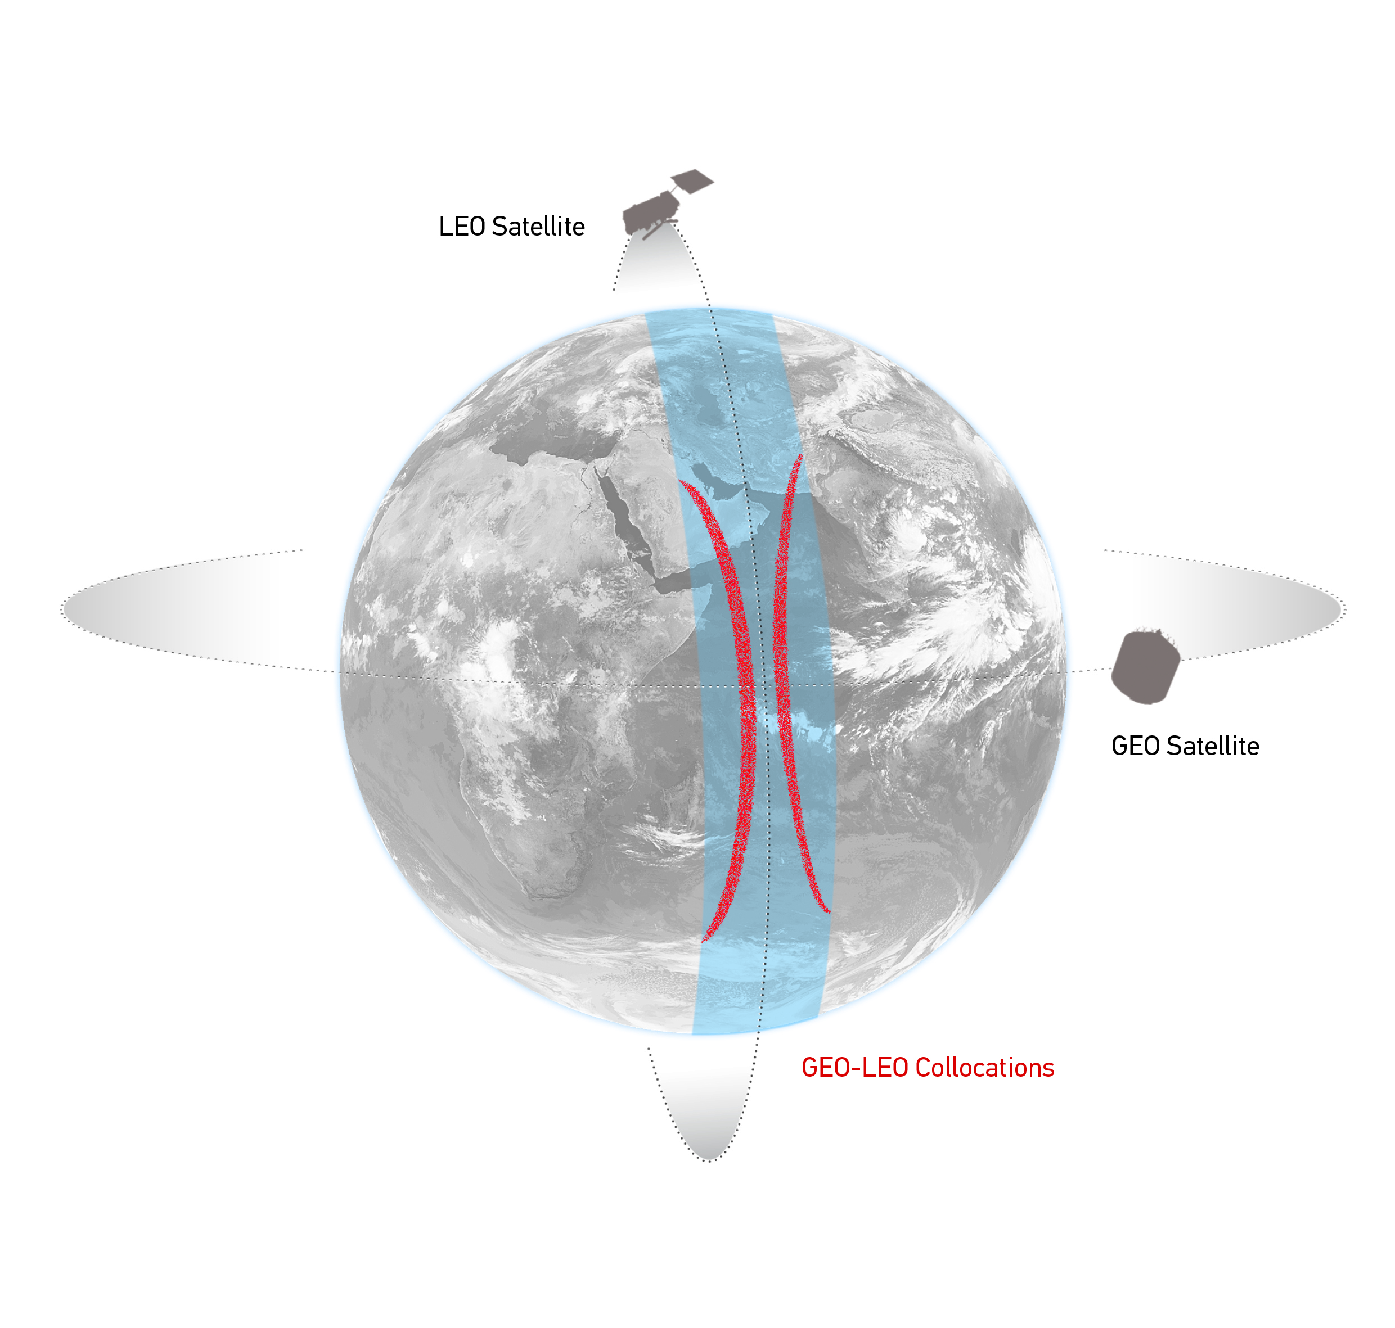
GEO-LEO IR - Hyperspectral SNO
Simultaneous near-Nadir Overpasses
of GEO imager and LEO sounder
Select Collocations
Spatial, temporal and geometric thresholds
Schematic illustration of the geostationary orbit (GEO) and polar low Earth orbit (LEO) satellites and distribution of their collocated observations.

Slide 9
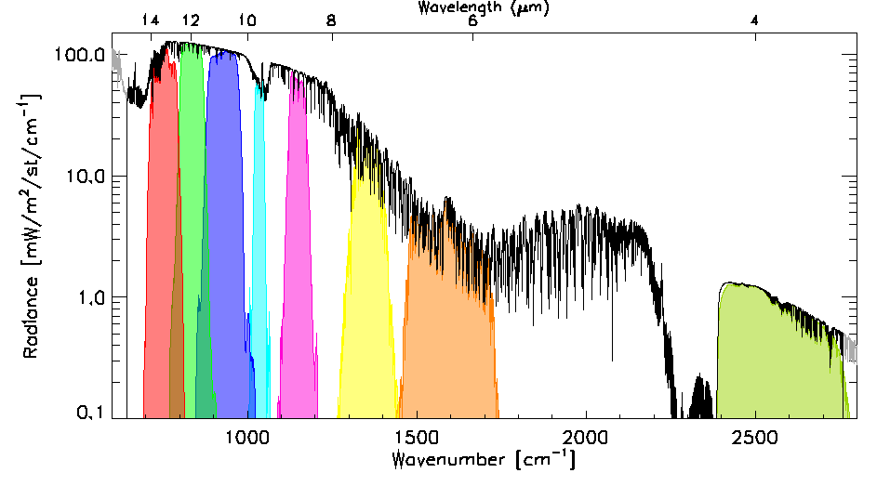
GEO-LEO IR - Hyperspectral SNO
Simultaneous near-Nadir Overpasses
of GEO imager and LEO sounder
Select Collocations
Spatial, temporal and geometric thresholds
Spectral Convolution:
Convolve LEO Radiance Spectra with GEO Spectral Response Functions
to synthesise radiance in GEO channels
Example radiance spectra measured by IASI (black), convolved with the Spectral Response Functions of SEVIRI channels 3-11 from right to left (colored shaded areas).

Slide 10
GEO-LEO IR - Hyperspectral SNO
Simultaneous near-Nadir Overpasses
of GEO imager and LEO sounder
Select Collocations
Spatial, temporal and geometric thresholds
Spectral Convolution:
Convolve LEO Radiance Spectra with GEO Spectral Response Functions
to synthesise radiance in GEO channels
Spatial Averaging
Average GEO pixels in each LEO FoV
Standard Deviation of GEO pixels as weight
LEO FoV~10km
~ 3x3 GEO pixels
Illustration of spatial transformation. Small circles represent the GEO FoVs and the two large circles represent the LEO FoV for the extreme cases of FY2-IASI, where nxm=3x3 and SEVIRI-IASI, where nxm=5x5.

Slide 11
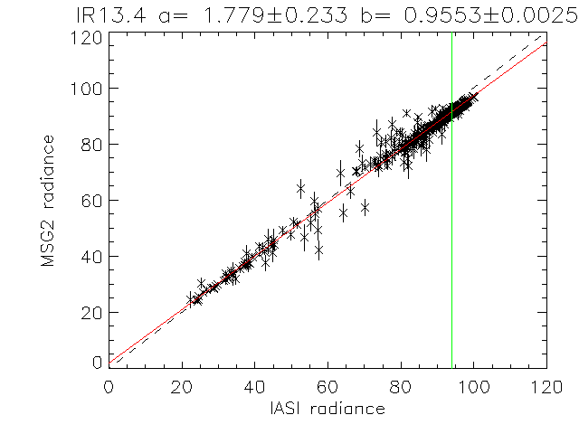
GEO-LEO IR - Hyperspectral SNO
Simultaneous near-Nadir Overpasses
of GEO imager and LEO sounder
Select Collocations
Spatial, temporal and geometric thresholds
Spectral Convolution:
Convolve LEO Radiance Spectra with GEO Spectral Response Functions
to synthesise radiance in GEO channels
Spatial Averaging
Average GEO pixels in each LEO FoV
Standard Deviation of GEO pixels as weight
Weighted Regression of LEO v GEO rads
Evaluate Bias for Standard Radiance Scene
Weighted linear regression of L_{GEO|REF} and <L_{GEO}> for Meteosat-9 13.4μm channel based on single overpass of IASI

Slide 12
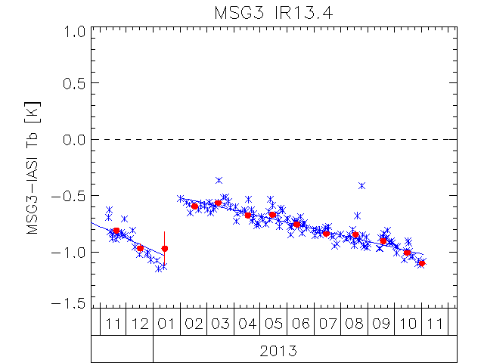
GEO-LEO IR - Hyperspectral SNO
Simultaneous near-Nadir Overpasses
of GEO imager and LEO sounder
Select Collocations
Spatial, temporal and geometric thresholds
Spectral Convolution:
Convolve LEO Radiance Spectra with GEO Spectral Response Functions
to synthesise radiance in GEO channels
Spatial Averaging
Average GEO pixels in each LEO FoV
Standard Deviation of GEO pixels as weight
Weighted Regression of LEO v GEO rads
Evaluate Bias for Standard Radiance Scene
Plot time series of Bias
Time Series of Bias from inter-calibration of 13.4μm channel of Meteosat-10/SEVIRI with Metop-A/IASI
expressed in Brightness Temperature Bias for Standard Scene Radiance
Blue x = Daily Result, Blue Line=trend
Red dot = Monthly Average

Slide 13
GSICS GEO-LEO IR Product Status 2016-02
GPRC | Monitored Instrument | Reference Instrument | GSICS NRT Correction | GSICS Re-Analysis Correction | GSICS Bias Monitoring
EUMETSAT | Meteosat-8 – 11 } Meteosat-7 | Metop-A/IASI | Operational Demo | Operational Demo | Plots RAC
JMA | MTSAT-1R } MTSAT-2 } | IASI (+ AIRS) | Demo | Demo | Plots RAC
NOAA | GOES-13 & -15 Imager GOES-11 & -12 Imager | IASI (+ AIRS) | Pre-op | Pre-op Demo | Prototype
 | GOES Sounder | IASI (+ AIRS) | Development | Development | In development
CMA | FY2C – E | IASI (+ AIRS) | Development | Development | Prototype
KMA | COMS-1 | IASI | Prototype | Prototype
ISRO | INSAT-3D | IASI | Prototype | Prototype
Full GSICS Product Catalog available at http://www.star.nesdis.noaa.gov/smcd/GCC/ProductCatalog.php

Slide 14
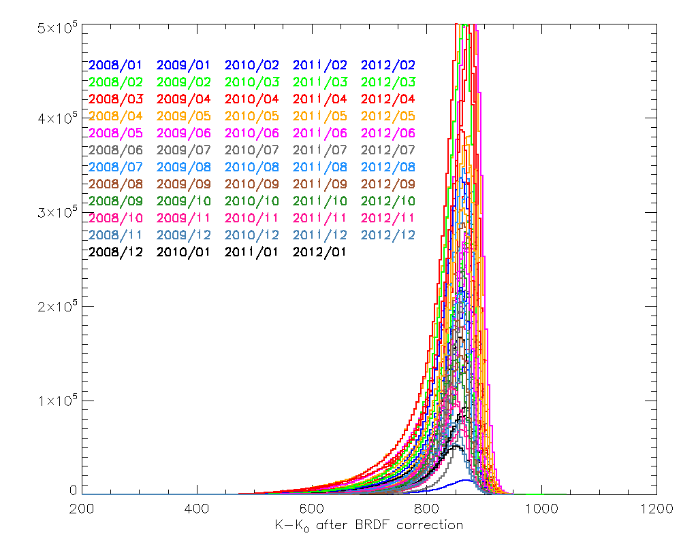
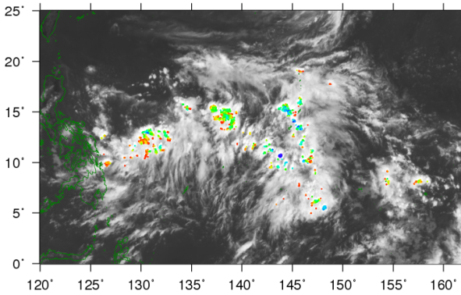
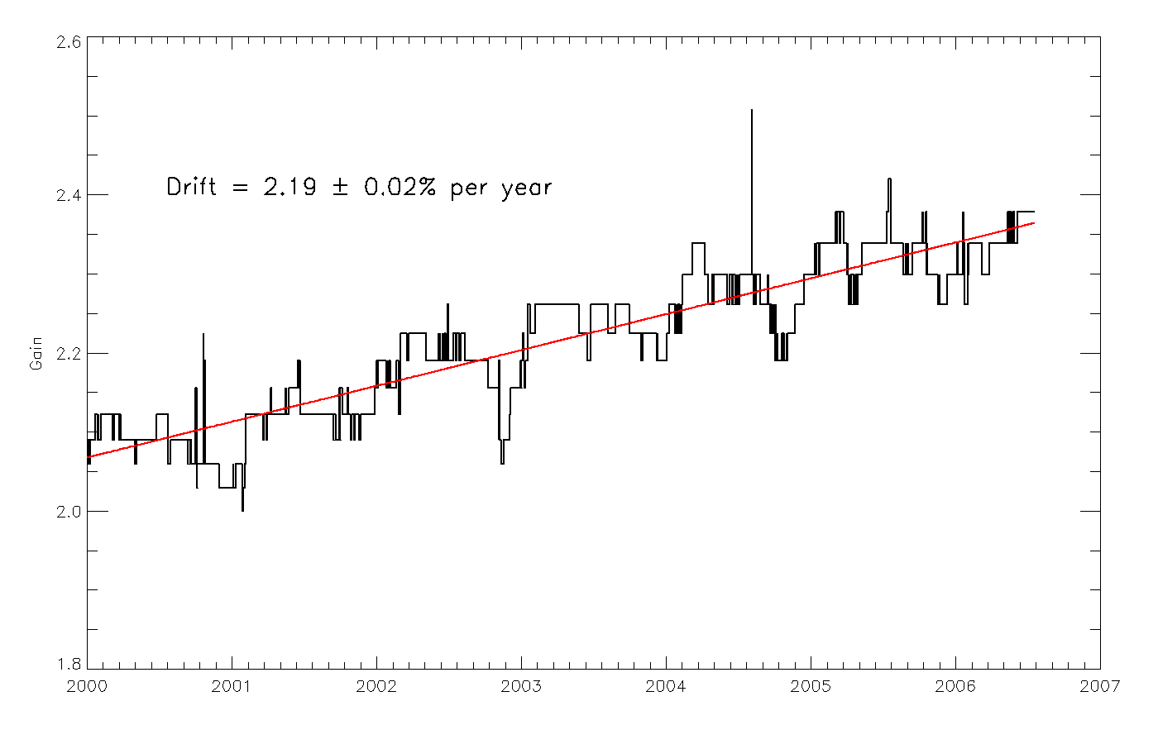
GEO-LEO VIS - Deep Convective Clouds (DCCs)
Bright, natural solar diffusers
Near Top Of Atmosphere
Little water vapour, aerosol
Globally available
In Equatorial Band
Use as Pseudo Invariant Targets
to transfer calibration MODIS->GEO
Select coldest, brightest pixels
Identify using T_{IR} threshold
Homogeneity Tests
Limit viewing and solar geometry & Normalise
Build up monthly PDF statistics
Compare mode/mean with ref obs
Derive Calibration Coefficients
Seasonal and Land/Sea Variations
MTSAT-2 DCC detection 2012-07-01T04
10.8μm TB [K]
Gains for Meteosat-7/VIS using Aqua/MODIS Reference via DCCs

Slide 15
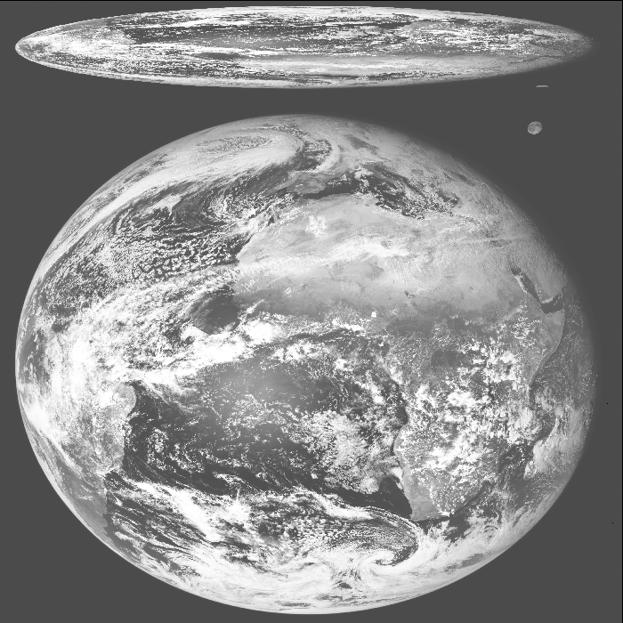
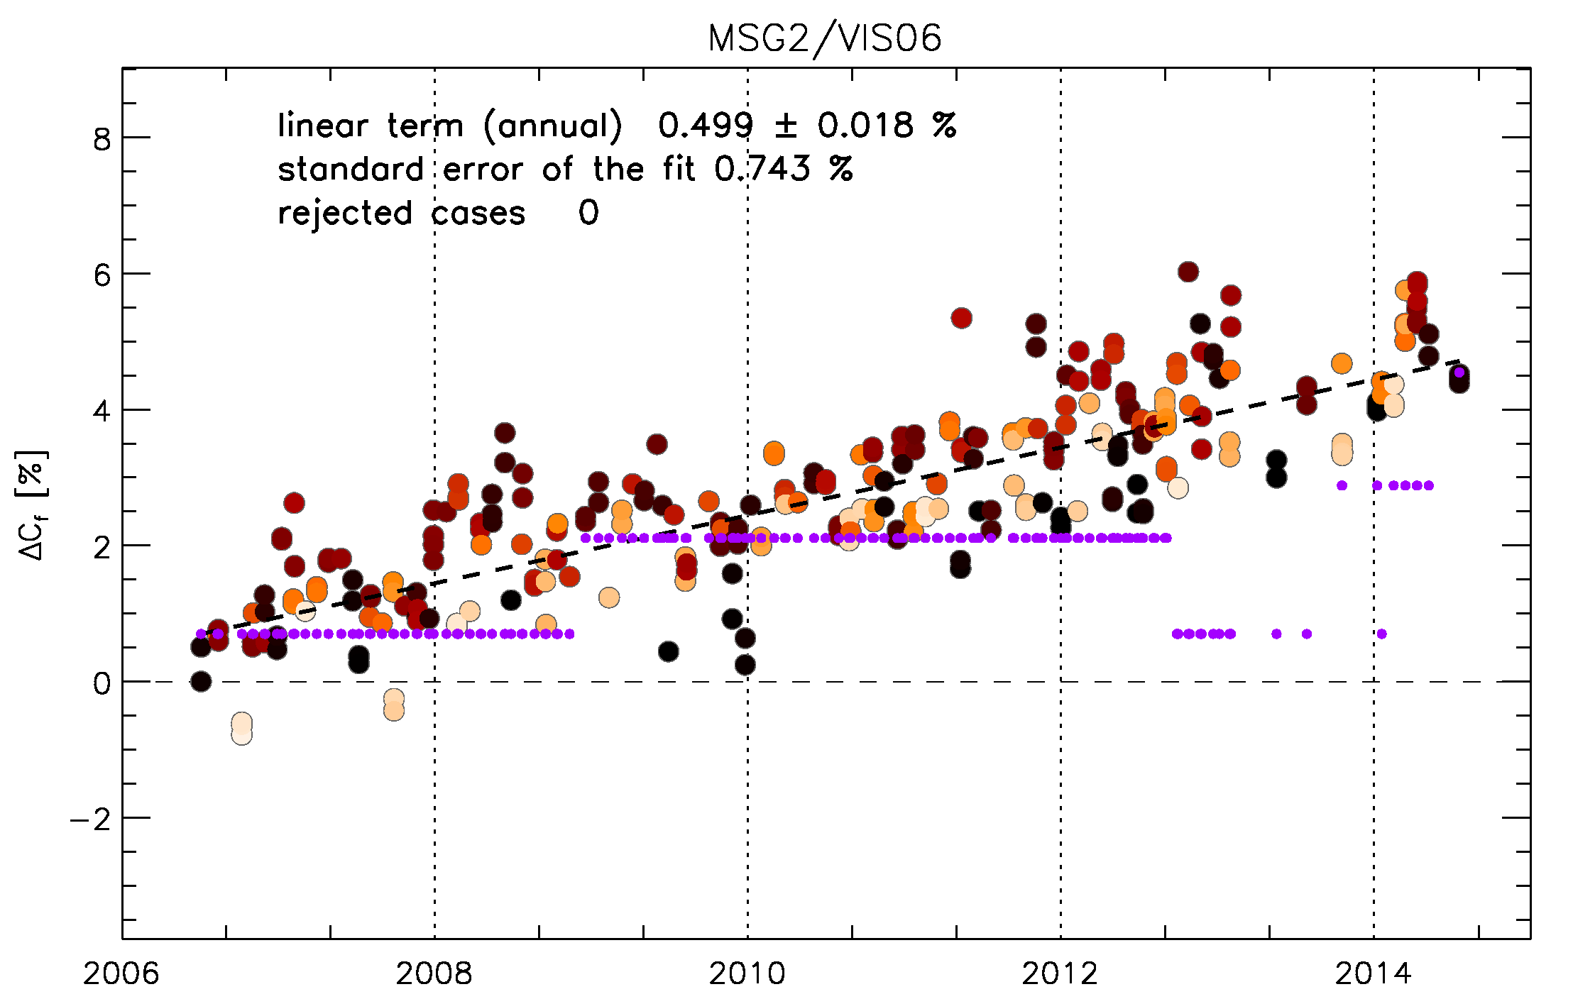
GEO-LEO VIS/NIR - The Moon
Dark, natural solar diffuser
No kind of atmosphere
Extremely stable
Can apply retrospectively to generate FCDRs
Globally available
Select pixels of Moon
Applying threshold to IR image
Calculate integrated irradiance
Compare with model
ROLO developed by USGS
<1% relative uncertainty
Applicable to full Reflected Solar Band
Use as Pseudo Invariant Targets
to transfer calibration MODIS->GEO
SEVIRI L1.0 image
Meteosat-9/VIS06 Bias Change
wrt ROLO Model Lunar Irradiance
(after phase angle correction)

Slide 16
GSICS Procedure for Product Acceptance
Based on QA4EO
Products progress from
Demonstration Mode
Through
Pre-Operational Mode
To
Operational Mode
By a series of reviews
Over period of ~1.5yr
Subject to meeting acceptance criteria

Slide 17
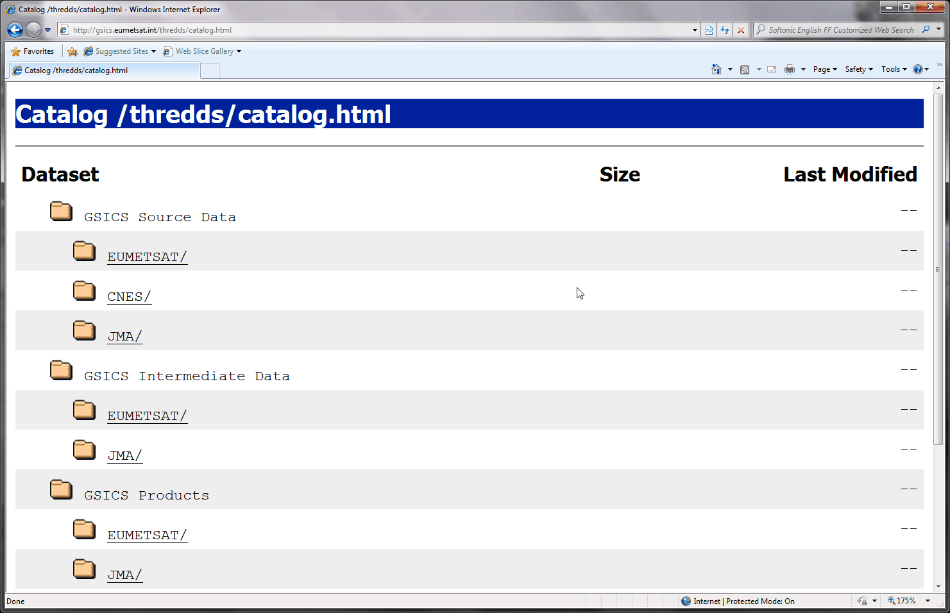
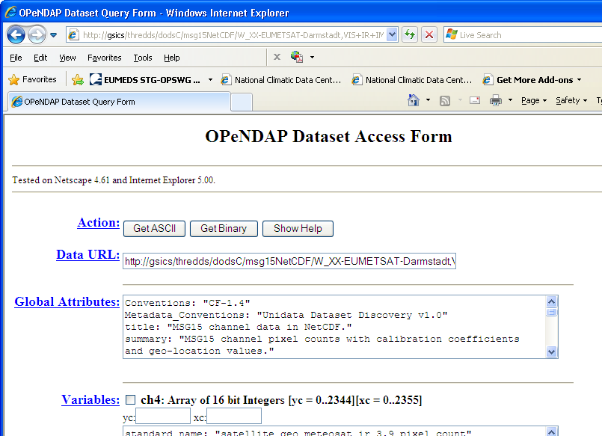
Where to get the data?
GSICS Bias Monitoring
Hosted on websites of GSICS Processing & Research Centres (GPRCs)
http://gsics.tools.eumetsat.int/plotter/
GSICS Corrections
− GSICS Data & Products Servers
− THREDDS-based system
− NetCDF format
− WMO GTS standard file names
− Unidata & CF conventions
See gsics.wmo.int for links
GTS = Global Telecommunication System
CF = Climate and Forecast

Slide 18
Conclusions
GSICS is maturing into a system for generating inter-calibration products
suitable for integrating into operational processing
First products have been declared operational
Continuing to develop new inter-calibration products
While cooperating with related activities
To integrate GSICS into WIGOS
To support Architecture for Climate Monitoring from Space
Today: Examples of potential future activities & interactions
Rest of the Week: Focus on development of GSICS deliverables

Slide 19
Thank You
Notes:
19

Slide 20
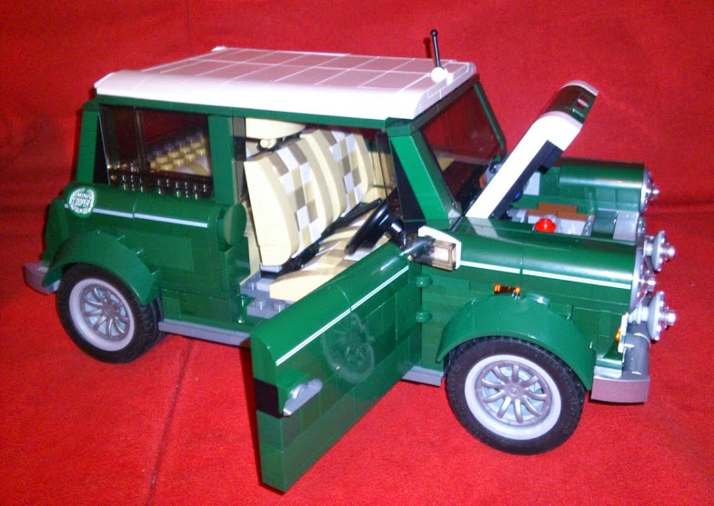
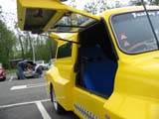
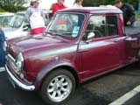
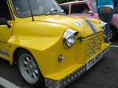
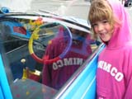
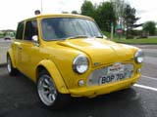
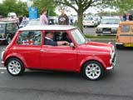
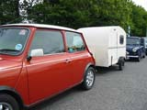
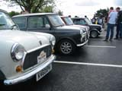
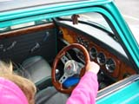
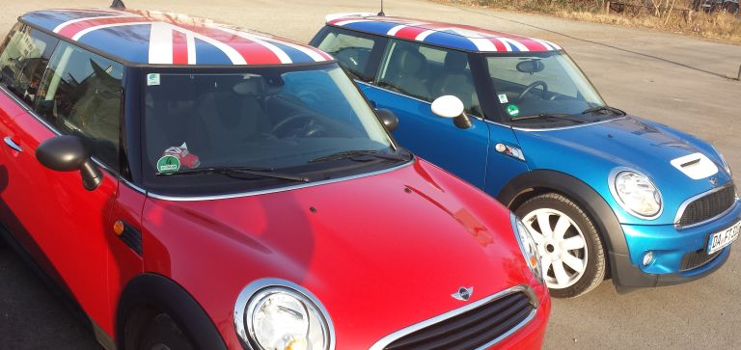
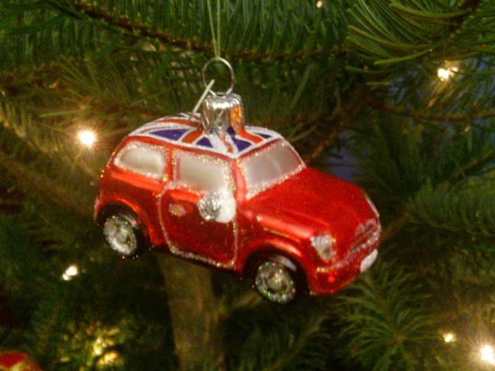
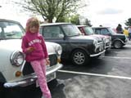
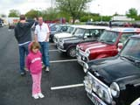
Not that sort of Mini Conference ☹

Slide 21
 | Mini Conference Agenda
 | Chair: Larry Flynn
9:00 | Tim Hewison | EUMETSAT | Introduction to Mini Conference & GSICS | 1a | 0:20
9:20 | Chu Ishida | JAXA | Welcome to JAXA | 1b | 0:10
9:30 | Yoshiteru Kitamura | JMA | Welcome address | 1c | 0:10
9:40 | Dave Doelling | NASA | CLARREO Pathfinder | 1d | 0:20
10:00 | Rob Roebeling | EUMETSAT | FIDUCEO - Defining FCDR uncertainties | 1e | 0:20
10:20 |  |  | Coffee break |  | 0:30
10:50 | Hu Xiuqing "Scott" | CMA | Progress on ground-based lunar observations | 1f | 0:20
11:10 | Fred Wu | NOAA | Lunar radiance calibration | 1g | 0:20
11:30 | Toru Koyama | AIST | Lunar calibration based on SELENE/SP data | 1h | 0:20
11:50 | Lunch Break |  |  |  | 1:10
 | Chair: Misako Kachi
13:00 | Fougnie Bertrand | CNES | Toward a wider use of the moon for in-flight characterization | 1i | 0:20
13:20 | Seongick Cho | KIOST | Operation and Calibration of GOCI | 1j | 0:20
13:40 | Hiroshi Murakami | JAXA | Himawari-8 Ocean Color and Aerosol | 1k | 0:20
14:00 | Yukio Kurihara | JAXA | Himawari-8 SST | 1l | 0:20
14:20 | Hiroshi Murakami | JAXA | Calibration activities of GCOM-C/SGLI | 1m | 0:20
14:40 | Kei Shiomi | JAXA | Calibration activities of GOSAT | 1n | 0:20
15:00 |  |  | Coffee break |  | 0:30
15:30 | Takeo Tadono | JAXA | Calibration activities of ALOS/AVNIR2 PRISM | 1o | 0:20
15:50 | Takeshi Motooka | JAXA | Calibration activities of ALOS-2/PALSAR | 1p | 0:20
16:10 | Takeshi Masaki | JAXA | Calibration activities of TRMM & GPM Radars | 1q | 0:20
16:30 | Marehito Kasahara | JAXA | Calibration activities of GCOM-W/AMSR2 | 1r | 0:20
16:50 | Ralph Ferraro | NOAA | Intercalibration on ATMS and SAPHIR | 1s | 0:20
17:10 | Shengli Wu (Remote) | CMA | Intercalibration on the FY3/MWRI | 1t | 0:20
17:30 | Takashi Maeda | JAXA | Intercalibration of AMSR2 and PMWs | 1u | 0:20
17:50 | Likun Wang | NOAA | New SNO LoS based fast/acccurate algorithm | 1v | 0:20
18:10 | All |  | Discussion |  | 0:20
18:30 | END

Slide 22
Notes to speakers
Please follow file naming convention: 1a_Hewison_Introduction.pptx/pdf/ppt
Presentations will be uploaded to the GSICS Wiki
Unless you tell me not to
All slots are strictly 20min
Please leave at least 5min for questions
The chair will give a warning after 13min
Thank you!

