Slide 1
CLARREO Pathfinder - Overview
D. Doelling for Bruce Wielicki and the CLARREO project
2016 GSICS Joint Meeting on Research and Data Working Groups
Tsukuba, Japan
29 February to 4 March 2016

Slide 2
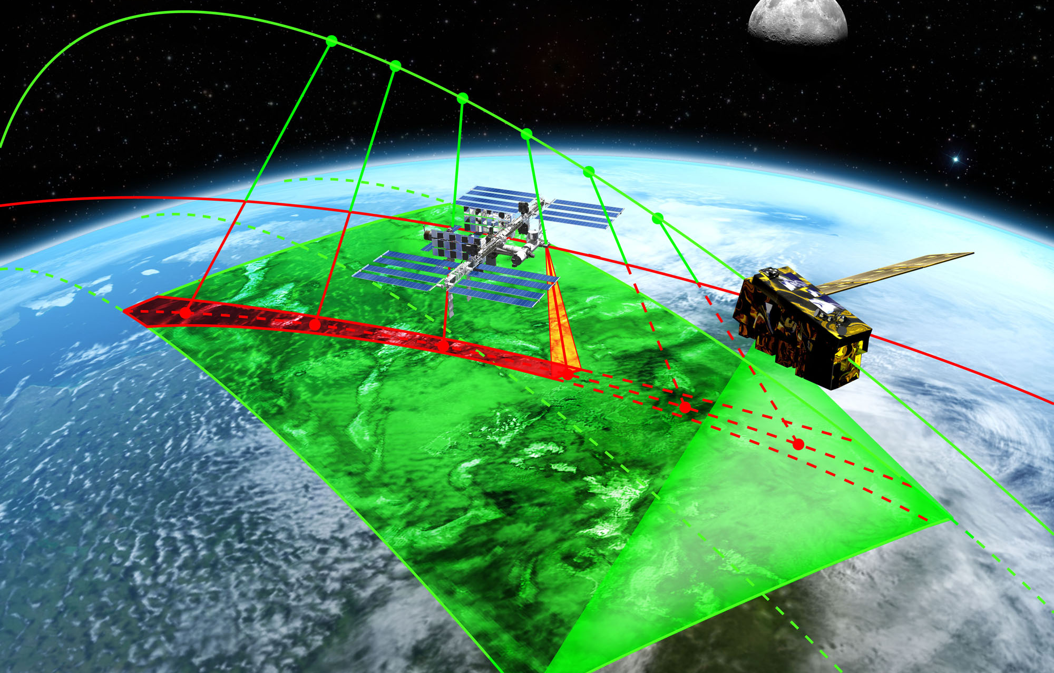
CLARREO Pathfinder on ISS (2020)
CLARREO Pathfinder Begins in 2016!

Slide 3
CLARREO Pathfinder Mission Summary
Demonstrate CLARREO calibration accuracy spectrometers (IR and RS) on International Space Station
Nominal launch is in 2020, nominal operations 2 years
At least one and potentially both spectrometers: final decision ~ mid-2016 (depends on final funding levels and international collaboration
Class D low cost mission
  Instrument design life 1 year at 85% probability, ~ 50% of achieving 4 yrs
Demonstrate CLARREO level SI traceability in orbit
Demonstrate CLARREO Reference Intercalibration for VIIRS, CERES, and CrIS instruments
Take intercalibration observations for additional sensors (LEO, GEO) but Pathfinder budget only covers L0 processing for these orbit crossings
If demonstrate success, then request funding to process full data stream and additional instrument intercalibration events, as well as nadir spectral benchmarking observations.

Slide 4
CLARREO Pathfinder on ISS
Lessons learned from CLARREO Pathfinder will benefit a future CLARREO mission
  Reduced risk
  Demonstration of higher accuracy calibration approaches
  Prove that high accuracy SI-traceability can be transferred to orbit
  Show that high accuracy intercalibration is achievable
CLARREO Pathfinder will demonstrate highest accuracy radiance and reflectance measurements from orbit
  First on-orbit SI-traceable reflectance with uncertainty <0.5% (k=2)
  First on-orbit SI-traceable temperature with uncertainty <0.1 K (k=3)
Lessons learned from CLARREO Pathfinder will produce benefits across many NASA Earth Science Missions
  Improved laboratory calibration approaches
  Development and testing of innovative on-orbit SI-traceable methods
  Transfer calibration to sensors in operation at time of CLARREO Pathfinder
  Improved lunar irradiance standard
CLARREO Pathfinder will improve accuracy across Earth Sciences

Slide 5
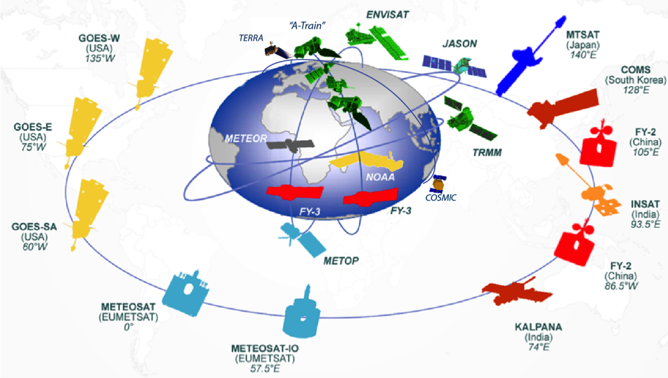

Near-Term Impact (<1 year)
Near-term (<1 year):
  Provide first observed far-infrared (IR) spectra since Nimbus 4 IRIS in 1971 to enable studies of the Earth’s water vapor greenhouse effect (50% in the far-IR), atmospheric cooling rate, and cirrus effects on the far-IR.
  Provide a year of data on-orbit crossings with NPP, JPSS1, METOP, Terra, Aqua, and geostationary satellites (5 for global coverage). Demonstrate the use of IR and RS as reference instruments for intercalibration as part of GSICS (Global Space Based Inter-Calibration System).
  Put the lunar spectral irradiance on an SI-traceable scale with 10 to 20 times the current accuracy of 5 to 10% (1 sigma).
LANDSAT
Benefits and linkages to other missions

Slide 6
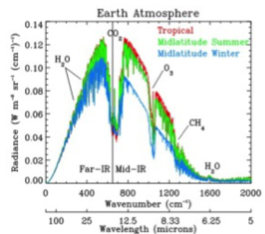


Mid-Term Impact (2-3 years)
  Disclaimer: Assumes that the instruments are preforming well on orbit (i.e., achieving climate change accuracy, acceptable instrument noise, acceptable duty cycle) and the mission is extended beyond the initial year.
  During the 2nd and 3rd year of the technology demonstration, the following could be accomplished if funded as extensions:
  Quantify interannual variability of the far-IR greenhouse effect, atmospheric cooling rate, and cirrus effects on the IR
  Quantify interannual variability of both reflected solar and thermal infrared spectra: the first full spectra ever observed of the Earth.
  Ability to use the calibration reference instruments through monthly intercalibration over 3 years to detect trends in calibration change of operational instruments such as CrIS, IASI, VIIRS, HIRS, AVHRR, CERES, and geostationary satellite sounders and imagers.
Calculated top-of-atmosphere clear sky Earth infrared spectra, illustrating the far-IR and mid-IR portions, as well as the large contribution of the far-IR to the Earth’s infrared radiant energy system. Image Credit: M. Mlynczak.

Slide 7
Longer Term Impact (4-5 years)
  Disclaimer: Again, this assumes that the instruments are preforming well on orbit and the mission extended beyond year 3.
  During the 4th and 5th year of the technology demonstration, the following can be accomplished:
    Provide an initial anchor for a climate record benchmark at levels of accuracy a factor of 5 to 10 beyond current instruments.
    Extend the statistical reliability of the inter annual natural variability for Far Infrared science and for IR and RS Spectral fingerprints of climate change examined in years 2 and 3 by covering a full normal 5 year ENSO cycle (i.e. El Nino and La Nina phases).
    Extend the ability to determine long term calibration drifts in a wide range of Earth sensors in LEO and GEO.
    Extend the lunar irradiance spectral calibration to include many more lunar cycles and thereby verify the variations due to libration of the moon.
    Verify the calibration capability of the instruments over the full nominal 5 year nominal instrument lifetime of future missions.
    Incorporate any lessons learned into future instrument designs, further reducing risk.
Continuity of the SDT is a cr

Slide 8
What won’t the CLARREO Pathfinder do?
  A low-cost pathfinder on ISS should not be expected to achieve the full complement of scientific goals of a full CLARREO mission (conducted on one or more specialized free-flyer spacecraft), however, it can certainly be expected to achieve the risk-reduction goals mentioned prior and to demonstrate the full performance of the calibration and verification systems.
  The short planned lifetime (1 to 2 years) of the CLARREO Pathfinder will likely result in a record shorter than the 5 years of observations needed to begin the CLARREO full mission spectral fingerprint benchmarks (L2 and L3 data products)
  The Pathfinder budget will support full Level 0 processing, but will not support complete Level 2 and 3 processing. Only observations sufficient to demonstrate the calibration accuracy and intercalibration capability will be processed to Level 1. No level 2 or 3 processing is planned. Only Level 4 processing sufficient to demonstrate intercalibration for CERES, VIIRS, and CrIS.
  If the Pathfinder is judged highly successful, HQ may decide at a later time to fund processing of the Pathfinder Level 0 observations to provide full CLARREO mission L1 through L4 data products.
  GNSS-RO observations are not obtained on ISS
  CLARREO full mission pre-formulation studies will continue in parallel with CLARREO Pathfinder
Demonstrating calibration accuracy and intercalibration capability
Key steps toward a full CLARREO mission

Slide 9
ISS Accommodation Studies

Slide 10
CLARREO Pathfinder Instruments
Infrared (IR) Instrument
Reflected Solar (RS) Instrument
Fourier Transform Spectrometer
Systematic error less than 0.1K (k=3)
200 – 2000 cm⁻¹ contiguous spectral coverage
0.5 cm⁻¹ unapodized spectral resolution
25 km – 100 km nadir only fov,
1 earth sample every 200 km
Mass: < 75 Kg
Power: < 125 W
Grating Spectrometer
Gimbal-mounted (2-axis)
Systematic error less than 0.3% (k=2) of earth mean reflectance
320 – 2300 nm contiguous spectral coverage
4 nm sampling, 8 nm res
300 m fov, 100 km swath
Mass: < 70 Kg
Power: < 100 W

Slide 11
CLARREO Pathfinder Location

Slide 12
Infrared Accuracy Validation
1) deep cavity verification blackbody (0.9995 emissivity) that can vary temperature from 210K to 330K: i.e. verify complete earth viewing dynamic range
(normal instrument blackbody has emissivity of 0.99 and only has one temperature)
2) 3 phase change cells (mercury, water, gallium) with melt temperatures of -38C, 0C, and 30C to calibrate the blackbody thermistors across the dynamic range
3) heated halo to verify the emissivity of the blackbody
4) optics design to eliminate polarization sensitivity
5) atmosphere absorption lines to verify interferometer spectral response
6) one half of all observations by the IR instrument are calibration observations, one half are earth viewing

Slide 13
Reflected Solar Accuracy Validation
1) instrument mounted on a 2 axis pointing gimbal to allow instruments to use the exact same optical path for lunar, solar, and earth viewing
2) deep space views for zero level verification
3) attenuators and solar views for nonlinearity verification
4) optics design to reduce polarization dependence below accuracy requirements
5) lunar and solar views to verify gain
6) lunar and solar views to verify flat fielding of detector array
7) lunar and solar views to verify stray light contributions
8) solar absorption lines to verify spectral response

