Slide 1
Lunar Radiance Calibration
X. Wu, F. Yu, and X. Shao
2016-02-29
Introduction – details on Thursday

Slide 2
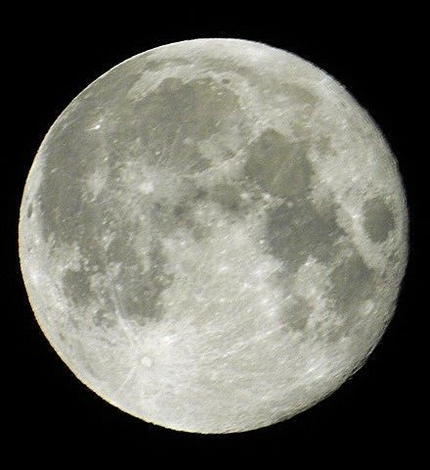
Lunar Irradiance Calibration
Jinghua Tian, Amateur Photographer
Instrument response to known signals, in this case lunar irradiance.

Slide 3
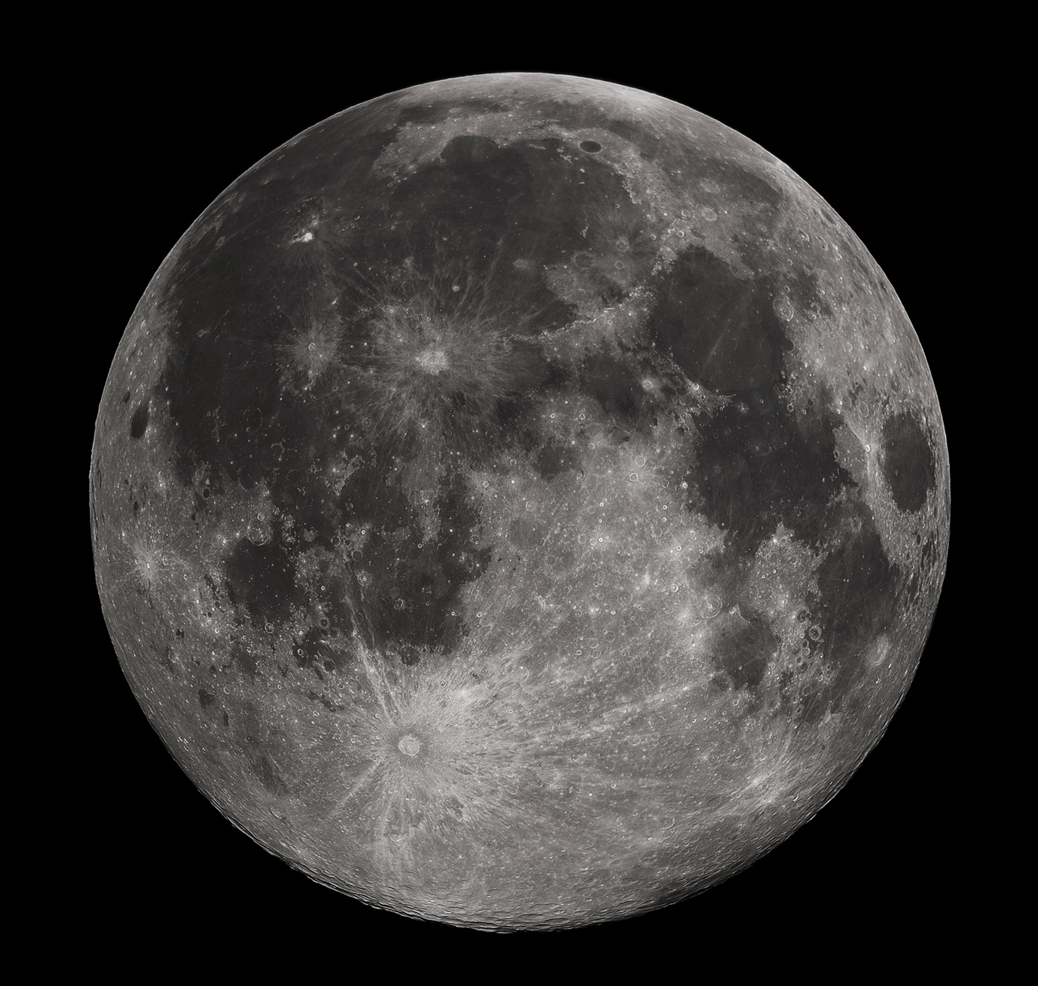
Lunar Irradiance Calibration
Gregory H. Revera via Wikimedia
Instrument response to known signals, in this case lunar irradiance.

Slide 4
Initial Results of Lunar Calibration
Accuracy is consistent, internally and with other methods.
But the precision is also consistently below expectation.

Slide 5
Uncertainty in Irradiance Calibration
E_{Lunar}: Model uncertainty
  Accuracy (absolute): Discrepancy with MODIS & SeaWiFS (5-10%)
  Precision (relative):
    Phase angle dependence (~3%)
    Libration (~2%)
f_{i}: Is over-sampling constant or known?
C^{i}_{M}: Which pixel is/isn’t the Moon?
  Edge detection
  PSF
C_{S}: Space clamp and 1/f noise

Slide 6
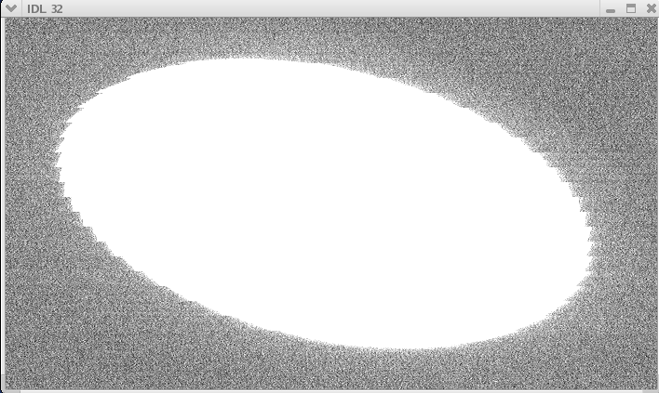
Lunar vs. Space Pixels

Slide 7
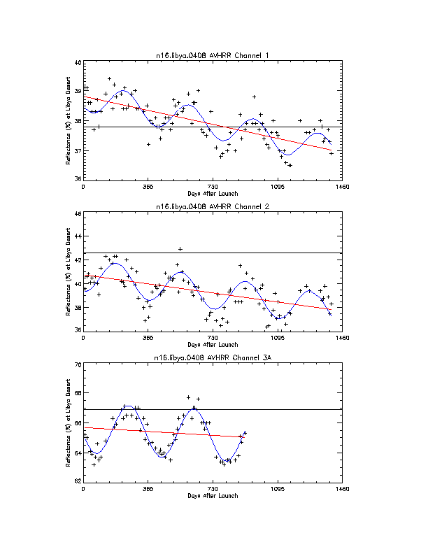
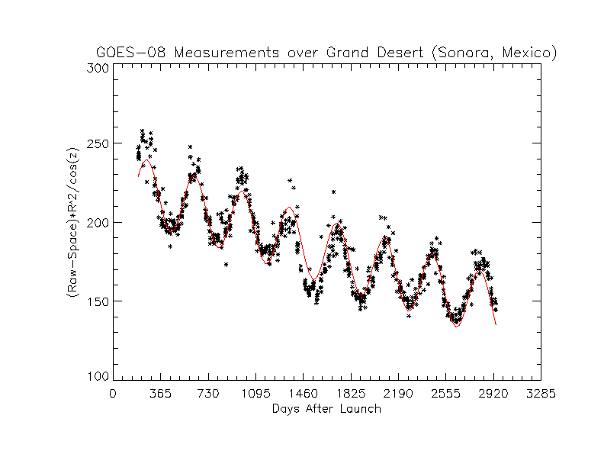
Desert Radiance Calibration

Slide 8
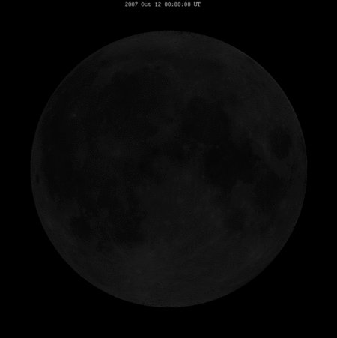
Difficulties for
Lunar Radiance Calibration
Select Targets
Compute Angles
Determine BRDF

Slide 9
Progress Since 2014
Select Targets
  Comparison of A New Lunar Radiometric Model based on SELENE/SP with Satellite Observing Lunar Images. Kouyama, T.¹, Y. Ishihara², R. Nakamura¹, S. Tsuchida¹, T. Matsunaga³, F. Sakuma⁴, Y. Yokota³, and S. Yamamoto³
Compute Angles
  Astronomer
Determine BRDF
  SELENE/SP
  PLEIADES
  AHI/ABI
2016-02-29 Tsukuba Japan

Slide 10
Summary
Lunar radiance calibration primarily addresses the difficulty of determining lunar irradiance from GOES Imager.
  More applicable to AHI/ABI/AMI
  Also have other benefits
Initial goal is to use it as a trending tool.
  Absolute calibration (i.e., SI traceable) and inter-calibration is possible.
Status
  Target selection has been nearly completed and presented to EUMETSAT Conference at Toulouse.
  Angle determination based on pattern recognition and coordinate rotation proves feasible and presented to SPIE at Toulouse. Expect improvement based on orbit parameters.
  BRDF determination is on-going. Expect collaboration with JMA (Visiting Scientist) and GSICS community.
More details in 4h.

