Slide 1
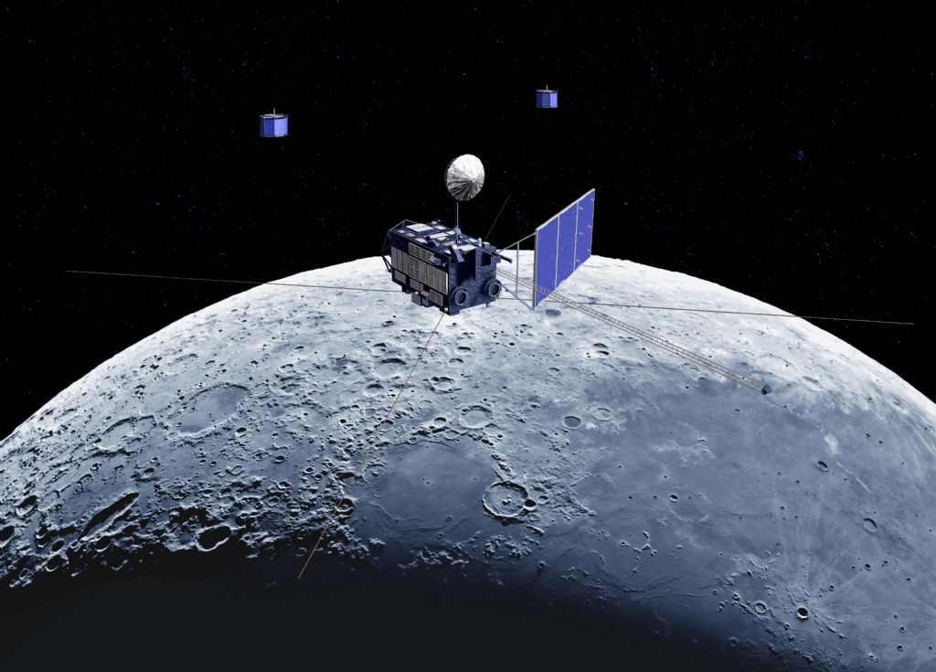
Lunar Calibration based on SELENE/SP data
Toru Kouyama (AIST)
Matsunaga, Nakamura, Yamamoto, Yokota and Ishihara
SELENE/SP Team
・SP lunar reflectance model
・Basic characteristics of SP model
・Our recent lunar calibration activities using SP model

Slide 2
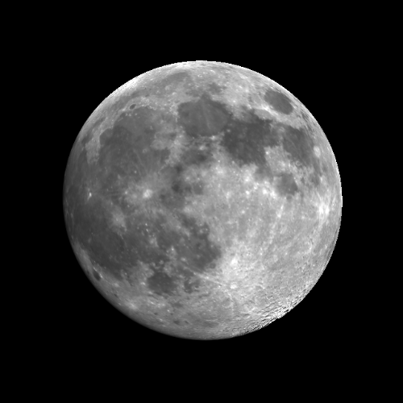
Using Moon for Radiometric calibration
Extremely Photometrical stable (1% change ⬄ 1 Myr)
[Kieffer, 1997]
Earth
No atmospheric and aerosol absorption and scattering
Moon is an ideal target for radiometric calibration
Reliable Lunar reflectance model is important, and SELENE/SP team has tried to develop such a reliable reflectance model.
Notes:
“Photometrical properties” do not change in any Moon observation.
Lunar calibration is one of ideal calibration methods

Slide 3
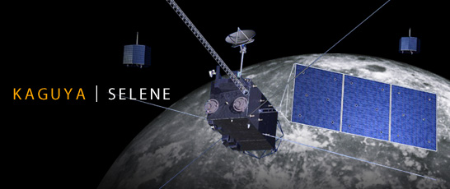
SELENE(KAGUYA) and SP
(Spectral Profiler)
SELENE:
・Size: 2 x 2 x 5m, 14 science instruments
・Orbit: Polar orbit (non sun-synchronous)
Altitude: 100 km
Ground track repeat cycle: ~ 30 days
・Mission period: 2007 – 2009 (finished)
Observing lunar surface
with various solar incident and phase angle conditions.

Slide 4
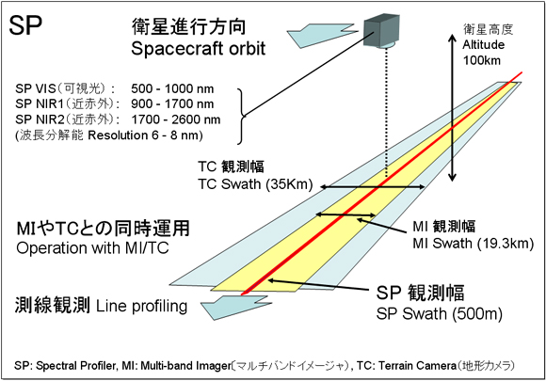
SELENE(KAGUYA) and SP
(Spectral Profiler)
Sensor type: Spectrometer
Point sensor
Spectral
Multi-band Imager
Terrain Camera
http://www.kaguya.jaxa.jp/en/equipment/tc_e.htm
Notes:
Sensor type: Spectrometer
Spectral range:
500-2600 nm
Spectral resolution:
6 nm (VNIR 520-960 nm)
8 nm (NIR-SWIR > 900 nm)
Observation swath
500 m

Slide 5
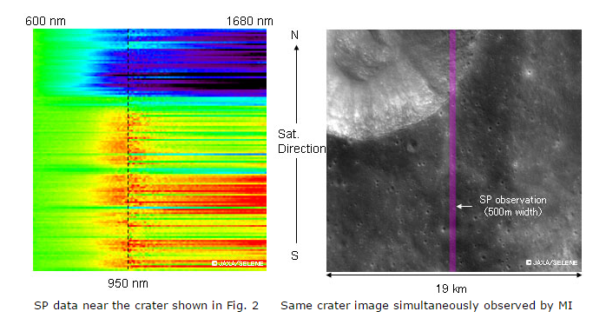
SELENE(KAGUYA) and SP
(Spectral Profiler)
SP Data
MI image and SP footprints
Wavelength
http://global.jaxa.jp/press/2007/12/20071214_kaguya_e.html
Notes:
During the mission, SP obtained this kind of data globally and repeatedly.

Slide 6
SP Lunar Reflectance model (Yokota et al., 2011)
Integrating 70 million observation data covering whole lunar surface with various phase angle conditions
Reflectance map (758nm, i=30, e=0, α=30°)
Spectral range:
512 – 1650 nm (160 channels)
Δλ = 6 - 8 nm
1˚ x 1˚ grid interval: published
0.5˚ x 0.5˚: to be published
Reflectance spectrum
Including incident, emission and phase angle dependencies using empirical functions
Notes:
Including incident, emission and phase angle dependencies using empirical functions

Slide 7
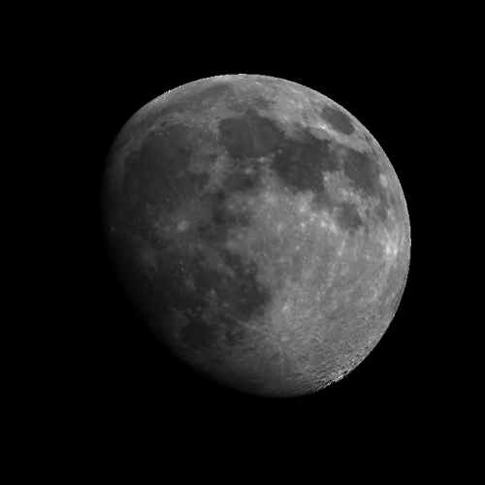
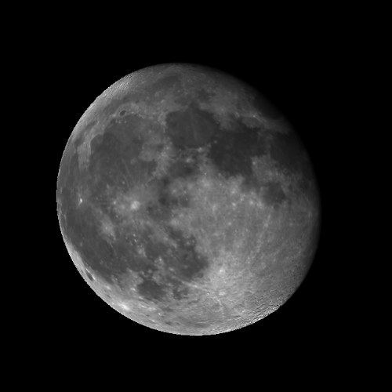
Simulating Moon observations
April 13, 2003
April 15
April 18

Slide 8
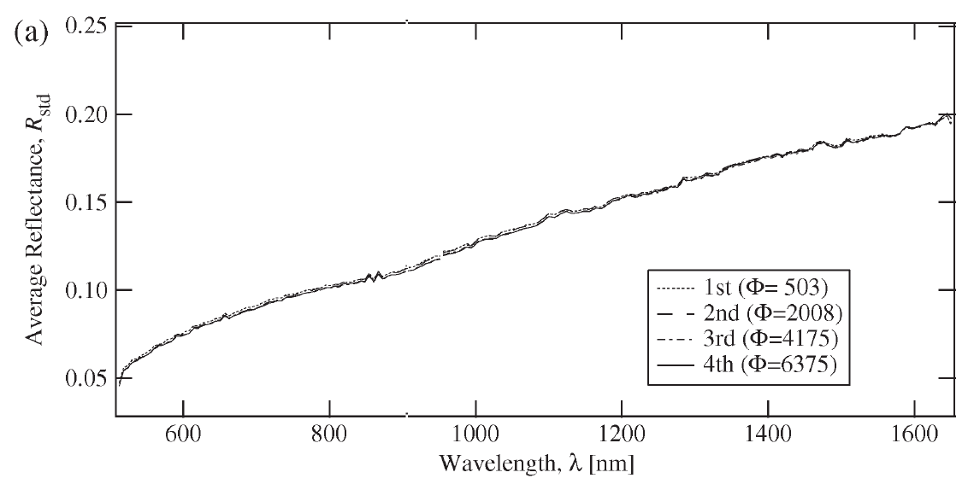
SELENE(KAGUYA) and SP
Sensitivity stability of SP during mission
Comparison of four observations of
Apollo 16 landing site [Yamamoto et al., 2011]
Nov. 19, 2007
Mar. 12, 2009
The degradation of SP was not significant over the mission period (variation: up to 1 %) [Yamamoto et al., 2011].
Notes:
Sensor stability during the mission

Slide 9
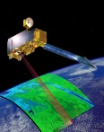
・SP model characteristics
Comparing with actual Moon observation data
Terra / ASTER

Slide 10
ASTER vs SELENE/SP
Observed
Simulated*
[Kouyama et al., Inpress, Icarus]
ASTER/Band 2 (660 nm)
April 14, 2003
*Integrated with ASTER Band2
Spectral response function (SRF)

Slide 11
Brightness Comparison: ASTER vs SELENE/SP
 | Band 1 (520-600 nm) | Band 2 (630-690nm) | Band 3 (760-860nm)
Correlation Coefficient | 0.992 | 0.993 | 0.993
・SP model describes lunar surface contrast very well
Good for measuring sensitivity deviation among pixels
and relative degradation of a sensor

Slide 12
Brightness Comparison: ASTER vs SELENE/SP
 | Band 1 (520-600 nm) | Band 2 (630-690nm) | Band 3 (760-860nm)
Correlation Coefficient | 0.992 | 0.993 | 0.993
Mean ratio (= Bias): Observed / Simulated | 1.27 | 1.01 | 0.95
Standard deviation of ratio (= Precision of each pixel) | 0.05 | 0.04 | 0.04

Slide 13
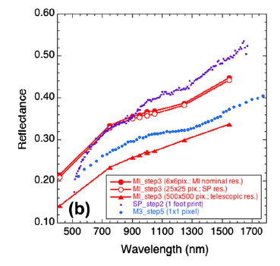
SP calibration issue
[Ohtake et al., 2013]
SP reflectance has a steeper profile
(cf. Ohtake et al., 2010 & 2013)
SP’s reflectance
In shorter wavelength region, SP model tends to describe lunar brightness darker than actual.
・More investigation for absolute accuracy of SP model is required
for measuring absolute degradation
Notes:
This plot shows a comparison of observation results among many sensors at a same place
SP reflectance shows a steeper profile than those
As a result… In shorter wavelength region, SP tends to describe Moon reflectance darker.
感度偏差: sensitivity deviation

Slide 14
SP calibration issue
Correction with other lunar reflectance model (ex. ROLO)
Ratio (ASTER/SP)
Fitted curve as a correction curve for SP model
Brightness ratio of Band 1
1.27 → 1.09
Lunar Irradiance
[Kouyama et al., Inpress, Icarus]
Measuring ROLO irradiance is from Kieffer and Stone, 2005
Good Solution?

Slide 15
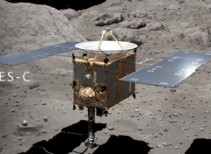
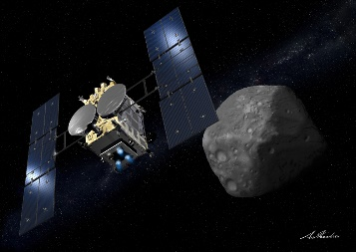
Lunar calibration for planetary explorers
©JAXA
©JAXA
Hayabusa
Hayabusa2

Slide 16
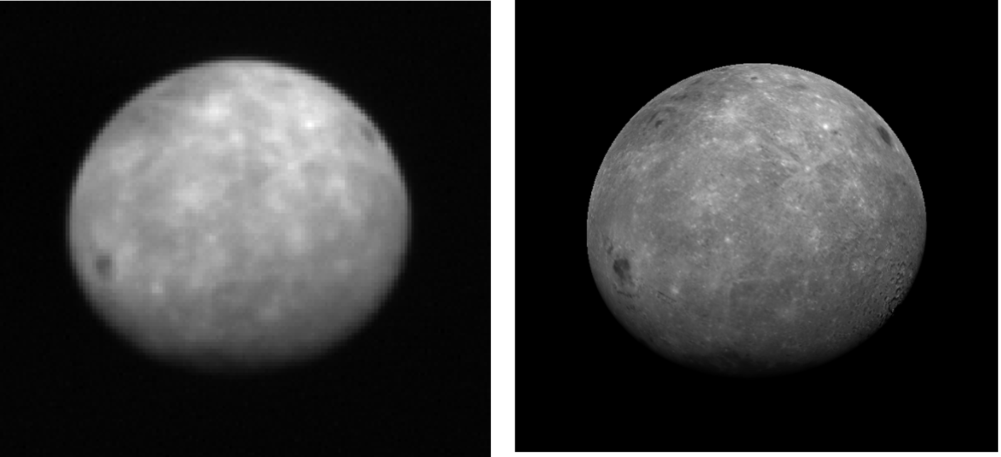
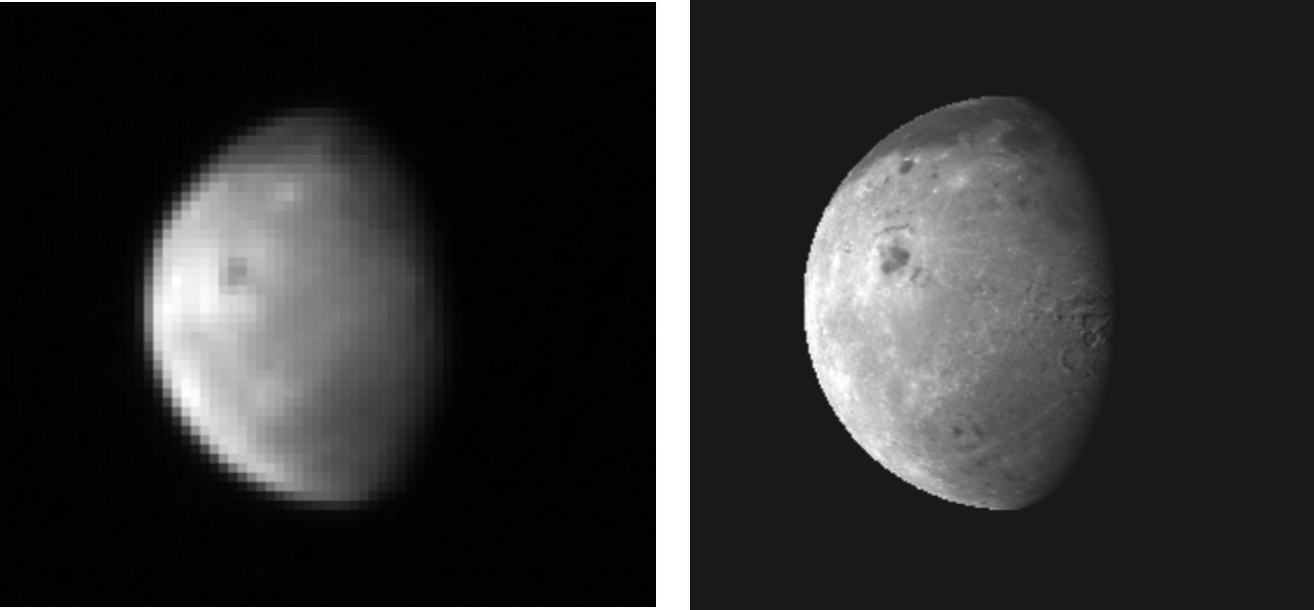
Observation
Simulation (Higher resolution)
Hayabusa
(AMICA)
2004.05.17
observed mainly the far side of the Moon
Visible band (~550nm)
Hayabusa2
(ONC-T)
2015.12.05
Visible band (~550nm)

Slide 17
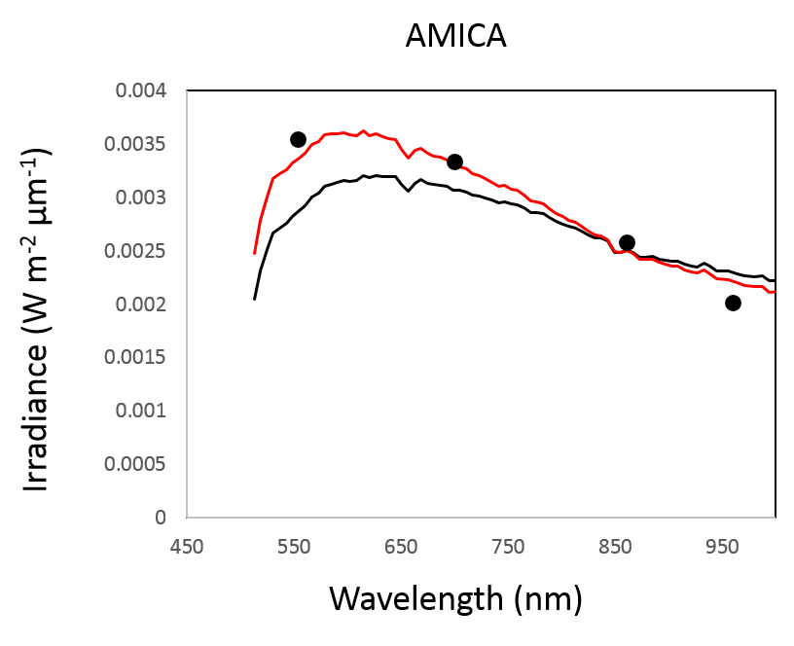
Irradiance comparison
Hayabusa/AMICA vs SP model
SP model
Corrected SP model with ROLO
Hayabusa/AMICA
AMICA’s irradiance is measured with calibration parameters reported in Ishiguro et all., 2011.

Slide 18
Summary
Lunar reflectance model based on SELENE/SP hyper-spectral data
has been developed. Using the model, we can simulate/predict
any moon observation.
SP model describes lunar surface contrast very well.
The model can be used for evaluating relative degradations of
sensors.
However…
Large brightness bias exists between SP model and actual Moon
observations.
Correction using other models may be a possible solution for improving absolute accuracy of SP model.
We can simulate not only the near side of the Moon, but also the far side!
Collaboration with ROLO/GIRO is very important.
Notes:
論理の飛躍: leap in logic

Slide 19
Supplement slides

Slide 20
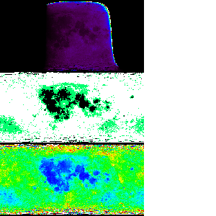
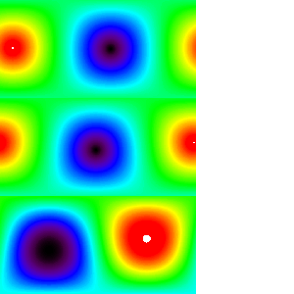
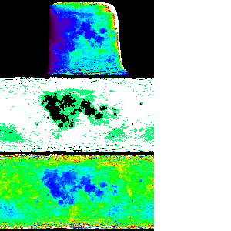
Reflectance map (i=30,e=0,α=30)
Geometry data
Incident angle
Emission angle
x Solar Irradiance
Lunar radiance map
Highland, mare and middle albedo region map
Phase angle at observation time

Slide 21
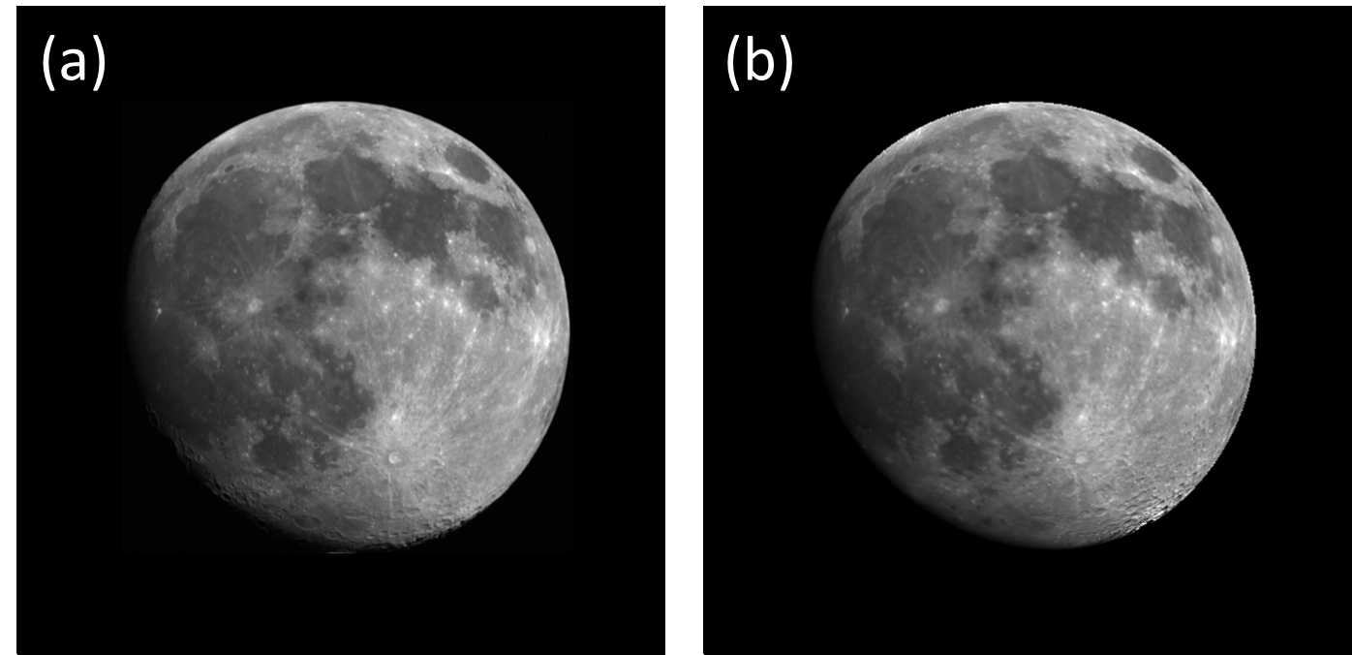
Other Known calibration issues
Model accuracy tends to be worse in high emission angle and high latitude regions
ASTER
Model
Using this model requires estimating the location where each pixel looks at on the moon surface (=ray tracing calculation).
=> Error from uncertainty of pixel registration should be considered.

Slide 22
Deference of phase angle dependency: ROLO vs SP

Slide 23
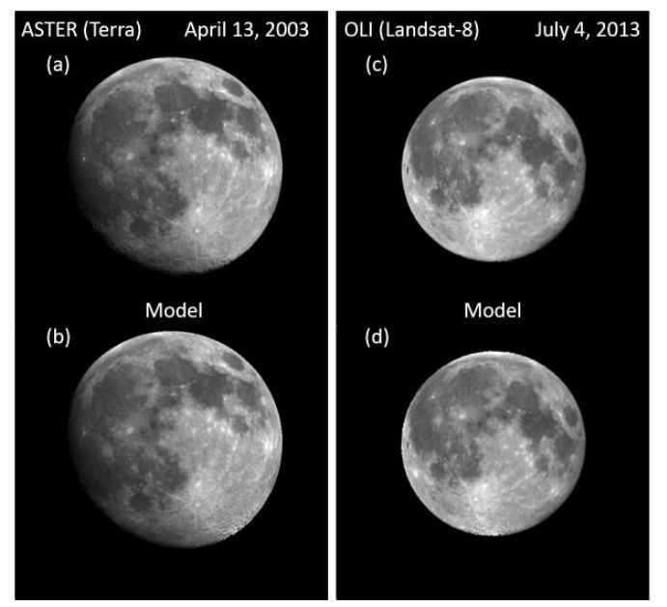
[Kouyama et al., 2014, LPSC]

Slide 24
Definition of three albedo groups of Moon surface

Slide 25
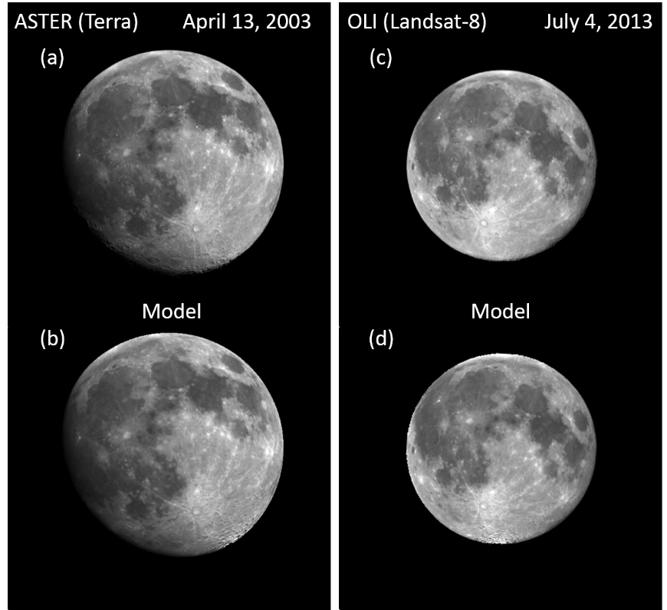
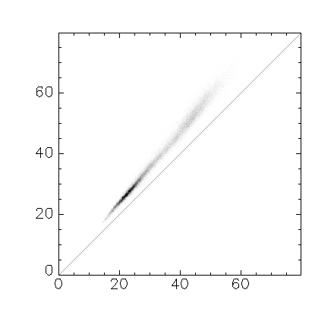
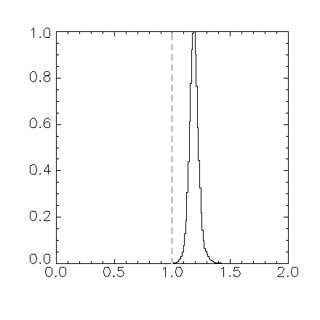
ASTER@2003.04.14 vs Model (SELENE/SP)
ASTER (Band 1) Large bias
Observed radiance (W m⁻² str⁻¹ μm⁻¹)
Relative Frequency
Modeled radiance (W m⁻² str⁻¹ μm⁻¹)
Observed / Model
Mean (Obseｒved/Model) = 1.27
SD = 0.05
SE (= SD/√Number of pixels used) = 0.0002

Slide 26
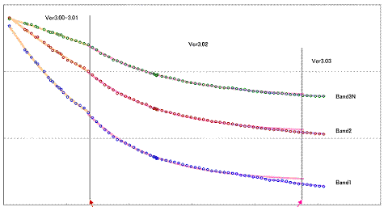
ASTER/VNIR degradation curves
1.0
0.9
Band 3
0.8
Band 2
Band 1
0.7
0
Day since launch
3000

Slide 27
ASTER Moon observation:
Moon observation conducted by ASTER is only once (April, 2003).
We are proposing the second Moon observation by ASTER to NASA/Terra.
14 April, 2003
EOM
?
Degradation ratio
?
?
Time
2016 or 2017

Slide 28
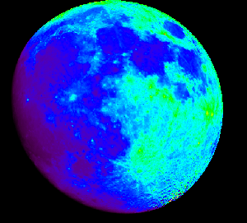
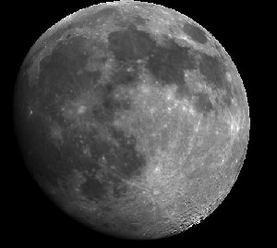
Simulated hyperspectral images
SRF convolution
Simulated band image

Slide 29
Model equations
i: incident, e: emission, α: phase anlge
F_{sun}: Sun light Flux (W/m²/um)
S: SRF
r: reflectance using i=30, e=0, α=30 as the basis condition [Yokota et al.,2011] (11)
From SP model
X_{L}: Empirical function of sun-light scattering
f: Empirical function of phase angle dependencies

Slide 30
Model equations
After Yokota et al., 2011, Eq (11)
Reflectance to be calculated
i: incident angle
e: emission angle
α: phase angle
X_{L}: Lunar lambert function
Correction terms for Limb darkening effect
f: Empirical function of phase angle dependencies
B: Shadow hiding opposition effect
P: Regolith phase function
h, c, g, B₀: Model coefficients
Notes:
c₁=-0.019, c₂=0.242x10⁻³, c₃=-1.46x10⁻⁶

Slide 31
Model equations
After Yokota et al., 2011, Eq (11)
Reflectance to be calculated
i: incident angle
e: emission angle
α: phase angle
X_{L}: Lunar lambert function
Correction terms for Limb darkening effect
f: Empirical function of phase angle dependencies
B: Shadow hiding opposition effect
P: Regolith phase function
h, c, g, B₀: Model coefficients

Slide 32
Model equations
After Yokota et al., 2011, Eq (11)
Reflectance to be calculated
i: incident angle
e: emission angle
α: phase angle
X_{L}: Lunar lambert function
Correction terms for Limb darkening effect
f: Empirical function of phase angle dependencies
B: Shadow hiding opposition effect
P: Regolith phase function
h, c, g, B₀: Model coefficients
High land, mare and medium albedo

Slide 33
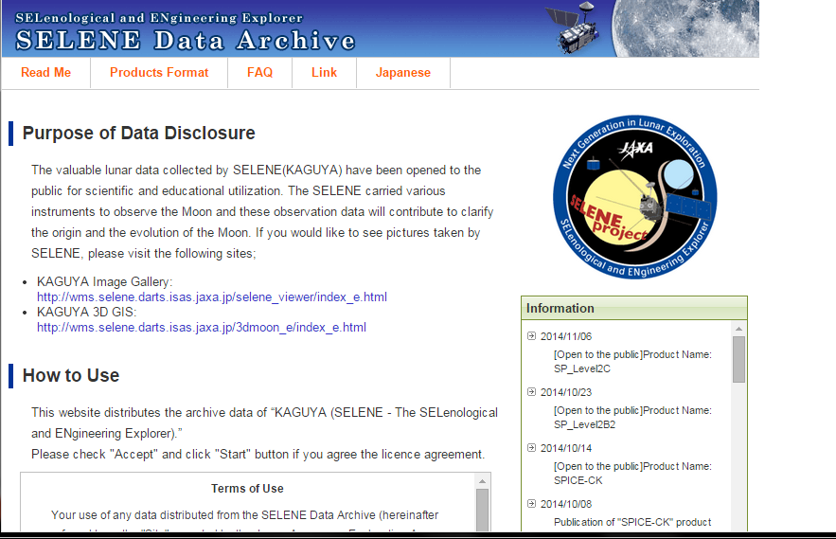
SELENE(KAGUYA) and SP
http://l2db.selene.darts.isas.jaxa.jp/index.html.en

Slide 34
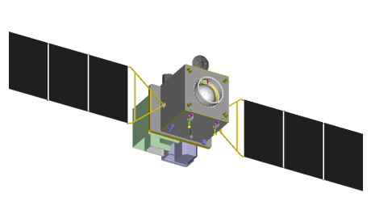
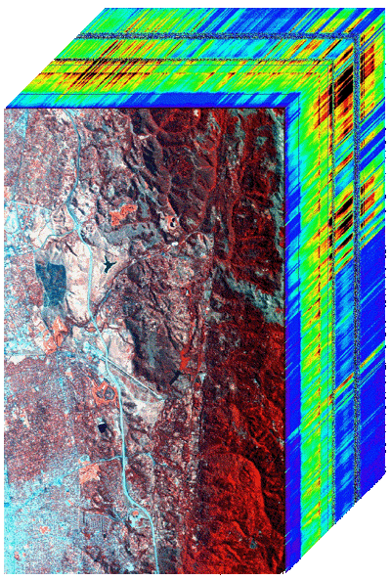
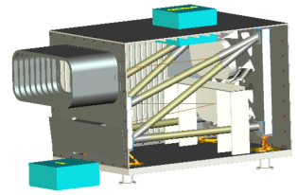
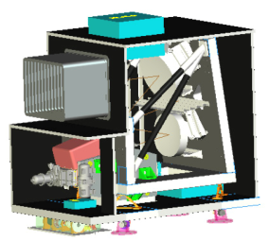
HISUI mission
ALOS-3
(JAXA)
Panchromatic
Stereo Camera
HISUI
Multispectral Imager
Hyperspectral Imager
Hyperspectral
Image “Cube”
The hyperspectral imager:
Contiguous and high resolution spectral information from visible to short-wave IR
The multispectral imager:
4 Bands observation with a high spatial resolution by a wide swath

Slide 35
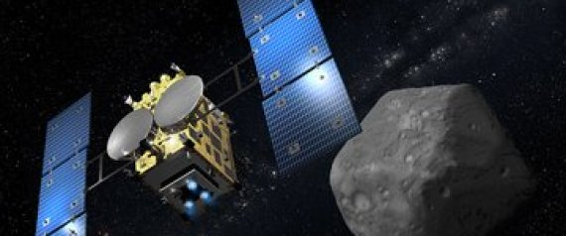
Hayabusa-2
Japanese satellite for exploring a small asteroid

