Slide 1
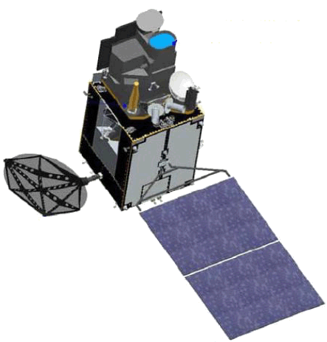
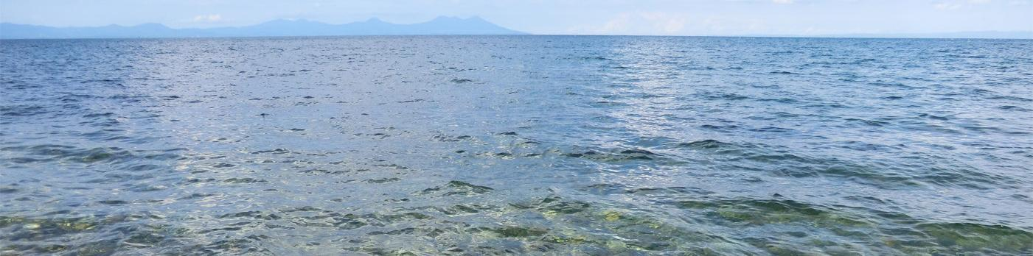
JAXA Himawari-8
Ocean Color and Aerosol
Hiroshi Murakami
JAXA/EORC
2016 GSICS Data & Research Working Groups Meeting
Mini Conference, 29 Feb.,2016

Slide 2
1. Product development in EORC
JAXA Himawari-8 products (planned)
Level | Product name |  | Grid size | Format
L1 | Reflectance (6 bands) Brightness temperature (10 bands) |  | 0.02°~0.05° Equal lat-lon grid (Full disk) 0.01° (around Japan) | NetCDF4
L2 | Atmosphere | Aerosol optical thickness, Angstrom exponent, cloud properties
 | Ocean | Sea surface temperature Ocean color (Rw, Chla..)*
 | Land | Fire detection, Vegetation index, Snow cover
 | Flux | Short-wave radiation, PAR, UV*..
L3 | Hourly average
Underlined products are produced regularly (* will be open soon)
Other products are under investigation
JAXA products are distributed by FTP with simple user registration http://www.eorc.jaxa.jp/ptree/

Slide 3
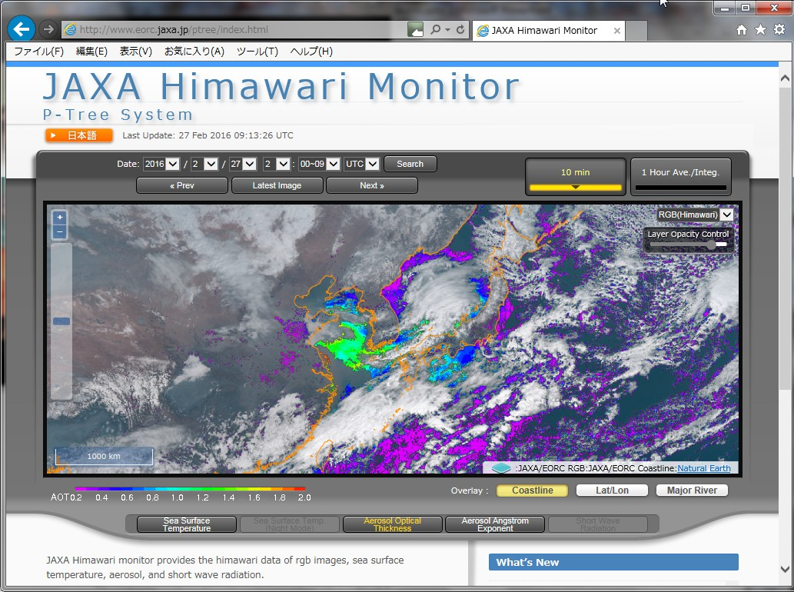
http://www.eorc.jaxa.jp/ptree

Slide 4


2. Aerosol estimation & atmospheric correction
t₀t₁ × ρ_{s}^{BRF}
1 − S_{a} × ρ_{s}
ρ_{t} /t’ = ρ_{r} + T₀T₁×ρ_{g} + ρ_{a} +
Satellite data
TOA reflectance
ρ_{t}
Geometry, time
Vi-cal correction
Solar irradiance
ρ_{t}
E₀ cos θ₀
t₁
Total transmittance
Rayleigh LUT (t’, ρ_{r})
Solar
zenith
Molecular
scattering
ETOPO1 elevation
Gas absorption correction & Rayleigh subtraction
ρ_{r}
ρ_{a}
Cloud
TOMS/OMI ozone
Aerosol
T₁ direct
transmittance
JMA objective analysis Pres., vapor
t’ , ρ_{r}
cloud mask
T₀ direct
transmittance
S_{a}
no cloud
Spherical
albedo
Surface reflectance ρ_{s} (with BRF)
T₁ ρ_{g}+ t₁ ρ_{w}
pre assume ρ_{s}(λ)
Land: λ = VIS
Ocean: λ = NIR, SWIR
Direct
irradiance
Diffuse irradiance
Aerosol estimation
t₀
Total transmittance
ρ_{s}
ρ_{w}+ρ_{g}
Aerosol τ and model
surface
solar
irradiance
reflection
by vegetation
Aerosol LUT
t₀, t₁, T₀, T₁, R_{a}, S_{a}
ρ_{a}, t₀t₁, S_{a}
Surface reflection
Surface reflectance
r_{rs}⁰⁻
LUTs were made by Pstar3 which is developed and distributed by OpenCLASTR project
http://www.ccsr.u-tokyo.ac.jp/~clastr/
ρ_{s}
Ocean Color

Slide 5






Targets of the Himawari-8 aerosol products
Investigate technical issues through collaboration with JAXA LEO missions (GCOM-C, EarthCARE, GOSAT-2..) and JMA/MRI
Himawari-8/AHI
JMA
Algorithm development
Technical issues:
Product accuracy
  Surface reflectance (+BRDF) estimation
Consistency with the assimilation models
  Aerosol scattering and absorption parameters
  Aerosol vertical structure
GCOM-C PI research
EORC+JMA/MRI
Products
Users
EORC, JMA/MSC
Model assimilation
EarthCARE PI research
JMA/MRI-EORC collaborative research (EarthCARE, GCOM-C, GOSAT)
JAXA-MRI, NIES, Kyusyu-U collaborative research
Near future
Monitoring & Prediction
JMA..
The aerosol algorighms are based on Fukuda et al., 2013 (land) and Higurashi and Nakajima, 1999 (Ocean)

Slide 6
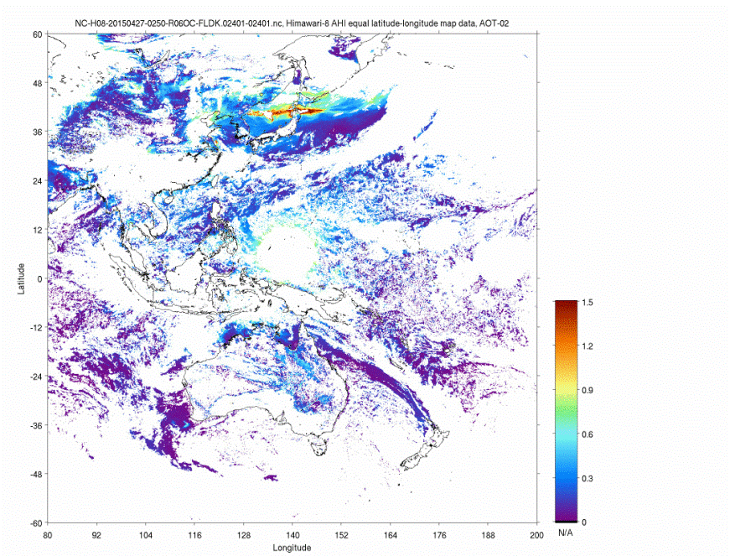
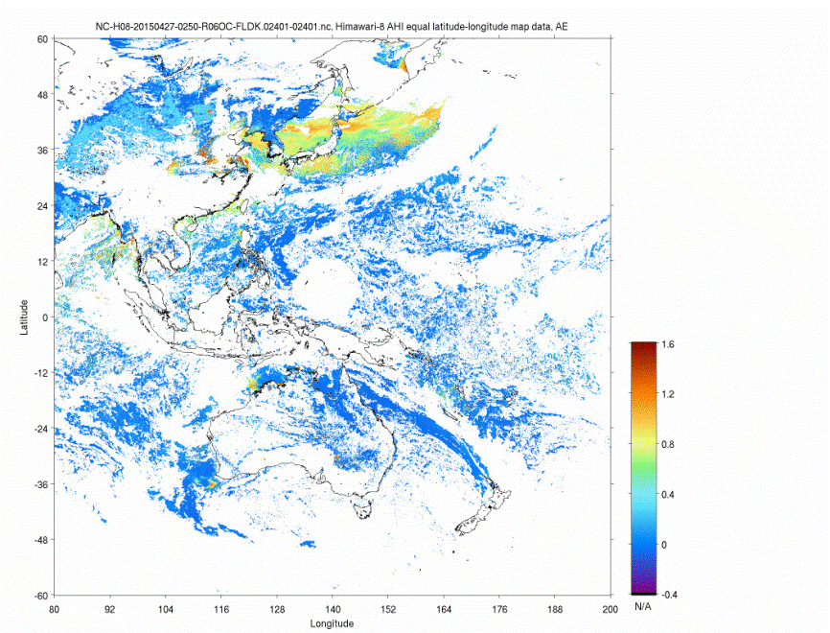
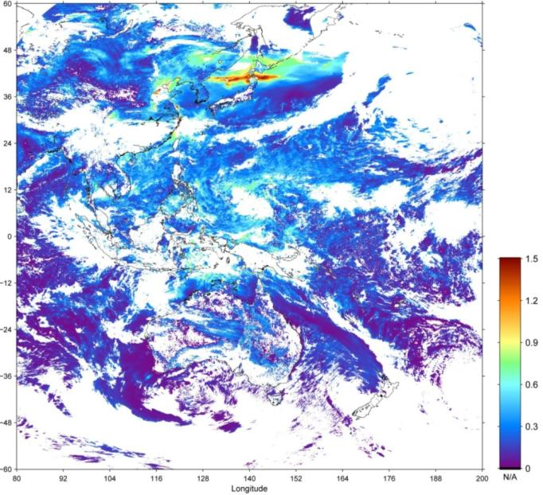
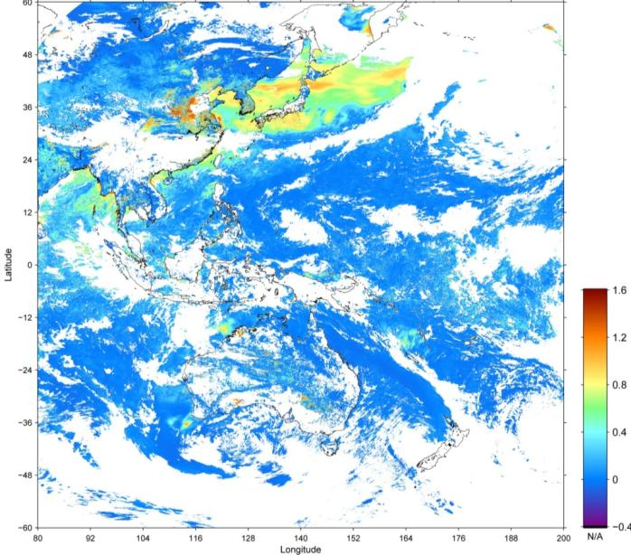
Examples of aerosol estimation
Examples in 27 April 2015 (product tests)
Aerosol optical thickness
Aerosol angstrom exponent
daytime mean
daytime mean

Slide 7
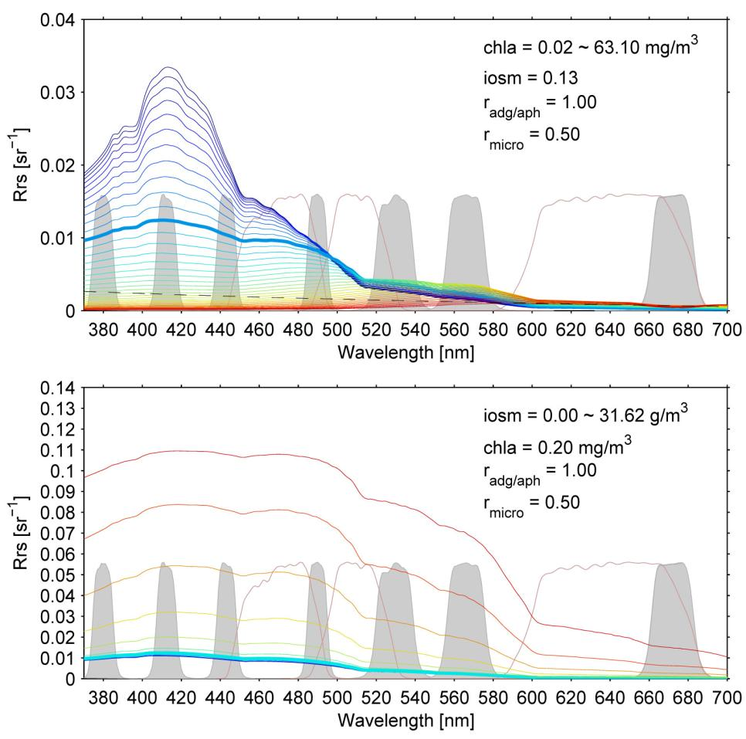
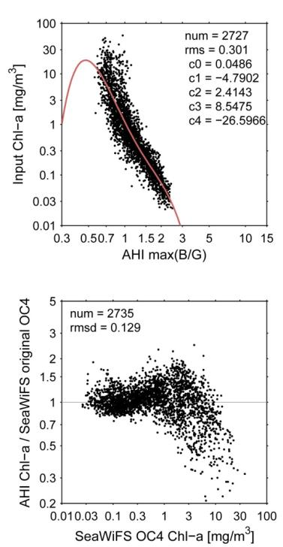
3. Ocean color: AHI Chla algorithm
Low sensitivity in low Chla
Chla
SGLI
AHI
Regression by NOMAD data
Low sensitivity in High Chla
Inorganic suspended
matter (IOSM)
Wavelength of the green band is at 510nm
OCx-type algorithm cannot estimate Chla in > ~3mg/m³
B3 is used for the high Chla
Higher sensitivity at Blue than Red
Blue and Green bands are new bands from the previous Himawari-7

Slide 8
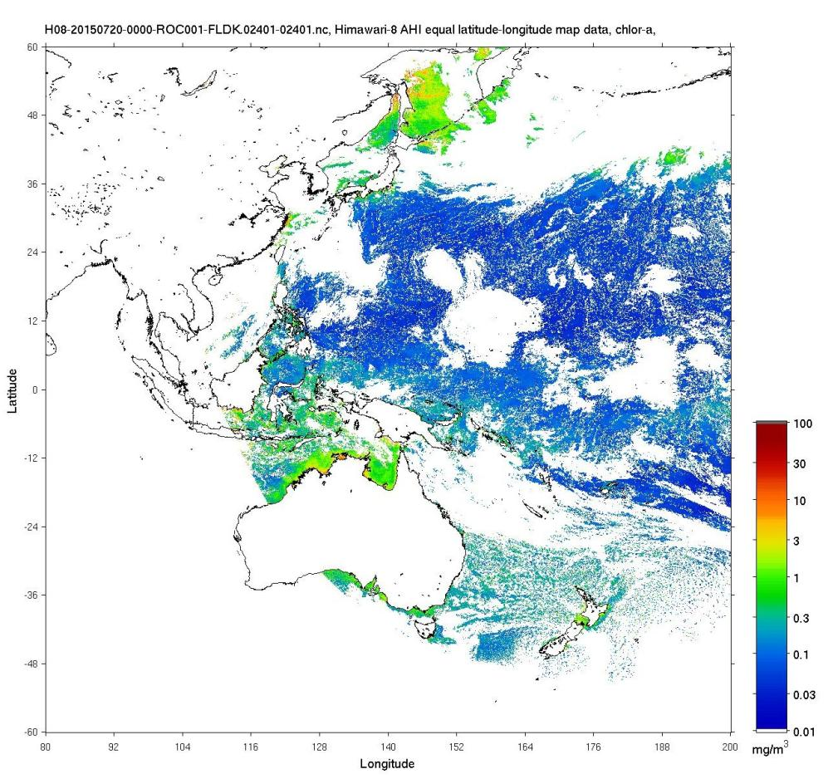
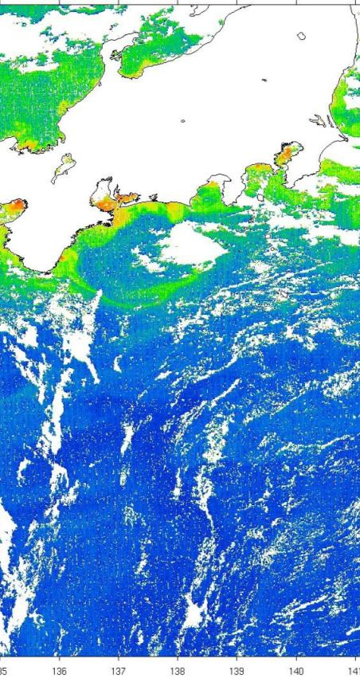
3. Ocean color: Chl-a 2015/07/20 00:00 (AHI)

Slide 9
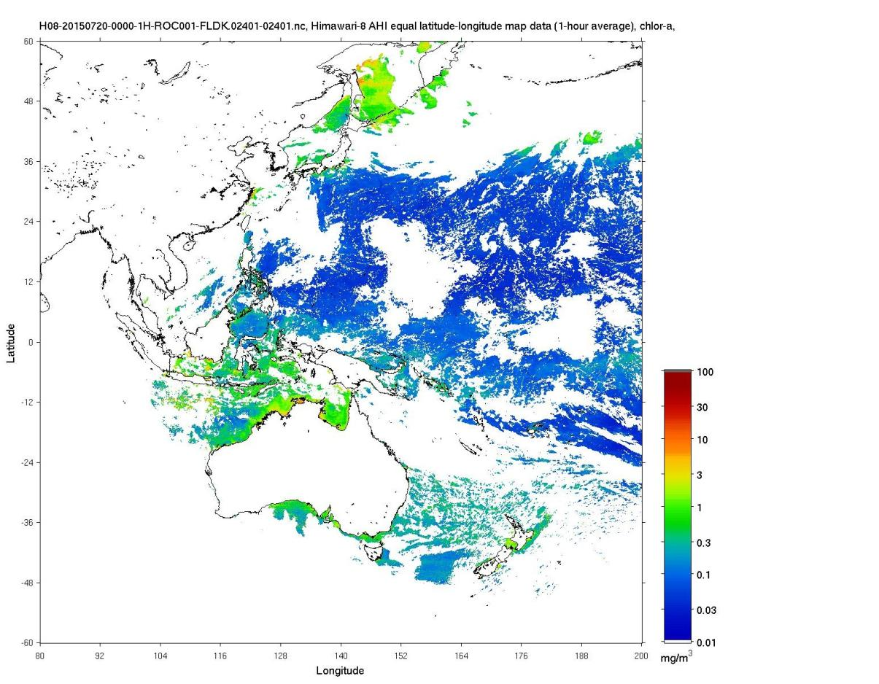
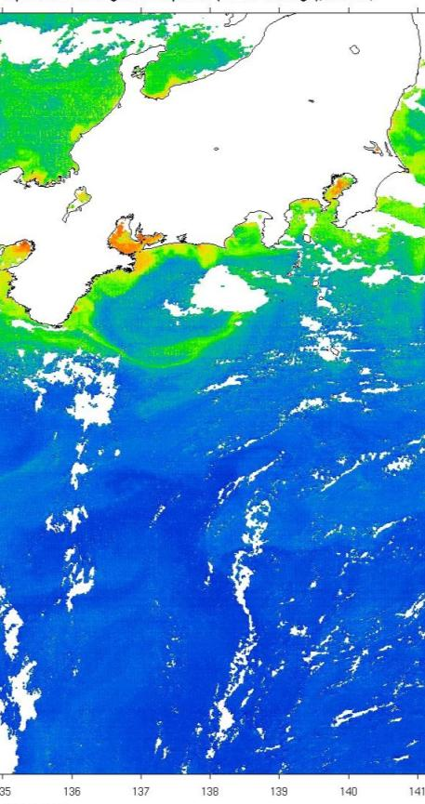
3. Ocean color: Chl-a 2015/07/20 00:00-00:50 (AHI)

Slide 10
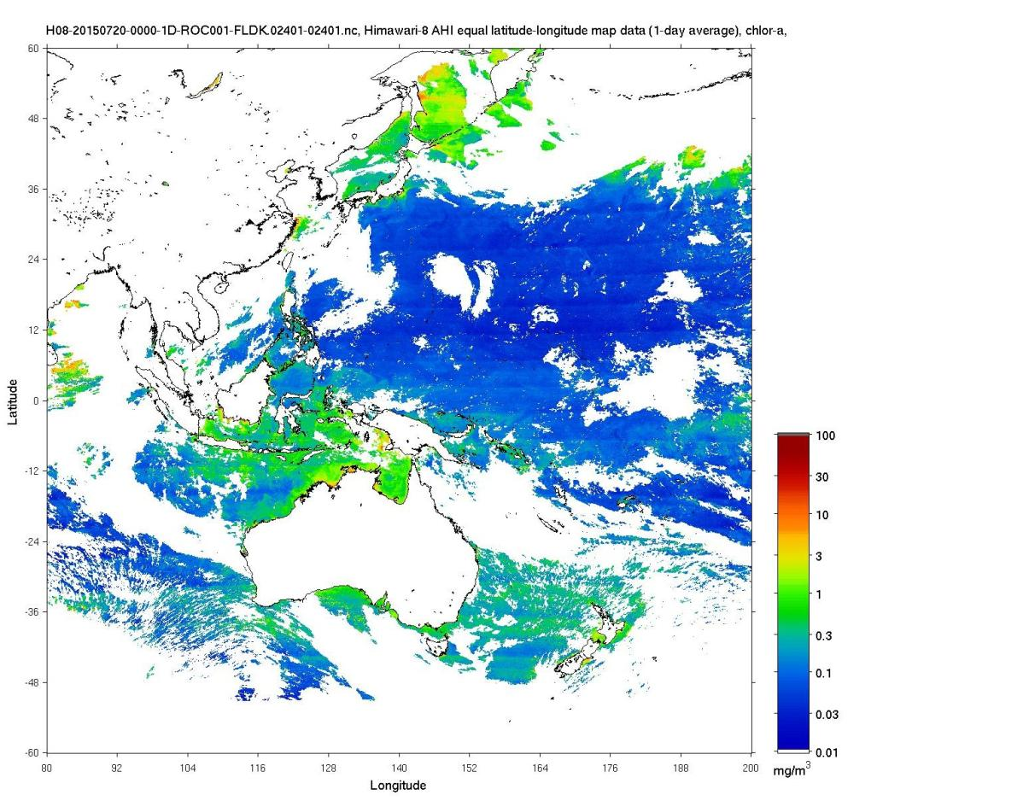
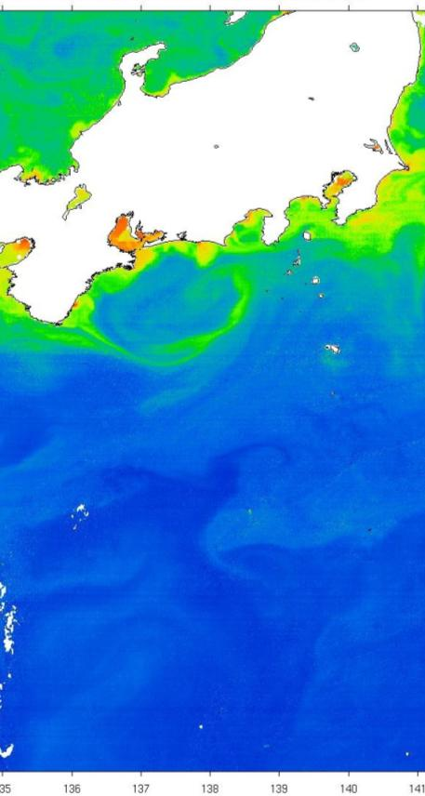
3. Ocean color: Chl-a 2015/07/20 00:00-05:50 (AHI)

Slide 11
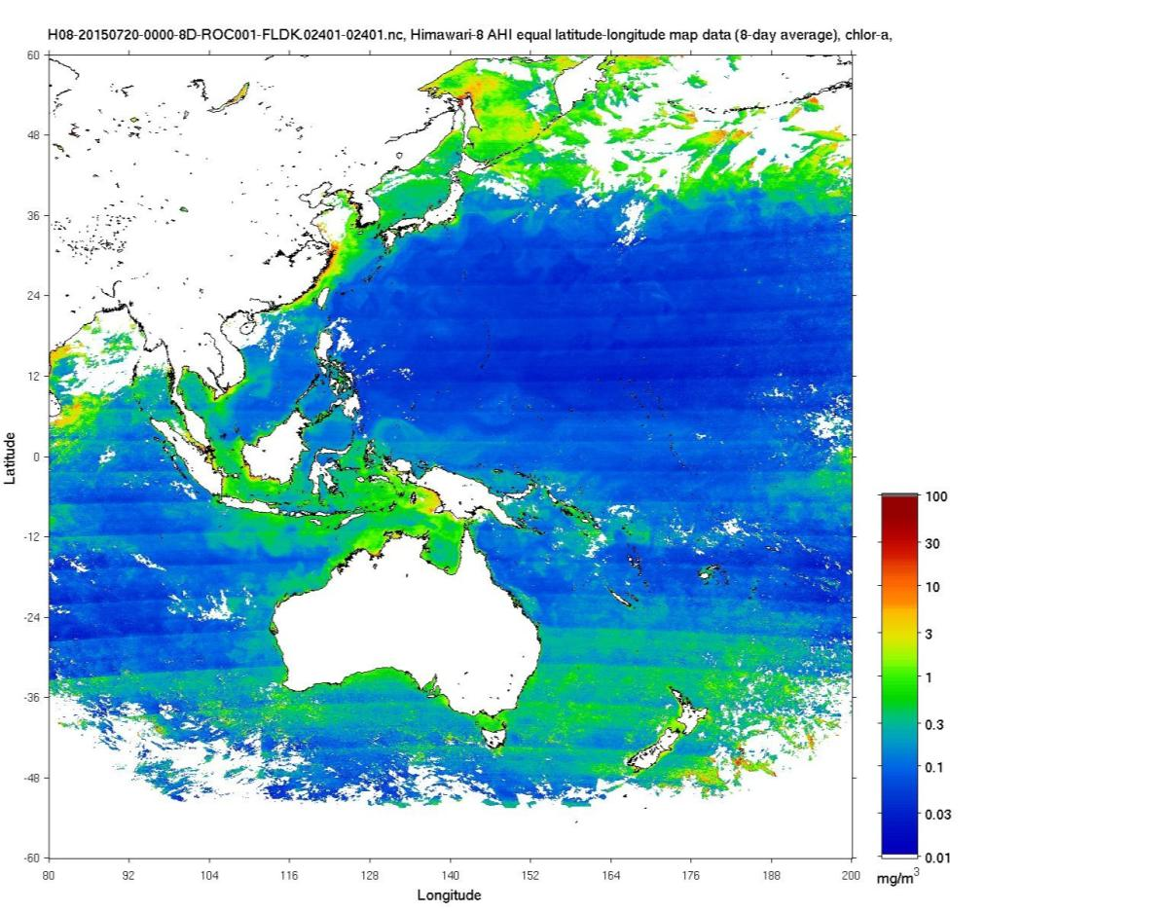
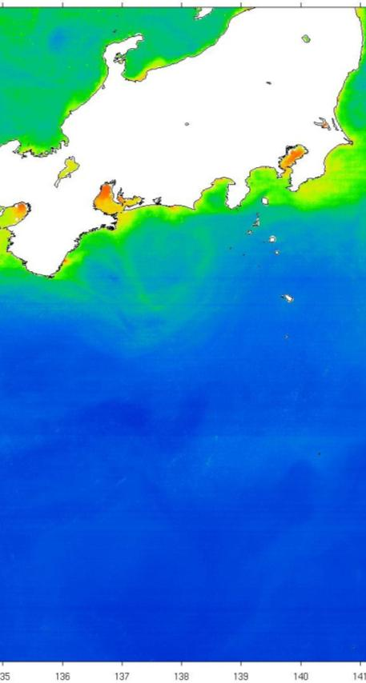
3. Ocean color: Chl-a 2015/07/20-27 00:00-05:50 (AHI)

Slide 12
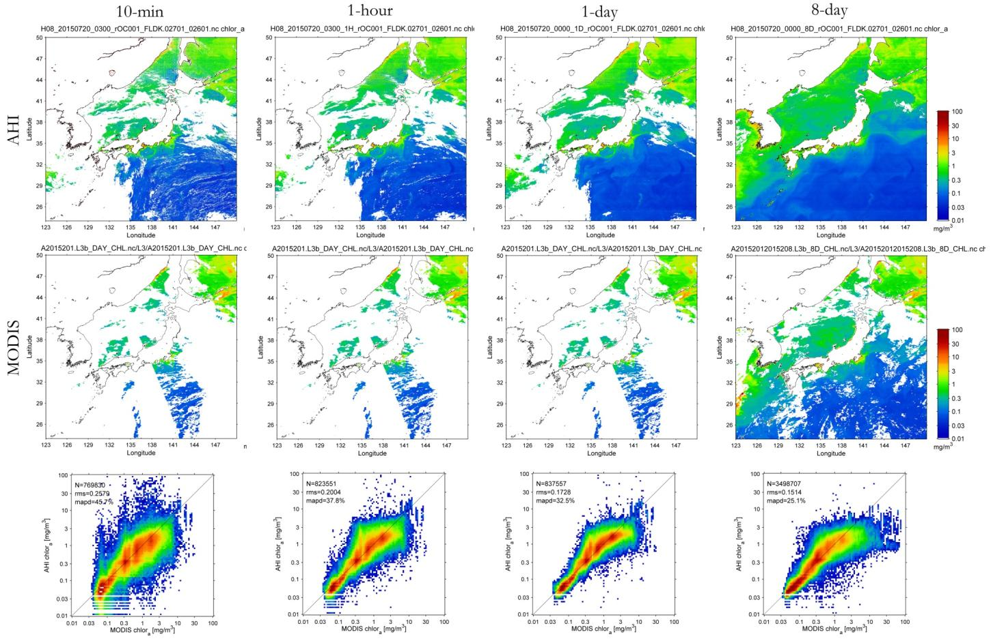
3. Ocean color: AHI Chla comparison with MODIS
10-min AHI Chla
hourly AHI Chla
daily AHI Chla
8-day AHI Chla
AHI Chla agrees to MODIS Chla in less than 10mg/m³ after temporal average (>1-hour)

Slide 13
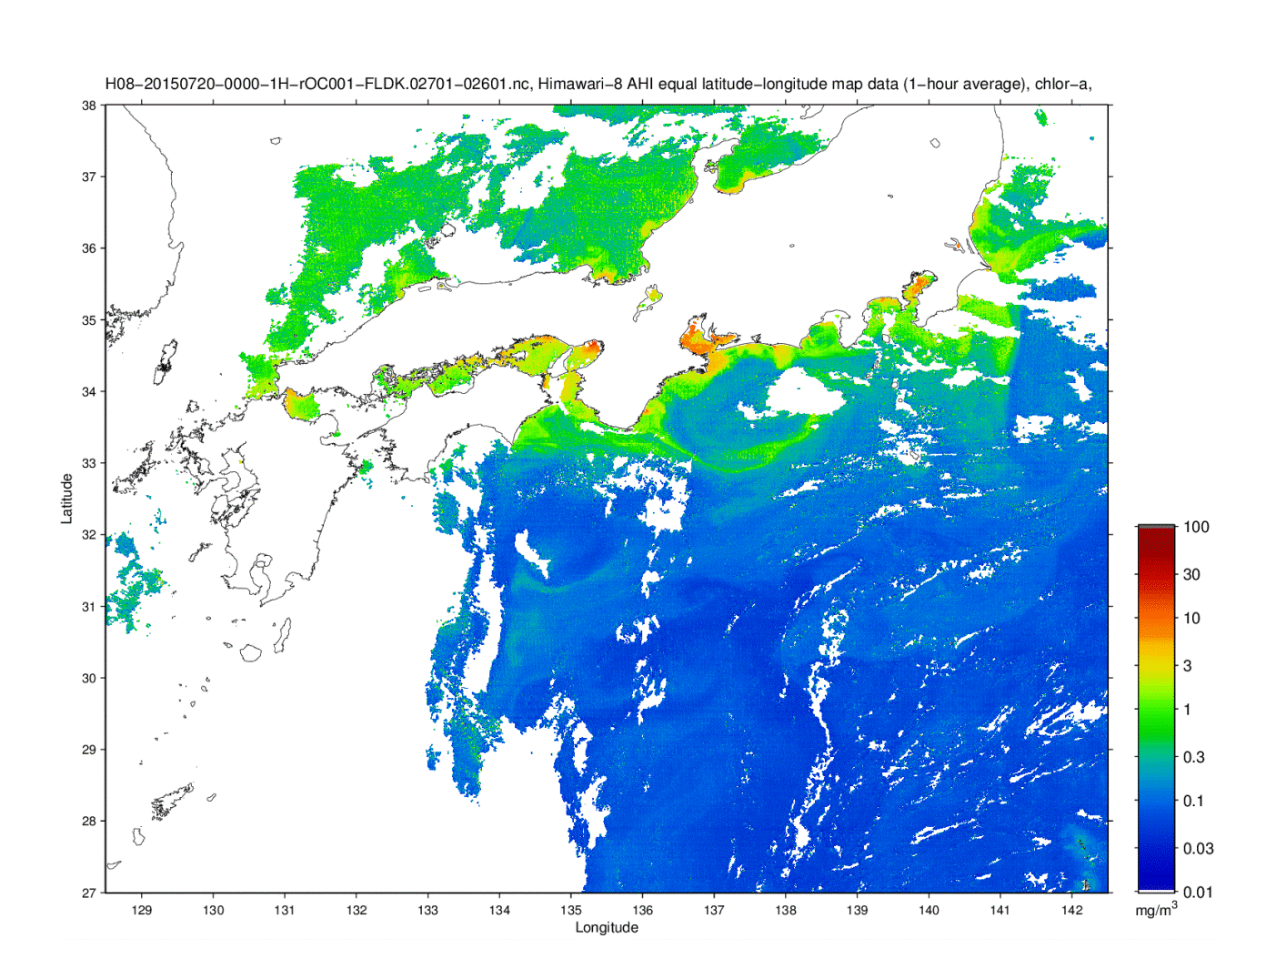
3. Ocean color: 2015/07/20~27 hourly Chla

Slide 14
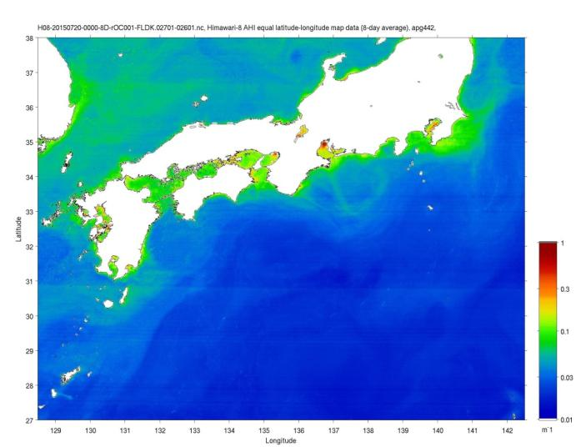
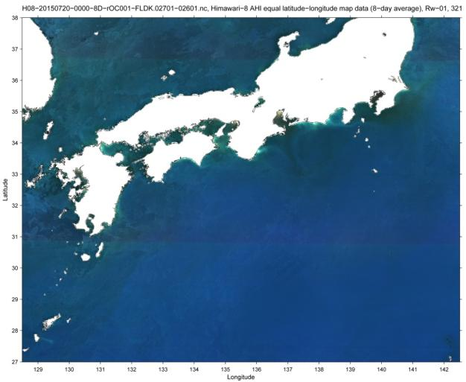
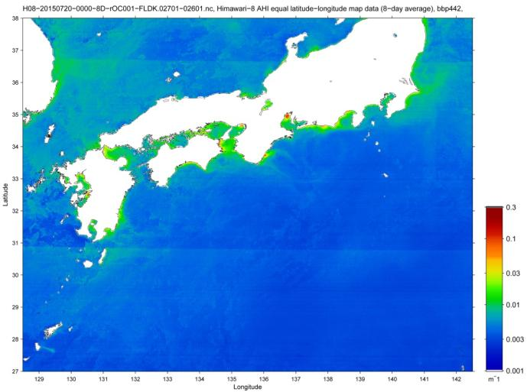
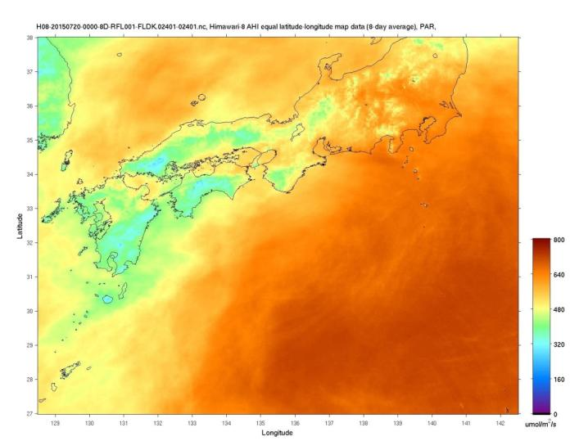
3. Ocean color: other products
AHI 20150720-27 8-day average
R_{rs}
a_{pg}442
b_{bp}442
PAR

Slide 15
4. Vicarious calibration
Inter-band calibration (Bands 4 and 5 are fixed) using Aqua MODIS R_{rs} in visible
t₀t₁ × ρ_{s}^{BRF}
1 − S_{a} × ρ_{s}
Satellite data
ρ_{t} /t’ = ρ_{a} + ρ_{r} + T₀T₁×ρ_{g} +
Geometry, time
Vi-cal correction
Vicarious calibration
ρ_{t}
ρ_{t}(λ), λ = VIS
ρ_{t}(λ), λ = NIR, SWIR
Rayleigh LUT (t’, ρ_{r})
ETOPO1 elevation
Gas absorption correction & Rayleigh subtraction
Gas absorption correction & Rayleigh subtraction
TOMS/OMI ozone
JMA objective analysis Pres., vapor
t’ , ρ_{r}
LUTs are consistent with the AC algorithm
cloud mask
no cloud
λ = NIR, SWIR
Surface reflectance ρ_{s} (with BRF)
λ = VIS
pre assume ρ_{s}(λ)
Land: λ = VIS
Ocean: λ = NIR, SWIR
Aerosol estimation
R_{a}, t₀t₁, S_{a}
Aerosol τ and model
Aerosol τ and model
Aerosol LUT
t₀, t₁, T₀, T₁, R_{a}, S_{a}
ρ_{a}, t₀t₁, S_{a}
Surface reflectance
ρ_{w}(VIS)
ρ_{s}
Atmospheric correction algorithm
BRDF correction
Reference R_{rs}

Slide 16
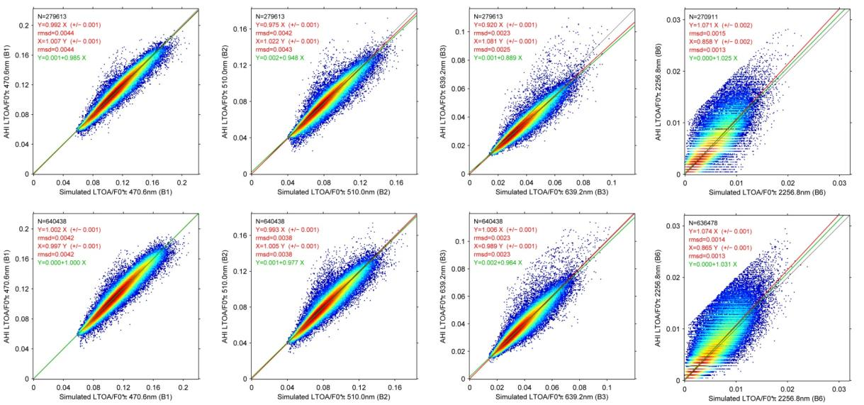
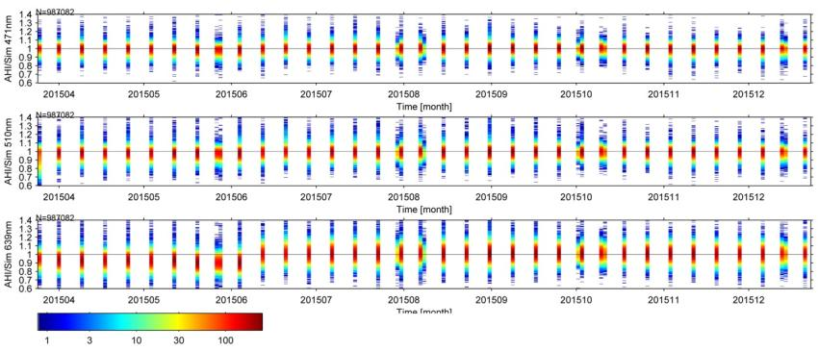
4. Calibration sensitivity: AHI Cross cal with MODIS R_{rs}
Before
6/8 04:30
Band 1
Band 2
Band 3
Band 6
AHI
AHI/sim=0.992
AHI/sim=0.975
AHI/sim=0.920
AHI/sim=1.071
after
7/7
AHI
AHI/sim=0.997
AHI/sim=0.993
AHI/sim=1.006
AHI/sim=1.074
Simulated
Simulated
Simulated
Simulated
Band 1
Band 2
the results are stable after 8 June 2015.
Band 3

Slide 17
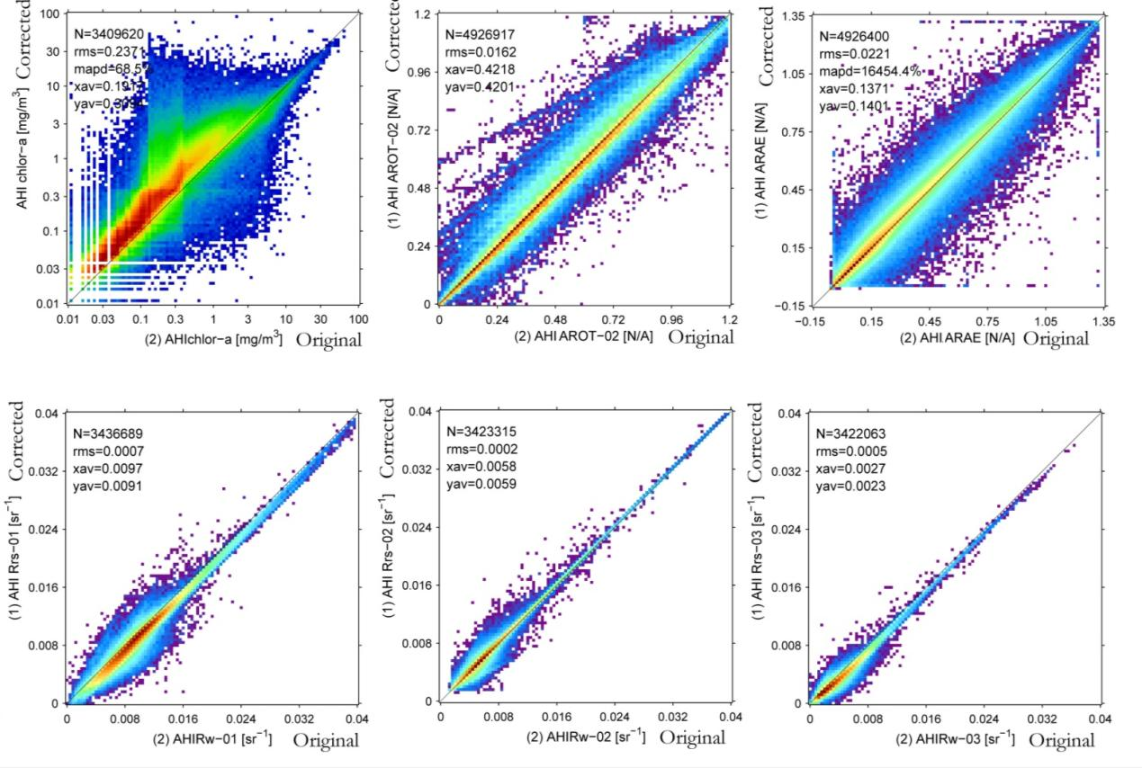
4. Calibration sensitivity:
  Effect of the vicarious calibration correction
AHI with corr
Chla
AOT510
AE
AHI w/o corr
AHI w/o corr
AHI w/o corr
AHI with corr
R_{rs}470
R_{rs}510
R_{rs}640
AHI w/o corr
AHI w/o corr
AHI w/o corr
Chla needs the accurate gain correction

Slide 18
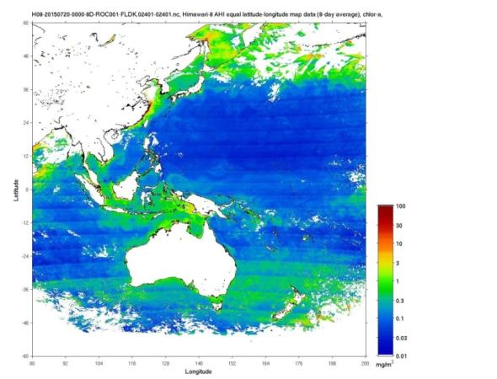
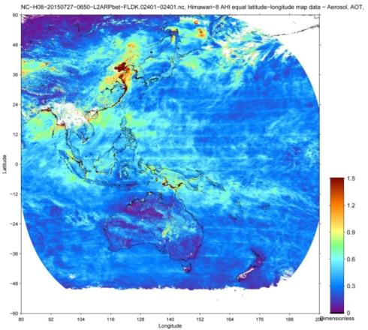
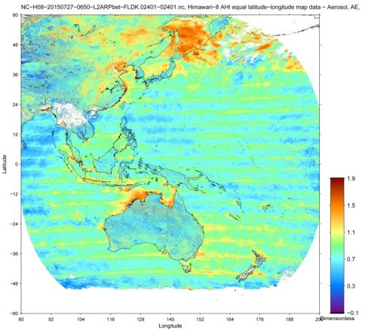
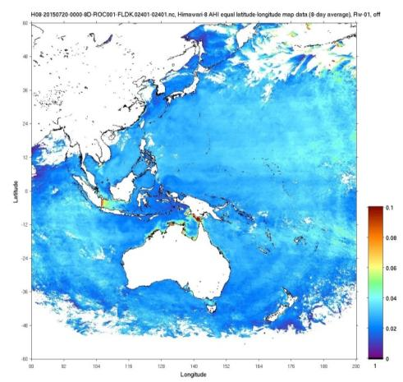
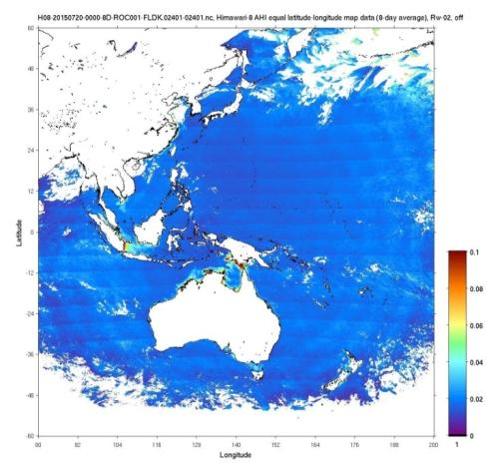
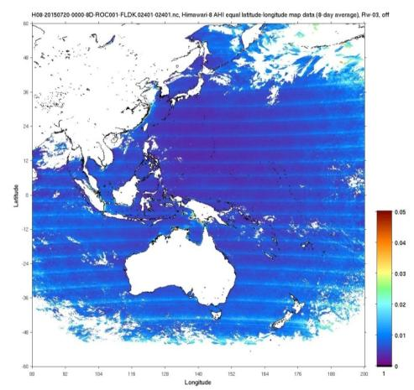
4. Calibration sensitivity: detector difference
Chla
AOT510
Angstrom Exponent
R_{rs}470
R_{rs}510
R_{rs}640
Detector gain normalization error is enhanced in some products

Slide 19
5. Summary
JAXA Himawari products, aerosol, SST, ocean color, PAR/SWR.. are developed by using heritage from JAXA LEO missions (GCOM-C, EarthCARE, GOSAT1-2), and will make consistent products
Current key targets of the products are to input aerosol data to the MRI/JMA aerosol prediction model (and SST to JAMSTEC regional ocean model)
Chla can be derived by AHI by averaging more than six images (1 hour) to reduce the white noise (That becomes harder in the winter time..)
AHI data seems to be stable, and aerosol properties can be derived by using the standard L1B data without the vicarious adjustment
Ocean color (Chla) needs the vicarious adjustment (~50% bias without the correction)
Scan noise appeared in multi-day average image of Ocean color (R_{rs}), Chla, AOT and AE (due to bands 2 and 3)

