Slide 1
Impacts of GSICS inter-calibration on JAXA’s HIMAWARI-8 SST
Yukio Kurihara (JAXA/EORC)
February, 2015
Annual meeting of GRWG+GDWG at JAXA

Slide 2
Topics
Himawari-8 SST by JAXA
Impacts of GSICS inter-calibrations
Summary

Slide 3
Contents
Himawari-8 SST by JAXA
Impacts of GSICS inter-calibrations
Summary

Slide 4
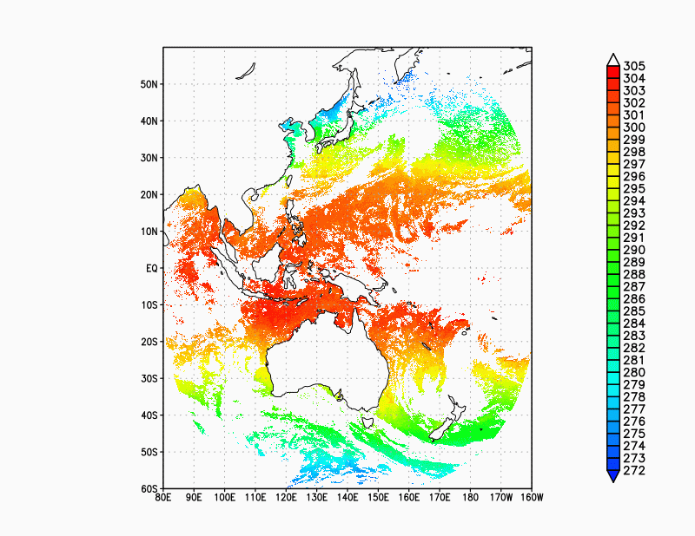
Himawari-8 SST by JAXA
High observation frequency and high spatial resolution
Skin SST estimation by quasi-physical algorithm
Cloud detaction by Baysian inference method
Himawari Monitor
(Future) Synergy with MODIS/Terra and Aqua, AMSR-2/GCOM-W, VIIRS/Suomi-NPP, and SGLI/GCOM-C
http://www.eorc.jaxa.jp/ptree/index.html

Slide 5
Algorithm outline
SST algorithm
Skin SST
Quasi-physical algorithm which uses parameterized radiative transfer equation
RTM (RTTOV10.2), NWP data and no in-situ data for the algorithm calibration
Cloud algorithm
Cloud probability
Bayesian inference method
Empirical PDF

Slide 6
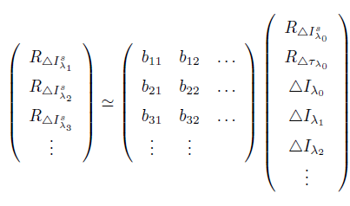
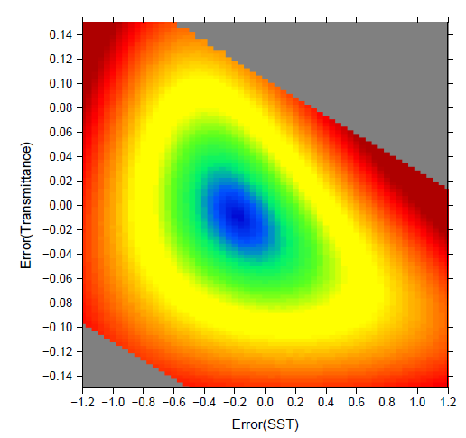
SST calculation
SST_{λ0}
SST_{most likely}
SST_{λ1}
MLE / Least Square
SST_{λ2}
:
likelihood
/ residual
r(x)
Satellite data
$$x=({R^{s}}_{λ_{0}},{R^{τ}}_{λ_{0}})$$
$$dJ$$
Newton’s method

Slide 7
Combinations for JAXA’s prodact
10.4 + 11.8 + 8.6 (SST 8.6)
10.4 + 11.8 + 3.9 (SST 3.9) (nighttime only)

Slide 8
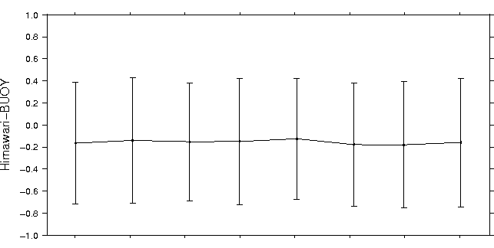
Quality of the Himawari-8 SST (8.6 um)
Cloud probability < 0.3
Bias – 0.12 ~ – 0.18
STDV 0.54 ~ 0.58
2015/6
7
8
9
10
11
12
2016/1

Slide 9
Contents
Himawari-8 SST by JAXA
Impacts of GSICS inter-calibrations
Summary

Slide 10
Navigation and Calibration correction
26 March
Applied co-registration to bands 7 – 6 (Navi.)
18 May
Changed horizontal sampling interval (Cali.)
8 June
Updated calibration coefficients (Cali.)

Slide 11
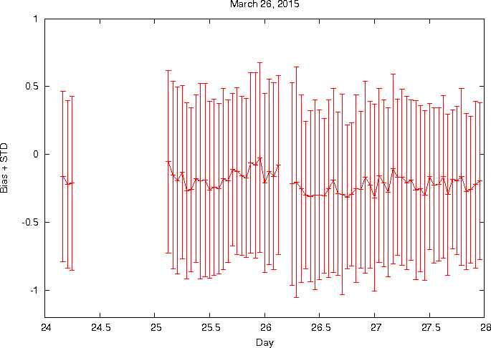
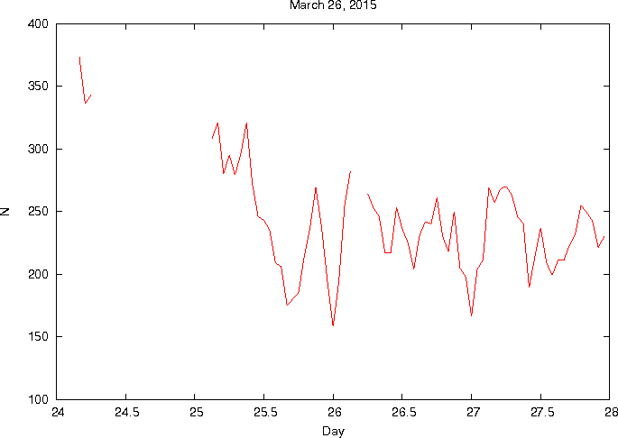
March 26, 2015 (Navigation)
Applied co-registration process
Target bands : Band 7 – Band 16
Bias and STDV
N
H8SST - buoy

Slide 12
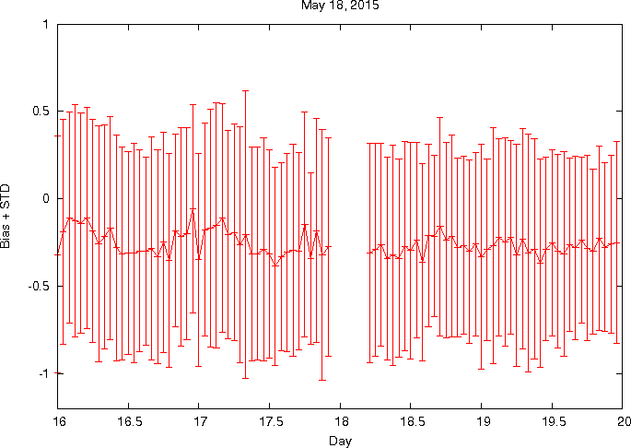
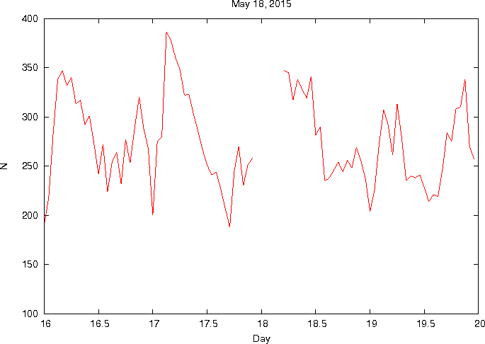
May 18 (Calibration)
Changed horizontal sampling interval
Bias and STDV
N
H8SST - buoy

Slide 13
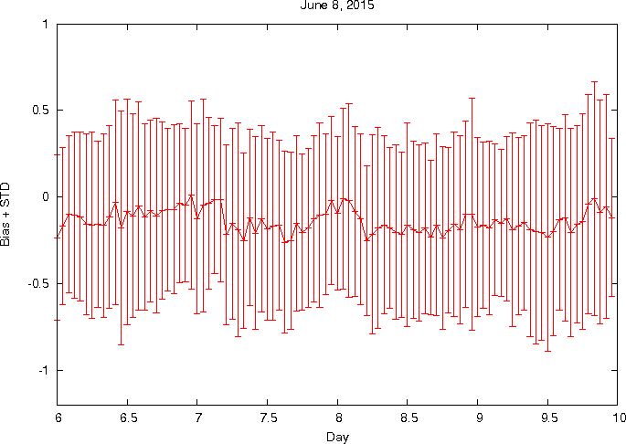
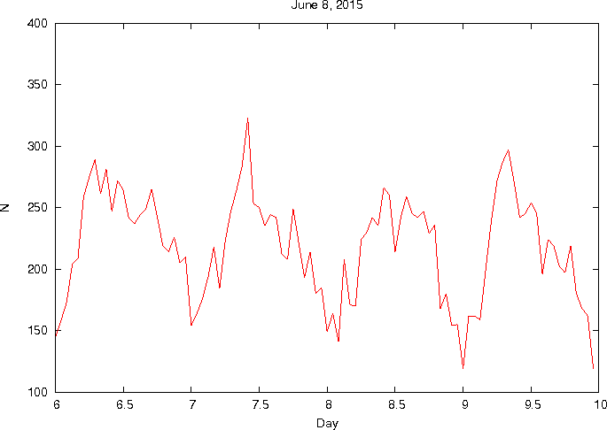
June 8 (Calibration)
Updated calibration coefficients
Bias and STDV
N
H8SST - buoy

Slide 14
Data
Himawari-8 data
Nighttime (1200, 1500, and 1800 UTC), November, 2015
Inter-calibration coefficients
Airs, IASI-A for IR bands of 3.9, 8.6, 10.4, and 11.2 um
Downloaded from the Meteorological Satellite Center
Himawari-8 SST
SST 8.6, SST 3.9
Cloud probability < 0.3
Buoy data
Tropical moored buoy and drifting buoy
Downloaded from the iQuam of NOAA
Other satellite SSTs
MODIS/Terra and /Aqua, VIIRS/Suomi-NPP

Slide 15
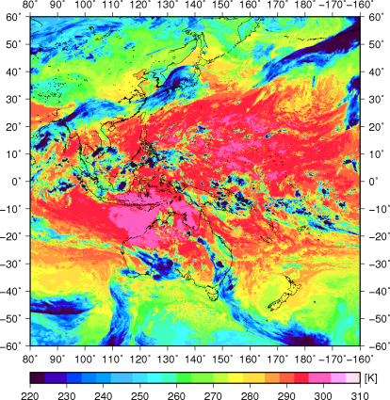
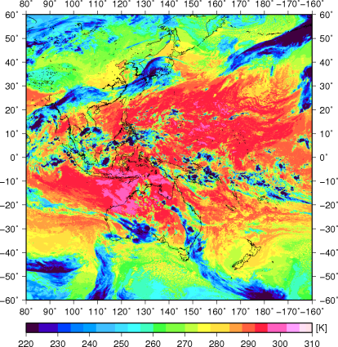
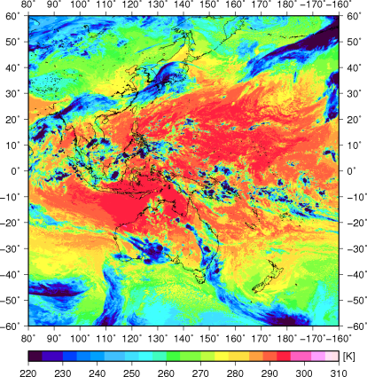
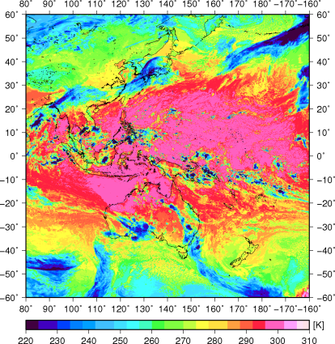
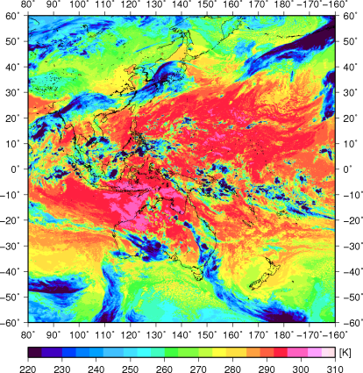
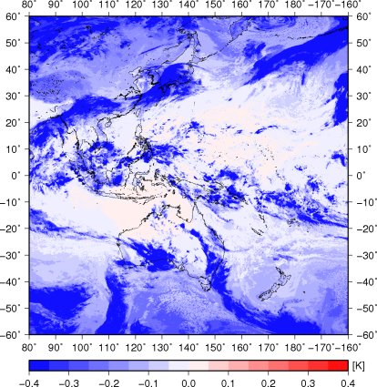
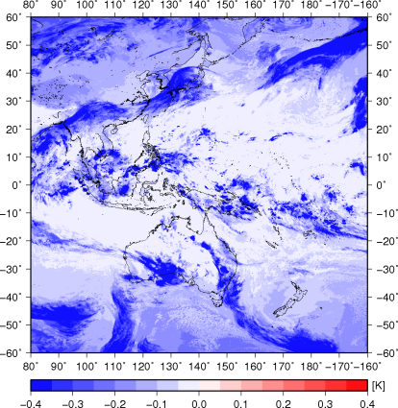
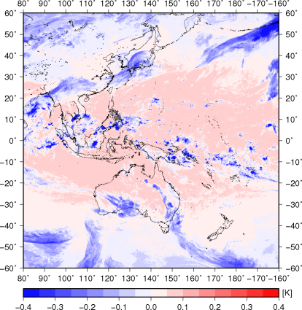
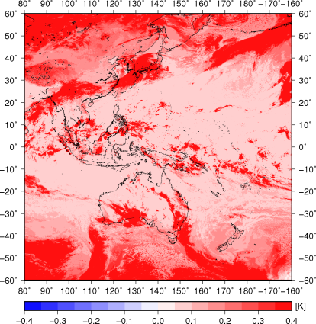
10.4 um
11.8 um
8.6 um
3.9 um
GSICS inter-calibrated (IASI-A)
Inter-calibrated Data – Original data

Slide 16
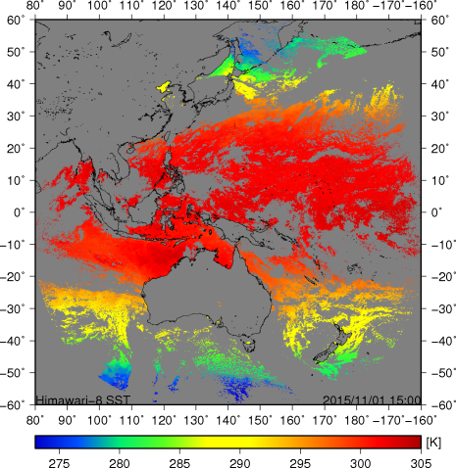
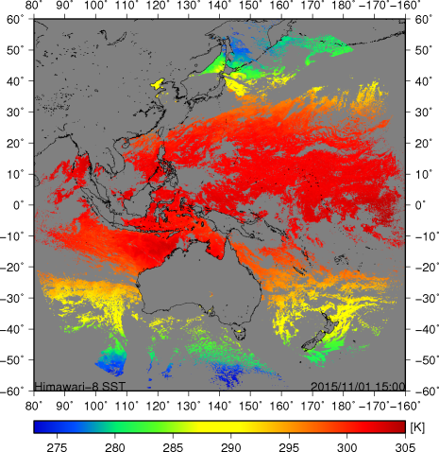
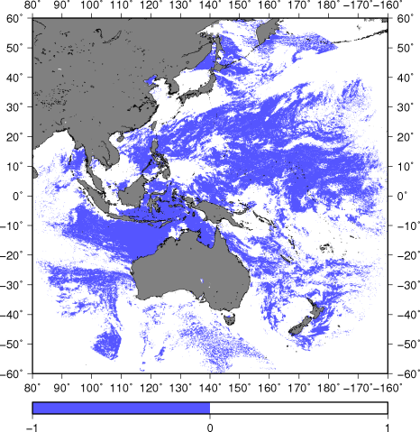
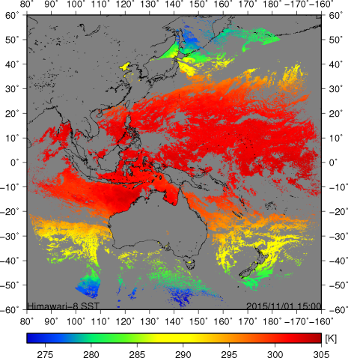
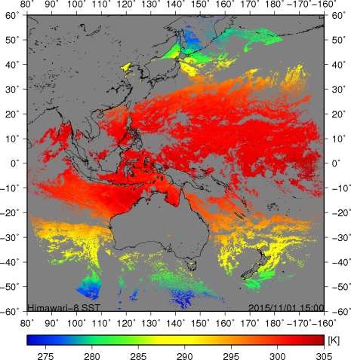
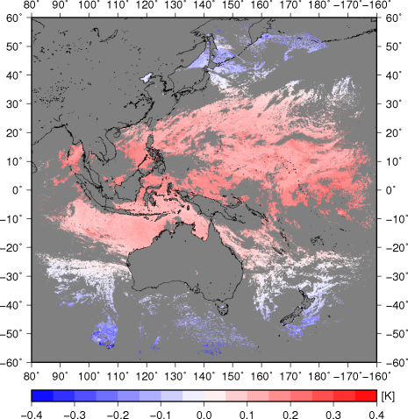
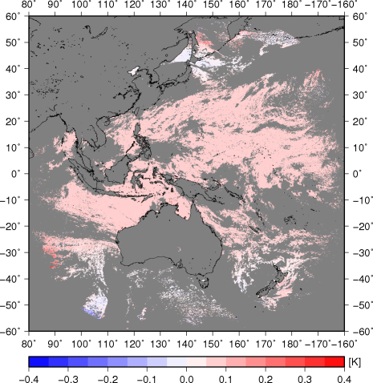
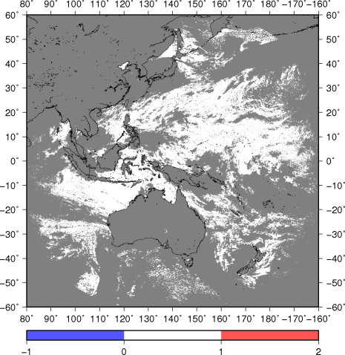
SST 8.6
SST 3.9
Cloud mask
GSICS inter-calibrated (IASI-A)
Inter-calibrated Data – Original data

Slide 17
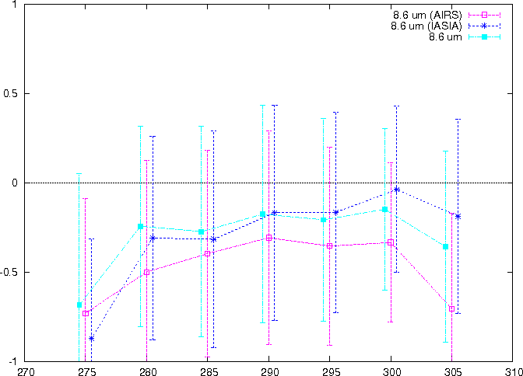
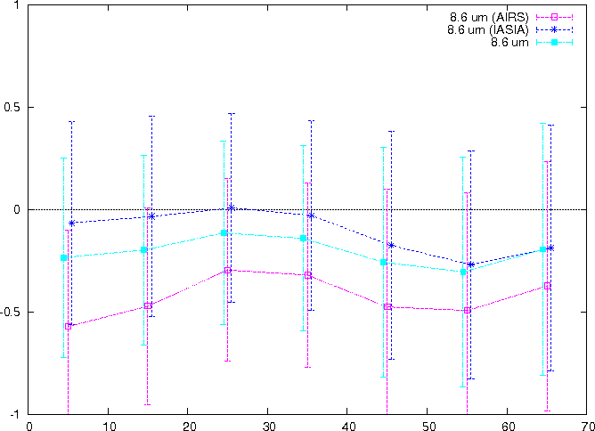
Impacts on Himawari-8 SST (8.6)
Bias and standard deviation against buoy data
Magenta : GSICS (Airs)
Blue: GSICS (IASI-A)
Light Blue : Original
satellite – buoy (K)
buoy data (K)
satellite zenith angle (degree)
Inter-calibration (Airs) increased negative bias.
Inter-calibration (IASI-A) increased the temperature dependency of the bias.
Inter-calibration (IASI-A) improved negative biases.

Slide 18
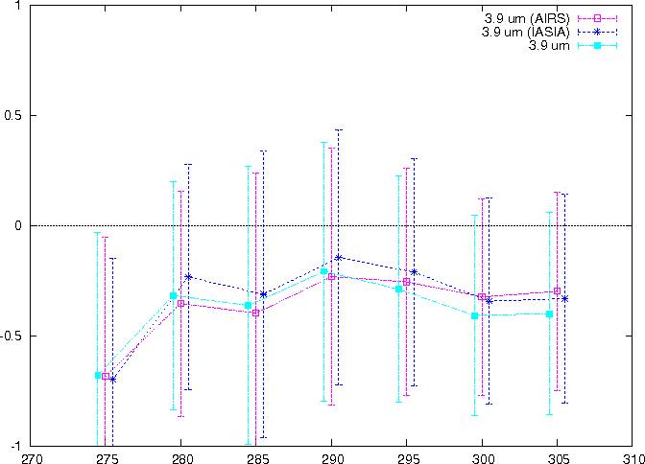
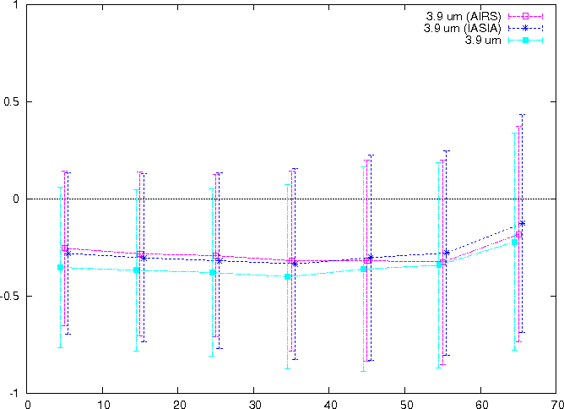
Impacts on Himawari-8 SST (3.9)
Bias and standard deviation against buoy data
Magenta : GSICS (Airs)
Blue: GSICS (IASI-A)
Light Blue : Original
satellite – buoy (K)
buoy data (K)
satellite zenith angle (degree)
Inter-calibration (Airs?,IASI-A) improved negative biases.

Slide 19
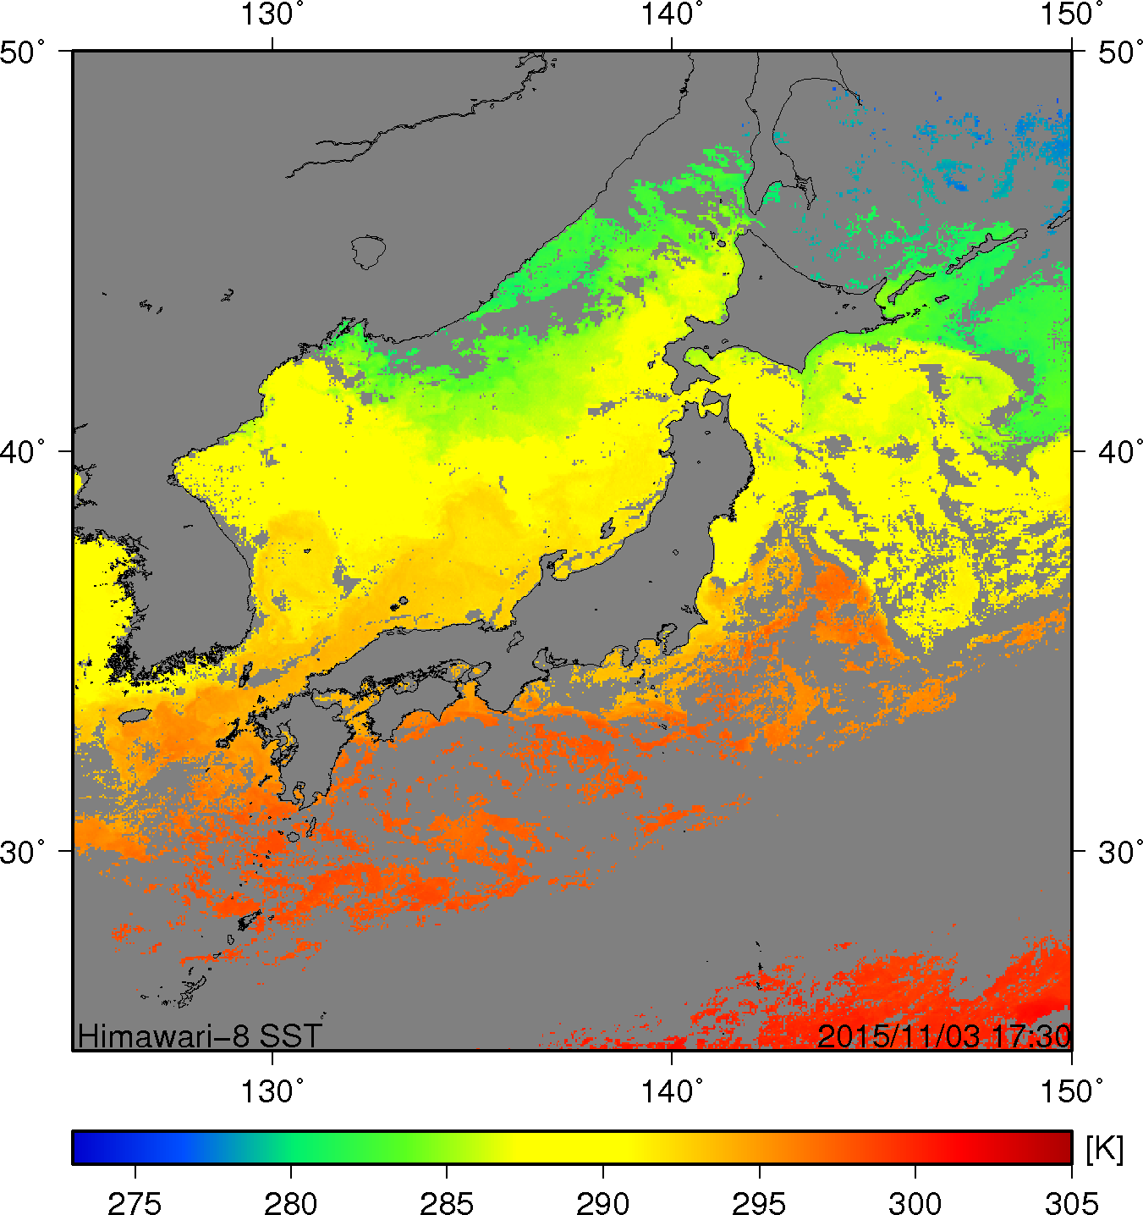
Comparison with other satellite SST
Date
17:30 UTC, 3 Nov. 2015 (night-time)
GSICS inter-calibration
IASI-A
Inter-calibrated SST
Himawari-8 SST (3.9)
Other satellite SST (3.7)
MODIS/Terra
MODIS/AQUA
VIIRS/Suomi NPP
Himawari-8 (Original)
37 N

Slide 20
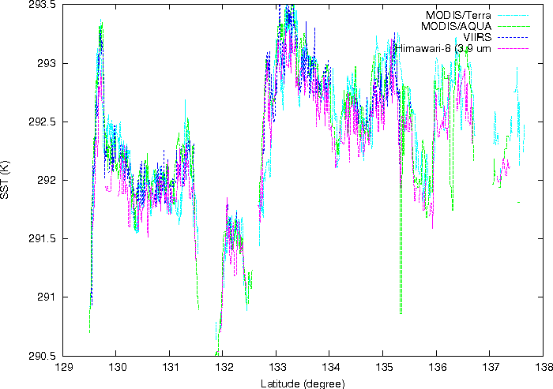
Longitude (degree)

Slide 21
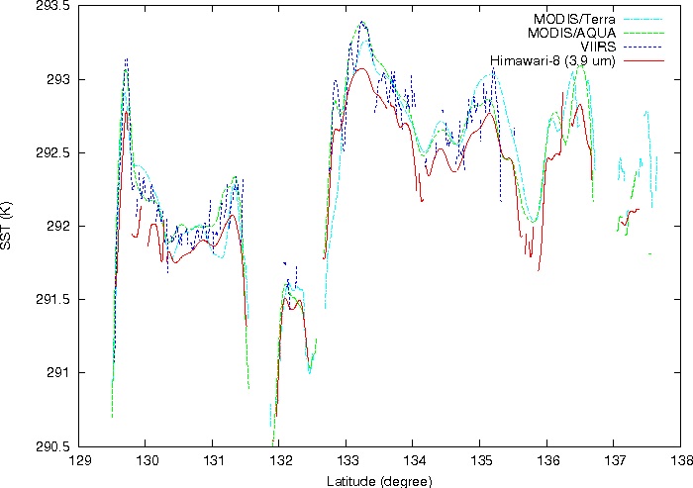
Longitude (degree)

Slide 22
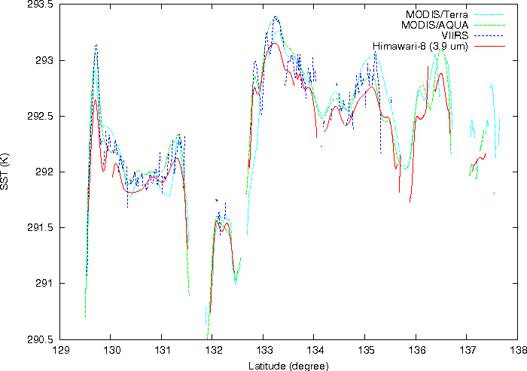
applied GSICS (IASI-A)
Longitude (degree)

Slide 23
Contents
Himawari-8 SST by JAXA
Impacts of GSICS inter-calibrations
Summary

Slide 24
Summary
SST retrieval is sensitive to the calibration of the satellite data.
Impacts of the GSICS inter-calibration on the Himawari-8 SST were examined by using the data during the nighttime in Nov. 2015.
GSICS inter-calibrations seemed to depend on the reference instrument.
Impacts on the Himawari-8 SST seemed to depend on the IR data which were used to estimate SSTs.
GSICS inter-calibrations based on IASI-A is likely to have made positive impacts on the Himawari-8 SSTs which were retrieved by using 3.9 um data.
Consistency of the satellite SSTs is likely to be improved by inter-calibration.

Slide 25
Thank you

Slide 26
Back ups

Slide 27
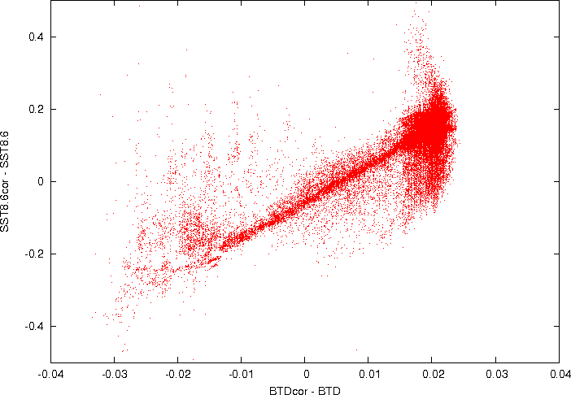
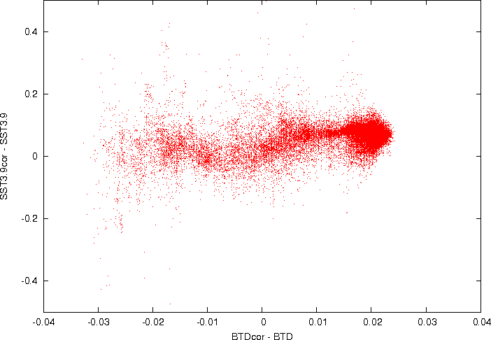
Himawari-8 SST (8.6)
Himawari-8 SST (3.9)
BTD 10.4 – 11.8

Slide 28
